Slide 1
2017 University of Waterloo E62
Clean Snowmobile

Slide 2
Agenda
Chassis
Motor
Driveline
Batteries
Battery Container
Environmental Benefits

Slide 3
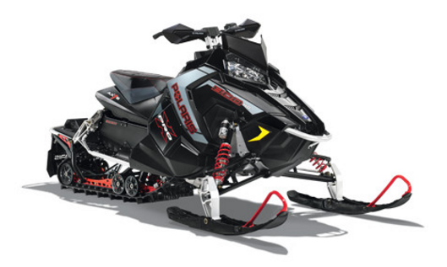
Chassis
Short track sled
Increased handling
Reduced weight
Stock seat maintains rider comfort
2015 Polaris AXYS 800 Rush Pro-X

Slide 4
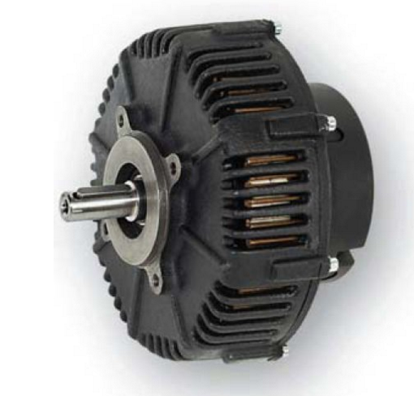
Motor
DC Brush Motor
Higher Starting Torque vs. AC Motors
Cheaper Speed Control vs. alternative options
Overall lower cost compared to BLDC Motor

Slide 5
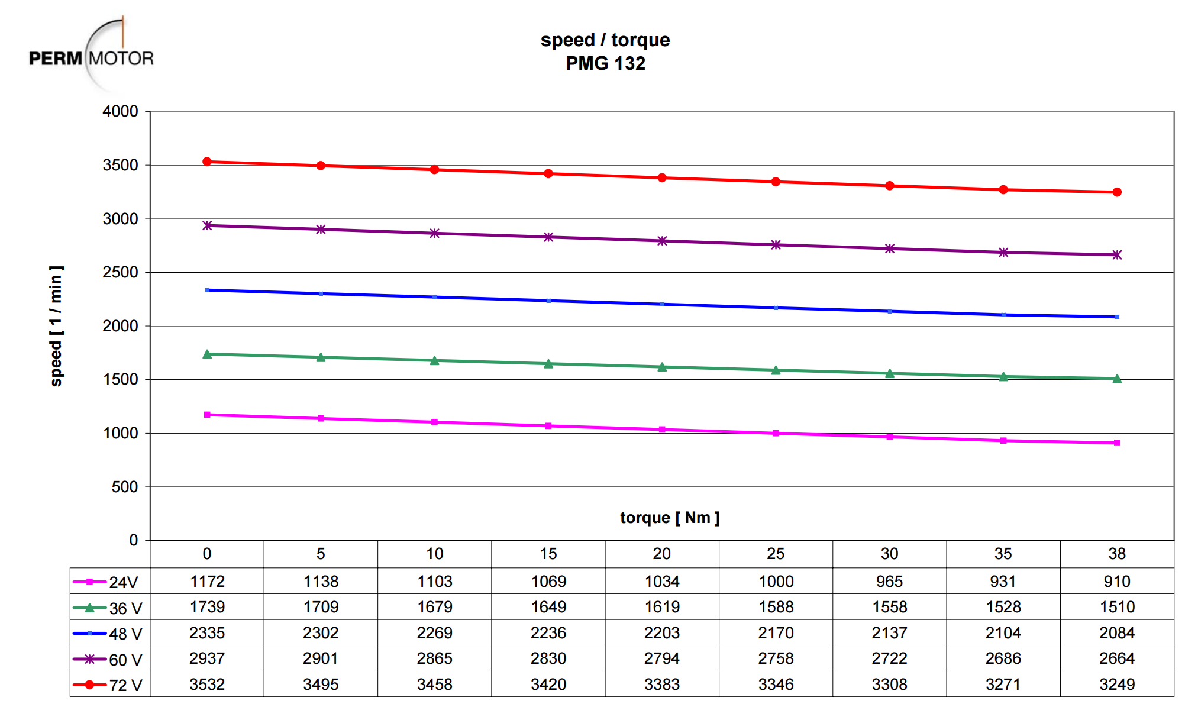
Motor
PMG 132
Peak Efficiency of 88.6%
Peak hp of 88.6%
Maintains torque at higher RPM
[1] https://www.shiftev.com/index.php/shop/motors-2014-01-09/motor-perm-pmg-132-24-72-vdc-19-1-peak-hp-detail.html

Slide 6
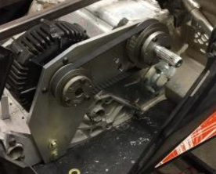
Driveline
Timing belt drive
98% mechanical efficiency [2]
Minimal vibration and reduced noise
No need for lubrication or tensioning
Focus on simplicity and reliability
[2] http://www.womackmachine.com/pdf/rb365/47th/section10/sec10pg504pumpmotortransmissionefficiencies.pdf

Slide 7
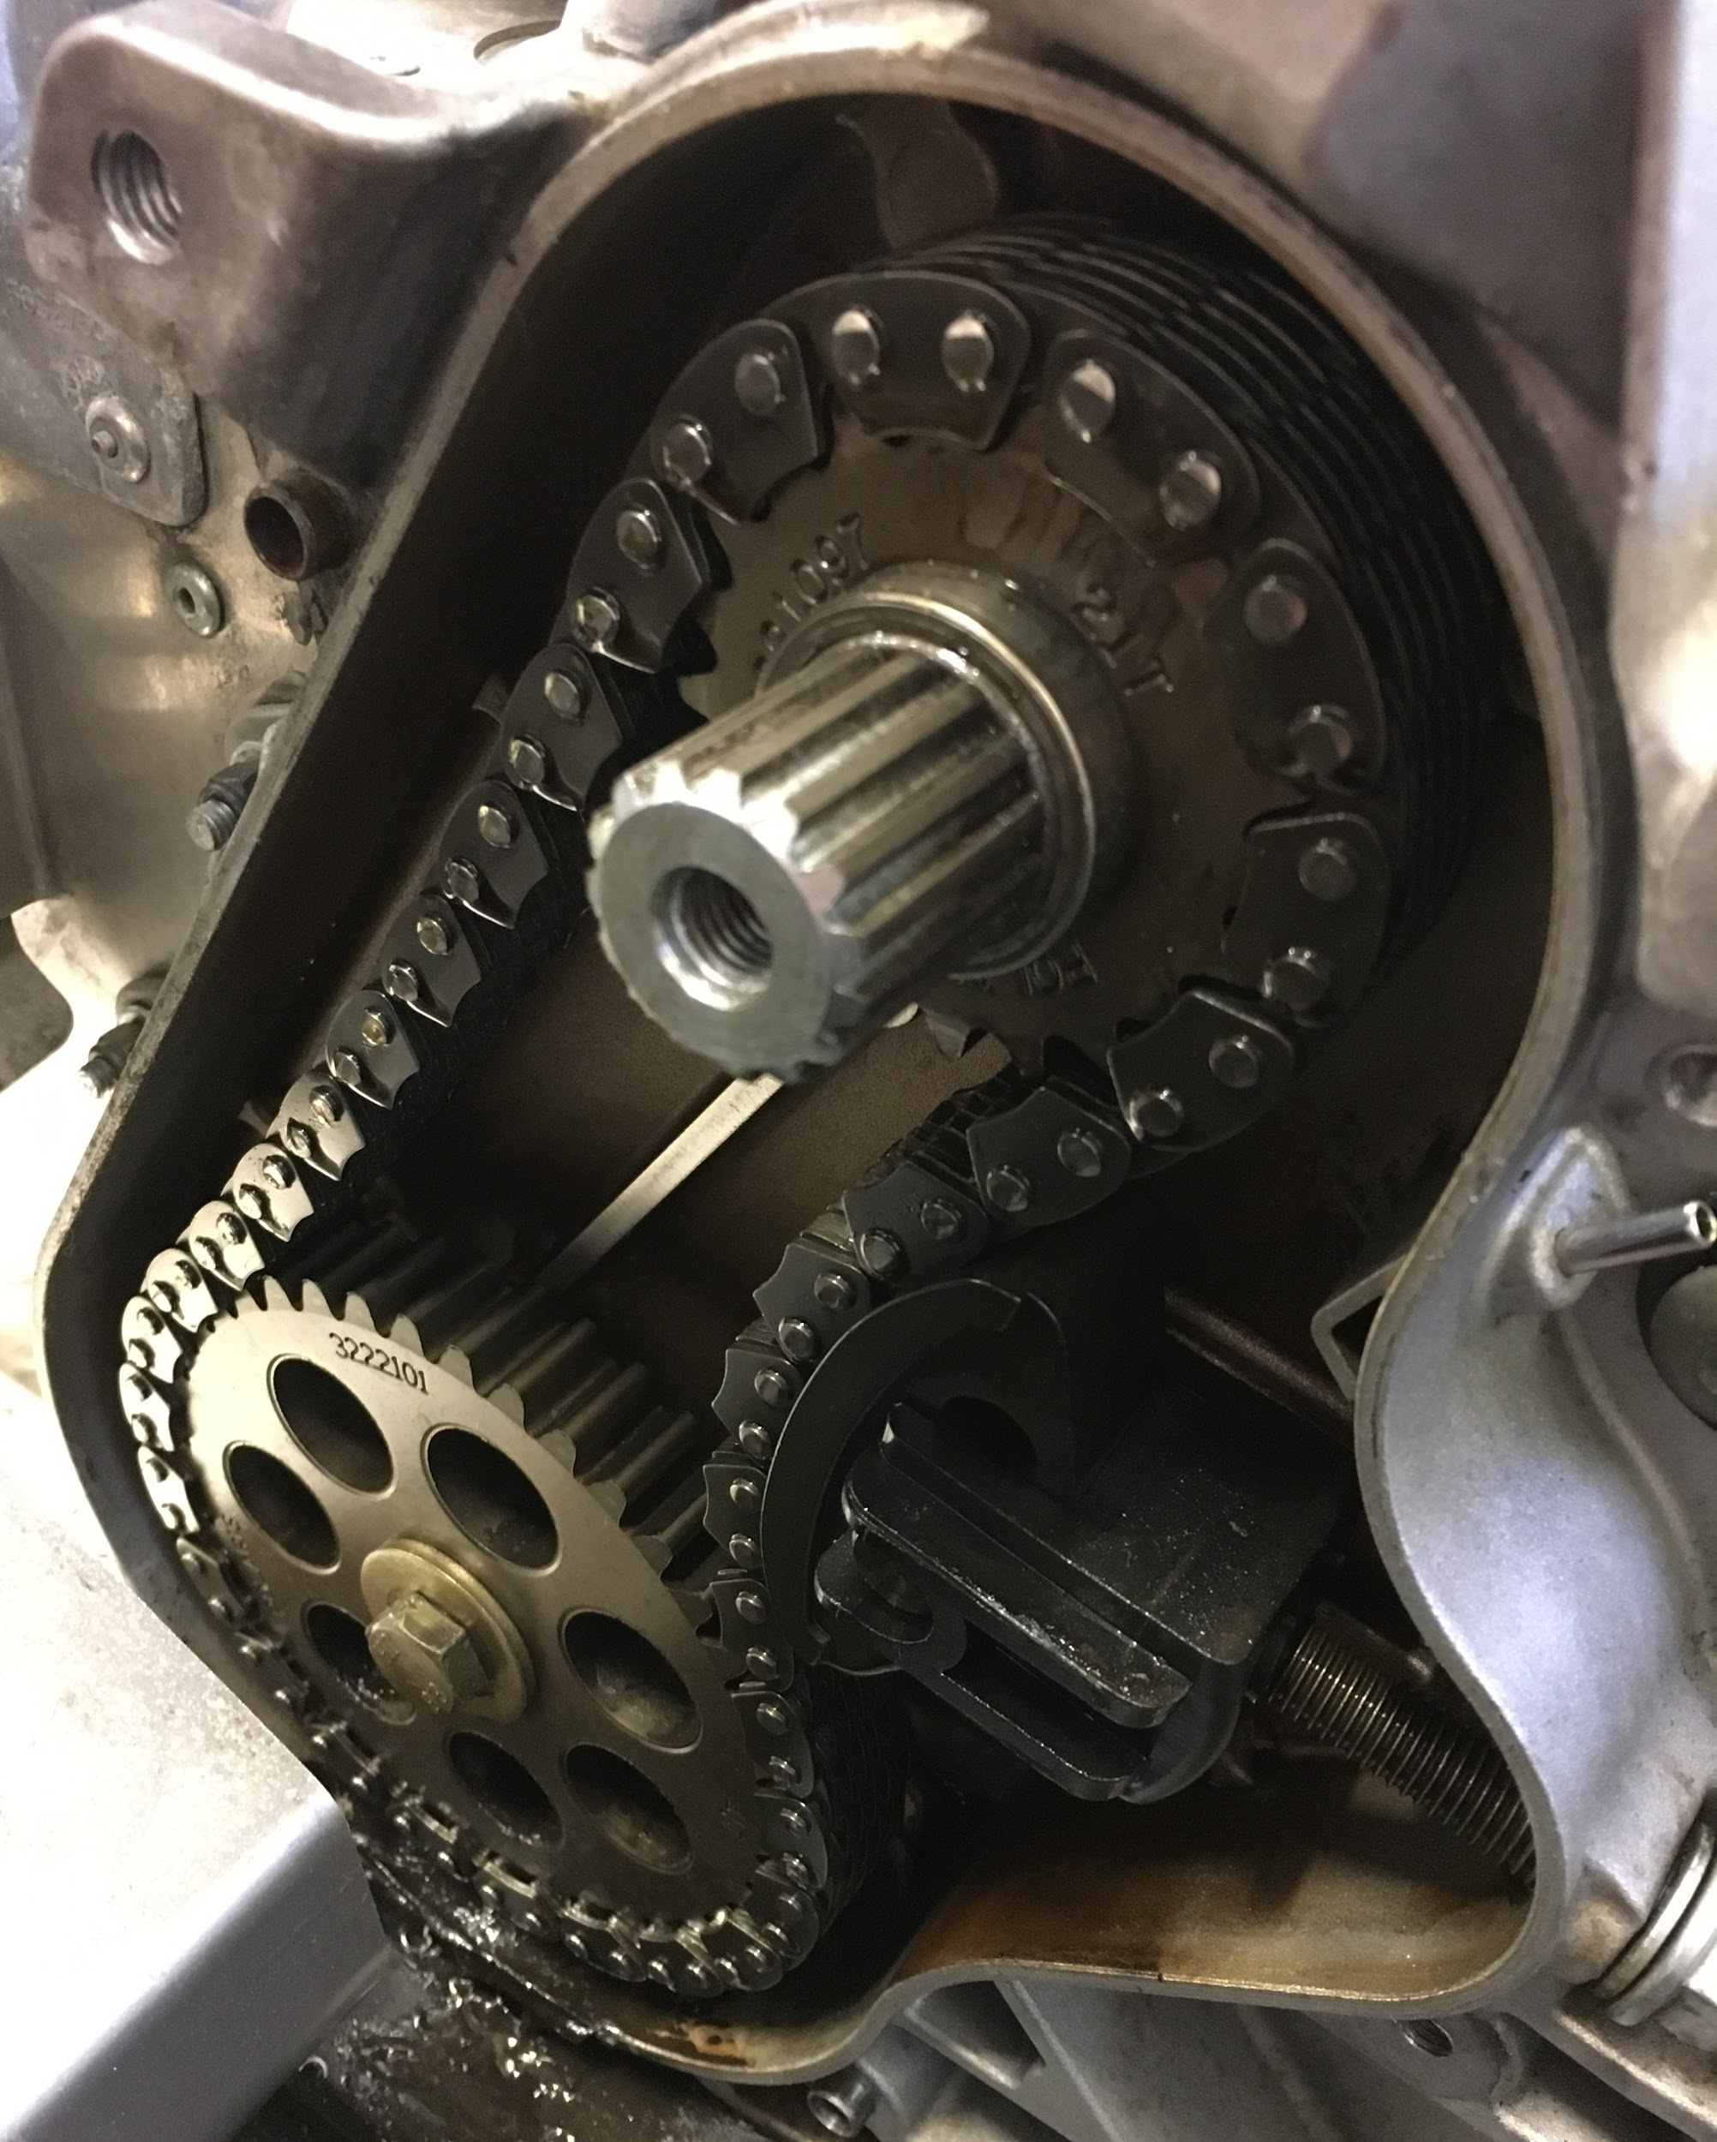
Driveline
Modified sprocket ratio
Optimized for maximum torque at 25 mph

Slide 8
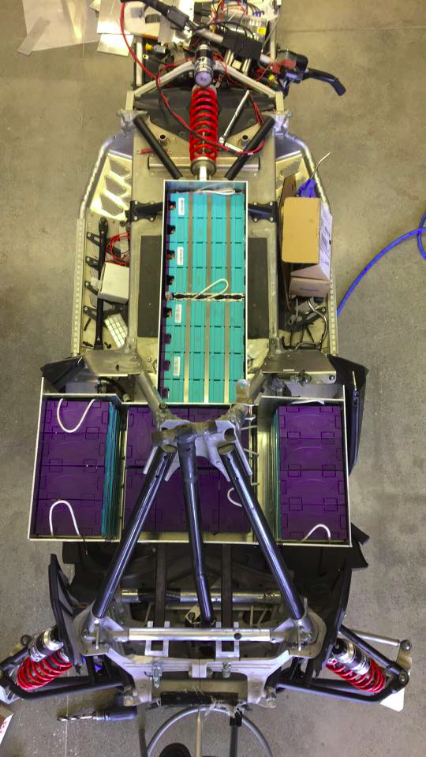
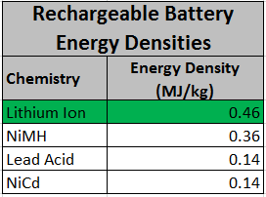
Batteries
6x 12V Lithium Ion Modules
Lightweight and offer highest storage capacity
Range of 12-15 mi.
http://www.epectec.com/batteries/chemistry/

Slide 9
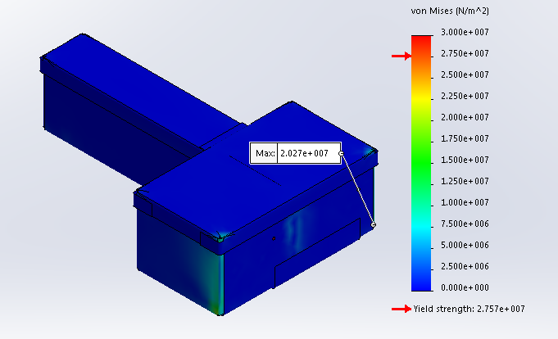
Battery Container
Lightweight, strong aluminum casing
Withstands high force from acceleration and deceleration
Insulation rated at 200V
Unobtrusive design
Notes:
20G (horizontal) and 10G (vertical), yield strength of aluminum is 28MPa, stress analysis shows that the battery box can withstand the forces from acceleration and deceleration

Slide 10
Environmental Benefits
Designed for field research applications
Sustainable power source (solar and/or wind)
Zero emissions
Quiet (low wildlife impacts)
Lightweight (less vegetation impacts)

Slide 11
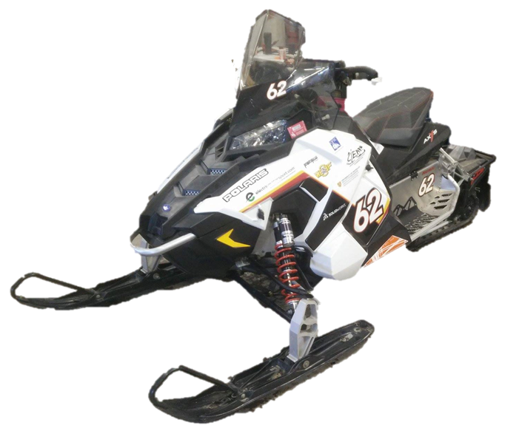
Summary
Snowmobiler Perspective
Familiar look and feel
Easy manoeuvrability and control
Dealer/Outfitter/Manufacturer Perspective
Reliability/longevity
MSRP: $15910 USD
Environmental Perspective
Zero-emissions
Quiet

Slide 12
Questions?

