Slide 1
2016 University of Waterloo Clean Snowmobile

Slide 2
Philosophy
Embrace design challenges
Engage students and public through originality
Open and safe learning environment for students
3 Year Cycle
Focus on reliability

Slide 3
Design Criteria
Six criteria chosen to weigh against CSC scoring
Weighting represents impact based on prior experience
Used to evaluate relative merit of various design alternatives
Efficiency | 20%
Emissions | 21%
Weight | 16%
Power | 8%
Noise | 18%
Reliability | 17%

Slide 4
Before this year
2013 Polaris Rush 600
Upgraded to align with 2014 Pro-R Model
Competition MSRP requires current model

Slide 5
Engine Selection
Weber MPE 750 Turbo
Originally used in Polaris FST models
750cc, 2 cylinder, four-stroke
143hp @ 7750rpm

Slide 6
2016 Design
Drivetrain
E-CVT
Increased track pitch
Increased idler diameter
Exhaust System
3 way catalytic converter
Replaceable configuration
Overall
Balanced approach of engine, control, and driveline efficiency
Systems with modularity and independence
Engine
Miller Cycle
Electronic throttle control
Stoichiometric calibration

Slide 7
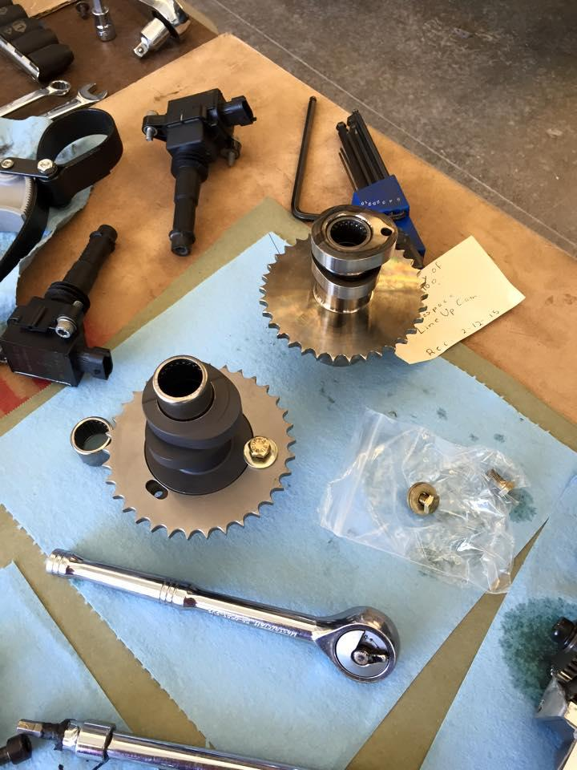
Miller Cycle
Trade displacement (power) for efficiency (3% efficiency gain, 15% power loss)
Expansion ratio is greater than compression ratio
11:1 pistons 30 degree later valve closing produces stock 9:1

Slide 8
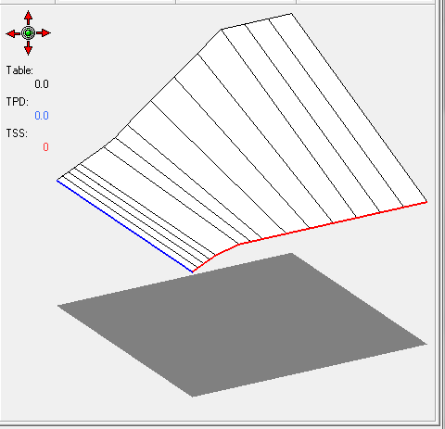
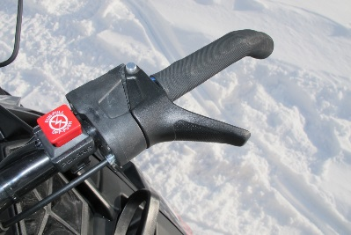
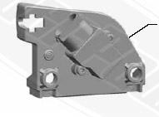
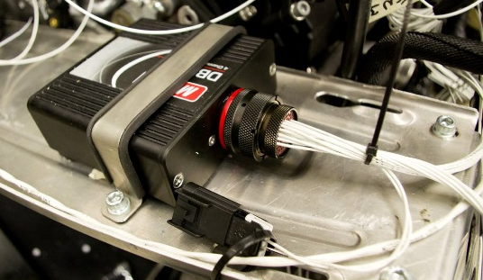
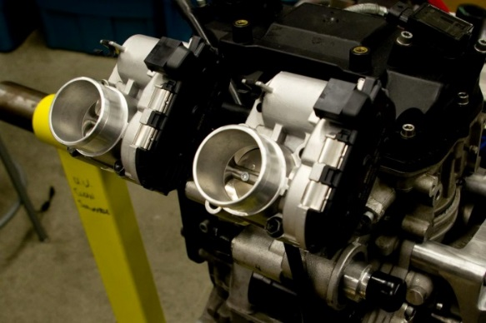
Electronic Throttle Control
Cable
Motec M400 ECU
Processes analog values from request unit
Translation table, with throttle safety switch
Motec DBW4
Independent feedback control of throttle bodies
Emphasis on safety
CAN

Slide 9
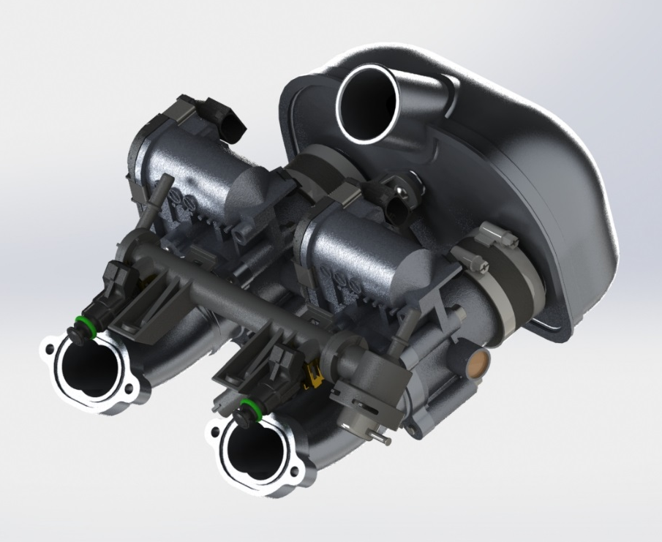
Electronic Throttle Control

Slide 10
Electronic Throttle Control
Snowmobiler Perspective
Improved fuel economy
Extraordinarily responsive if so desired
Extraordinarily forgiving if so desired
Expensive components are protected inside the snowmobile
Familiar throttle cable feel
Dealer/Outfitter/Manufacturer Perspective
System is modular (upgrade path, assembly line)
System is invisible to the user
System can be marketed as high-tech
Opportunity for different response based on rider experience
Environmental perspective
A ‘BAT’ package can use a smoother throttle response to reduce emissions from harsh transients

Slide 11
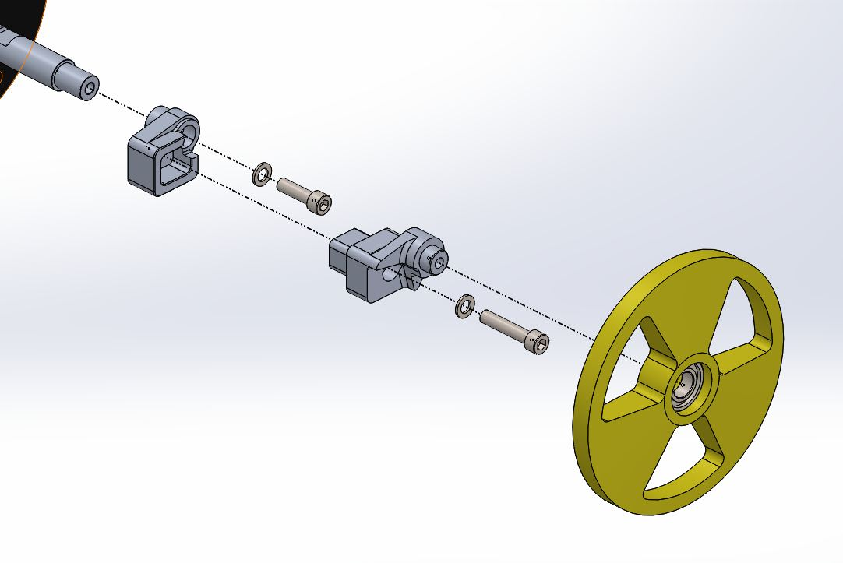
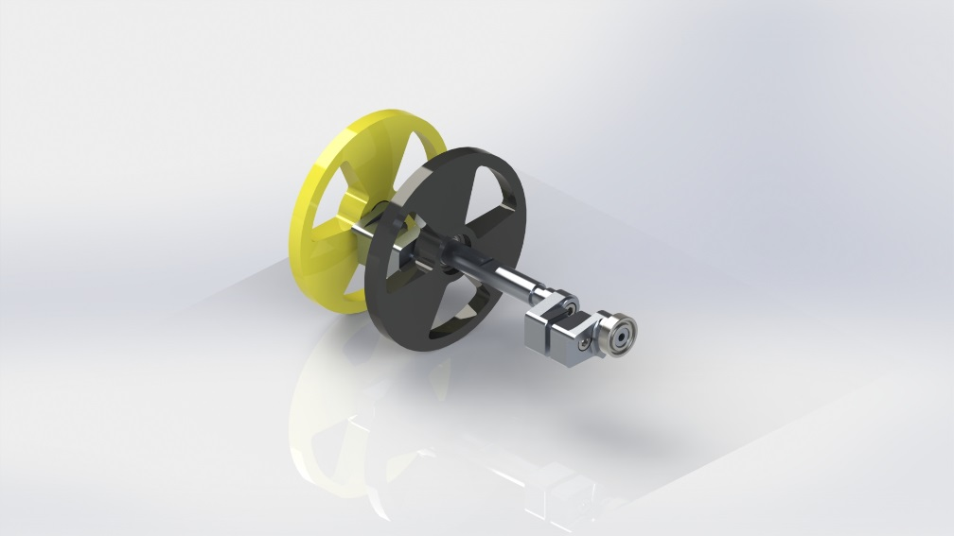
Drivetrain
Large diameter rear idler wheels
Reduces bearing and track losses

Slide 12
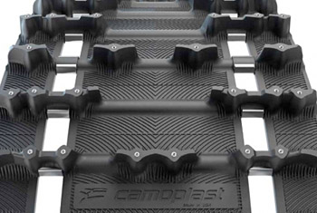
Drivetrain
2.86” Pitch Track
Camoplast ICE Attak XT, 120”
1.2” lug, pre-studded, 37lb
3lb savings over 2.52” pitch version (121”)
Use of pre-studded track allows for increased traction and control
Only 2lb heavier than the stock track for 2013 600 Pro-R

Slide 13
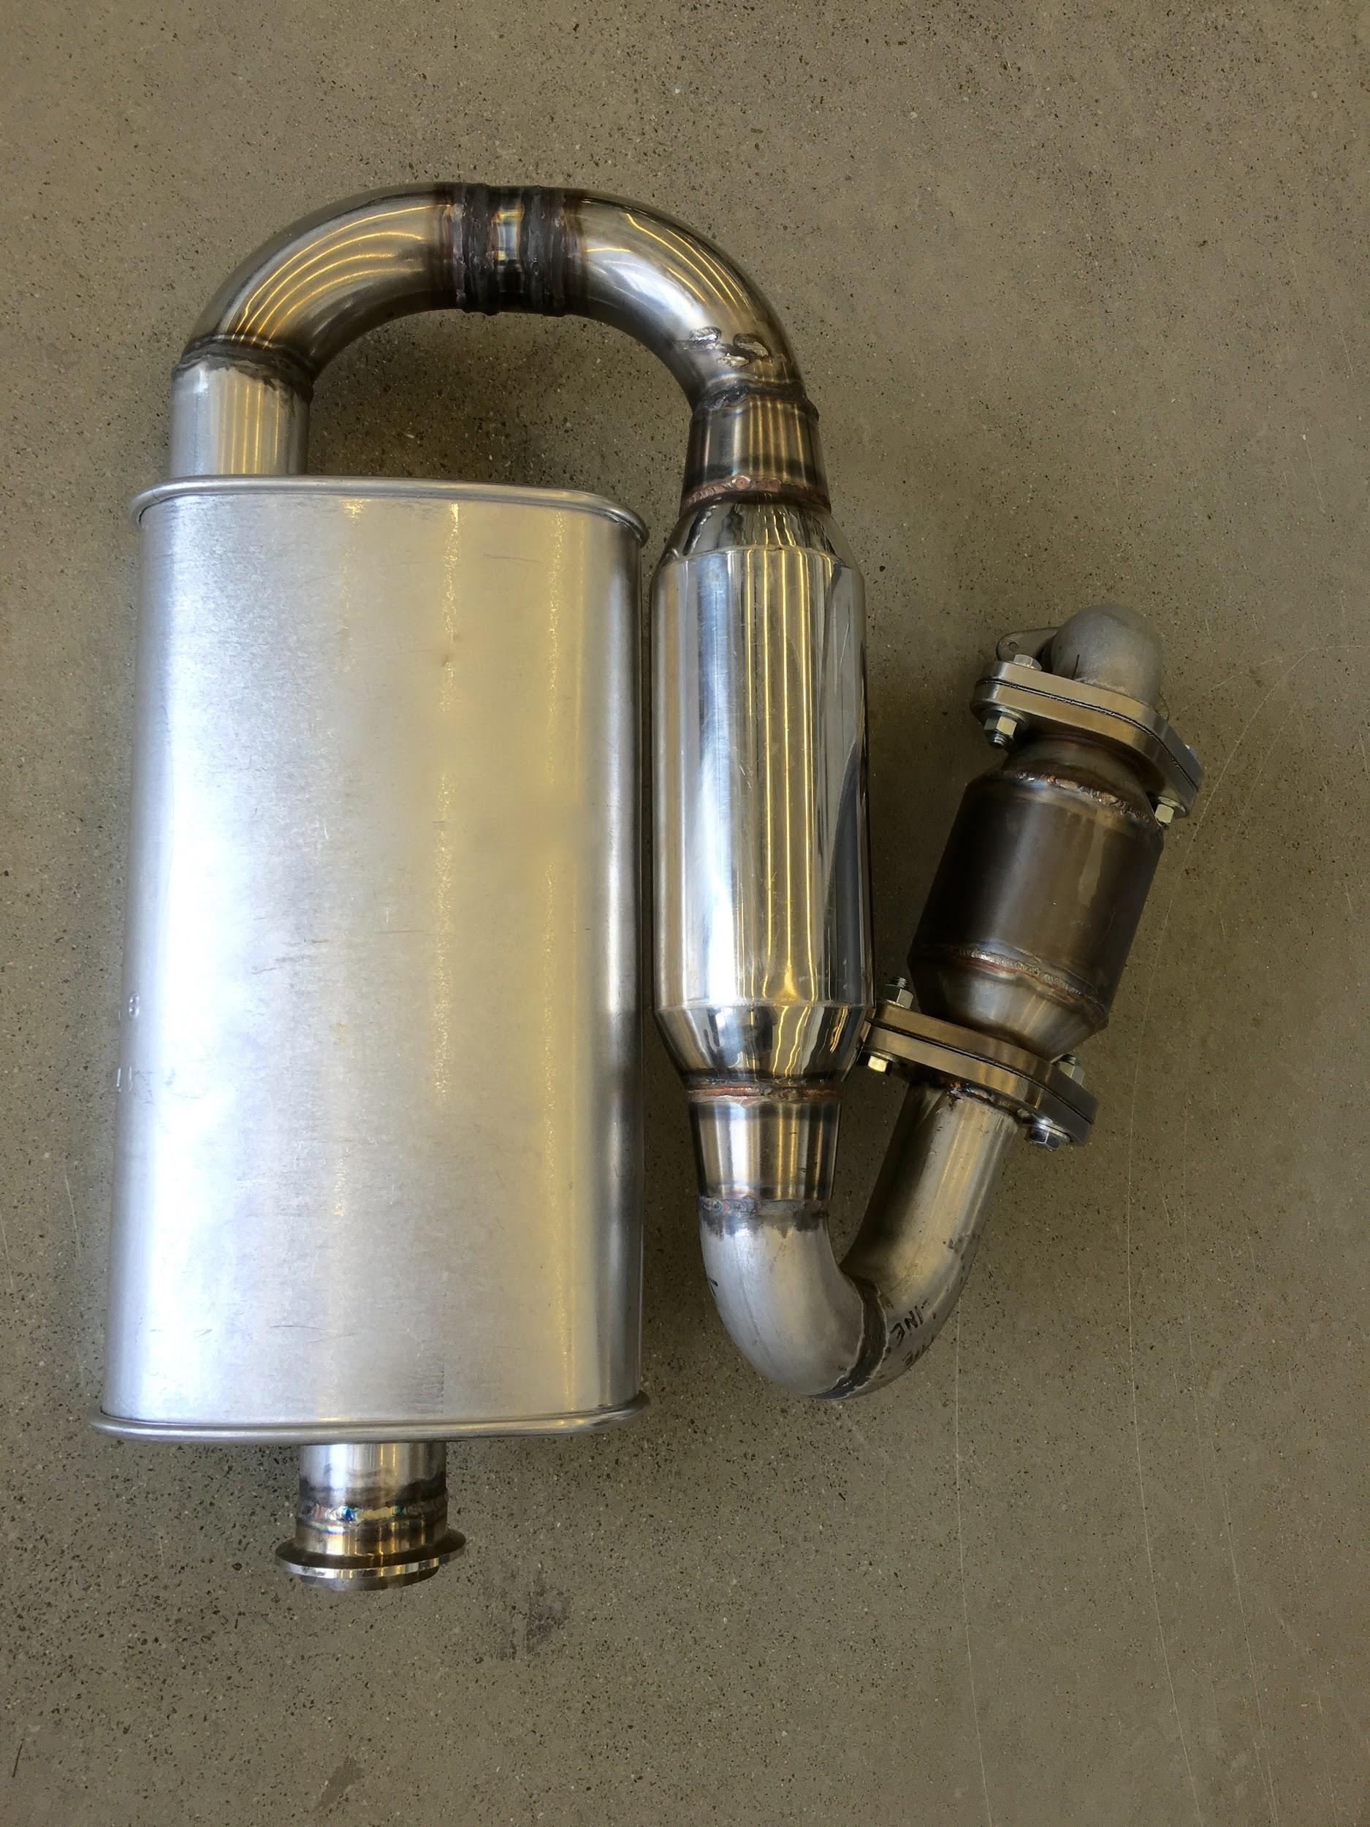
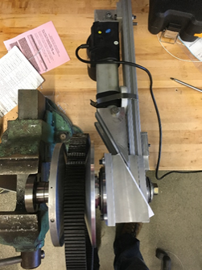
New for 2016
Exhaust System
E-CVT

Slide 14
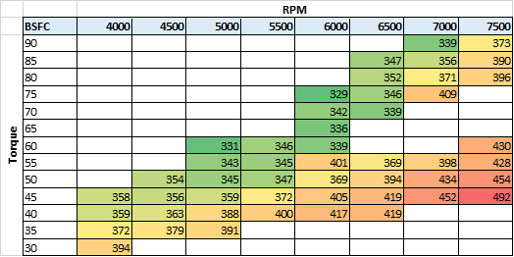
Testing, yes testing.
BSFC Map

Slide 15
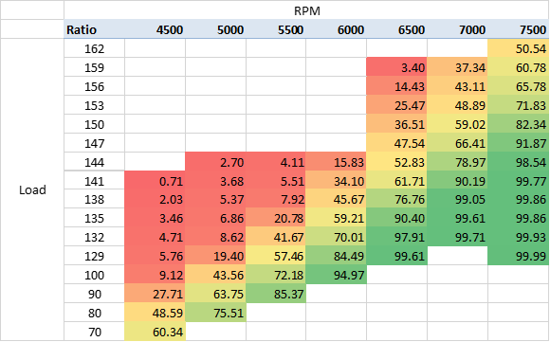
Testing, yes testing.
Clutch position

Slide 16
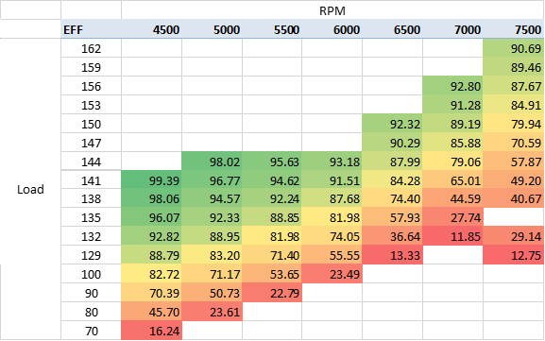
Testing, yes testing.
Clutch Efficiency

Slide 17
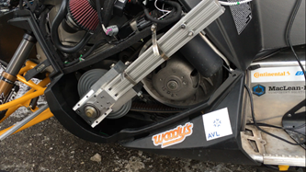
Electronic Continuously Variable Transmission

Slide 18
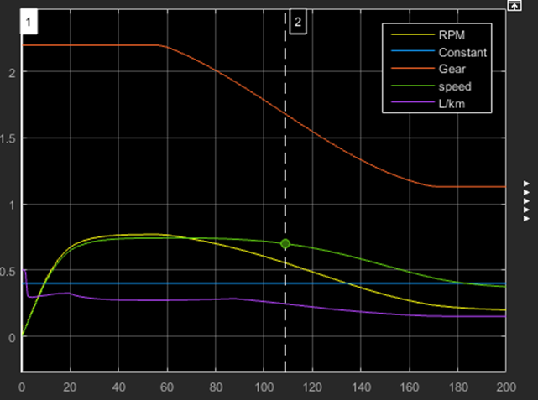
Electronic Continuously Variable Transmission

Slide 19
Electronic Continuously Variable Transmission

Slide 20
Emissions After-Treatment
Three-Way Catalytic Converter
Dramatically reduces emissions
Widely available technology
Muffler and Resonator
Targets a wide range of sound frequencies
Complete assembly is 15lb
Reduced Backpressure
High flow muffler and resonator
2” tubes

Slide 21
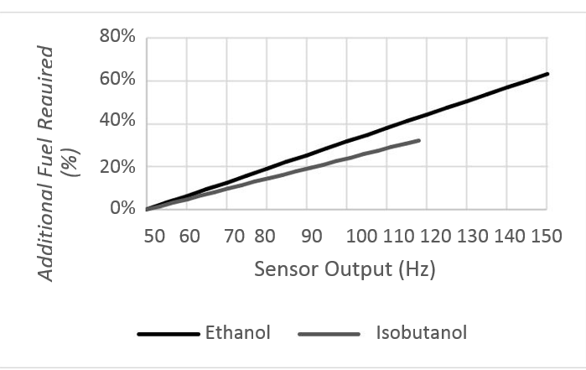
Emissions After-Treatment
Three-Way Catalytic Converter
Dramatically reduces emissions
Widely available technology
Muffler and Resonator
Targets a wide range of sound frequencies
Complete assembly is 15lb
Reduced Backpressure
High flow muffler and resonator
2” tubes

Slide 22
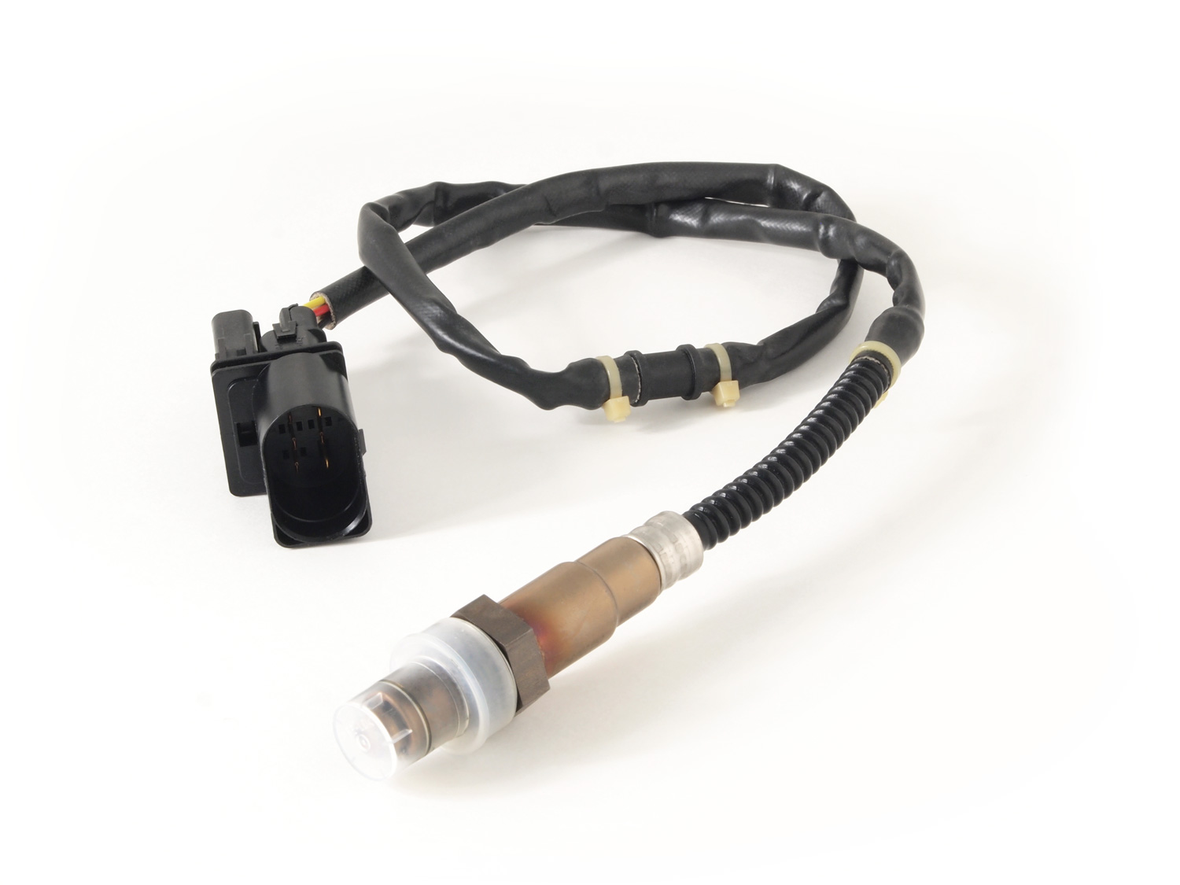
Emissions After-Treatment
Stock Wideband lambda
PID tuned for environment instabilities
Changes PID parameters based on rpm
Modifies open loop fuel table by up to +/- 20%
Can maintain lambda within +/-0.02 with constant input

Slide 23
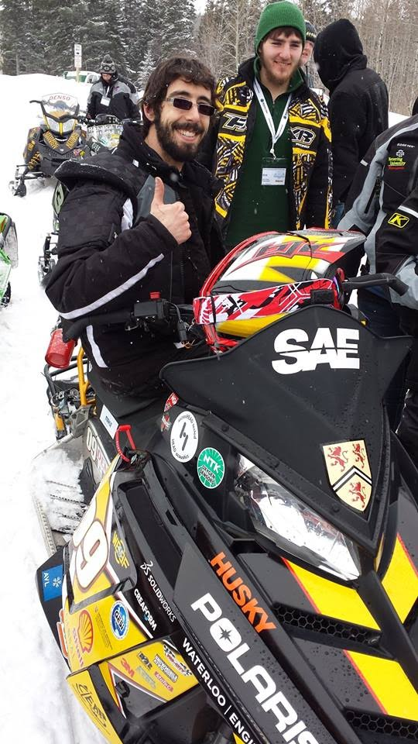
Summary
Snowmobiler Perspective
Four-stroke reliability and longevity
Capable of high performance
Premium suspension
Familiar look and feel
Dealer/Outfitter/Manufacturer Perspective
Modularity and configurability
Reliability/longevity
Environmental Perspective
Reduced fuel consumption
Reduced emissions

Slide 24
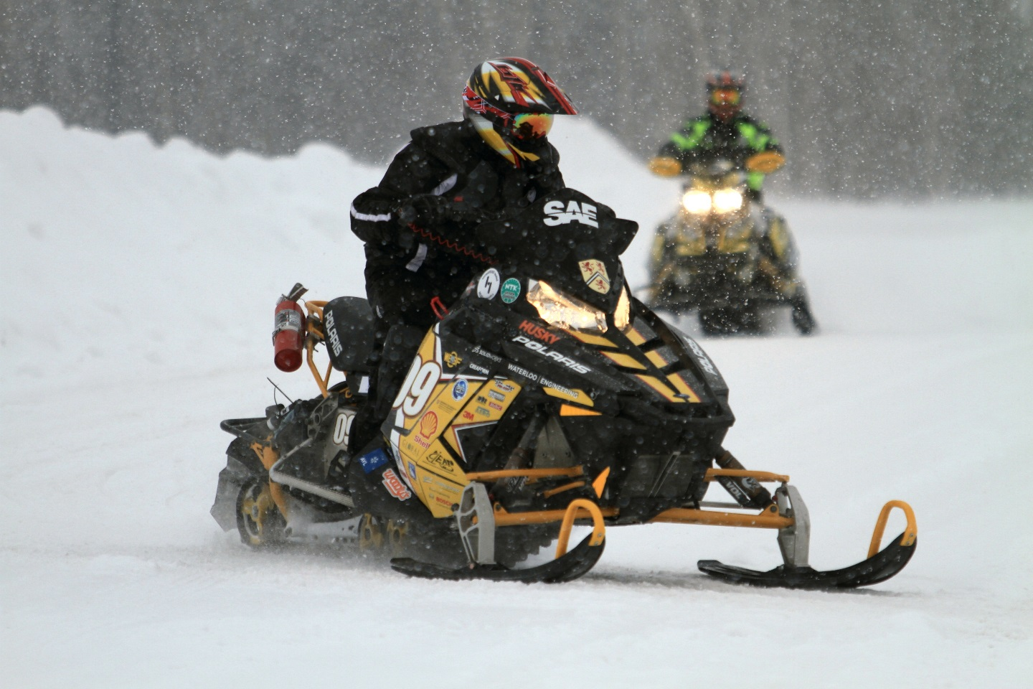
Questions?

