Slide 1
2015 University of Waterloo Clean Snowmobile

Slide 2
Philosophy
Develop a platform that meets competition objectives while providing a significant design challenge and engaging student and public interest by being unconventional and exciting.
Provide an open and friendly environment in which students can gain experience and develop skills that will enrich their undergraduate experience and benefit them professionally.

Slide 3
Base Snowmobile
2013 Polaris Rush 600
Upgraded to align with 2014 Pro-R Model
Competition MSRP requires current model
Donated by Polaris Industries

Slide 4
Engine Selection
Weber MPE 750 Turbo
Originally used in Polaris FST models
750cc, 2 cylinder, four-stroke
143hp @ 7750rpm
Over 130hp limit
Less disincentive to de-tune

Slide 5
Design Process
Six criteria chosen to weigh against CSC scoring
Weighting represents impact based on prior experience
Used to evaluate relative merit of various design alternatives
Efficiency | 20%
Emissions | 21%
Weight | 16%
Power | 8%
Noise | 18%
Reliability | 17%

Slide 6
2015 Design
Miller Cycle conversion
Electronic throttle control
Stoichiometric calibration with three-way catalytic converter
2.86” pitch track
Large diameter rear idler wheels
Balanced approach of engine, control, and driveline efficiency
Systems with modularity and little inter-dependence
Contingency if a system was delayed/failed

Slide 7
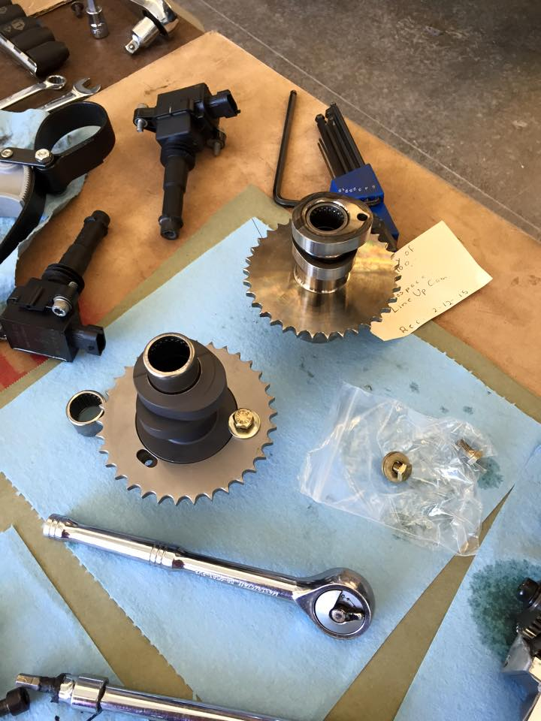
Miller Cycle
Trade displacement (power) for efficiency
Power drops by ~15%, efficiency gain of ~3%
Expansion ratio is greater than compression ratio
More work per unit of air-fuel charge
Efficiency gain when maintaining trapped compression ratio
Achieved with higher compression piston and custom camshaft with late intake valve closing
Good way of increasing efficiency of a turbocharged engine without knocking

Slide 8
Miller Cycle
11:1 Piston
Forged aluminum
Lateral gas ports for top ring
Large accumulator groove between rings
Increased wrist pin lubrication
Custom Camshaft
Added 15° intake valve duration, retarded by 13.5°
Tradeoff between available grinds, approaching desired intake valve closure, and maintaining valve overlap

Slide 9
Miller Cycle
Snowmobiler Perspective
Better fuel economy
Engine still just as durable
Outfitter/Dealer Perspective
Modification is largely invisible to user
Engine durability
Environmental/Landowner Perspective
More complete burn (specific emissions)
More efficient (overall emissions)
Quieter (less effective displacement)

Slide 10
Electronic Throttle Control
Throttling losses in SI are significant at part load
Throttle opening is usually tied to power demand from rider
Good for normally aspirated systems
Turbocharged engines have other means of power modulation (wastegate or variable nozzle)
Counter-intuitive that turbocharger is ‘fighting’ throttle at part-load
Mechanical throttle control also transfers harsh transients from rider over bumps, etc
Electronic Throttle Control ‘decouples’ user power demand from powertrain response
Reduce throttling losses
Can ‘damp’ transient response
Allows drastically different powertrain response without changing engine calibration
Same steady-state performance

Slide 11
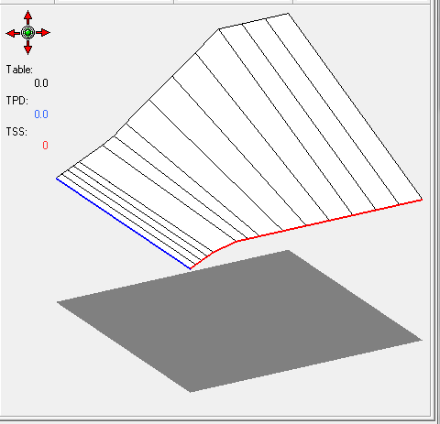
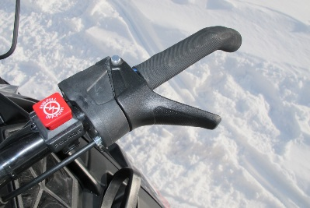
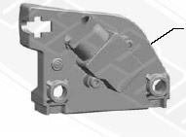
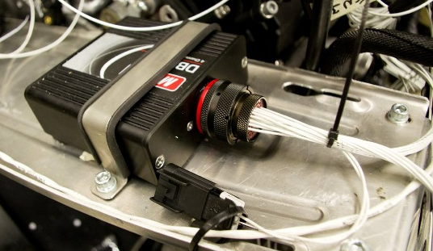
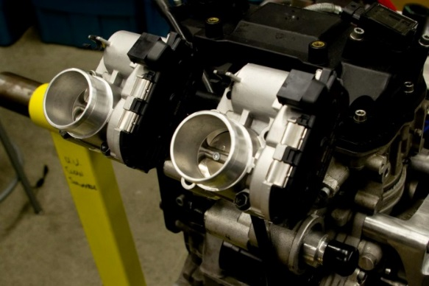
Electronic Throttle Control
Cable
Motec M400 ECU
Processes analog values from request unit
Translation table, with throttle safety switch
Motec DBW4
Independent feedback control of throttle bodies
Emphasis on safety
CAN Network
Decentralized control
Allows dedicated data-logger
CAN

Slide 12
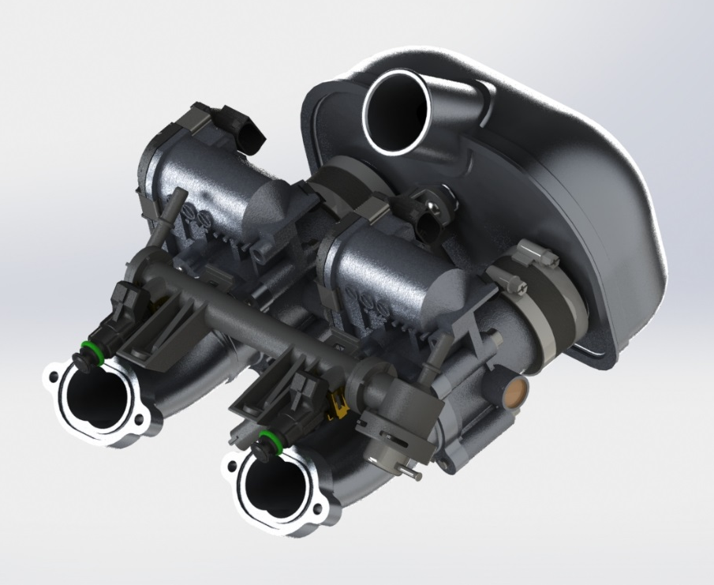
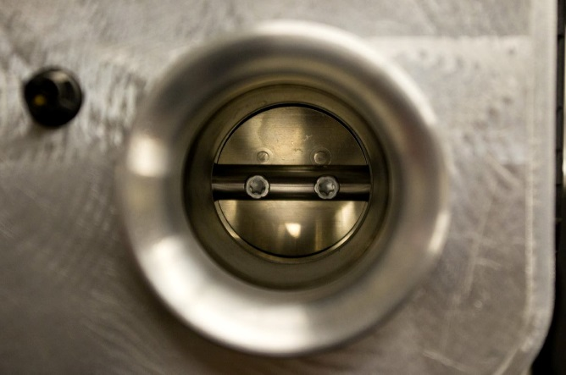
Electronic Throttle Control

Slide 13
Electronic Throttle Control
Snowmobiler Perspective
Improved fuel economy
Extraordinarily responsive if so desired
Extraordinarily forgiving if so desired
Expensive components are protected inside the snowmobile
Familiar throttle cable feel
Dealer/Outfitter/Manufacturer Perspective
System is modular (upgrade path, assembly line)
System is invisible to the user
System can be marketed as high-tech
Opportunity for different response based on rider experience
Environmental perspective
A ‘BAT’ package can use a smoother throttle response to reduce emissions from harsh transients

Slide 14
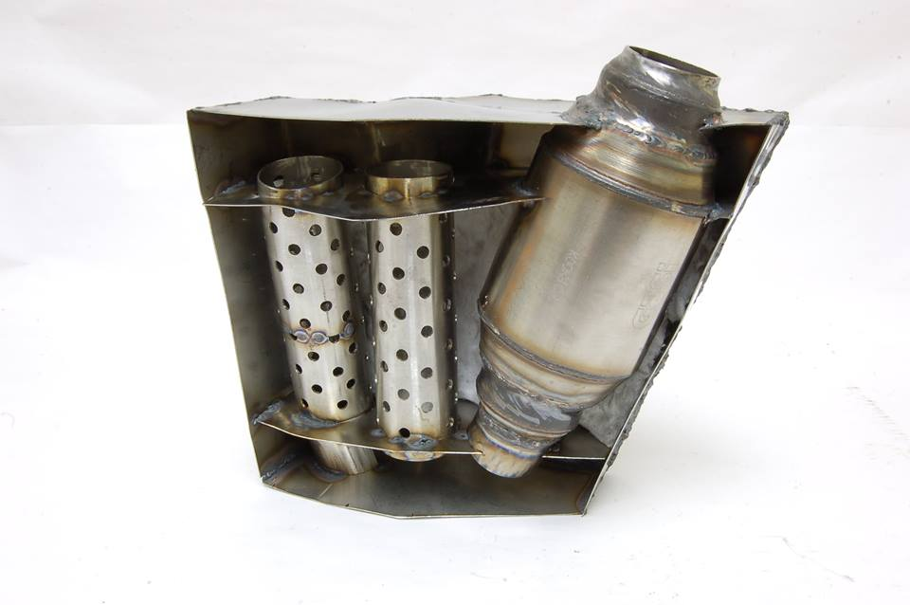
Emissions After-Treatment
Three-Way Catalytic Converter
Effective way of dramatically reducing tailpipe emissions
Widely available technology
Integrated into muffler
Muffler fits inside sled – no more mogul-buster!
Completed assembly is ~11lb
No impedance of snowmobile manoeuverability
Next iteration will deal with increased backpressure

Slide 15
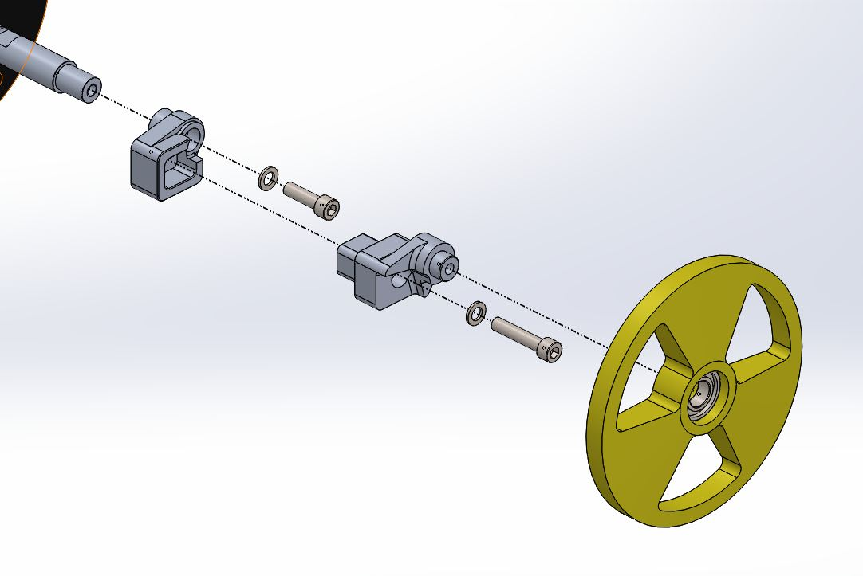
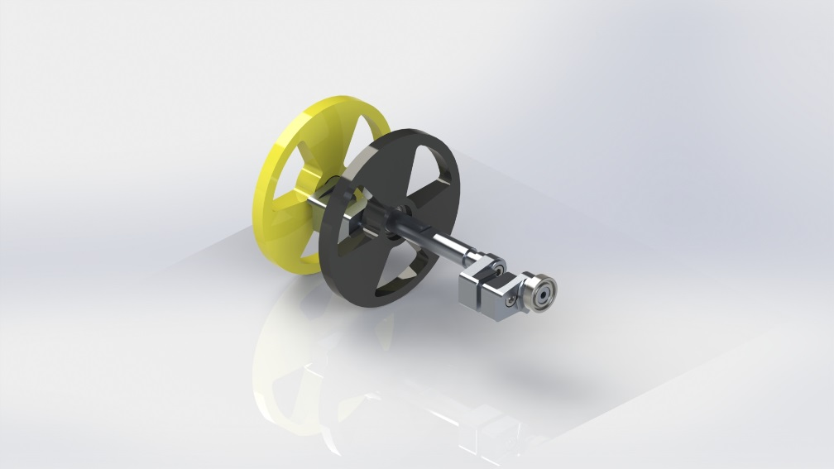
Drivetrain
Large diameter rear idler wheels
Reduce bearing and track losses at rear axle
Inelastic behaviour of track under bending strain
Proportional to strain, therefore proportional to curvature (inverse of wheel radius)
Rear idler wheels are the point of greatest curvature (7.125” diameter)
8” wheel reduces losses by around 10%

Slide 16
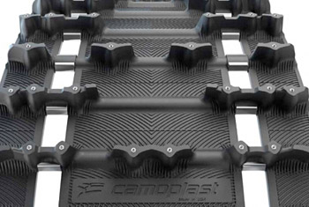
Drivetrain
2.86” Pitch Track
Camoplast ICE Attak XT, 120”
1.2” lug, pre-studded, 37lb
3lb savings over 2.52” pitch version (121”)
Use of pre-studded track allows for increased traction and control
Only 2lb heavier than the stock track for 2013 600 Pro-R

Slide 17
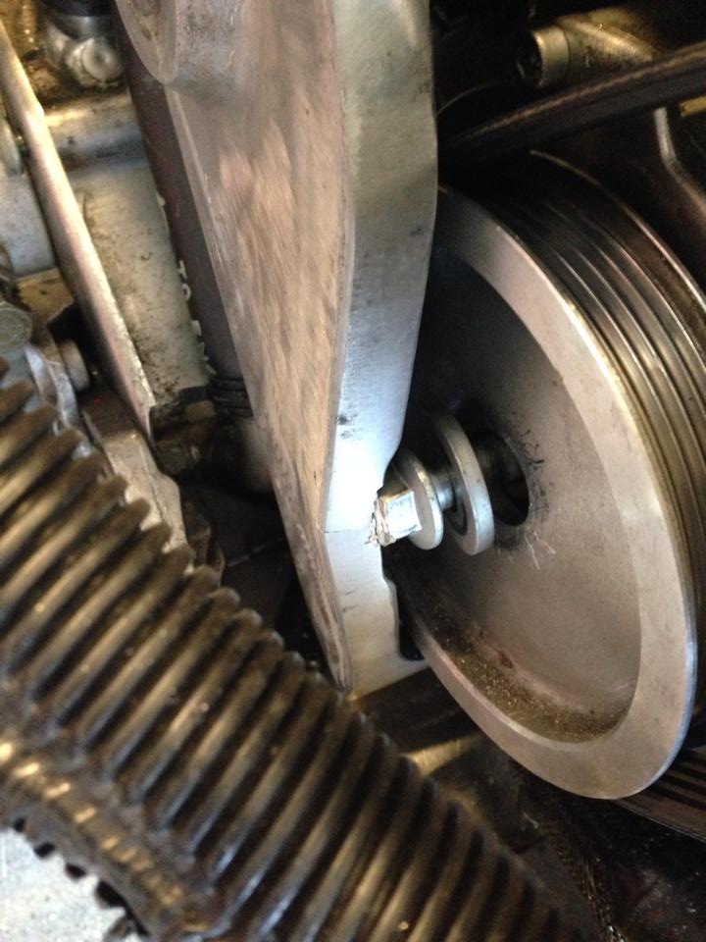
Challenges Encountered
Limited dynamometer availability
University requires their (part-time) operator present
Many teams vying for dyno time
Very little dynamometer tuning was performed
Cut short by alternator pulley excitement
Fabrication delays
Decreased occupancy limit in student machine shop with highest demand ever
Understaffing of engineering machine shop
Several critical components weren’t completed until last week

Slide 18
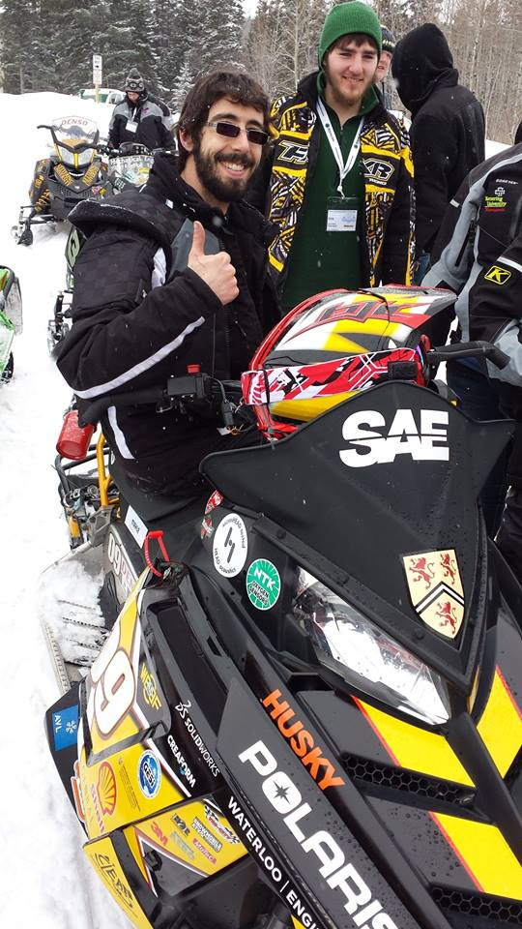
Summary
Snowmobiler Perspective
Four-stroke reliability and longevity
Capable of high performance
Premium suspension
Familiar look and feel
Dealer/Outfitter/Manufacturer Perspective
Modularity and configurability
Reliability/longevity
Environmental Perspective
Reduced fuel consumption
Reduced emissions

Slide 19
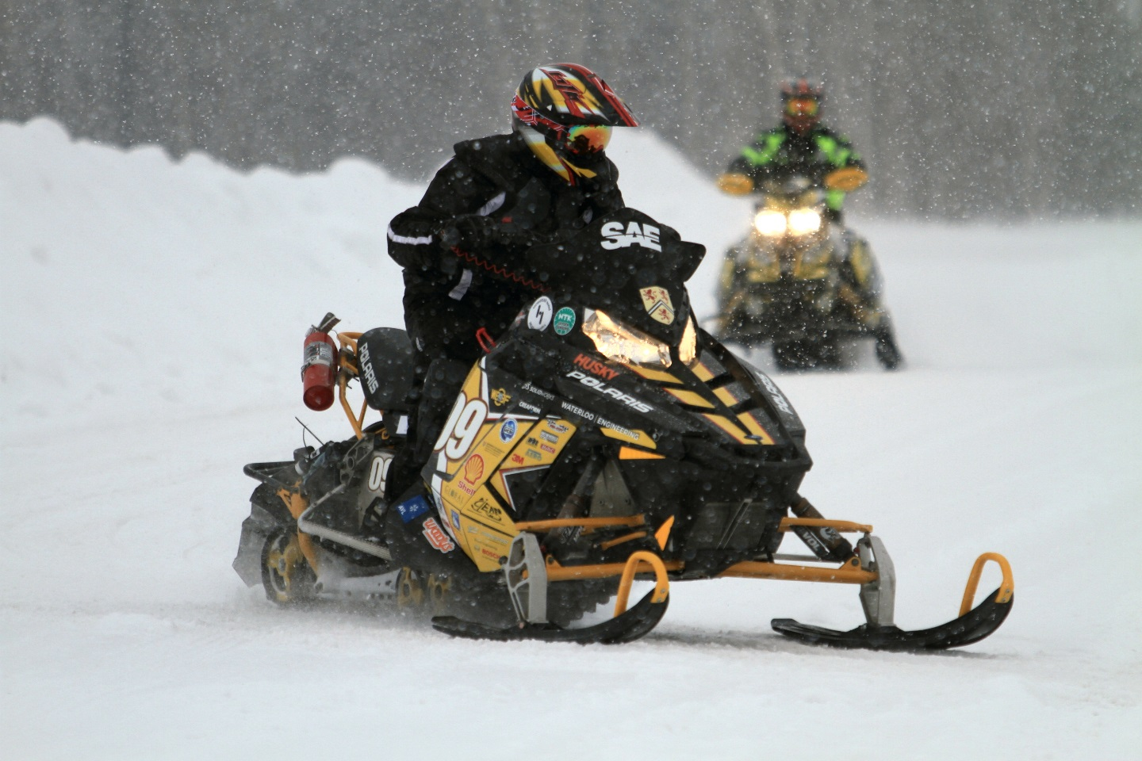
Questions?

