Slide 2
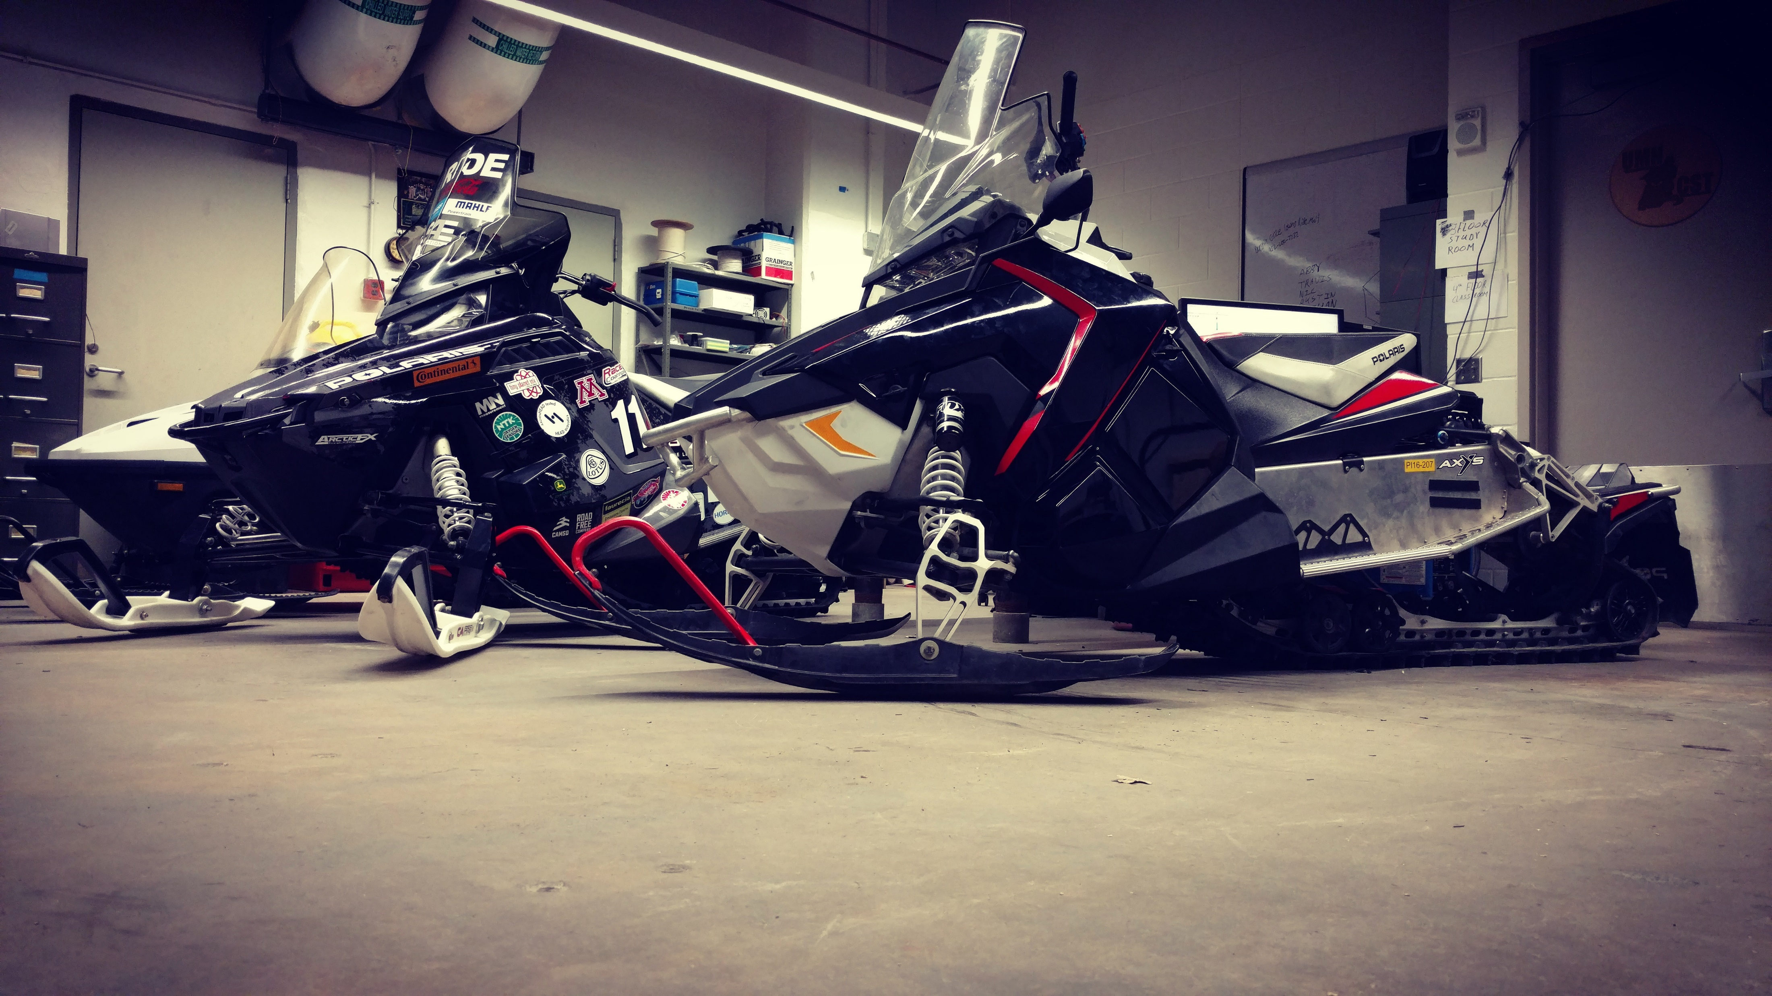
Overview
Project Management
Base Sled Selection
Engine Management
Muffler Design and Catalyst Implementation
Noise Reduction

Slide 3
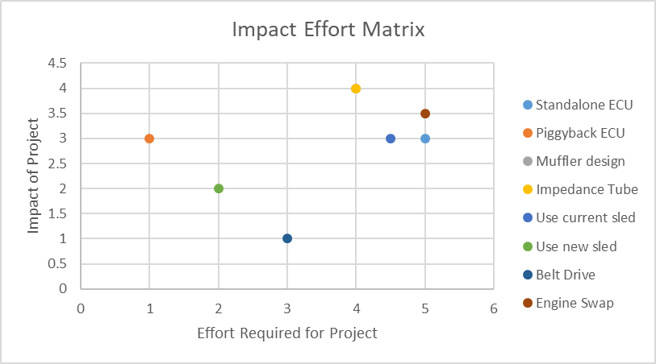
Project Management
Focus on project selection
Projects that can be done with resources we have
Identify risks and create mitigation plans

Slide 4
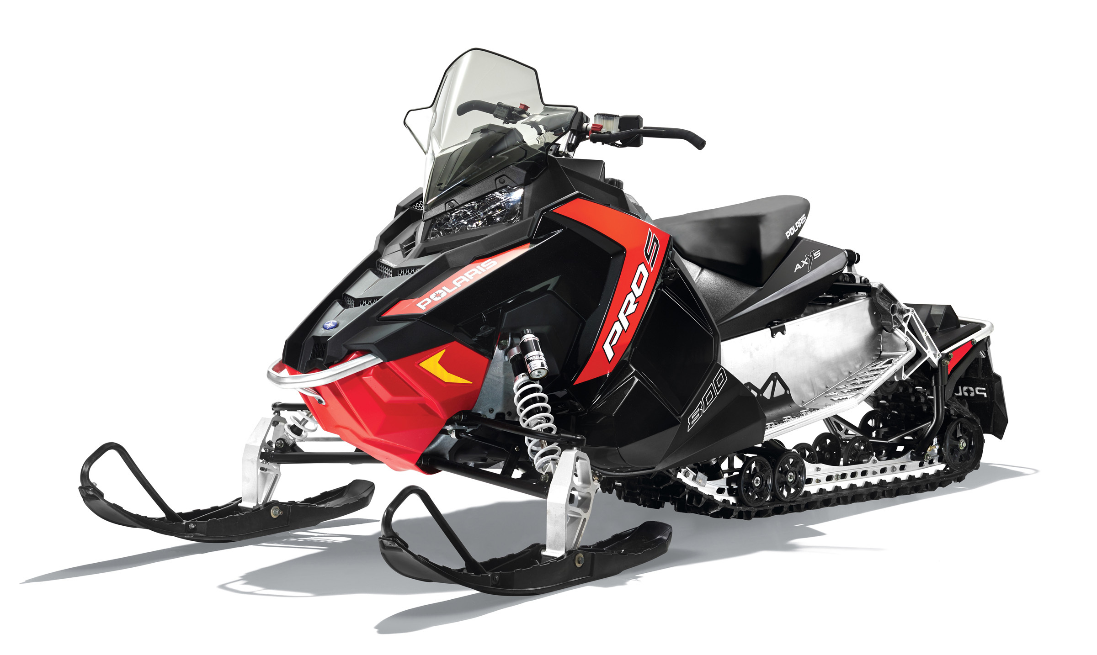
Base Sled Selection
2015 Indy 600 SP | 2016 Switchback 600
121 inch track | 137 inch track
449 lbs | 447 lbs
$9599 MSRP | $11,899 MSRP
Pro-Ride Chassis | Axys Chassis

Slide 5
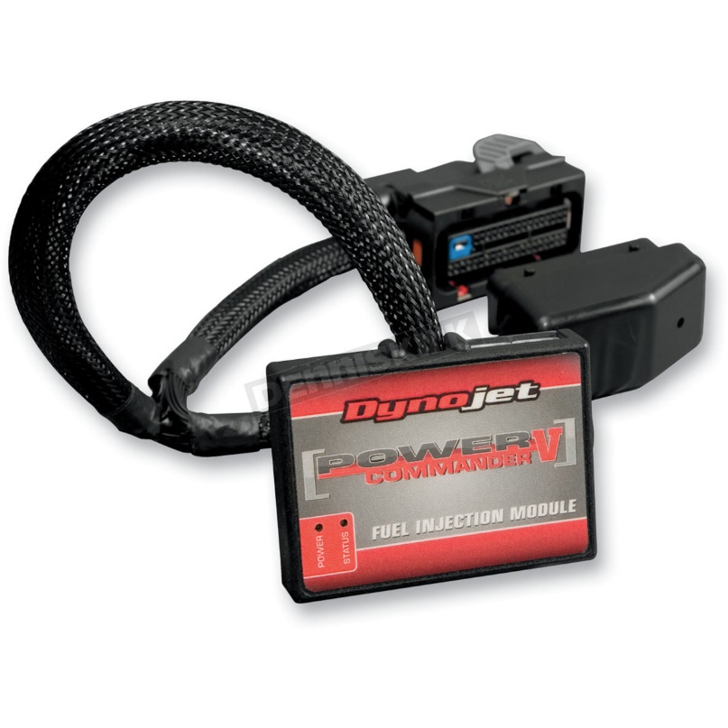
Engine Management
Dynojet Power Commander V
Low-risk
Ease of returning to stock
Dyno tuning not needed for a running sled
Has the features we needed
Ethanol Sensor

Slide 6
Catalyst Selection
Heraeus 1:20:1 Three-way catalyst
$E=\left[1−\frac{\left(HC+{NO}_{x}\right)−15}{150}\right]∗100+\left[1−\left(\frac{CO}{400}\right)\right]∗100≥100$
HC conversion prioritized
Upsized from 70x75mm to 72x130mm
98.23% Mode 5 HC Conversion efficiency

Slide 7
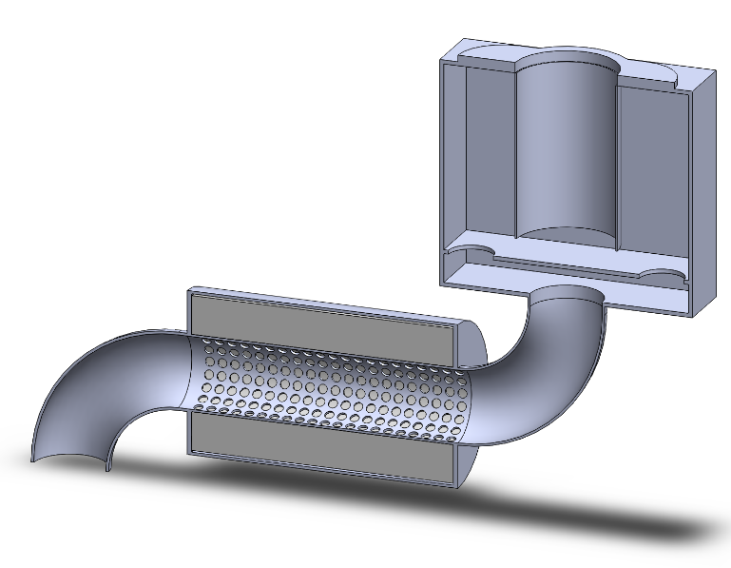
Muffler Design
Three-chamber muffler
Catalyst housed in muffler entrance
“Box” used as catalyst heat shielding

Slide 8
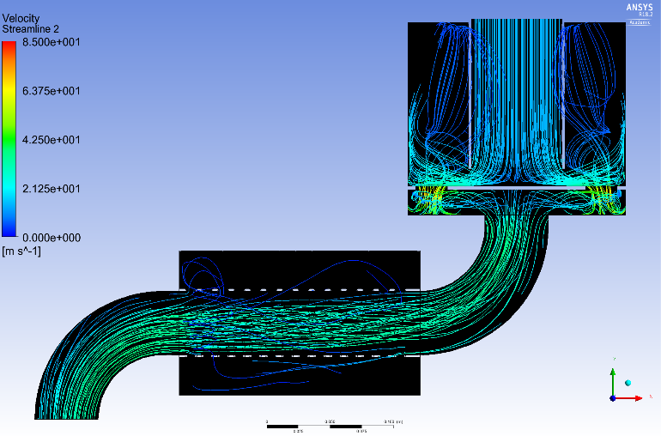
Muffler Simulation and Results
Peak backpressure of 0.692 PSI
Destructive interference

Slide 9
Target Frequency Identification
Competition sound files of 2017 CSC analyzed
Top 4 teams considered
200-2000 Hz loudest for all teams

Slide 10
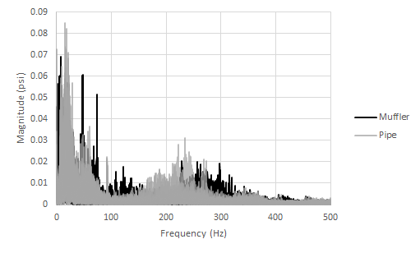
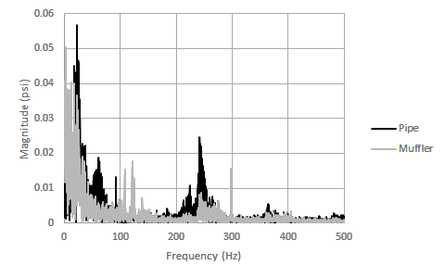
Exhaust Pressure Measurement
Measurement of exhaust pressure before and after the expansion chamber shows a change in pressure wave frequency.
7500 RPM
Across all RPM

Slide 11
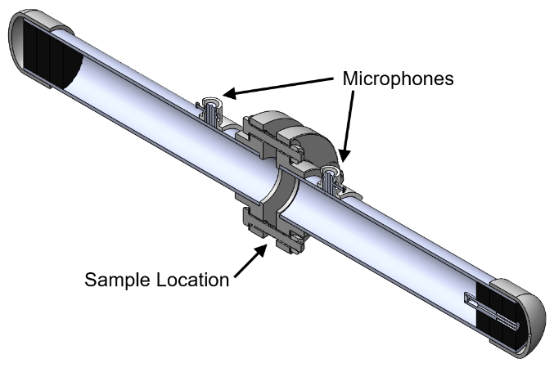
Impedance Tube
Added a second microphone to quantify sound reflection
Various improvements to test setup improved accuracy
Square Wave Sine Wave
Op-amps on microphones

Slide 12
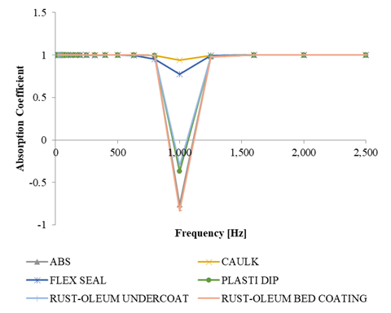
Sound Materials
Coatings were tested on ABS samples similar in thickness to the side panels
Flex Seal and Caulk were found to reduce a resonance in the system at 1000Hz, a target frequency
Flex Seal was applied to the interior of side panels

Slide 13
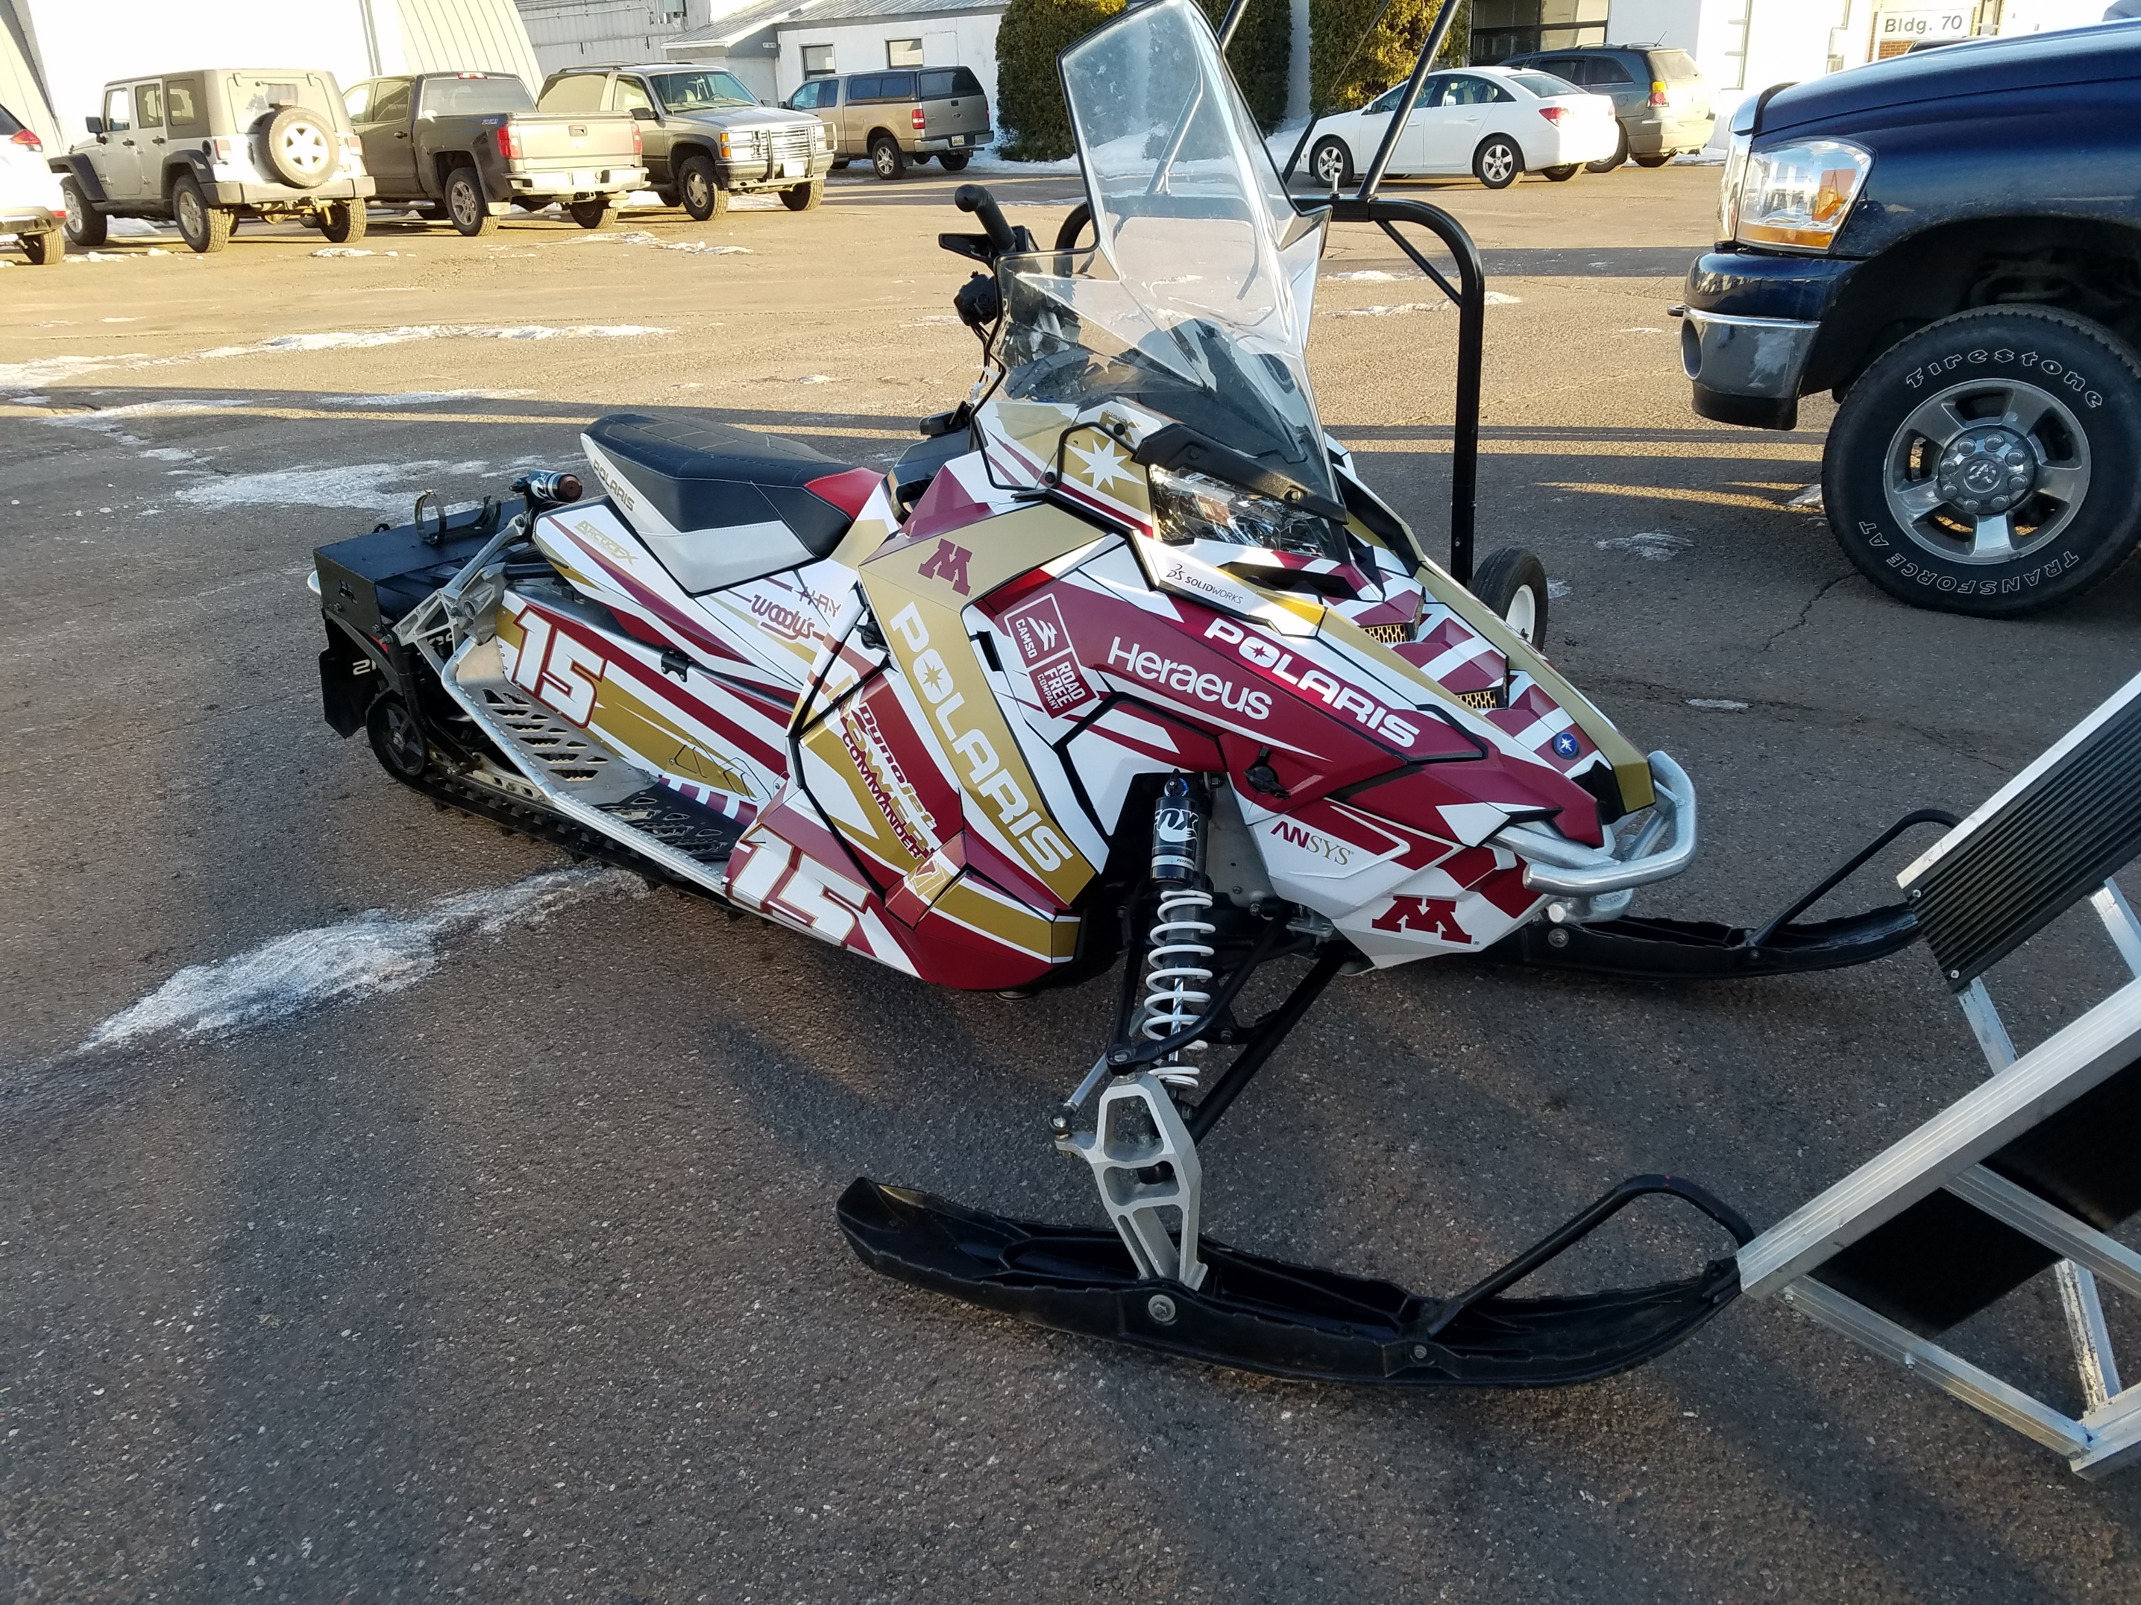
Summary
Fun sled with over 100HP and 137” track
Flex fuel capability
Significantly reduced emissions
Sound deadening aimed at reducing unpleasant resonances
MSRP value of $12,083.52

Slide 14
Thanks to Sponsors and Organizers

Slide 15
Questions?

Slide 16
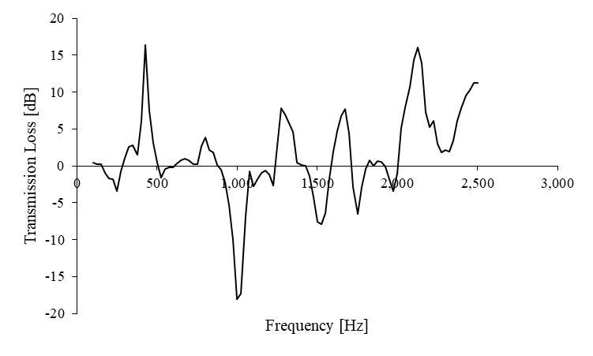
Resonator

Slide 17
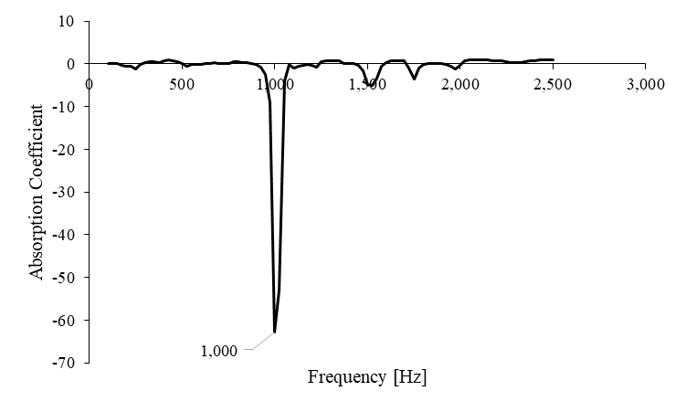
Resonator

Slide 18
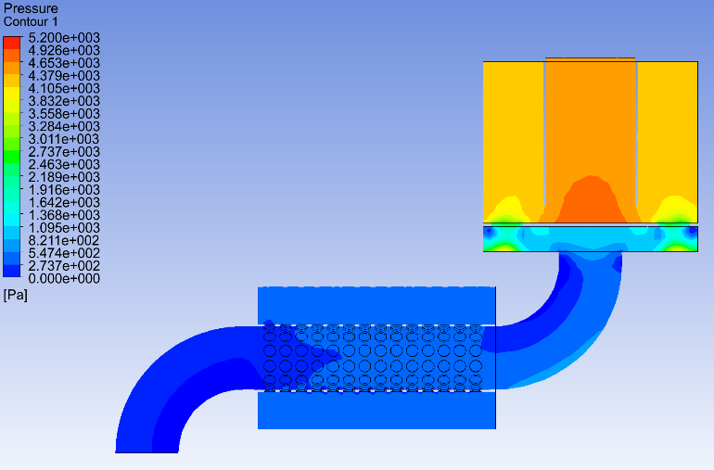

Slide 19
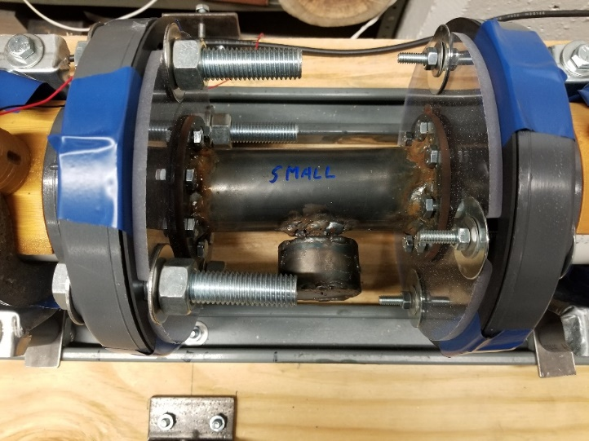

Slide 20
Transmission Loss Calculation
$$\left.α=\frac{ΔE}{E_{Incident}}=\frac{E_{Incident}−E_{After}}{E_{Incident}} (eq 1\right)$$
$$\left.τ=\frac{P_{Out}}{P_{In}} (eq 2\right)$$
$$\left.P=\frac{Ap_{Amp}^{2}}{ρc} (eq 3\right)$$
$$\left.τ=\frac{\frac{Ap_{Out}^{2}}{ρc}}{\frac{Ap_{In}^{2}}{ρc}}=\frac{p_{Out}^{2}}{p_{In}^{2}}={\left(\frac{p_{Out}}{p_{In}}\right)}^{2} (eq 4\right)$$
$$TL=10\log_{10}\left.\left(\frac{1}{τ}\right) in dB (eq 5\right)$$

Slide 21
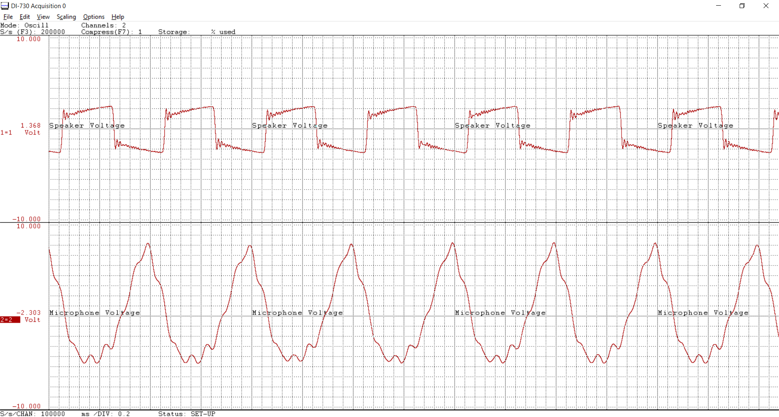
Appendix A-1: Speaker output when square wave excitation is applied

Slide 22
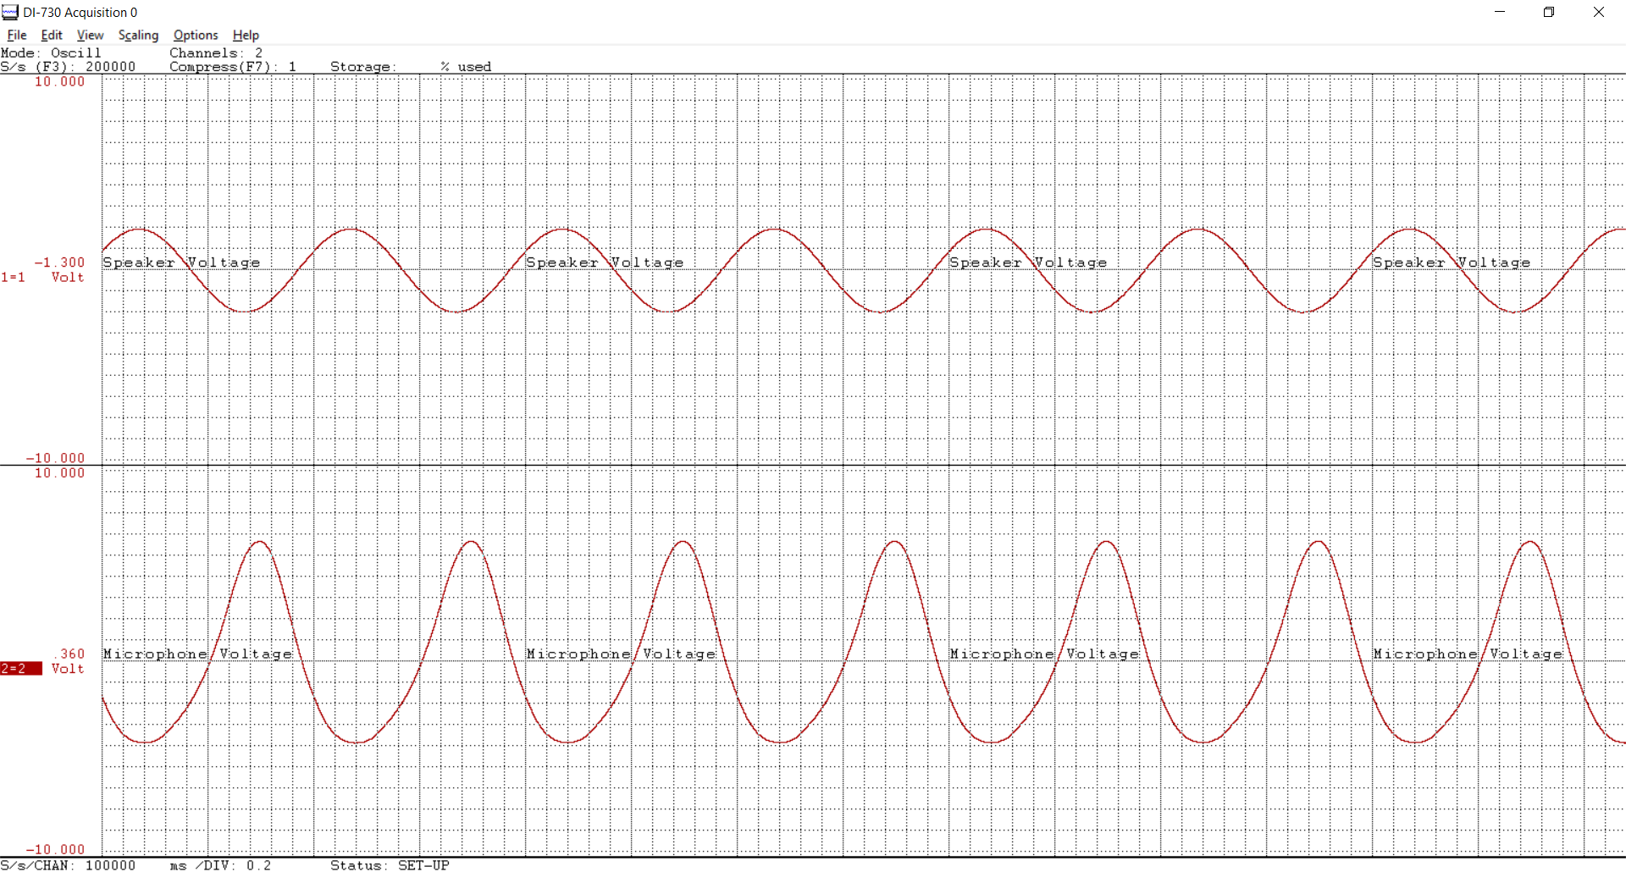
Appendix A-2: Speaker output when sinusoidal excitation is applied

Slide 23
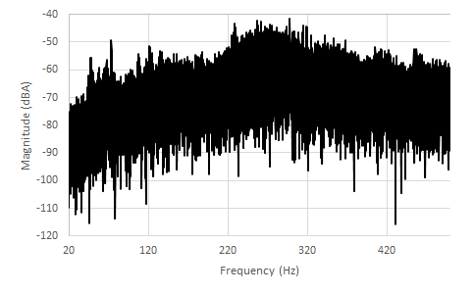

Slide 24
Before Catalyst
HC | 1.13%
CO₂ | 2.0%
CO | 3.05%
NO | 40ppm
NO₂ | 2ppm
NO_{x} | 43ppm
 | Idle | 3000RPM | 4000RPM
Temperature | 698C | 852C | 856C
O₂ | 5.4% | 1.5% | 0.8%
HC | 0.02% | 0.09% | 0.06%
CO₂ | 11% | 15.4% | 10.7%
CO | 154ppm | 754ppm | 6852ppm
NO | 65ppm | 271ppm | 21ppm

