Slide 1
University of Minnesota-Twin Cities
SAE International Clean Snowmobile Challenge 2017

Slide 2
2015 Polaris Indy 600 SP
600cc 2 stroke Liberty engine
Rated 125 hp
Fox IFP shocks

Slide 3
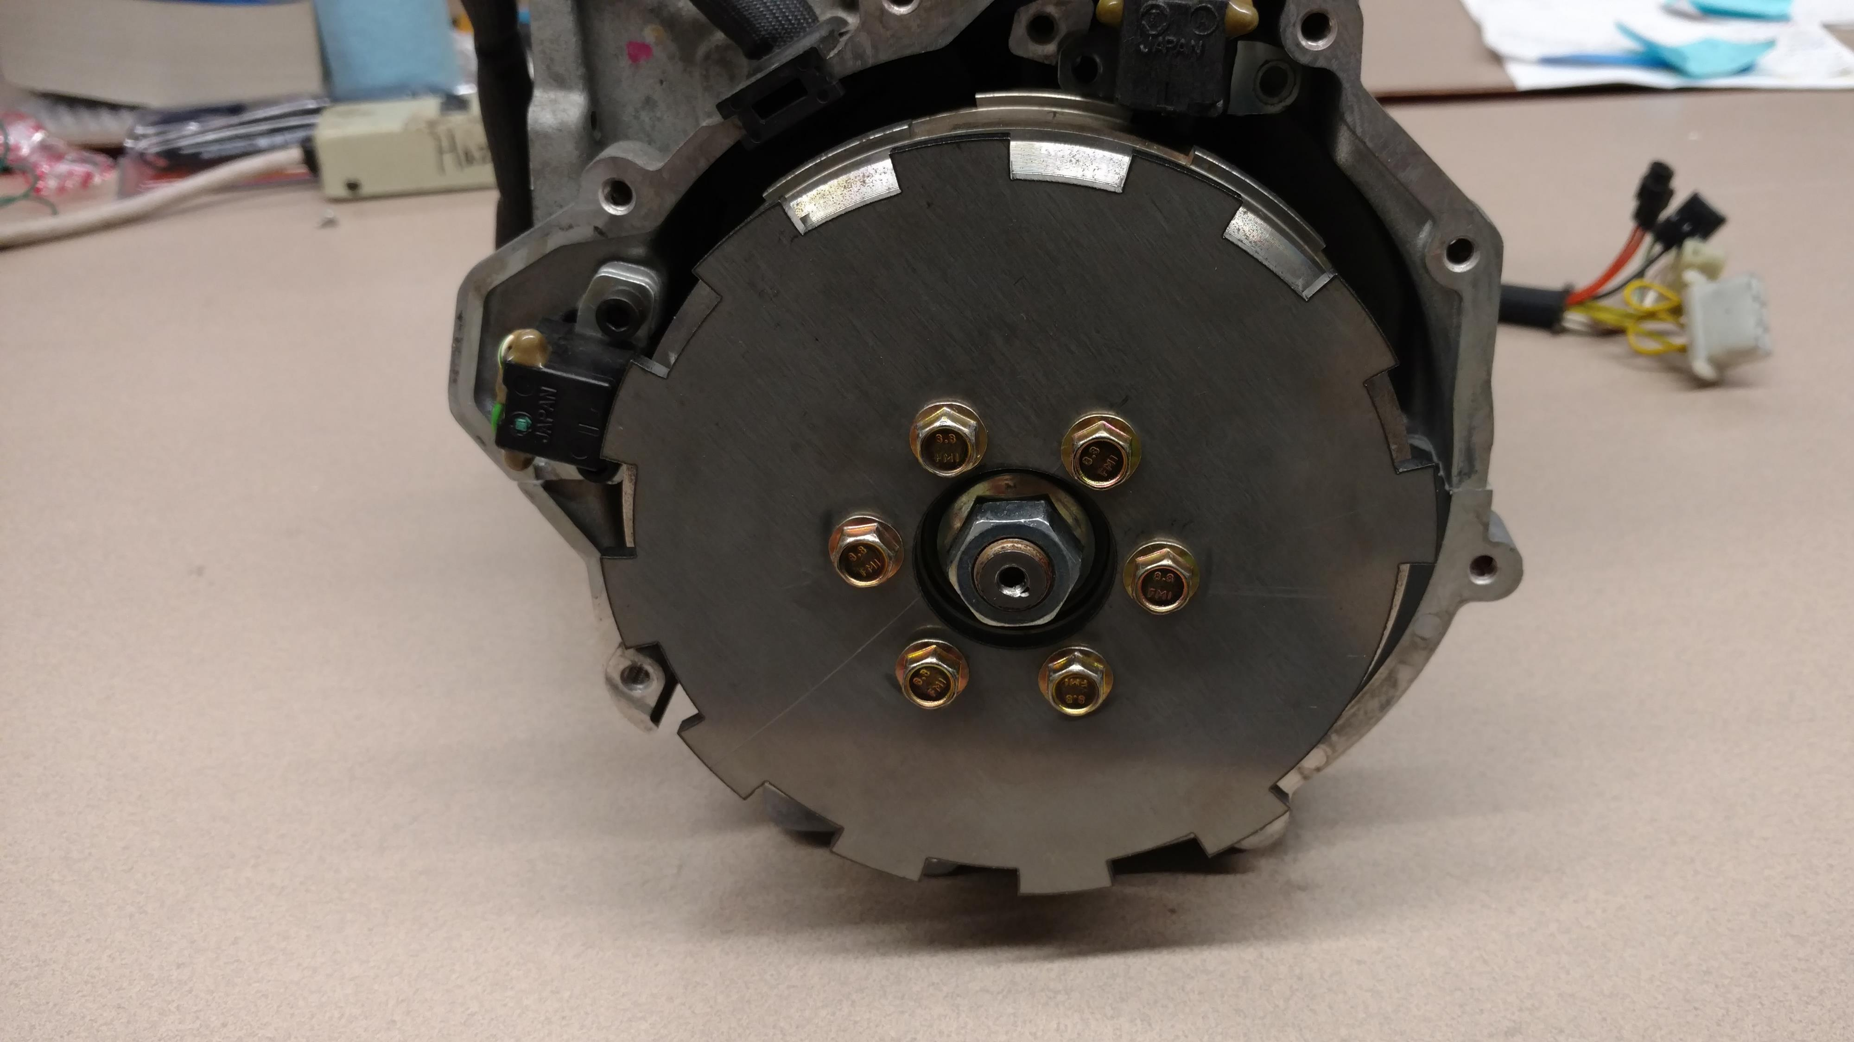
Modification Overview
Skis and Track
Exhaust and Catalyst
Sound Deadening Foam
Standalone ECU and Ethanol Sensor

Slide 4
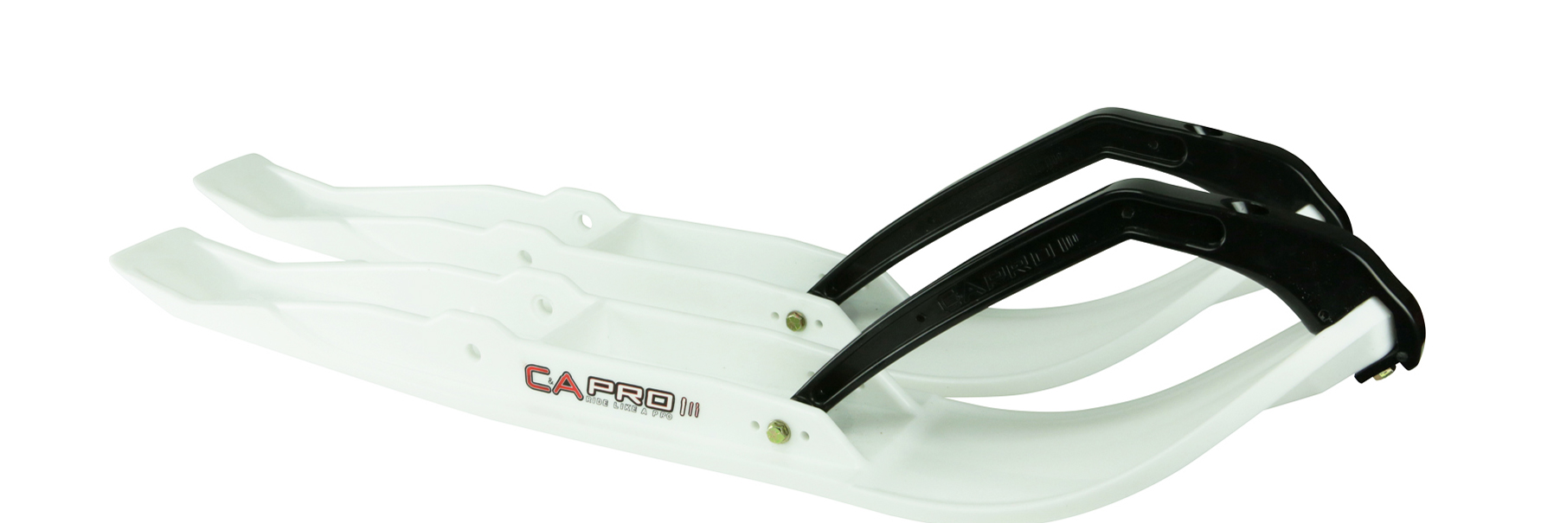
Handling
C&A Pro TRX Skis
Camso Ice-Attack XT Track

Slide 5
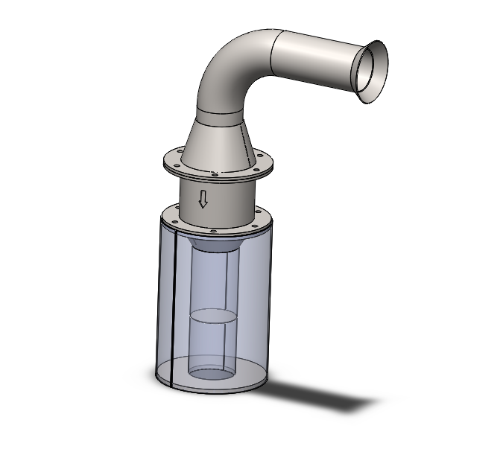
Exhaust System
Incorporates catalyst and a new muffler
Baffled to reduce noise
3-Way Catalyst
BASF TEX-0587 coating
Catalyst density 300 cells per square inch
2/9/1 ratio (Pt:Pd:Rh)

Slide 6
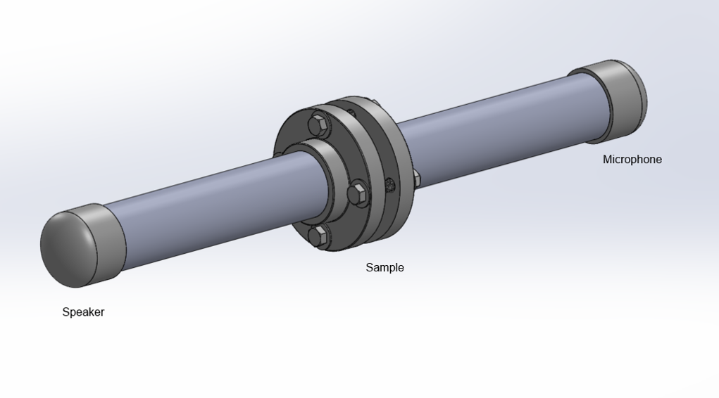
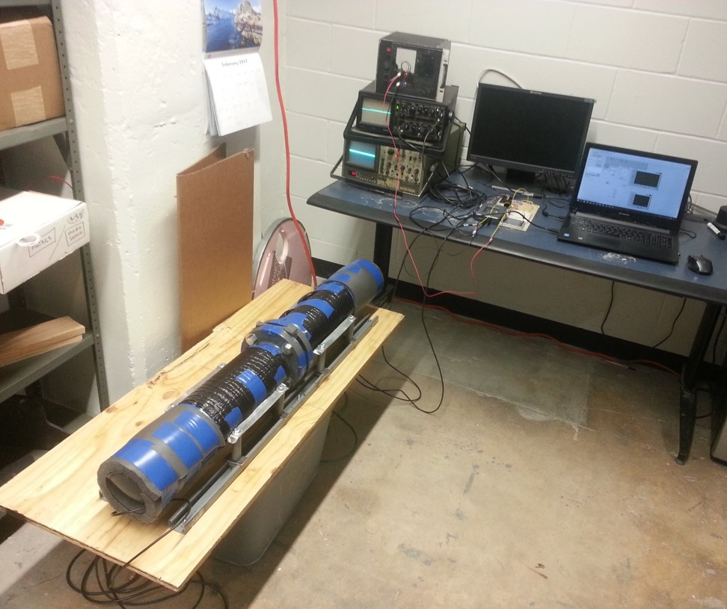
Noise Reduction
Impedance tube and software
Allows testing of materials
Measures absorption coefficient
Best material tested was incorporated on sled

Slide 8
Engine Management
Performance Electronics PE3
Standalone ECU
Supports 0-100% Ethanol mixtures
Air/Fuel ratio calibration strategy

Slide 9
Sled Overview
0-100% Ethanol Capable
Handling upgrades for on-trail performance
Quieter exhaust muffler and aftertreatment
Sound deadening materials

Slide 10
Acknowledgments
Our Sponsors: Polaris, BASF, Heraeus, Camso, C&A Pro, Ford, Celestica, Race Coatings, Minnesota Measurements, Toro, and others
Michigan Tech and the Keweenaw Research Center
SAE International
Judges and Volunteers

Slide 12
