Slide 1

University of Minnesota
Clean Snowmobile Team
Notes:
Introductions

Slide 2
Overview
Our Team
Goals
Design Objectives
Development Process
Current Snowmobile

Slide 3
Goals
Increase Membership
    15 Members
      750% Growth from last year
Increase Resources
    Shop Space
      January 25th, 2016
    Equipment acquisitions
      5-gas emissions analyzer
      Dataq
Gain sponsorships
Attend competition

Slide 4
Design Objectives
Catalyst
    Heraeus 3-way catalyst
Belt Drive
    Reduce noise
    Reduce rotating mass
PE3 ECU

Slide 5
Emissions Control
Data at idle
3-way catalytic converter
  Heraeus
    Implemented on snowmobile
  BASF
    Testing 2-stage catalyst system
Supplier | Catalyst Wash Coat
Heraeus | 1:20:1- Pt:Pd:Rh 50 g/ft³
BASF | 2:9:1- Pt:Pd:Rh 60 g/ft³
Emissions | Percentage/ppm
HC | 1.13%
CO₂ | 2.0%
CO | 3.05%
NO_{x} | 40 ppm

Slide 6
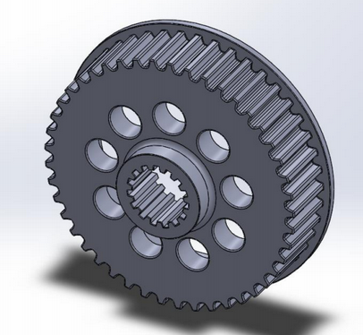
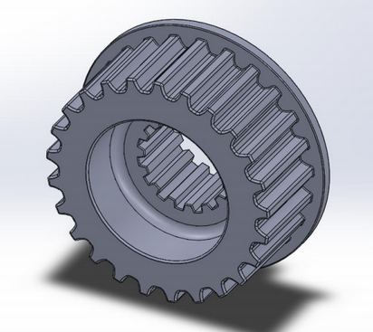
Belt Drive System
Reduces Rotating Mass
    1.1 kilogram reduction
Eliminate Chain Bath
    Potential noise reduction

Slide 7
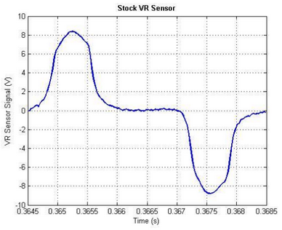
Engine Control System
Stoichiometric Air/Fuel Ratio
PE3 ECU
Skip-tooth timing wheel

Slide 8
Summary
MSRP: $10,225
Electrical Component Issues
Improvements for 2017 Competition
    Better Project Management
    Greater Industry Support
    Increase Testing

Slide 9













Huge Thanks!

Slide 10
University of Minnesota
Clean Snowmobile Team
Notes:
Any questions?

