Slide 1
University of Minnesota
Clean Snowmobile Team

Slide 2
Overview
Our team
Original snowmobile
Design objectives
Development process
Current snowmobile

Slide 3
UMNCST Timeline
10 person team
Idea of a team started in August 2014
Snowmobile on campus in November
First time running on 2/21/15
  2 hours before oil fitting failure

Slide 4
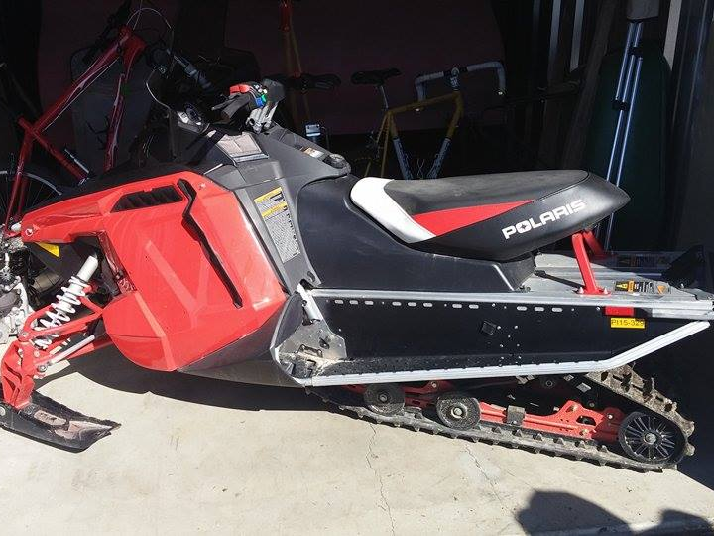
2015 Polaris INDY 600 SP

Slide 5
Design Objectives
Improve a snowmobile in ways that are:
  Inexpensive
  Effective
  Easily implemented

Slide 6
Development Process
“If it’s not free, we can’t afford it”
C&A Pro TRX skis
  Wider, more floatation on top of the snow
  U shaped outer keels
  Tapered ends

Slide 7
Development Process
Woody’s Trail Blazer IV Carbides
  6 inch, 60 degree
  General improvement over stock
Camoplast ICE Attak XT
  More aggressive lug design
  Pre-studded for reduced weight

Slide 8
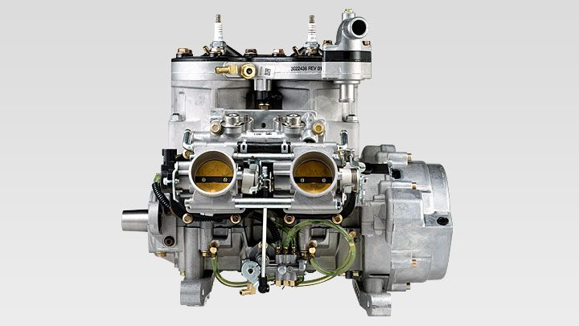
Development Process
Liberty 600cc engine
  Reduced to 300cc
  Theoretically improve fuel consumption and emissions

Slide 9
Development Process
Next year we’re looking into:
  Dynamometer
  Performance Electronics 3 ECU
  Catalytic converter
  Track noise
  Money
  Tools
  Shop space

Slide 10
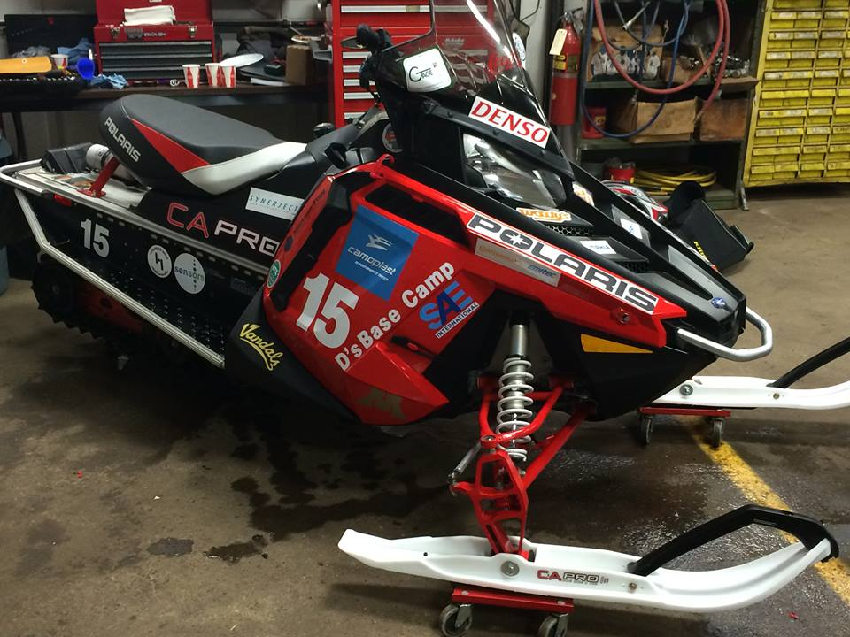
Current snowmobile

Slide 11
Summary
Inexpensive improvements to track, skis, and engine
Using this experience to propel the team through the next year

