Slide 1
UAF Bristol Bay Campus
Design of a meaningful Snuukuuq
Frank Nicholson, Ryan Giordano, Tiarna Bartman,
University Alaska Fairbanks - Bristol Bay Campus

Slide 2
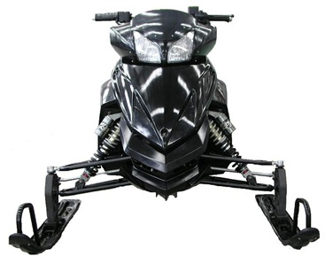
Chassis:Phantom Snowmobile (PD250LT)
We have the smallest sled in SAE CSC history.
The weight of the snow machine is approximately 400 pounds making it the lightest sled ever brought to the competition.

Slide 3
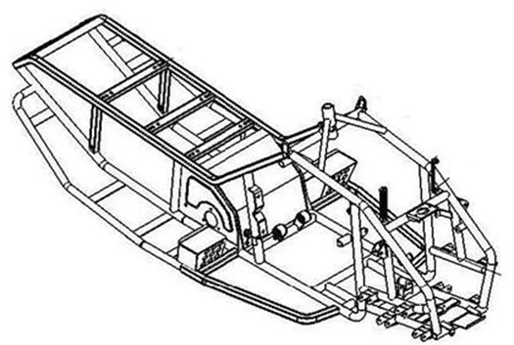
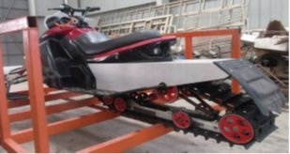
Introduction
Steel frame that weighs 27.2 kg (60 lb)
The track is only ten inches wide, and 110 inches long.

Slide 4
Other Specifications
Engine Type | Water cooled, 4-Stroke, 2 Cylinder
Displacement | 250cc
Starting System | Electric
Fuel Capacity(Gal/L) | 4.8 gallons/18L
Max. Power | 14.5hp
Transmission
Gear shift | CVT (with Reverse)
Suspension
Front suspension | A-arm Independent
Front shocks | Aluminum body piggy-back
Rear suspension | Slide rear type
Rear travel | 8.5 inches
Front travel | 7.0 inches
Maximum Speed (Approx) | ＞45 mph/70 km/h
Fuel Consumption (Approx) | 354g/kw.h
Brake | Hydraulic Disc Brake

Slide 5
Phantom Snowmobile Factory

Slide 6
Minor Frame Modification

Slide 7
Minor Frame Modification
Owner of FMC Motor Company, Inc. watches as frame is modified
Purchased Machine with Motor, Radiator and drive chain.

Slide 8
Loaded in the car!

Slide 9
Snowmobile Operator Perspective:
CONTENT: 12.5 points
Phantom PD250LT (electric)
Converted to Electric Snowmobile
Practical choice for clean environments
Range is 4 miles with current pack which is sufficient for short trips.
Battery recharges in one hour
High fuel prices curtails research projects
Shipping in smaller containers reduces freight costs

Slide 10
Dealer/Outfitter Perspective:
CONTENT: 12.5 points
Phantom PD250LT (electric)
Service
7 Removable Turnigy Batteries
Zero Maintenance Belt
No Oil changes, etc.
Extremely Low MSRP: under $11K
Durable design based on Eagle NRG belt
Easy to drive. No special switches
Extremely comfortable for smaller riders. Handlebar risers can be installed for taller riders.

Slide 11
Environmental Perspective:
CONTENT: 12.5 points
Snowmachine lightweight allows for a more efficient design.
The electricity power used to recharge the batteries is more efficient than gasoline, even when using dirty coal.
Using the lightest Syncho Belt available, we made the machine quiet. Further upgrades can make the track quieter.
The Eagle NRG belt is about 65 decibels, but is also more efficient, and requires no side pieces to keep the belt attached.

Slide 12
Environmental Perspective:
CONTENT: 12.5 points
The electricity power used to recharge the batteries is more efficient than gasoline, even when using dirty coal.
Extreme lightweight allows for a more efficient design.
Using the lightest Syncho Belt available, we made the machine quiet. Further upgrades can make the track quieter.
The Eagle NRG belt is less than 60 decibels, but is also more efficient, and requires no side pieces to keep the belt attached.

Slide 13
Test Results
CONTENT: 12.5 points
Snowmobile ran at 24 volts

Slide 14
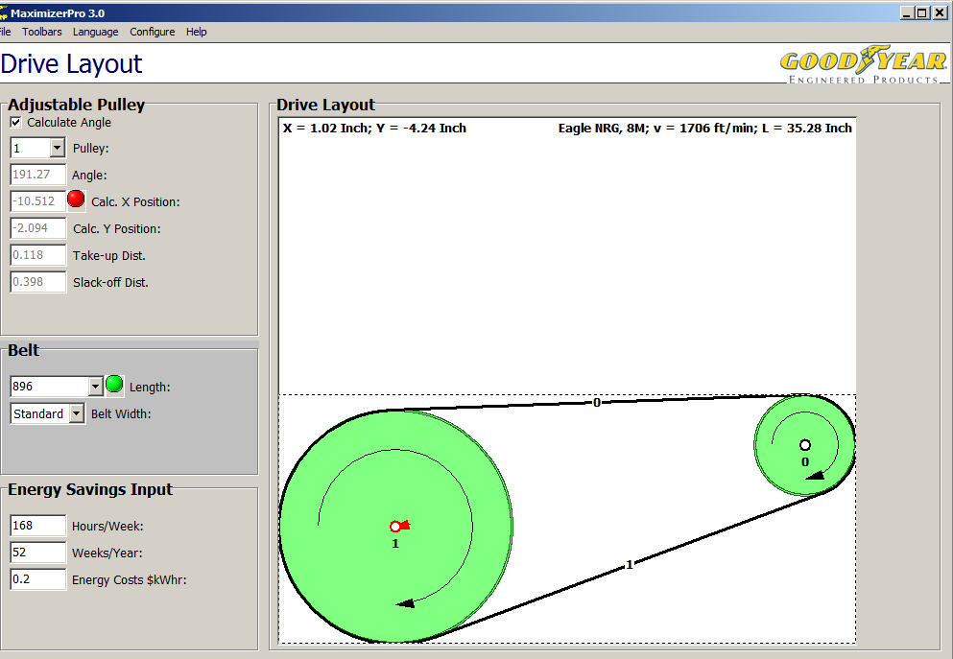
Drive Chain Upgrade

Slide 15
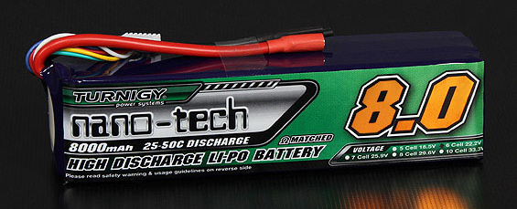
Batteries Used

Slide 16
Questions?

