Slide 1
St. Cloud State University Slick Cylinders
SAE Clean Snowmobile Team

Slide 2
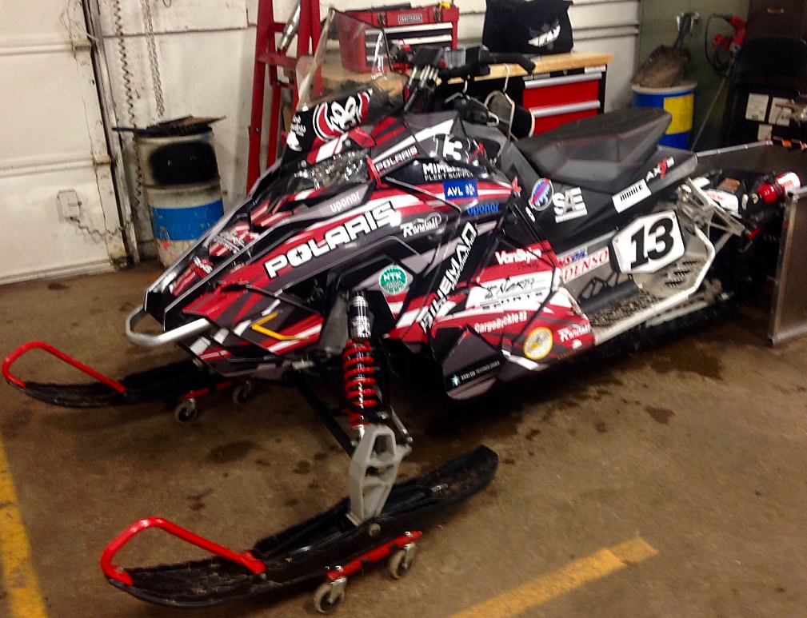
Presentation Overview
About the Team
Design Process
Major Modifications
Catalytic Converter Selection
Tuning
Side by Side Comparison
Sponsors
Questions

Slide 3
Team Members
From Left: Dan Kezar, Jake Harper, Heather VanSlyke, Jim Wicklund, Travis Meyer, & Gene Studniski

Slide 4
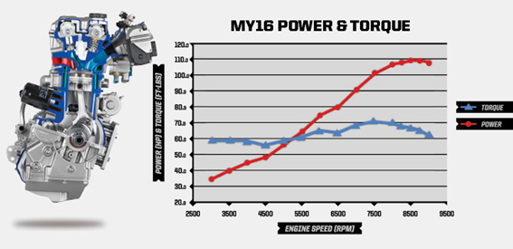
Design Process
Engine selection
2016 Polaris RZR XP 1000
110 hp 4-stroke DOHC Twin Cylinder
Max torque of 72 ft-lbs
Wet Sump Oil System & Liquid Cooling
Sled Selection
2015 Polaris Rush 800 Pro-S
MSRP: $12,799
Stock Sled Weight: 431 lbs (Dry)
Stock Engine: 154 hp 2-stroke
Track Length: 120”

Slide 5
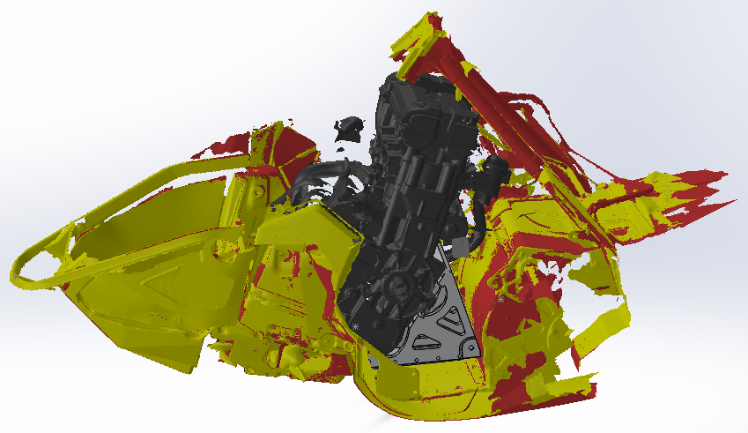
Design Process
Artec 3D scan of chassis and engine
Design parts based off of the scan
Notes:
Most of the innovation and modifications to the sled came from the necessity of fitting the larger 4 stroke engine in the the chassis of the rush pro s

Slide 6
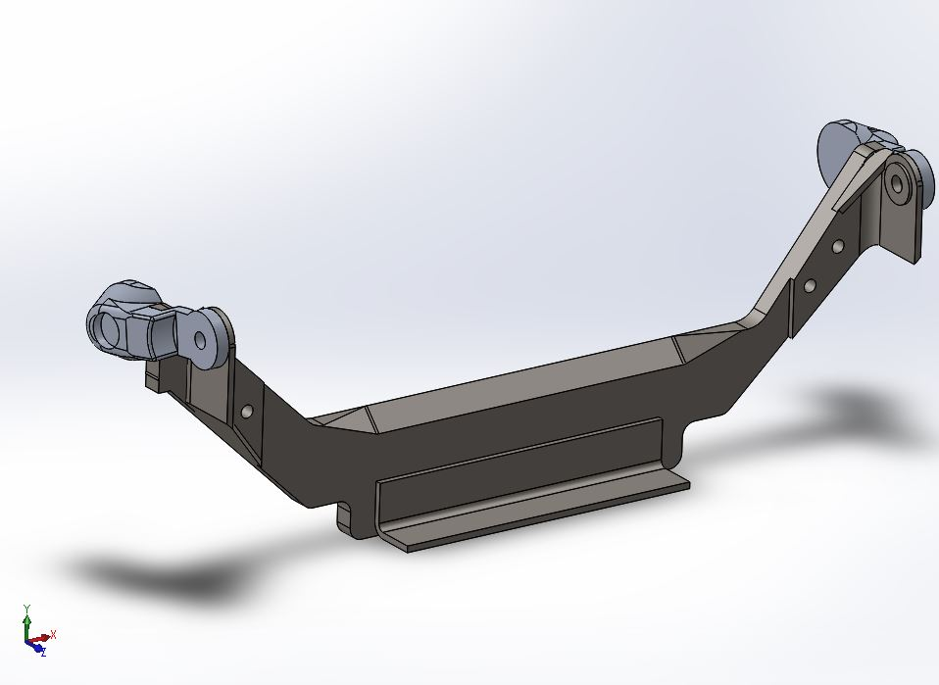
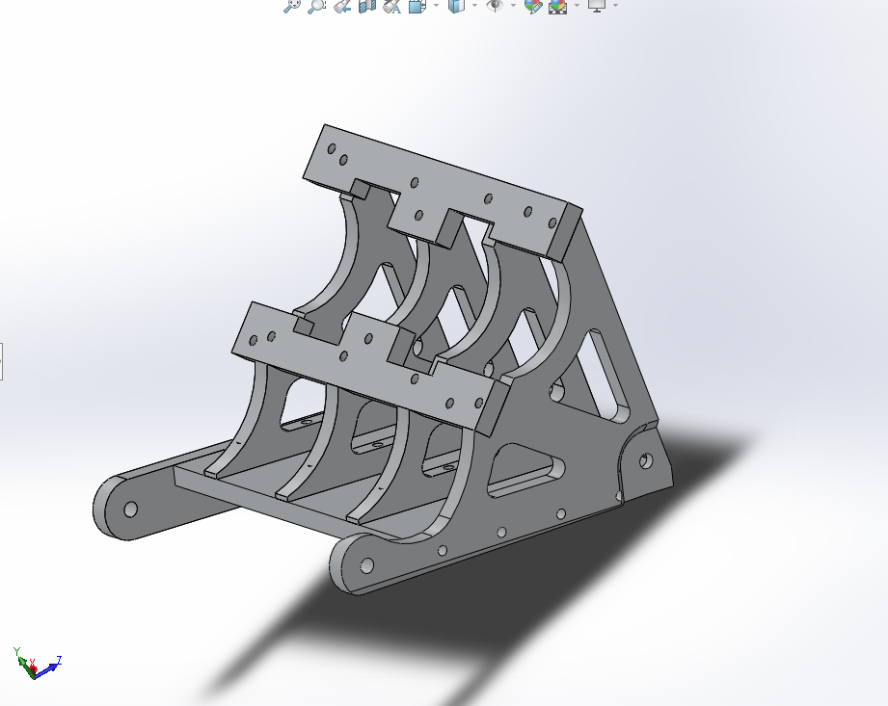
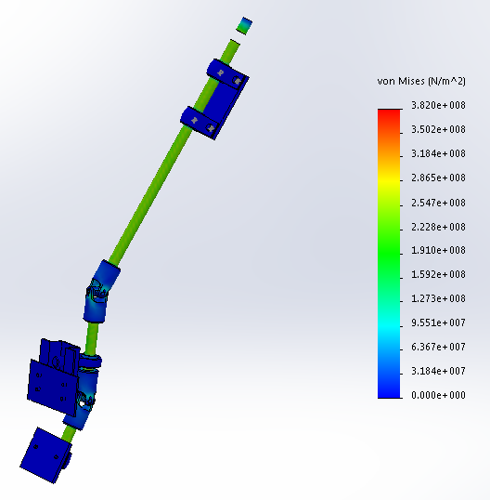
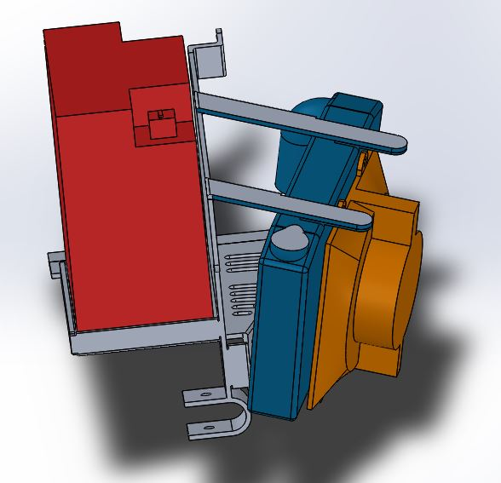
Major Modifications
Engine Mount
Support plate
Steering Column
Battery and Radiator Mount
Air box
Notes:
Unfortunately we did not manage to dyno because it broke down the day we were scheduled to test.

Slide 7
Catalytic Converter Selection
Benefits of Catalytic Converter Selection:
Very Similar Specifications between 2008 Chevrolet Aveo and 2015 RZR Engine
1600cc vs 999cc
103hp vs 110hp
2.5” pipe diameters
Distance to engine block comparable
3ft on Aveo vs. 1ft on this sled
Temperature range
Reaction range of 500F - 800F
Measured 765F
Notes:
This catalytic converter features a ribbed body that minimizes expansion and distortion when the converter heats up. These ribs form a channel that protects the cushioning mat from direct exposure to exhaust gases, and they hold the ceramic catalyst in proper alignment. The converters use a monolithic honeycomb catalyst which is designed for maximum flow and surface area. The manufacturer of the catalytic converter states that it will begin reacting at 500°F. For the new RZR 1000 engine the temperature at peak RPM will be 763°F leaving an adequate range of temperature for the converter to fully operate.

Slide 8
Tuning

Slide 9
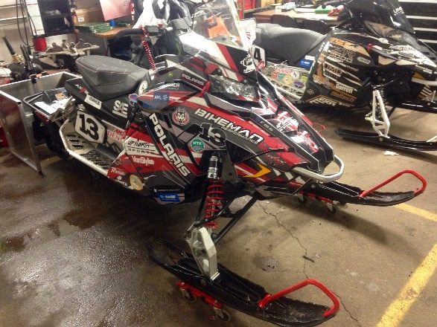
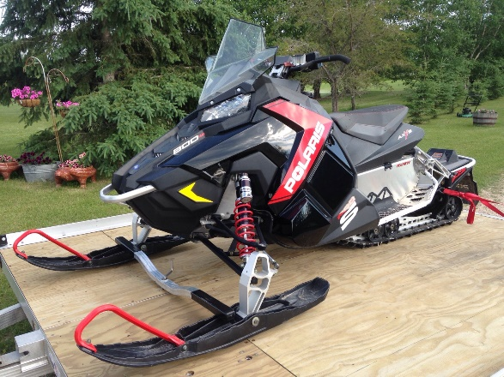
Side by Side Comparison
Modified Rush XP 1000
4 stroke
620 lbs wet
110 hp
72 ft-lbs of torque
Catalytic converter
$13,801
Stock Rush 800 Pro-S
2 stroke
546 lbs wet
154 hp
102 ft-lbs of torque
$12,799

Slide 10
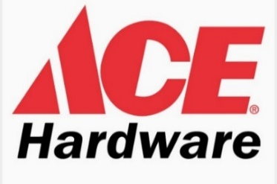
Thank You to Our Sponsors
Meyer Family
Jeff Hegle
Josh Muonio
VanSlyke Family

Slide 11
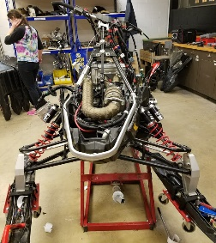
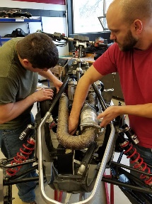
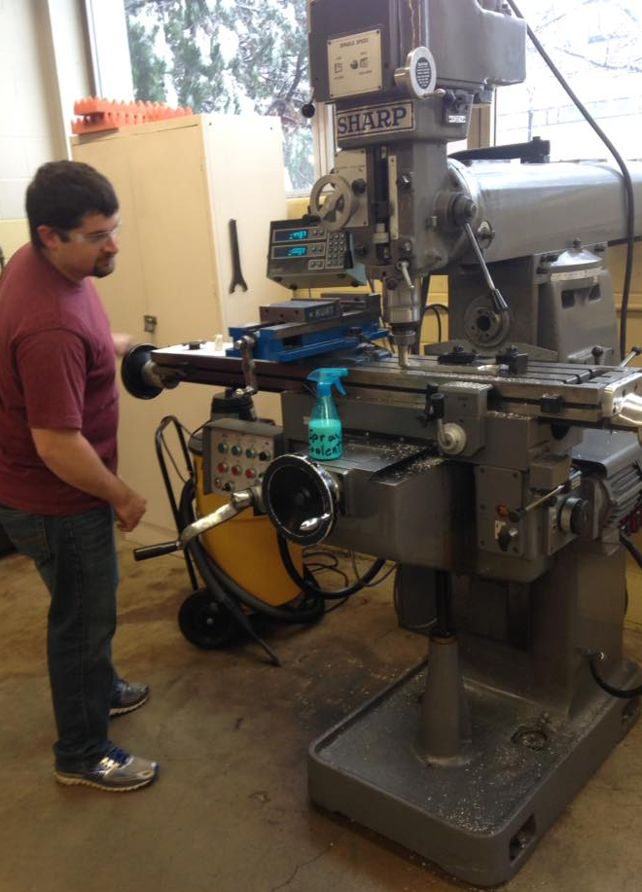
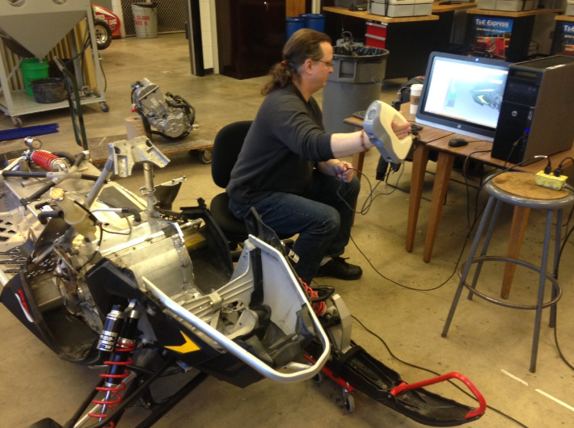
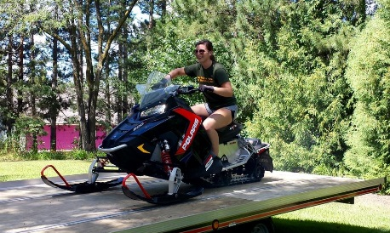
Questions?

