Slide 1
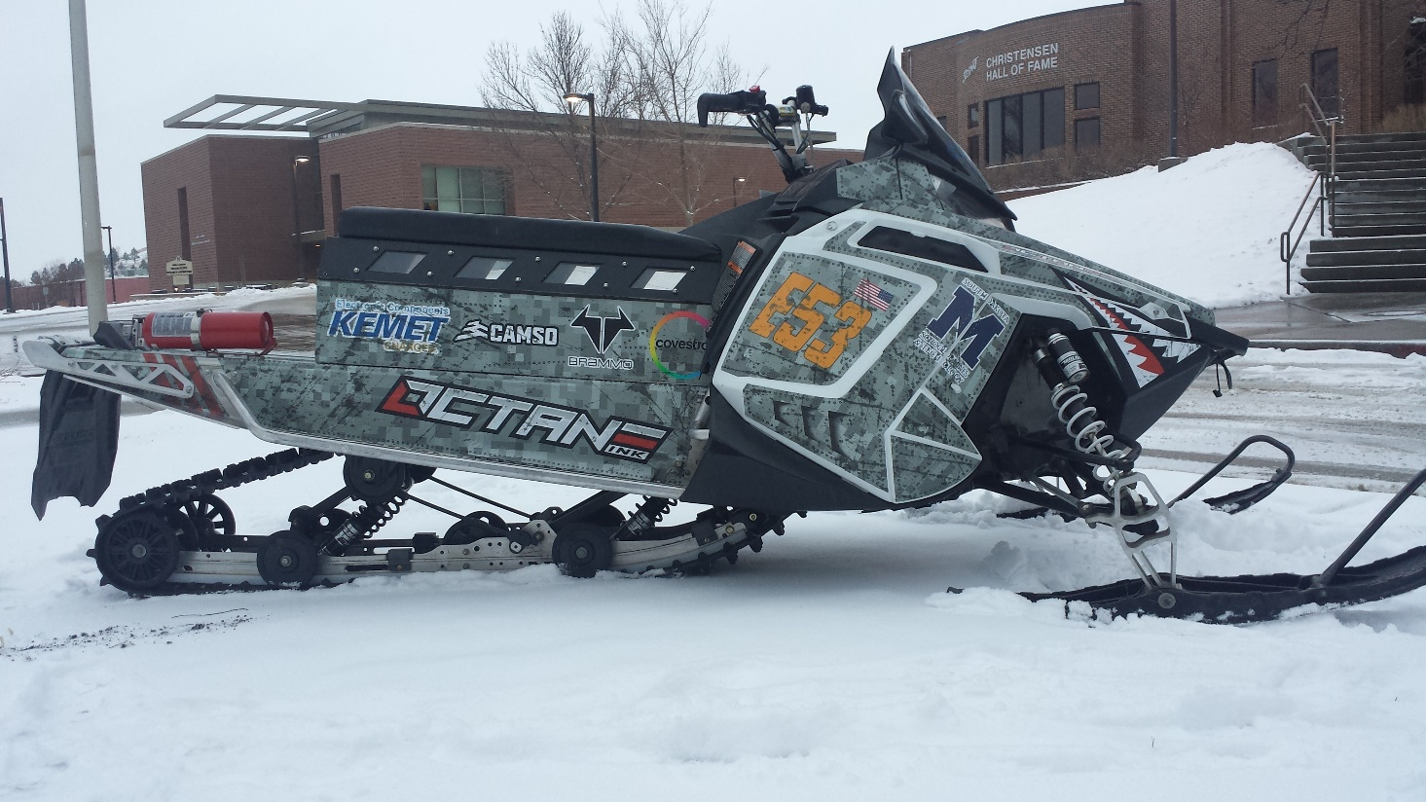
South Dakota School of Mines and Technology
Electric Snowmobile Team
2017

Slide 2
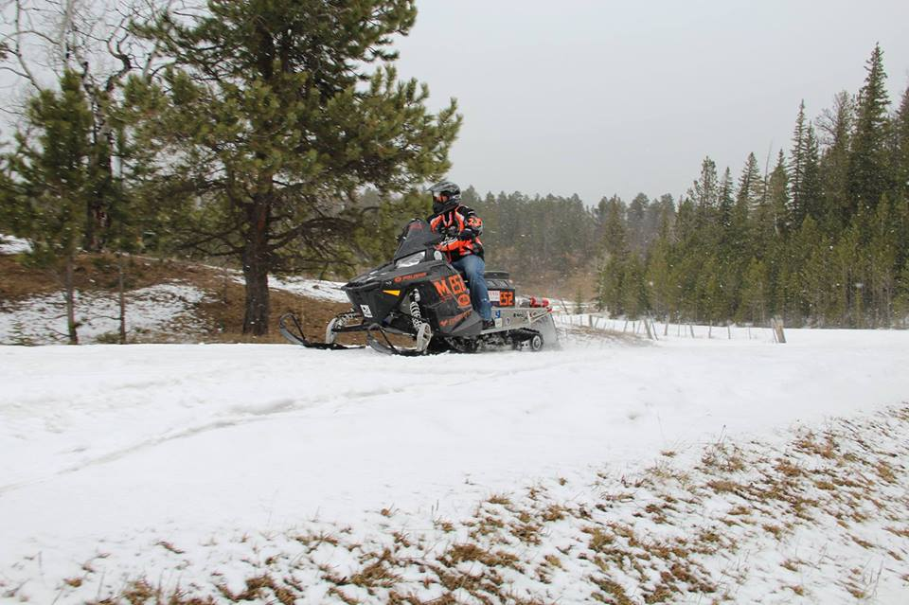
Overview
Who are we
System Overview
Usability, Functionality, and Performance
Dealer Benefits and Maintenance
Environmental Impacts

Slide 3
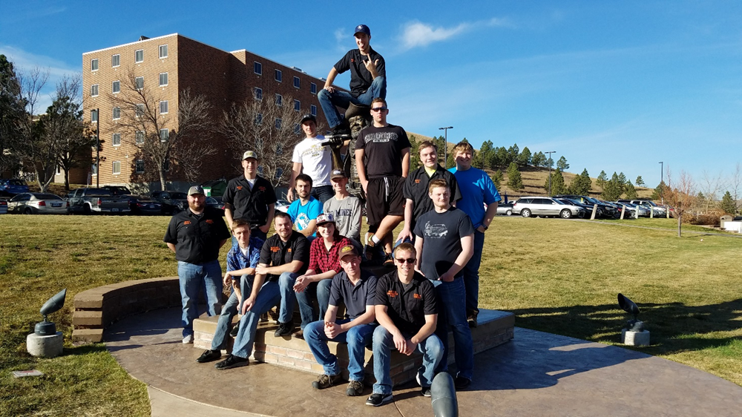
Who are we
Student organization on campus, open to all students
Main focus is to design and build an electric snowmobile
Comprised of ME, EE, Physics, and CEE undergrad students
2017 SDSM&T Clean Snowmobile Team

Slide 4
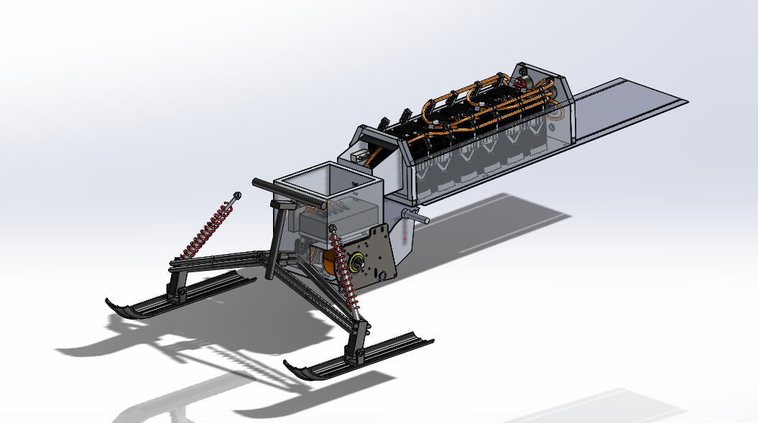
System Overview
2014 Polaris Switchback Assault
6 Brammo BPM 15/90 Li-ion battery modules
88.8 VDC, 90 Ah, 7.99 kWh
Internal heaters keep at optimum temperature in cold conditions
Sevcon Gen4 motor controller
Parker-Brammo GVM1425 liquid cooled motor
54 hp, 60lb*ft
Direct Drive
Modular component design
SolidWorks Concept of modular assembly
Notes:
Talk about the general specs of the snowmobile and what we had to change from the original snowmobile.
Don’t be afraid to spend some time talking over the SolidWorks Image on this page to point out the components we made.

Slide 5
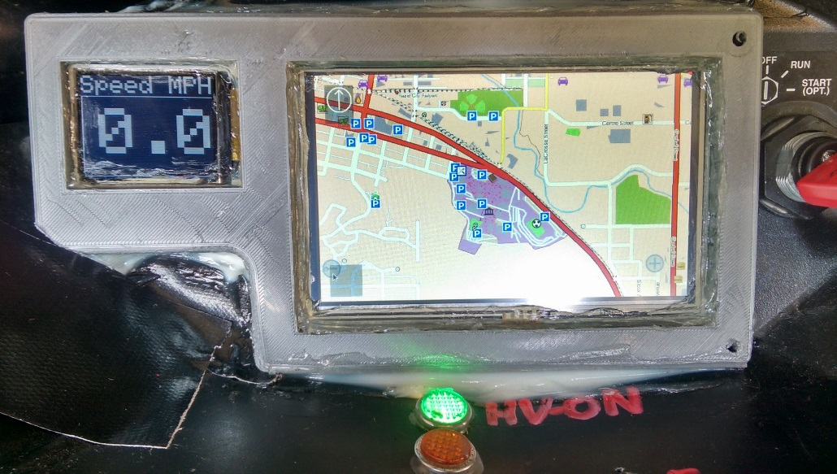
Usability and Functionality
Functions like a traditional snowmobile
Controls all carried over from stock
Easy to read GPS speedometer/location/mapping
Bright LED status lights on dash
Crossover chassis – versatility
Hard-packed snow and deep snow capability
Storage space on tunnel
Comfortable seating and standing positions
LCD display on Dashboard
Notes:
Mention that all controls are where they would normally be on a conventional snowmobile.
Talk about the display and what was used to make it (R-Pi w/ open source Navit software, Arduino LCD)
A crossover snowmobile has characteristics that make it good in a varying terrains, it can handle groomed trails just as well as deep snow.
In my experience, this snowmobile is way more comfortable to sit on than my own 2004 Polaris RMK, just my opinion.

Slide 6
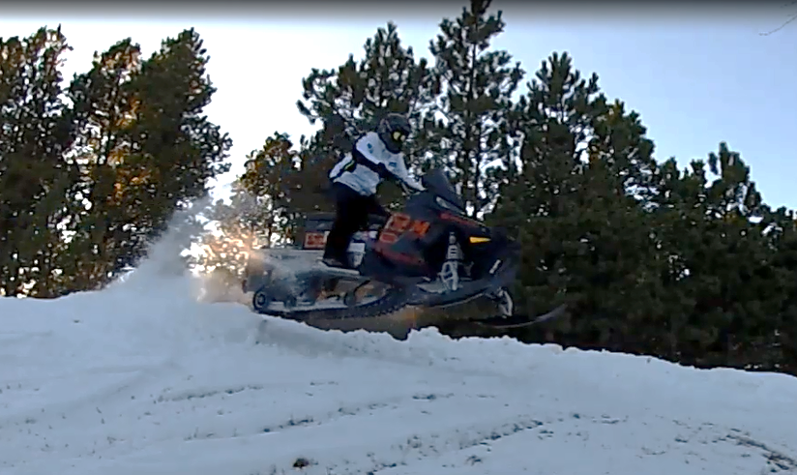
Performance
Top Speed – 40 mph
Range – Testing indicates 20-25 miles
Weight ~ 620lb
Charge time ~ 8 hours from 0% to 100%
Notes:
Maybe mention gearing here and how it was selected to optimize efficiency during the range test at comp while still giving us a reasonable top speed.
Mention that I put around 200 miles worth of testing on it during December and January, plus whatever else you guys did. Maybe mention your towing the old heavy sled uphill with a rider on it?
If asked, the rear suspension was designed by a Senior Design team that all graduated in December. The purpose was to use geometry to alter the roll center so the skis would not lift under acceleration. We also increased spring rates to improve load handling and impact handling abilities. IT ACTUALLY WORKED! If anyone comments or notices that the orange arm isn’t in there anymore, tell them it was removed to because it was a reliability concern for competition. (It was a first draft prototype after all)

Slide 7
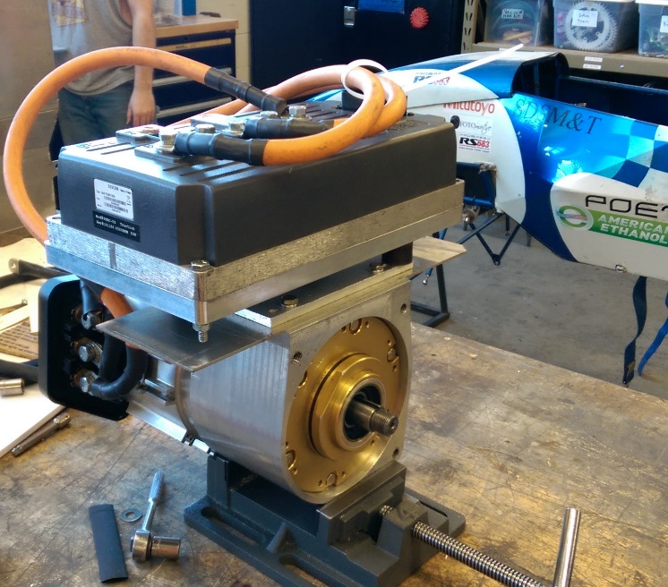
Dealer Benefits and Maintenance
Aluminum containers provide strong structures to protect sensitive electronics
Modular battery container and motor compartment
Easy to remove/replace as needed
Easy access to perform repairs inside compartments if needed
Minimal routine maintenance
Diagnostic software – plug and play with PC to view system data
Cost – initially high due to use of high-end components
Improved performance, range, reliability
Modular motor and motor controller mount
Notes:
Emphasize how easy it would be for dealers to service
The containers are easy to access for trained personnel and can be removed easily too if need-be.
The only annual maintenance would be to change the chain case oil and check coolant levels.
If you read the design paper, remember my comments about the Ford Focus Electric in terms of cost. Emphasize that we are pushing performance and quality over cost. This is a one-off prototype, so they need to keep that in mind.

Slide 8
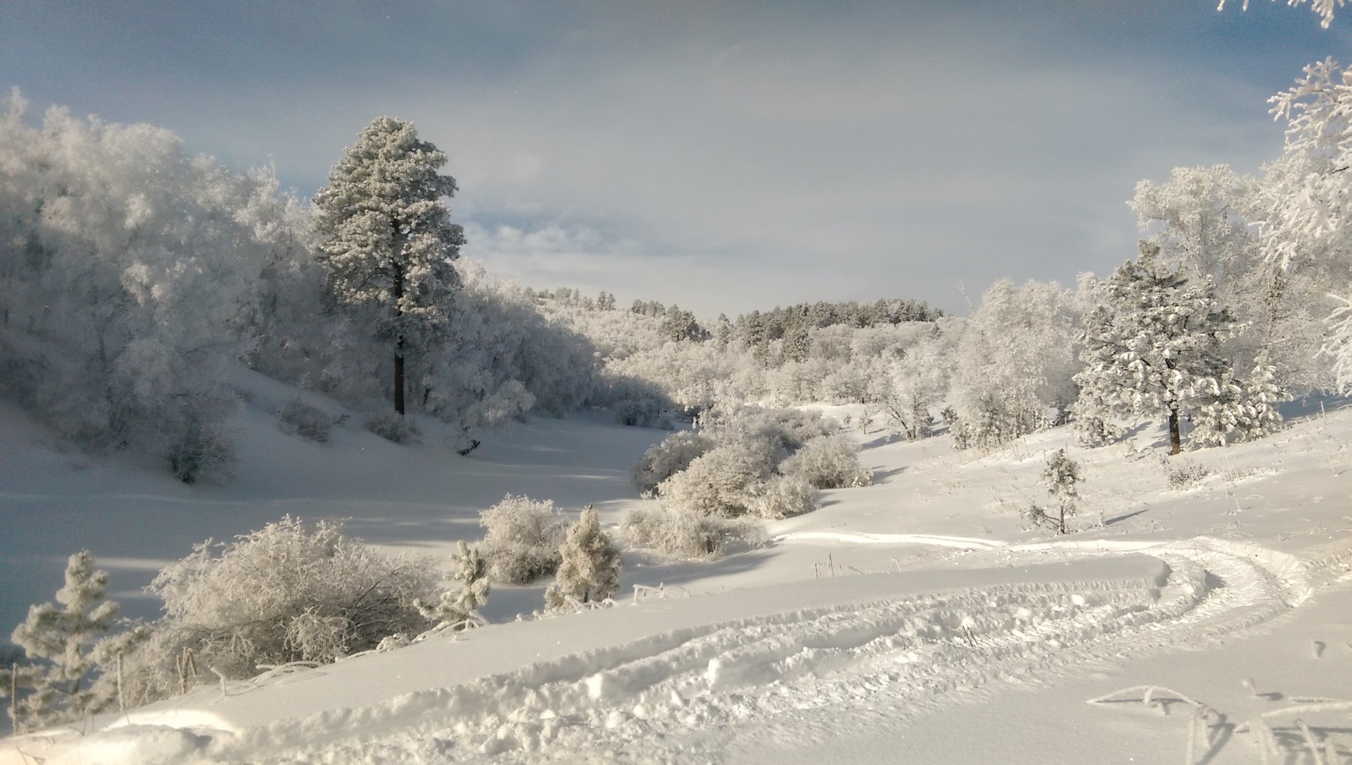
Environmental Impacts
Light weight and long track help prevent treading on potentially delicate ground
Ice caps in Greenland
Quiet operation – only noise from drive-belt
<80 dB at top speed
No noise while ‘idling’
Zero source emissions
Frozen landscape of the Black Hills in South Dakota
Photo: Bennett Prosser
Notes:
Fairly self explanatory. Maybe mention Yellowstone and the delicate-ness of the polar ice caps.
It should be much quieter with the new belt, maybe use a phone app to get a better dB #, but mention how much more comfortable it is to a rider having an almost silent machine to enjoy the wilderness with. I personally loved having the silent sled versus my obnoxiously loud one.

Slide 9
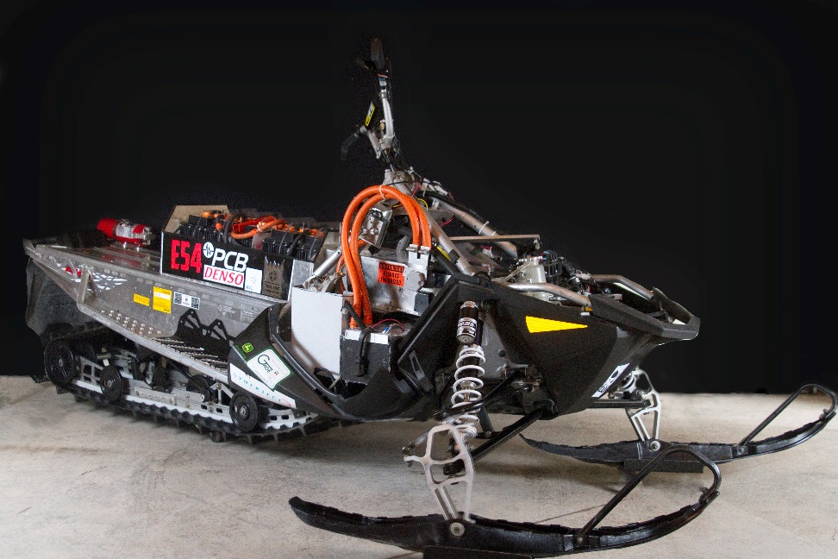
Summary
Who are we
System overview
Usability and functionality
Dealer benefits and maintenance
Environmental impacts

Slide 10
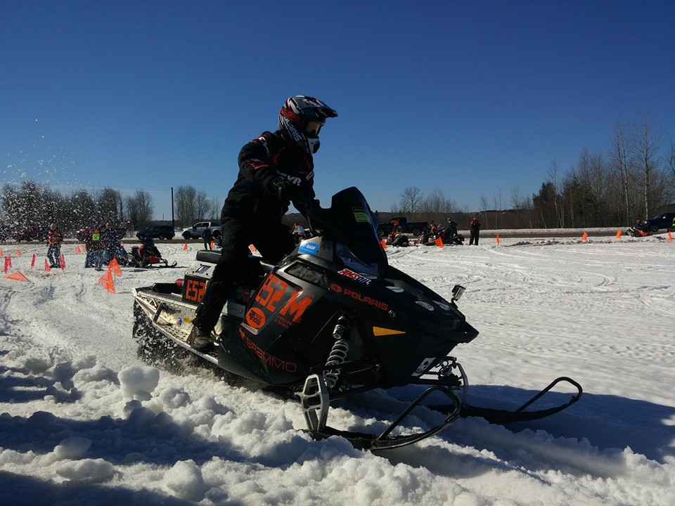
Questions?

