Slide 1
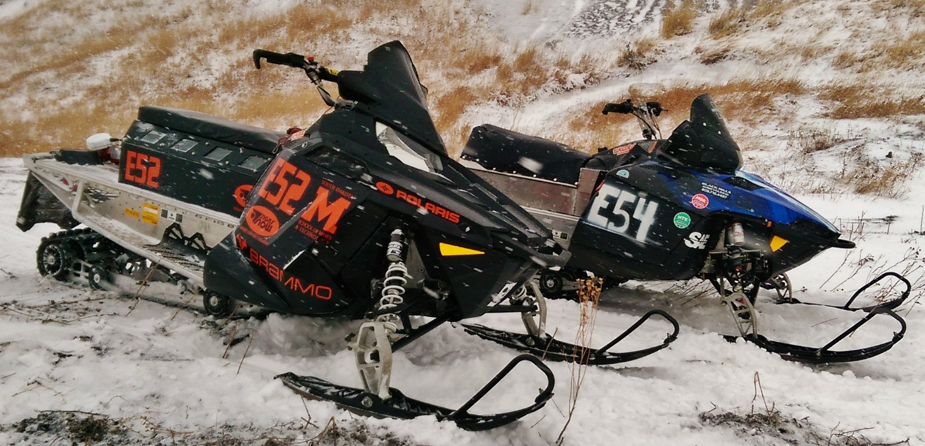
South Dakota School of Mines and Technology
Electric Snowmobile Team
2015

Slide 2
Overview
Who we are
System overview
Usability and Functionality
Dealer benefits and maintenance
Environmental Impacts

Slide 3
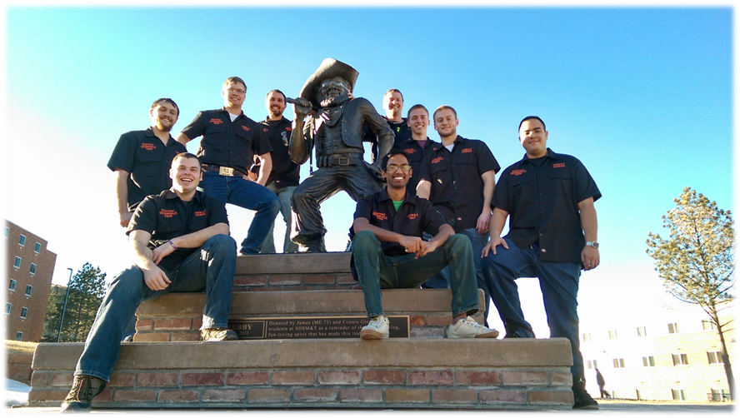
Who we are
Student Organization on Campus
Main focus is to design and build electric snowmobile
Comprised of ME and EE undergrad students
2015 SDSMT Electric Snowmobile Team

Slide 4
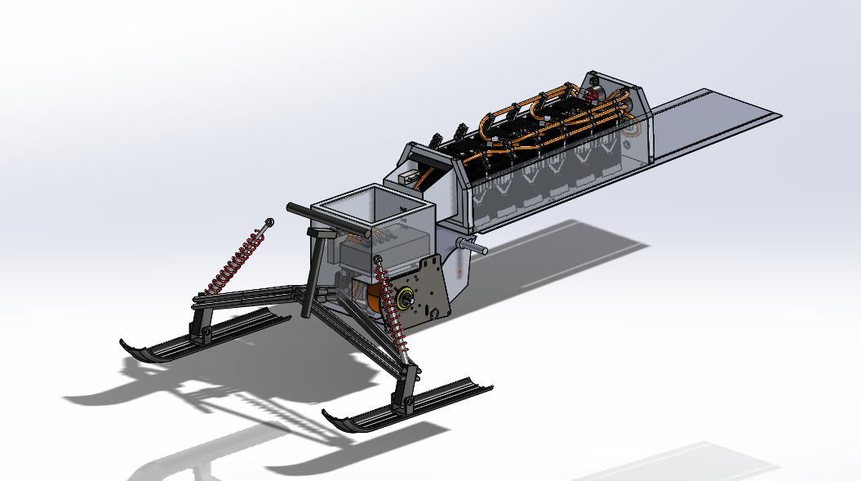
System Overview
2014 Polaris Switchback Assault
6 Brammo BPM 15/90 Li-ion battery modules
88.8 VDC, 90 Ah, 7.99 kWh
Sevcon Gen4 motor controller
Parker-Brammo GVM1425 liquid cooled motor
54 hp, 66lb*ft
Direct Drive
Modular component design
SolidWorks Concept of modular assembly

Slide 5
Usability and Functionality
Functions like a traditional snowmobile
Controls all carried over from stock
Easy to read GPS speedometer/location/mapping
Crossover chassis – versatility
Hard-packed snow and deep snow capability
Storage space on tunnel
Range – testing shows 25-30 miles per charge
Peak torque and strong acceleration
Towing capability
Performance

Slide 6
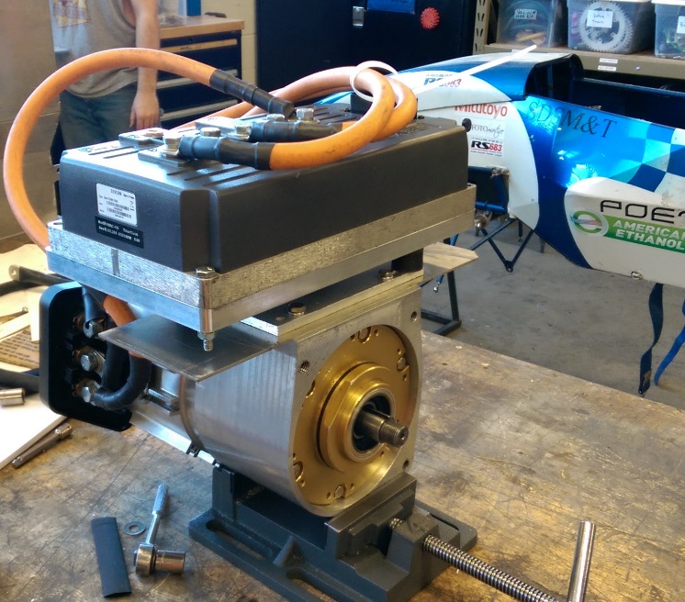
Dealer Benefits and Maintenance
Aluminum containers provide strong structures to protect sensitive electronics
Modular battery container and motor compartment
Easy to remove/replace as needed
Easy access to perform repairs inside compartments if needed
Minimal routine maintenance
Diagnostic software – plug and play with PC to view system data
Cost – initially high due to use of high-end components
Improved performance, range, reliability
Modular motor and motor controller mount

Slide 7
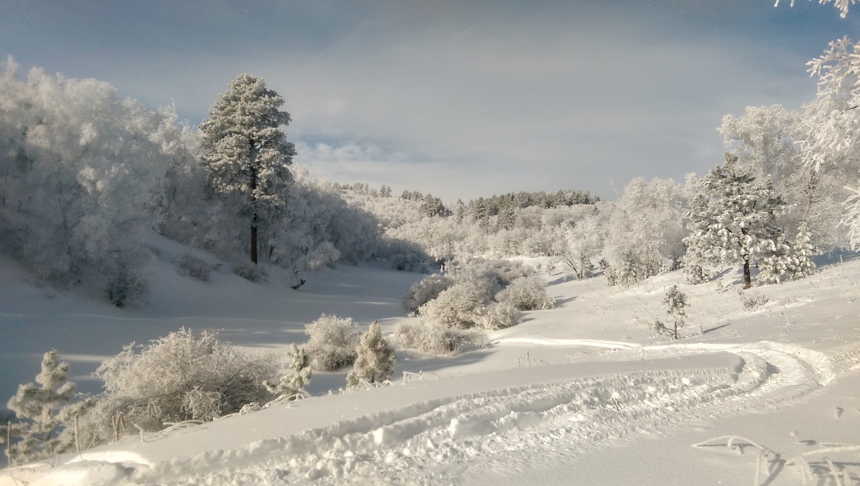
Environmental Impacts
Light weight and long track help prevent treading on potentially delicate ground
Quiet operation – only noise from drive-belt
Zero source emissions

Slide 8
Summary
Who we are
System overview
Usability and functionality
Dealer benefits and maintenance
Environmental impacts

Slide 9
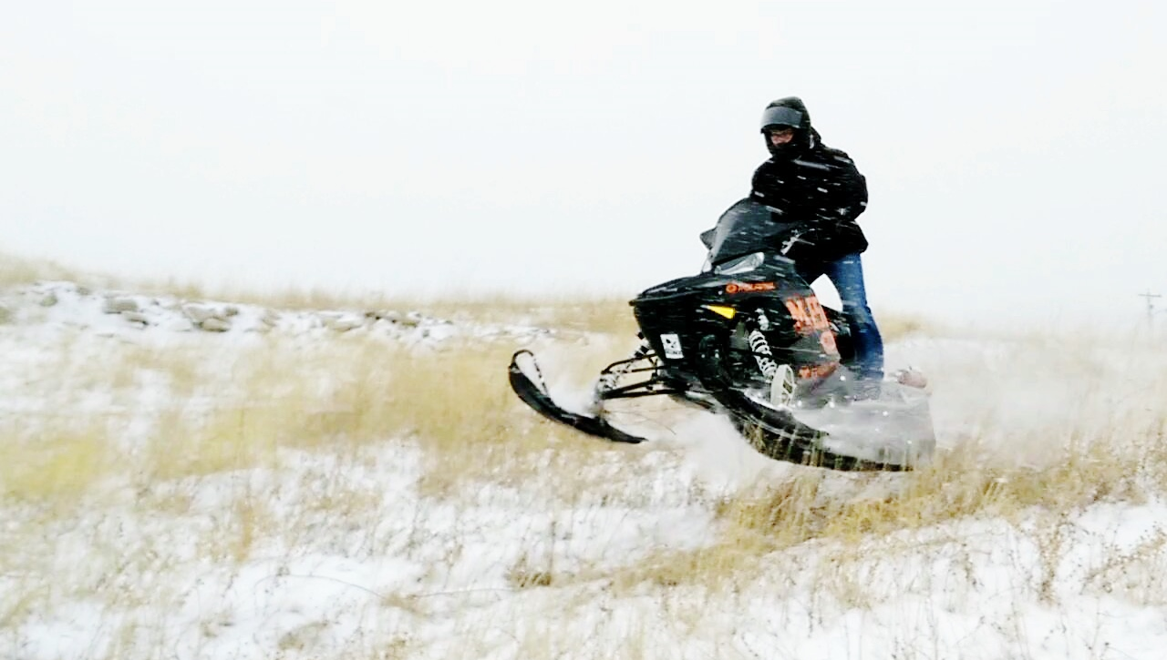
Questions?

