Slide 1
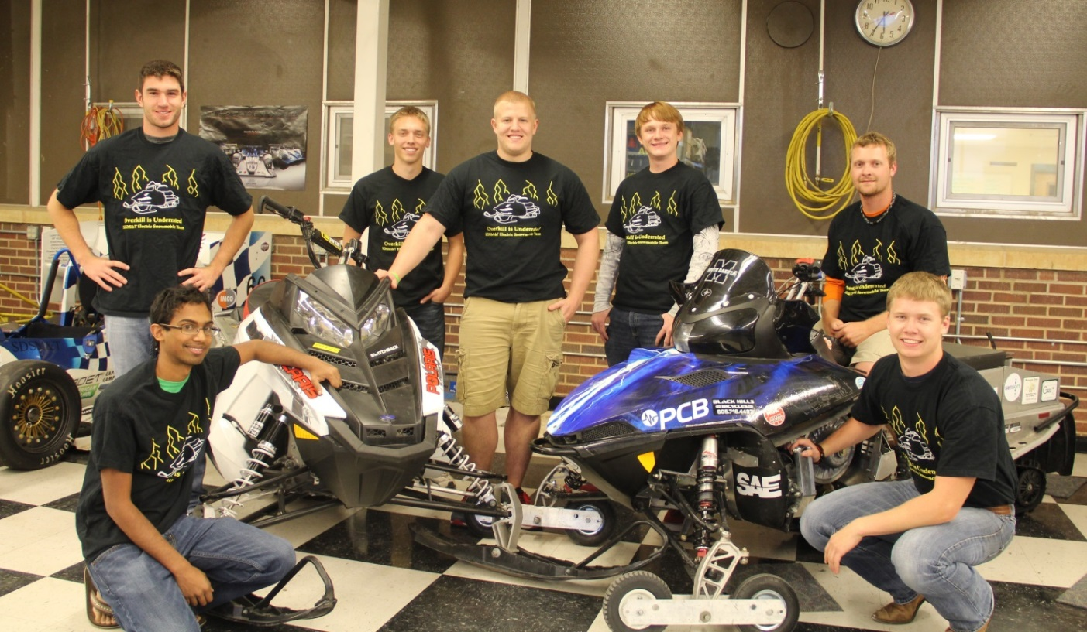
SDSMT Zero Emissions Snowmobile
Bennett Prosser, Kyle Roe

Slide 2
Overview
Goals
System Overview
Operator Perspective
Dealer/Outfitter Perspective
Environmental Impacts
Test Results

Slide 3
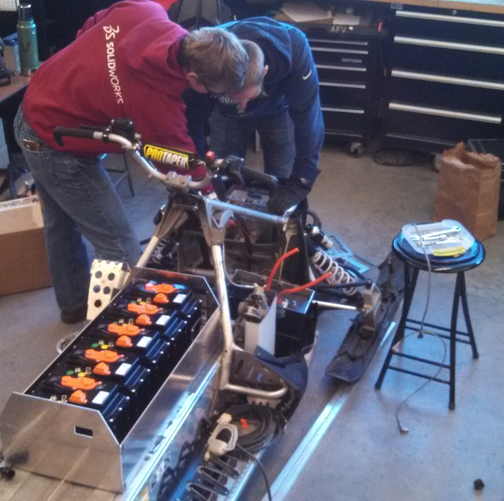
Who We Are
SDSMT Student Organization with focus on ZE sled
Undergraduate ME and EE students
4 Juniors
3 Sophomores

Slide 4
Goals
Develop electric snowmobile based on existing IC chassis
Approach performance levels of current gasoline sleds
Acceleration
Handling/Capability
Range
FUN

Slide 5
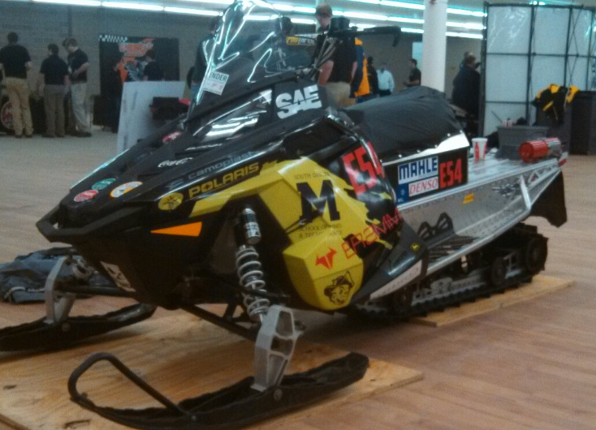
System Overview
2014 Polaris Switchback Assault
Brammo 15/90 Li-ion battery modules (6)
88.8V, 90Ah, 7.98kWh
Sevcon Gen4 motor controller
Parker/Brammo GVM1425 liquid cooled PMAC motor
56hp peak, 67lb*ft
Safety systems
Brammo BMS
Bender IMD
SDSMT ZE Snowmobile – 2014 Switchback

Slide 6
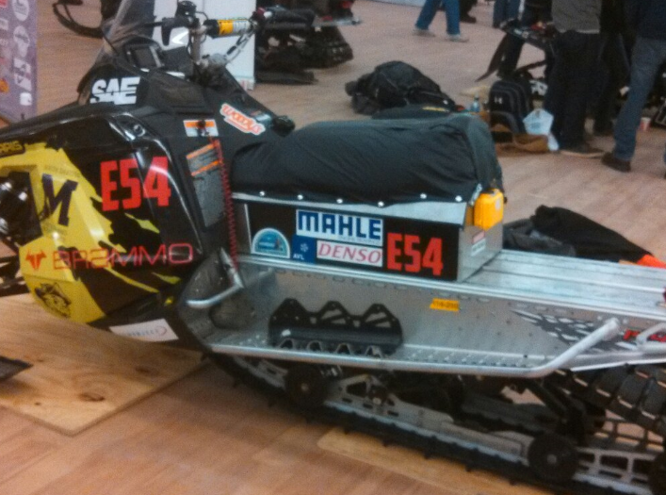
Operator Perspective
Functions like conventional snowmobile
Crossover chassis - benefits
Range
Wh / [V * I / mph] = D
D = 36 miles at 20mph
Peak torque and power at
low motor rpm
Ergonomics and comfort
Seat concept

Slide 7
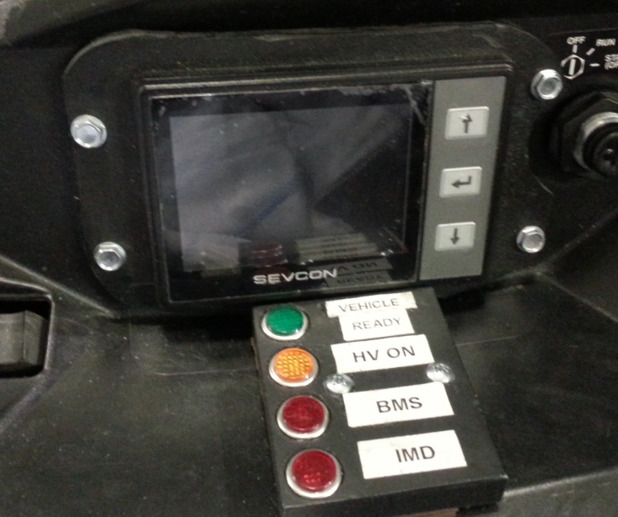
Dealer / Outfitter Perspective
Modular design allows for easy maintenance
Removable battery container
Fault indication lights – BMS, IMD
Fault reporting and logging from controller
Diagnostic software for BMS, batteries, controller
Fault lights and data display

Slide 8
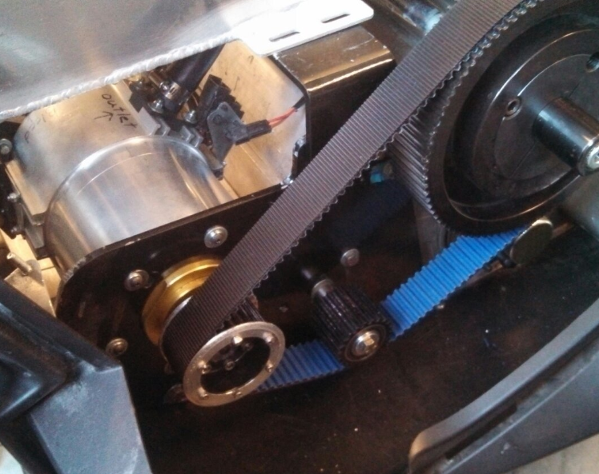
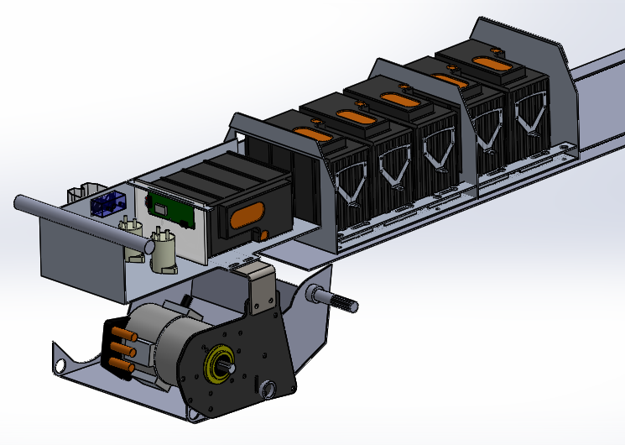
Dealer / Outfitter Perspective
Components reduce maintenance needs
Gates Polychain direct drive belt
No cleaning, no clutch tuning
Only annual maintenance changing chain-case oil, checking coolant levels
Direct-drive belt and motor
Aluminum Battery container

Slide 9
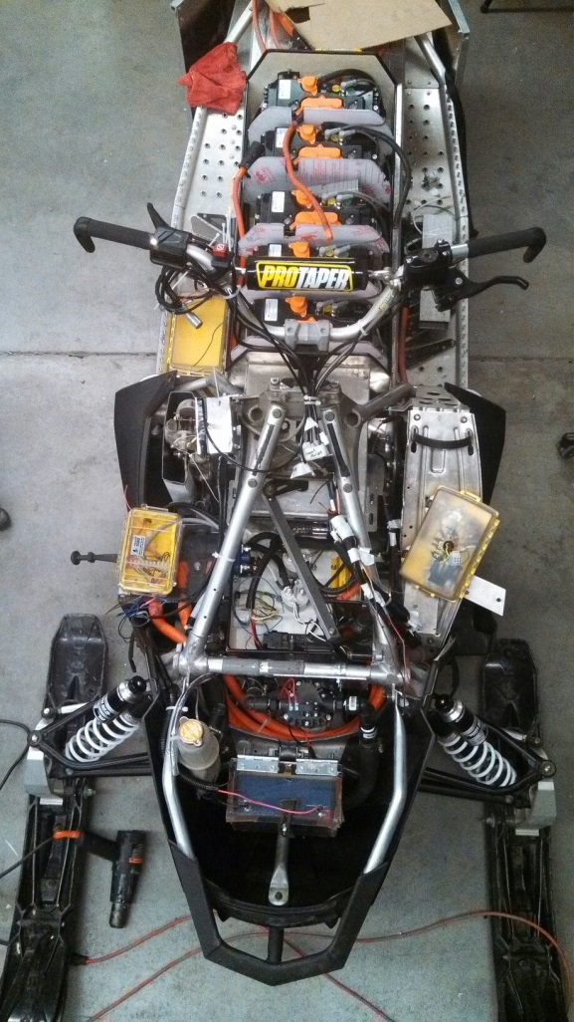
Dealer / Outfitter Perspective
Cost
Initial cost is high →high end components and performance
Quality, value
Minimal operation costs mitigate higher initial cost
Top view without plastics

Slide 10
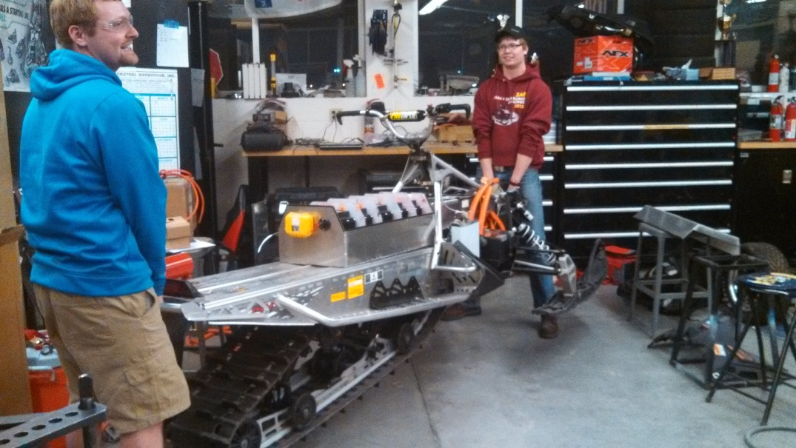
Environmental Perspective
Zero source emissions
Energy consumption significantly less than IC snowmobile
Sealed motor compartment
Light weight = softer treading
Minimal noise impact
Only noise from belt and track drive
Light weight being demonstrated

Slide 11
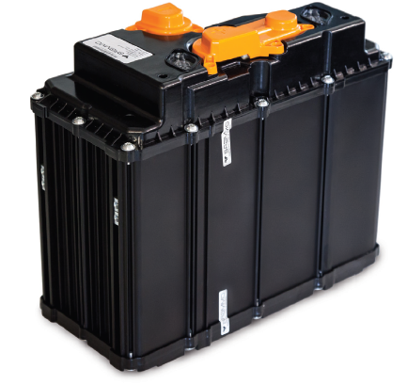
Results / Testing
2012/2013 concept capable of 20 miles with 8kWh battery
2014 concept loses 200+ lbs
With same 8kWh capacity
30+ mile range
Healthier batteries
Strong acceleration
Good handling
Cold weather capability
Brammo 15/90 Li-ion module
Photo: Brammo Inc.

Slide 12
Summary
Goals
System Overview
Operator Perspective
Dealer/Outfitter Perspective
Environmental Impacts
Test Results

Slide 13
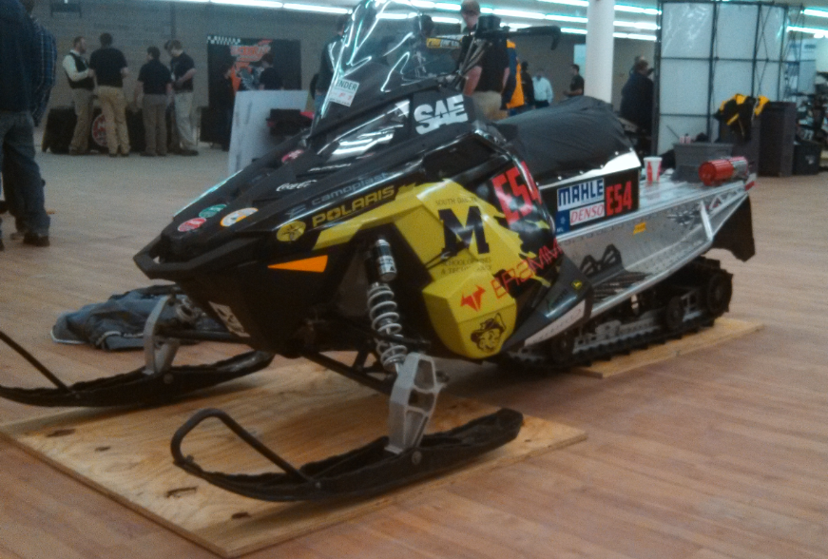
Questions?

