Slide 1
South Dakota School of Mines and Technology
Diesel Snowmobile Team 2018
Kurt Mentele, Chase Goddard
Notes:
Walter- Stand there and look pretty until the questions segment
Kurt- Introduce the project and all the team members. “Chase will now give an overview of the presentation.”

Slide 2
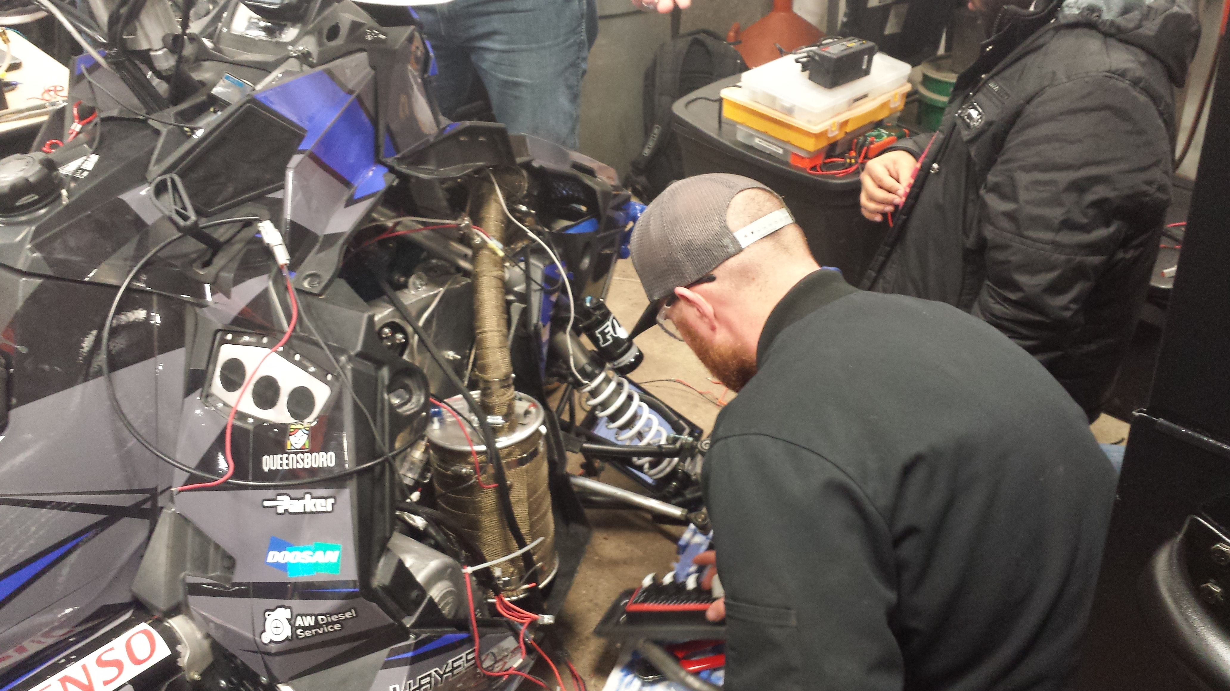
Overview
Who we are
System overview
Design Process
Innovations
Emissions, Noise, and Fuel Economy
Test Results
Notes:
1. Chase- An overview of what our presentation today is who we are, an overview of our system, the design process, key innovations, emissions, noise, and fuel economy, and test results. Next, Kurt will introduce the team”

Slide 3
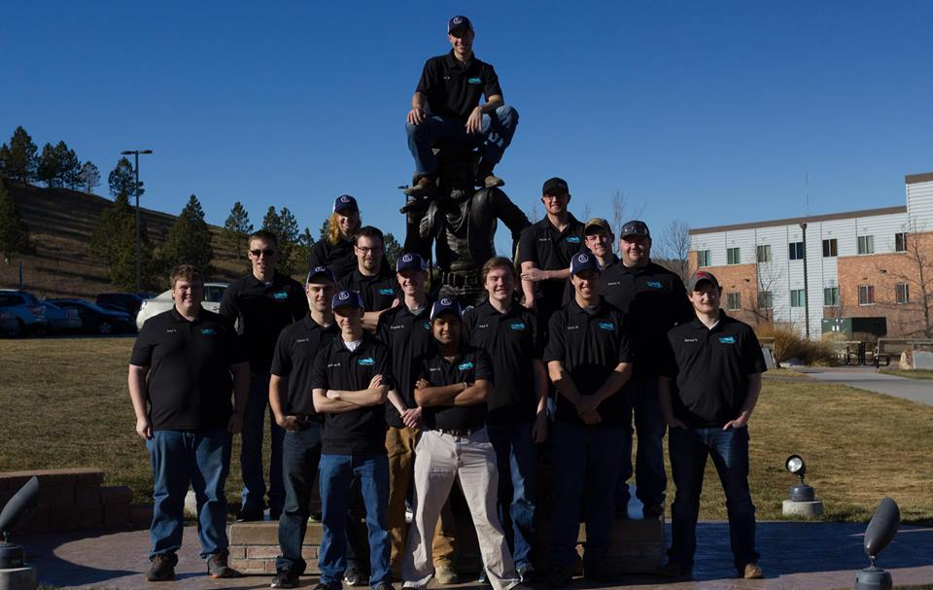
Who we are
The SDSM&T Clean Snowmobile Team is open to the student body.
Mechanical Engineers, Civil Engineers, Electrical Engineers, Physics
12th consecutive appearance at the clean snowmobile challenge
2018 SDSM&T Clean Snowmobile Team
Notes:
1. Kurt- “Our team is solely comprised of undergraduate students with unique disciplines that range from, ME’s to EE’s, and CE’s to Physics students. This team is open to all students on campus, and we all work toward the common goal of building an diesel snowmobile. This is our team’s twelfth consecutive appearance at the CSC, and the first year in the DUC. Now that you know who we are, chase will give an overview of our snowmobile.”

Slide 4
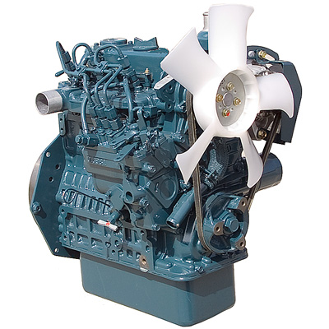
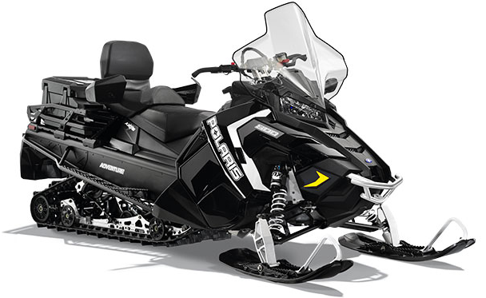
System Overview
2018 Polaris Titan
custom motor mounting
Implemented stock heat exchangers to cool motor
Kubota D902 inline three cylinder diesel motor
In house fabricated exhaust system
Custom stub shaft for cvt mounting
EPA Tier 4 Compliant
Kubota D902
2018 Polaris Titan Adventure
Notes:
Chase – The base of our project is a 2018 Polaris Titan Adventure chassis fitted with a Kubota D902 Engine. Combining this motor with a snowmobile chassis was a challenge the team was willing to take on. A couple of the most notable features are the custom motor mounts and stub shaft that allows us to run the stock Polaris P-85 primary clutch along with the TEAM BOSS secondary clutch. Aesthetically, one of the goals was to maintain a stock appearance. The team worked hard to accomplish this. Building this sled in-house, gave the flexibility to fabricate subsystems in order to obtain this goal. Next, Kurt will explain how the team followed the design process.

Slide 5
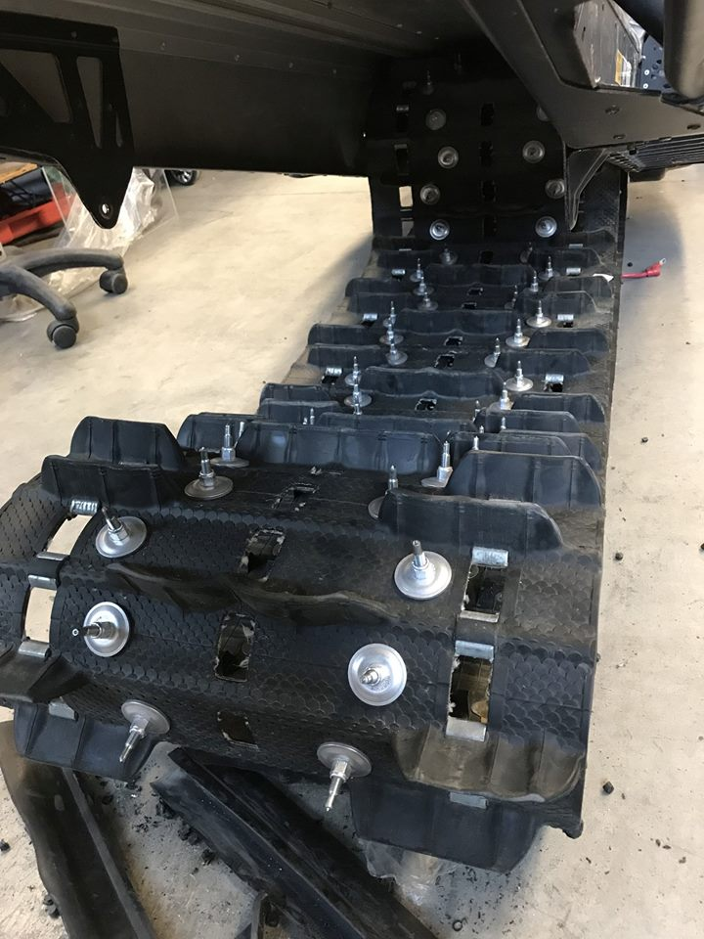
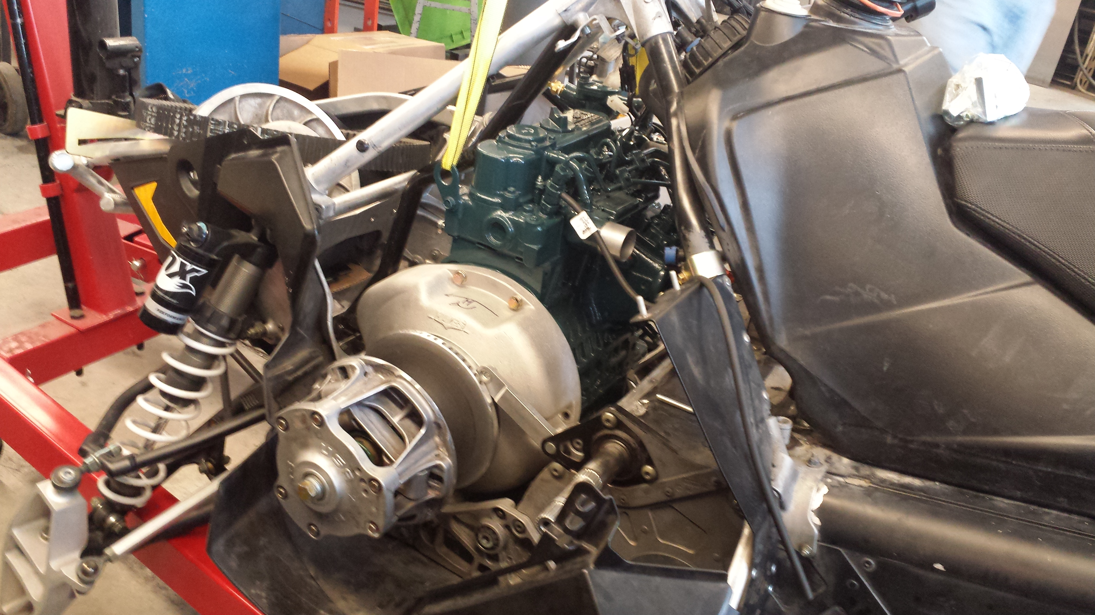
Design Process
Designation of Subsystems
Weekly Meetings
Stub Shaft with Primary Clutch
Studded Track
Notes:
Kurt- Designation of Subsystems- “ In a project as large as this one, no one person can do everything, so small subsystem groups were formed to increase the efficiency of the build. Some of these subsystem teams were, fuel system, electrical system, exhaust system, mounting system, and clutching system. Each team dedicated their time to that specific system, and helped other teams out when they were waiting on parts, or finished their system. A great deal of teamwork was involved in making all the individual systems mesh together, to create one dynamic system.
Chase- weekly meetings/gantt chart “Every week there is a leaders meeting, a team meeting, and two subsystems meetings. In these meetings, everyone is brought up to speed with the overall scope of the project. Updating other team members on ordered parts, financial status, and design discussions occur. The team implemented the use of a Gantt chart to improve efficiency, set deadlines, and hold members accountable for each sub-system. The team also discusses community outreach events that are attended, such as STEM nights and Nostalgia nights. Events like these helps the community better know about who our team is and what our team does, both at school and for the community.’ I will now turn it over to Kurt to talk about the innovations of the snowmobile.

Slide 6
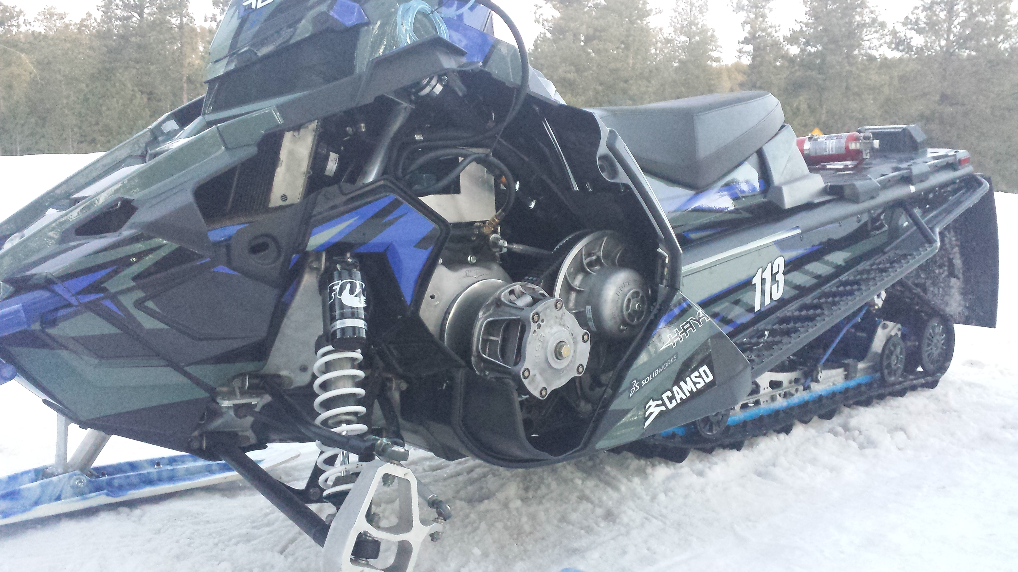
Innovations
Clutching
Exhaust System
Fuel system
Factory ride Appearance
Completed Clutching
Notes:
Clutching – Kurt- “Our team knew coming in, that the clutching of this snowmobile was going to be the most difficult aspect of the project. We brainstormed multiple clutching ideas, and came to a consensus on using the stock Polaris Clutches. Hayes custom built us a stub shaft that connected to the flywheel of the engine and tapered down to fit the P-85 primary clutch. The clutches were tuned to run on the Polaris 800 HO motor, so we had to figure out what springs and weights we needed in our clutches, to have our Kubota motor effectively drive the sled through the CVT.”
Exhaust System – Chase – “Our exhaust system uses the small amount of space effectively, while doing its job to reduce emissions and minimize noise. The exhaust system utilizes a DOC and DPF from a VW engine, to collect hydro carbons and particulate matter making it very clean. The clean exhaust then travels from the DPF to the Walker Quiet Flow SS muffler. This muffler greatly reduces the noise outputted, making the snowmobile a prime candidate for use in environmentally sensitive areas.
Fuel System – Kurt – Our fuel system does not use the stock mechanical fuel pump that the D902 comes with, instead we implemented the use of the stock electric fuel pump from the Titan. This allows us to easily calculate the amount of fuel that our sled is using. We also integrated a 10 micron Parker-Racor SNAPP fuel filter. This filter collects all the particles from the fuel, and also has a water separator, to ensure that the cleanest possible fuel is being transported to the injection pump.
Factory Ride Appearance - Chase – A goal to challenge the team this year was to make the sled have a factory ride appearance. This includes outer appearance and internally as well. Keeping stock clutching and using purchasable exhaust components allows a professional look to be maintained inside of the sled. Outside of the sled there are upgraded lights, rox handguards, fox suspension, and a killer wrap to top it all off. Next, Kurt will talk about emissions.

Slide 7
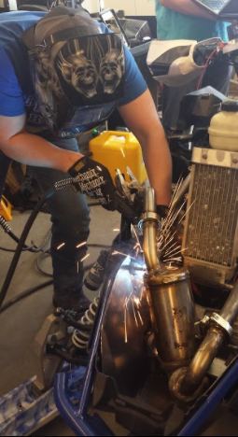
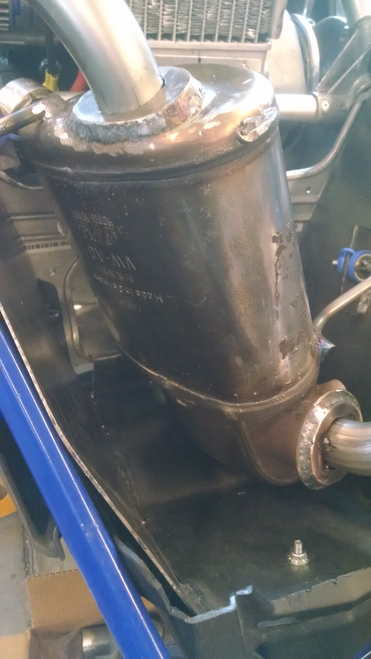
Emissions and Fuel Economy
Implementation of DOC and DPF to improve emissions
Walker Quiet Flow SS Muffler
Electronic Fuel Pump
Welding the Exhaust
DOC and DPF
Notes:
Kurt- To reiterate what Chase said, the emissions and fuel economy were the most important aspect we took into account when building this snowmobile. Our VW DOC and DPF eliminates almost all particulate matter and hydrocarbons. To finish it off the Walker Quiet Flow SS muffler quiets the noise of the snowmobile down while still allowing for max performance.
Chase- We tested the pressure of the stock Polaris fuel pump, and measured the flow to be about 30 psi, and the Kubota is very fuel efficient. Knowing this, we routed the return fuel line very close to the motor, to keep the return flow warm as it exited the motor. The heat exchangers on the tunnel also keep the fuel in the tank warm by just running and circulating the coolant. These design aspects allow for efficient use of fuel and reduce the risk of gelling up. Test Results

Slide 8
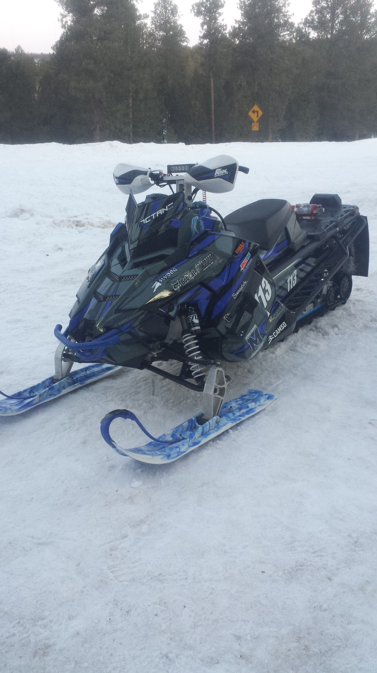
Test Results
Clutching
Completed Sled
Notes:
Kurt- When our team first tested the snowmobile, the clutching was limiting the snowmobile. We chose the correct primary clutch spring, and was engaging correctly, but the weights we used were too light, and limiting the max speed. We figured out we needed heavier weights for the primary, but the stock Titan secondary, has too aggressive of a ramp angle on the helix, not allowing the snowmobile to shift. Our options for this problem, would be to get a different secondary or machine the one we have to a more mellow ramp angle. The heavier weights and new secondary would work in tandem to increase the performance of the snowmobile. Summary

Slide 9
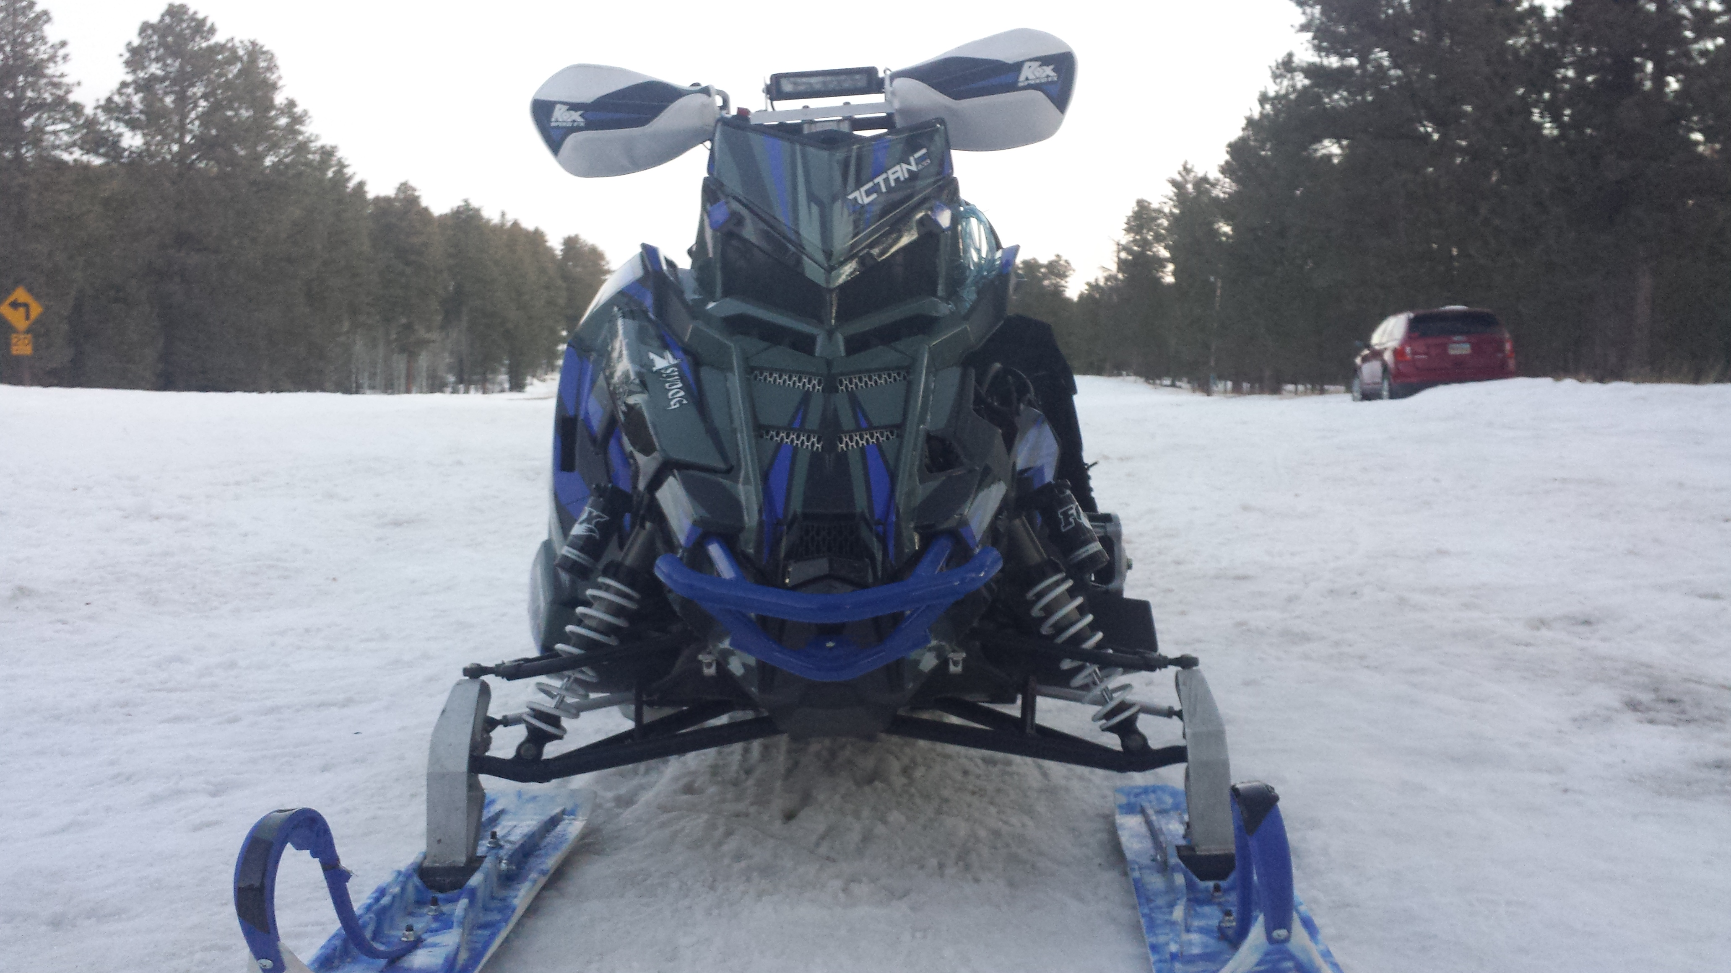
Summary
Design Process
Innovations
Emissions
Test Results
Completed Sled
Notes:
Chase - In summary, today we talked to you about some of the aspects of our snowmobile. Kurt and I explained to you our design process, some of the innovations implemented on this years sled, how we worked to make our sled as clean as possible, and some of the testing we conducted with the snowmobile. With that, our team would like to thank you for your time, and open the floor to questions.

Slide 10
Questions?
Completed Sled

