Slide 1
SDSM&T Clean Snowmobile
Joshua Burkart, Kurt Mentele, Jared Ross, Walter Wrage
Notes:
jared

Slide 2
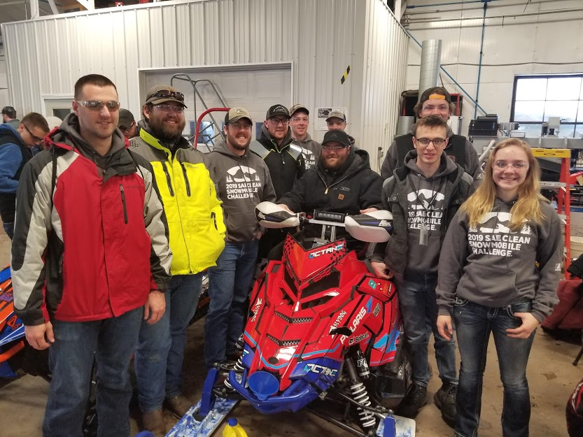
Our Team

Slide 3
Mission Objective
Improve a utility snowmobile by reducing negative environmental impacts while ensuring unchanged usability, maneuverability, and affordability.
Notes:
jared

Slide 4
Overview
SDSMT clean snowmobile
Improvements
Electronics
Cooling
Clutching
Snowmobile Emissions
Noise Emissions
Exhaust Emissions
Notes:
kurt

Slide 5
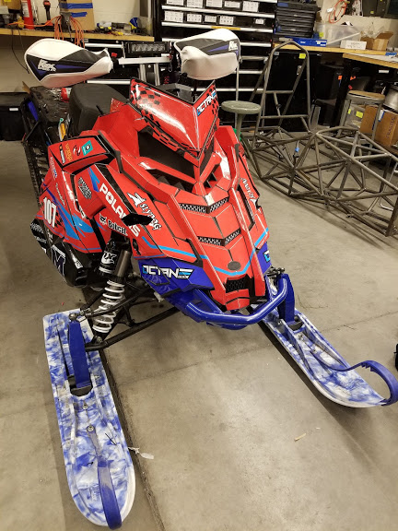
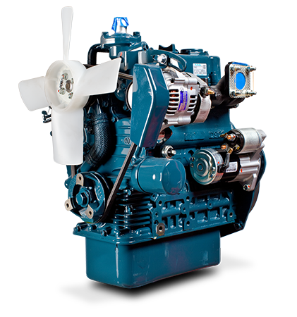
Our Snowmobile
Chassis: 2018 Polaris Titan
Engine: Kubota D902
https://www.kubota.com.au/product/d902/
Notes:
kurt

Slide 6
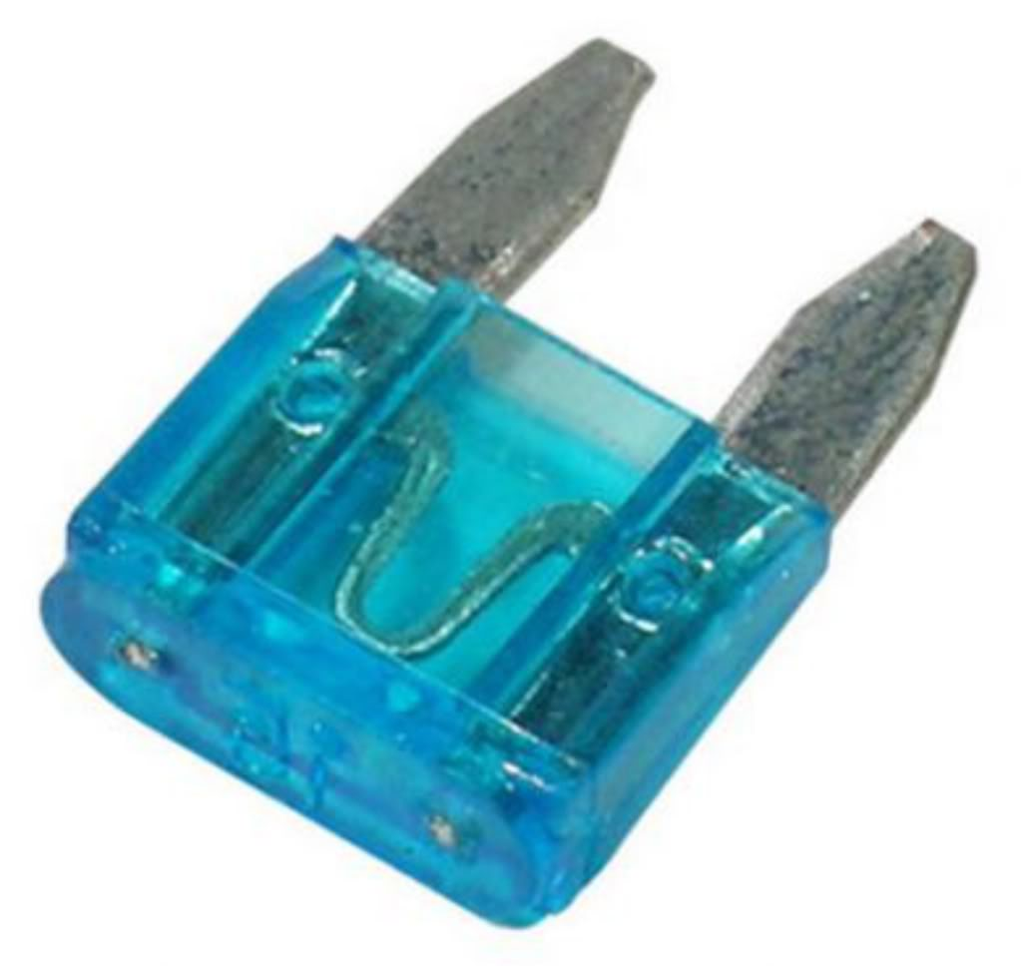
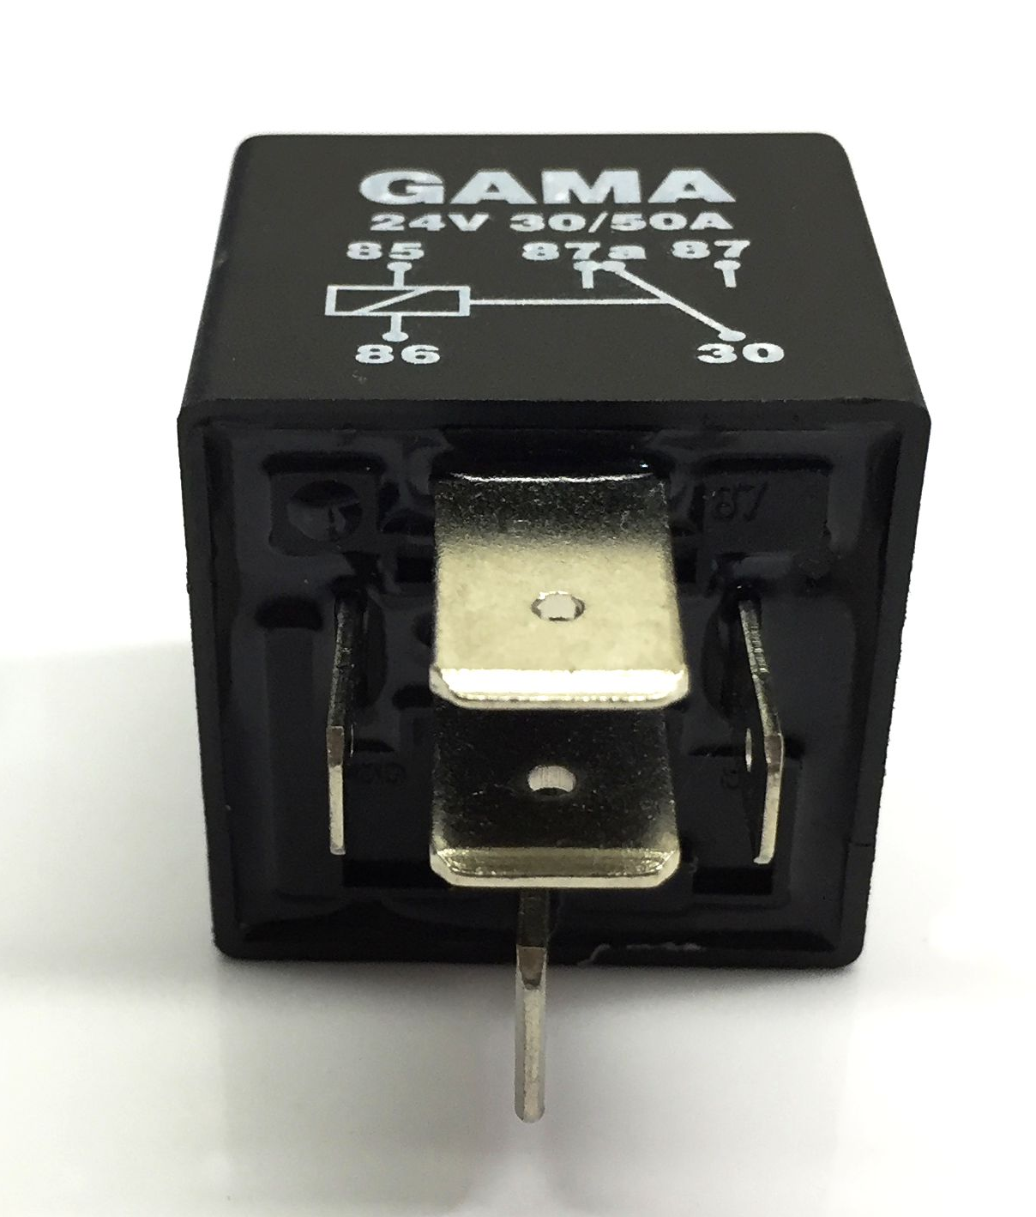
12 V Electrical Design
Automotive fuse and relay box
Safety
Easy parts replacement
High side voltage control
Ground fault safety
Voltage Drop Calculations

Slide 7
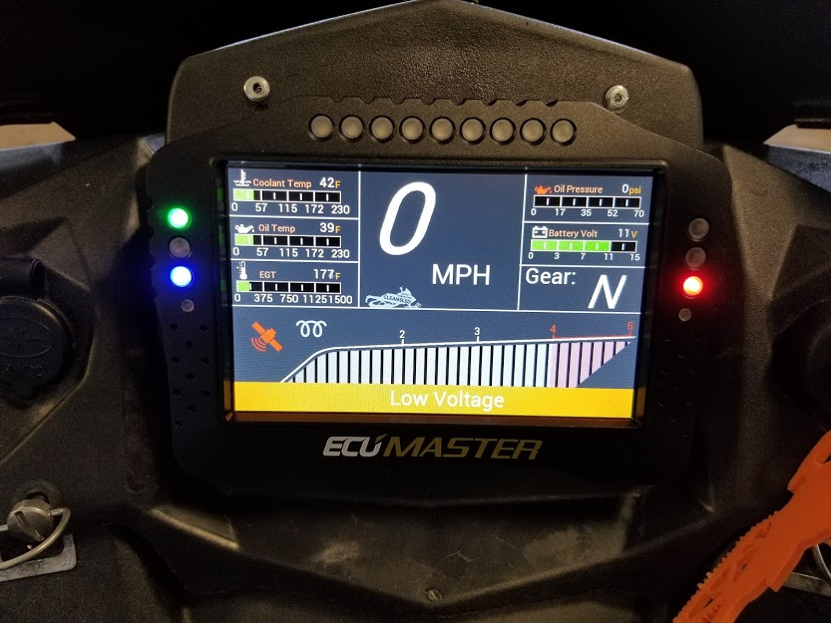
ECUMaster Interactive Display
Features
Real time sensor and RPM feedback
Advanced logical output control
Integrated GPS functionality
Data logging capability
Benefits
CAN Bus functionality
Future-proof
Notes:
josh

Slide 8
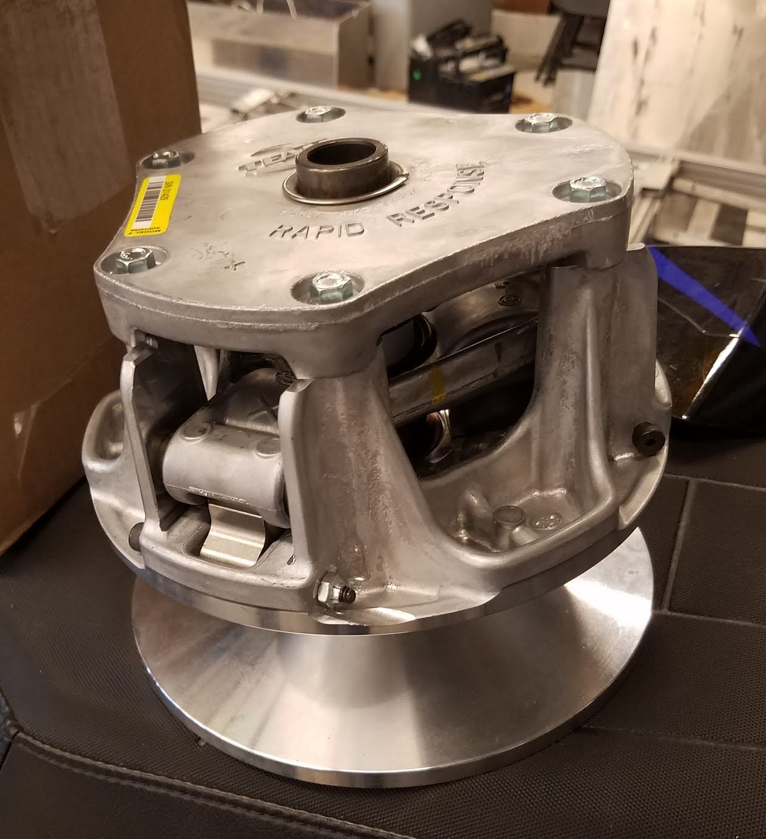
Different TEAM Industries primary clutch
Heavier Weights
Larger clutching components
Matched spring rate
Notes:
Walter
Heavier weights provide the necessary force to overcome the spring and belt tension to allow full shift at max engine rpm.
The larger clutching components allow fitment of required weights and forces applied with those weights.
The spring rate sets not only engagement rpm, but also shift rate and shift speed.

Slide 9
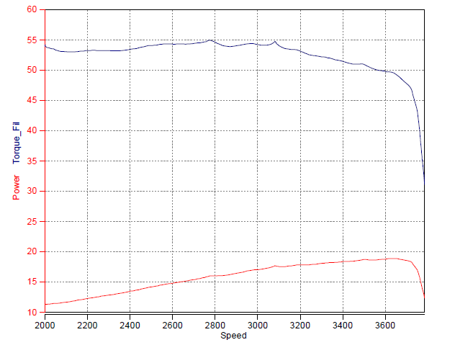
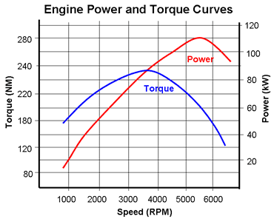
D902 Torque Curve
D902
Average 2 Stroke

Slide 10
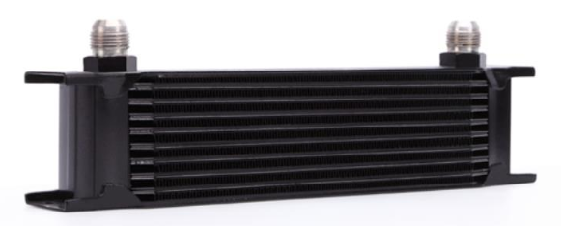
Addition of an oil cooler allows for engine longevity and future improvement
https://www.mishimoto.com/10-row-oil-cooler.html
Notes:
Walter
The oil cooler really promotes engine life in a utility style vehicle. It is thermostatically controlled to allow quick warm up time. The cooler will allow for a power increase, and also allow more engine driven accessories to be used while under full load, such as a hydraulic pump, or generator. This will ensure that the engine oil temp will not cause problems.

Slide 11
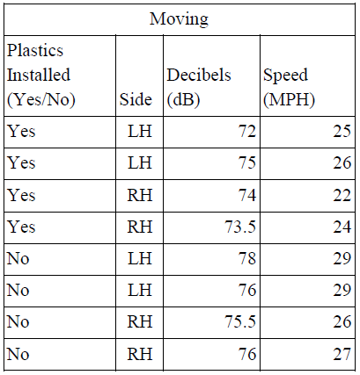
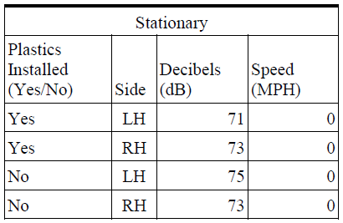
Initial Tests were done to locate sources of sound emissions and obtain
baseline for the sound levels
Notes:
kurt

Slide 12
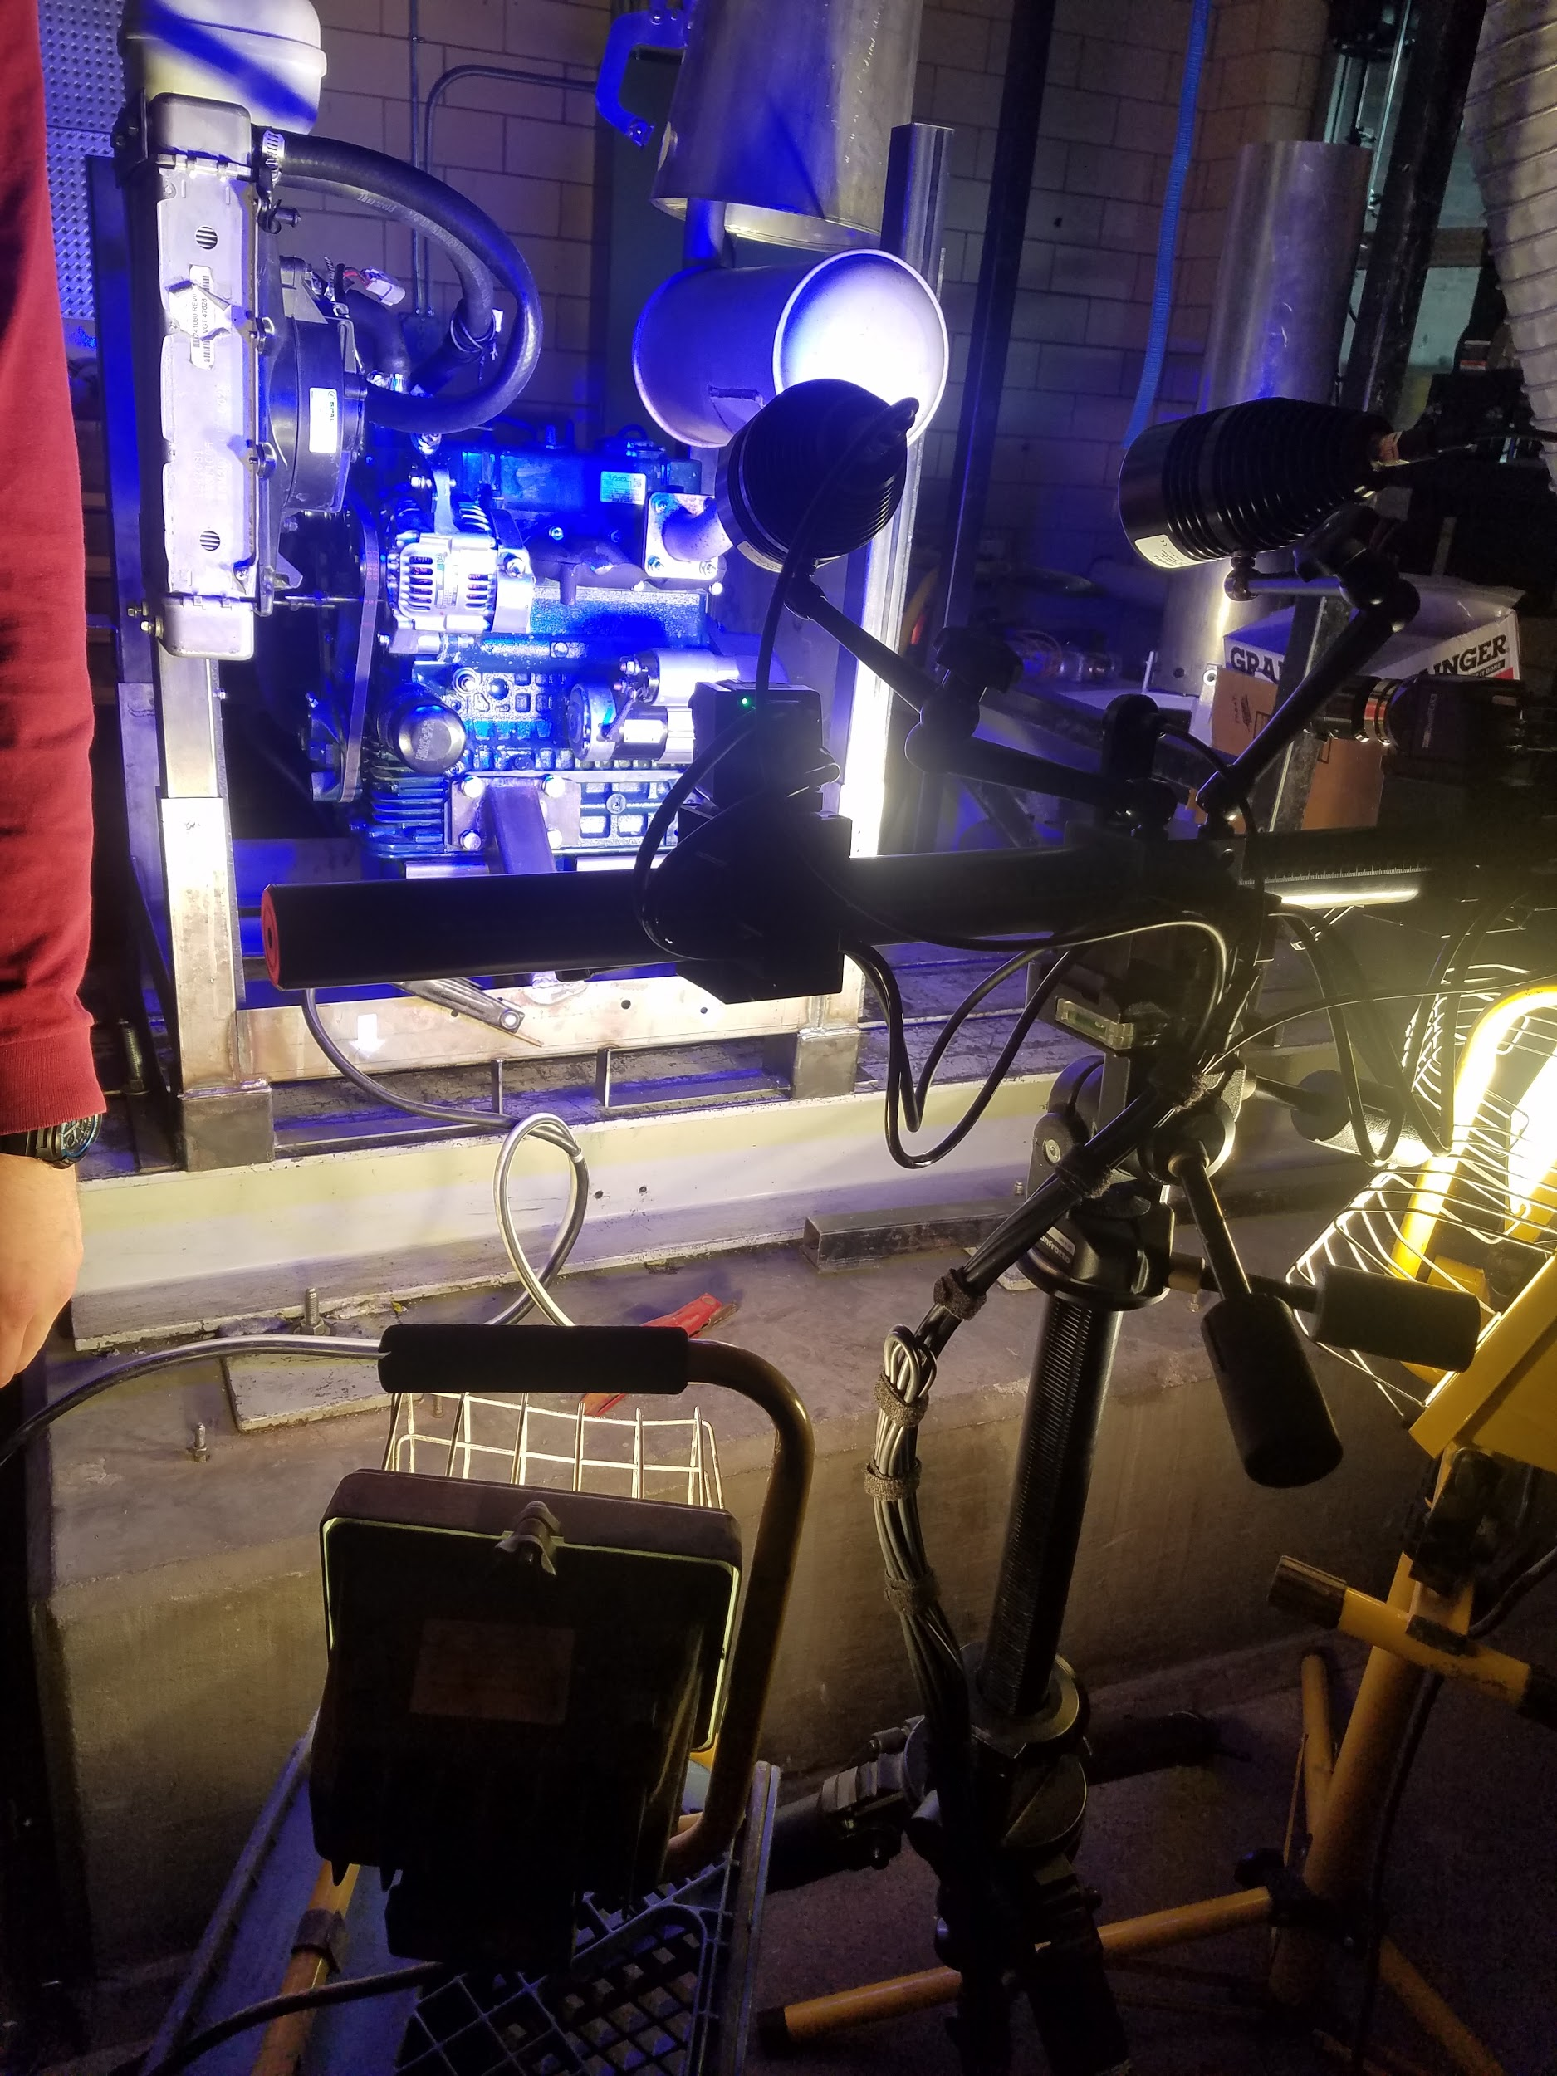
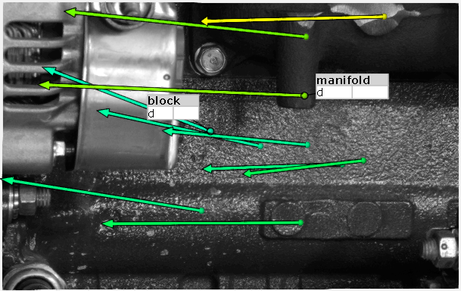
High Speed Camera Testing
Notes:
kurt

Slide 13
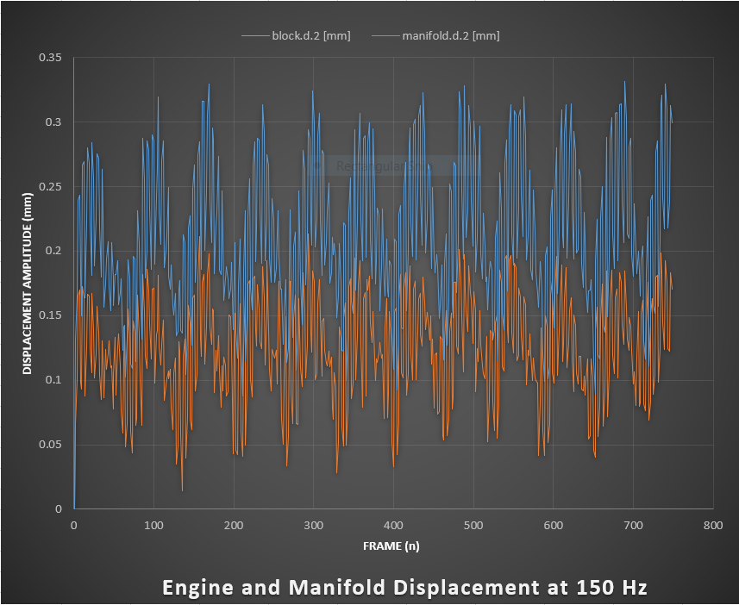
High Speed Camera Testing Data
The chart on the right shows the movement of the engine relative to the Exhaust manifold.
They are about 15 degrees out of phase.
The noise is caused by other components vibrating throughout the system.
Notes:
kurt

Slide 14
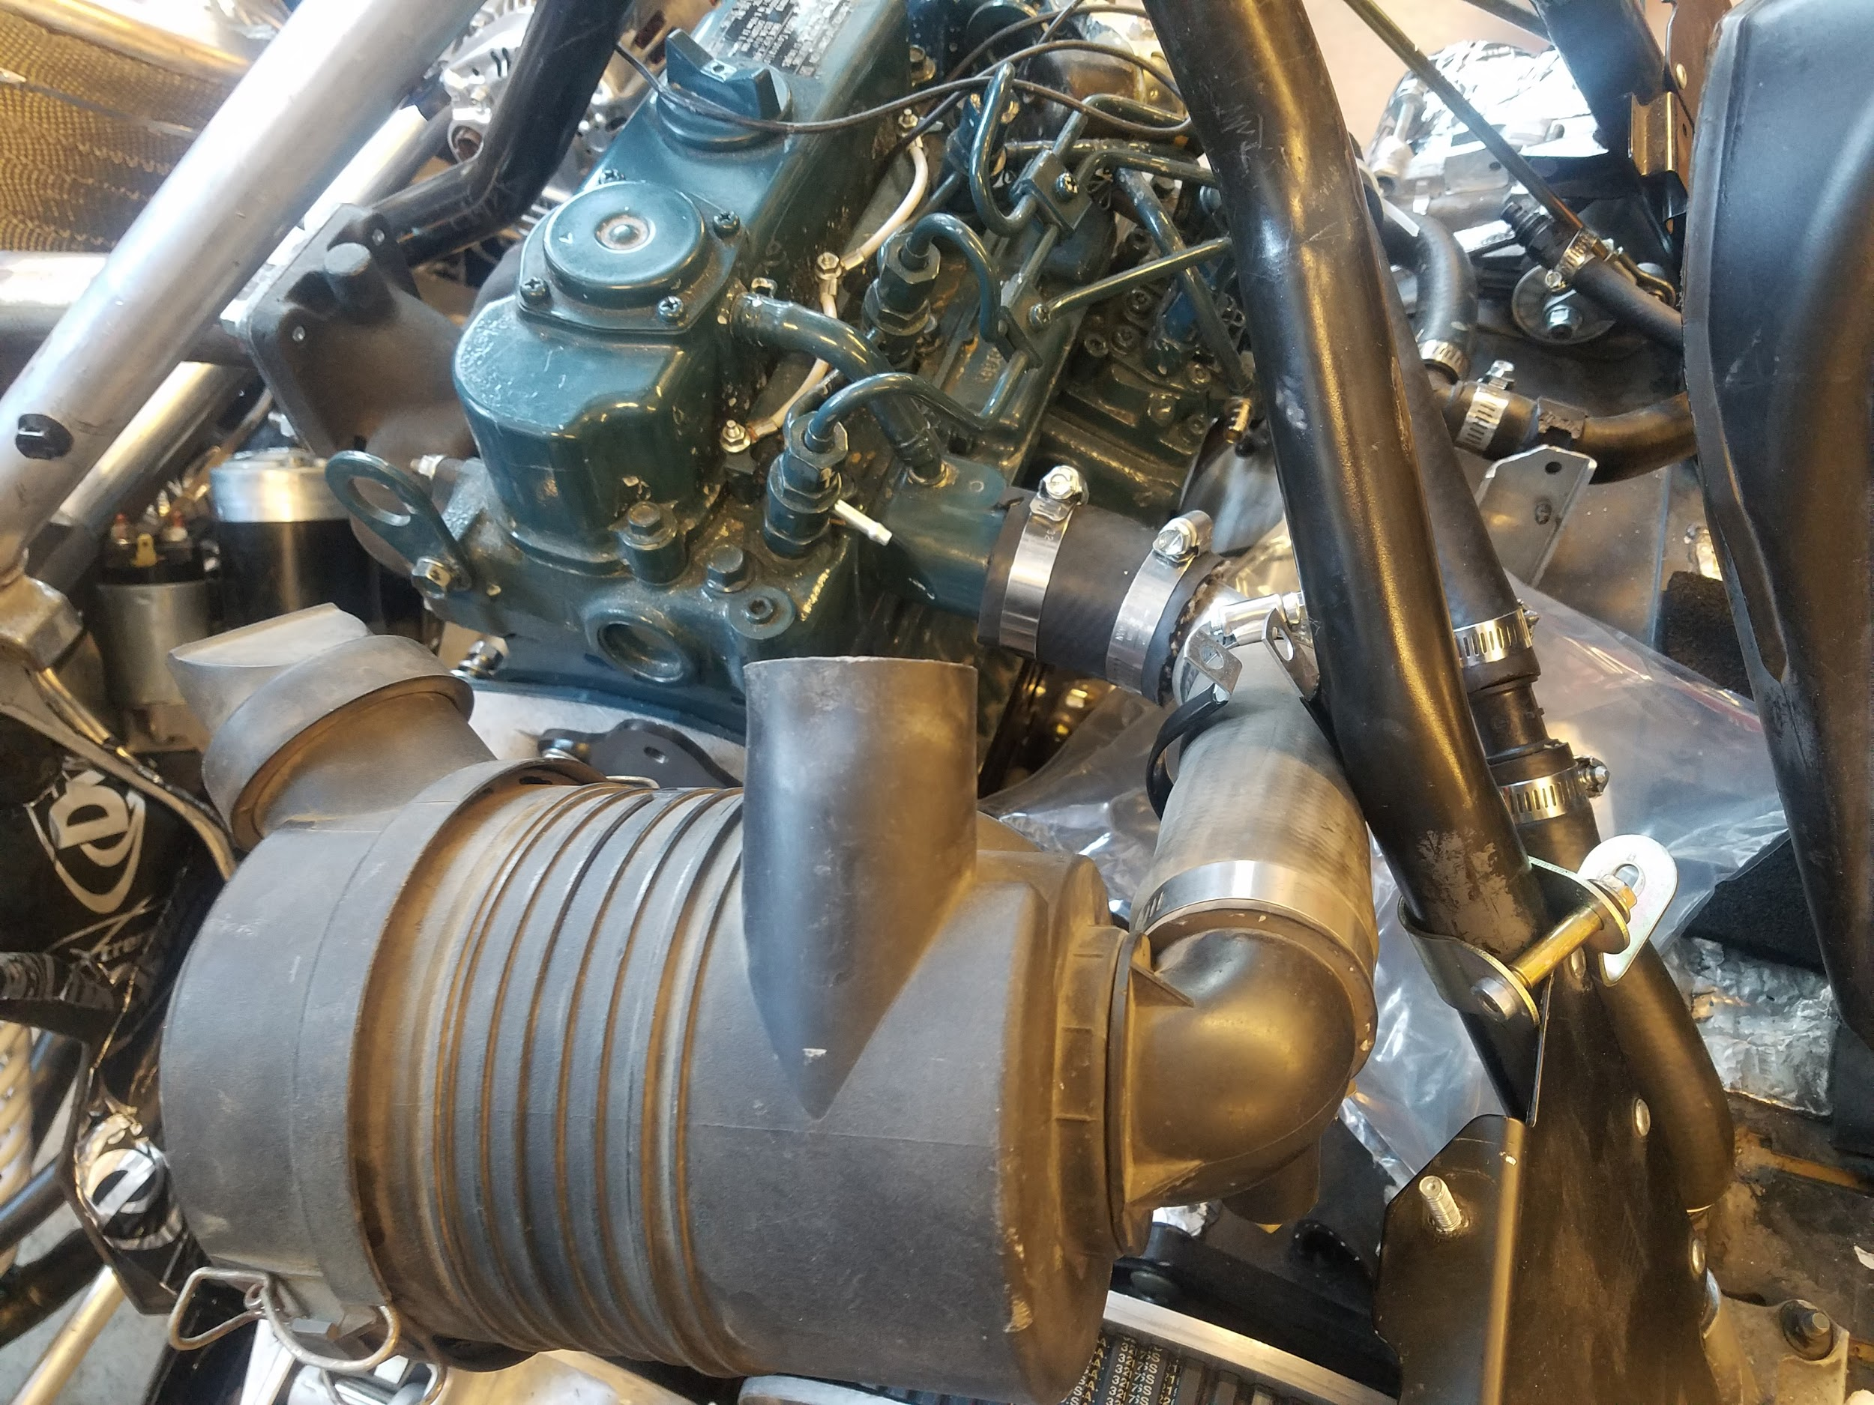
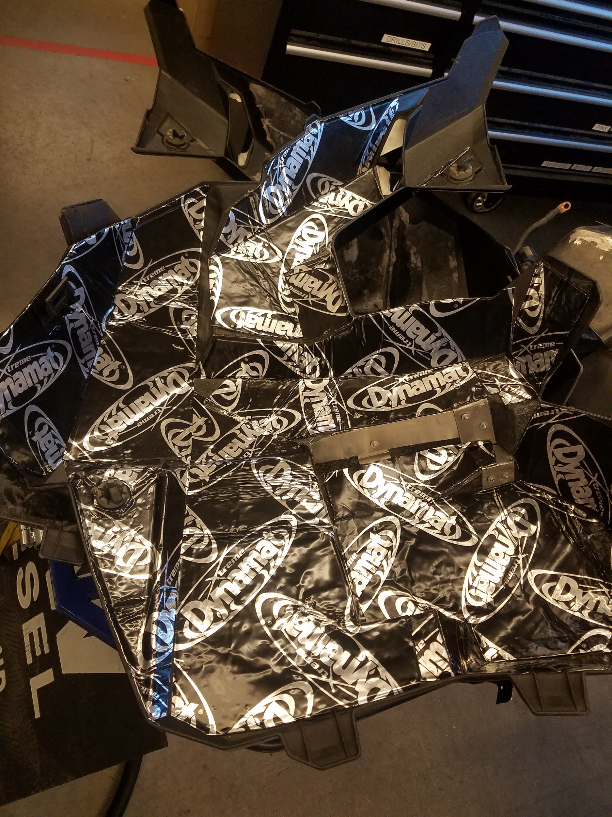
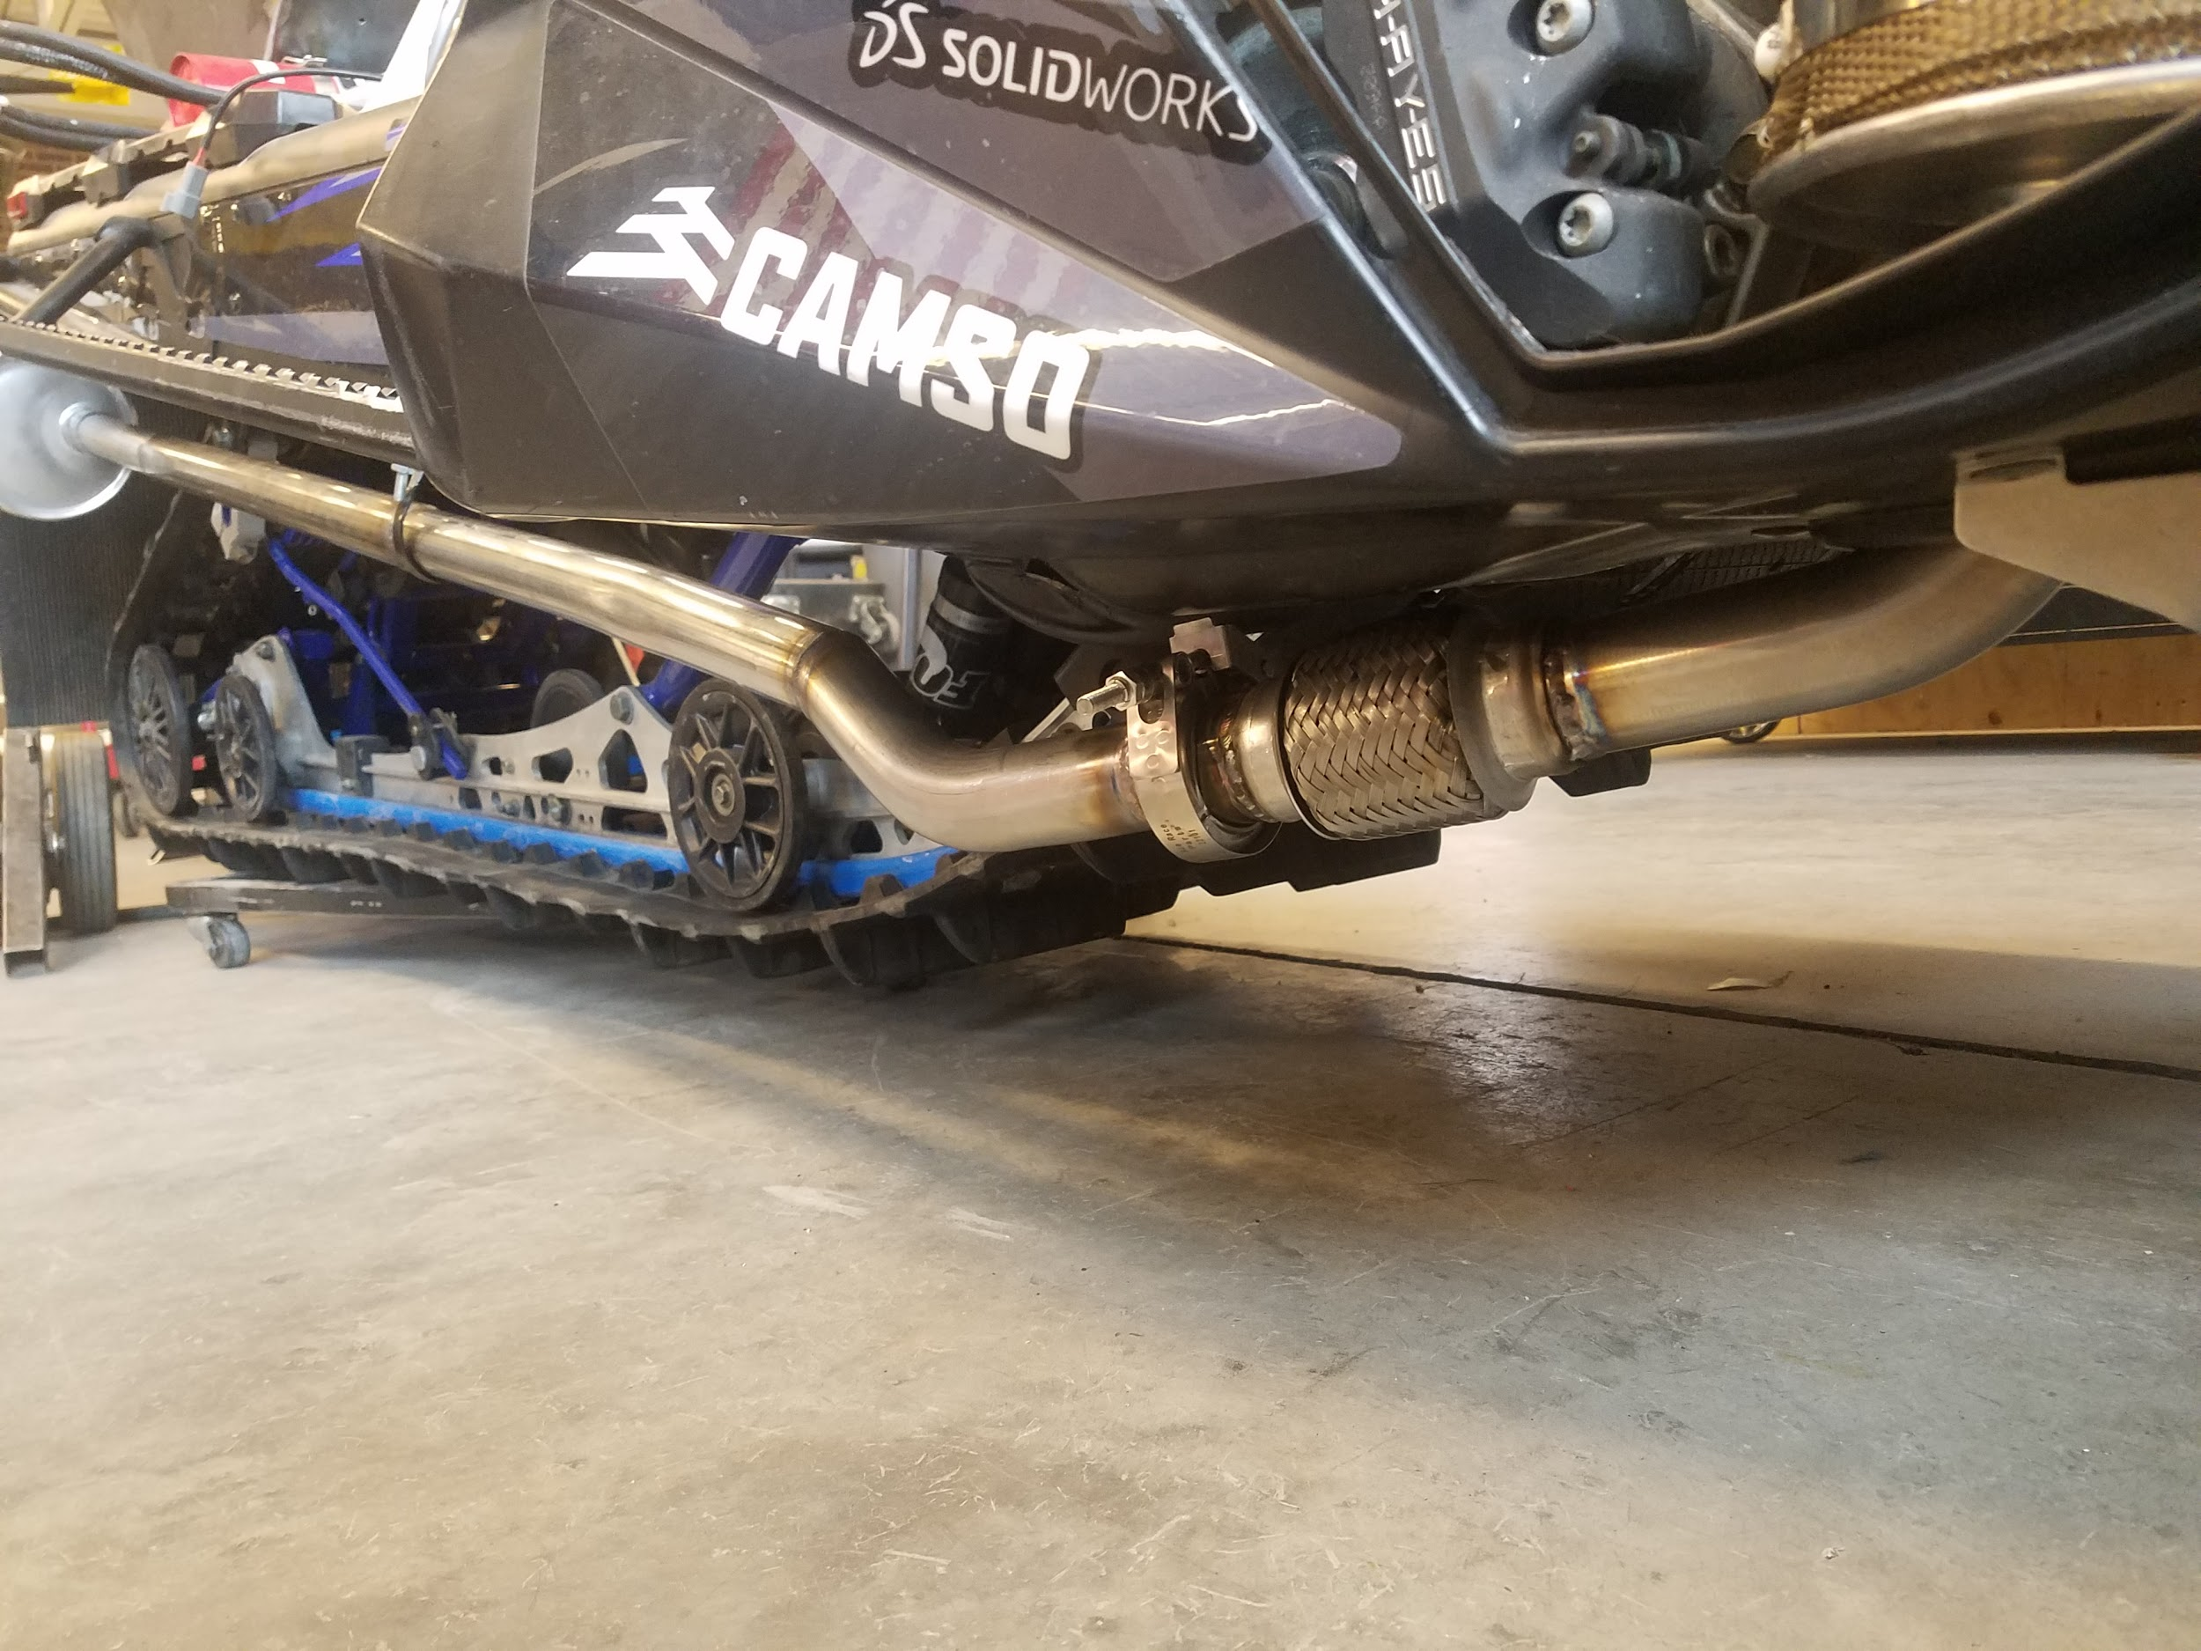
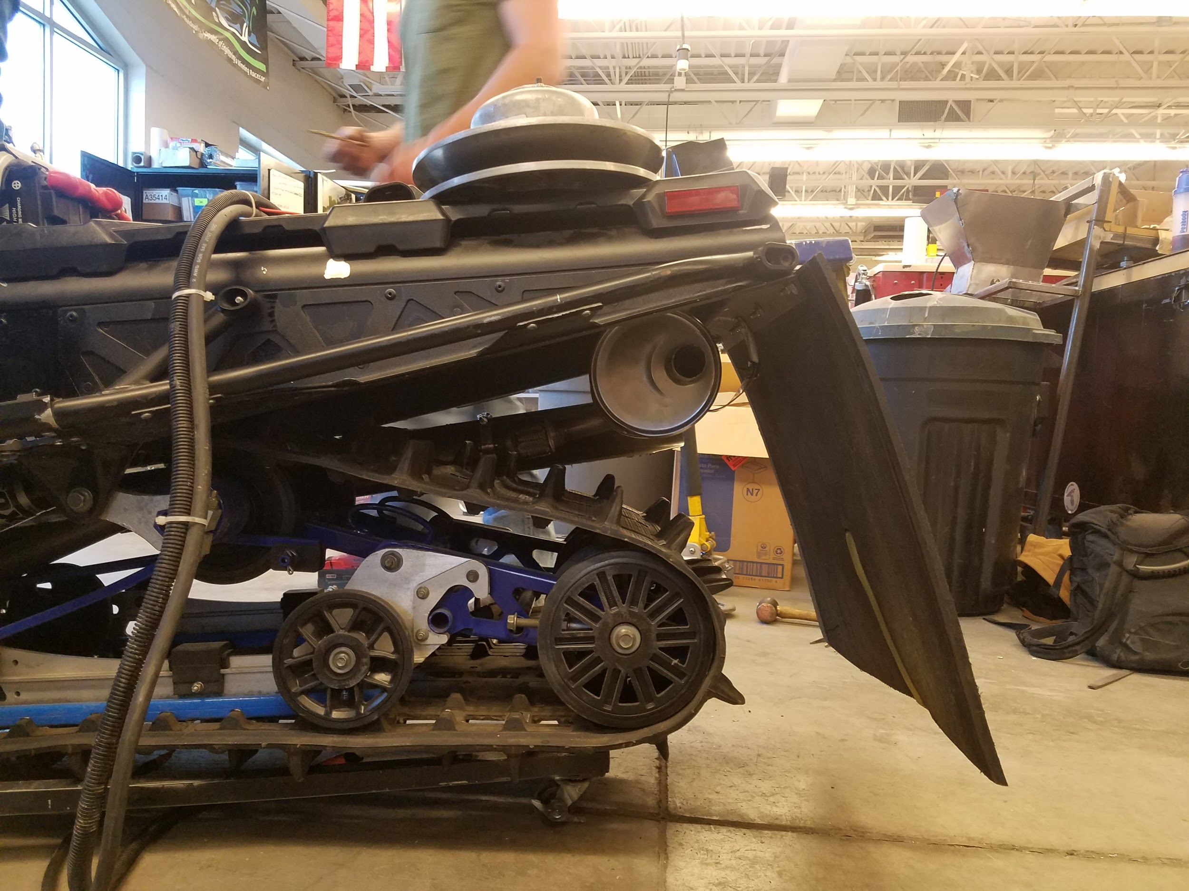
Several approaches were used to lower the sound emissions to 67 dB while moving 35 mph at 50 ft
Dynamat and Dynaliner (1)
Flex-pipe and exhaust mounting (2)
Tunnel dump exhaust (3)
Stock Kubota Intake (4)
(4)
(1) (2) (3)
Notes:
kurt

Slide 15
Emission Control Device Selection
Tier 4 raw emissions
Particulate matter is too high for requirements
DPF required
Notes:
jared

Slide 16
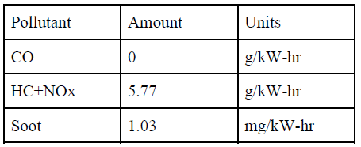
Exhaust Gas Emission Testing Results
E-score of 206
Emission requirements met
Notes:
jared

Slide 17
Endurance Testing and Fuel Economy
Testing in the Black Hills
Estimated MPG: 32 MPG
Using BSFC of 5.49 g/hr
Duty Cycle of 50%
Notes:
Walter
The economy was estimated by using the BSFC at wide open throttle, then our top speed along with fuel density is used to calculate a theoretical wide open throttle fuel usage. This number is then related linearly to throttle position. So, at 50% throttle, our mileage would be twice that of a 100% duty cycle.

Slide 18
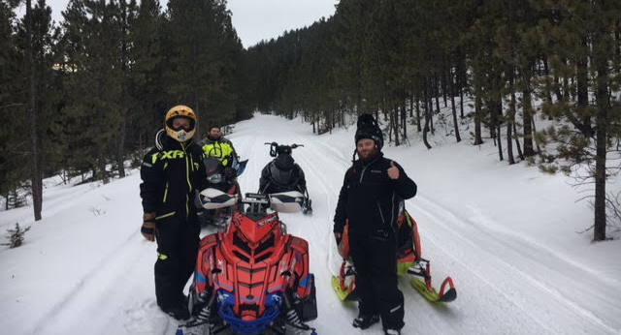
Conclusion
“Perfection is not attainable, but if we chase perfection we can catch excellence”
-Vince Lombardi

