Slide 1
SAE Clean Snowmobile Challenge Design Presentation
2019 SAE Clean Snowmobile Challenge
Rochester Institute of Technology Clean Snowmobile Team
Jeff Phelps and Lucas Miller

Slide 2
Agenda
Introduction
Chassis
Engine
Team organization
Overview of Design Process
Project Planning
Solutions
Muffler Redesign
Throttle body sizing
Calibration strategy
Flex Fuel
Conclusion
Questions

Slide 3
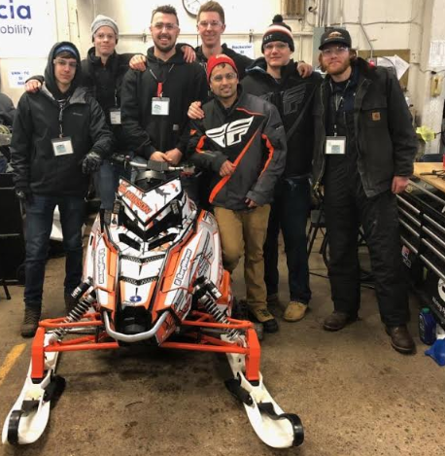
Introduction
Presenters
Team
Jeff Phelps
School Status: 4th year
Major: Mechanical Engineering Technology
Role: Project Manager
Lucas Miller
School Status: 5th year
Major: Mechanical Engineering Technology
Role: Engine Tuning & Calibration

Slide 4
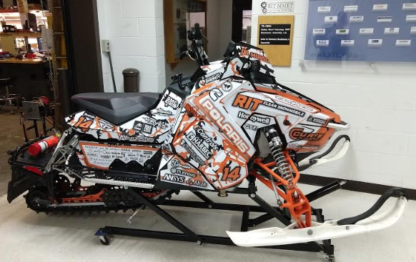
Chassis
2016 Polaris Rush pro-s
Curve Industries xs skis
Increased front spring rate

Slide 5
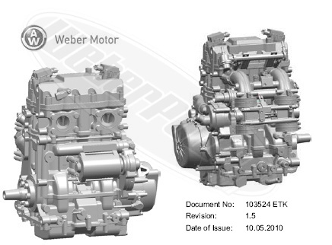
Engine
Manufacturer: Weber
Displacement: 749cc
Usage: Polaris FS IQ Touring
Stroke: 4
Compression Ratio: 11.5:1
Injection: Multi-Port Injection
Fuel Source: Gasoline
Stock Power: 80 HP
http://www.weberpower.com/mpe.html

Slide 6
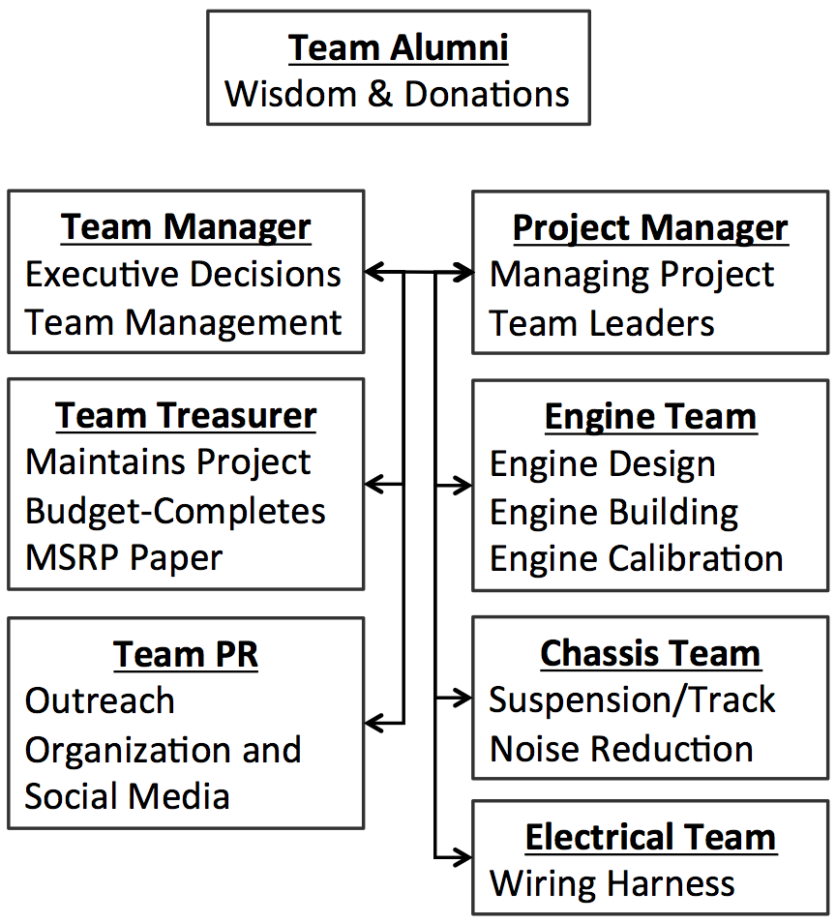
Team Structure

Slide 7
Overview of Design Process
Using the 2018 CSC as a baseline for the 2019 design season, the team utilized the experience to identify key issues and low scoring categories.
The DMAIC process has been used for multiple years as it allows a clearly defined workflow throughout the year for each of the groups within the team.

Slide 8
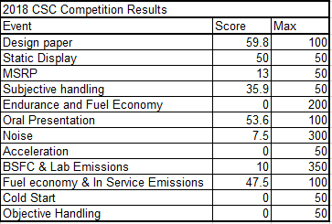
Project Planning
2018 Benchmark
Muffler Issues
High noise levels
Bolt in catalyst loosening
Oil leak issues
AN fittings vibrating loose
Engine mounting issues
Improper clutch spacing
Inability to Cold Start
Idle issues

Slide 9
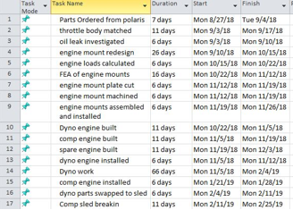
Solutions
Approaches selected
Muffler Issues- Full Redesign
Oil leak issues- switch back to hose clamps
Engine mounting issues-Engine Mount Redesign
Inability to Cold Start- logging starts
Idle issues- Reduce throttle body size

Slide 10
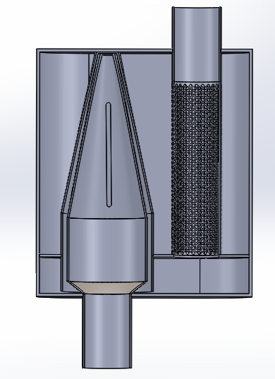
Muffler Design- Components
Inner Cone with cut out slots
Outer Cone to guide the reverse flow
Catalytic Converter
Perforated Tube wrapped with glass fiber sound
absorbent packing material
Inlet and Outlet pipes

Slide 11
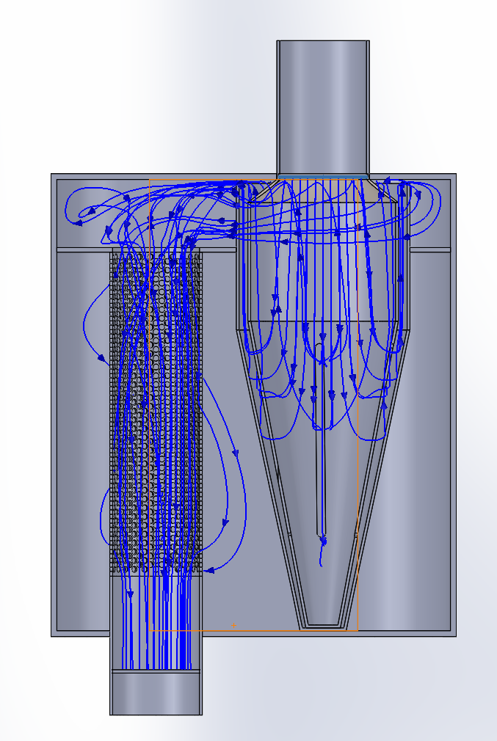
Muffler Design-Flow
Inlet Flow through Catalytic Converter to Inner Cone with Slots
Flow exits slots from inner cone and is guided back by the outer cone
Flow escapes outer cone through a gap between the face of the outer cone feature and the top inner wall of the shell
Flow circulates in the top chamber and exits through the perforated tube

Slide 12
Muffler Design- Sound Wave Flow Principles
Cones act as a baffling device by reducing the volume of the entering sound waves
Sound waves reflect off the cone, interfering with the entering sound waves, cancelling each other out
Reducing the size of the slots in the cone benefits the sound dampening
Reducing the gap distance between the outer cone feature and the top inner shell wall limits the amount of flow that can escape, reducing the noise
Perforated tubes dissipate the sound wave energy by converting them to heat energy through frictional dampening via the perforated holes
Sound absorbent packing material reduces the high pitch sound waves

Slide 13
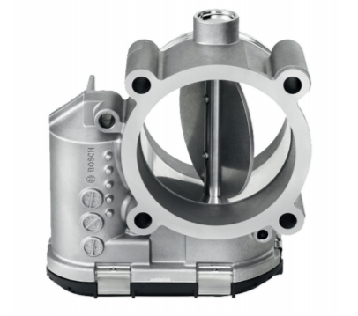
Throttle Body Size Reduction
Idle was too high during 2018 comp
No vacuum leaks were identified
Throttle position at idle was at minimum
Switch to a smaller throttle body (54mm to 46mm)
This allowed for lower clutch engagement speed
No decrease in peak power was seen

Slide 14
Engine Calibration Strategy
Stoichiometric for cruising loads and speeds
Increased fueling outside of typical cruising range
Increased power
Decreased Nox
Decreased Cylinder Temperatures and Increased Reliability
Data Logging
Used to refine initial fuel table from dyno
Knock Sensor used for spark and fuel correction for Ethanol

Slide 15
Flex Fuel
Closed Loop O2 is utilized to allow the engine to run any type of fuel from E0 to E85 gasoline/ethanol mix
ECM reads lambda and adjusts fuel pulse width in order to maintain stochiometric conditions
ECM has the ability to learn pervious engine operating parameters to adjust pulse width quicker
Accidental testing shows that the engine is not capable of switching to a gas/ethanol/diesel mixture using this approach

Slide 16
Conclusion
A reduction in noise and emissions was attained
Rider comfort and appearance were maintained
Technologies utilized
Engine swapped
3d printed Intake
Custom designed and fabricated exhaust system
Engine tuning & dynamometer time

Slide 17
Questions?

