Slide 1
SAE Clean Snowmobile Challenge Design Presentation
2018 SAE Clean Snowmobile Challenge
Rochester Institute of Technology Clean Snowmobile Team
Josh Bush & Eric Oswald

Slide 2
Agenda
Introduction
Overview of Design Process
  DMAIC
Problem Definition
Measurement
Analysis
  Engine Simulation
Implement
  Engine Reliability
  Intake Manifold
  Exhaust Muffler
  Flex Fuel
Control
Conclusion
Questions

Slide 3
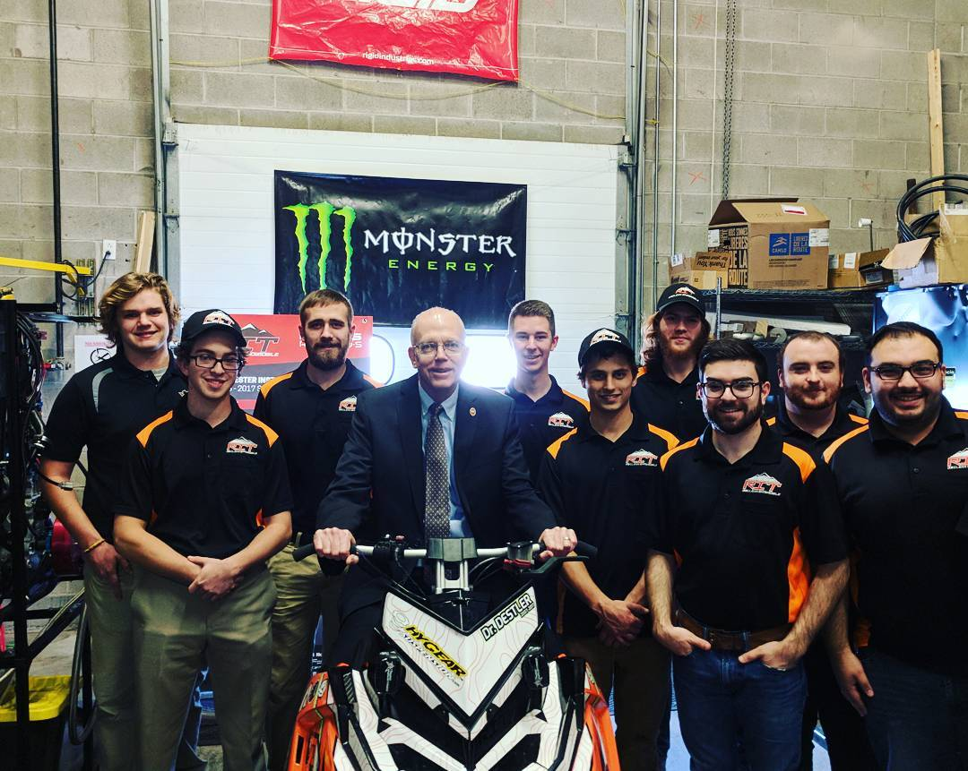
Introduction
Presenters
Team
Josh Bush
  School Status: 4th year
  Major: Mechanical Engineering Technology
  Role: Project Manager
Eric Oswald
  School Status: 5th year
  Major: Mechanical Engineering Technology
  Role: Powertrain Lead

Slide 4

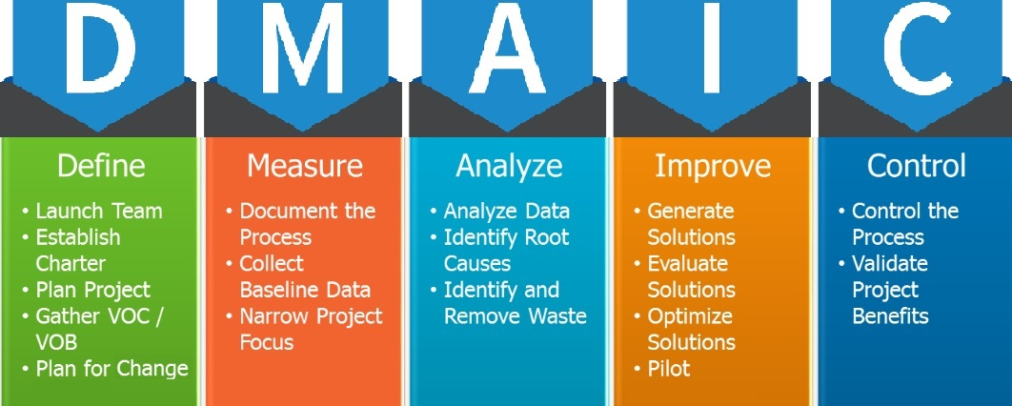
Overview of Design Process
Define:
  Using the 2017 CSC as a baseline for the 2018 design season, the team utilized the experience to identify areas for improvement.
Measure:
  Documentation, including competition results, simulation results, and testing results, were collected on the defined problems.
Analyze:
  Research was conducted on the identified problems to determine root causes based on published data and standard practices.
Improve:
  New designs were developed
Control:
  Designs were verified first via simulation, then physically on the machine

Slide 5
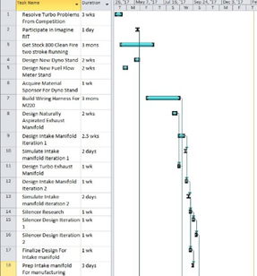
Define
2017 Benchmark
Failure of the MGT1238 Turbocharger
  Non-robust construction
  Unable to complete endurance run
  Low engine power
  High Emissions
  Low Fuel Economy
High noise levels
Slow Acceleration
Inability to Cold Start
2018 Project Timeline

Slide 6
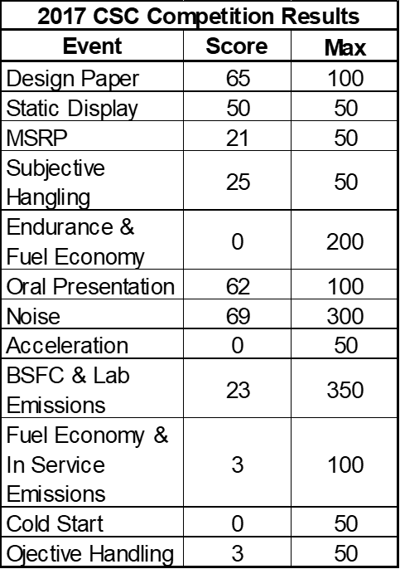
Measure
Measurement Method:
Competition Scores
Testing Results
Simulation Results
Physical measurement

Slide 7
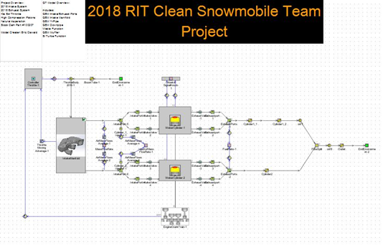
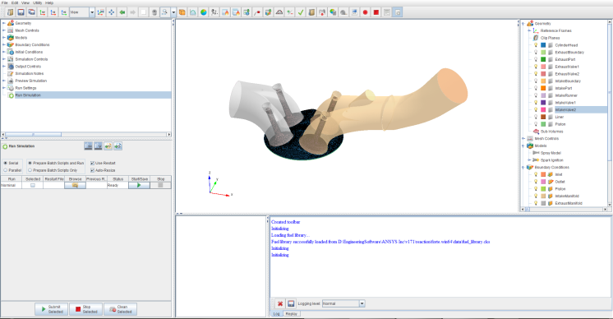
Analyze– Engine Simulation
Use of 2 main simulation platforms
  GT Power
  ANSYS
Allows for quick design changes in order to see reaction in engine performance
Aided design in the following areas
  Intake Manifold
  Exhaust Muffler
  Engine Calibration

Slide 8
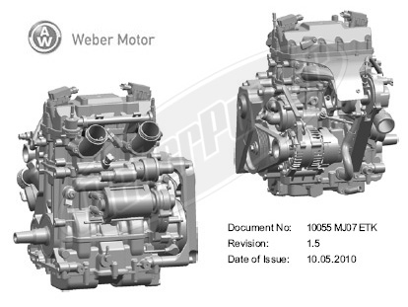
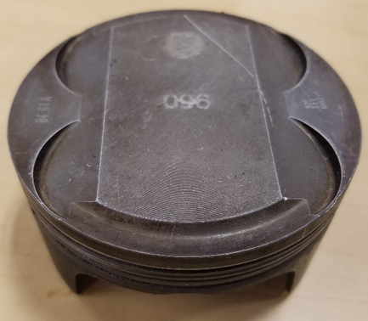
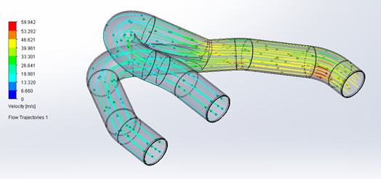
Implement– Engine Reliability
Specifications:
Manufacturer: Weber
Displacement: 749cc
Usage: 2008 Polaris IQ Touring FS
Stroke: 4
Compression Ratio: 11.5:1
Injection: Multi-Port Injection
Fuel Source: Gasoline
Stock Power: 80 HP
Naturally-Aspirated Manifold:
Equal runner length
Exhaust Gas Scavenging
High Flow
Optimized length for peak torque at specific rpm

Slide 9
Implement - Flex Fuel
Closed Loop O2 allowed for the engine to inject any type of fuel from E0 to E85 gasoline/ethanol mix
ECM reads lambda and adjusts fuel pulse width in order to maintain a fuel ratio
ECM has the ability to learn pervious engine operating parameters to adjust pulse width quicker
Injectors are sized correctly, according to GT-power to accept ethanol blended fuel

Slide 10
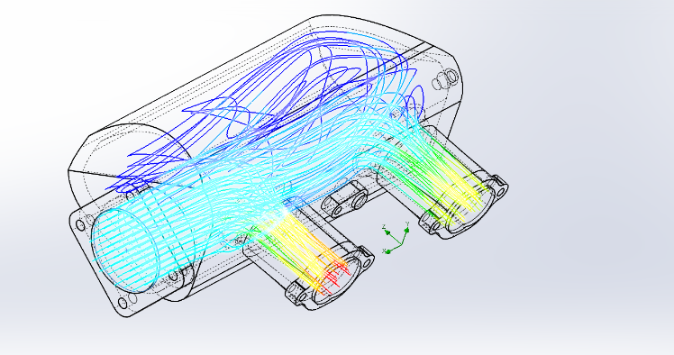
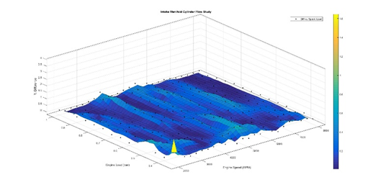
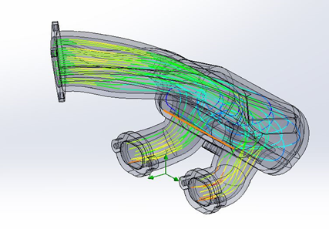
Intake Manifold
Provides a non-biased flow to each cylinder
Intake runner was optimized for torque using GT-Power
Due to the new engine mounting location, the exterior geometry was constrained to the current configuration
2017 Intake
2018 Intake

Slide 11
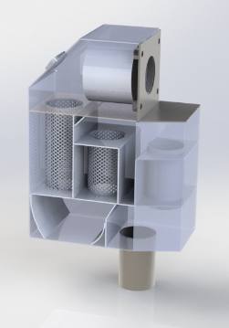
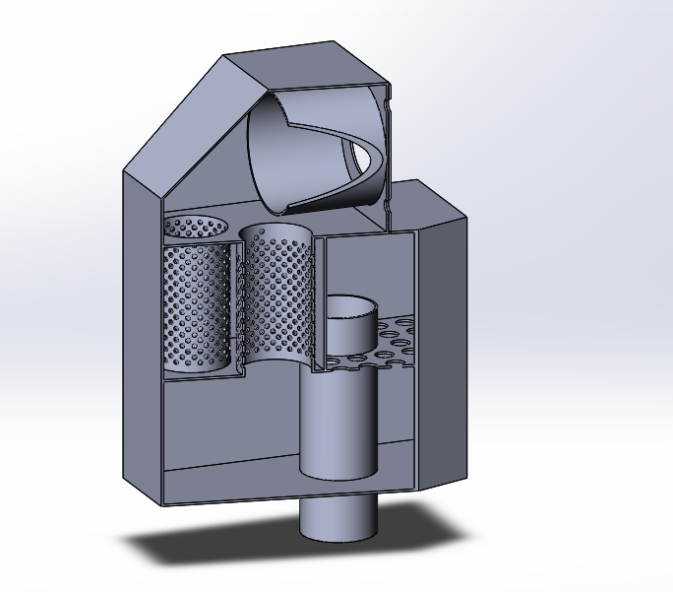
Exhaust Muffler
Designed to reduce noise of the overall snowmobile
Features increased flow path length and more chambers to cancel sound
Glass packing was utilized to surround the perforated tubes in each chamber.
Designed for EGR outlet accessibility
Back pressure and noise was minimized using GT-Power
Features integrated 3-way catalytic converter for ease of packaging
2017 Muffler 2018 Muffler

Slide 12
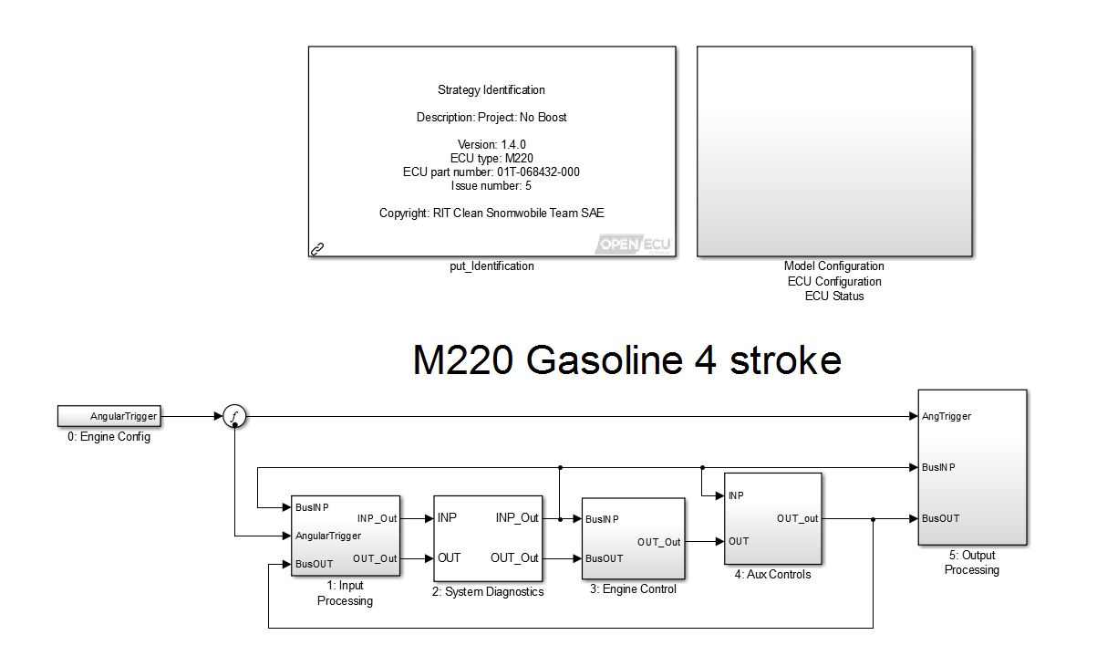
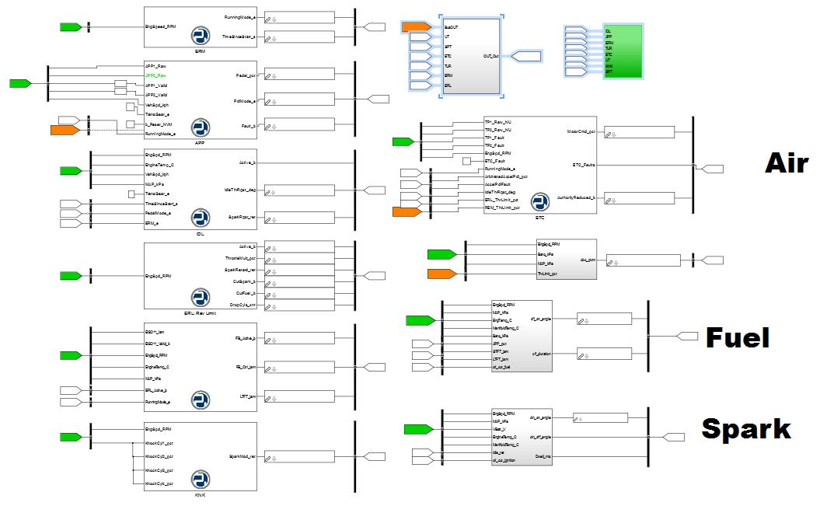
Future Implementation
Stock Weber Turbocharger
  Increase power delivery
Liquid Cooled EGR
  Allows for cooler cylinder temperatures to reduce NOx emissions
Pi Innovo ECM (M220)
  Allows for rapid protyping through Simulink
  Can modify/write engine source code
  Uses ETAS INCA for engine calibration allowing for in vehicle data recording

Slide 13
Control
Passed static and dynamic Tech Inspection
Tuned to a lamda ratio of 1 on both cylinders
Improved power through intake and exhaust optimization
Improvement in all areas when compared to 2017 baseline

Slide 14
Conclusion
RIT Clean Snowmobile Team was able to create a fuel efficient & lower emission snowmobile
Using various technologies such as, flex fuel, catalytic converter, custom intake/exhaust system, with a custom ECM controlling all systems.
Improvements can be made in the following areas for the RIT CST:
  Creating/comparing more test data
  Creating test data for stock snowmobile
  Time and project management skills

Slide 15

Questions?

