Slide 1
SAE Clean Snowmobile Challenge Design Presentation
2017 SAE Clean Snowmobile Challenge
Rochester Institute of Technology Clean Snowmobile Team
Eric Oswald & Dyllan Barnum

Slide 2
Agenda
Introduction
Overview of Design Process
Define Stage
Measure Stage
Analysis Stage
Design Stage
Chassis
Bogie Wheels
Engine Selection
Design Stage
Engine Simulation
Turbocharger Matching
High Compression Pistons
Intake Manifold
Exhaust Muffler
Liquid Cooled EGR system
Flex Fuel
Conclusion
Questions

Slide 3
Introduction
Presenters
Team
Eric Oswald
School Status: 4th year
Major: Mechanical Engineering Technology
Role: Project Manager/Powertrain Lead
Dyllan Barnum
School Status: 5th year
Major: Mechanical Engineering Technology
Role: Chassis Design Lead

Slide 4
Overview of Design Process
Define: State problem, goals, and scope of project
Measure: Collect all relevant data to form a customer requirements list
Analyze: Use the customer requirements to create a cause and effect diagram
Design: Optimize designs using previous data to meet specifications
Verify: Show the design works within the design criteria and custom requirements.

Slide 5
Define – Market Research
Purpose: To discover the main objective that the design needs to meet defined the scope of the project
Obtained: Usually through surveys from the rider, dealers, regulatory agency and the general public
VOC: Customer requirements can be represented by 6 major categories: Low Emissions, Noise, Fuel Efficiency, Performance, Reliability and Cost

Slide 6
Measure – Pareto Chart
Used to create a visual on the heavy point break downs
Created targets to achieve and areas of focus
Highest scored categories
Low Emissions
Quiet Operation
Fuel Efficiency

Slide 7
Analyze – Benchmarking Competitors
Compared to the last year top 4 Clean Snowmobile Challenge teams
Added the 2016 RIT Clean Snowmobile Team to show improvement over the previous year
Used Pareto Chart to set goals based on importance of each category
Used other snowmobiles to set goals and show improvement areas
Numbers were calculated based on previous year’s results

Slide 8
Analyze – House of Quality
HOQ helps to manipulate customer requirements into the product requirements that need to be met
Has the opportunity to adjust the product requirement
Shows the projected design compared to competitors
Data extracted is to meet customer requirements to optimize in Low Emissions, Quiet Operation and Fuel Efficiency

Slide 9
Design - Chassis
Stock: 2016 Polaris Pro-S
Lighter weight/Increased handling from 2016 CSC Snowmobile
Rider forward position increases handling and control by centralizing mass
Utilization of stock mounting points for engine swap
Maintain stock clutch spacing

Slide 10
Design – Rear Suspension
Stock bogie wheels are 6in in diameter made out of plastic
New set-up is 8in made out of 6061-T6 Aluminum
Using max engine torque there is a theoretical 7.66% reduction in friction
FEA was used in order to gain a perspective on how well our new design will hold up to the forces
Lowest FOS is 8, so there is potential for weight reduction

Slide 11
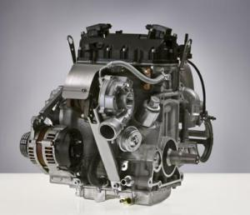
Design – Engine Selection
Manufacturer: Weber
Displacement: 749cc
Usage: 2008 Polaris IQ Touring FST
Stroke: 4
Turbocharger: Stock
Compression Ratio: 9:1
Injection: Multi-Port Injection
Fuel Source: Gasoline
Stock Power: 140 HP

Slide 12
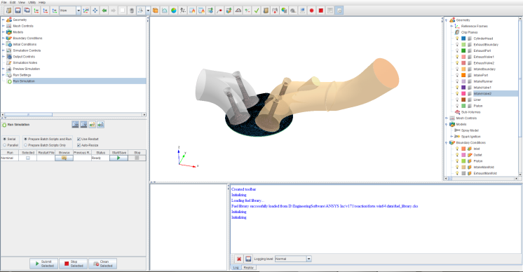
Design – Engine Simulation
Use of 2 main simulation platforms
GT Power
ANSYS
Allows for quick design changes in order to see reaction in engine performance
Aided design in the following areas
Intake Manifold
Exhaust Muffler
Turbocharger Matching
Piston Selection
Cam Shaft Selection

Slide 13
Design – Turbocharger Matching
The MGT1238Z from Honeywell was selected
The use of a turbocharger is to increase the power of the engine without increasing displacement
GT Power simulation was used to confirm a correct match for both compression and turbine housing.
Upon simulation and testing the turbocharger was entering surge. In order to correct for this the internal wastegate was opened slightly to prevent surge.

Slide 14
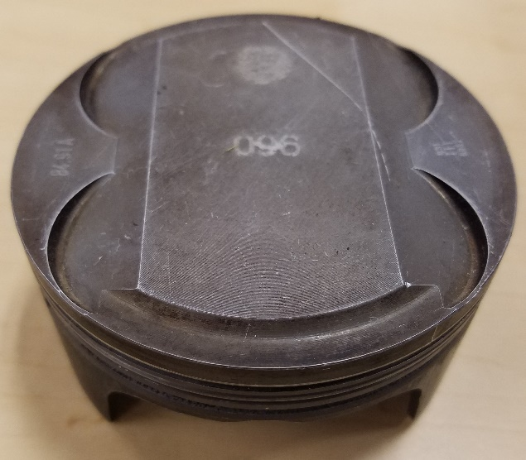
Design – High Compression Pistons
Stock turbo pistons were swapped for NA high compression pistons
Compression ratio went from 9.0:1 to 11.5:1
Concerns over engine knock were considered into the engine calibration
Improvements on engine torque and reduction in NO_{x} were targeted

Slide 15
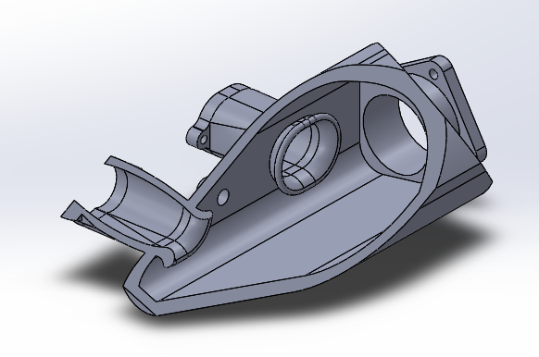
Design – Intake Manifold
Due to the new chassis a new intake manifold design was necessary
New design also allowed for a closer placement of the ETC system. This will improve the response from the engine
Maintains the same flow rate as used in 2016 verified in Star CCM+ and GT-Power
Intake runner was optimized for torque using GT-Power

Slide 16
Design – Exhaust Muffler
Designed to reduce noise of the overall snowmobile
Features various chambers to cancel targeted frequencies
Designed for EGR outlet accessibility
Back pressure and noise was minimized using GT-Power
Features integrated 3-way catalytic converter for ease of packaging

Slide 17
Design – Liquid Cooled EGR
Uses inert exhaust gas to lower NO_{x} within the combustion chamber
Exhaust gas is pulled through a cooler in order to reduce temperatures of the combustion to reduce knock tendency.
Increased temperature from the 2016 CSC system to reduce condensation

Slide 18
Flex Fuel
Closed Loop O2 allowed for the engine to inject any type of fuel from E0 to E85 gasoline/ethanol mix
ECM reads lambda and adjusts fuel pulse width in order to maintain a fuel ratio
ECM has the ability to learn pervious engine operating parameters to adjust pulse width quicker
Injectors are sized correctly, according to GT-power to accept ethanol blended fuel

Slide 19
Verify – High Compression Pistons
Torque
NO_{x} Reduction

Slide 20
Verify - Exhaust Gas Recirculation

Slide 21
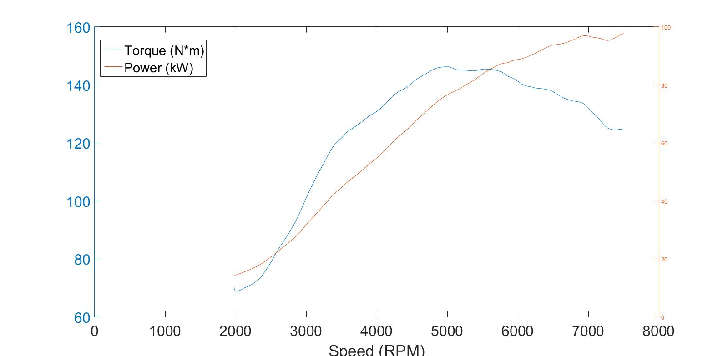
Verify – Engine Power

Slide 22
Conclusion
RIT Clean Snowmobile Team was able to create a fuel efficient & lower emission snowmobile
Using various technologies such as, turbocharging, EGR, flex fuel, catalytic converter, custom intake/exhaust system, with a custom ECM controlling all systems.
Improvements can be made in the following areas for the RIT CST:
Increased controllability of the EGR system
Creating/comparing more test data
Creating test data for stock snowmobile
Time and project management skills

Slide 23
Questions?

