Slide 1
Applying Lean Six-Sigma DMADV Methodology to the Design Cycle of a High-Efficiency, Low Emissions Snowmobile
2016 RIT SAE Clean Snowmobile Team
March 9th, 2016
Presenters: Dylan Outtrim & Anthony NaDell

Slide 2
Design Process Issues
Typical design process:
  Long cycle time
  Requires multiple revisions
Decided to use design for Lean Six Sigma - DMADV Process
  Emphasis on designing product correctly the first time
  Results in:
    Reduced design time
    Lower developmental cost
    Higher product quality
    More satisfied customer

Slide 3
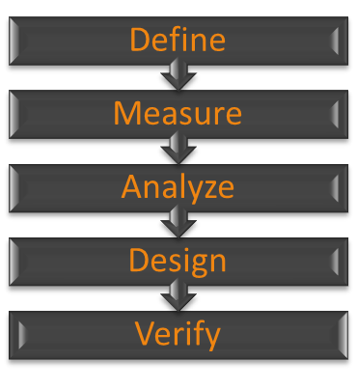
Design for Lean Six Sigma Process (DMADV)
Define the objectives of the product/system being designed
Determine customer requirements and desires for product/system
Transform customer requirements into technical specifications and identify desired technology to be used
Develop and optimize subsystems to meet the technical specifications
Verify designs are working correctly and meet customer requirements

Slide 4
Define – Market Research
Purpose: Discover the main objectives of the system being designed
Typically is done through surveys and interviews
However for CSC, completed by the CSC Judging Committee
Goal of competition is to design a snowmobile for use in pristine areas such as national parks
Snowmobile needs to meet desires of:
  Rider
  Dealer
  Environmentalist
  Landowner

Slide 5
Define – Voice of Customer (VOC)
Event | Maximum Points
Engineering Design Paper | 100
MSRP | 50
Lab Emissions | 300
Brake Specific Fuel Consumption | 50
In-Service Emissions | 50
In-Service Fuel Economy | 50
Oral Presentation | 100
Fuel Economy & Endurance | 200
Acceleration | 50
Objective Handling | 50
Subjective Handling | 50
Cold Start | 50
Static Display | 50
Objective Noise | 150
Subjective Noise | 150
No-Maintenance Bonus | 100
Total | 1550
VOC outlines the customer wants and needs for the product
CSC Judging Committee describes the VOC in the form of the Scoring Matrix
Points distribution used to rank how important each event is to the customer

Slide 6
Measure – CSC Points Breakdown
Similar events consolidated into categories of Critical To Customer (CTC) Requirements
Weight of each category shown to the right:

Slide 7
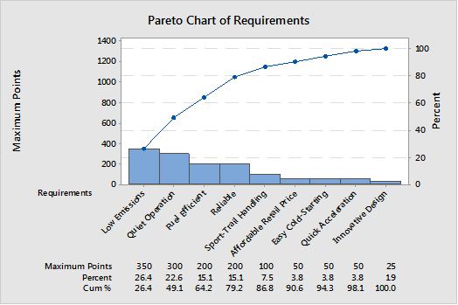
Measure – Pareto Chart for Points
Visual representation of points breakdown for identification of areas to target
Highest scored categories:
  Low Emissions
  Quiet Operation
  Fuel Efficiencies
  Reliability

Slide 8
Analyze – Benchmarking
Competitively benchmarked our goals against the last year’s Top Five CSC Teams
Based goals off of importance from Pareto and compatibility with current performance snowmobiles

Slide 9
Analyze – Quality Function Deployment (QFD)
Transforms Critical to Customer categories into Critical to Quality (CTQ) Characteristics
Allows customer wants to be transformed into product requirements
Calculates how sensitive the overall system is to adjustment of each product requirement

Slide 10
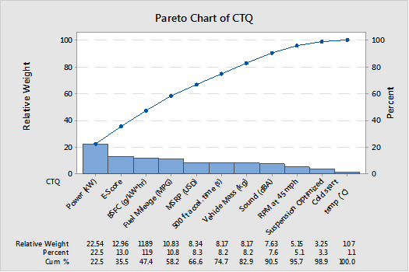
Analyze – Pareto Chart of Critical to Quality Characteristics (CTQ)
Displays importance of CTQ Characteristics

Slide 11
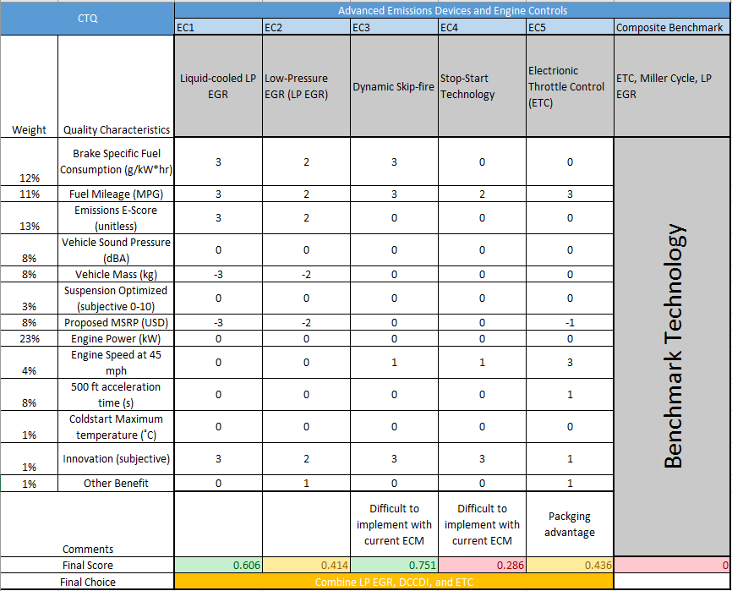
Analyze – Pugh Matrix
Compares current technologies to new innovative designs
Used to select components that will be used on snowmobile
Completed for system level and subsystem level

Slide 12
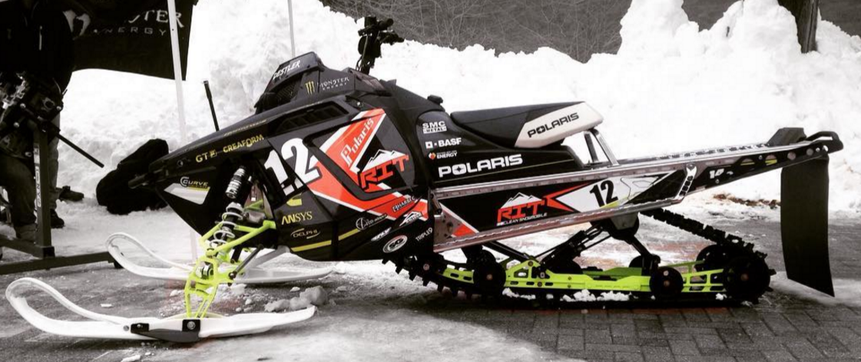
Design - Summary

Slide 13
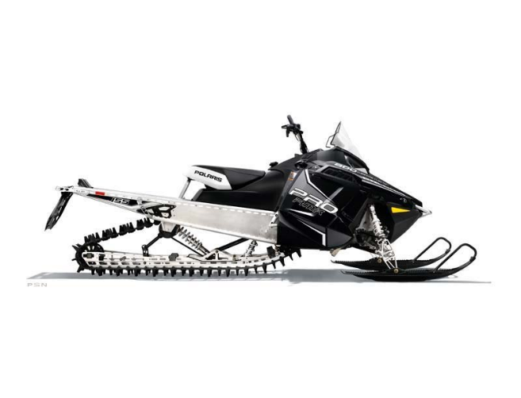
Design - 2013 Polaris PRO RMK Chassis
Light weight aluminum chassis
Belt driven system reduces weight
155” rear suspension replaced by 144” used by 2015 Polaris Switchback Assault
  Smoother ride
  Improved handling

Slide 14
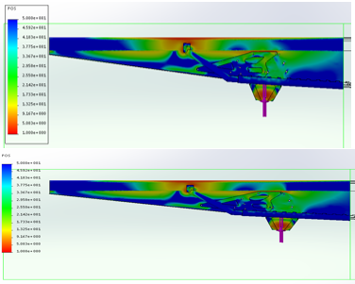
Design - Chassis Modification
Rear suspension mounting points shifted approximately 1” forward to accept new suspension
High strength stainless steel rivets used
Brackets did not leave reinforced area of tunnel
FEA performed on a simplified model showed FOS to be a minimum of 25 in the areas of interest

Slide 15
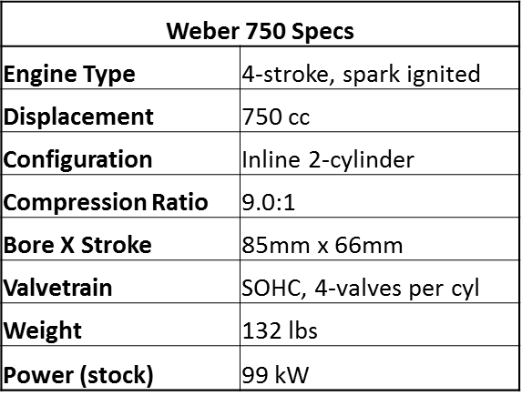
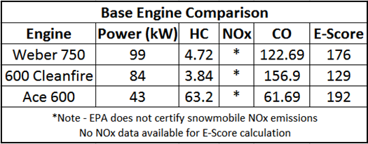
Design – Weber 750 MPE
Versatile Multi-Purpose Engine
Stock power density of 1.54 kW/kg
Balance of low-emissions and high power

Slide 16
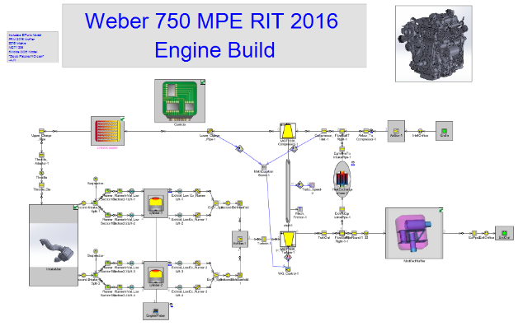
Design – Engine Simulation
Gamma Technologies software GT-Power
Provides the ability to simulate changes to engine design quickly and efficiently
Used to validate design changes
  Intake Manifold
  Muffler
  Turbocharger selection
  Cooled EGR system

Slide 17
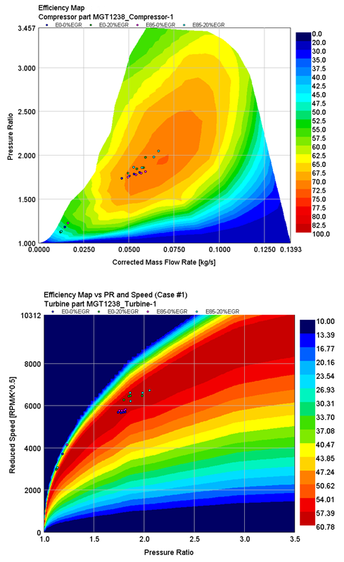
Design – Honeywell MGT1238Z Turbocharger
Internal waste-gate turbocharger
More durable that GT1749V turbocharger used in 2015
Matched using GT-Power simulation

Slide 18
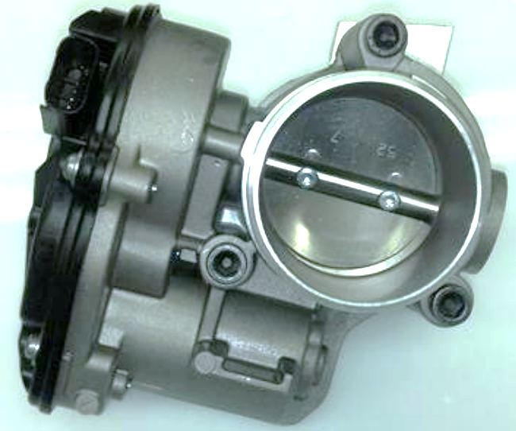
Design – Dephi Electronic Throttle Control (ETC)
Uses off-the-shelf components
  Delphi electronic throttle body
  Ski-Doo pedal position sensor
Safe, reliable and low-maintenance
  Redundant non-contact TPS/PPS
  No cables to lubricate or “stick”
  Governor mode for inexperienced riders
Enables advanced controls
  Filters small throttle inputs
    Smoother operation & lower fuel consumption
  Masks power losses from emissions controls while reducing pumping losses

Slide 19
Design – Flex Fuel Compensation
Technical Services Entrol 88 ECM in conjunction with a lambda sensor to establish a closed loop O₂ control system.
Air-fuel ratio is monitored by the ECM to adjust fueling accordingly
Block learn capability of ECM allows for short term fuel trim to become a global multiplier.
  Changes hold even after engine is turned off
Validated in dyno testing to run from E0 to E85 and adjust for abrupt changes in ethanol content

Slide 20
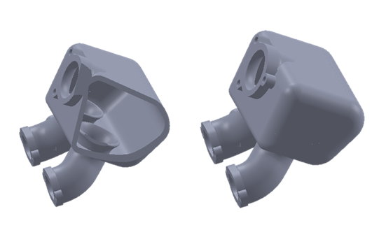
Design – Intake Manifold
Reduced flow restriction in intake system
Allowed the runners and manifold to be a single piece
Compatible with single ETC
Design verified using GT-Power and Star-CCM simulation

Slide 21
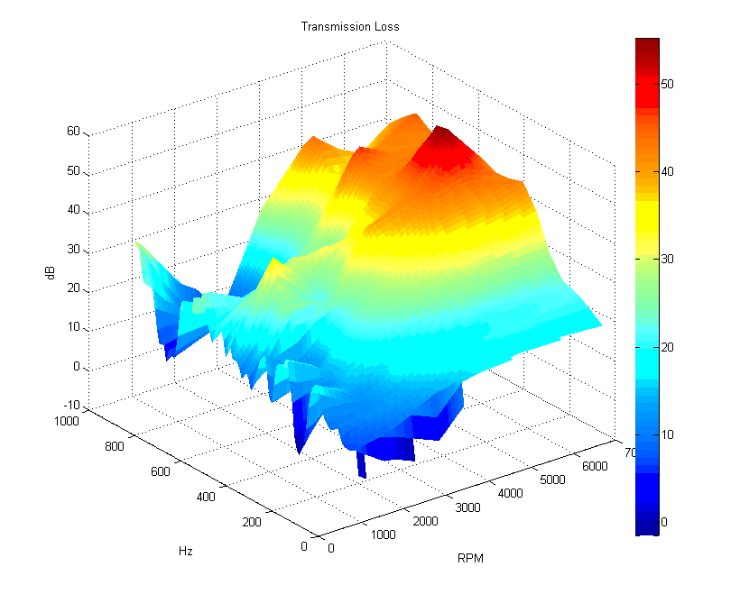
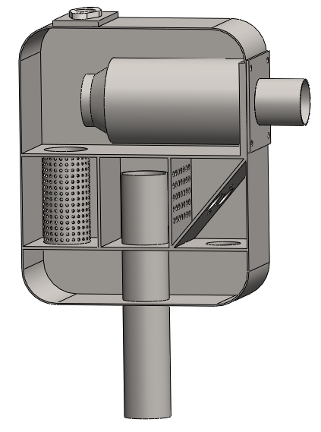
Design – Custom Muffler
Several resonant chambers
Internal baffles
Constructed from sheet steel
Three way catalyst sleeved into first chamber
  Quick catalyst changes
  Improved packaging

Slide 22
Verify - Power/Torque
Per dyno data:
  Engine power: 127 HP @ 7000 rpm
  Maximum torque: 145 N-m @ 5000 rpm

Slide 23

0

