Slide 2
Snowmobile Design Process
Design for Lean Six Sigma - DMADV Process
Emphasis on designing product correctly the first time
Results in:
Highly optimized system
Lower developmental cost
Higher product quality
Reduced design time
More satisfied customer

Slide 3
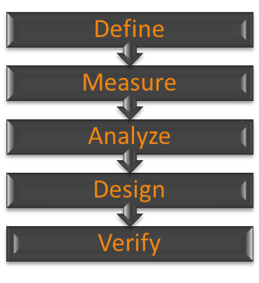
Design for Six Sigma Process
Define the project
Determine customer requirements and desires
Identify and Generate concepts
Develop and optimize designs
Verify performance of designs

Slide 4
Define – Market Research
Completed by the CSC Judging Committee
Goal of competition is to design a snowmobile for use in pristine areas such as national parks
Snowmobile needs to meet desires of:
Rider
Dealer
Environmentalist
Landowner

Slide 5
Define – Voice of Customer
Event | Maximum Points
Engineering Design Paper | 100
MSRP | 50
Lab Emissions | 300
Brake Specific Fuel Consumption | 50
In-Service Emissions | 50
In-Service Fuel Economy | 50
Oral Presentation | 100
Fuel Economy & Endurance | 200
Acceleration | 50
Objective Handling | 50
Subjective Handling | 50
Cold Start | 50
Static Display | 50
Objective Noise | 150
Subjective Noise | 150
No-Maintenance Bonus | 100
Total | 1550
Outlines what the customer wants from or in the product
CSC Judging Committee describes the VOC in the form of the Scoring Matrix

Slide 6
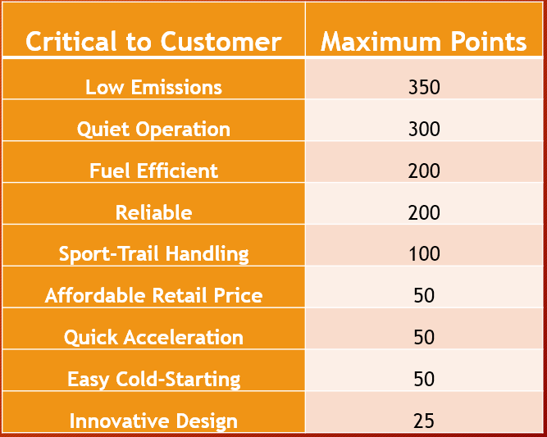
Measure – CSC Points Breakdown
Consolidated similar events into categories
Weight of each category shown to the right:

Slide 7
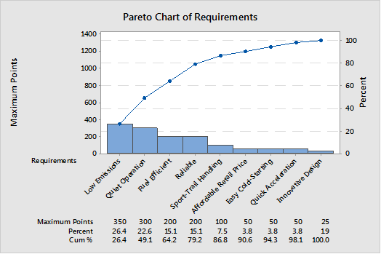
Measure – Pareto Chart for Points
Displays visual of points break down
Highest scored categories:
Low Emissions
Quiet Operation
Fuel Efficiencies
Reliability

Slide 8
Analyze – Benchmarking
Competitively benchmarked our goals against the last year’s Top Five CSC Teams
Based goals off of importance from Pareto

Slide 9
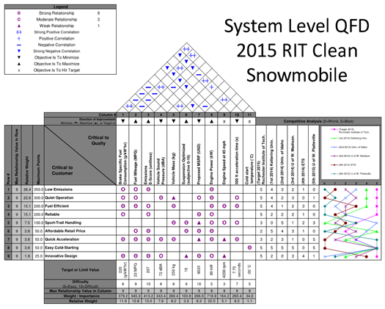
Analyze – Quality Function Deployment (QFD)
Transforms Critical to Customer categories into Critical to Quality Characteristics
Allows customer wants to be transformed into product requirements
Calculates how sensitive the system is to adjustment of each product requirement

Slide 10
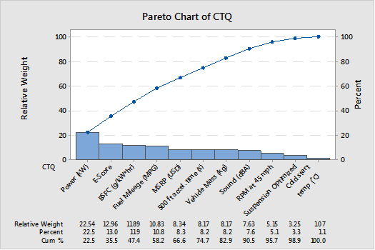
Analyze – Pareto Chart of Critical to Quality Characteristics (CTQ)
Displays importance of CTQ Characteristics

Slide 11
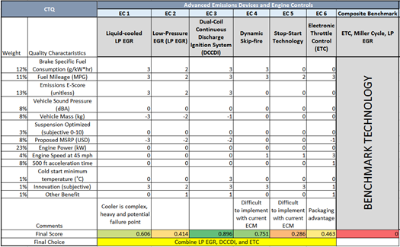
Analyze – Pugh Matrix
Compares current technologies to new innovative designs
Used to select components that will be used on snowmobile
Completed for system level and subsystem level

Slide 12
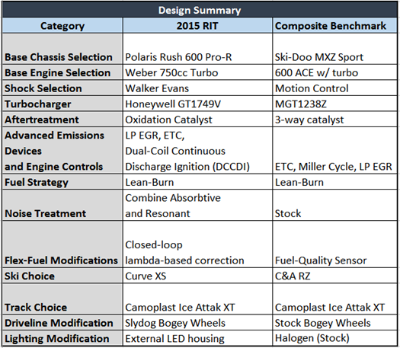
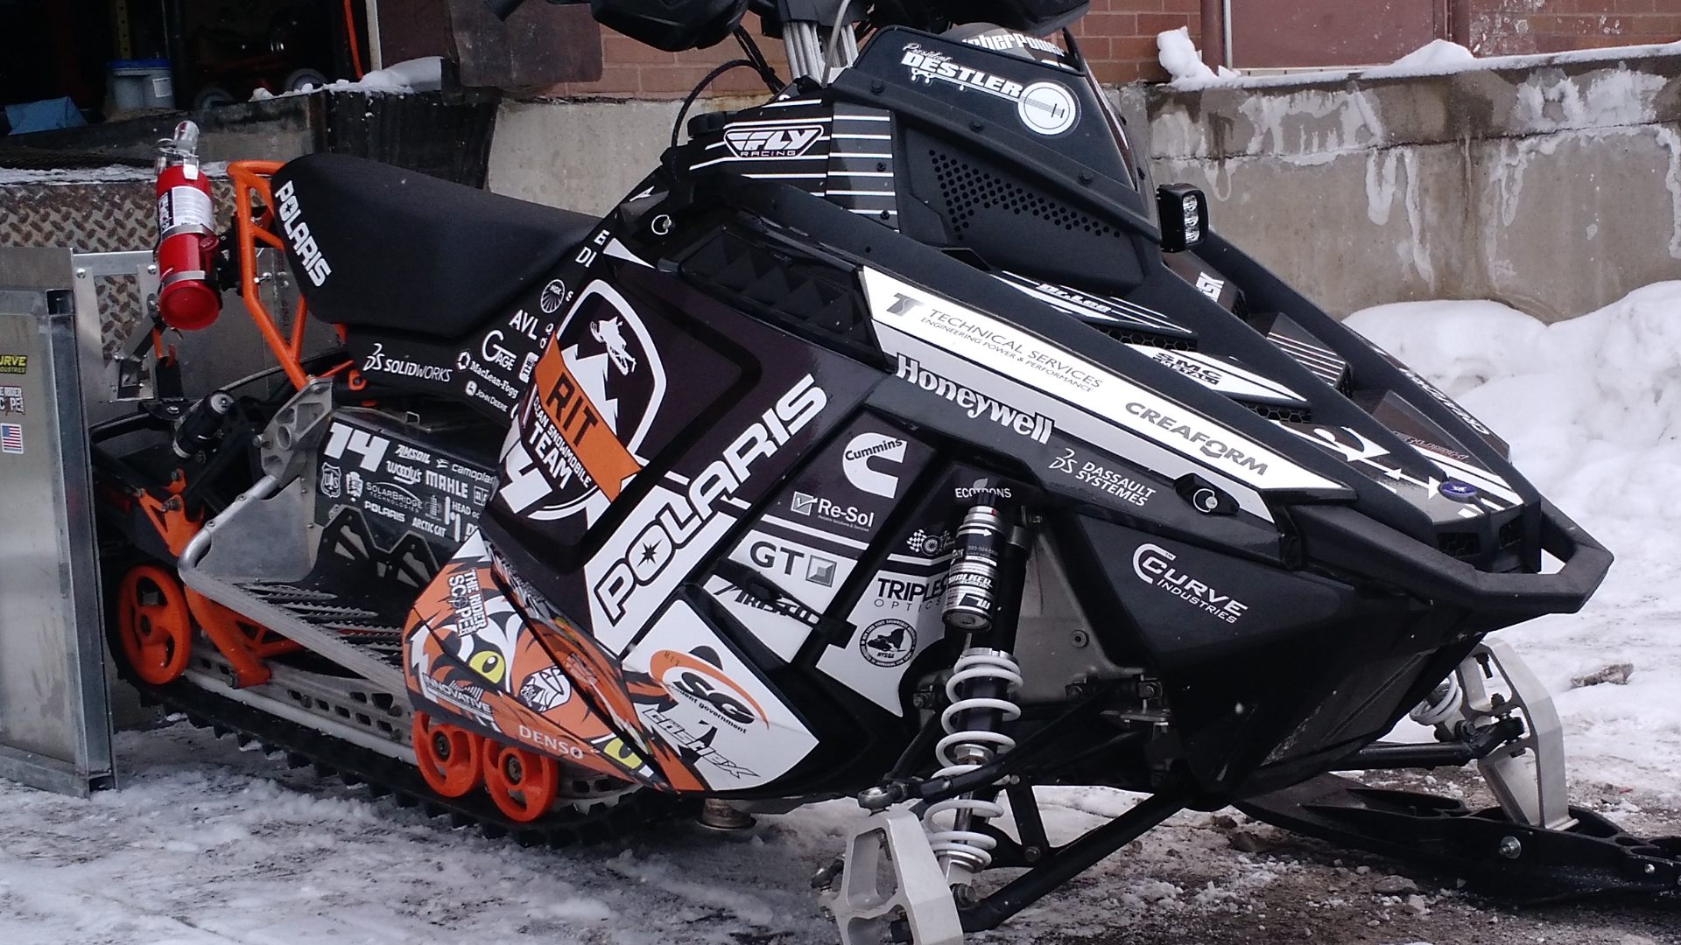
Design - Summary

Slide 13
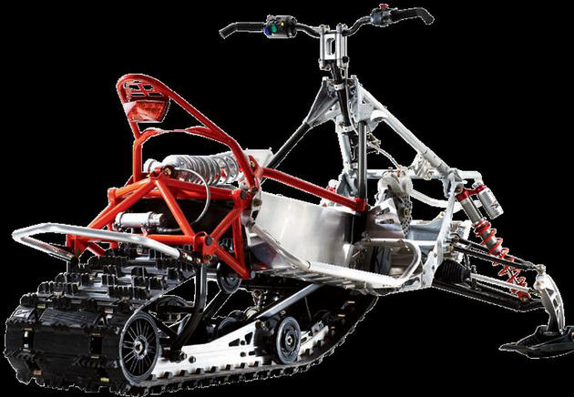
Chassis – 2013 Polaris Rush Pro-R
Polaris Pro-Ride chassis
Lightweight and nimble
Bonded Aluminum construction
Comfortable ergonomics
Innovative suspension design
Rising rate rear shock

Slide 14
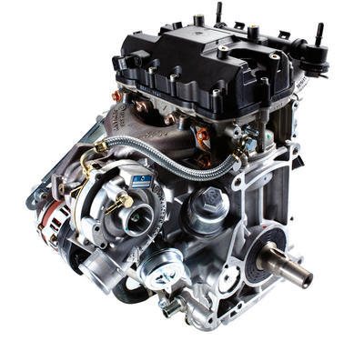
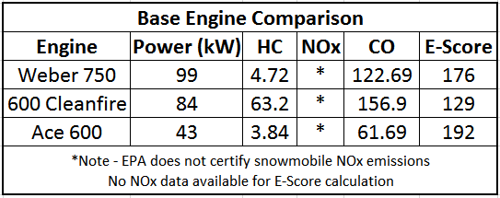
Design – Weber 750 MPE
MPE – Multi-purpose Engine
Reliably configurable from 40 to 140+ HP
Small package size and light-weight
Balance of low-emissions and high power
Weber 750 Specs
Engine Type | 4-stroke, spark ignited
Displacement | 750 cc
Configuration | Inline 2-cylinder
Compression Ratio | 9.0:1
Bore X Stroke | 85mm x 66mm
Valvetrain | SOHC, 4-valves per cyl
Weight | 132 lbs
Power (stock) | 99 kW

Slide 15
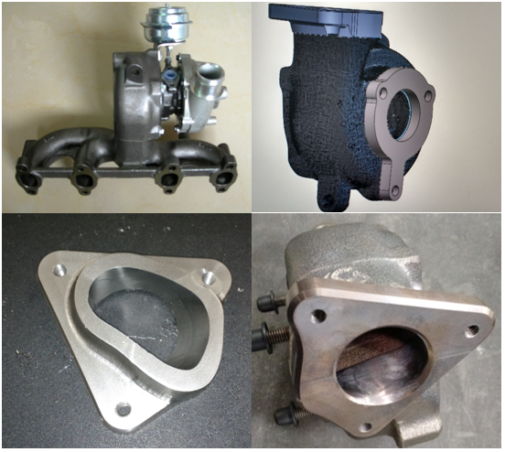
Design – Honeywell GT1749V Turbocharger
Variable-vane turbocharger lowers boost threshold
Torque increase at lower RPM
Earlier clutch engagement and taller gear ratios
Ideal for future engine development
Engine downsizing
EGR controls advantage
Exhaust gas temp limited
Requires EGT below 850˚C for fastest response
EGR, butanol, or lean operation allow use on gasoline engine.

Slide 16
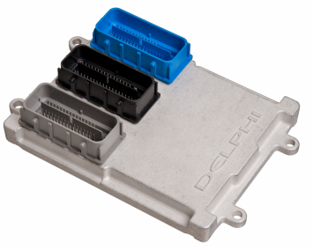
Design – Delphi MT88 ECM & Wiring Harness
Reliable and powerful for automotive & marine
Waterproof and temperature/vibration resistant
Can be mounted on-engine
Drivers for ETC, EGR, CCP, UEGO, injector, and ignition
Allows for advanced calibration strategies
Allows for live-update calibration changes
Calibration with TechniCAL by Technical Services Engineering
Diagnostic fault codes make dealer service quick and simple.
CAN J1939 communication standard

Slide 17
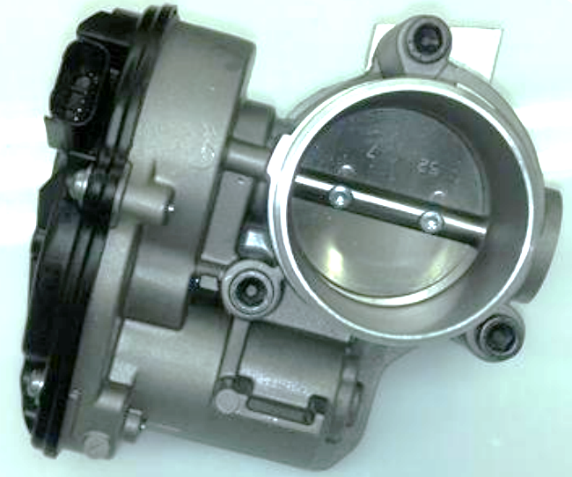
Design – Electronic Throttle Control (ETC)
Uses off-the-shelf components
Delphi electronic throttle body
Ski-Doo pedal position sensor
Safe, reliable and low-maintenance
Redundant non-contact TPS/PPS
No cables to lubricate or “stick”
Governor mode for inexperienced riders
Enables advanced controls
Filters small throttle inputs
Smoother operation & lower fuel consumption
Masks power losses from emissions controls while reducing pumping losses

Slide 18
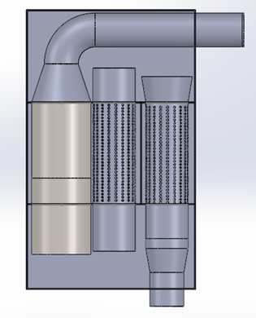
Design – Custom Muffler
Absorptive and resonant chambers
Destructive resonance at peak power for quiet operation
Constructed from sheet stainless steel and stock exhaust shells for low production costs.
Internal catalytic converter for emissions reduction
Oxidation catalyst for lean burn calibration
CO & HC reduced by catalyst, NOx production minimized with dilution

Slide 19
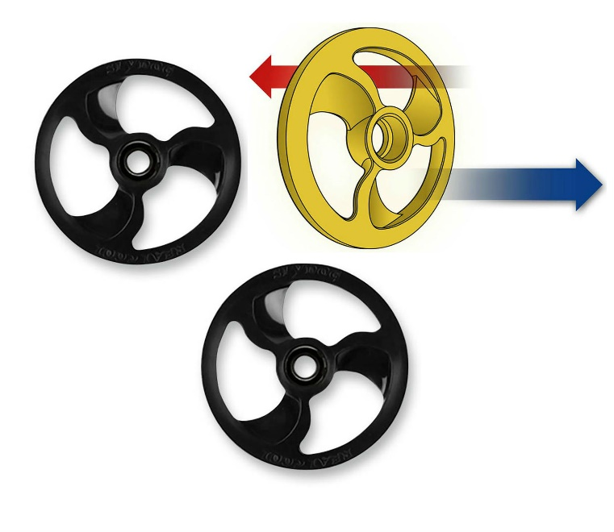
Design – Track friction reduction
Additional bogey wheels to reduce sliding friction
Slydog bogey wheels use a airfoil profile to blow snow into the skid
Lubricates the hyfax and track clips
http://powersports-blog.denniskirk.com/

Slide 20
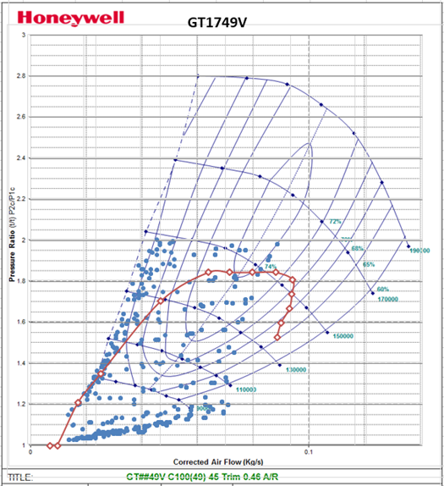
Verify – Turbocharger
Mass air-flow and pressure ratio data collected on engine dyno
Speed and load lines are visible and correlate well with the calculated peak-power model.
Higher than expected pressure ratios required to meet power target
Mass flow rate slightly lower than expected.
Peak power and speed is located in highest efficiency island of performance map
Beneficial for emissions, efficiency and performance.

Slide 21
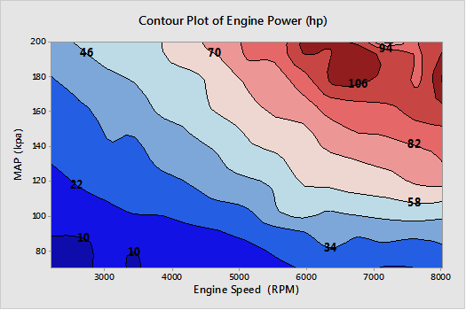
Verify - Engine
Engine power contour plot shows a peak power of 108 HP at 6700 RPM
Power is competition limited
Produced 138 SAE HP on high-boost lean calibration

Slide 22
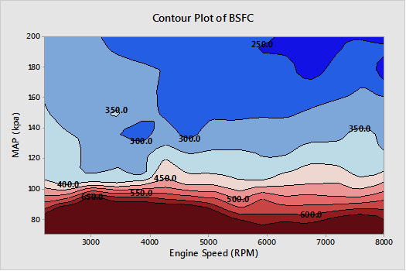
Verify – Brake Specific Fuel Consumption (BSFC)
BSFC calculated from AFR data due to data acquisition error.
RIT Believes this data is reasonably accurate at steady-state operation, but acknowledges the presence of noise.
As expected, BSFC is highest when pumping losses are largest, and are lowest at high loads.

Slide 23
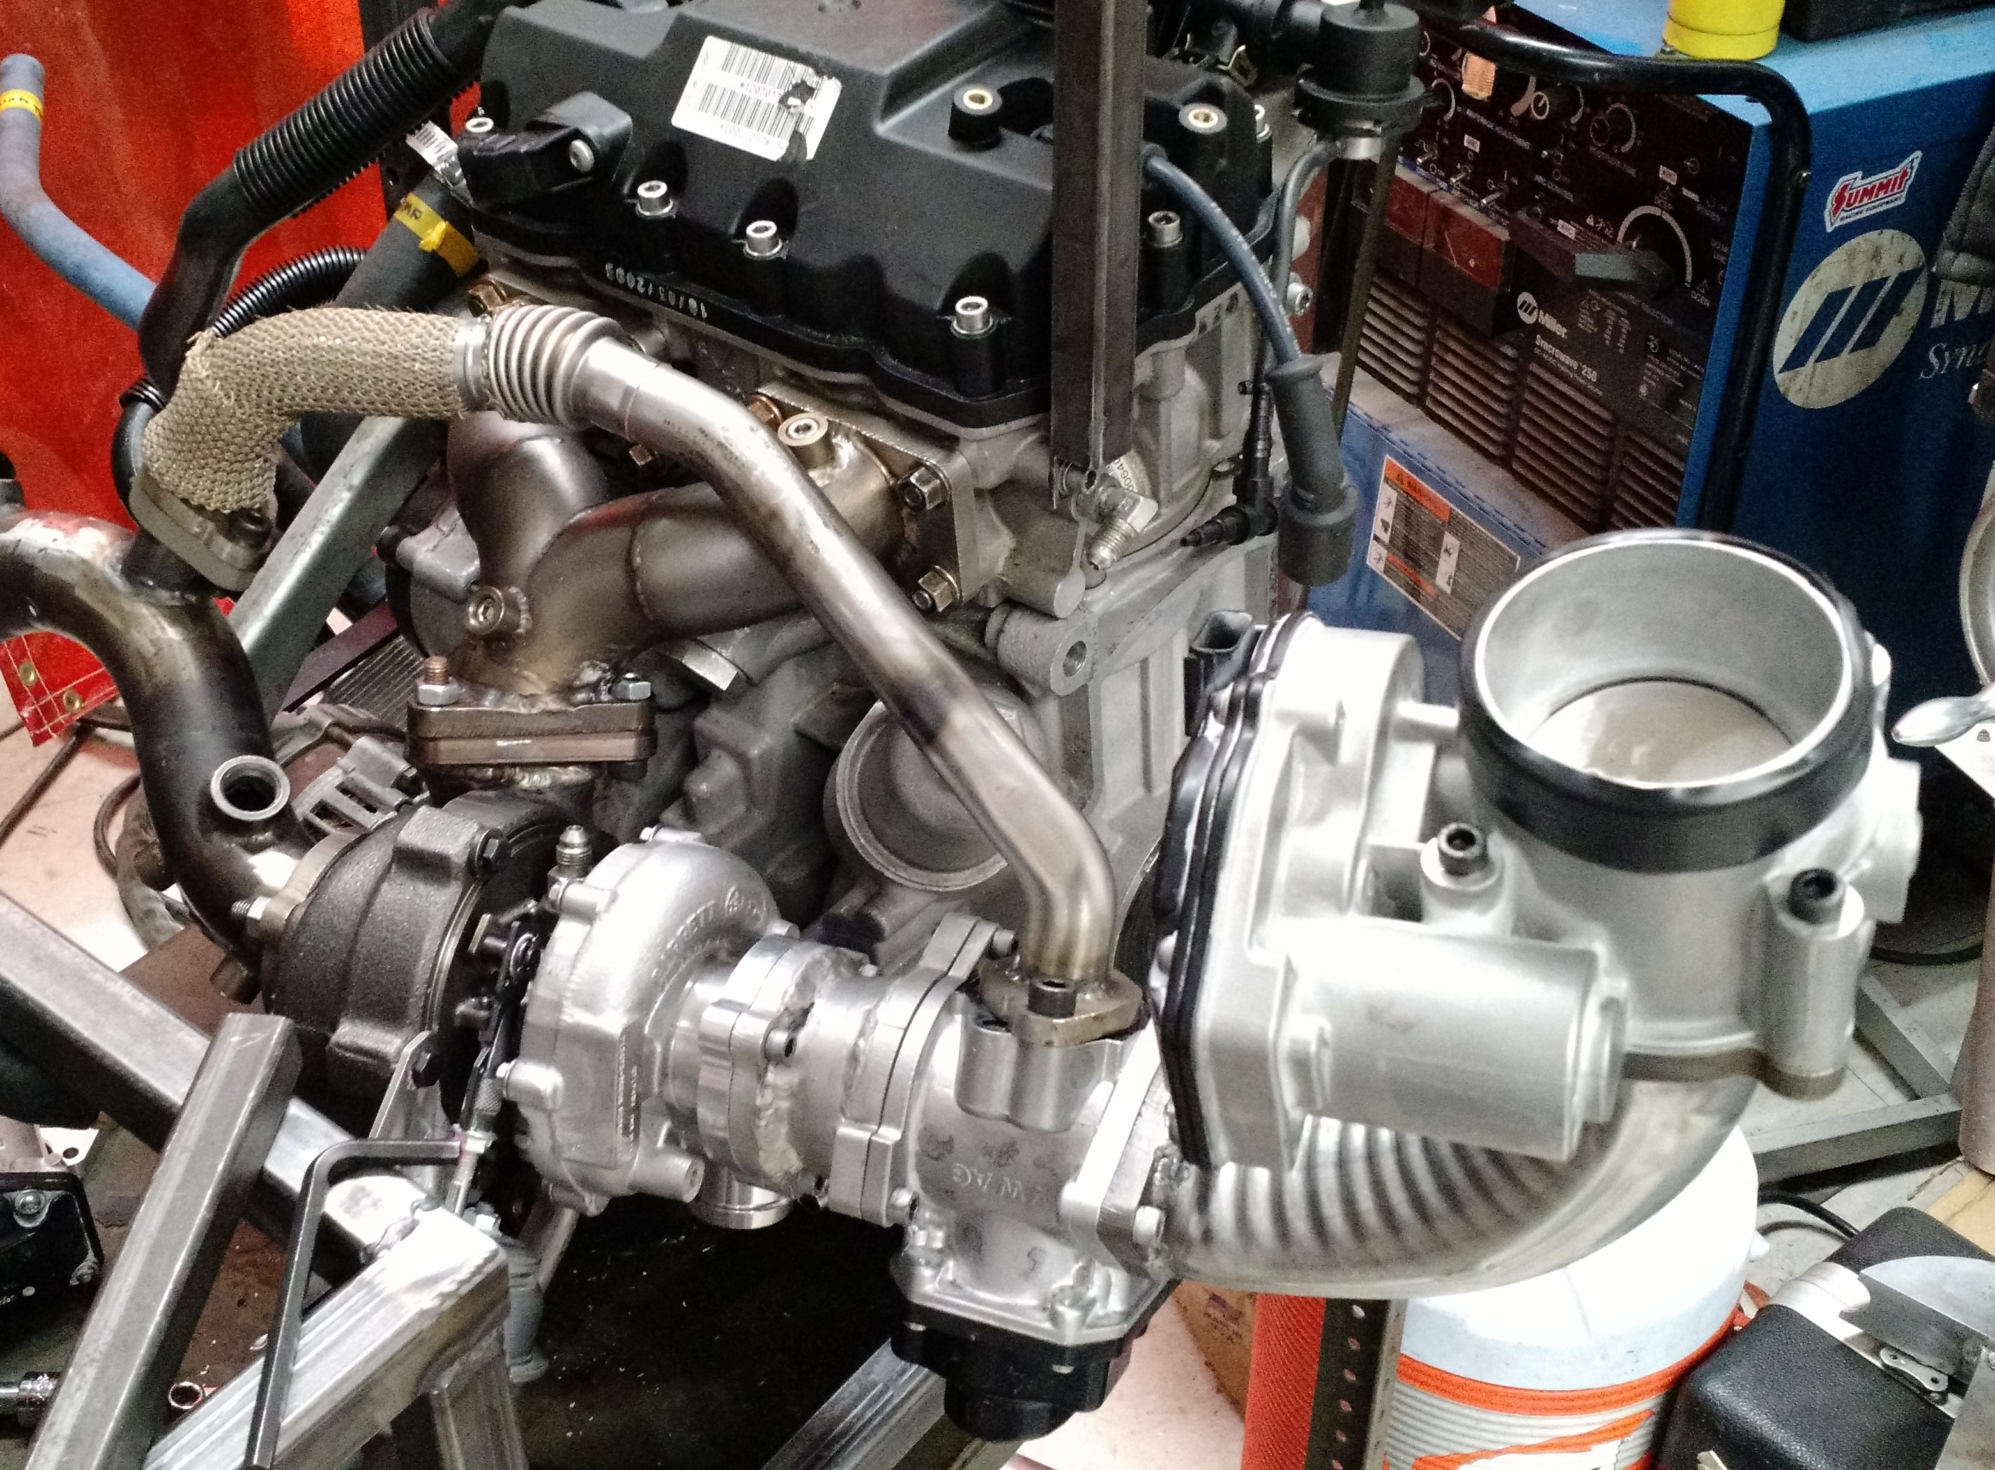
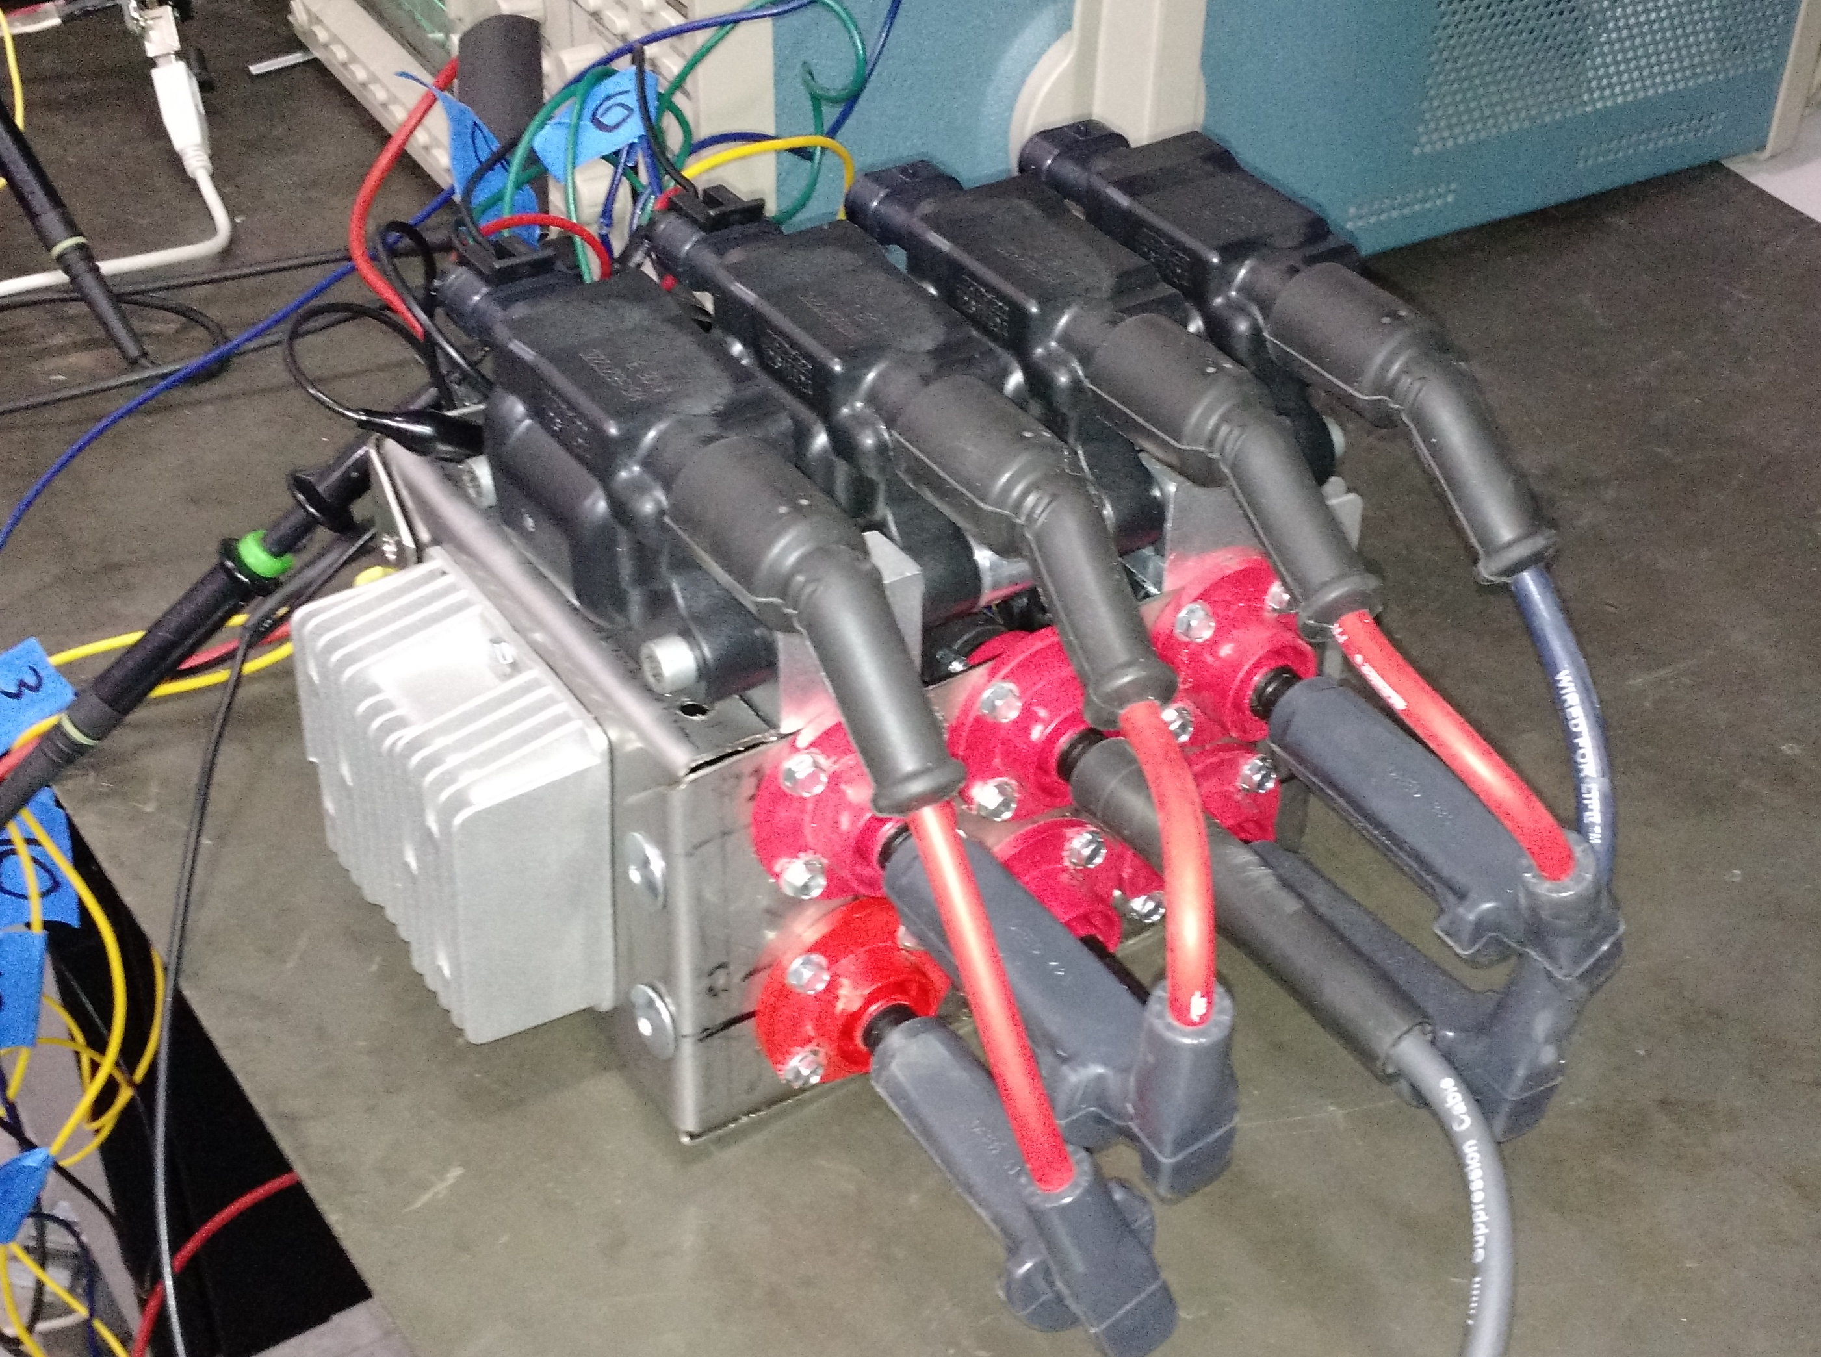
Unverified Designs – Removed from Competition Snowmobile for 2015
Low-Pressure Exhaust Gas Recirculation (EGR) System
Reduces combustion temperature and pumping work
Lower Nox & lower BSFC
Potentially higher PM & HC – dependent on calibration & dilution limits of engine
Dual Coil Continuous Discharge Ignition (DCCDIS)
Design to increase the dilution limit by providing a quasi-continuous spark event
Long duration & high energy
Extends glow discharge phase
Inspired by SwRI HEDGE II

Slide 24
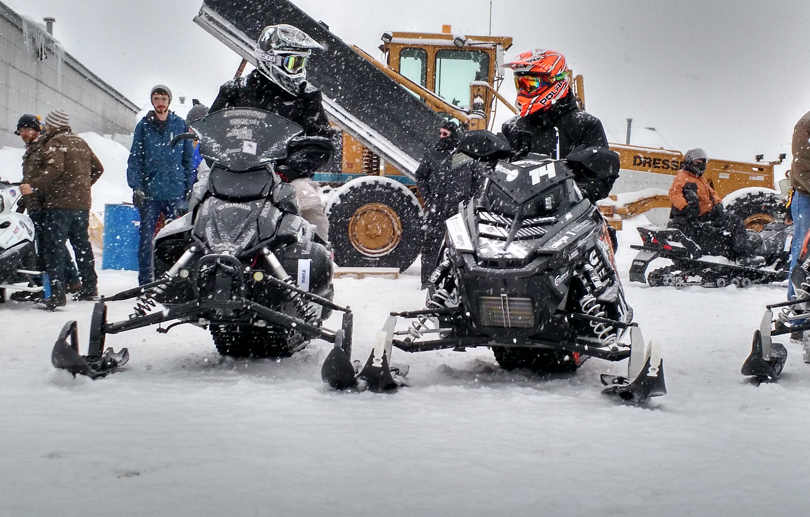
Thank you!
Thank you to all our sponsors, supporters, and CSC volunteers – we wouldn’t be able to do this without you!

