Slide 1
Electric snowmobile
Queen's Fuel Cell Team - SAE Clean Snowmobile Challenge 2015

Slide 2
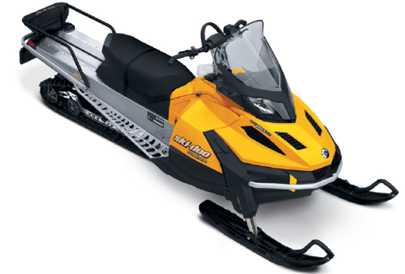
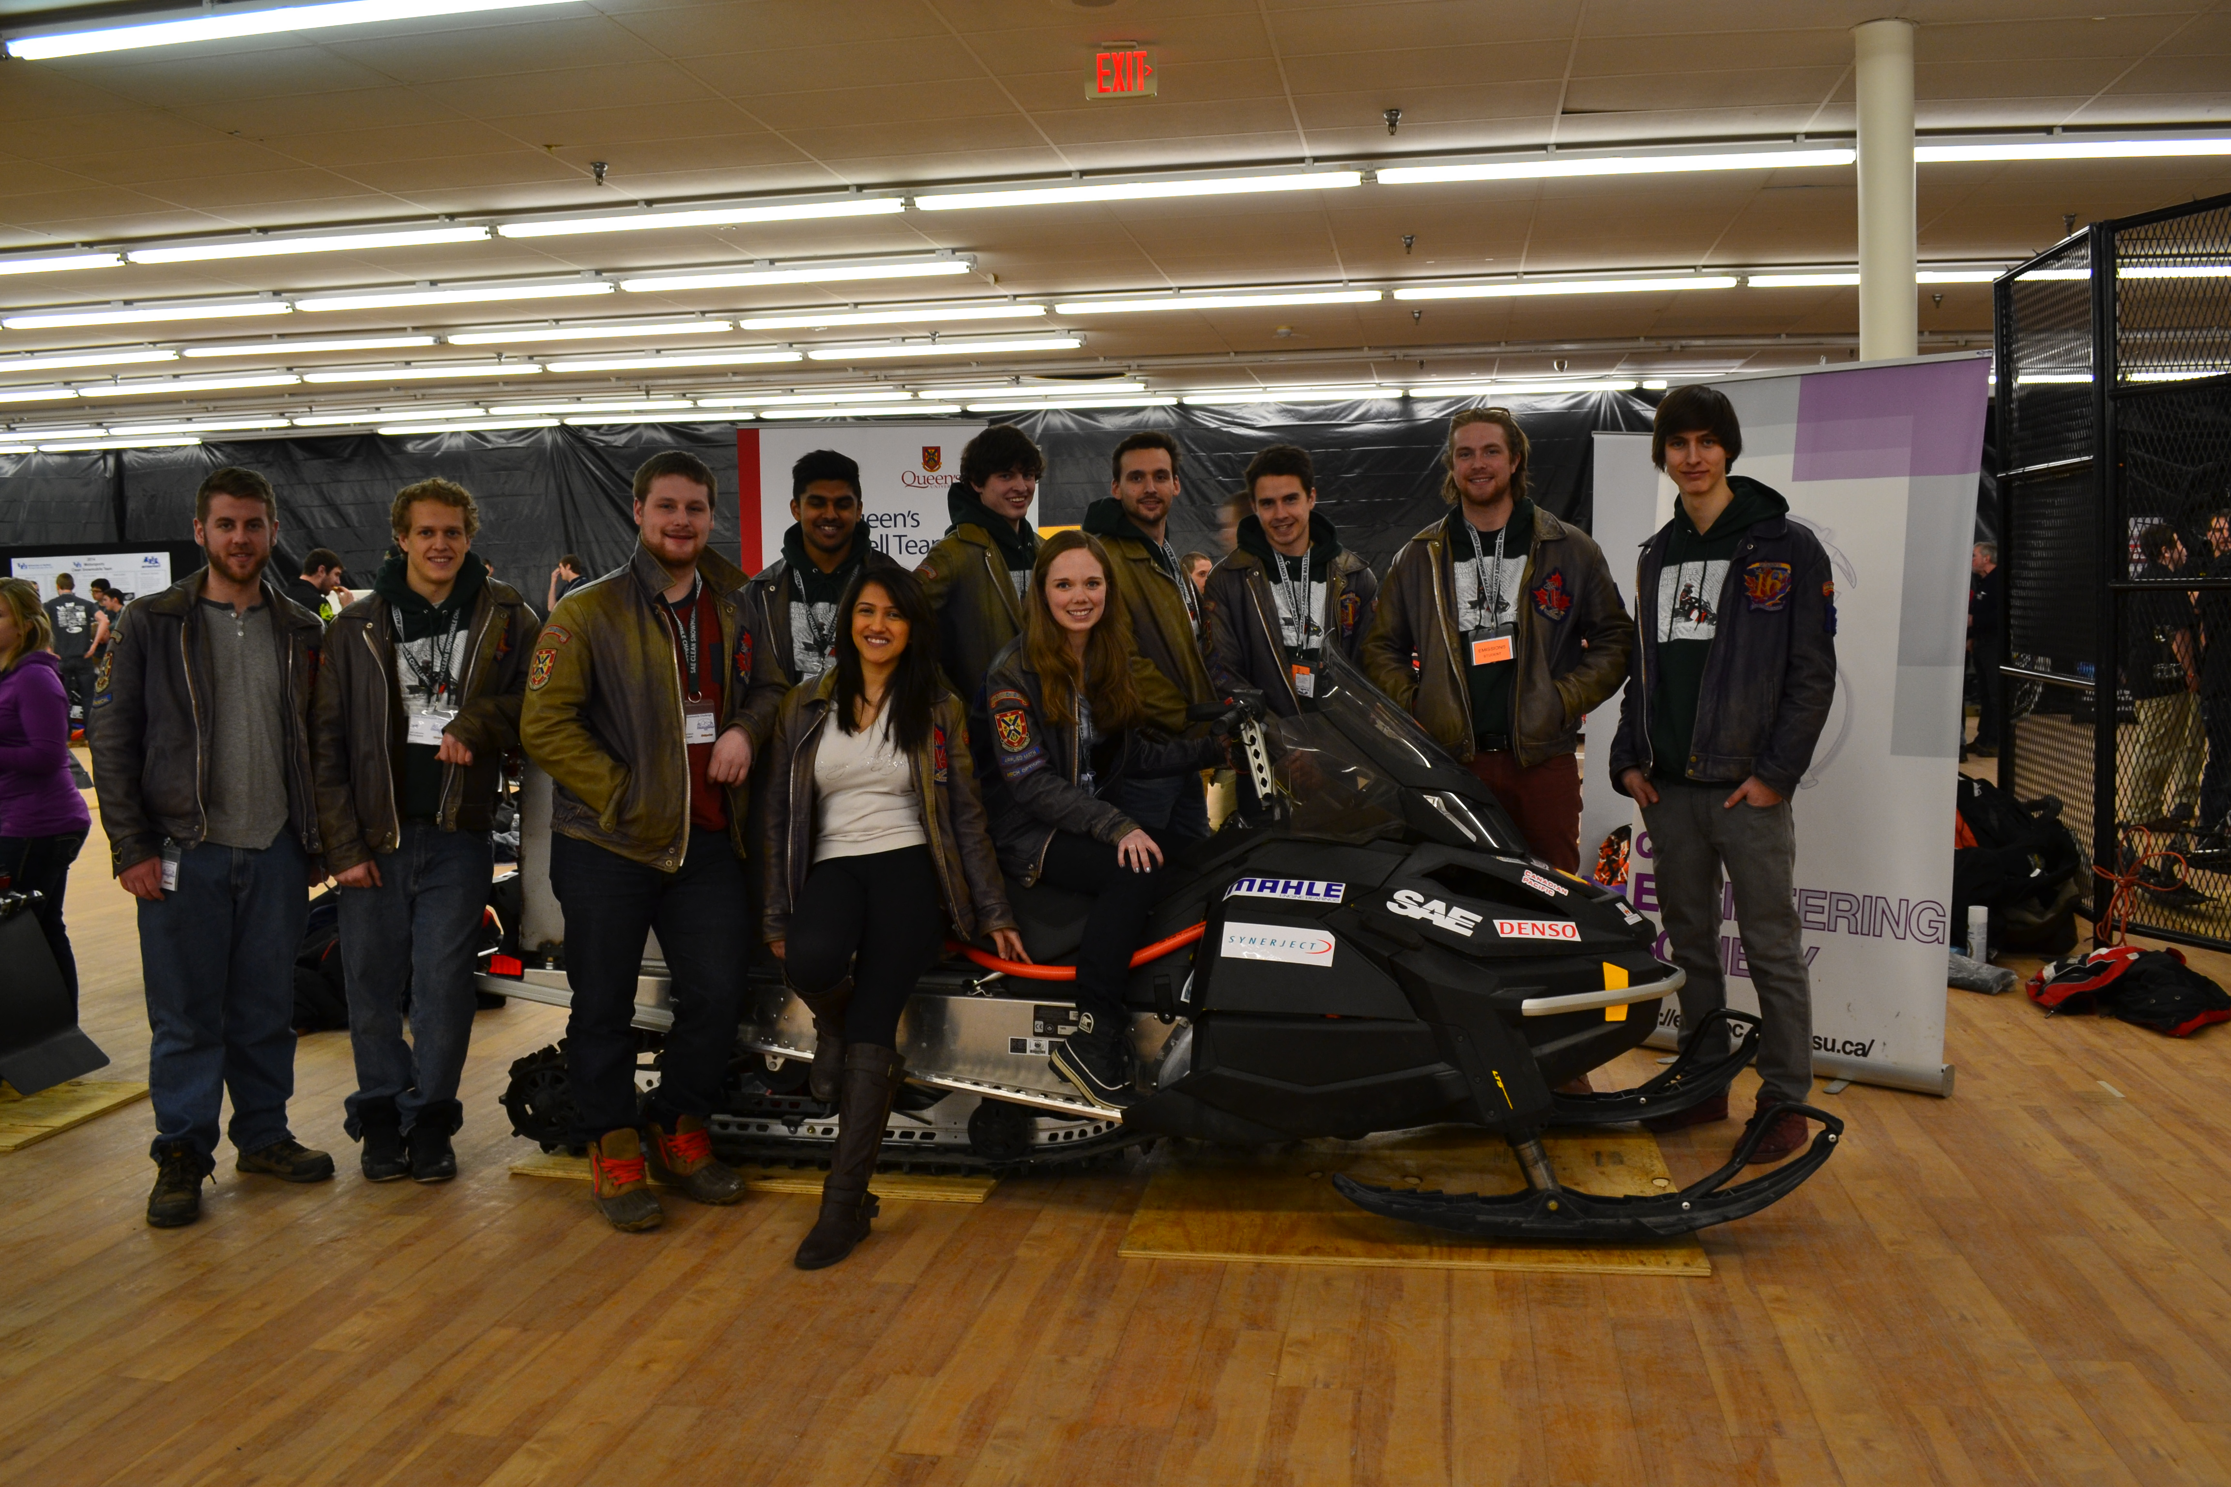
ICE
EV
FCEV
Base
Phase 1
Phase 2
Notes:
Start with IC sled, convert to EV for decreased environmental impact and proof of concept. End with fuel cell conversion in order to increase range and decrease dependence on fuel.

Slide 3
Skandic Tundra LT EV Conversion
Engine Specs
600 cc – 2 Stroke
Max RPM of 7250
Fuel Specs
Regular Unleaded
40 L/10.6 Gal. Tank
Hydraulic Breaking
Dry Weight
229 kg/505 lbs.
Notes:
Donated skandic tundra LT from BRP, larger sled in order to accommodate necessary systems involved with proposed fuel cell system

Slide 4
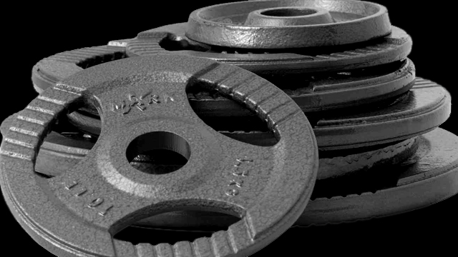
EV Conversion Objectives
Notes:
Meet the SAE CSC Safety Standards
Surpass a pure electric range of 10 mi / 25 km so it can be used in practical applications
Have a dry sled weight of < 350 kg
Cold start to 100 ft in < 40 sec.
Draw Bar Pull of 350 lbs/ 150 kg in order to carry equipment in remote regions
Provide safe electric powertrain to integrate fuel cell concept

Slide 5
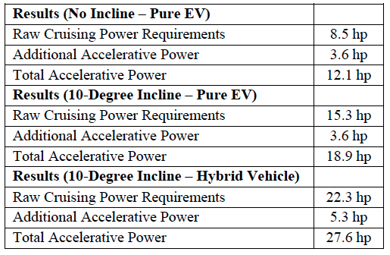
Power Requirements/Calculations
Notes:
Did calculations to find power required for different possible cases in order to make the snowmobile useful in many areas
Cruising at constant velocity plus accelerating to that needed about …
Same calculations for 10 degree incline with …
For hybrid vehicle with additional systems that add weight the necessary horsepower required was …

Slide 6
Motor selection: Ac
Less intensive transmission conversion
Higher energy conversion efficiency
More compact
Longer lifetime and higher reliability
Notes:
DC motors often require more maintenance and have a shorter lifetime when compared to AC motors
DC motors cannot run as high in rpm due to the brushes
DC motors don’t require energy conversion losses that AC motors undergo in electric vehicle applications
AC motors are naturally more compact, rugged, and have increased lifetimes when compared to DC motors
An AC motor’s primary advantage when applied to electric vehicles comes down to its ability to provide a high torque output over a much larger range of rpm
fixed gear ratio can be used without sacrificing performance
Comparing an AC motor to an equivalent DC motor in power output at a specified rpm, the AC motor will be more efficient

Slide 7
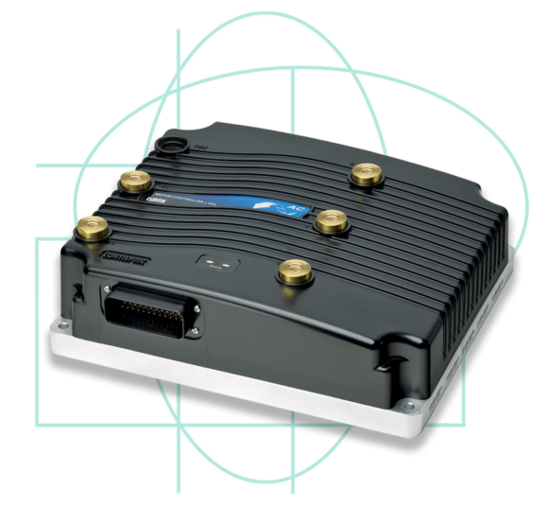
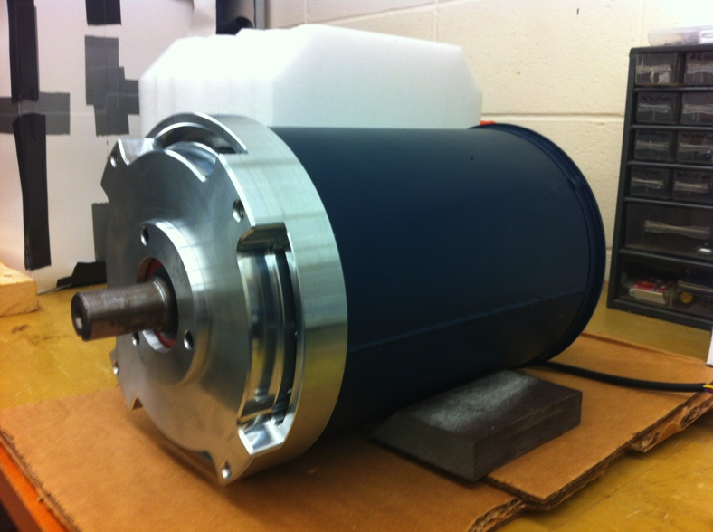
Motor and motor Controller
AC – 35 by HPEVS
Curtis 1238-R
Notes:
89% conversion efficiency
Three phase AC induction motor with 35 HP max and 10 HP continuous
Programmable motor controller to adjust performance

Slide 8
Gear Ratio/Transmission
Gates Polychain GT Carbon Belt
Direct belt drive
Total gear ratio of 1.4
Easy maintenance
Low Noise
Notes:
Gear ratio designed for fuel cell snowmobile, efficiency of gates is ~98%
A synchronous belt was chosen because of its high efficiency of 98%, and ease of use and it is less noisy in comparison to a chain drive.
The gear ratio of the belt drive is 0.6. Able to meet noise regulations and draw bar pull.
Direct drive chosen because of simplicity and ease of maintenance

Slide 9
Our Li-ion Batteries
25 Dow Kokam Cells
2.7—4.2V, 3.7V Nominal
Pulse Discharge Current 750A
Max Discharge Current 450A
Max Charge Current 225A
Pack Specs:
96 V nominal
6.9 kWh*
Series orientation
* Dependant on operating current
Notes:
Custom made battery pack to reduce costs
High enough capacity to last for decent amount of time

Slide 10
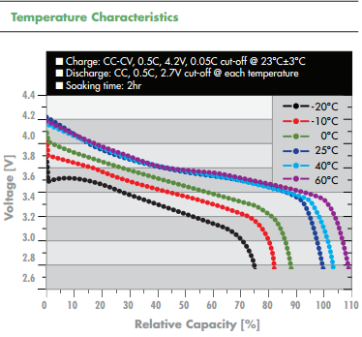
Our Li-ion Batteries
Discharge Temperature ranges from -30˚C/-22˚F to 60˚C/140˚F

Slide 11
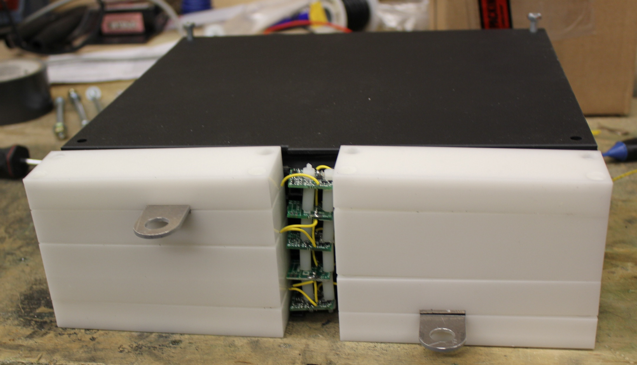
The Battery Pack Assembly
Notes:
White is Delrin Plastic from Dupont is electrically insulative and also UL 94 V-0 Flame Rated

Slide 12
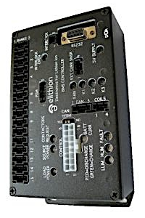
The Battery Management System
Prevents Harmful Battery Conditions by Shutting Down the HV Battery Pack
Distributed system with individual monitoring
Wireless display
Elithion - Lithiumate Pro
Monitors
Cell Voltage
Cell Charge/Discharge
State of Charge
Ambient temperature
Notes:
Used to manage batteries for best performance and battery lifetime

Slide 13
Temperature Monitoring
Notes:
Since the BMS didn’t directly monitor the cell temperature, an arduino board was configured for this purpose. Monitors temperature in order to prevent overheating of batteries

Slide 14
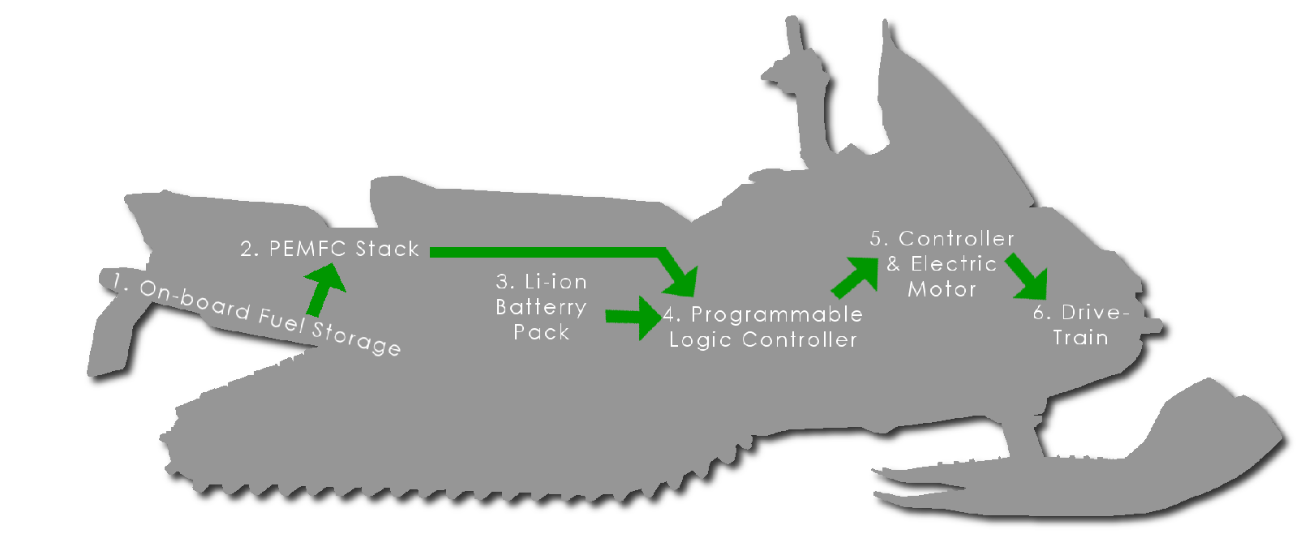
Fuel Cell integration
Notes:
Future goal is to integrate a fuel cell into the design in order to increase the range of the vehicle.

Slide 15
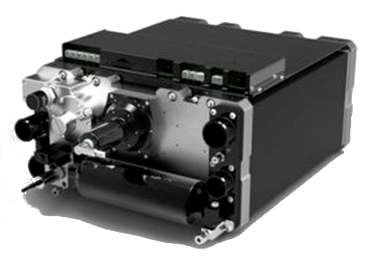
Fuel Cell Options
Polymer Electrolyte Membrane Fuel Cell
Hydrogen as fuel
High efficiency of 55%
Low temperature operation
Adds ~220 km
~7.5 hours runtime
Image From: http://www.directindustry.com

Slide 16
COST estimates
Vehicle Type | Cost (CAD)
FC Snowmobile | ~ $106 000
Battery | ~ $33 000

Slide 17
Performance estimates
 | Hybrid Fuel Cell Snowmobile | Battery Powered Snowmobile
Weight | ~400 kg | ~300 kg
Range | 246 km (150 miles) | 24 km (15 miles)
Time at 30 km/h | 8h 11min | 48min
Notes:
These values are only estimates, no tests have been done to confirm them

Slide 18
Advantages and Disadvantages
Advantages | Disadvantages
Zero Emission | High Cost
Longer Range | Complex System
Safety - Fuel | Lack of Hydrogen Infrastructure
Refill Time | Safety - Electrical
Renewable Fuel | Temperature/Start up Limitations

Slide 19
Our Sponsors

Slide 20
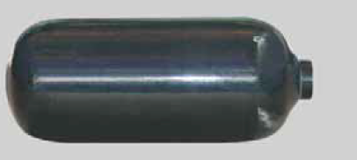
Compressed Hydrogen Tanks
High pressure hydrogen 700 bar (~10 000psi)
Higher the pressure, more capacity and therefore longer range
High performance tanks made from extruded aluminum and externally wrapped in carbon fibre

