Slide 1
Clean snowmobile
Queen's Fuel Cell Team - SAE Clean Snowmobile Challenge 2014

Slide 2
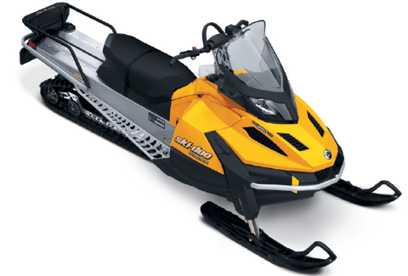
ICE
EV
FCEV
Phase Ο
Phase α
Phase β

Slide 3
Skandic Tundra LT EV Conversion
Engine Specs
600 cc – 2 Stroke
Max RPM of 7250
Fuel Specs
Regular Unleaded
40 L/10.6 Gal. Tank
Hydraulic Breaking
Dry Weight
229 kg/505 lbs.
Notes:
Donated skandic tundra LT from BRP, larger sled in order to accommodate necessary systems involved with proposed fuel cell system

Slide 4
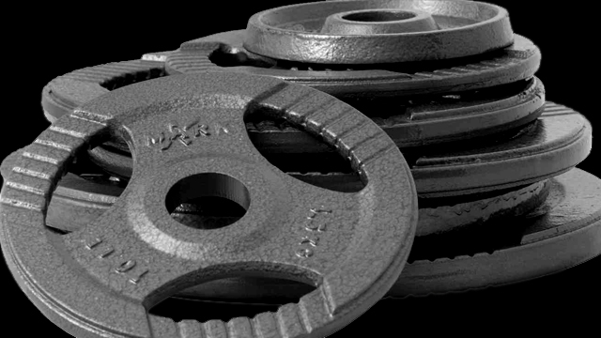
EV Conversion Objectives
Notes:
Meet the SAE CSC Safety Standards
Surpass a pure electric range of 10 mi / 25 km
Have a dry sled weight of < 350 kg
Cold start to 100 ft in < 40 sec.
Draw Bar Pull of 350 lbs/ 150 kg

Slide 5
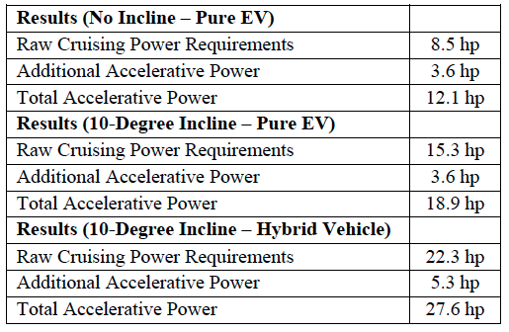
Power Requirements/Calculations
Notes:
Did calculations to find power required for different possible cases
Cruising at constant velocity plus accelerating to that needed about …
Same calculations for 10 degree incline with …
For hybrid vehicle with additional systems that add weight the necessary horsepower required was …

Slide 6
AC vs. DC
Notes:
DC motors often require more maintenance and have a shorter lifetime when compared to AC motors
DC motors cannot run as high in rpm due to the brushes
DC motors don’t require energy conversion losses that AC motors undergo in electric vehicle applications
AC motors are naturally more compact, rugged, and have increased lifetimes when compared to DC motors
An AC motor’s primary advantage when applied to electric vehicles comes down to its ability to provide a high torque output over a much larger range of rpms
fixed gear ratio can be used without sacrificing performance
Comparing an AC motor to an equivalent DC motor in power output at a specified rpm, the AC motor will be more efficient

Slide 7
AC vs. DC
• Less intensive transmission conversion
• Higher energy conversion efficiency
• More compact
• Longer lifetime and higher reliability
Notes:
DC motors often require more maintenance and have a shorter lifetime when compared to AC motors
DC motors cannot run as high in rpm due to the brushes
DC motors don’t require energy conversion losses that AC motors undergo in electric vehicle applications
AC motors are naturally more compact, rugged, and have increased lifetimes when compared to DC motors
An AC motor’s primary advantage when applied to electric vehicles comes down to its ability to provide a high torque output over a much larger range of rpms
fixed gear ratio can be used without sacrificing performance
Comparing an AC motor to an equivalent DC motor in power output at a specified rpm, the AC motor will be more efficient

Slide 8
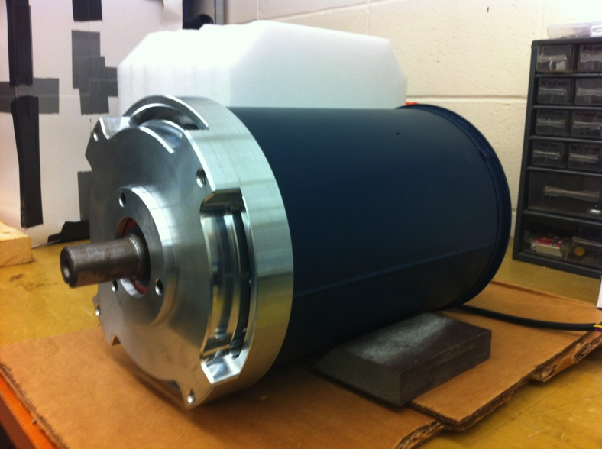
Motor Selection
AC – 35 by HPEVS
Notes:
89% conversion efficiency

Slide 9
Continuous Motor Curves
Notes:
Can see the peak and continuous ratings of motor.
Can see max torque region at low rpm, drops off after around 3000 rpm
Max continuous power of around 30hp

Slide 10
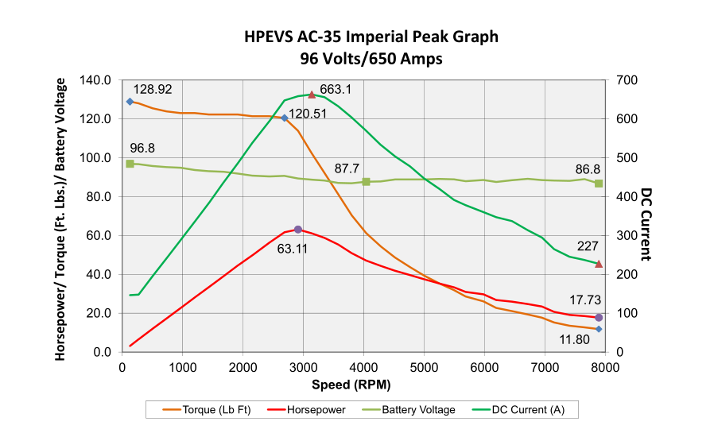
Peak Motor Curves
Notes:
Can see the peak and continuous ratings of motor.
Can see max torque region at low rpm, drops off after around 3000 rpm
Max power at about 60hp, can’t maintain

Slide 11
Gear Ratio/Transmission
Gates Polychain GT Carbon Belt
Direct belt drive
Total gear ratio of 1.4
Notes:
Gear ratio designed for fuel cell snowmobile, efficiency of gates is ~98%, A synchronous belt was chosen because of its high efficiency of 98%, and ease of use and it is less noisy in comparison to a chain drive. The gear ratio of the belt drive is 0.6. Able to meet noise regulations and draw bar pull.

Slide 12
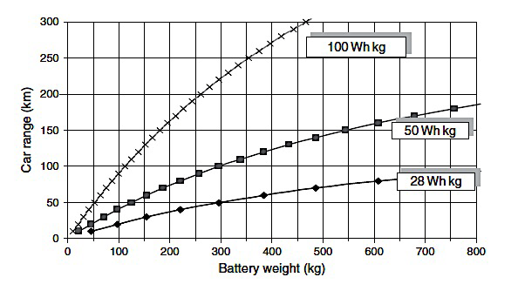
Battery Chemistry Selection
Pistoia, G., "Battery Operated Devices and Systems - From
Portable Electronics to Industrial Products," Elsevier, 2009.

Slide 13
Battery Type | Lead Acid | Ni Cad | Ni MH | Li-Ion
Battery Voltage | 2.1 V | 1.25 V | 1.2 V | 3.7 V
Pros | Superior long-term reliability Most Economical | High mechanical strength High efficiency charge Good cold weather discharge | No heavy metals Relatively high capacity Better energy density than NiCad and Lead Acid | No memory effect Low self-discharge Very high energy density Superior cycling abilities Good cold weather discharge capabilities
Cons | Low cycle life Low energy density High self-discharge in flooded batteries Poor low temperature discharge abilities | Low energy Memory effect Toxicity High self-discharge especially in sealed cells | More expensive than Ni-Cad Very high self-discharge (more than Ni-Cad) | The most expensive Safety problems Requires control of charge/discharge limits Degrades at high temperatures
Battery Chemistry Selection

Slide 14
Why Li-ION Batteries
• Highest energy density
• No memory effects
• Low self-discharge
• Superior cycling abilities
Superior Cold-Start Capabilities

Slide 15
Our Li-ion Batteries
25 Dow Kokam Cells
2.7—4.2V, 3.7V Nominal
Pulse Discharge Current 750A
Max Discharge Current 450A
Max Charge Current 225A
Pack Specs:
92.5 V nominal
6.9 kWh*
* Dependant on operating current
Notes:
Duplicate this slide for more content based slides – the default ‘new slide’ doesn’t work. I recommend keeping titles concise to fit in the given space.

Slide 16
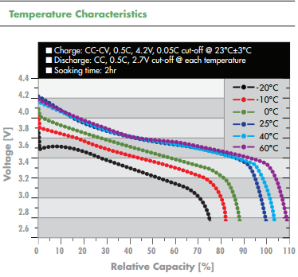
Our Li-ion Batteries
Discharge Temperature ranges from -30˚C/-22˚F to 60˚C/140˚F

Slide 17
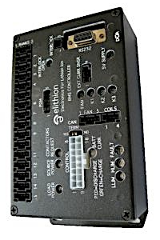
The Battery Management System
Prevents Harmful Battery Conditions by Shutting Down the HV Battery Pack
Elithion - Lithiumate Pro
Monitors
Cell Voltage
Cell Charge/Discharge
State of Charge
Notes:
Duplicate this

Slide 18
Temperature Monitoring
Notes:
Since the BMS didn’t directly monitor the cell temperature, an arduino board was configured for this purpose

Slide 19
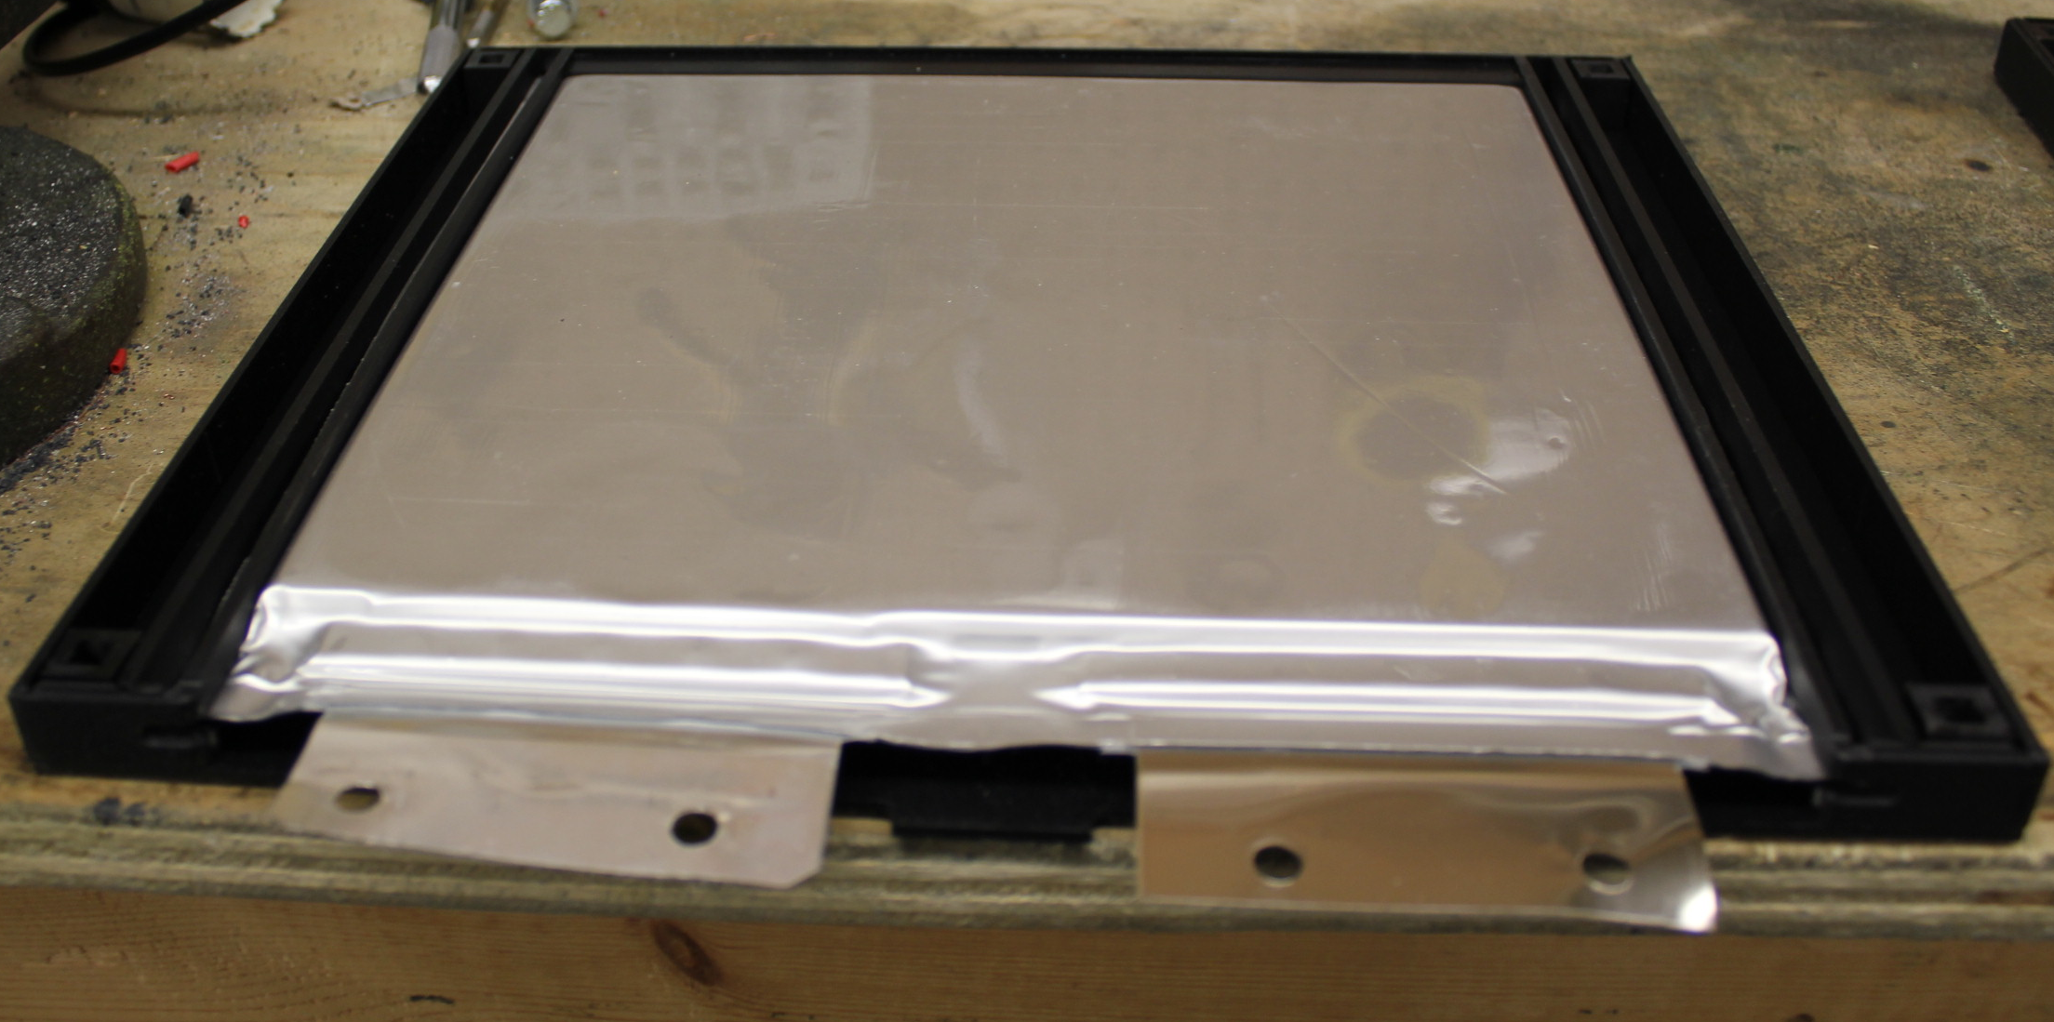
The Battery Pack Assembly
Notes:
Black Boltaron electrical insulative and UL 94 V-0 flame rated sleeves for each cell

Slide 20
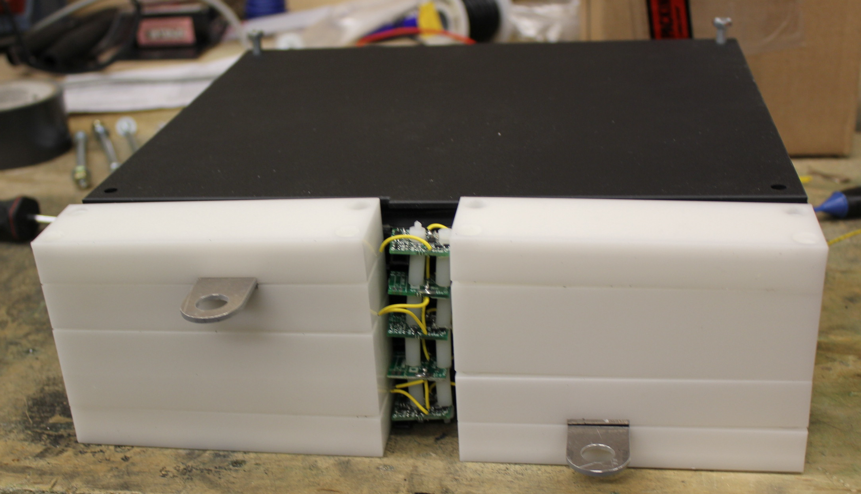
The Battery Pack Assembly
Notes:
White is Delrin Plastic from Dupont is electrically insulative and also UL 94 V-0 Flame Rated

Slide 21
MSRP & COST
Vehicle Type | Cost (CAD)
FC Snowmobile | ~ $106 000
Battery | ~ $33 000

Slide 22
Our Sponsors

