Slide 1
University of Wisconsin – Platteville 2019 SI Snowmobile Team
Presenters:
Camden Stoppleworth
Micheal Duenk

Slide 2
Snowmobile Selection
Engine Type​ | 4-Stroke GTDI​
Engine Details​ | Liquid Cooled ​ Ford 1.0 L EcoBoost​
Cylinders​ | 3​
Displacement​ | 999cc​
Bore x Stroke (mm)​ | 71.9 mm X 82.0 mm​
Fueling​ | Direct Injection​
Chassis:
2017 Arctic Cat ZR 7000
Engine:
Ford 1.0 L EcoBoost

Slide 3
Design Goals
Clean
Modern engine
Exhaust
Quiet
Custom Camso track
Efficiency
Engine management
Driveline improvements
Flex Fuel
Ethanol compatability of
0-85%
User Friendly
Simple display and controls
Easy starting
Low-maintenance

Slide 4
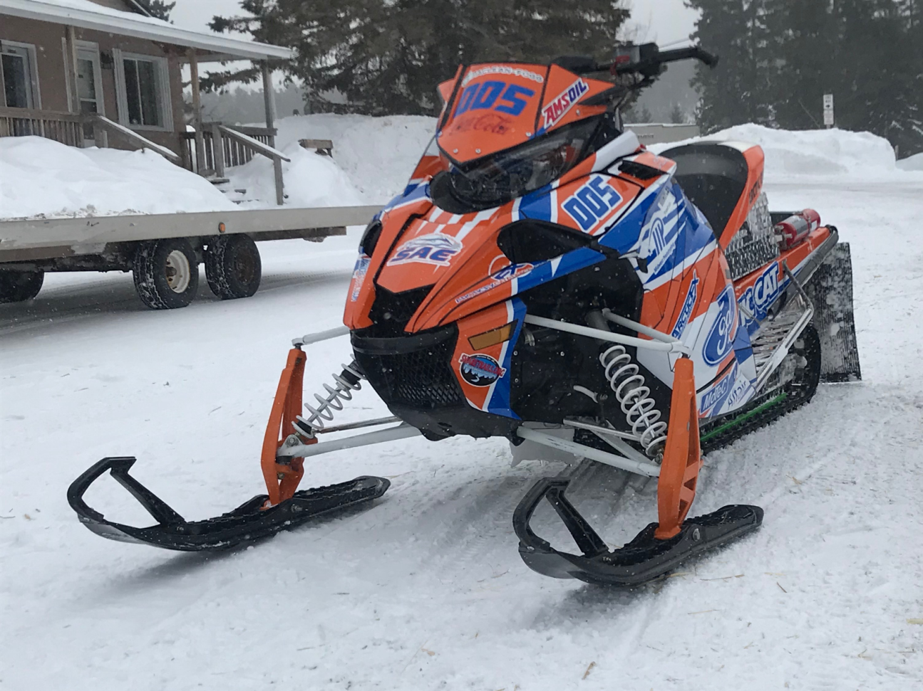
Team Goals
Stock appearance
Lower engine operating RPM
Reduce emissions
Decrease intake and driveline noise
Driveablility

Slide 5
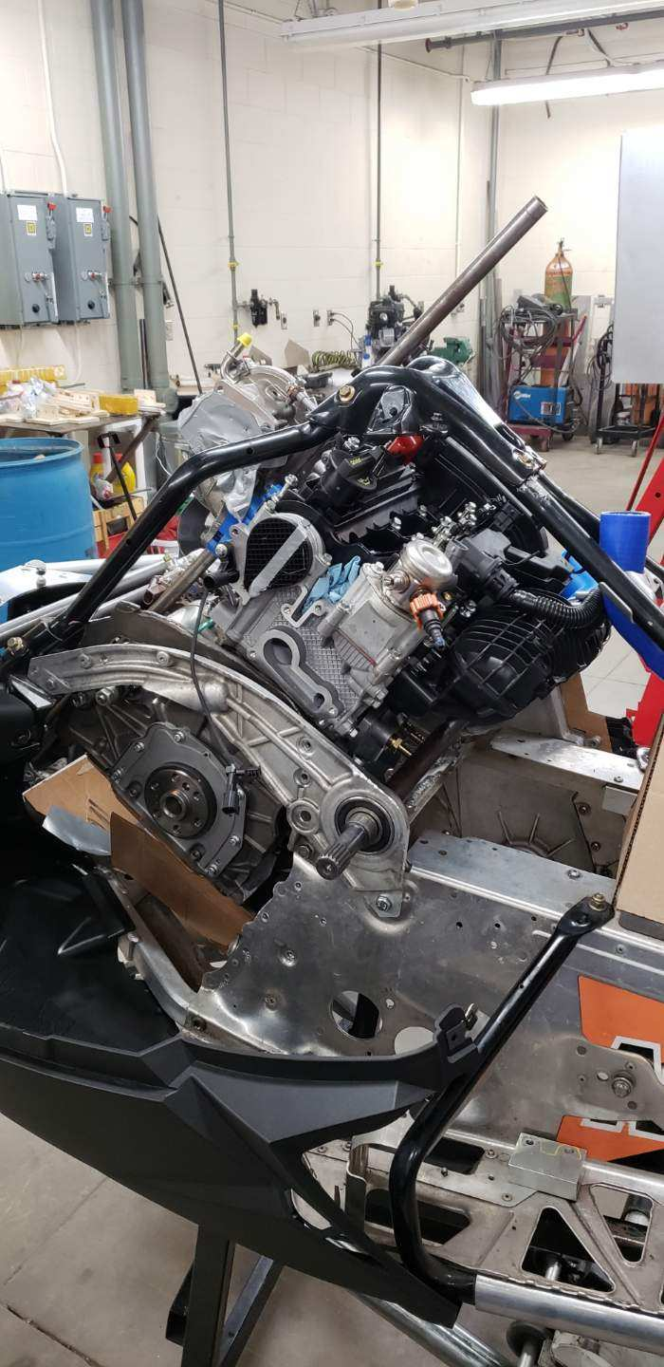
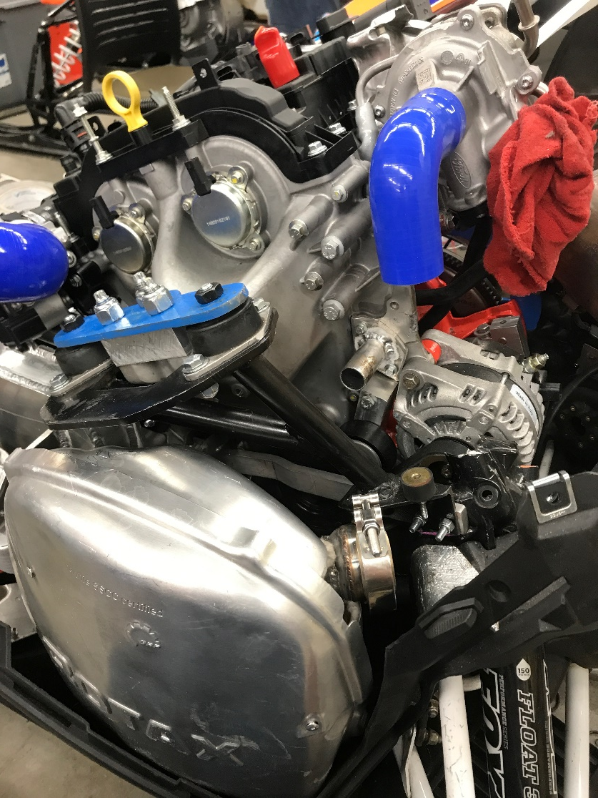
Stock Appearance
2017 ZR 7000
Yamaha Sidewinder panels
Engine orientation
Exhaust/intake routing

Slide 6
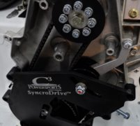
Lower Operating RPM
Gear ratio change
2.03:1 to 1.25:1
45 MPH cruising RPM
4500 RPM from 2018
3000 RPM currently

Slide 7
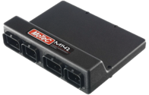
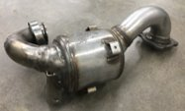
Reduced Emissions
Catalyst
Ford 3-way catalytic converter
Placement near turbocharger outlet
Engine Selection
Ford 1.0L Ecoboost
Variable Cam timing
Direct Injection
Turbocharged
Engine Management
Motec M142 ECU
Data logging
Variable cam control
Direct injection capable

Slide 8
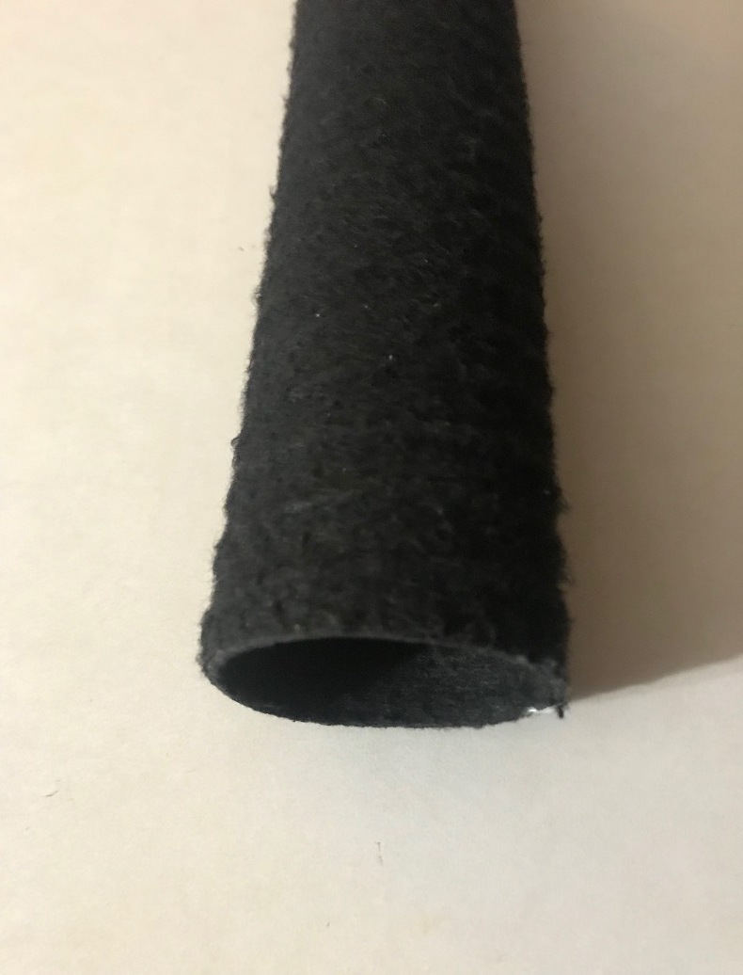
Noise Mitigation
Rotax 900 ACE silencer
Camso quiet ramp track
Introvert drivers
Porous acoustic ducting

Slide 9
Camso Track

Slide 10
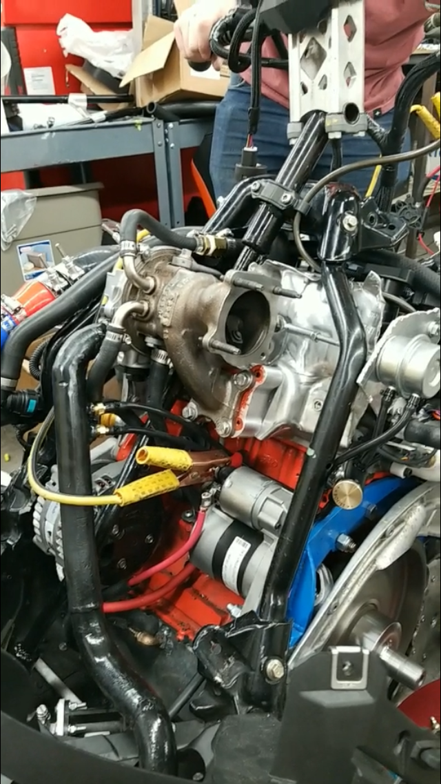
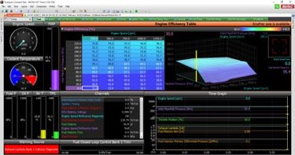
Drivability
Engine calibrations
Clutch tuning
Gear ratio change
Mechanical steering
Stock frog joint

Slide 11
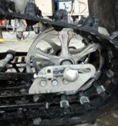
Driveline
Rear Wheels
Replaced stock rear idler wheels with 10” diameter billet aluminum wheels
Graphite Infused Slides
Track
Custom Camso Ice Attak XT
Ported
Quiet Ramp Technology
In-lug Studs
Single ply
Idler Wheels & Placement

Slide 12
Consumer Appeal
Low Maintenance
No valve adjustment
Timing belt
Belt Drive
Low Operating Cost
Fuel mileage
Comfort
Reliability
Engine life
Diagnostics & sensors
High Performance
Variable Cam timing
Turbocharged

Slide 13
Summary
Consumer Benefits​
Reliable​
Competitive Cost​
MSRP of $18,412.70 USD
Environmental Benefits​
Low Emissions​
Quiet​
Fuel Efficient​

Slide 14
Thank You

