Slide 1
University of Wisconsin-Platteville Clean Snowmobile
Internal Combustion

Slide 2
Design Improvements
Improved steering system
Lower Severity and probability of failure
Over structure redesign
Snug to the engine
Increase strength
Under seat fuel cell
Lower center of gravity
Flex Fuel Capable
Ethanol 0-85%
Engine controls
Variable cam control
Smart alternator control

Slide 3
Chassis and Engine
Chassis: 2017 Arctic Cat ZR 7000 LXR
Engine Specifications:
Manufacture | Ford Motor Company
Stroke | 4 Stroke
Cooling | Liquid Cooling
Number of Cylinders | 3
Displacement | 999cc
Bore x Stroke (mm) | 71.9mm x 82.0
Fuel Delivery | High Pressure Direct Injection

Slide 4
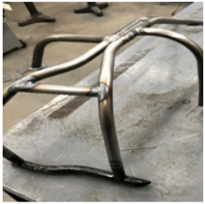
Over Structure
Custom X-Brace to support chassis and protect engine

Slide 6
Engine Benefits
Ethanol Content Fuels
Variable Cam Timing
100 ft-lbs of Torque from 1500 to 6000 rpm
Average of 100 hp
Ford 1.0 L EcoBoost
Improved Reliability
Direct Injection
International Engine of the Year:
2012,2013,2014
1.0 L Engine of the Year
2012,2013,2014,2015,2016,2017
World Wide Parts and Technical Support

Slide 7
Driveline Enhancements
Specialty Motorsport Belt Drive System
12 Pounds in Weight Reduction
Rear 10’’ Diameter Billet Aluminum Wheels
Graphite Infused Slides
Idler Wheels Placement

Slide 8
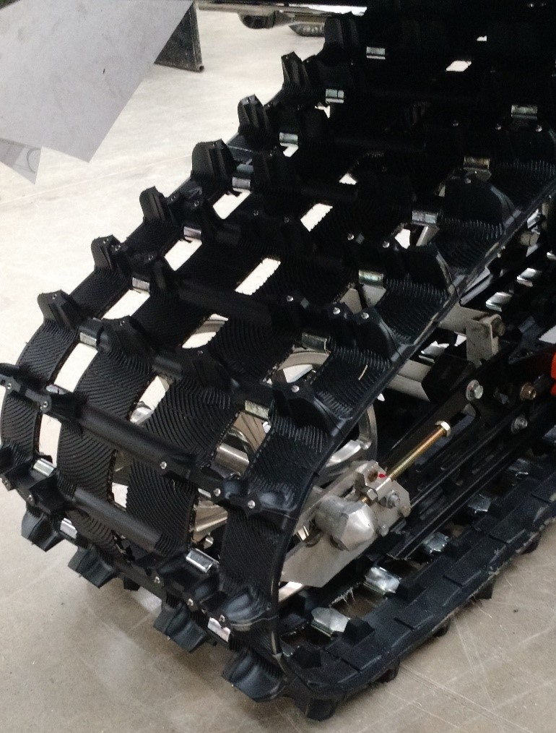
Ice Attack XT Track
Custom Camso Ported Track
Single ply for reduced weight
Quite Ramp Technology
In-lug Studs for Superior Traction and Braking Control

Slide 9
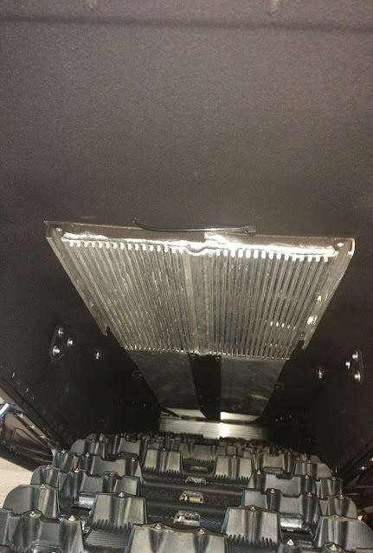
Noise Reduction
Arctic Cat ZR 7000 Muffler for Reduced Noise Pollution
Custom Airbox to limit intake noise
Tunnel Undercoating

Slide 10
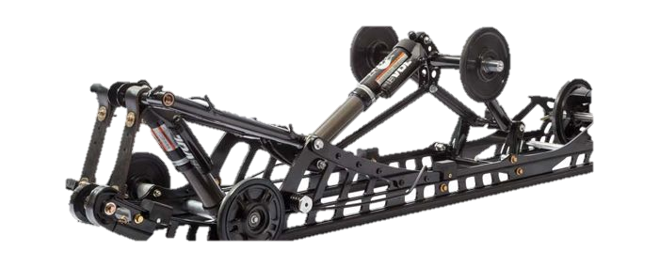
Suspension
Easily Adjustable
Wide Stance for greater stability
Floating Front Rear Suspension
Increased Traction
Better cornering

Slide 11
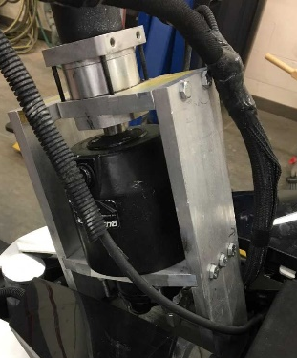
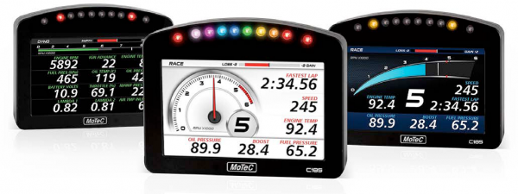
Controls and Displays
Hydraulic Steering for reduced rider fatigue
Utilizes Mercury Helm and Cylinder
4 to 1 Gear box ratio
Motec C125 Full Color
Ability to monitor all engine systems

Slide 12
Consumer Appeal
Rider Forward
Reliability
Engine Life
Diagnostics & Sensors
Performance
Turbo Charged
0-60 Time: 4.5 seconds
Low Maintenance
Reduced Oil Changes
Belt Drive
Lower Operating Cost
Part readily available
Fuel Mileage
13 Miles Per Gallon on E85
16 Miles Per Gallon on E15

Slide 13
Dealer Appeal
Sales
Marketable
Performance
Reliability
MSRP: 18,811.67 USD
Service
Parts Availability
Easy to work on

Slide 14
Acknowledgements and Questions
We would like to thank you all for taking time to listen to our presentation.
Any Questions?

