Slide 1
University of Wisconsin - Platteville 2017 Clean Snowmobile Team
Presenters:
Will Bryant
Isaac (Chuck) Peterson

Slide 2
Snowmobile Choice
Chassis: 2017 Arctic Cat ZR 7000 LXR
Engine: Ford 1.0 L EcoBoost
Engine Type | 4-Stroke GTDI
Engine Details | Liquid Cooled Ford 1.0 L EcoBoost
Cylinders | 3
Displacement | 999cc
Bore x Stroke (mm) | 71.9 mm X 82.0 mm
Fueling | Direct Injection

Slide 3
Design Strategy
Clean
Modern engine
Exhaust
Quiet
Undercoating
Custom Camso track
Efficiency
Engine management
Driveline improvements
Flex Fuel
Ethanol 0-85%
User Friendly
Ergonomic rider position
Simple display and controls
Easy starting
Adjustable suspension

Slide 4
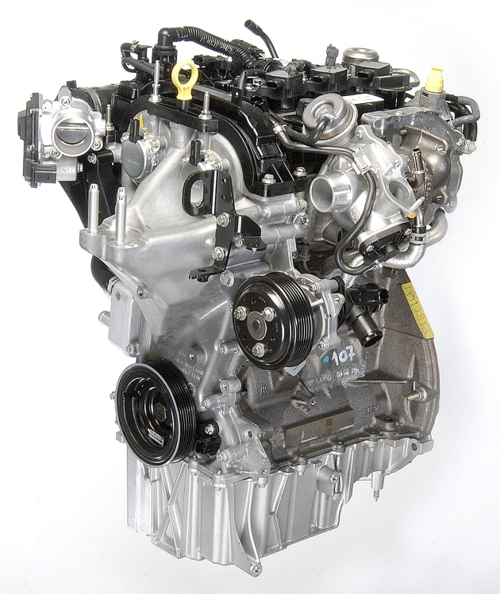
Engine Selection
Ford 1.0 L EcoBoost
Variable Cam timing
Direct Injection
Average 120 hp
International Engine of the Year:
2012, 2013, 2014
1.0 L Engine of the Year:
2012, 2013, 2014, 2015, 2016

Slide 5
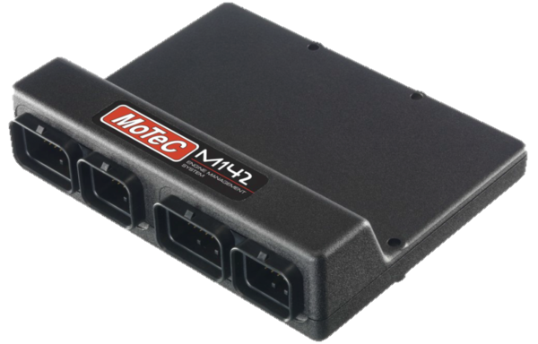
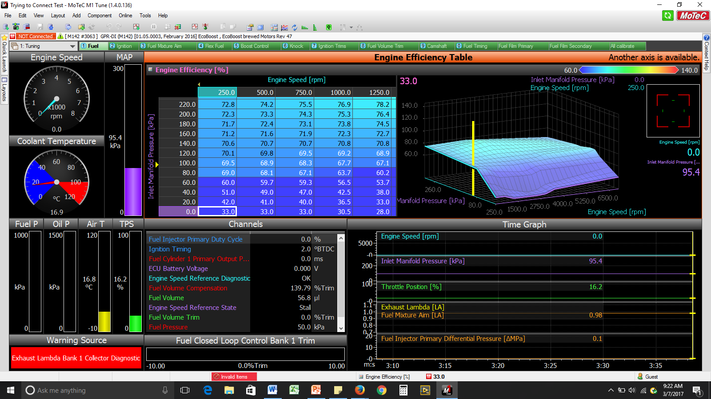
Engine Management
Motec M142 ECU
Direct injection
Data logging
Variable cam control
High quality connectors

Slide 6
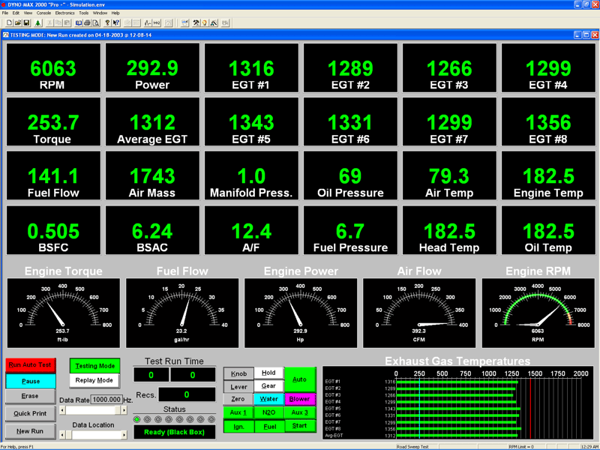
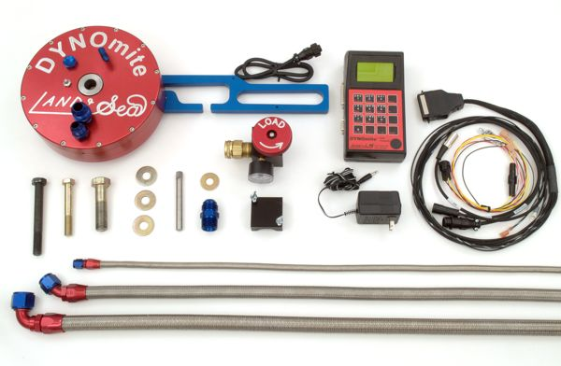
Engine Tuning and Calibration
DYNOmite Water-Brake Dynamometer
Motec LTC Wideband Monitering
Exhaust Gas Temperature
EMS Emissions Analyzer

Slide 7
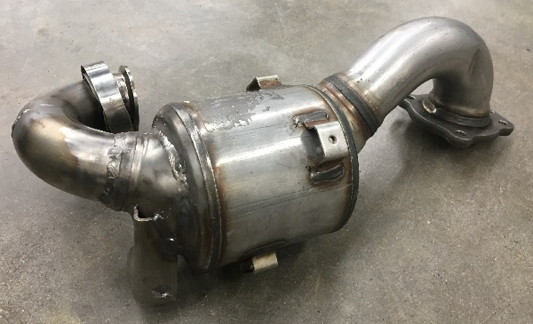
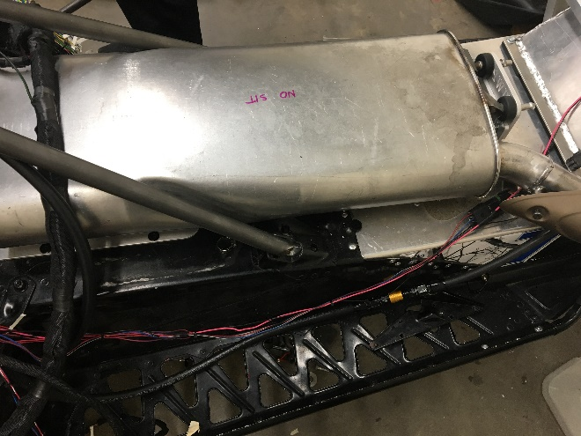
Exhaust System
Reducing Emissions
Ford 3-Way Catalytic Converter
Catalyst placement
Advantages
Tailored to specific exhaust frequencies and flow requirements
Integrated and cooled exhaust manifold
No maintenance

Slide 8
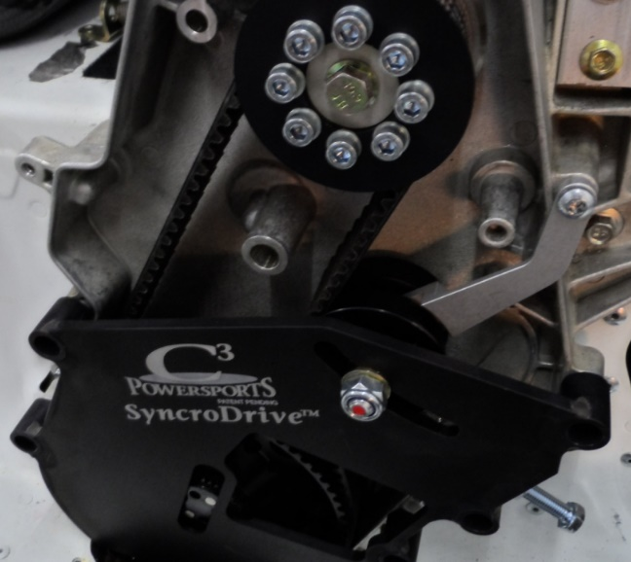
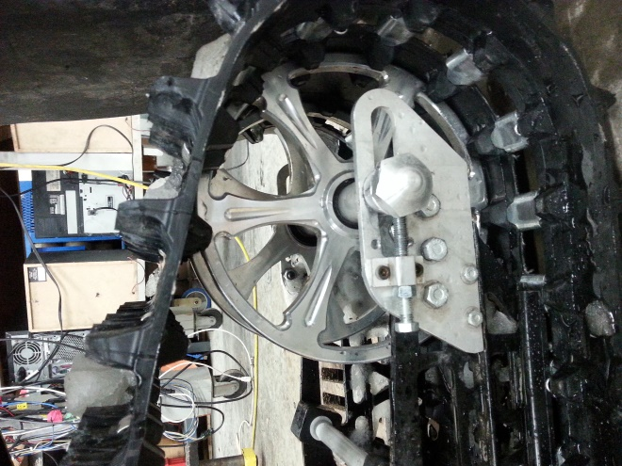
Driveline Improvements
Belt Drive System
C3 Powersports
Replaced Stock Rear Idler Wheel with 10” Diameter Billet Wheels
Graphite Infused Slides
Track
Custom Camso Ice Attak XT
Ported
Quiet Ramp Technology
In-lug Studs
Idler Wheels & Placement

Slide 9
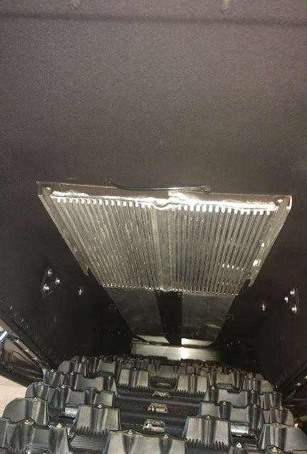
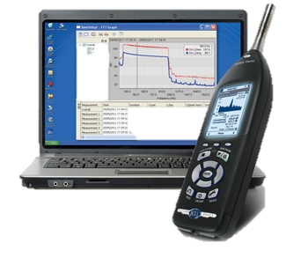
Sound Attenuation
Tailored exhaust system
Custom track
Bogie wheels staggered and phased
Undercoating
Performed SAE J1611

Slide 10
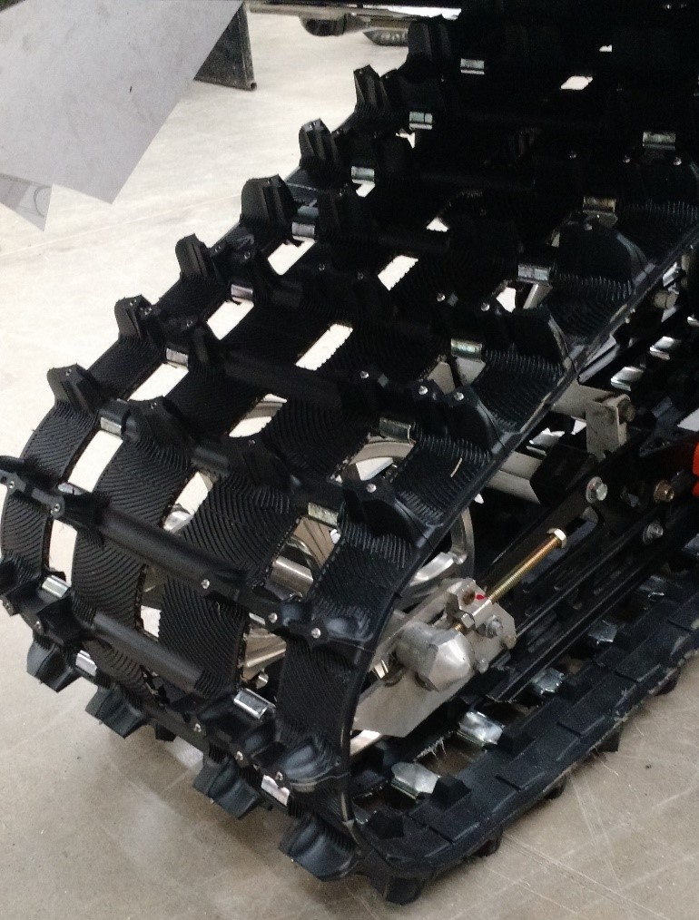
Track Porting Justification

Slide 11
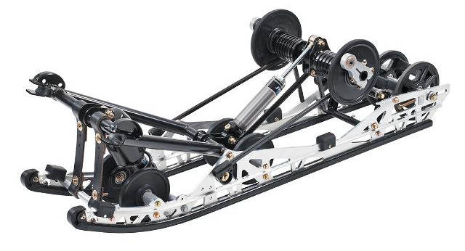
Suspension
Easily Adjustable Suspension
Floating Front Rear Suspension
Improved control
Better traction

Slide 12
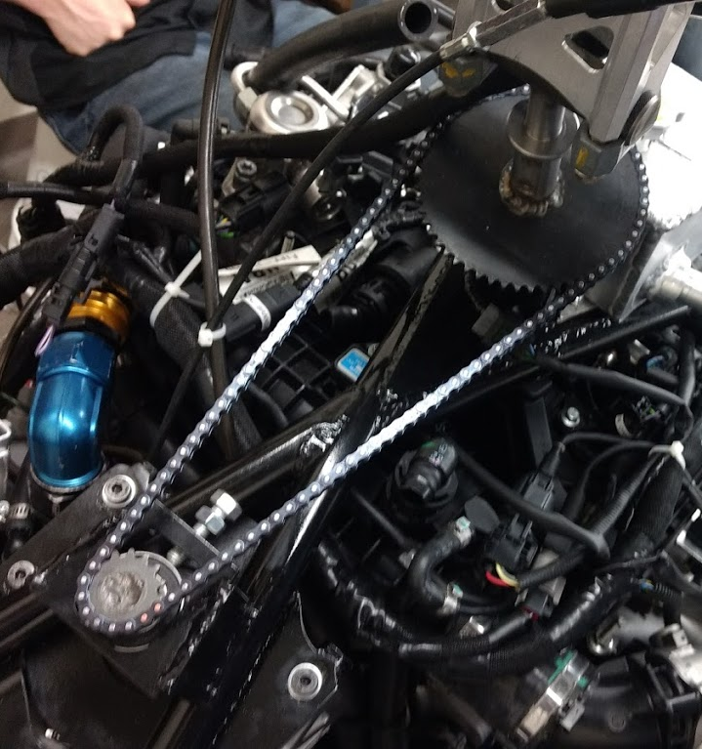
Steering System
Mercury hydraulic helm and cylinder
Reduced rider fatigue - feedback
Replicates stock steering functionality
Future plans
Double chain
Shorter steering stem
Steer-by-wire
Industry future

Slide 13
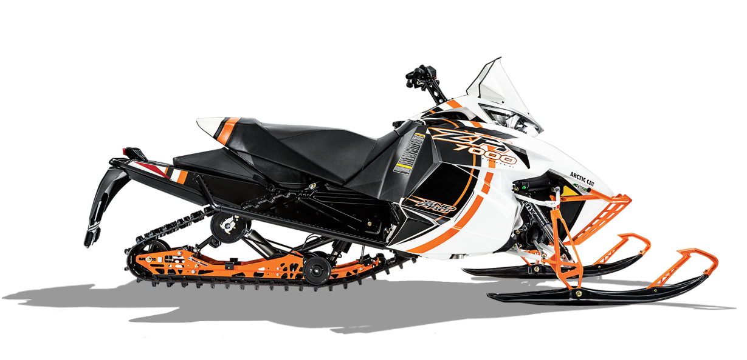
Consumer Appeal
Low Maintenance
No valve adjustment
Timing belt
Belt Drive
Low Operating Cost
Fuel mileage
Comfort
Reliability
Engine life
Diagnostics & sensors
High Performance
TrailTrac
Variable Cam timing
Turbocharged

Slide 14
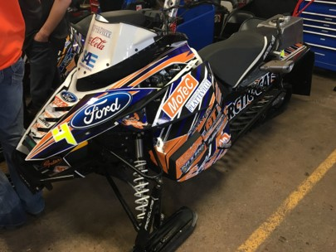
Dealer Appeal
Sales
Marketable to consumers
Aesthetics
Performance
Service
Worldwide dealer network
Ease of maintenance

Slide 15
Summary
Consumer Benefits
Reliable
Competitive Cost
$16,707.09 USD MSRP
Dealer Benefits
Environmental Benefits
Low Emissions
Quiet
Fuel Efficient

Slide 16
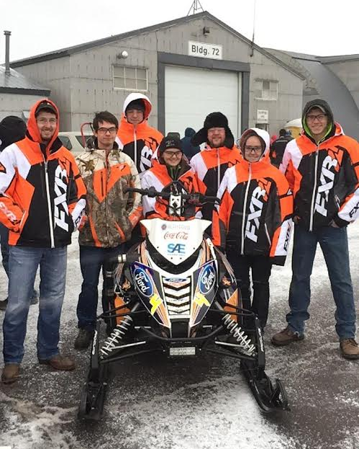
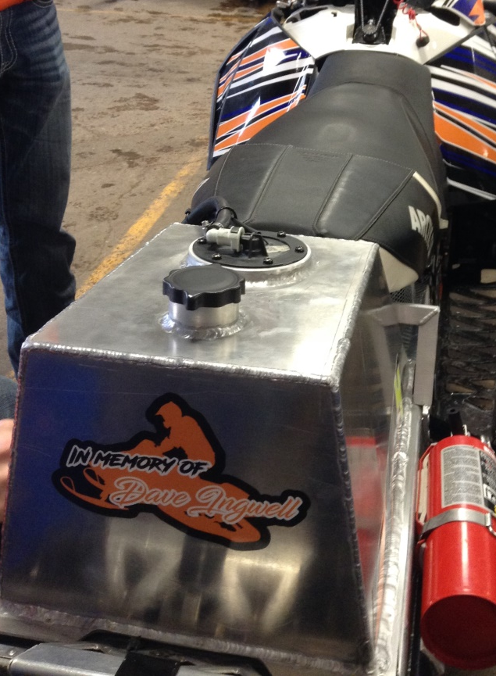
Thank You!
Questions?

