Slide 1
University of Wisconsin - Platteville 2015 Clean Snowmobile Team
Presenters:
Ozzie Goodman
Zak Parker

Slide 2
Design Objectives
Create Efficient Snowmobile Fueled by 16%-32% Isobutanol
Emissions Reductions
Noise
Exhaust
Maintain Stock Riding Qualities
Performance
Comfort

Slide 3
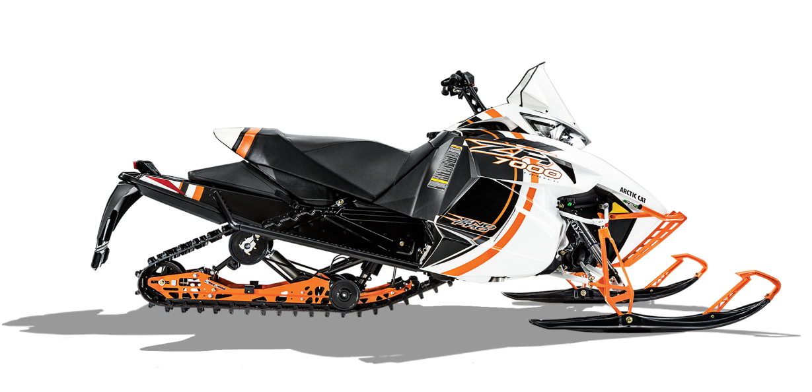
Consumer Appeal
Low Maintenance
Low Operating Cost
Fuel Mileage
Comfort
Ergonomics
Reliability
High Performance
TrailTrac

Slide 4
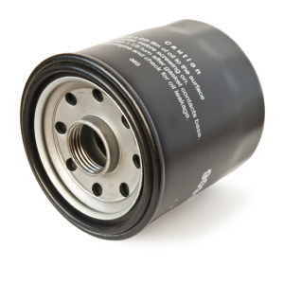
Dealer Appeal
Sales
Marketable to consumers
Aesthetics
Performance
Comfort
Service
Readily available parts
Ease of Maintenance

Slide 5
Snowmobile Choice
Chassis: 2014 Arctic Cat ZR 7000 LXR
Model: ProCross
Engine Type | 4-Stroke
Engine Details | Liquid Cooled Genesis 130FI
Cylinders | 3
Displacement | 1049 cc
Bore x Stroke (mm) | 82mm X 66.2mm
Exhaust | Single
Fueling | Electronic Fuel Injection

Slide 6
Design Strategy
Efficiency
Engine Management
Driveline Improvements
Clean
Engine Selection
Custom Exhaust
Quiet
Sound Deadening Material
Flex Fuel
Isobutanol mix 16%-32%
User Friendly
Ergonomic Rider Position
Trail Performance Related
Simple Display and Controls
Easy Starting
Adjustable Suspension

Slide 7
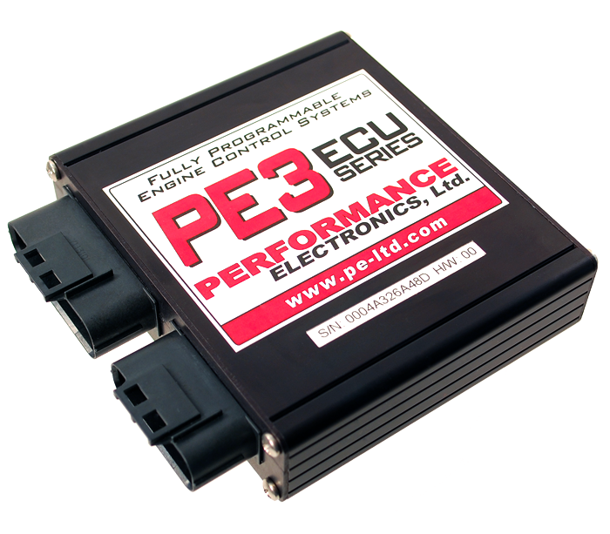
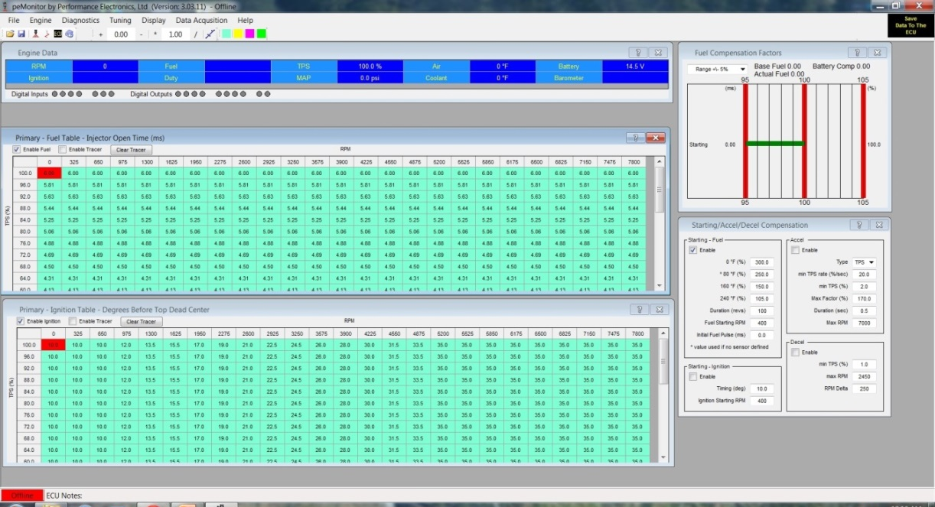
Engine Management
Performance Electronics Stand Alone ECU
User Friendly
Wi-fi Tuning Capabilities

Slide 8
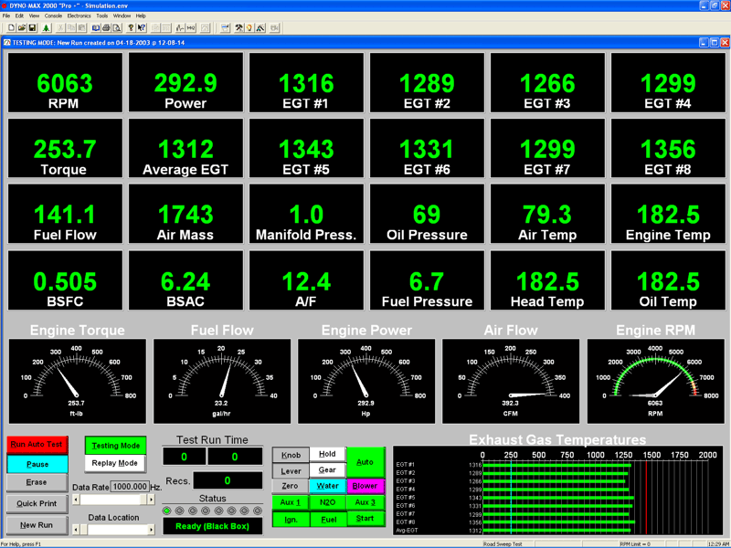
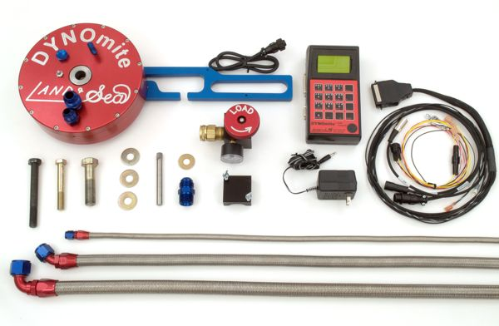
Engine Tuning and Calibration
DYNOmite Water-Brake Dynamometer
AFX Wide Band AFR Monitor
Exhaust Gas Temperatures
EMS Emissions Analyzer

Slide 9
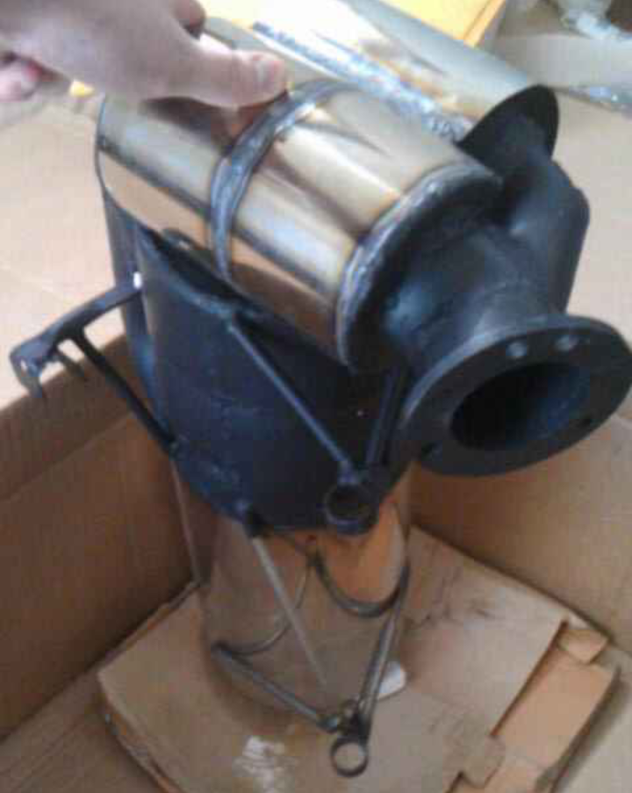
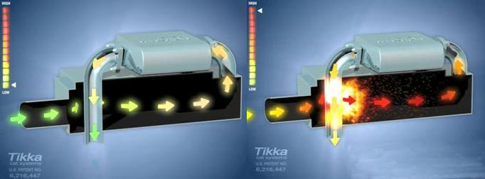
Environmental Benefits
Reducing Emissions
Tikka Race
Pre-Burn Catalytic System
Pre-Cats
Main Cat
Advantages
Maintains Stock Back-Pressure
Replaces Previous Muffler
No Maintenance

Slide 10
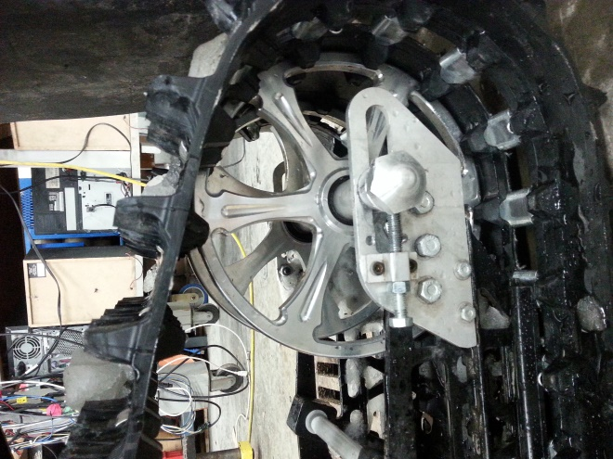
Driveline Improvements
Belt Drive System
C3 Powersports
Replaced Stock Drivers
Proline Roller Drivers
Replaced Stock Rear Idler Wheel with 10 Inch Diameter Billet Wheels
Dupont Teflon Slides
Track
Camoplast Ice Attak XT
Added Bogie Wheels (8)

Slide 11
Design of Experiment: Driveline Improvements
-1 stock A: Chain/Belt Sigma: Standard Deviation
+1 Adjusted B: Bogie Wheels
C: Idler/Big Wheel

Slide 12
Design of Experiment: Driveline Improvements
 | A | B | C | AB | AC | BC | ABC
y average (-) | 80.6 | 84.2 | 86.3 | 79.2 | 79.9 | 77.9 | 78.9
y average (+) | 78.4 | 74.7 | 72.6 | 79.8 | 79.0 | 81.0 | 80.1
y(+) - y(-) | -2.2 | -9.5 | -13.7 | 0.6 | -0.9 | 3.1 | 1.2
delta/2 | -1.10 | -4.75 | -6.87 | 0.28 | -0.47 | 1.57 | 0.58
$$y=79.5−1.1A−4.75B−6.87C+0.28AB−0.47AC+1.57BC$$
$$y=79.5−4.75B−6.87C+1.57BC$$

Slide 13
Driveline Improvement Results
Varying Driveline Configurations
Pull Test
Drill Test
Hp lost = (115 Volts)*(Amps)* (0.001341 Hp/W)
Overall Efficiency of 26%

Slide 14
Sound Management
Custom Muffler
Engine Compartment
Polymer Technologies Acoustical Barrier with Absorber
Reduced 7 dB

Slide 15
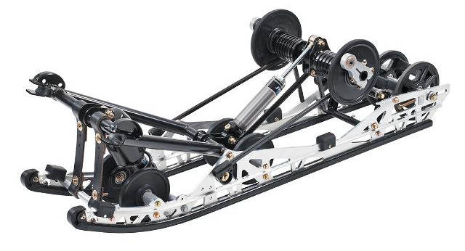
Suspension
Easily Adjustable Front and Rear Suspension
Capable of being tuned for various riding styles
Floating Front Rear Suspension
Improved Control in Small and Large Bumps
Better Traction

Slide 16
Summary
Consumer Benefits
Comfortable / Ergonomic
Easy and fun to ride
Reliable
Competitive Cost
$15,188 USD MSRP
Dealer Benefits
Easy to Sell
Easy to Service
Environmental Benefits
Low Emissions
Quiet

Slide 17
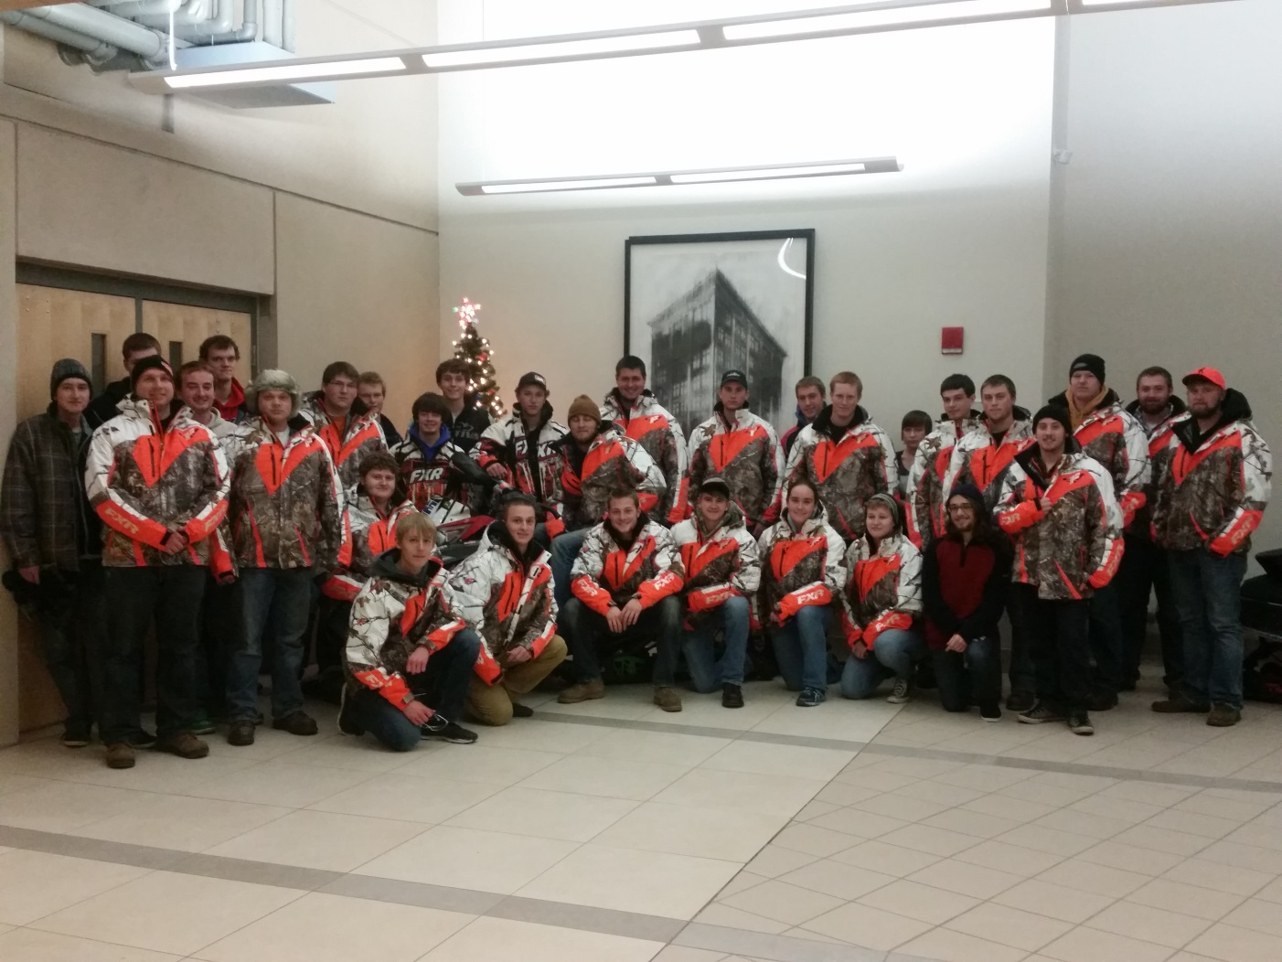
Thank You
Questions?

