Slide 1

University of Wisconsin - Platteville
2014 Clean Snowmobile Team
Presenters:
Niko Bognar
Brandon Krautkramer

Slide 2
Design Objectives
Create Efficient Snowmobile Fueled by 16%-32% Isobutanol
Emissions Reductions
  Noise
  Exhaust
Maintain Stock Riding Qualities
  Performance
  Comfort

Slide 3
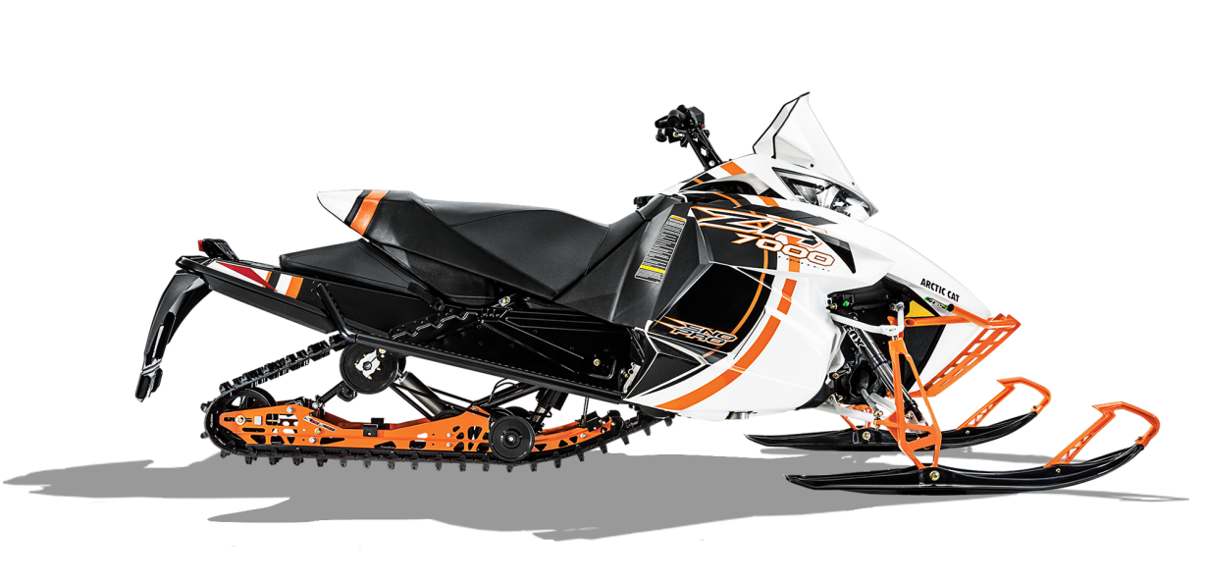
Consumer Appeal
Low Maintenance
Low Operating Cost
  Fuel Mileage
Comfort
  Ergonomics
Reliability
High Performance
  TrailTrac

Slide 4
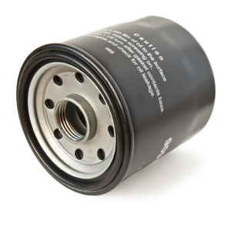
Dealer Appeal
Sales
  Marketable to consumers
    Aesthetics
    Performance
    Comfort
Service
  Readily available parts
  Ease of Maintenance

Slide 5
Snowmobile Choice
Chassis: 2014 Arctic Cat ZR 7000 LXR
Model: ProCross
Engine Type | 4-Stroke
Engine Details | Liquid Cooled Genesis 130FI
Cylinders | 3
Displacement | 1049 cc
Bore x Stroke (mm) | 82mm X 66.2mm
Exhaust | Single
Fueling | Electronic Fuel Injection

Slide 6
Design Strategy
Efficiency
  Engine Management
  Driveline Improvements
Clean
  Engine Selection
  Custom Exhaust
Quiet
  Sound Deadening Material
Flex Fuel
  Isobutanol mix 16%-32%
User Friendly
  Ergonomic Rider Position
  Trail Performance Related
  Simple Display and Controls
  Easy Starting
  Adjustable Suspension

Slide 7
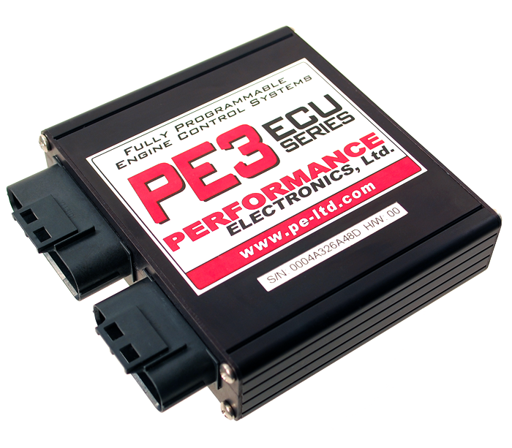
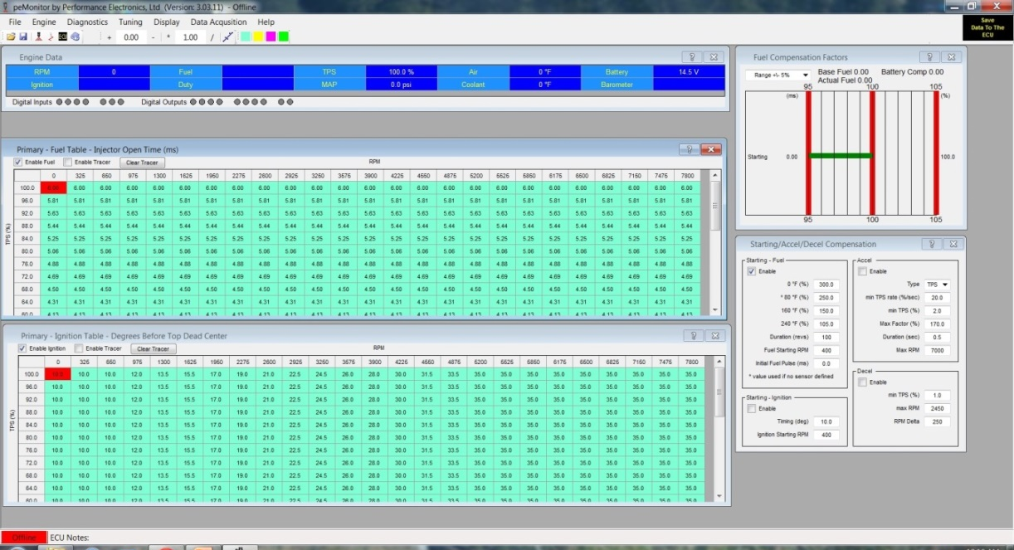
Engine Management
Performance Electronics Stand Alone ECU
  User Friendly
  Wi-fi Tuning Capabilities

Slide 8
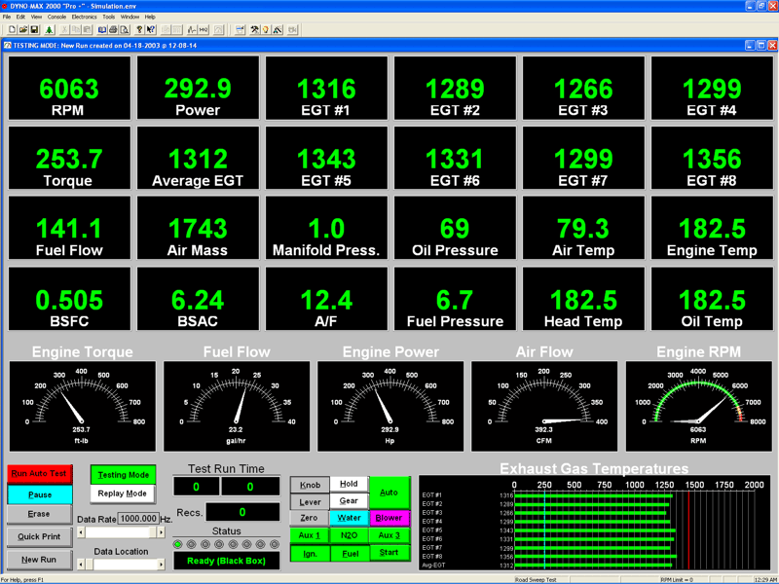
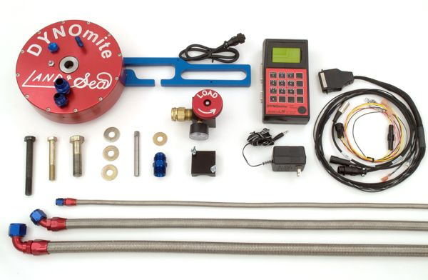
Engine Tuning and Calibration
DYNOmite Water-Brake Dynamometer
AFX Wide Band AFR Monitor
Exhaust Gas Temperatures
EMS Emissions Analyzer

Slide 9
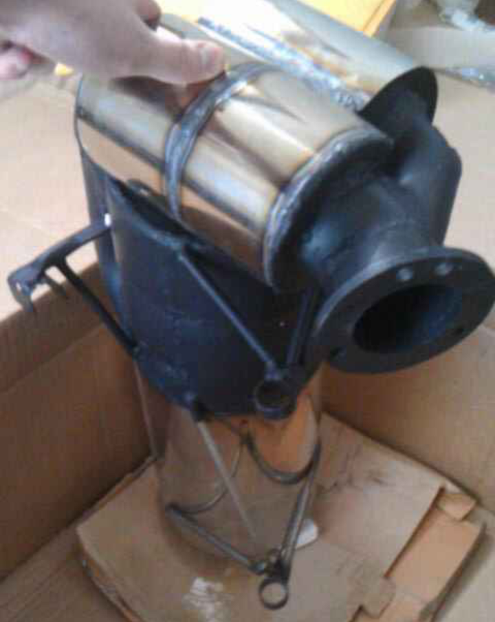
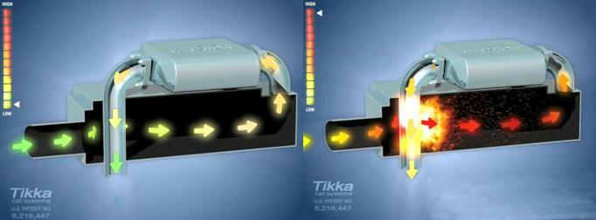
Environmental Benefits
Reducing Emissions
Tikka Race
Pre-Burn Catalytic System
  Pre-Cats
  Main Cat
Advantages
  Maintains Stock Back-Pressure
  Replaces Previous Muffler
  No Maintenance

Slide 10
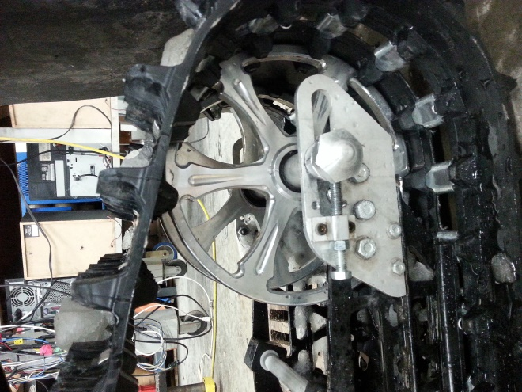
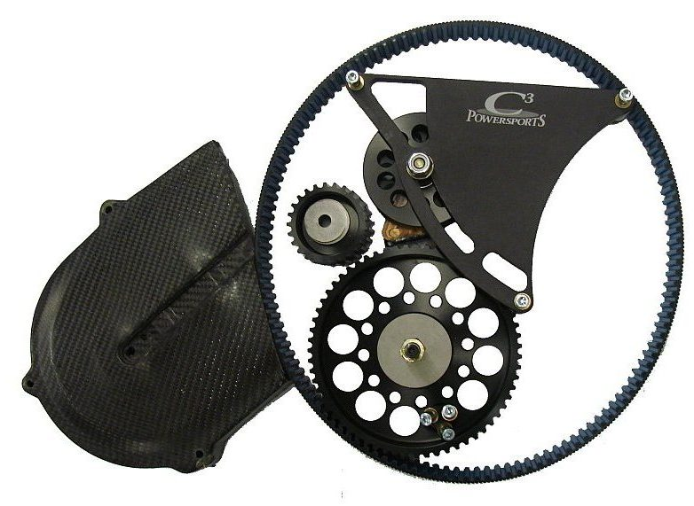
Driveline Improvements
Belt Drive System
  C3 Powersports
Replaced Drivers
  9 Tooth to 10 Tooth
Replaced Stock Rear Idler Wheel with 10 Inch Diameter Billet Wheels
Dupont Teflon Slides
Track
  Camoplast Ice Attak XT

Slide 11
Driveline Improvement Results
Varying Driveline Configurations
Drill Test
  Hp lost = (115 Volts)*(Amps)* (0.001341 Hp/W)
  22% More Efficient
Pull Test
Throttle Position Test
  13.1% Reduction of Throttle Position at Same Speed and Conditions
Modification | % Reduction of TPS
Belt Drive System | 9.26
Big Wheel Kit | 2.12
Dupont Teflon Slides | 1.71
All Modifications Combined | 13.09

Slide 12
Sound Deadening
Custom Muffler
Engine Compartment
  Polymer Technologies Acoustical Barrier with Absorber
Reduced 7 dB

Slide 13
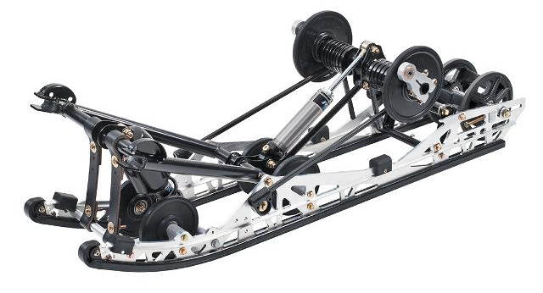
Suspension
Easily Adjustable Front and Rear Suspension
  Capable of being tuned for various riding styles
Floating Front Rear Suspension
  Improved Control in Small and Large Bumps
  Better Traction

Slide 14
Summary
Consumer Benefits
  Comfortable / Ergonomic
    Easy and fun to ride
  Reliable
  Competitive Cost
    $15,411.72 USD MSRP
Dealer Benefits
  Easy to Sell
  Easy to Service
Environmental Benefits
  Low Emissions
  Quiet

Slide 15
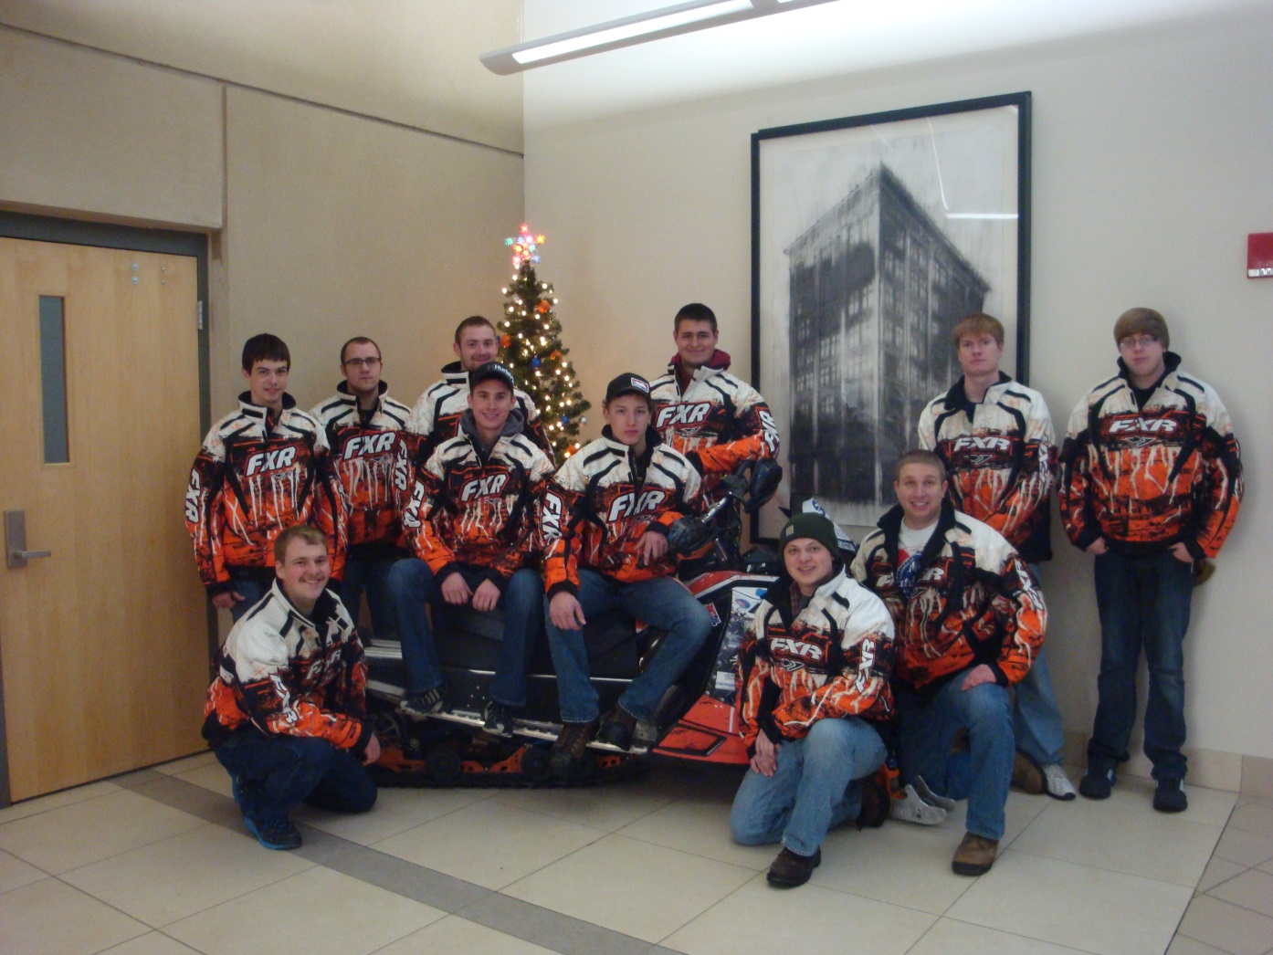
Thank You
Questions?

