Slide 1
University of Wisconsin Platteville 2017 CSC Diesel Team
Presenters:
Brandon Miller
Matt Stedl

Slide 2
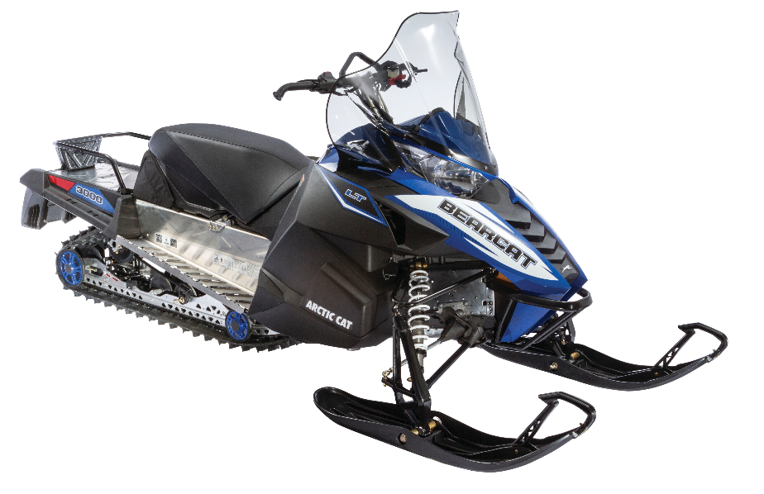
Platform Choice
Chassis: 2017 Arctic Cat Bearcat 3000 LT
Engine Type | 4-Stroke
Engine Details | Liquid Cooled Kubota D902
Cylinders | 3
Displacement | 898 cc
Bore x Stroke (mm) | 72.0 mm X 73.6 mm
Exhaust | Single
Fueling | Indirect Injection

Slide 3
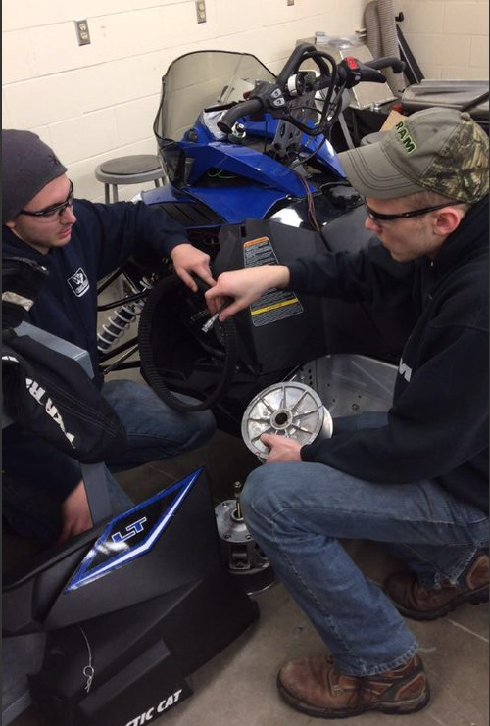
Design Strategy
Clean
Engine selection
Diesel Oxidization Catalyst
Quiet
Undercoating
Sound dampening foam
Efficiency
Driveline improvements
Emissions targeting
Fuel Compatibility
Bio Diesel 0-9%
User Friendly
Ergonomic rider position
Simple display and controls
Motor reliability
Adjustable suspension

Slide 4
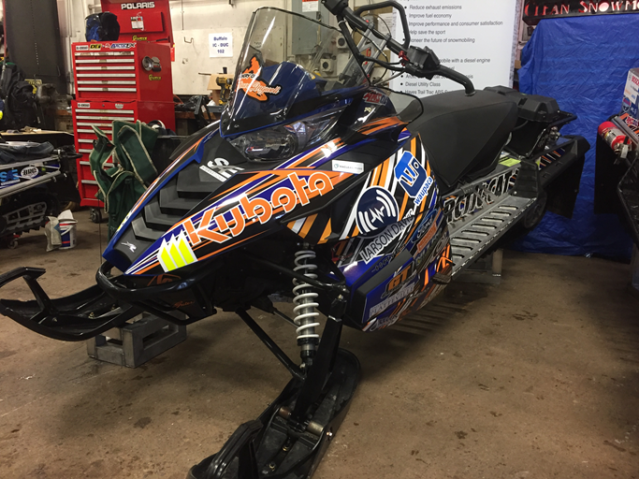
Consumer Appeal
Low Maintenance
Belt drive
Engine oil life
Low Operating Cost
Fuel mileage
Comfort
Reliability
Engine life
Mechanical fuel pumps
Cold Start
Performance
TrailTrac
Towing capabilities
GPS speedometer

Slide 5
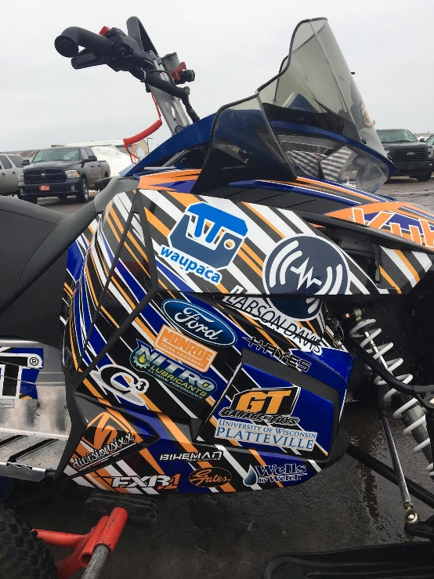
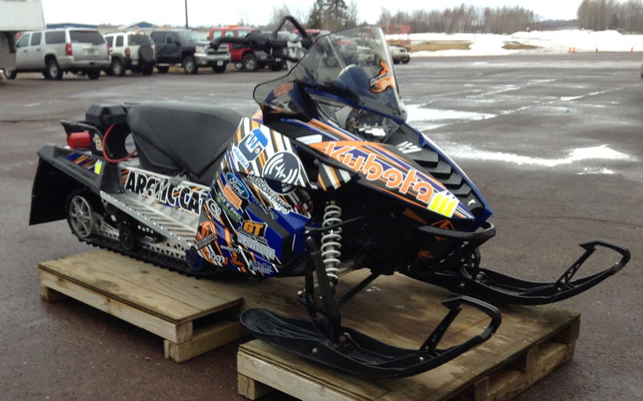
Dealer Appeal
Manufactures
Designed for ease of manufacturing
Expandable market
Sales
Marketable to consumers
Aesthetics
Performance
Work horse styling
Service
Readily available parts
Ease of maintenance
Simplicity

Slide 6
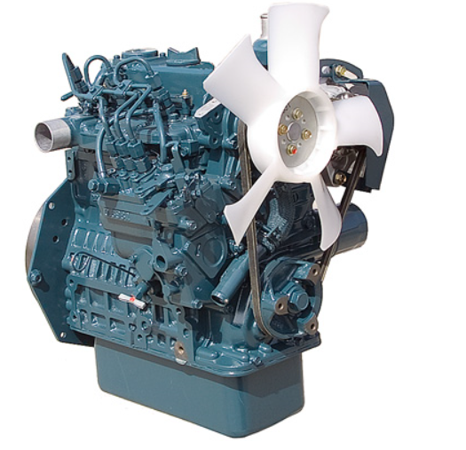
Engine Selection
Kubota D902
3600 rpm model
Indirect Injection
Average 24 hp
Mechanical lifter pump and high pressure pump
Overall dimensional size
Dry weight of 159 lb

Slide 7
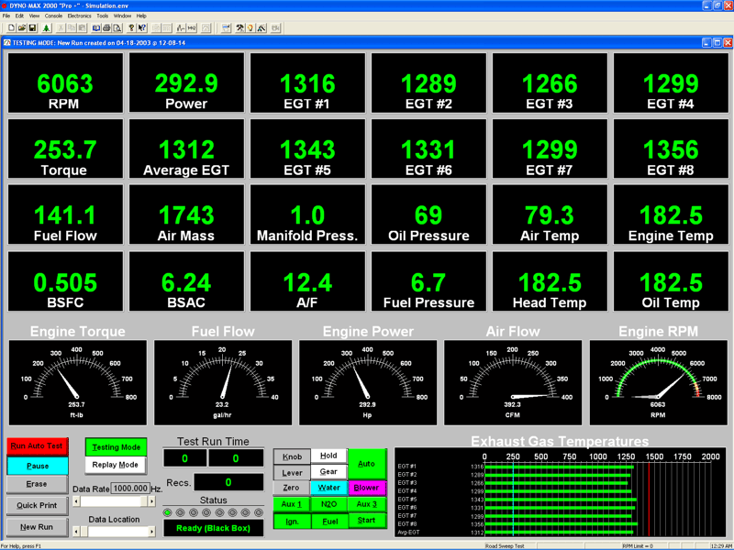
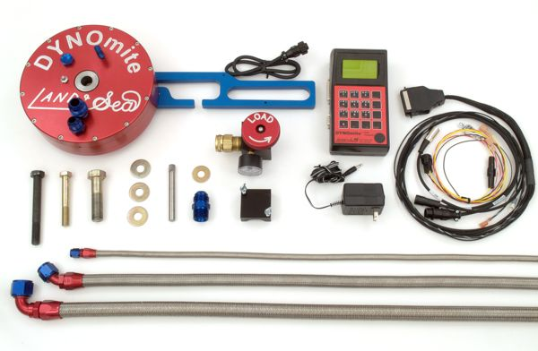
Engine Tuning and Calibration
DYNOmite Water-Brake Dynamometer
Exhaust Gas Temperature
EMS Emissions Analyzer

Slide 8
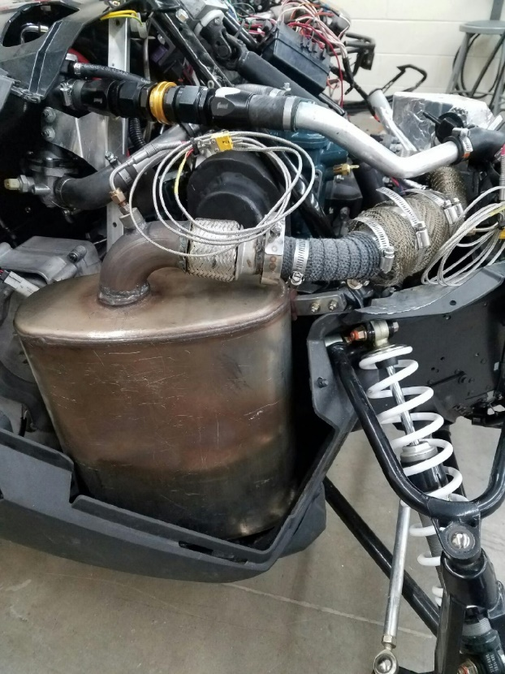
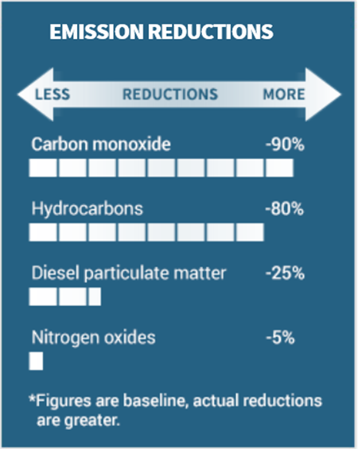
Exhaust System
Reducing Emissions
Diesel Oxidation Catalyst
Nett Technologies
Advantages
Stock Bearcat 3000 LT
Catalyst placement
No maintenance

Slide 9
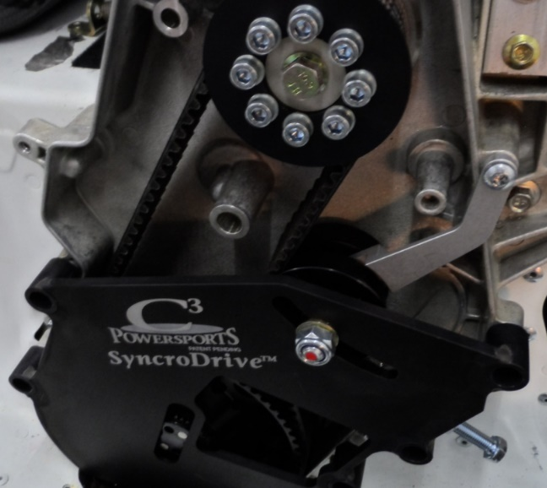
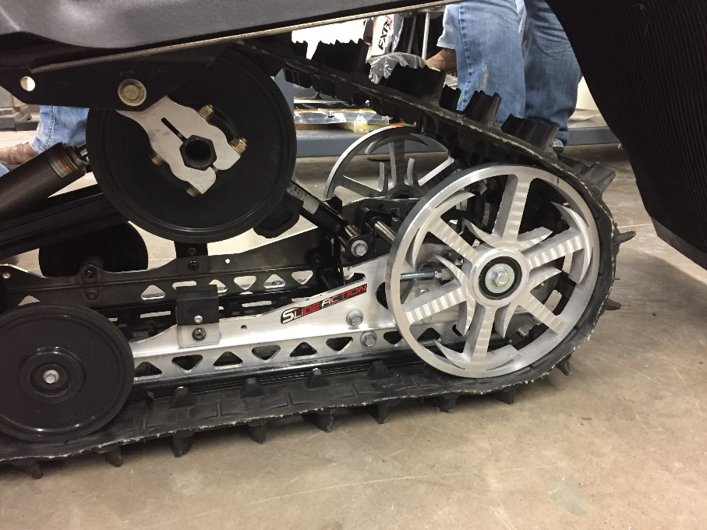
Driveline Improvements
Belt Drive System
C3 Powersports
Custom 10” Rear Idler Wheels
Graphite Infused Slides
Track
Quiet Ramp Technology
Added Idler Wheels

Slide 10
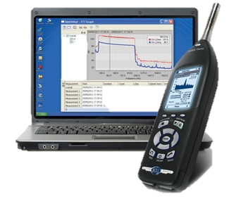
Sound Attenuation
Quiet-ramp track
Bogie wheels staggered and phased
Undercoating
Sound dampening foam
J1161

Slide 11
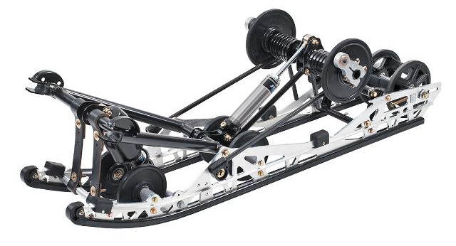
Suspension
Easily Adjustable Suspension
Floating Front Rear Suspension
Improved control
Better traction

Slide 12
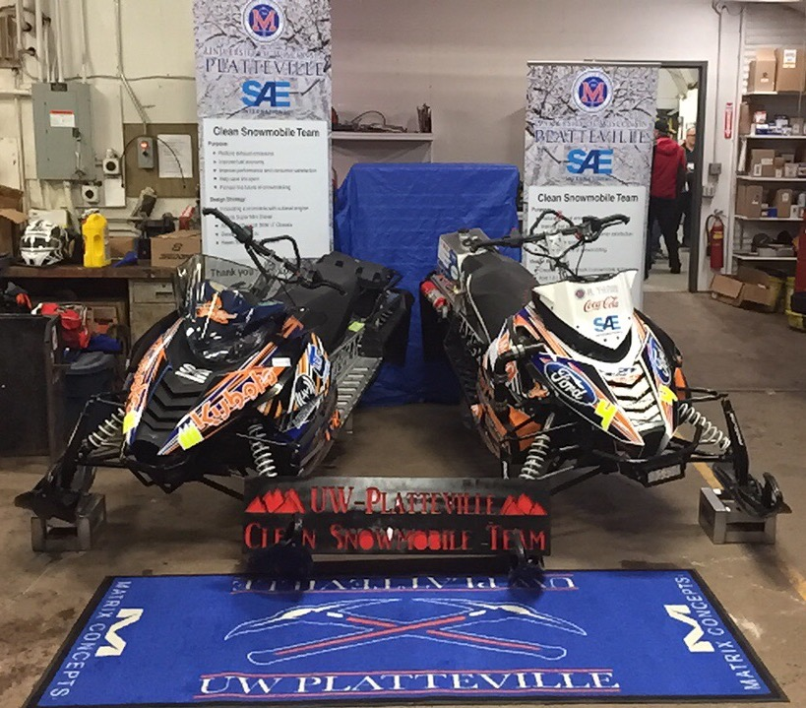
MSRP Value
Estimated Value $12,094.13
$1,995.13 value over stock Bearcat 3000 LT

Slide 13
Summary
Consumer Benefits
Reliable
Competitive Cost
$12,094.13 USD MSRP
Dealer Benefits
Environmental Benefits
Low Emissions
Quiet
Fuel Efficient

Slide 14
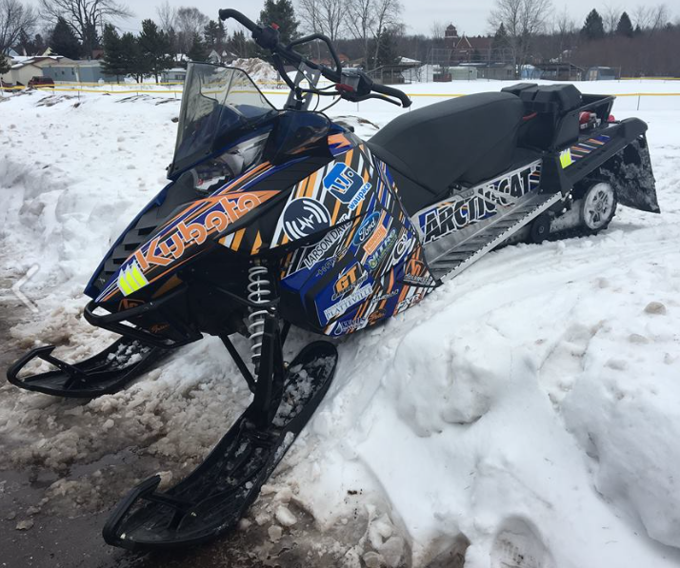
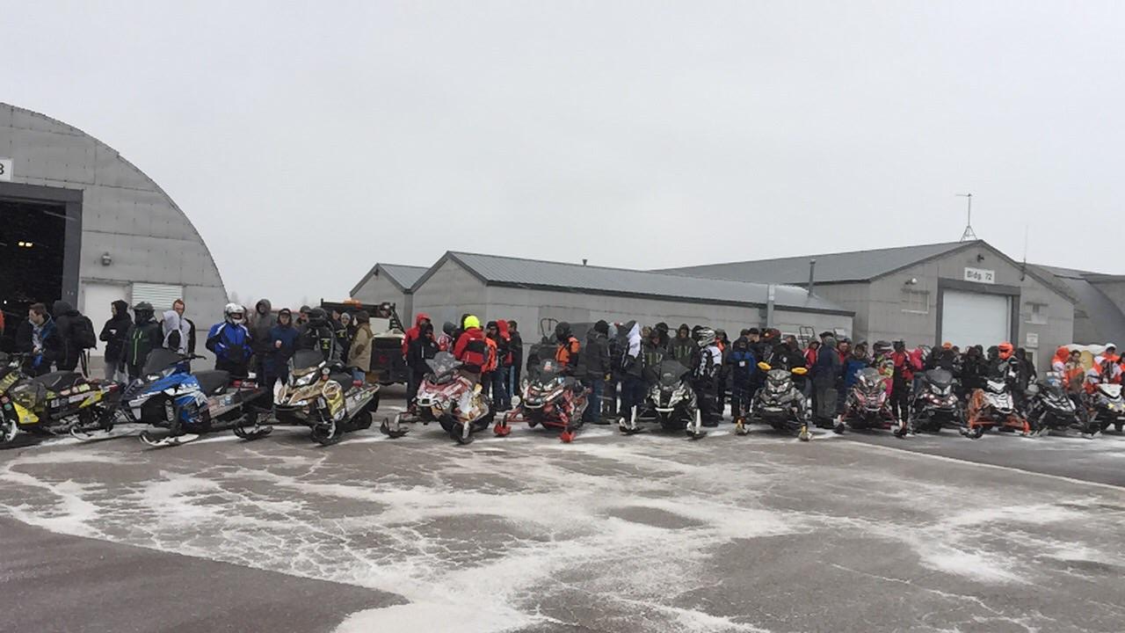
Thank You!
Questions?

