Slide 1
University of Wisconsin-Platteville 2018-2019 CSC CI Team
Presenters:
Erik Laskowski
Donald Hershaw

Slide 2
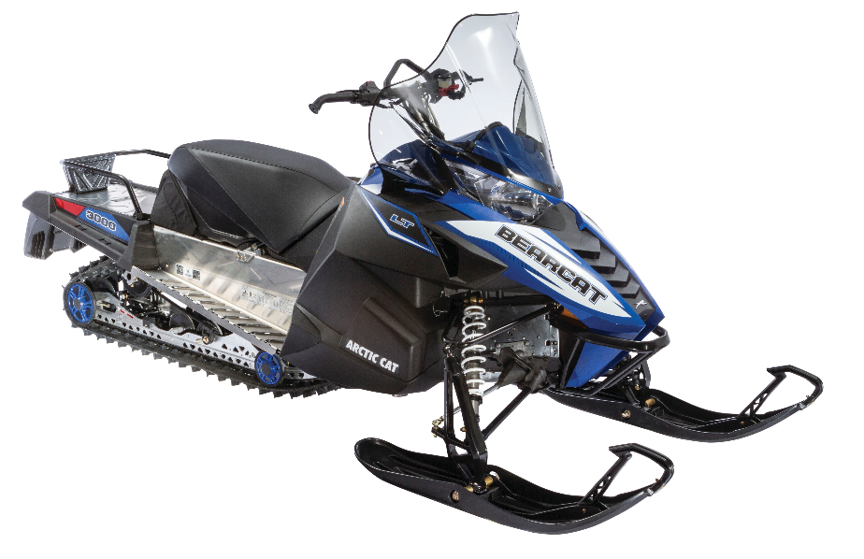
Platform Choice
Chassis: 2017 Arctic Cat Bearcat 3000 LT
Engine Type | 4-Stroke
Engine Details | Kubota D902 diesel
Cylinders | 3
Displacement | 898 cc
HP | 34
Torque | 47 ft/lb
Fueling | Indirect Injection

Slide 3
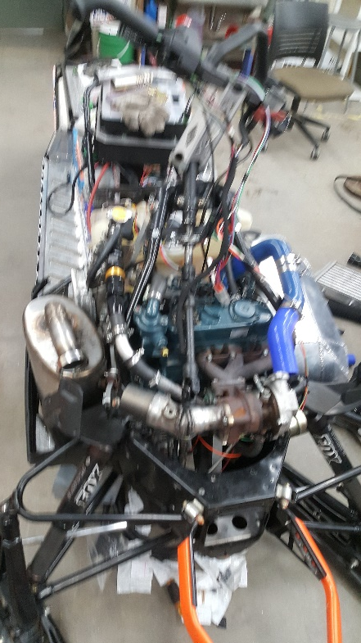
Design Strategy
Clean
Engine selection
Diesel Oxidization Catalyst
Diesel Particulate Filter
Quiet
Undercoating
Sound dampening foam
Efficiency
Driveline improvements
Emissions targeting
Fuel Compatibility
Bio Diesel 0-9%
User Friendly
Ergonomic rider position
Simple display and controls
Motor reliability
Adjustable suspension

Slide 4
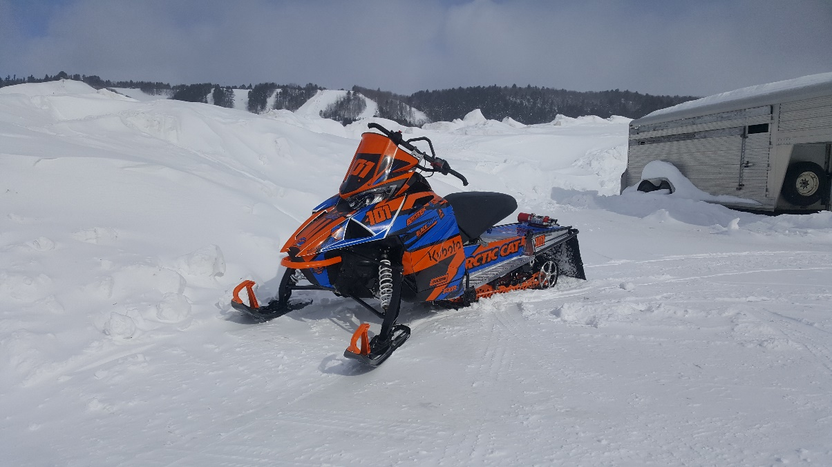
Consumer Appeal
Low Maintenance
Belt drive
Engine oil life
Low Operating Cost
Fuel mileage
Comfort
Reliability
Engine life
Mechanical fuel pumps
Cold Start
Performance
Towing capabilities
GPS speedometer

Slide 5
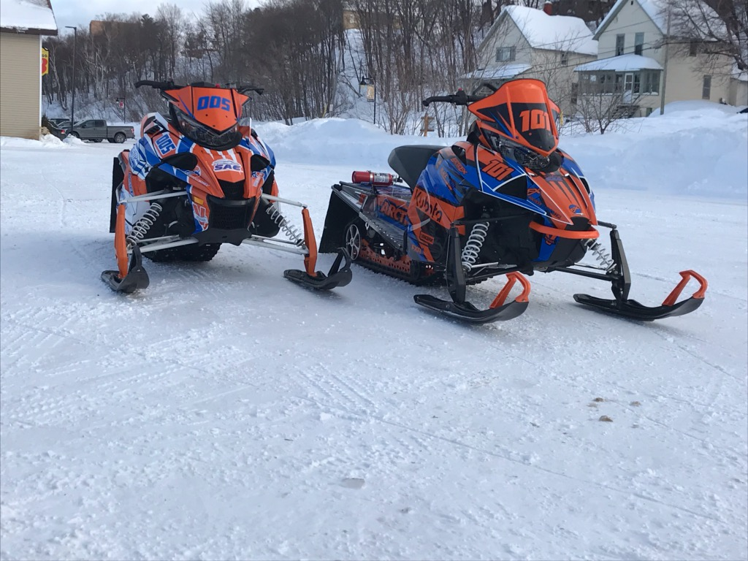
Dealer Appeal
Manufactures
Designed for ease of manufacturing
Expandable market
Sales
Marketable to consumers
Aesthetics
Performance
Work horse styling
Service
Readily available parts
Ease of maintenance
Simplicity

Slide 6
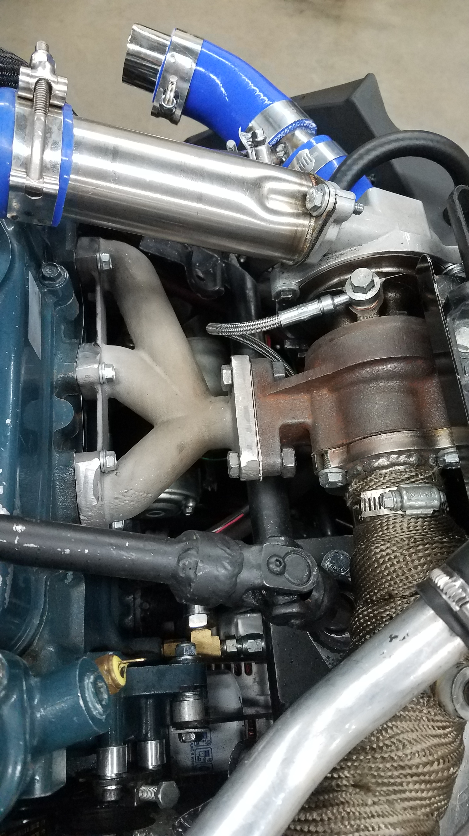
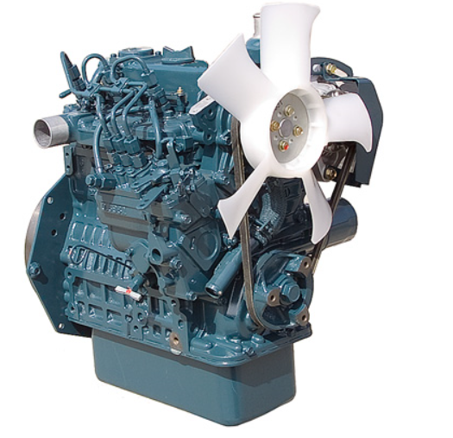
Engine Selection
Kubota D902
3600 rpm model
Indirect Injection
Average 24 hp
Mechanical lifter pump and high pressure pump
Overall dimensional size
Dry weight of 159 lb

Slide 7
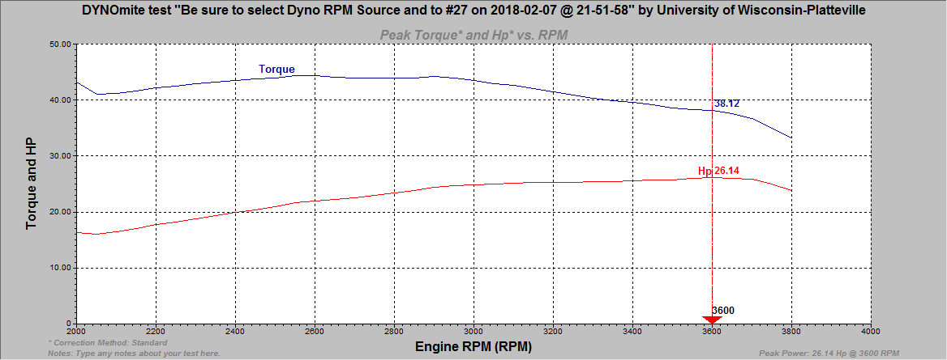
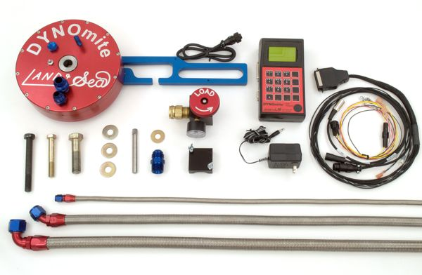
Engine Tuning and Calibration
DYNOmite Water-Brake Dynamometer
Exhaust Gas Temperature
EMS Emissions Analyzer

Slide 8
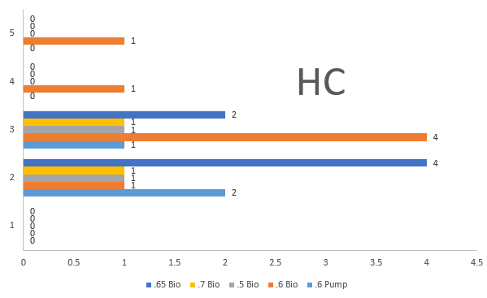
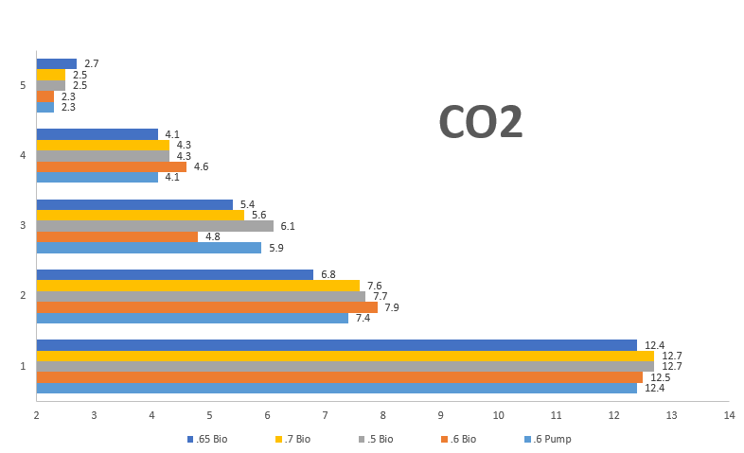
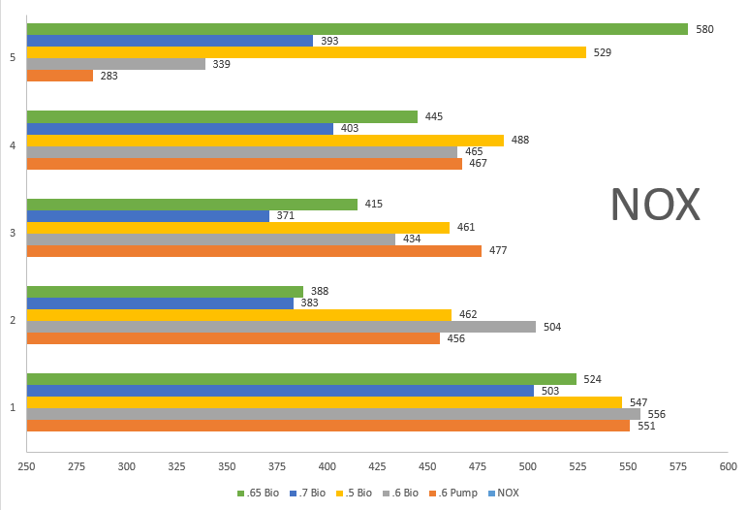

Slide 9
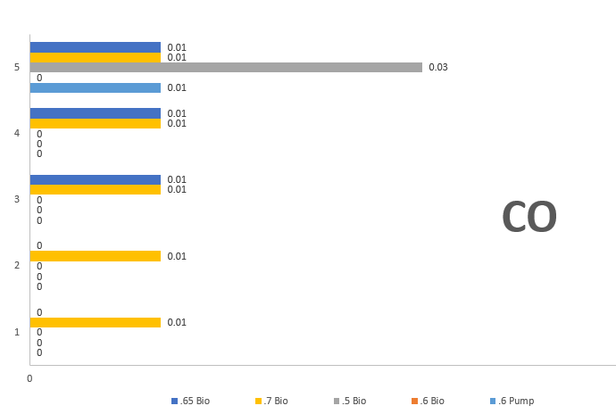
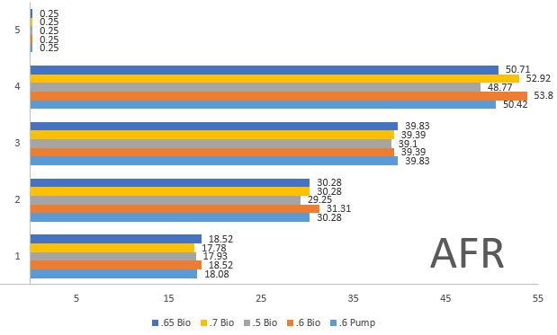

Slide 10
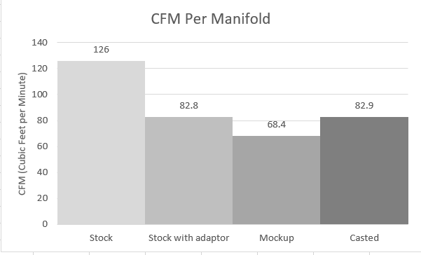
Flow Bench Testing
SuperFlow 750

Slide 11
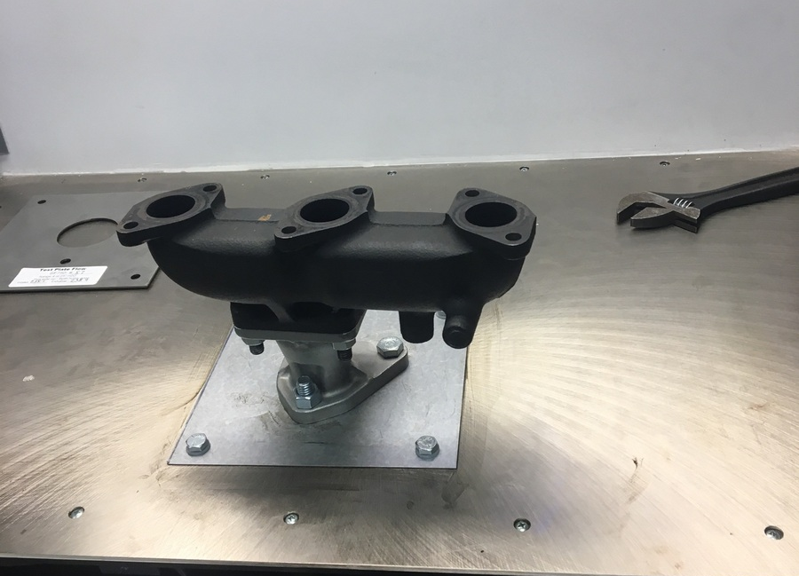
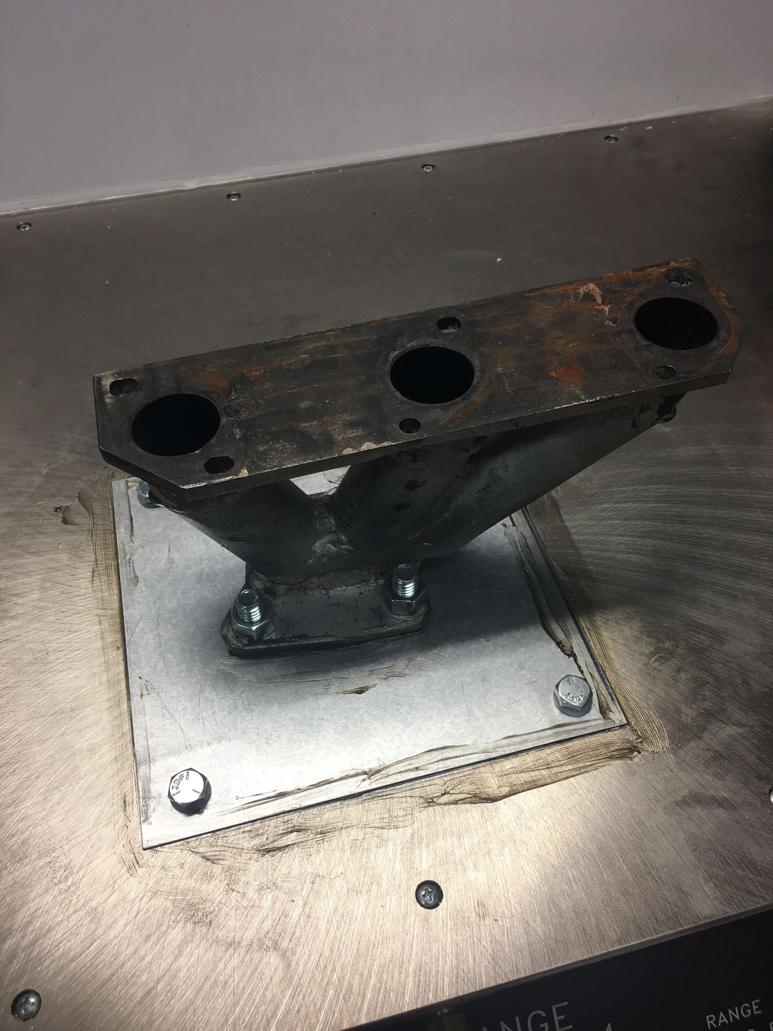
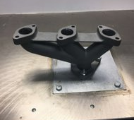

Slide 12
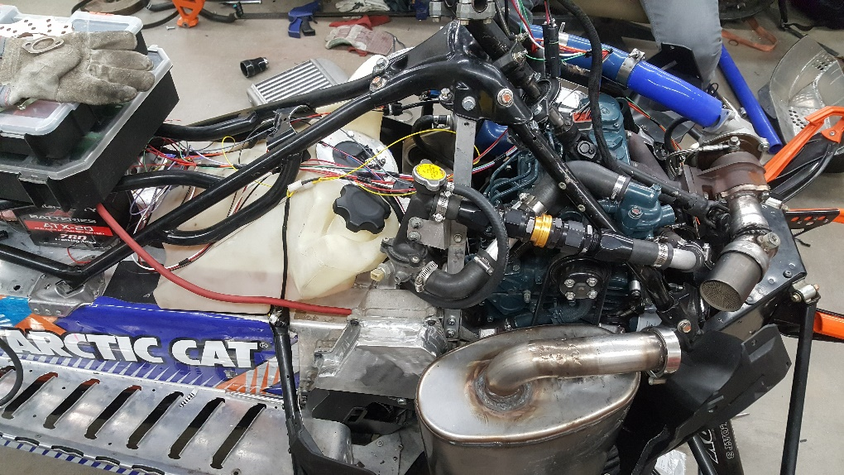
Exhaust System
Reducing Emissions
Diesel Oxidation Catalyst
Diesel Particulate Filter implemented in stock muffler
Able to regenerate particulate filter.

Slide 13
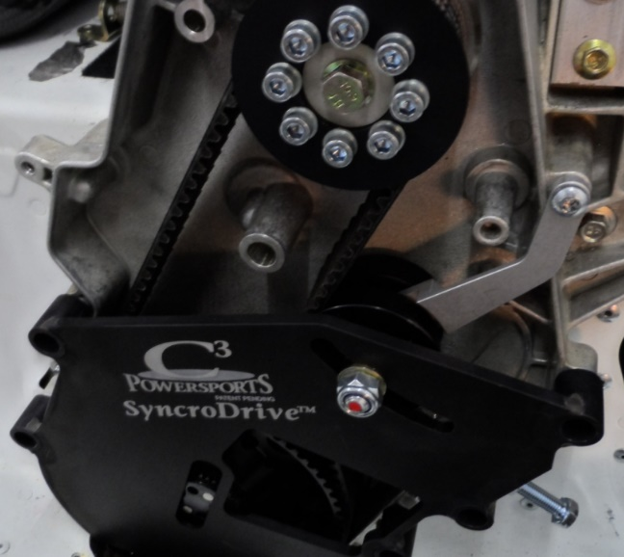
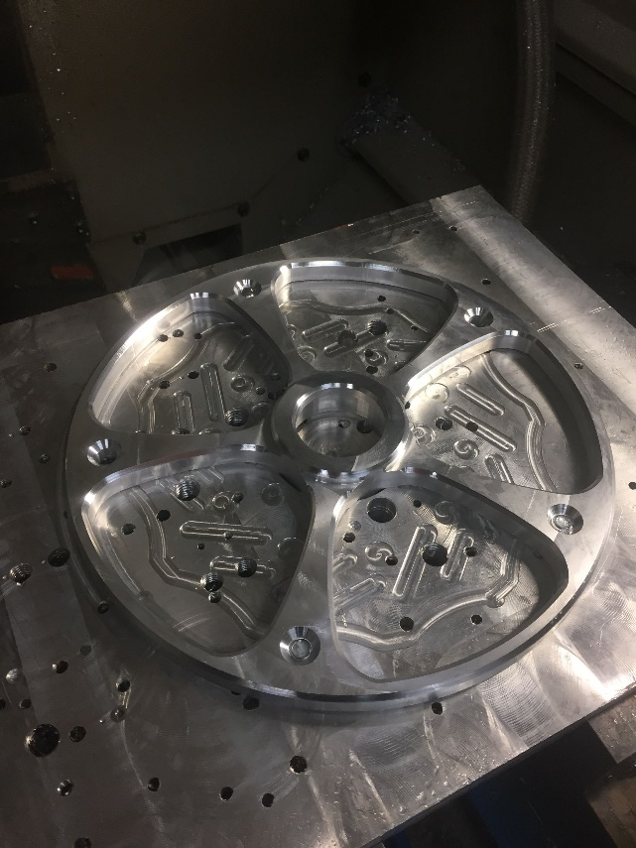
Driveline Improvements
Belt Drive System
C3 Powersports
Custom 10” Rear Idler Wheels
Graphite Infused Slides
Camso Track
Introvert Driver
Reduced number of bogie
Wheels.
Multiple anti stab kits

Slide 14
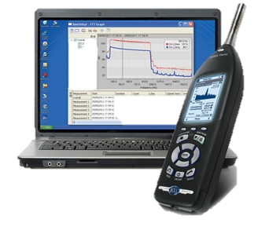
Sound Attenuation
Introvert VS Extrovert
Ported Track
Bogie wheels staggered and phased
Undercoating
Sound dampening foam
J1161
Quiet ramps

Slide 15
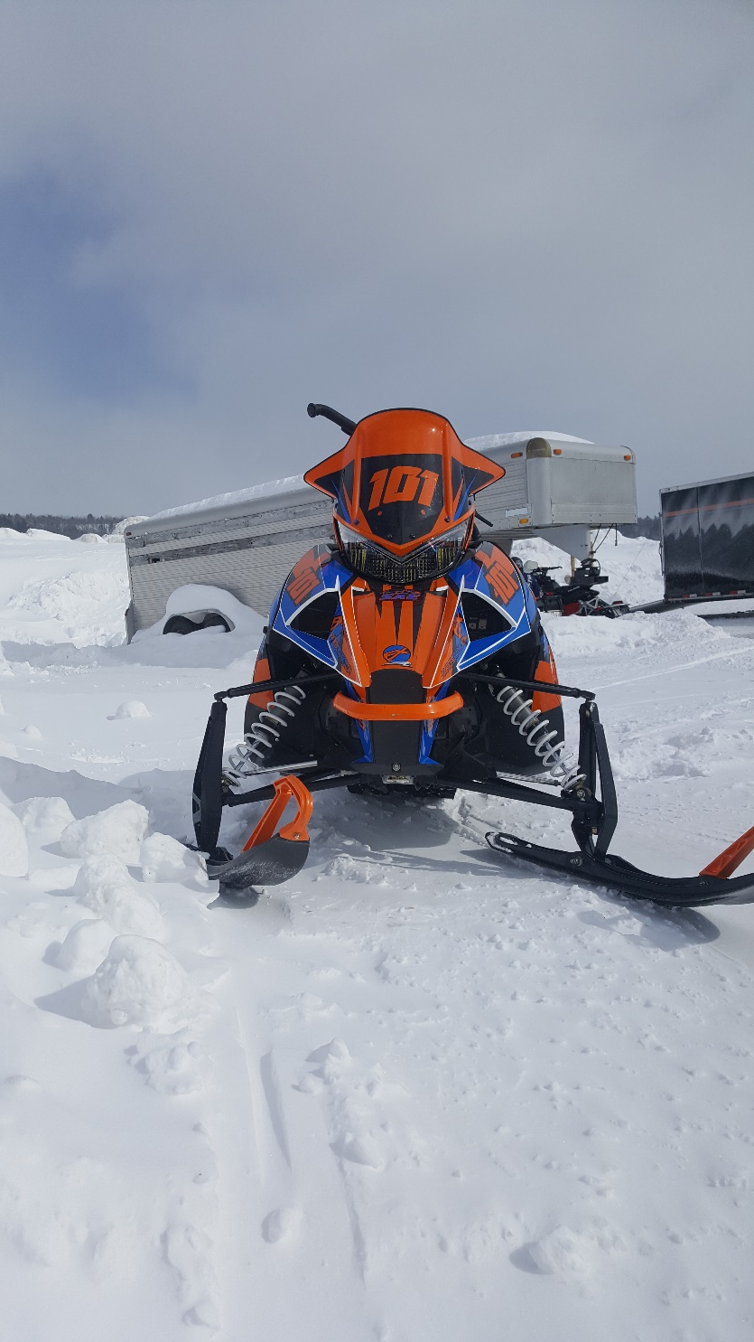
MSRP Value
Estimated Value $14,349.59
$4,149.78 value over stock Bearcat 3000 LT

Slide 16
Summary
Consumer Benefits
Reliable
Competitive Cost
$14,349.59 USD MSRP
Dealer Benefits
Environmental Benefits
Low Emissions
Quiet
Fuel Efficient

Slide 17
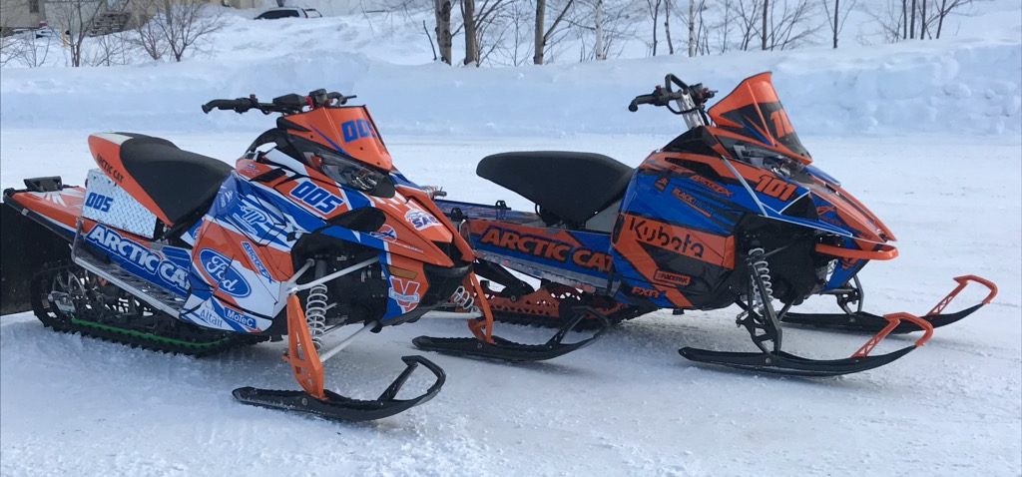
Thank You!
Questions?

