Slide 1
Re-Engineering a 2015 Polaris Indy
2017 SAE Clean Snowmobile Competition
Presented by: Josh McCoy, Mike Waloch, Nathan Zabel 3/7/16

Slide 2
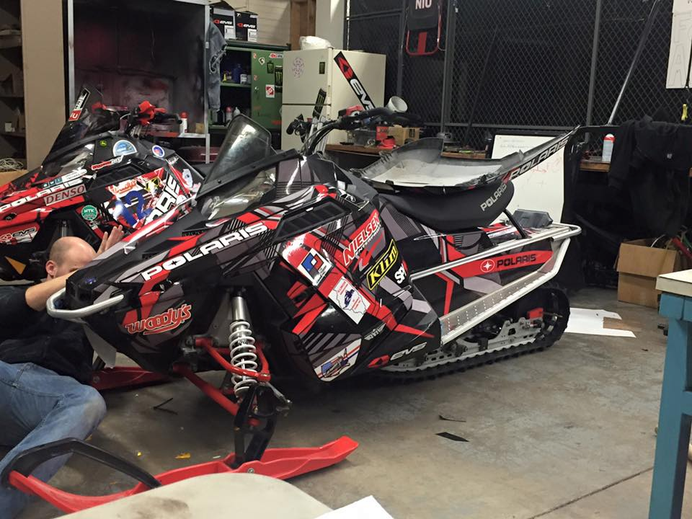
Outline
Snowmobile Choice
Chassis Improvements
Big Wheel Kit
Track Selection
Noise Reduction
Fuel Economy and Emissions
Ethanol Correction
Tuning
Exhaust Modifications
Emission Results
Cost Effectiveness
Conclusion

Slide 3
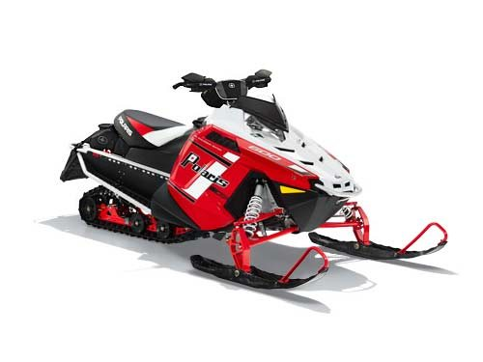
Snowmobile Choice
2015 Polaris Indy
600cc Two-stroke
Why?
Power to weight ratio
Consumer appeal
Large market demand

Slide 4
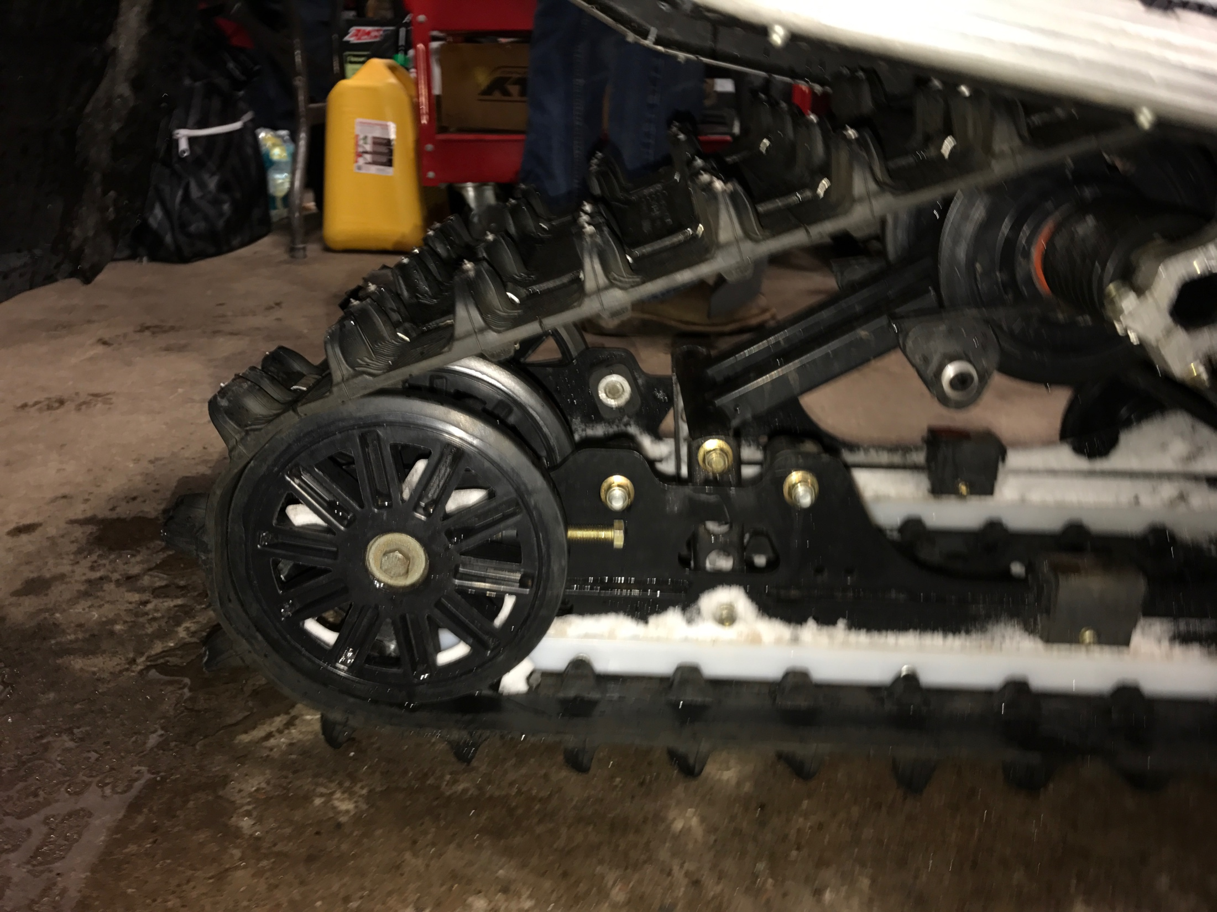
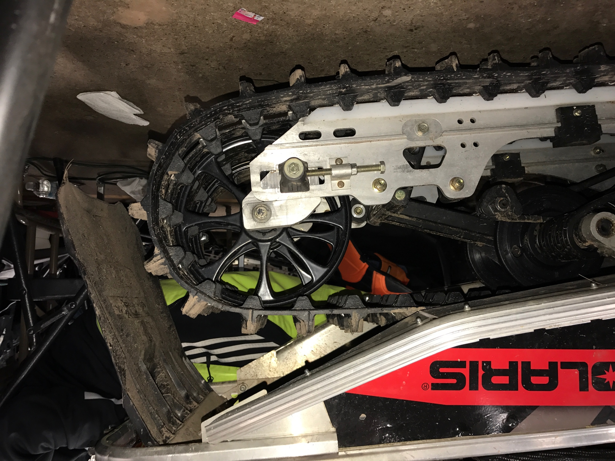
Chassis Improvements Big Wheel Kit
Big wheel kit is designed to reduce the rolling resistance of the track.
Improves fuel economy.
Before
After

Slide 5
Chassis Improvements Big Wheel Kit
-Skid and stock 7.5” rear wheel
Bottom of wheel not tangent to skid
-Skid with 10” Wheel
-Skid and stock 7.5” rear wheel
Skid with relocation bracket
Bottom of wheel is tangent to skid

Slide 6
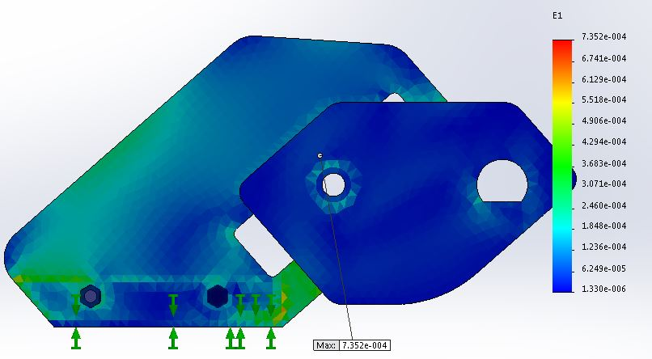
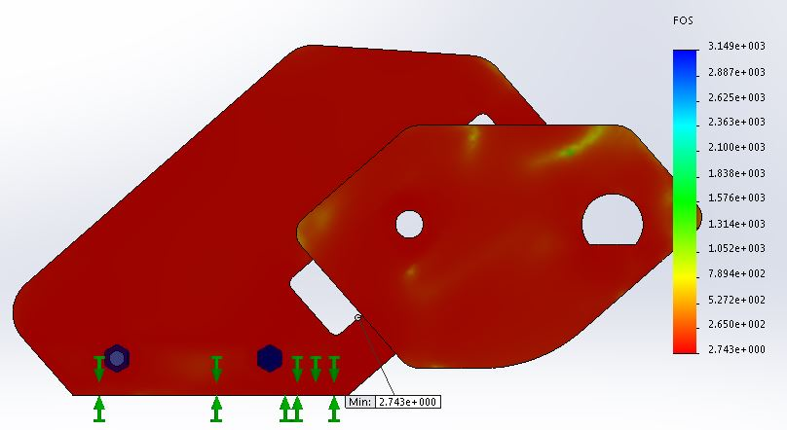
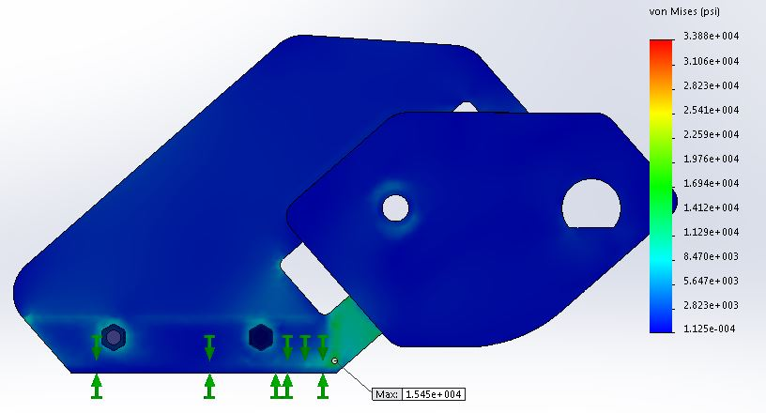
Chassis Improvements Big Wheel Kit
FEA Results
SolidWorks 2014
Yield Strength: 42,000 psi
Maximum Stress: 15,458 psi @ 500 lbf
Maximum Strain: 735 με
Minimum Factor of Safety: 2.74
Strain at 500 lbf
Factor of Safety at 500 lbf
Stress at 500 lbf

Slide 7
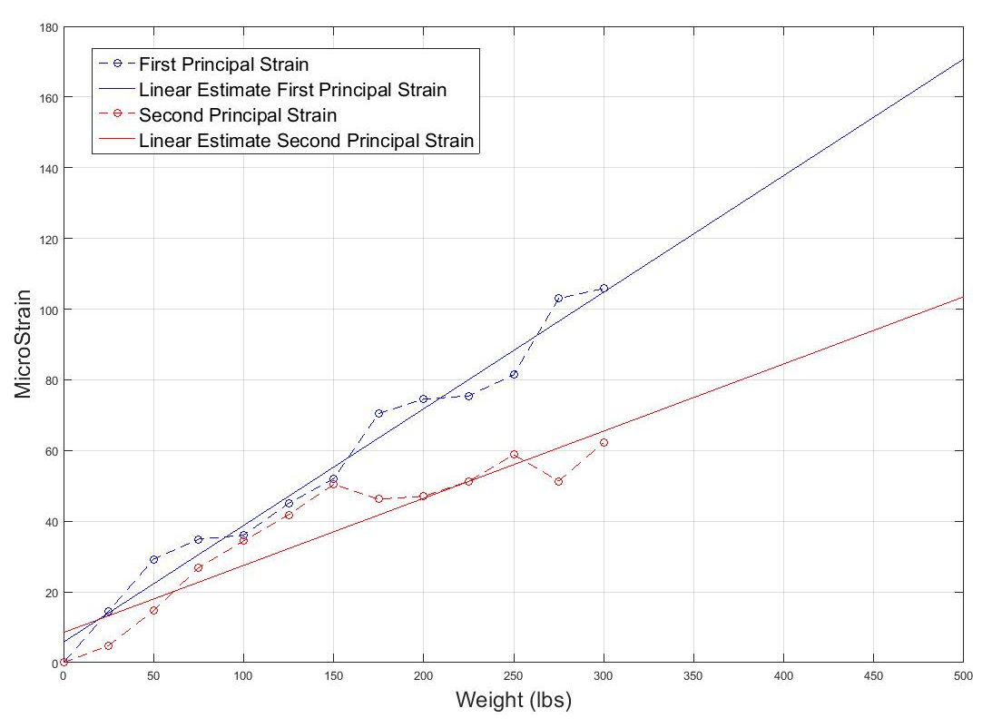
Chassis Improvements Big Wheel Kit
Physical Experiment
Strain measurements taken with 3 element strain gauges
FEA and Lab experimental strain values matched within 20%
FOS was verified within
± 0.2
12% reduction in rolling resistance
Principal Strains Taken at Center of Bracket

Slide 8
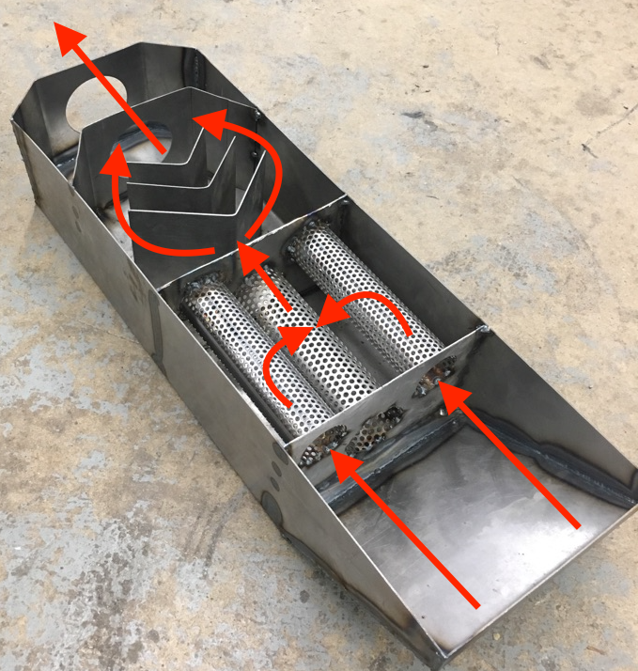
Noise Reduction
Custom designed multi-chambered muffler
Design featuring chambers and perforated tubing
Forced to remove due to issues with backpressure

Slide 9
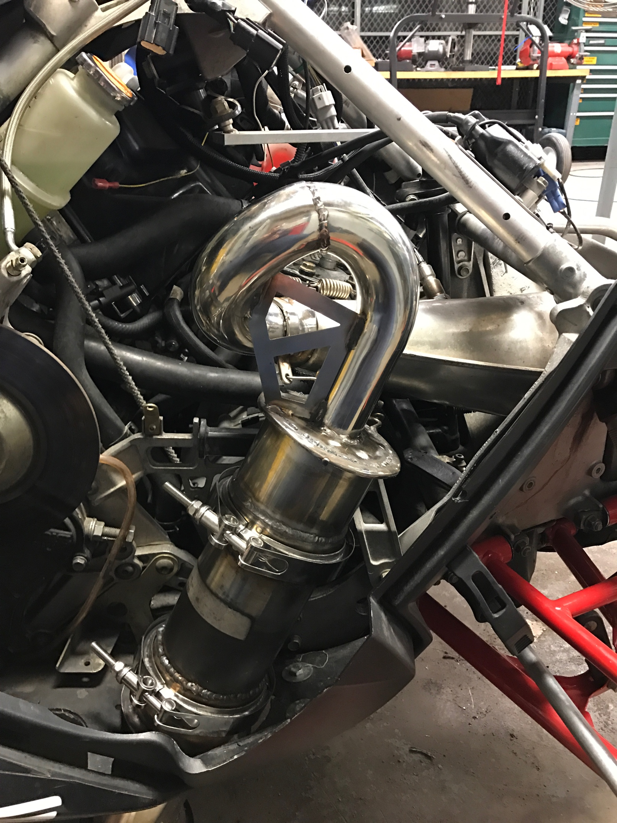
Catalytic Converter
3 Way Catalyst designed through collaboration by BASF and Emitec
Mounted by modifying Sno-Stuff trail can
Heat shield and wrap used to protect other components from heat

Slide 10
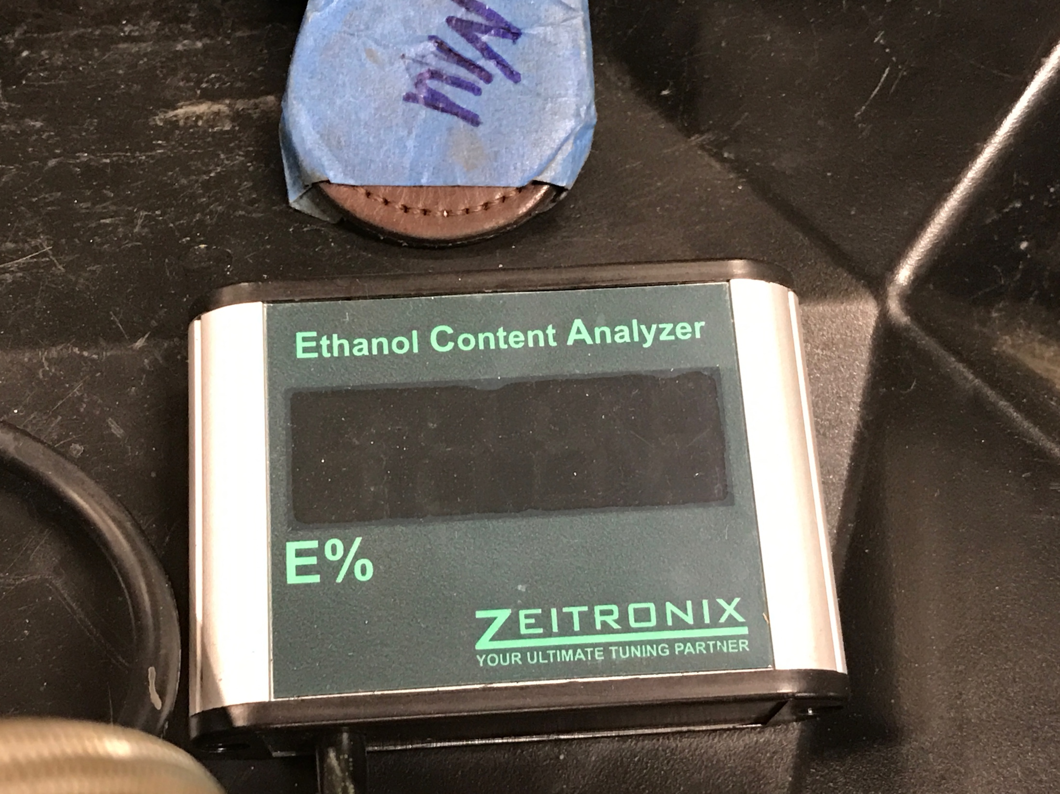
Fuel Economy and Emissions Conversion to Ethanol
GM Flex Fuel Sensor
Measure ethanol content of fuel
Zietronix ECA
Display ethanol content
Convert frequency to 5 volt signal

Slide 11
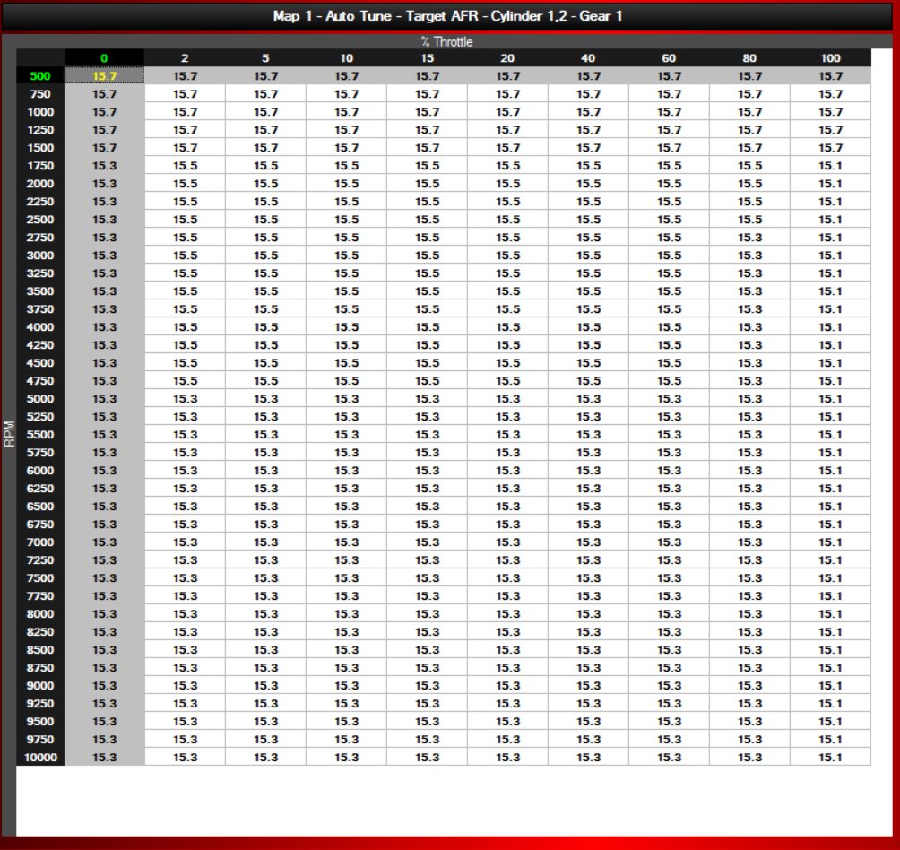
Fuel Economy and Emissions Tuning
Fuel Compensation
Auto tune to range of $λ 1.0 −1.1$
Scale fuel using pressure correction table
Allows use to run near stoich at all ethanol contents

Slide 12
Fuel Economy and Emissions Emissions Results: HC, NO, CO
Emissions data taken with a Horiba Mexa-584L
3922% decrease on average

Slide 13
Fuel Economy and Emissions Emissions Results: HC, NO, CO
1268% decrease on average

Slide 14
Fuel Economy and Emissions Emissions Results: HC, NO, CO
83% increase on average
Believe that calibration was not accurate

Slide 15
Cost Effectiveness
Cost of stock snowmobile
$8,399
MSRP calculated for competition
$9,542.90
Key Factors for Increase
Power Commander V
Big Wheel Kit
Custom exhaust system

Slide 16
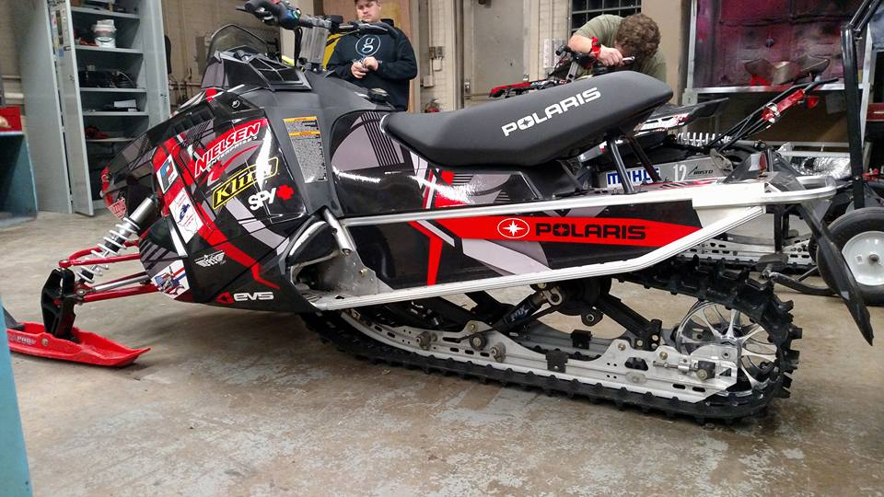
Conclusion
Improved Emissions
Full ethanol compensation
Consumer could run E0 to E100
Cost effective

Slide 17
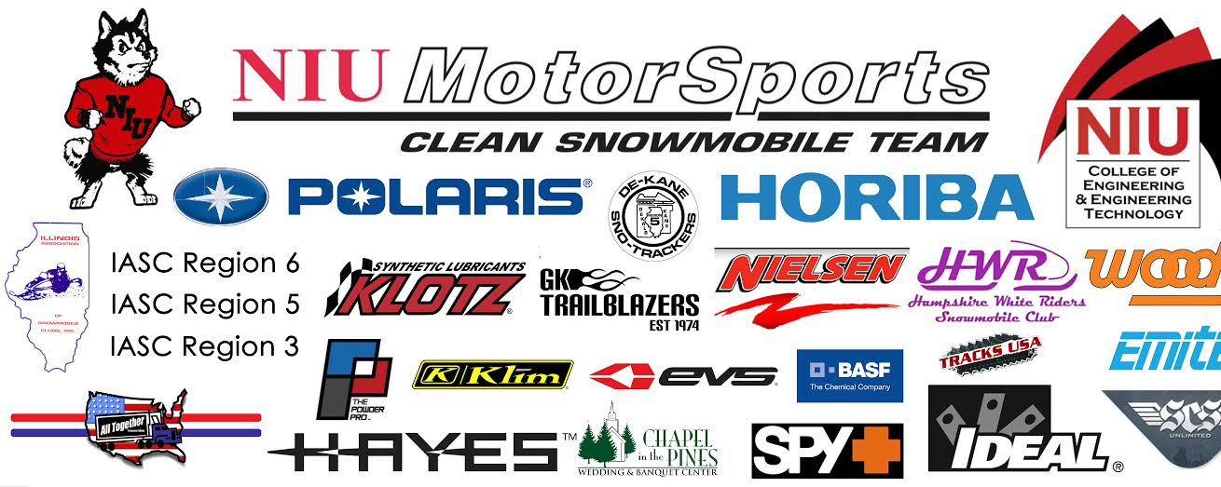
Thank you to our sponsors!

