Slide 1
Re-Engineering a 2015 Polaris Indy
2016 SAE Clean Snowmobile Competition
Presented by: Pryce McDaniel, Josh McCoy, Mike Waloch 3/7/16

Slide 2
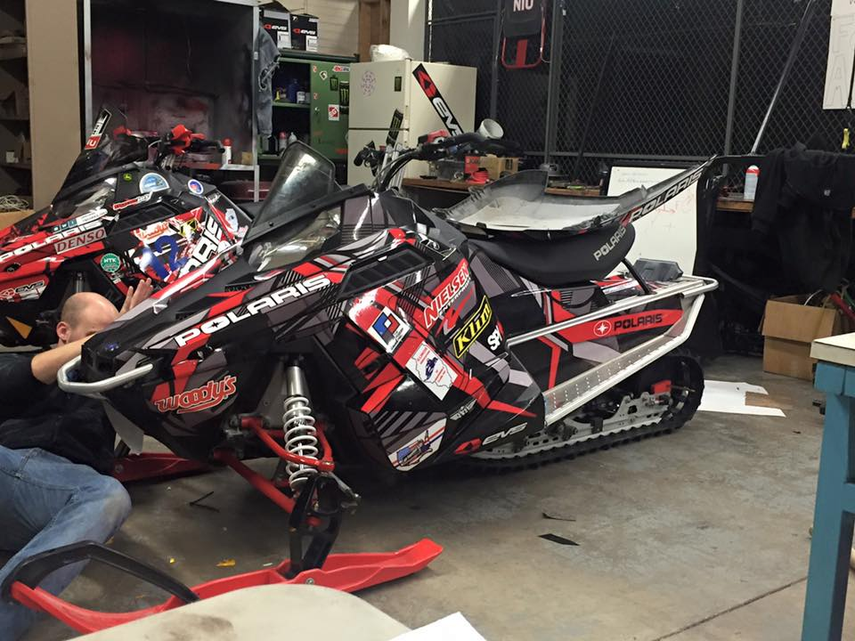
Outline
Snowmobile Choice
Chassis Improvements
Big Wheel Kit
Noise Reduction
Fuel Economy and Emissions
Conversion to Ethanol
Real-Time Fuel Compensation
Knock Control
Exhaust Modifications
Emission Results
Cost Effectiveness
Conclusion

Slide 3
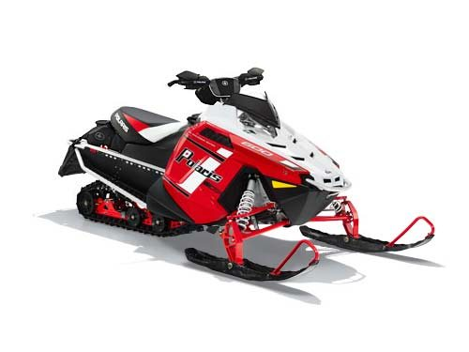
Snowmobile Choice
2015 Polaris Indy
600cc Two-stroke
Why?
Power to weight ratio
Consumer appeal
Large market demand

Slide 4
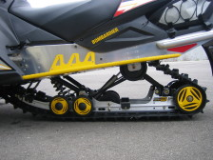
Chassis Improvements Big Wheel Kit
Big wheel kit is designed to reduce the rolling resistance of the track.
Improves fuel economy.
Before
After

Slide 5
Chassis Improvements Big Wheel Kit
-Skid and stock 7.5” rear wheel
Bottom of wheel not tangent to skid
-Skid with 10” Wheel
-Skid and stock 7.5” rear wheel
Skid with relocation bracket
Bottom of wheel is tangent to skid

Slide 6
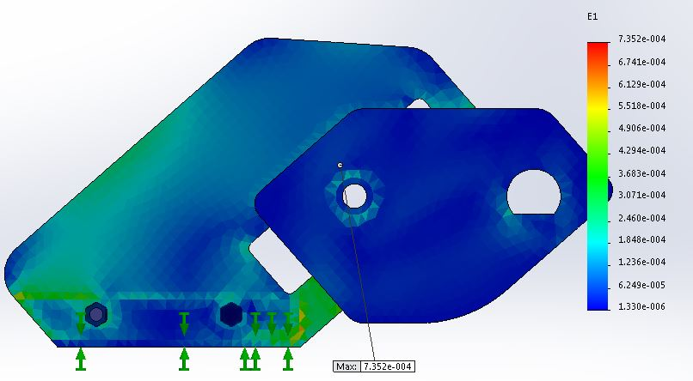
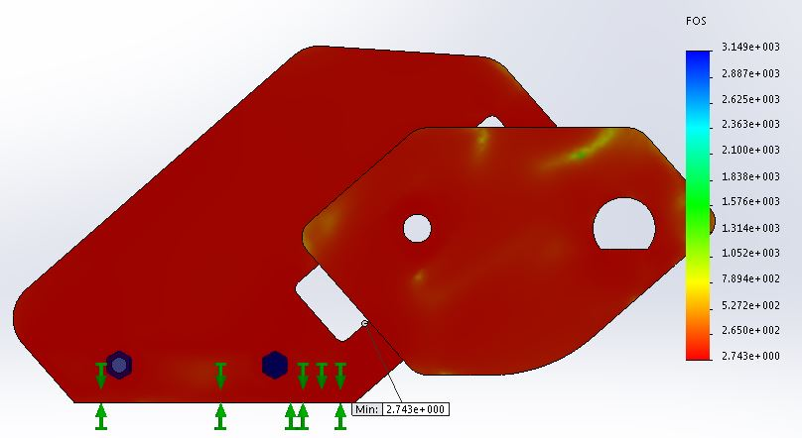
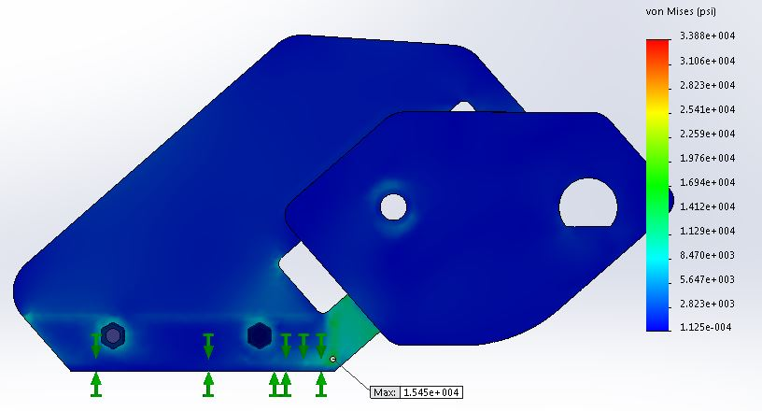
Chassis Improvements Big Wheel Kit
FEA Results
SolidWorks 2014
Yield Strength: 42,000 psi
Maximum Stress: 15,458 psi @ 500 lbf
Maximum Strain: 735 με
Minimum Factor of Safety: 2.74
Strain at 500 lbf
Factor of Safety at 500 lbf
Stress at 500 lbf

Slide 7
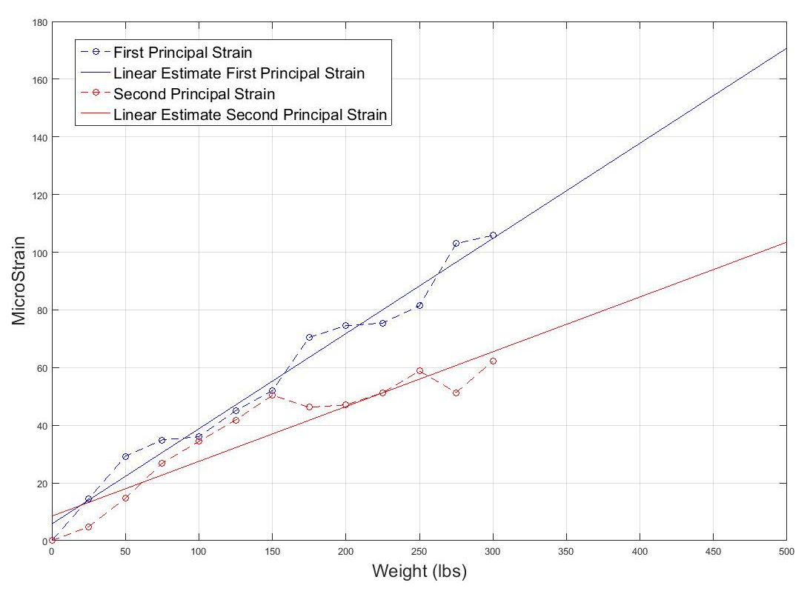
Chassis Improvements Big Wheel Kit
Physical Experiment
Strain measurements taken with 3 element strain gauges
FEA and Lab experimental strain values matched within 20%
FOS was verified within
± 0.2
12% reduction in rolling resistance
Principal Strains Taken at Center of Bracket

Slide 8
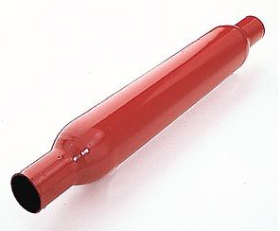
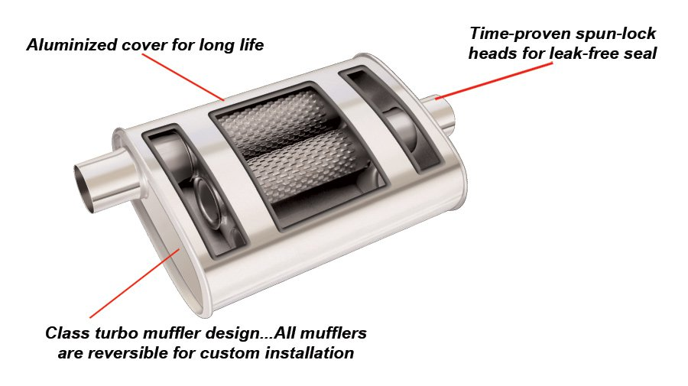
Noise Reduction
Additional mufflers
Thrush glasspack
Thrush Chambered turbo muffler
Results
10% reduction in exhaust noise
Structural integrity maintained

Slide 9
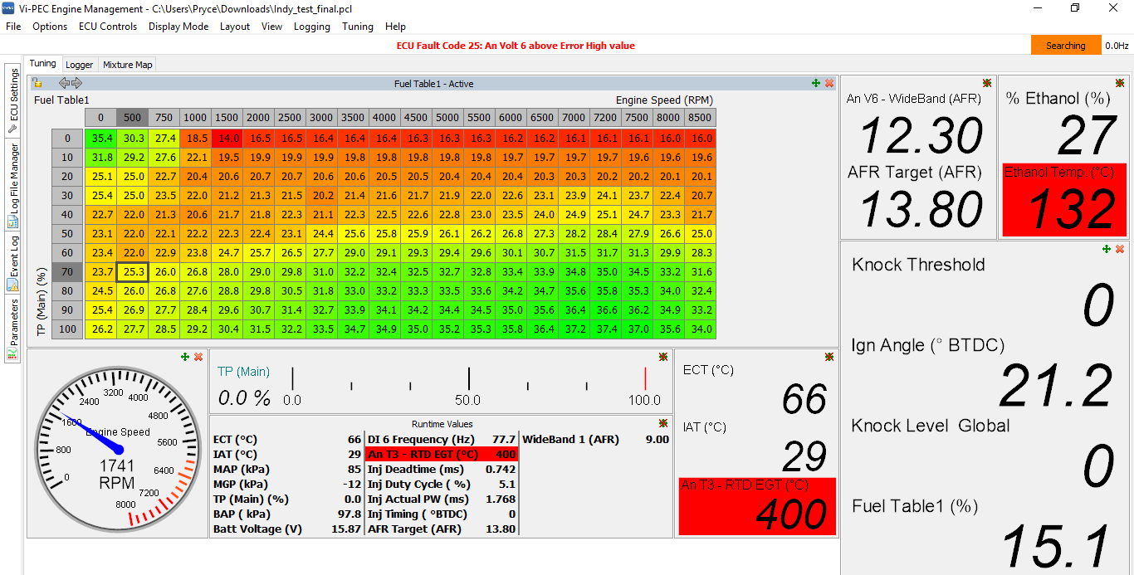
Fuel Economy and Emissions Conversion to Ethanol
Vipec ECU
Fuel tables
Ignition tables
Injection timing
Knock Calibration
GM Flex Fuel Sensor
Measure ethanol content
NGK AFX Air to Fuel Ratio gauge
Tuning to 0.95 to 1.1 λ
Vipec Tuning Software

Slide 10
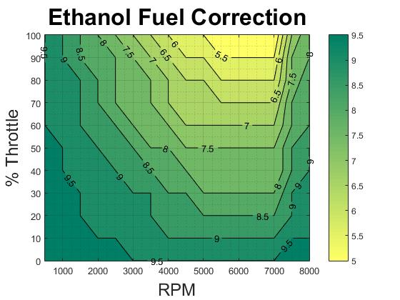
Fuel Economy and Emissions Real-Time Ethanol Compensation
Fuel Compensation
Fuel increase for 0~100% ethanol
Linear scale based on % ethanol
Based on RPM and throttle position range

Slide 11
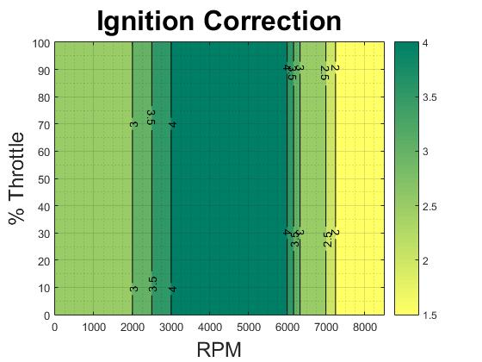
Fuel Economy and Emissions Real-Time Ethanol Compensation
Ignition Compensation
Ignition timing advance by 0~4 ⁰BTDC
Based on RPM and throttle position range
Max 4 ⁰ advance

Slide 12
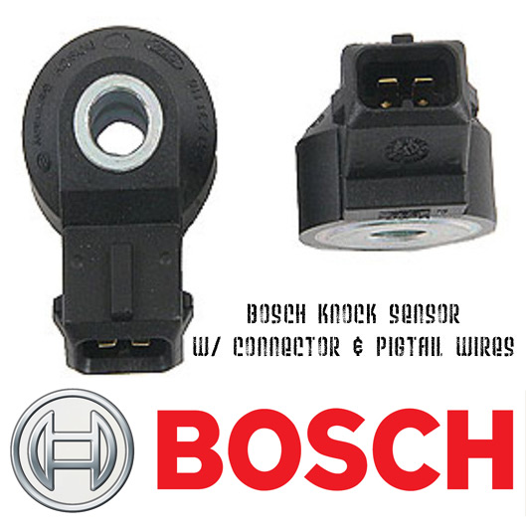
Fuel Economy and Emissions Knock Control
Bosch KS-4-K1 Knock Sensor
Used for ignition trim
Sampled between 10~40⁰ BTDC
MAX delay of 4⁰ BTDC
Protects engine while running lean conditions

Slide 13
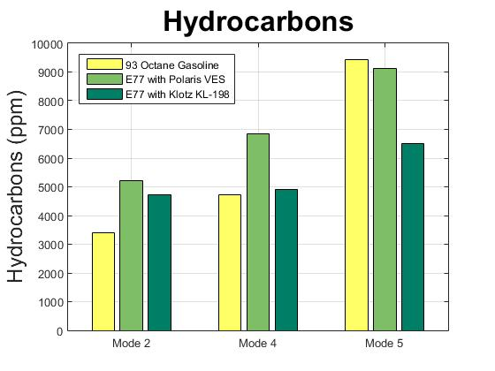
Fuel Economy and Emissions Emissions Results: HC, NO, CO
Emissions data taken with a Horiba Mexa-584L
3.76% increase on average

Slide 14
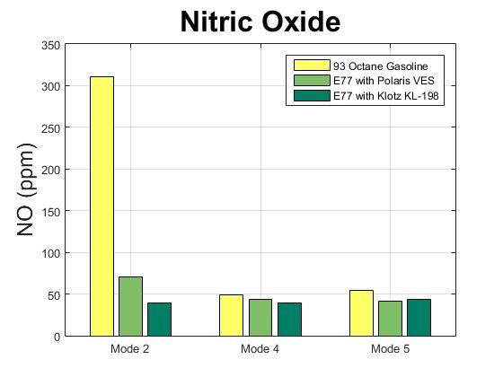
Fuel Economy and Emissions Emissions Results: HC, NO, CO
42.1% decrease on average

Slide 15
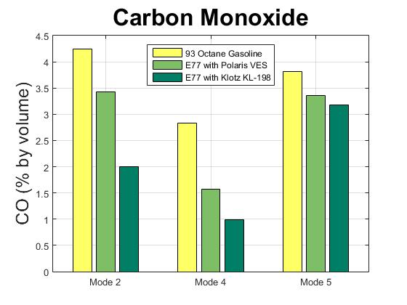
Fuel Economy and Emissions Emissions Results: HC, NO, CO
44.9% decrease on average

Slide 16
Cost Effectiveness
MSRP calculated for competition
$13,518
Considerations
Vipec: $2,195
Axle Relocation bracket: $58
Adjusted MSRP
$11,265

Slide 17
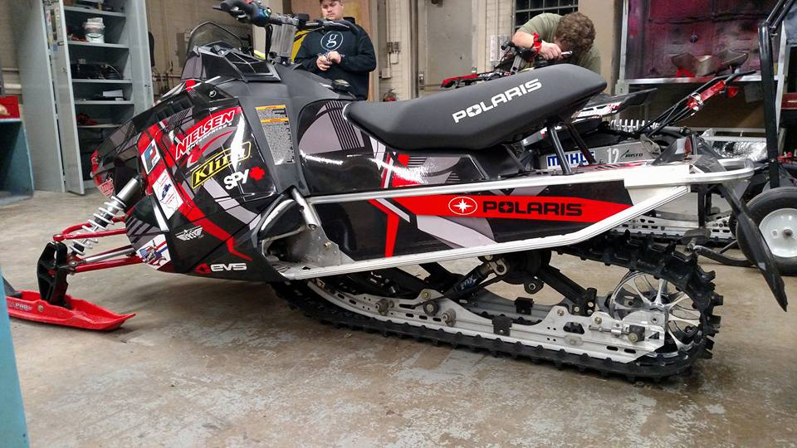
Conclusion
Improved Emissions
45% decrease in Carbon Monoxide
Full ethanol compensation
Consumer could run E0 to E100
Exhaust noise reduced
10%
Cost effective

Slide 18
Thank you to our sponsors!

