Slide 1
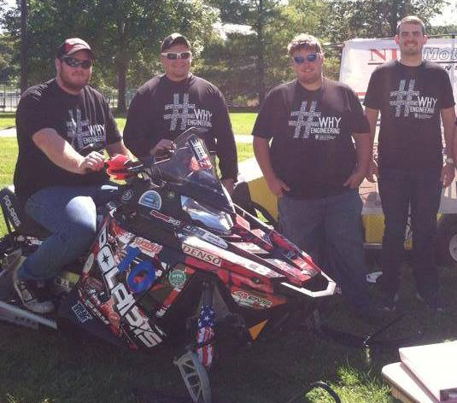
Northern Illinois University
Rich
Stueber
Pryce
Nutting
2015 SAE Clean Snowmobile Challenge

Slide 2
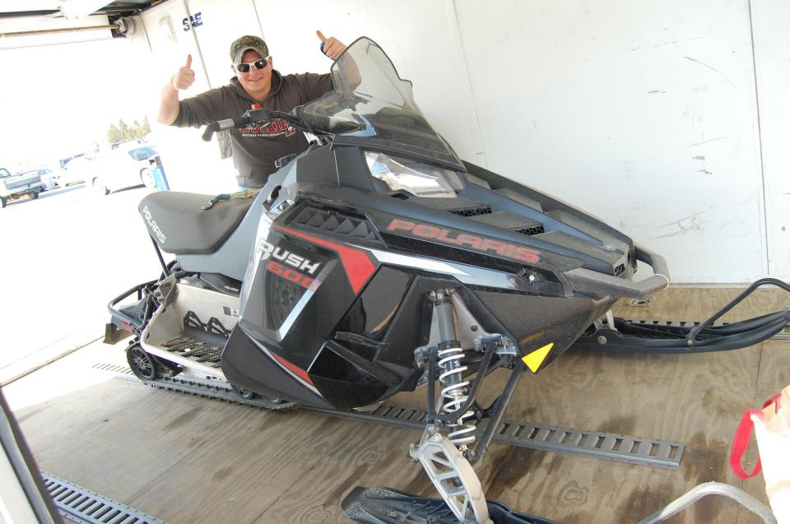
Snowmobile Selection
2011 Polaris Rush 600
What we set out to improve:
Exhaust Emissions
2-Stroke Engine Capabilities
Fuel Efficiency
Ability to run on Isobutanol blend

Slide 3
Overview of Improvements
Engine-Cooling-Drivetrain
Dynojet Power Commander V
Electric Start
O2 sensor/ Air fuel ratio gauge.
Handling
Woody’s Trail Blazer Carbides
Woody’s Carbide Studs
Hayes Trail Trac 1.0

Slide 4
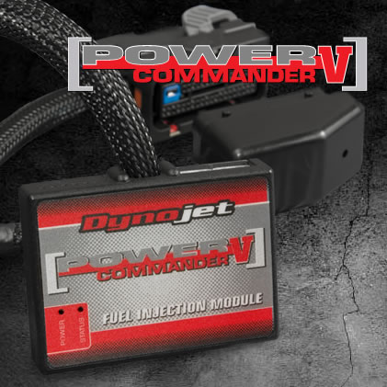
Power Commander V Fuel Injection Module
Allows for fuel map adjustment, while retaining factory ECU (Engine Control Unit) calibration
Allows for user-friendly tuning for target areas
Mode Switch can be added to switch between two fuel maps. Ex: Economy or Performance mode
Easily returned to factory settings

Slide 5
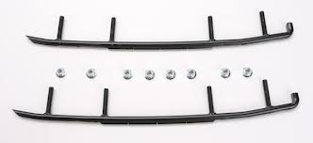
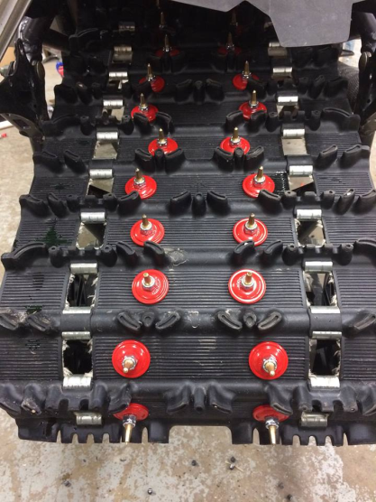
Handling
Woody’s Carbides
Reduces darting
Allows for more steering grip in turns
Woody’s Carbides Studs
Improves traction in most icy/snow
conditions
Decreases skidding while braking

Slide 6
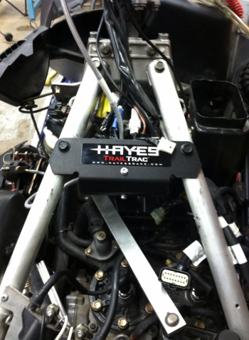
Handling Cont.
Hayes Trail Trac 1.0
ABS style braking system
Reduces skidding while braking
Helps keep the rear end in a straight line while braking

Slide 7
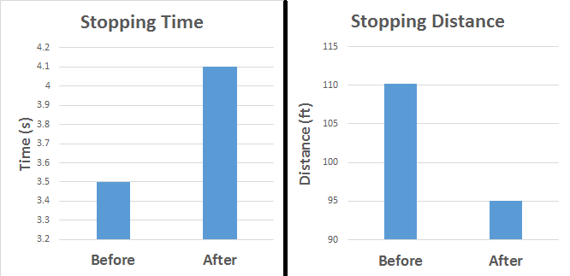
HAYES Trail Track Testing
Results displayed were taken at 45 MPH without Woody’s Studs
Conditions: little snow cover with layer of ice underneath.

Slide 8
Sound Emissions
Sound test was performed using SAE J192 Standard test
After 150 feet of constant speed, the machine then accelerates for 150 feet
Sound measurement is taken 50 feet perpendicular to the path of travel.
Sound levels during acceleration were found to be 76.9 dB
Sound levels at full throttle were found to be 81 dB
Conditions of the test day
Temperature: 19 Degrees Fahrenheit
Wind: 0 M.P.H.
Pressure: 30.23 inHg

Slide 9
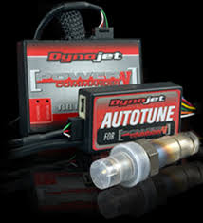
Isobutanol Conversion
Power Commander V
Allows for complete adjustment of fuel table off of AFR readings
O2 Sensor
Reads air-fuel ratio (AFR)
Dynojet Autotune
Allows for AFR data logging while the vehicle is being ridden (only when enabled)

Slide 10
Emissions Testing
Percent Change From Un-tuned 2 Injector Gasoline to Tuned 2 Injector Isobutanol
Emissions measurements were taken using a Nova 5 Gas Analyzer.

Slide 11
Dealer Benefits
This sled offers many desirable features and performance levels compared to equally priced and equipped snowmobiles
The current comparable model to our sled is a 2016 Polaris Rush 600 Pro-s
The MSRP for the Polaris Rush 600 Pro-s is $11,099, our sled’s MSRP is $13,246
The addition of these parts does not call for any additional maintenance, difficult installations and are readily available for any consumer as over the counter parts

Slide 12
Consumer Appeal
The 2-stroke motor is cheaper and easier to work on than 4-stroke motors
The chassis is highly adjustable to satisfy many types of riders and riding styles
Replacement parts are readily available over the counter
Modifications reflect improvements without major aesthetic changes

Slide 13
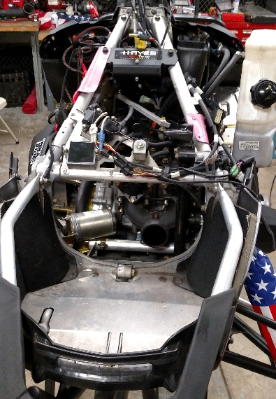
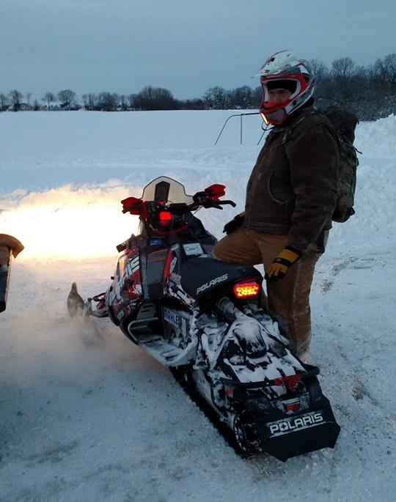
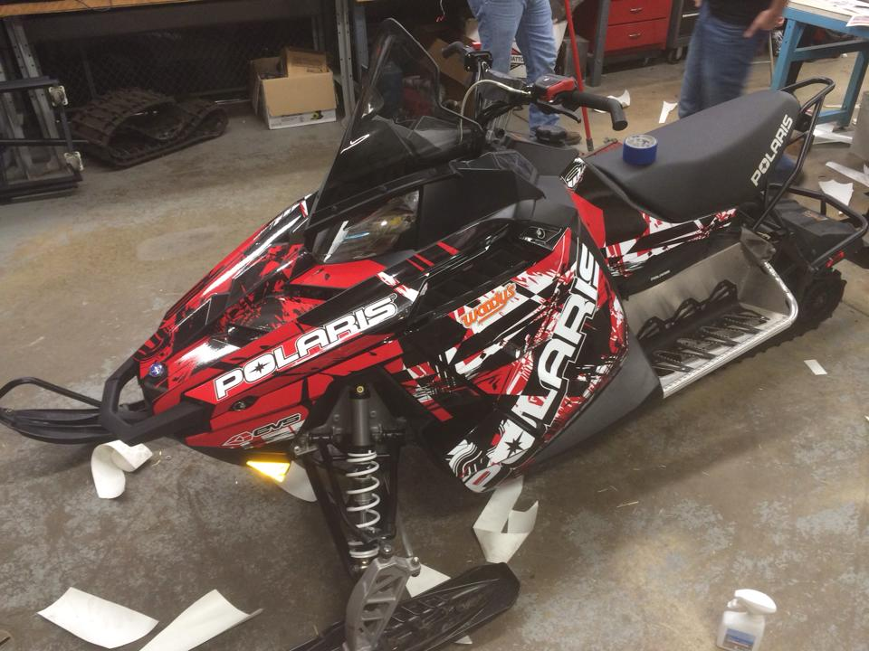
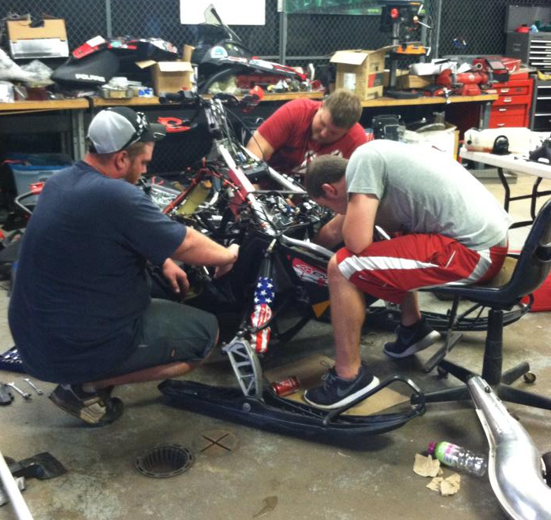
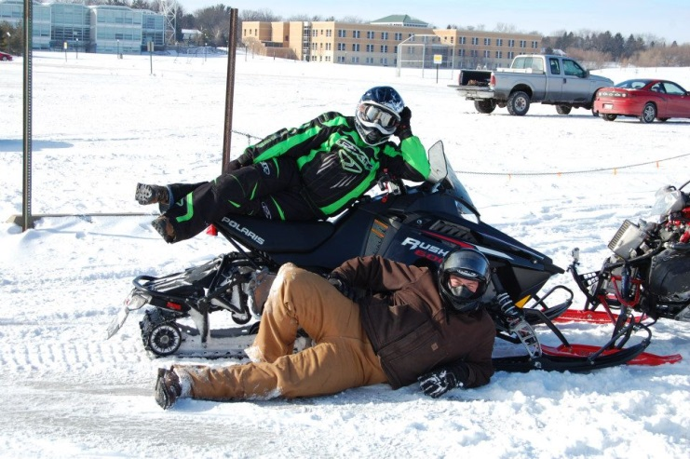
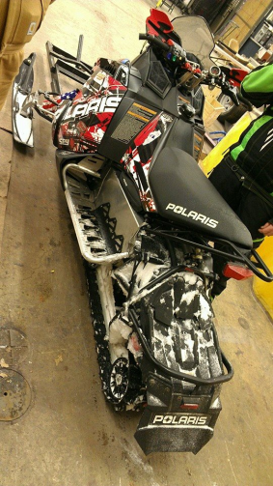
Questions?

