Slide 1
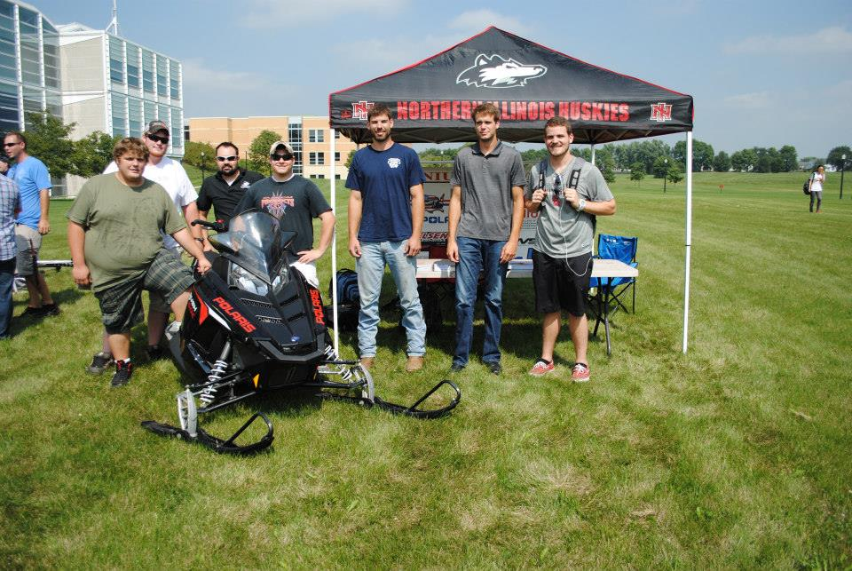
Northern Illinois University
2014 Clean Snowmobile Challenge

Slide 2
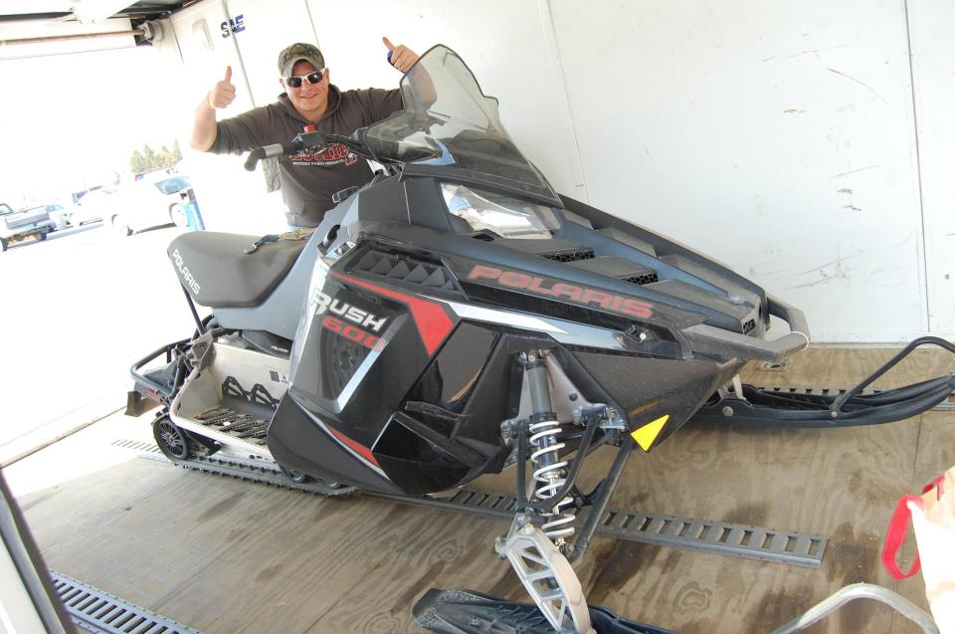
Snowmobile Selection
2011 Polaris Rush 600
What we set out to improve:
Exhaust Emissions
2-Stroke Engine Capabilities
Fuel Efficiency
Ability to run on Isobutanol blend

Slide 3
Rush Performance Enhancements
Engine-Cooling-Drivetrain
Dynojet Power Commander V
Electric Start
O2 sensor/ Air fuel ratio gauge.
Handling
Woody’s Trail Blazer Carbides
Woody’s Carbide Studs
Hayes Trail Trac 1.0

Slide 4
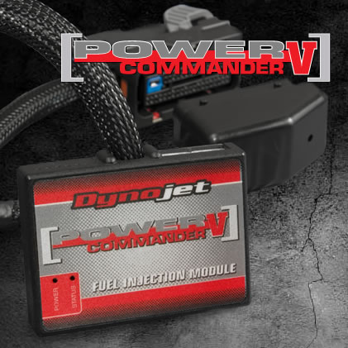
Power Commander V Fuel Injection Module
Allows for fuel map adjustment, while retaining factory ECU calibration
Mode Switch can be added to switch between two fuel maps. Ex: Economy or Performance mode
Easily returned to factory settings

Slide 5
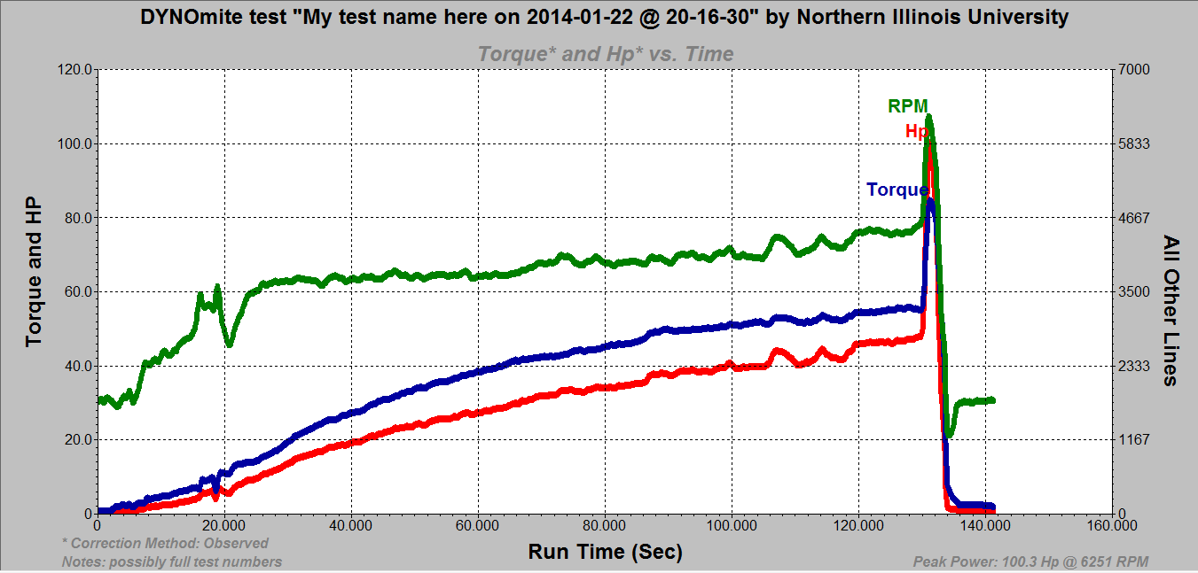
Dynamometer Testing
Peak Power: 100.3 Hp @ 6251 RPM
Peak Torque: 84.76 Ft Lbs
Factory Advertised Specs: 120 Hp

Slide 6
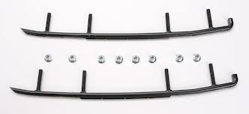
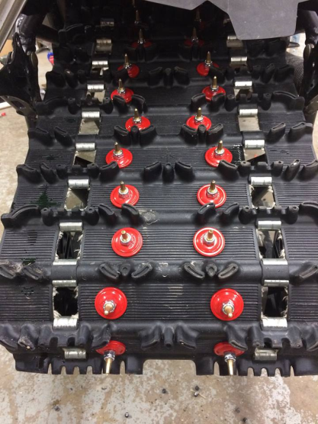
Handling
Woody’s Carbides
Reduces darting
Allows for more steering grip in turns
Woody’s Carbides Studs
Improves traction in most icy/snow
conditions
Decreases skidding while braking

Slide 7
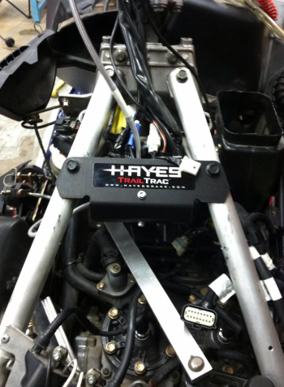
Handling Cont.
Hayes Trail Trac 1.0
ABS style braking system
Reduces skidding while braking
Helps keep the rear end in a straight line while braking

Slide 8
HAYES Trail Track Testing
Conditions: little snow cover with layer of ice underneath. Unpicked track
Tests measured both stopping distance and time
Tests were also done with picks installed.

Slide 9
Sound Emissions
Sound test was performed using SAE J192 Standard test
The machine accelerates for 150 feet after 150 feet of constant speed
Sound measurement is taken 50 feet perpendicular to the path of travel.
Sound levels were found to be 76.9 dB, also a full throttle full speed pass performed, which produced a 81 dB sound reading
Conditions of the test day
Temperature: 19 Degrees Fahrenheit
Wind: 0 M.P.H.
Pressure: 30.23 inHg

Slide 10
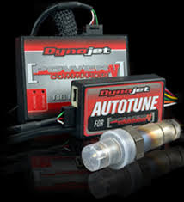
Isobutanol Conversion
Power Commander V
Allows for complete adjustment of fuel table off of AFR readings
O2 Sensor
Reads air-fuel ratio (AFR)
Dynojet Autotune
Allows for AFR data logging while the vehicle is being ridden (only when enabled)

Slide 11
Emissions Testing
Emissions measurements were taken using a Nova 5 Gas Analyzer.
Values are averages taken from the collection period. Engine was running 91 octane pump gasoline.

Slide 12
Dealer Benefits
This sled offers many desirable features and performance levels compared to equally priced and equipped snowmobiles
The current comparable model to our sled is a 2014 Polaris Rush 600 Pro-r
The MSRP for the Polaris Rush 600 Pro-r is $10,799, our sled’s MSRP is $12,956
The addition of these parts does not call for any additional maintenance, difficult installations and are readily available for any consumer as over the counter parts

Slide 13
Consumer Appeal
The snowmobile offers both performance and efficient adjustable modes
The 2-stroke motor is cheaper and easier to work on than 4-stroke motors
The chassis is highly adjustable to meet many types of riders and riding styles
Replacement parts are readily available over the counter

Slide 14
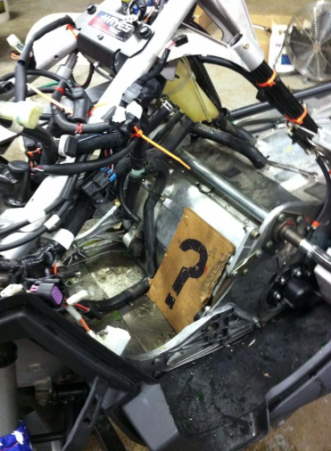
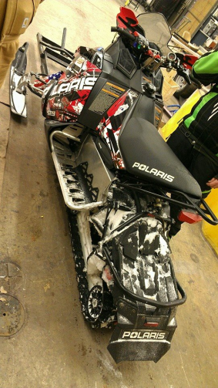
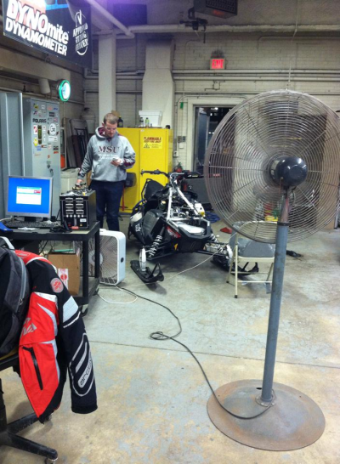
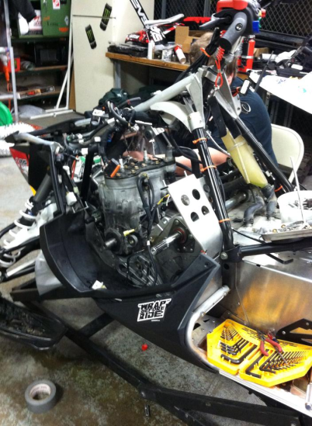
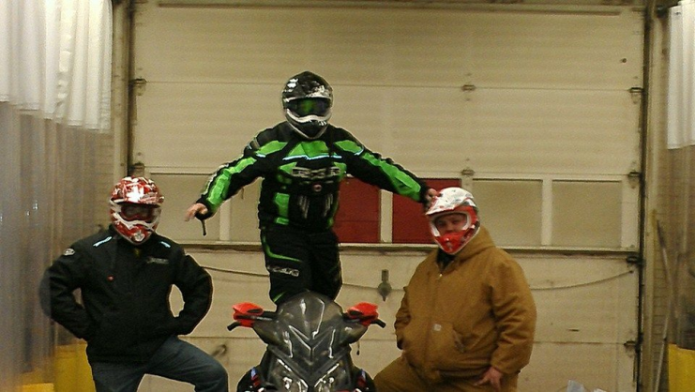
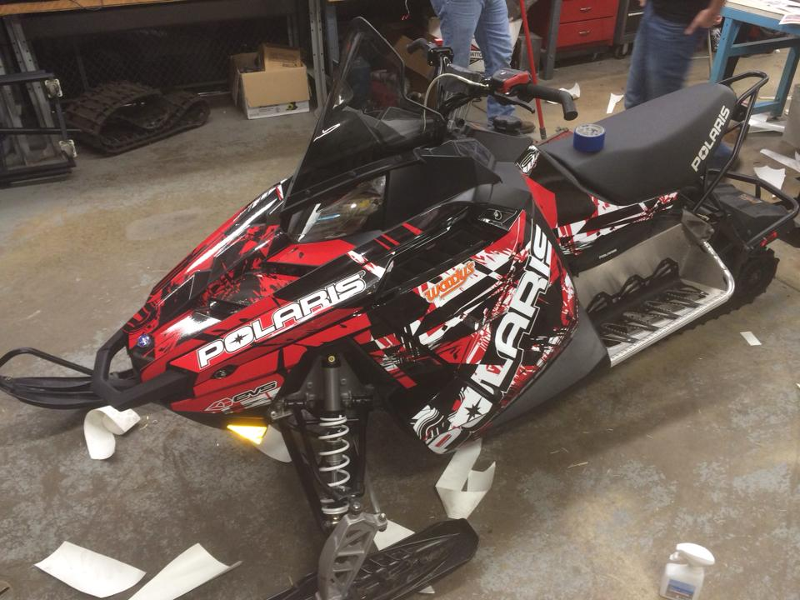
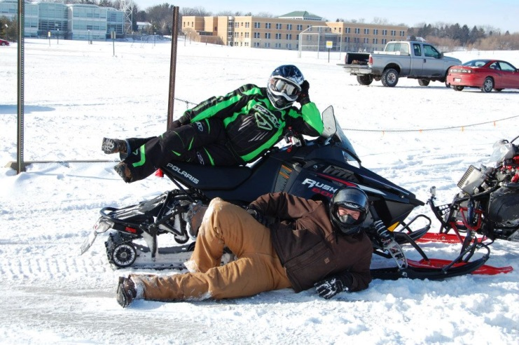
Questions?

