Slide 1
North Dakota State Clean Snowmobile Challenge 2015-2016
Presented by:
Steve Miller
Danika Gieske
Advisor:
Dr. Robert Pieri

Slide 2
Outline
Introduction
Strategy and Goals
Design
Engine
Exhaust System
Chassis Modifications
Conclusion
Questions

Slide 3
Introduction
2016 SAE Clean Snowmobile Challenge
Competing in the Diesel Utility Class
Stricter Regulations are forcing snowmobile industry to change
Tier 4 emission regulations have to be met
By implementing a diesel engine into the snowmobile NDSU hopes to research and develop technology that isn’t commonly seen in the snowmobile industry.
The target market for this sled are consumers looking for a long lasting and reliable snowmobile. This snowmobile is intended to be a working vehicle that can be used in a variety of applications.
Towing large loads through snow
Traveling long distances on a single tank of fuel
Commercial projects
Land owners, park managers

Slide 4
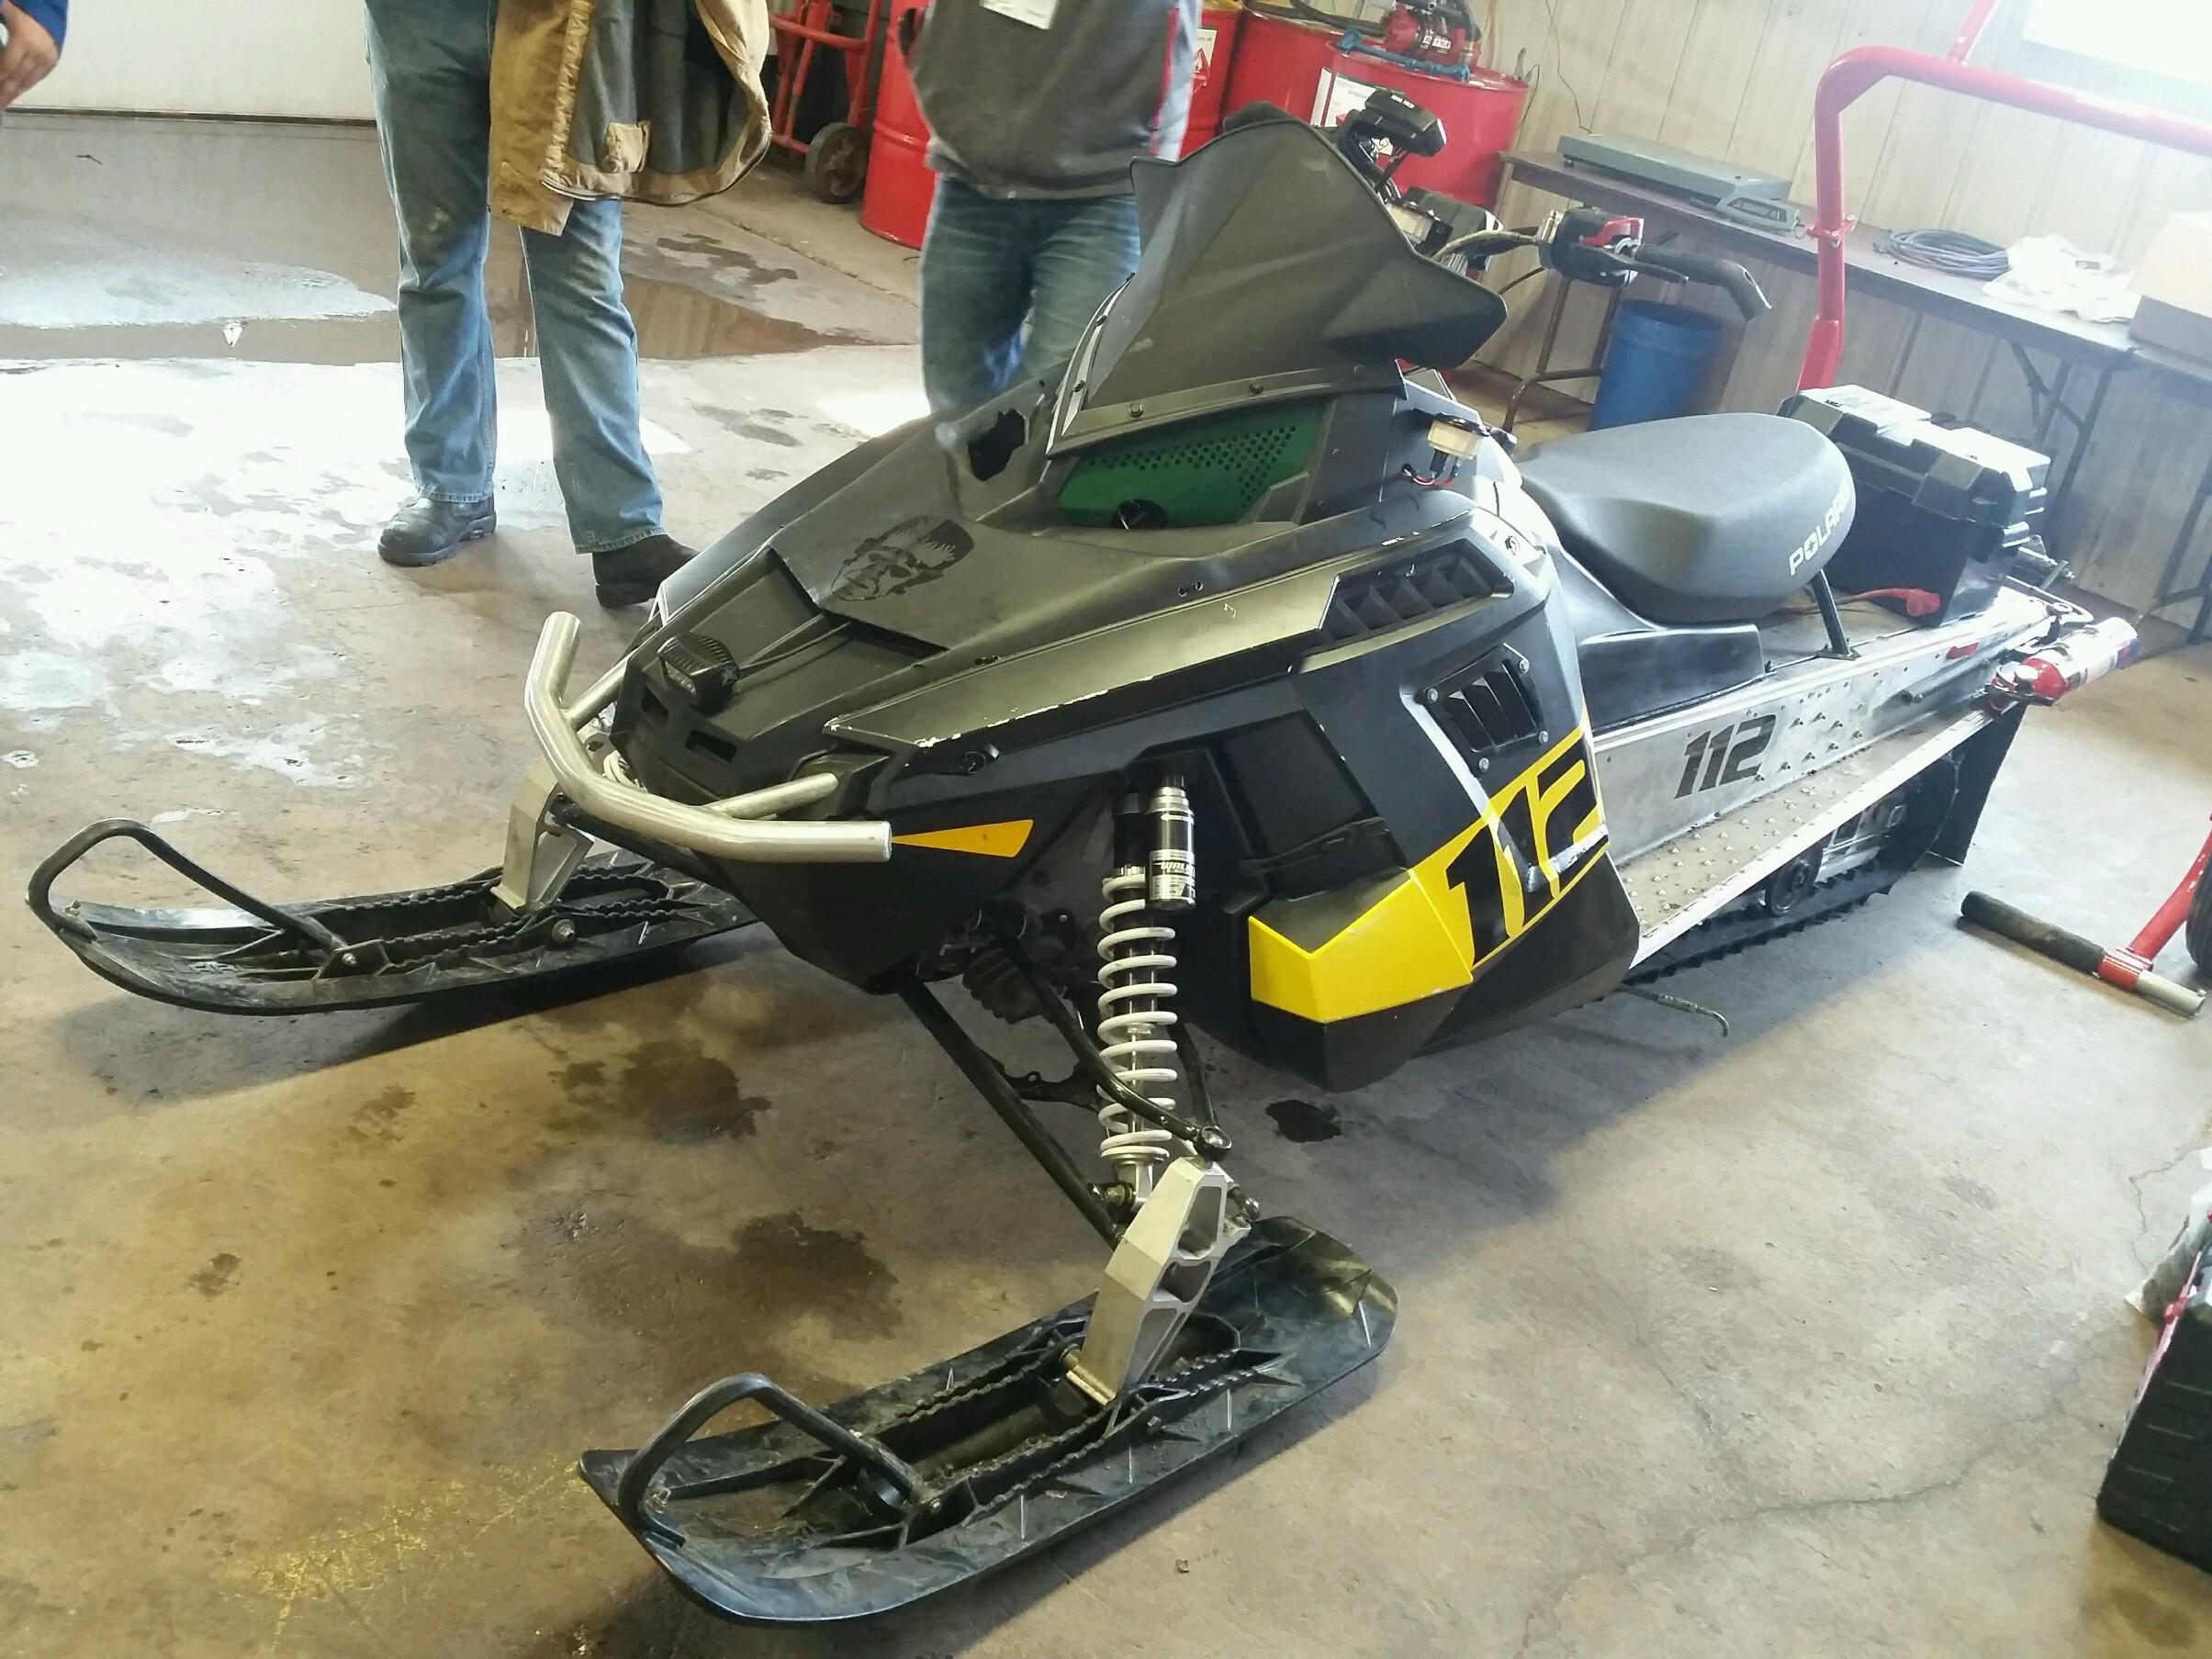
Comparison
VS
4WD Utility Truck
“Big Frank”

Slide 5
Goals and Strategy
Goals
Design a snowmobile that is reliable and focused around the key values of the competition.
Cleaner and quieter without sacrificing performance
Strategy
Install a Diesel engine into Polaris Voyageur Chassis
Incorporate a wall flow DPF
Make necessary chassis modifications to incorporate diesel engine
Market snowmobile to working class

Slide 6
Why Diesel???
Roughly half of all passenger vehicles in Europe run off of Diesel fuel
From 2010-2015 the amount of diesel vehicles in the United States has doubled to 155,000
Larger energy content than gasoline
139,000 BTU/Gal vs 124,000 BTU/Gal
Translates into higher fuel economy
Cheaper long term cost
Generally more expensive initially
(New York Times article)

Slide 7
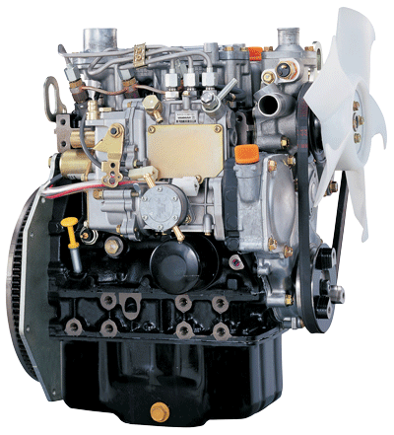
Engine Selection
3 Cylinder, 904cc Yanmar Diesel Engine
23.4 hp stock
50 ft-lb torque
Mechanical fuel injection
IHI RHF3 turbo charger
Increased power to weight ratio
Nearly doubles horsepower
Passes 2008 EPA Tier 4
Photo from Yanmar.com

Slide 8
Exhaust System
Volkswagen TDI Diesel Oxidation Catalyst (DOC) and Diesel Particulate Filter (DPF)
DOC converts CO (Carbon Monoxide), HC (Hydro Carbons) and PM (Particulate Matter) to the compounds CO₂ and H₂O
DPF primary objective is to remove soot from the exhaust
Switched from a partial flow DPF to a wall flow DPF
Creates a much more efficient filtration system
Partial flow filter has a valve that could let emissions exit without being treated
Wall flow forces all emissions through the appropriate filtration
Active regeneration
High temperatures burn soot instead of a fuel additive (passive regeneration)
Exhaust DPF and DOC

Slide 9
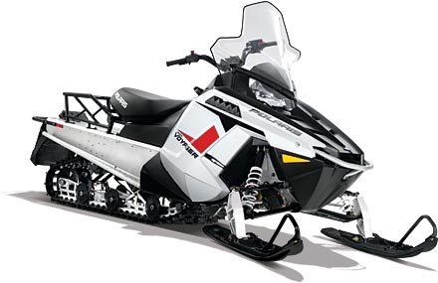
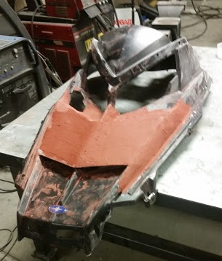
Chassis Selection
2014 550 Polaris Indy Voyageur 144" fan cooled
Longer track provides better traction in deep snow
Long tunnel provides storage space for cargo
Large size of engine caused several major chassis changes
Cooling system
Steering
Other chassis modifications
Towing hitch
Battery box
Hood sweep
Polaris Voyageur. Photo from Polaris.com
Hood sweep allows clearance for turbo

Slide 10
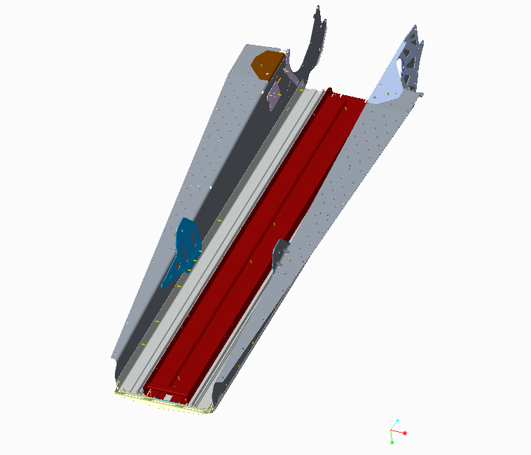
Cooling System
Indy Voyageur was originally fan-cooled
To increase cooling, a liquid cooled system was installed underneath the tunnel
Heat exchanger was taken from a liquid cooled Polaris Indy.
Had to decrease width of heat exchanger to fit between tunnel
Advantages
Saves much needed space under the hood
Allows the snow to maintain proper engine coolant temperature
CAD model of heat exchanger mounting

Slide 11
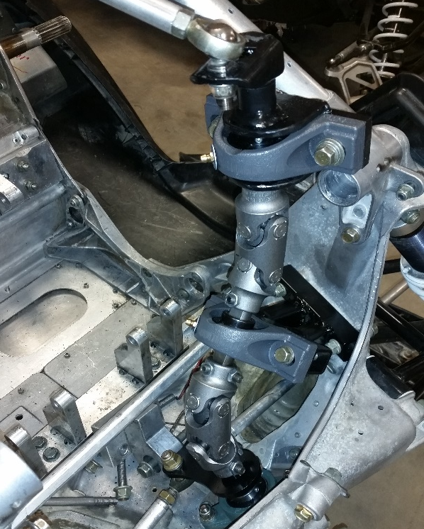
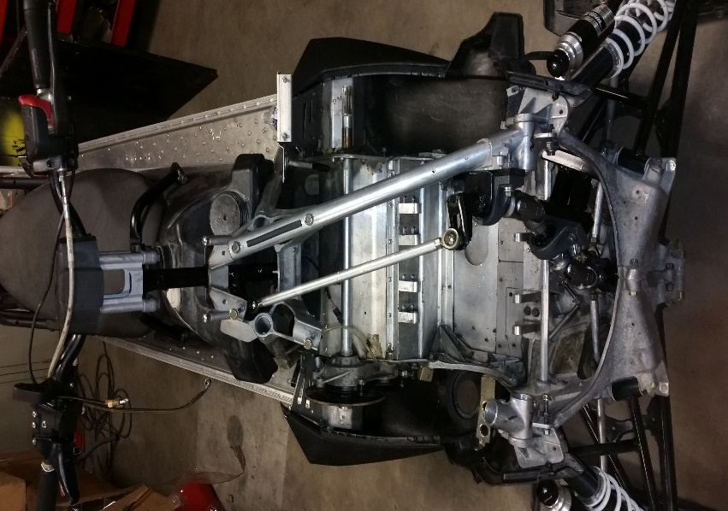
Steering System
Stock steering wasn't able to be used due interference with turbo
No direct path to steering outlet
Steering was re-routed to the side of the engine
U-joint steering column
Borgeson double u-joints
3/4-inch DD steering shaft
NTN mounted bearings
Components reused from the 2014 550 Indy Voyager steering system
tie rod and mounting plate
U-joint steering linkage
Stock tie rod and mounting plate

Slide 12
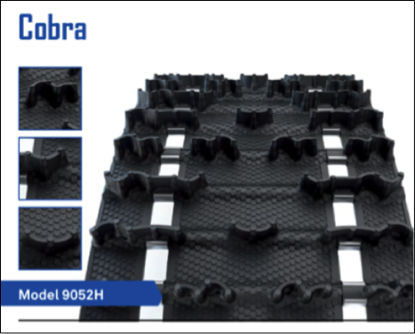
Snowmobile Features
Polaris floatation skis
Provide a larger area for weight distribution
Increase handling in deeper snow
Camso Cobra track
Lug designs generate less noise
Cupped lugs for superior acceleration & braking in loose, soft snow
Flexible lug design for off-trail performance
Suspension
Switched springs from stock 100lb/in to 155lb/in springs to ensure rider comfort and to prevent bottoming out due to heavy cargo
Camso Cobra track. Photo from Camso.com

Slide 13
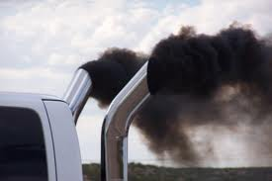
Design Challenges
Diesel engines are not common in the snowmobile industry
Many components had to be custom fabricated
Used parts from several industries: Auto, Agriculture and Snowmobile
Emissions from diesel engines are perceived as “Dirty”
Black smoke coming out of the exhaust causes negative perceptions
May leave black stains in the white snow
Distinct exhaust order

Slide 14
Conclusions
Diesel engines are work horses
Long reliable engine life
Diesel fuel has a higher energy content than gasoline
Increased fuel economy
Allows for longer travel to remote locations
Increased towing capabilities
Commercial application
Able to haul large loads
Diesel emissions technology is advancing
Cleaner and quieter exhaust systems
Smaller size

Slide 15
MSRP
Based on team estimates and the application of the sled, the MSRP for a mass produced version of this snowmobile would be $13,800
Long life of engine and fuel economy make this an attractive offer to consumers

Slide 16
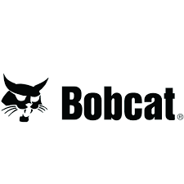
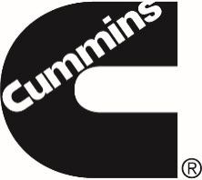
Questions?

