Slide 1
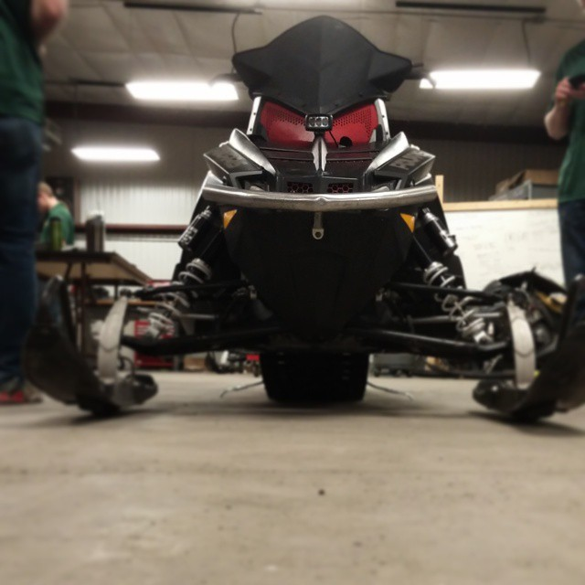
NDSU Clean Snowmobile
Presented by:
Michael Niehoff
Jared Quinlan
Advisor:
Dr. Robert Pieri

Slide 2
Goals & Objectives
Complete Each Event
Retrofit a Diesel Engine into a Snowmobile
Achieve 25 mpg
Increase Soot Control
Refine Power Delivery to Track
Provide Optimal Utility Snowmobile

Slide 3
Target Market
Utility Use
National Parks
Trail Riding
Commercial
Longevity
Low Maintenance

Slide 4
Advantages vs. Disadvantages
Improved Fuel Economy
Capable of long trips
Reach remote locations
Improved Torque Output
Pulling Capacity
Workhorse
Long Track
Improved traction for pulling
Deep snow compatible
Cold Starting Issues
Glow Plugs
“Dirty”
Diesel Particulate Filter
Diesel Oxidization Catalyst
Slow
High-Low Gearing

Slide 5
Chassis Selection
Utility Snowmobile
Indy Voyager
Balance of Traction & Lower Weight
Retrofit High-Low Transmission
Modify Overstructure
 | IQ WideTrak | Indy Voyager
Track | Width: 20” Length: 156” | Width: 15” Length: 144” or 155”
Dry Weight (lbs) | 671 | 498
Gearing (jackshaft to driveshaft) | High-Low Transmission | Fixed Gear Ratio
Cargo Rack | Yes | Yes

Slide 6
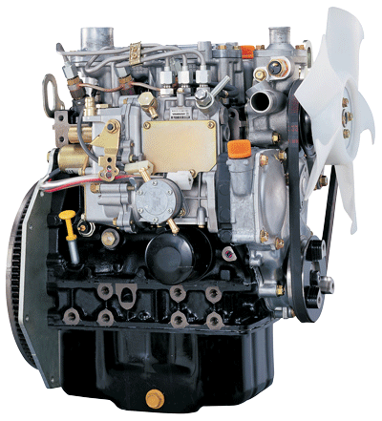
Engine Selection
3 Cylinder, 904 cc Yanmar Diesel
Lightweight
187 lbs
Size Constraints
Passes 2008 EPA Tier 4
High Output Power
23.4 Hp Stock
50 ft-lb torque
Turbocharger
IHI RHF3
Increased Air Flow Rate
Photo Courtesy of Yanmar.com

Slide 7
Emissions
Diesel Oxidation Catalyst
Light-Off Temperature
~185°C-225°C
Products
Carbon Monoxide (CO)
Hydrocarbons (HC)
Particulate Matter (PM)
Oxygen (O₂)
Reactants
Carbon Dioxide (CO₂)
Water Vapor (H₂O)

Slide 8
Emissions
Diesel Particulate Filter
Traps Particulate Matter
Effective Filter Removes up to 85% of PM
Regeneration Oxidizes Soot into Ash
Regeneration ~650°C
Peak EGT of ~450°C
Requires Active Regeneration

Slide 9
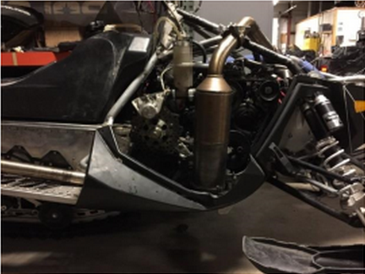
Noise Control
Track Noise
Rubber skirting
New bearings and bogey wheels
Exhaust Noise
Direct into snow
Insulation/Wrapping

Slide 10
Outfitter Perspective
MSRP: $15,579.99
Diesel Engine
Increased engine life over Gasoline
Diesel Fuel is readily available
High-Low Transmission
2” Receiver Hitch

Slide 11
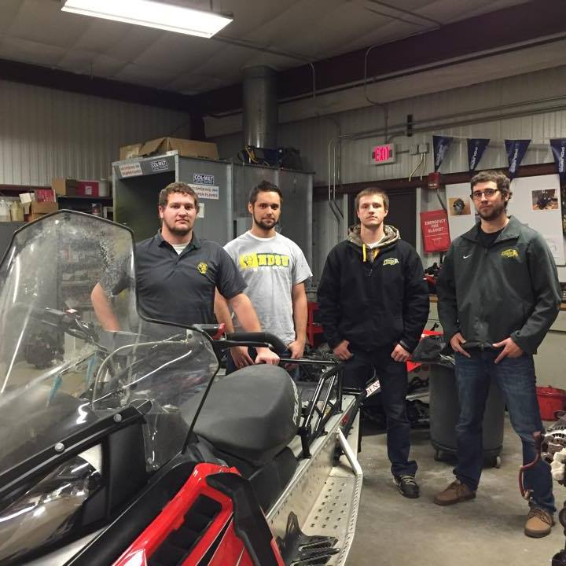
Conclusion
Utility Snowmobile
Efficient
Quiet
Clean

Slide 12
Thank You to Our Sponsors
NDSU Mechanical Engineering Dept. & NDSU SAE Polaris Industries Team Industries Great River Energy Camoplast BASF Wheels Inc. Exhaust Pro's Al's Snowmobile Parts McNelius Steel Klim RJ Mann & Associates SolidWorks

Slide 13
Questions?

