Slide 1
North Dakota State University
Ross Larson Justin Omdalen

Slide 2
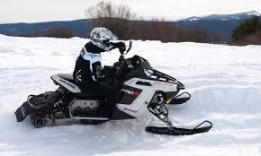
Successful Production Snowmobile
Who is your target market?
Will outfitters want this snowmobile?
Does the snowmobile meet regulations?
Photo Courtesy of snowmobile.com

Slide 3
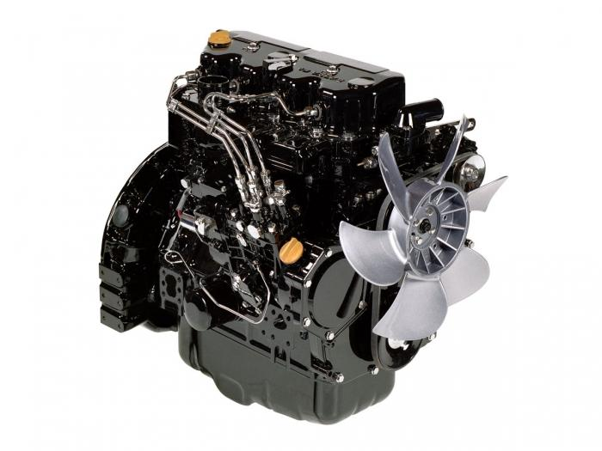
Design Overview
Polaris Pro-Ride Chassis
900cc Turbocharged 3-cylinder Diesel Engine
Diesel Oxidation Catalyst
Partial Diesel Particulate Filter
Photo Courtesy of Yanmar Engine

Slide 4
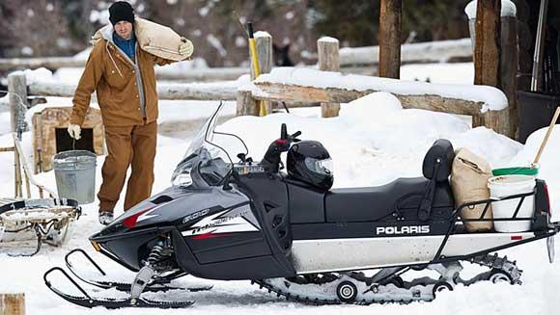
The Target Market
National Park Use
Utility Snowmobiles
Efficient Personal Use
Photo Courtesy of Charels Hudson

Slide 5
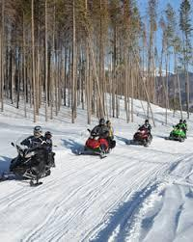
Operator Perspective
Perfect Cruising Snowmobile
Top Speed 58 MPH
Low End Torque For Pulling
Torque of 80 ft-lbs
Photo Courtesy of snowmobilers.org

Slide 6
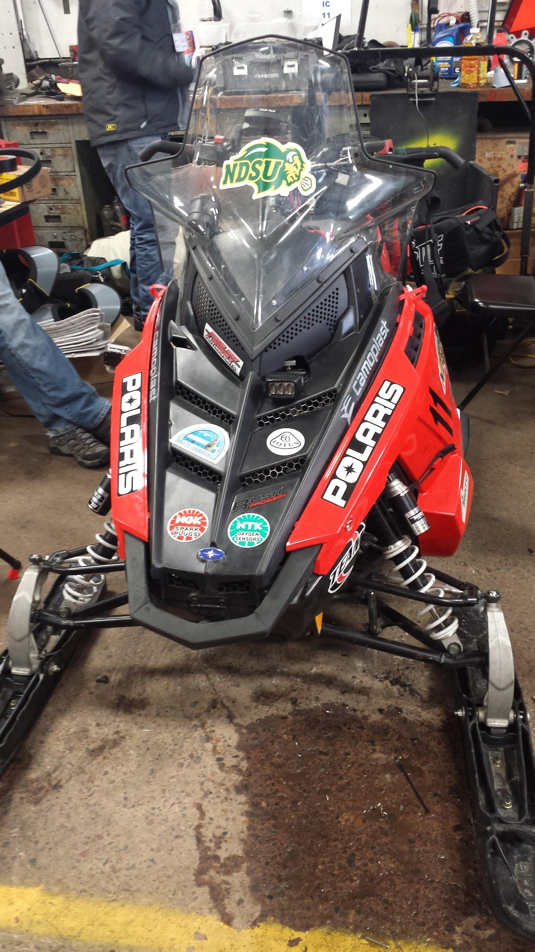
Operator Perspective
Rider Comfort
Noise
Rider warmth
Rider posture
Easily Adjustable Suspension

Slide 7
Outfitter Perspective
MSRP: $15,542.45
Increased vehicle life
Diesel engine life longer
Longer maintenance intervals
Increased oil change mileage
No altitude compensation required
Photo Courtesy of Wheels Inc.

Slide 8
Outfitter Perspective
Increased durability with diesel engine
Engine operates safe at all RPM levels
Handling and acceleration welcome novice riders
Increased fuel efficiency and range
Diesel fuel readily available in most riding areas

Slide 9
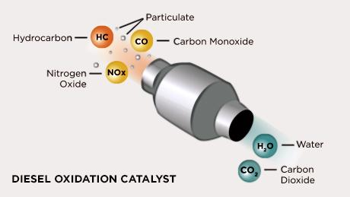
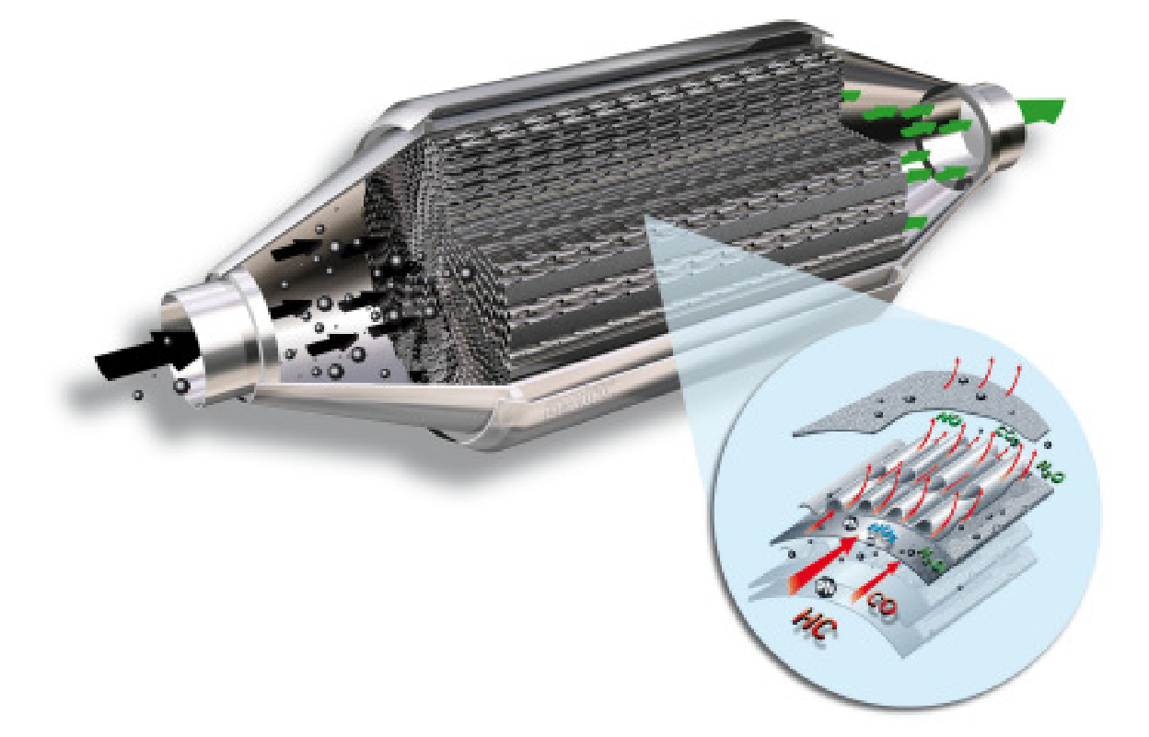
Environmental Perspective
Sound pollution is minimized with the diesel engine
The turbocharger, catalyst, and DPF help to reduce emissions
Partial Diesel Particulate Filter
Photo Courtesy of Emitec
Photo Courtesy of ipf.msu.edu

Slide 10
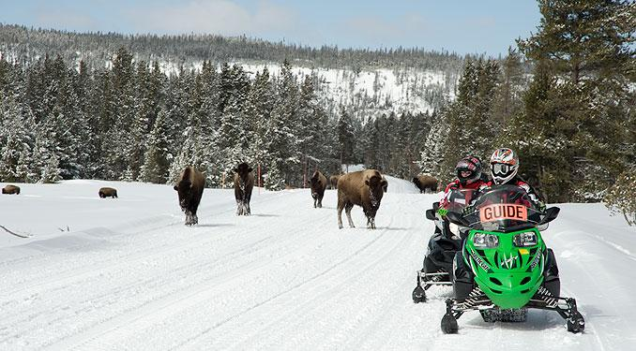
Conclusion
Meets goals of the competition
Simple solution for clean snowmobile
Photo Courtesy of seeyellowstone.com

Slide 11
Questions?

