Slide 1
2018 North Dakota State University Clean Snowmobile Challenge
Members: Jon Chelmo, Justin Davis, Colton McAllister, and Siwakorn Tangpong
Mentor: Dr. Robert Pieri
Notes:
Justin

Slide 2
Introduction
Participating in the diesel utility class.
Team management
4 senior design members
4 former clean snowmobile competitors
8 freshman and sophomore helpers
Target market
High performance in difficult terrain
Quite and clean operation
Improved maneuverability for the utility class

Slide 3
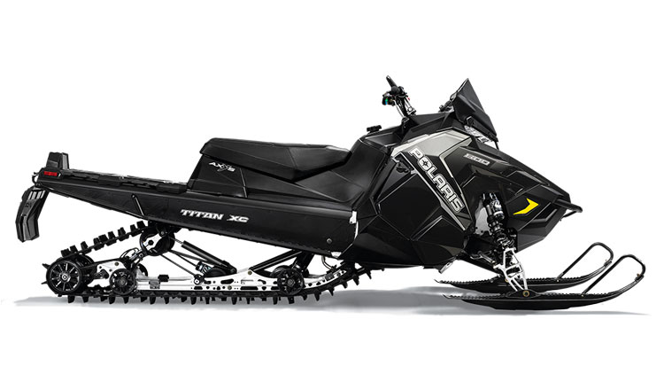
Snowmobile Selection
2018 Polaris Titan XC Key Specifications
155” X 20” track
Fox QS3 front shocks
AXYS chassis
Alternative Snowmobiles
Ski doo Tundra
Polaris Widetrak LX
Chassis Modifications
Engine mounts
Overstructure
Steering System
Track
Skis
Snow flap
Batterybox
Notes:
Justin
Notes
Maintain relationship with Polaris

Slide 4
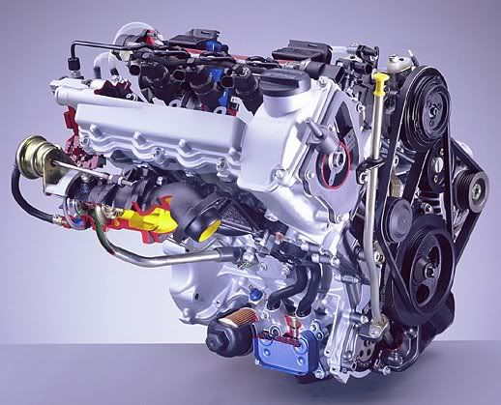
Engine Selection
Mercedes OM660
Details
799 cc turbocharged three cylinder diesel
Common rail direct injection
Advantages
Electronically controlled
Relatively light weight
Cost
What was done
Full engine rebuild
Injector cleaning
New factory turbocharger
New wiring harness
Aftermarket Electronic Control Unit
Alternative Engines
Yanmar 3TNM72
Kubota
Notes:
Justin

Slide 5
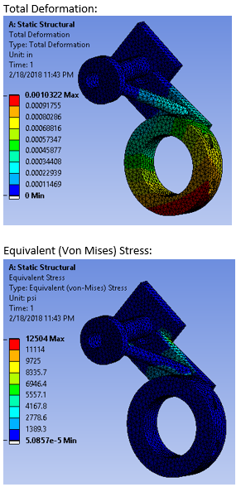
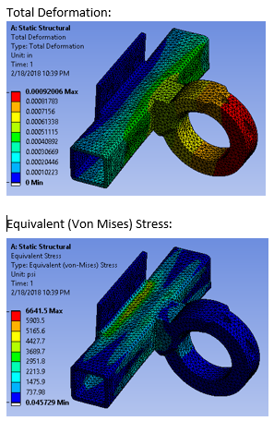
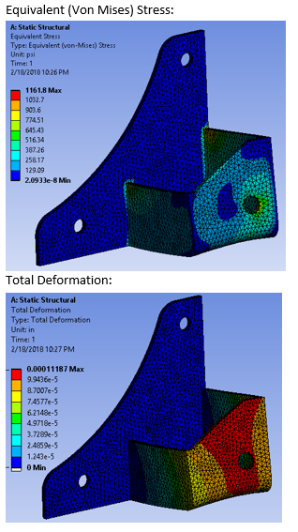
Engine Mounts
3 different locations around the engine
First engine mount : Lower right side of the engine
Second engine mount: Lower left side of the engine
Third Engine mount: Bellhousing flange at the back of the engine
First Engine Mount
Second Engine Mount
Third Engine Mount
Notes:
Jon

Slide 6
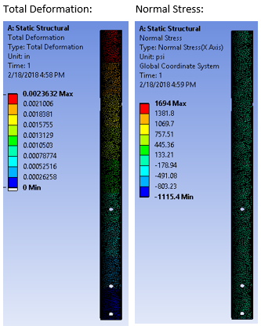
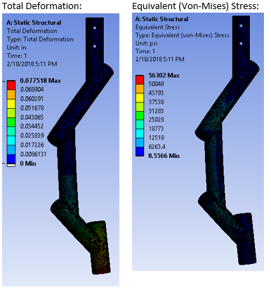
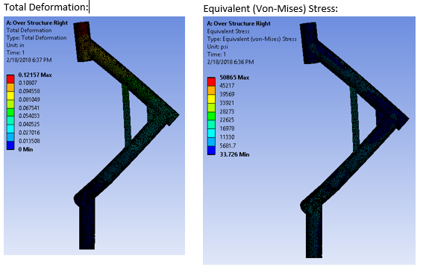
Overstructure
Fabricated new left & right sides of over structure to fit OM660 engine
Stock Supports
Left Support
Right Support
Notes:
Jon

Slide 7
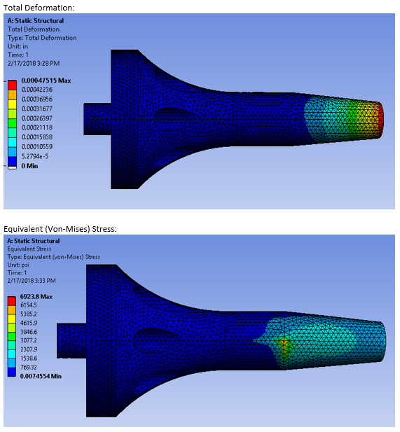
Drivetrain
Fabricated stub shaft to attach the primary
clutch to the flywheel/crankshaft
Modified Stub Shaft
Notes:
Jon

Slide 8
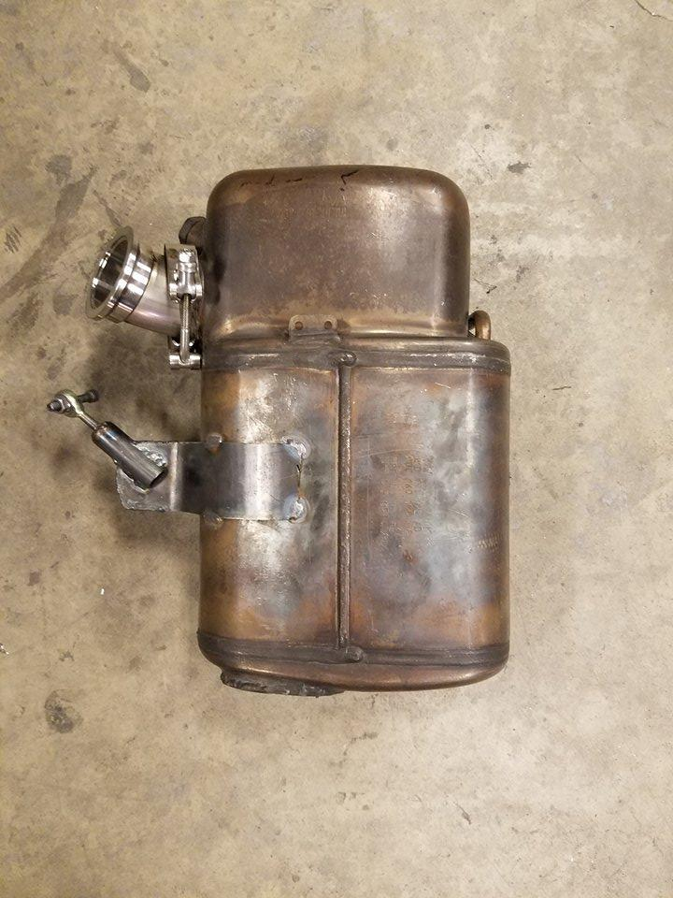
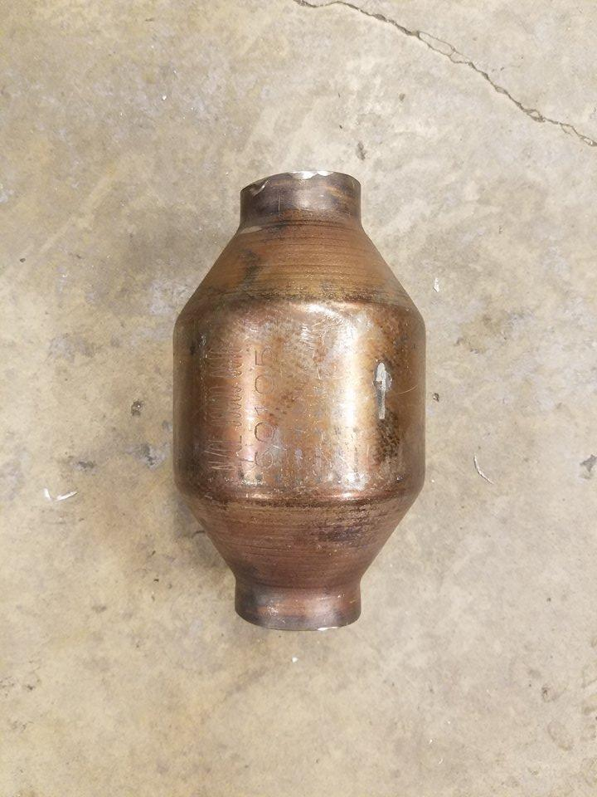
Exhaust System
Diesel particulate filter and preliminary catalyst
Filter diesel particles out
Remove nitrous oxides (NO_{X}) and carbon monoxide
Secondary catalytic converter
Remove remaining nitrous oxides
Diesel Particulate Filter and Primary Catalytic Converter
Secondary Catalytic Converter
Notes:
Colton

Slide 9
Steering System
Physically Linkage via Cable (Chosen)
Pliable, capable of routing anywhere
Physically linked, reliable
Easy to maintain
Electrical/Hydraulic (Alternative)
Added components (cords/reservoirs)
Higher cost and complexity
Notes:
Colton

Slide 10
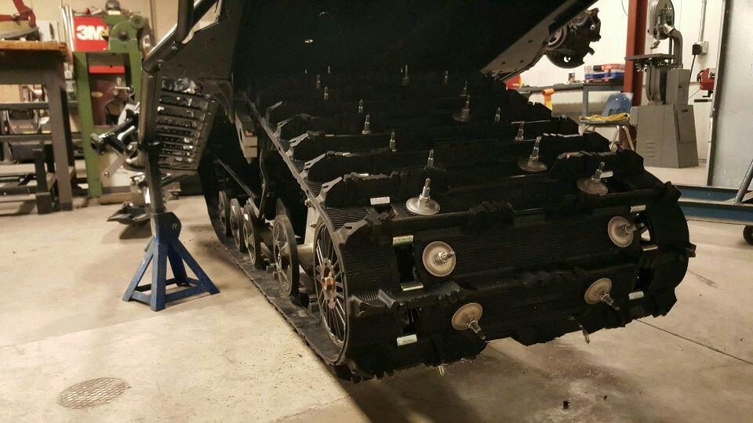
Track
Camso Ripsaw Track
1.25” lugs
More rigid lugs then the stock Cobra tracks
Provides better trail riding performance
Woody’s Studs
108 studs at 1.5”
Improves traction on icy surfaces
Notes:
Colton
Entire track modifications allows for better performance in difficult terrain and while towing

Slide 11
Manufacturer's Suggested Retail Price
MSRP - $17,103.37
Main components:
OM660
DPF
Track
ECU
Notes:
Korn (Reasons why it is competitive)

Slide 12
Conclusion
Powerful modern diesel
Improve mobility from traditional utility snowmobile
Ease of service
Quiet and clean operation
Competitive price
Notes:
Korn

Slide 13
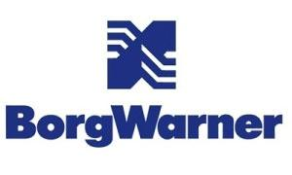
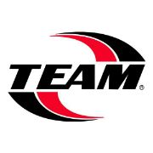
Questions?
Thank you to all of our sponsors
Notes:
Korn

