Slide 1
North Dakota State university Clean Snowmobile Challenge 2017
Presented by: Scott Becker, Nick Dirnberger, Ethan Peterson, and James Tibbles
Advisor: Dr. Robert Pieri

Slide 2
Introduction
Competing in the diesel utility class
Emissions Standards becoming more strict
EPA emissions requirements are fuel neutral
Target market and uses
Towing heavy loads
Reliable long distance travel
Replace larger utility vehicles with something smaller and more maneuverable

Slide 3
Design Goals and Strategy
Why Diesel?
Many large passenger vehicles and commercial equipment run on diesel
Higher energy content than gasoline
139,000 BTU/Gal versus 124,000 BTU/Gal
Generally more reliable and less expensive to maintain
Better fuel economy
Goals
Implement a Yanmar diesel engine into a 2015 Polaris Widetrak LX Chassis
Reduce impact on environment while maintaining functionality
Reduce emissions and sound
Improve fuel economy and power
Notes:
Talk about the rule objectives and team objectives.
How we set goals to improve on last years results.
Quick overview of emissions and noise reduction we decided on to obtain the objectives.

Slide 4
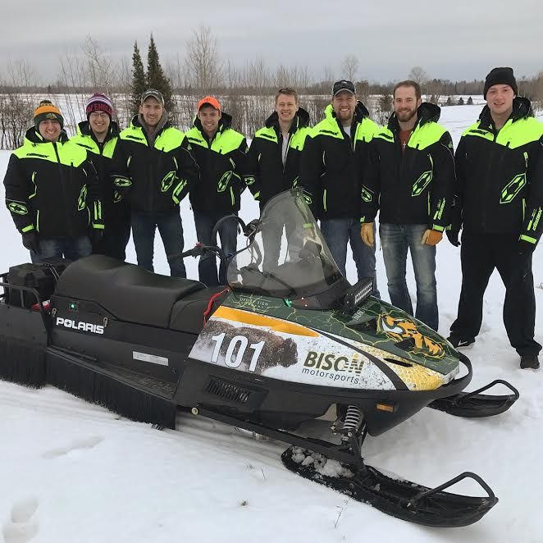
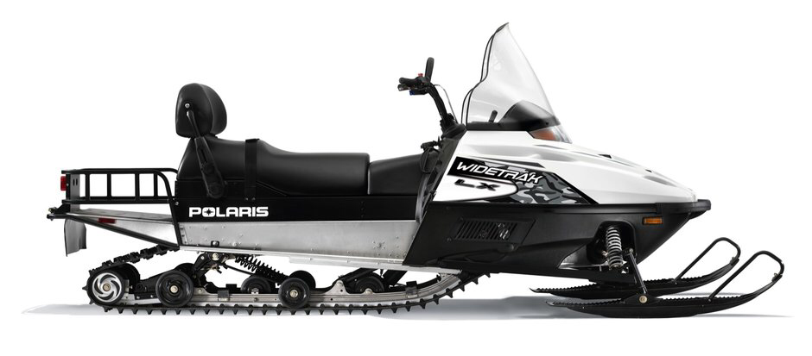
Snowmobile Chassis
2015 Polaris Widetrak LX
Modifications
20 inches wide by 156 inches long
500 cc Gasoline engine
Liquid Cooled
Gear Box
Camso Pre-studded track
Yanmar 3-cylinder Diesel Engine
IHI RHF3 Turbocharger
Volkswagen TDI DOC/DPF and MagnaFlow Diesel Catalytic Converter
Big Wheel Kit
Polaris Pro Float Skies
Noise Dampening Paint and Skirt
2015 Polaris Widetrak LX
NDSU Clean Snowmobile Design Team
Notes:
For this years competition the team selected to use a 2015 Polaris WideTrak.
Talk about the pros of this sled and why it was selected.
This sled abided by the rules of being a utility chassis that was made from the four major snowmobile manufacturers and no more than five years old.
The features we selected for based off of the input from previous teams was a model that had lots of room in the engine bay along with ...

Slide 5
Engine options
YANMAR 0.9L DIESEL
MERCEDES SMART FORTWO
Pros
Proven champion
reliability
No need for ECU (save $$$)
Compatible pre-existing output shaft design
Mounts can be modified to fit new chassis
Cons
Engine knock that needs to be fixed
rebuild
Pros
Electronic control
Horsepower
Weight
More relevant considering the progress of technology
Cons
Lead time for parts
needs new wiring harness ($$$)
Needs new ECU or ECU Flash ($$$$)
Needs output shaft designed and manufactured ($$$)
Unproven reliability
Notes:
Talk about the engine selection and why we selected the engine we did.
Talk about the Yanmar specs.

Slide 6
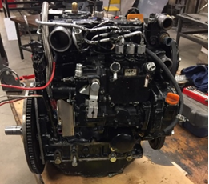
Engine Selection: Yanmar
need a standalone ECU to operate, which costs upwards of $5000
Remaining funds $500
4 months until Competition
This feat is unachievable with the remaining time.
Yanmar performed well at previous competition
No experience with Mercedes smart fortwo
Yanmar 3TNM72 engine

Slide 7
REBUILD
Need: excess noise, knock, and history of overheating
What was accomplished
Testing
Replaced cylinder head
Changed Rod Bearings
Replaced worn valve guide seals
New engine gasket set
Quietest the yanmar has ever been
Knock and overheating issues eliminated
Improved engine oil pressure

Slide 8
Clutching
Custom Primary (Drive) and Secondary (Driven) Clutches
Courtesy of TEAM Industries
Optimized for engagement around 1200 rpm
Diesel engines operate at lower rpms
Maximize power transfer

Slide 9
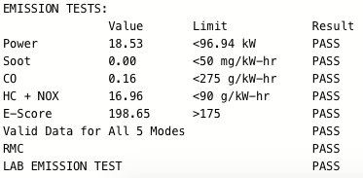
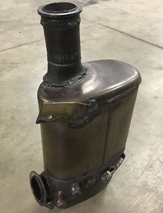
Emissions
Volkswagen TDI Diesel Oxidation Catalyst (DOC) and Diesel Particulate Filter (DPF)
Excellent results last year
Wall Flow System
Converts Carbon Monoxide (CO) to Carbon Dioxide (CO₂)
Converts Hydrocarbons (HC) to Water (H₂O)
Diesel Particulate Filter removes soot
Passive Regeneration process
Emissions Results from CSC 2016
Volkswagen Wall Flow DOC/DPF system
Notes:
Talk about why the DOC/DPF was used based off of last years results.
Talk about to improve these results a catalyst was looked into and selected.
The catalyst was selected to reduce the NOx levels produced from the sled.
If any tested data talk about it here.

Slide 10
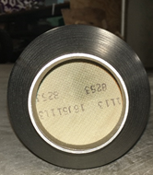
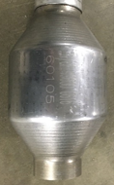
Emissions
MagnaFlow Diesel Ceramic Substrate Catalytic Converter
Last year judges recommended improving NOx levels
Added downstream of DOC/DPF
Reduces Nitrogen Oxides (NOx) to Nitrogen and Oxygen
Take care of any remaining CO, HC, or NOx
MagnaFlow Diesel Catalytic Converter
Notes:
Talk about why the DOC/DPF was used based off of last years results.
Talk about to improve these results a catalyst was looked into and selected.
The catalyst was selected to reduce the NOx levels produced from the sled.
If any tested data talk about it here.

Slide 11
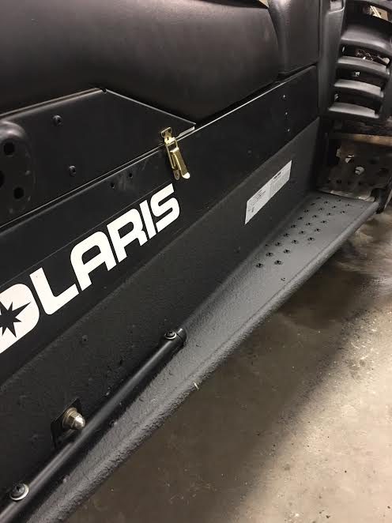
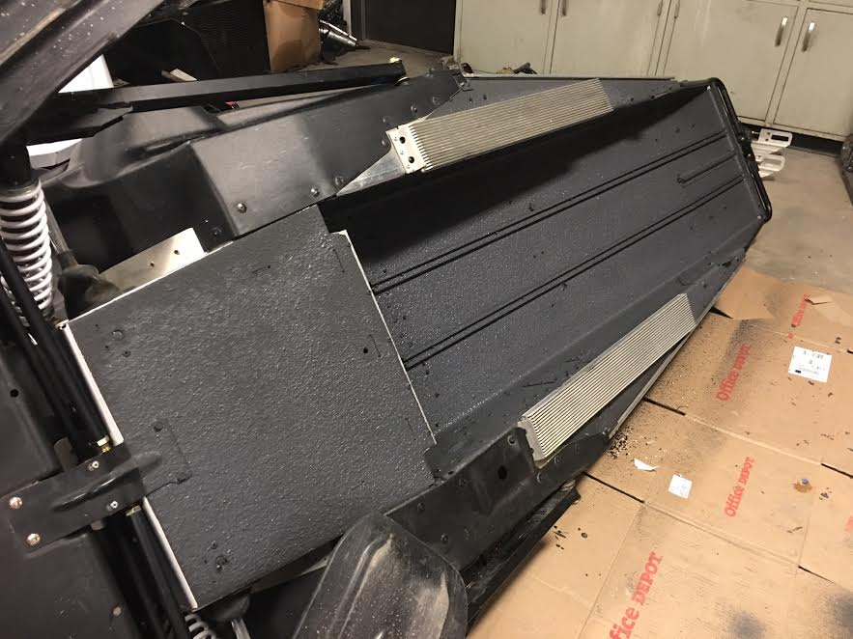
Noise Reduction
LizardSkin Sound Control Paint
Pros:
Thin Coat
Test Results Showing Noise Reduction
Cold Temperature Durability
Wear Resistant
Easy to Apply
Notes:
Talk about the thought process. How we wanted to reduce noise by using a paint that helped prevent vibration. Talk about the paint possibilities and why LizardSkin Sound Control paint was selected. Talk about testing the paint. Once we selected the paint we tested it to see possible affects it had on reducing noise. The test consisted of taking a controlled weight dropping it from a constant height into the test material and recorded the decibel reading. This was done on the test material with no paint on it, with one side of the test material painted and then both sides of the test material painted. The results showed the average of the maximum noise produced for the test material was determined to be 104.08 decibels with no sides painted. With a standard deviation of 1.33 dB. The average of the maximum noise produced by the sample was determined to be 95.78 decibels when one side was painted.The average of the maximum noise produced by the sample was determined to be 84.55 decibels when both sides were painted. Witha standard deviation of 1.67 dB. With a standard deviation of 3.3 dB. After that one side of the test material was painted with LizardSkin Sound Control. The same test was performed with 20 trials and the data was recorded.
From those results the team decided to paint both side of the tunnel of the snowmobile and all other spots that would be could be painted due to the added benefit of both sides being painted.
The noise dampening skirt was thought of to help contain the noise produced from the track of the snowmobile. Different materials were thought of that could contain the noise and be flexible enough to give when in contact of the ground. It was determined to use a nylon bristles as they would provide great flexibility and yet rigidity to not deform.

Slide 12
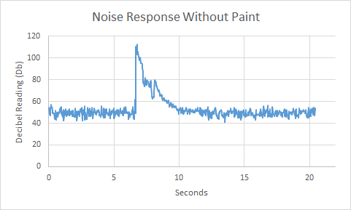
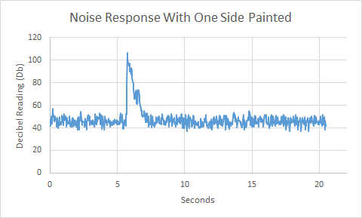
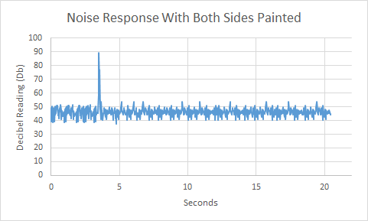
LizardSkin Paint Testing
Test Material | Average max peak noise (dB) | Standard Deviation in (dB) | 95% Confidence Interval of average max peak noise (dB)
No paint applied | 104.08 | 1.33 | 104.08 ± 0.61
One side of material painted | 95.78 | 1.67 | 95.78 ± 0.77
Both sides of material painted | 84.55 | 3.3 | 84.55 ± 1.74
Test Material | Time Taken for Test Material to Quiet Down
No paint applied | 3.04 seconds
One side of material painted | 1.22 seconds
Both sides of material painted | 0.40 seconds
Notes:
Talk about the thought process. How we wanted to reduce noise by using a paint that helped prevent vibration. Talk about the paint possibilities and why LizardSkin Sound Control paint was selected. Talk about testing the paint. Once we selected the paint we tested it to see possible affects it had on reducing noise. The test consisted of taking a controlled weight dropping it from a constant height into the test material and recorded the decibel reading. This was done on the test material with no paint on it, with one side of the test material painted and then both sides of the test material painted. The results showed the average of the maximum noise produced for the test material was determined to be 104.08 decibels with no sides painted. With a standard deviation of 1.33 dB. The average of the maximum noise produced by the sample was determined to be 95.78 decibels when one side was painted.The average of the maximum noise produced by the sample was determined to be 84.55 decibels when both sides were painted. Witha standard deviation of 1.67 dB. With a standard deviation of 3.3 dB. After that one side of the test material was painted with LizardSkin Sound Control. The same test was performed with 20 trials and the data was recorded.
From those results the team decided to paint both side of the tunnel of the snowmobile and all other spots that would be could be painted due to the added benefit of both sides being painted.
The noise dampening skirt was thought of to help contain the noise produced from the track of the snowmobile. Different materials were thought of that could contain the noise and be flexible enough to give when in contact of the ground. It was determined to use a nylon bristles as they would provide great flexibility and yet rigidity to not deform.

Slide 13
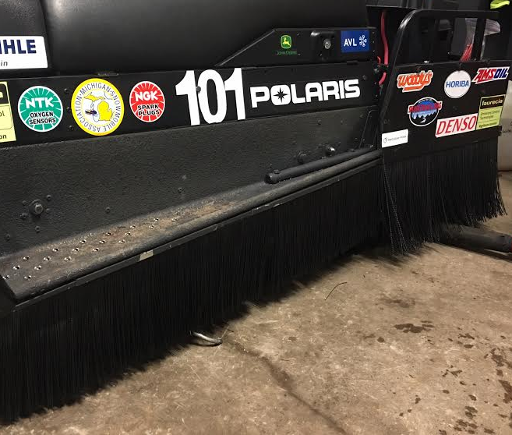
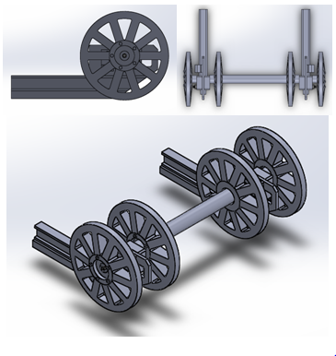
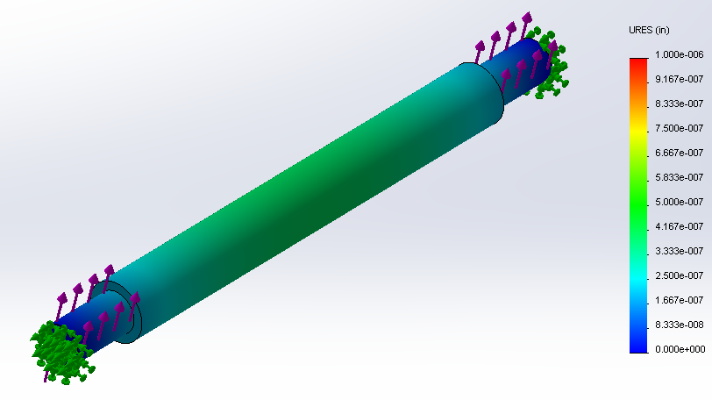
Noise Reduction
Noise Dampening Skirt
Nylon Bristles
Flexible
Bend Recovery
Cost Effective
Water Resistant
Big Wheel Kit
Decrease Track Slack
Known to Reduce Rolling Resistance
Notes:
The noise dampening paint was used to reduce the overall sound produced by the sled. The noise dampening skirt was thought of to help contain the noise produced from the track of the snowmobile as all noise is . Different materials were thought of that could contain the noise and be flexible enough to give when in contact of the ground. It was determined to use a nylon bristles as they would provide great flexibility and yet rigidity to not deform.
Do to the lack of big wheel kits for widetracks the team design a big wheel kit for the sled. The relocation of the axal for the

Slide 14
Manufacturers Suggested Retail Price
Estimated value of about $15,000 for mass produced version
Includes all aforementioned modifications
Attractive price due to long lifetime and low maintenance
Increased fuel economy and torque
Notes:
The cost of this sled is …
This is a competitive cost I guess with the durability of the sled (if it runs)
The resale value is …

Slide 15
Conclusion
Higher energy content than gasoline
Better fuel economy
Higher torque capabilities
Increased towing capacity
Reliable and relatively cheap to maintain
Nearly no soot particles and passes EPA standards for emissions with decreased NOx output
Quiet chassis due to sound control paint
Quieter exhaust from nylon skirt

Slide 16
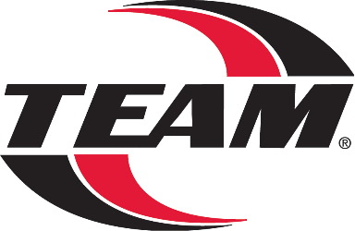
Questions?
Thank you to all our sponsors!

