Slide 1
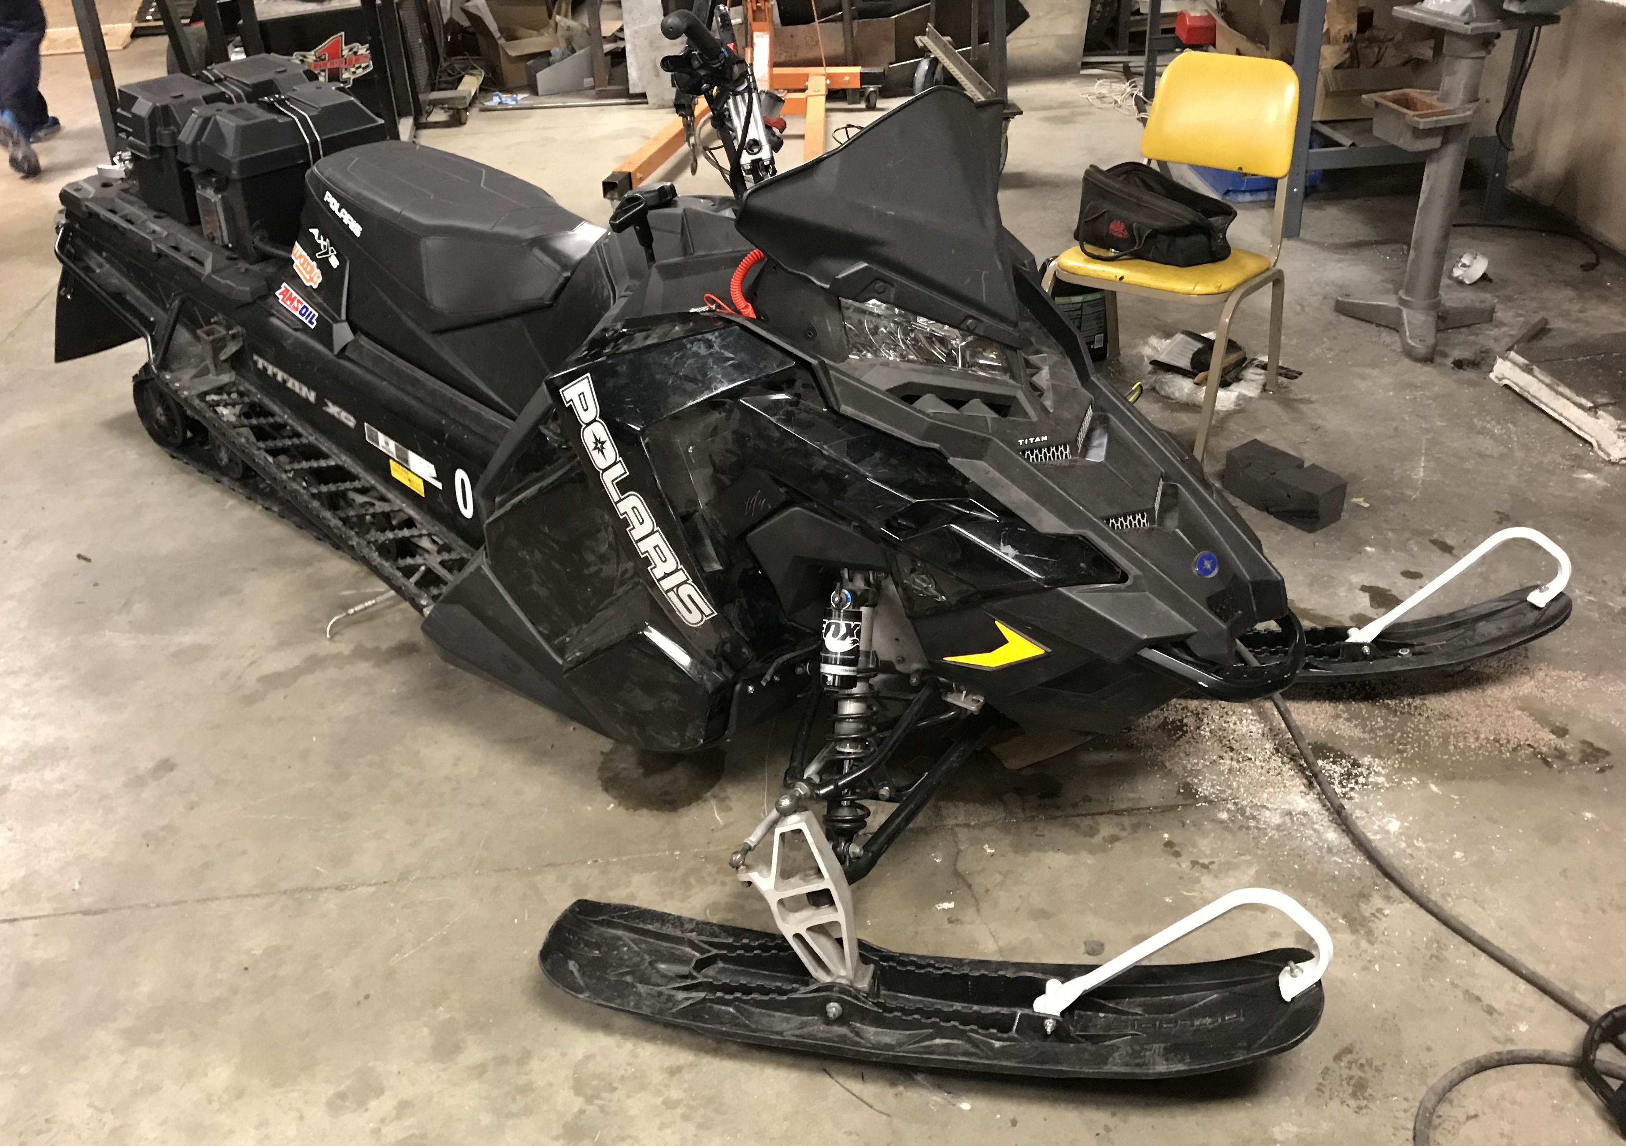
North Dakota State University
Clean Snowmobile Challenge 2019

Slide 2
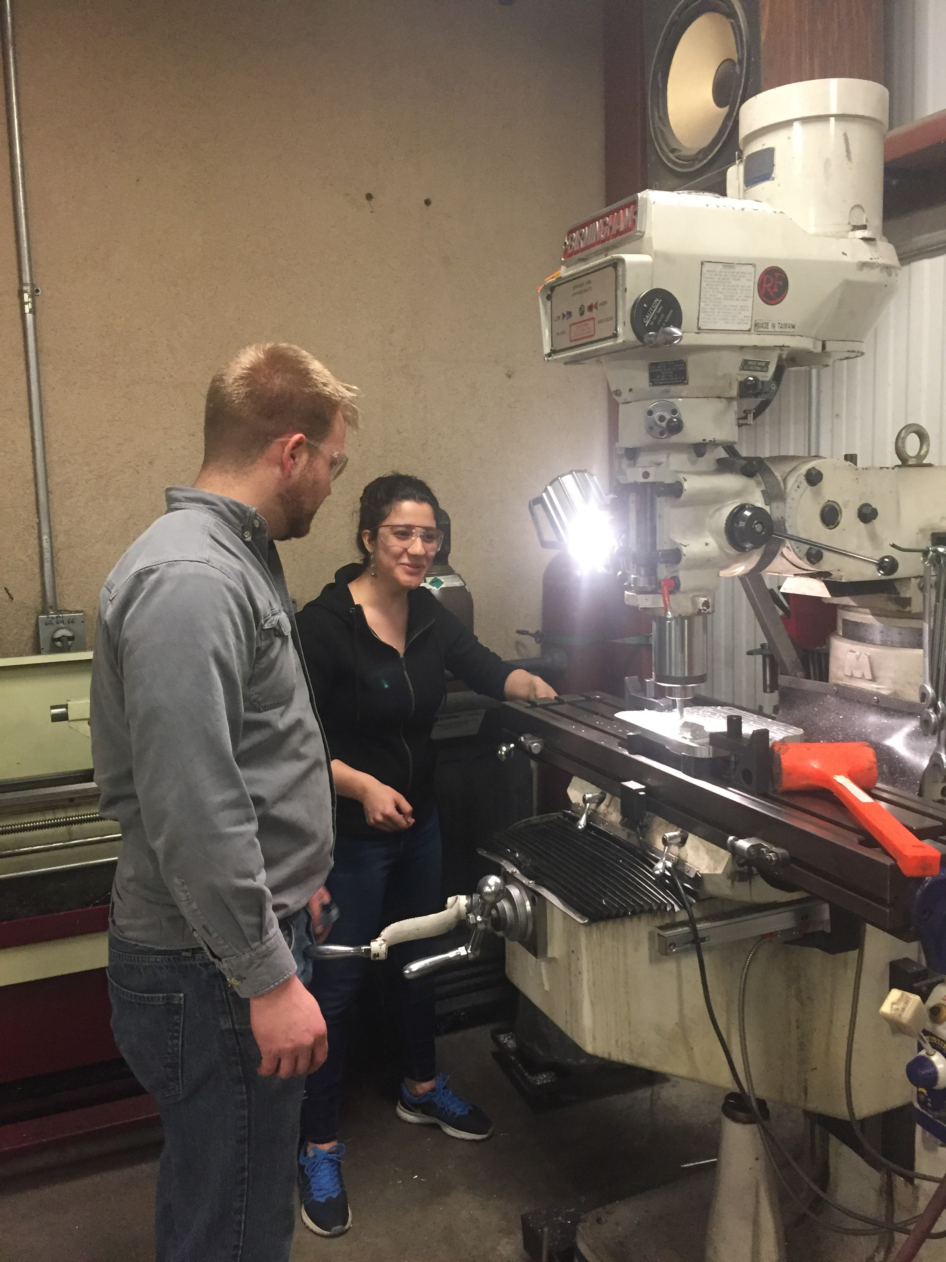
Introduction
Team Management
Snowmobile Components
Engine Selection
Oil System
Electronic Control Unit
Clutching
Design Components
Fuel Efficiency
Noise Reduction
Emission Reduction
Innovations
Questions

Slide 3
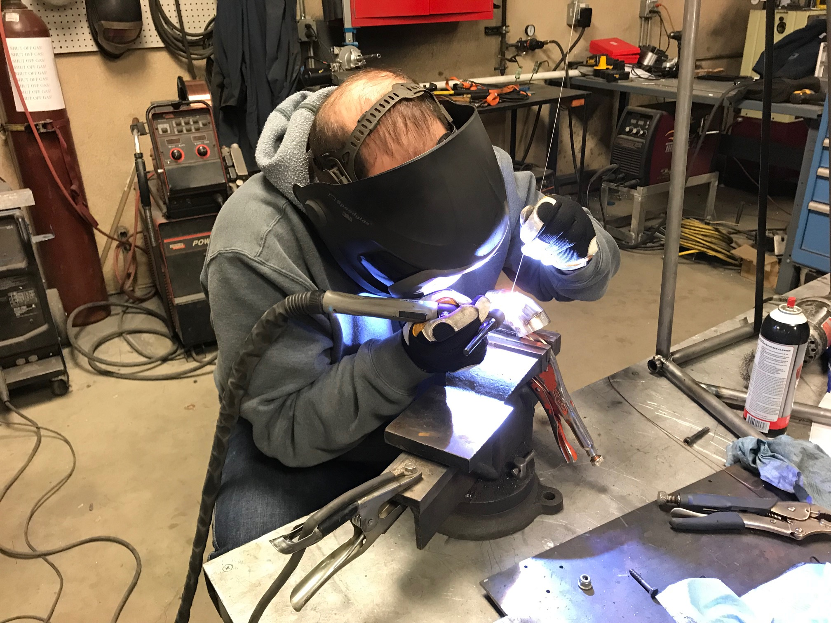
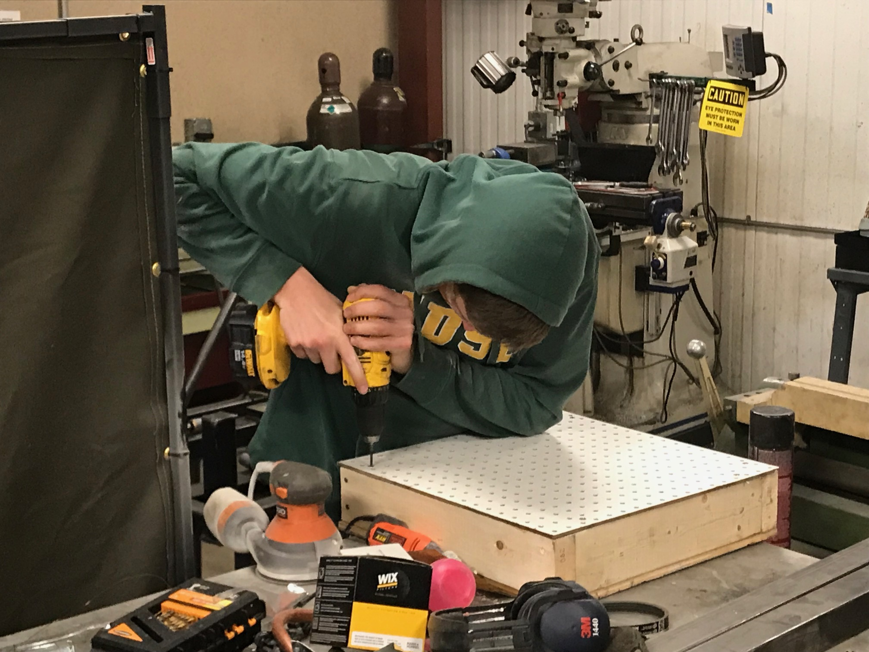
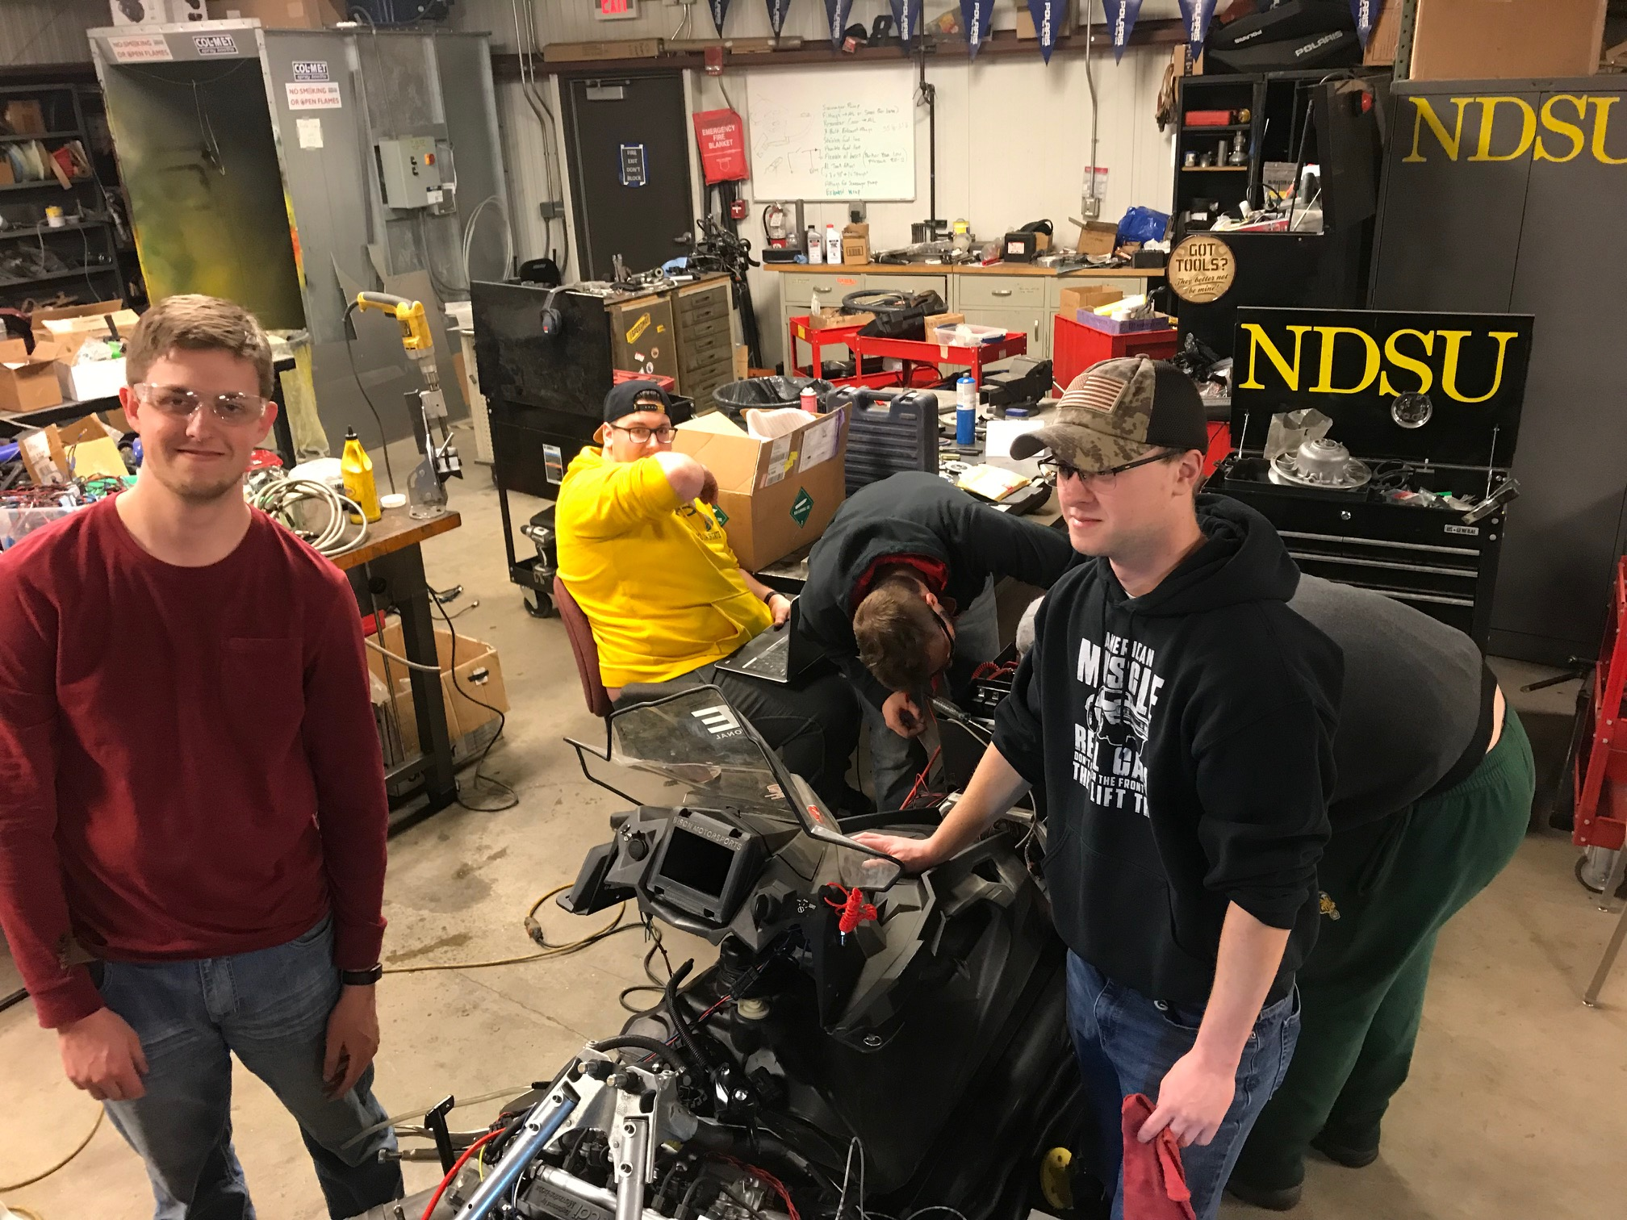
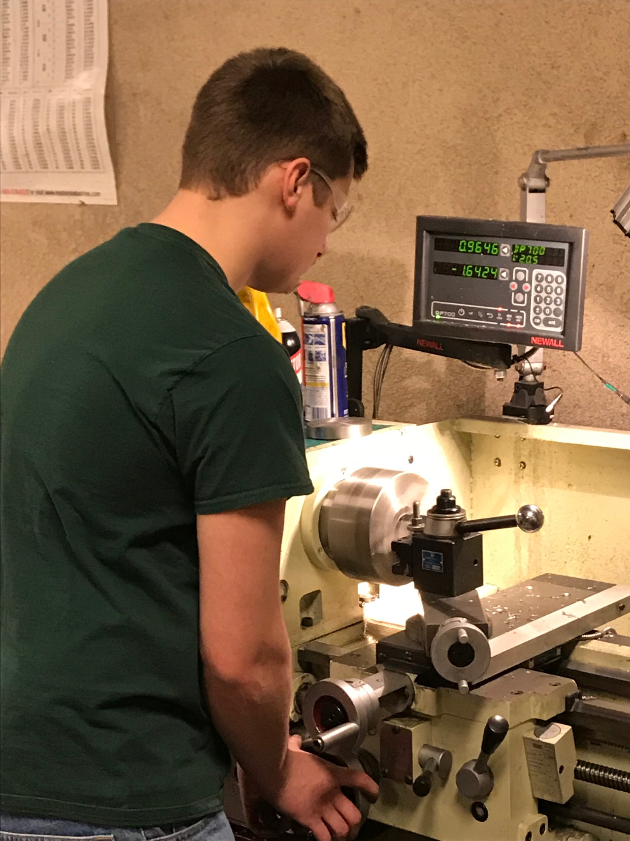
Team Management
Subgroup Responsibility | Subgroup Members
Engine Diagnosis | Mike, Kai, Luke, Jonah
Dry Sump Oil System | Bill, John, Mike
Part Modeling, FEA, Paperwork, Static Display | Mehrnoosh, Luke, Jonah
Engine and Chassis Electronics | Jason, Trent, Jonah
Display | Jonah, Luke, Trent
CVT | Brett, Bill, Jeff
EPS | Jeff, Matt, Caleb
Bodywork Modifications | Brett, Kai, Ben, Luke
Exhaust | Matt
Engine Mounting, Oil Reservoir, Overstructure Modification | Bill
Fundraising | Brett, Caleb, Kai, Mike, Jonah
5 Senior Design Members
9 Bison Motorsports Club Members
Innovations
Delegation of tasks

Slide 4
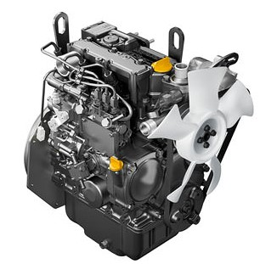
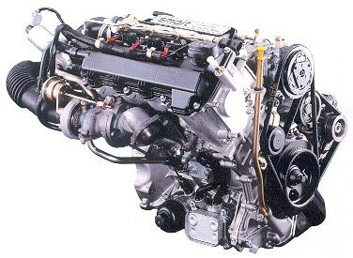
Engine Selection
2017 Season – YANMAR 3TNM72
900cc
Mechanical Injection
Cast Iron cylinder head and block
23hp
2018-2019 Season – Mercedes OM660
800cc
Common rail electronic injection
All-aluminum cylinder head and block
39.1hp
http://www.fram.nl/workshop/engine/smartengine.htm
http://www.fram.nl/workshop/engine/smartengine.htm

Slide 5
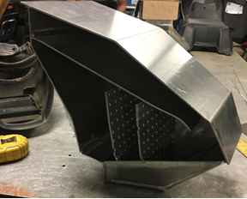
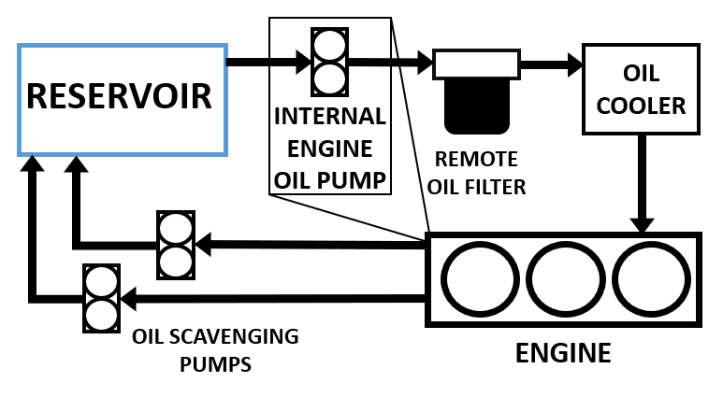
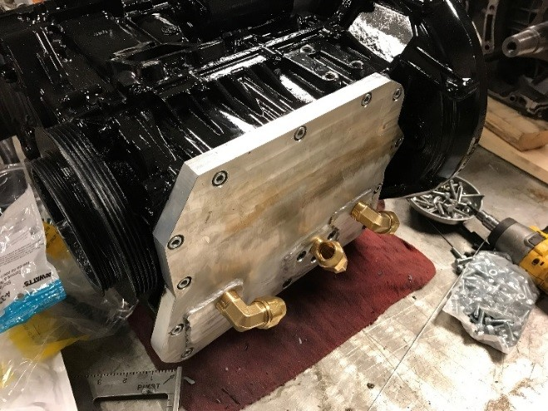
Oil System
Innovative Dry Sump Design
Additional Cooling Capacity
Electronic Scavenging Pumps
Easy Oil Change Access

Slide 6
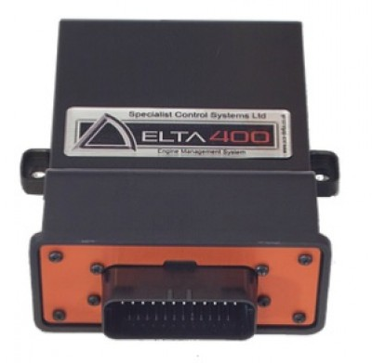
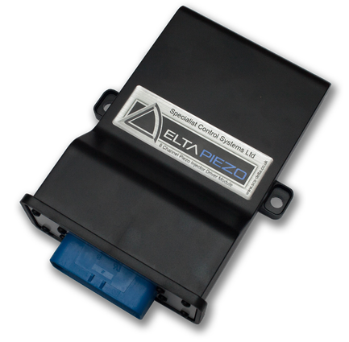
Electronic Control Unit
SCS Delta 400
Delta Piezo
OM660 Base Map
Engine Tuning
http://elise-spares.com/image/cache/data/
Addition/SCS%20ECU/Delta400_2-500x500.jpg
http://www.bimmerboost.com/images/imported/2017/06/file-1.jpg

Slide 7
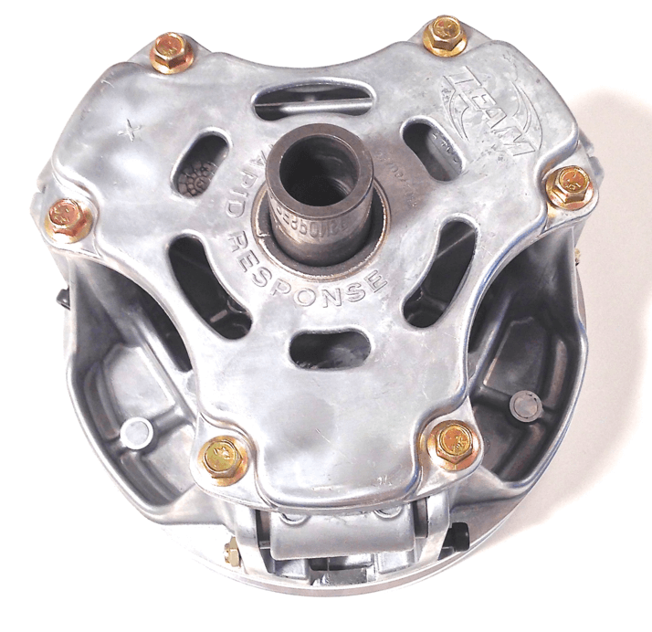
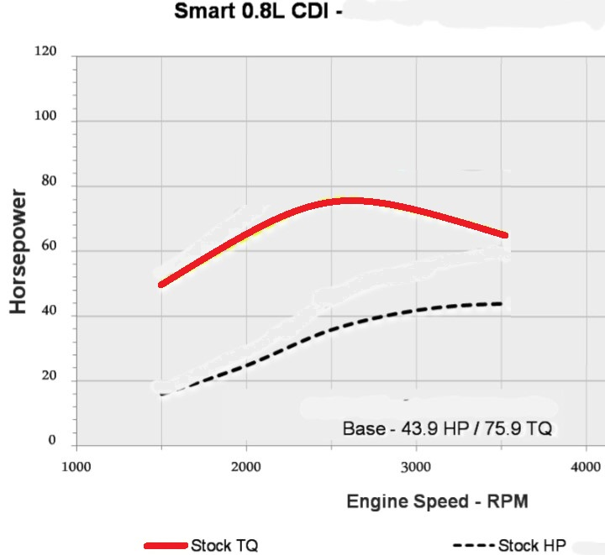
Clutching
TEAM Rapid Response Primary
Match Torque Curve
1350 RPM Engagement
Overdrive Ratio (0.7875:1)
Stock Secondary
https://dirtydawgperformance.com/wp-content/uploads/2015/05/polaris-atv-utv-p-clutch.png
https://malonetuning.com/ecu-tuning/mercedes-smart-cdi

Slide 8
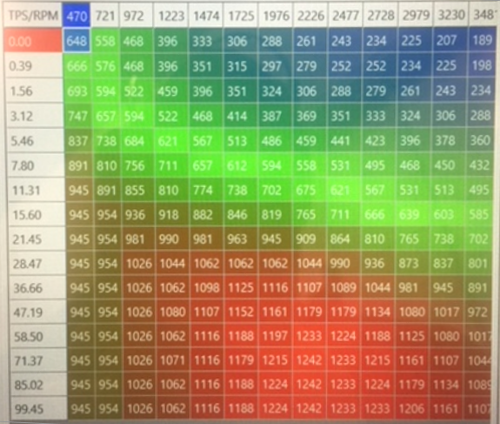
Fuel Efficiency
Precise Clutching
Engine Tuning
Dynamometer
Fuel Flow Meters

Slide 9
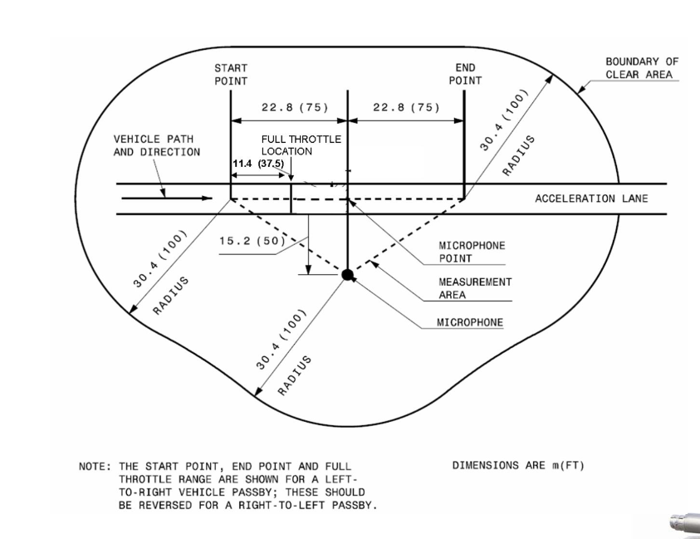
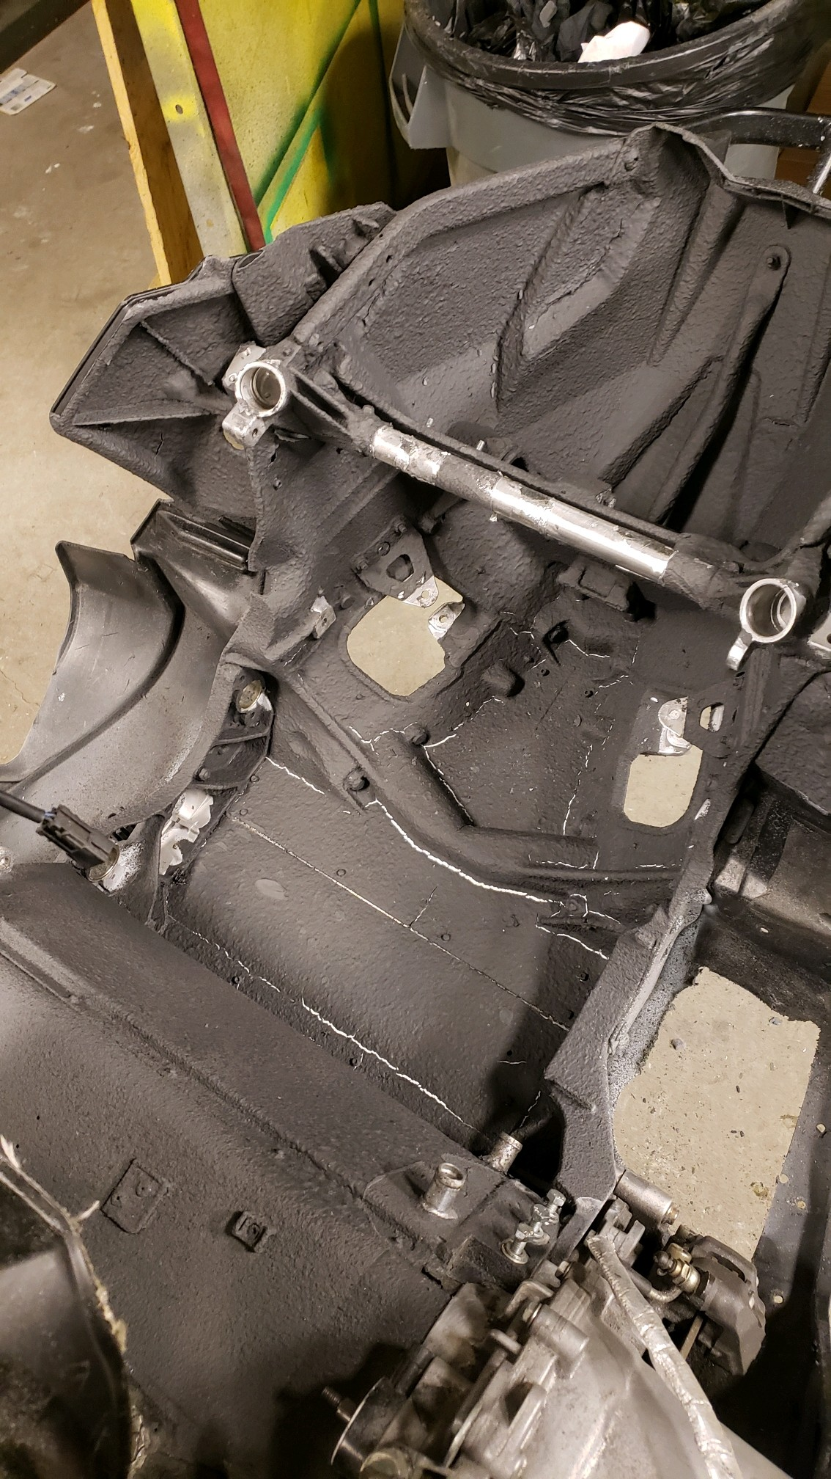
Noise Reduction
SAE J192 Acceleration Sound Test
Trial | Sound Level (dBa)
1 | 90.4
2 | 96.7
3 | 86.6
4 | 99.3
5 | 98
6 | 101.8
Average | 95.467
Michigan Tech

Slide 10
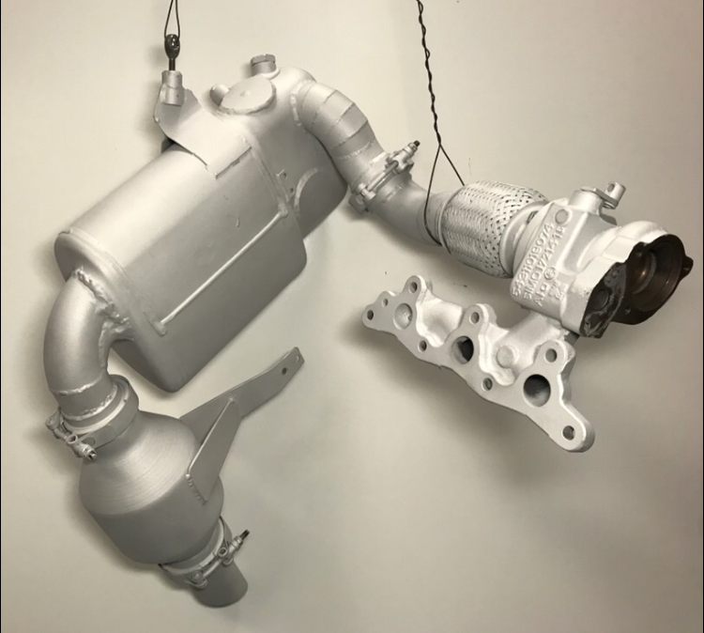
Emissions Reduction
Volkswagon DOC/DPF
Magnaflow Universal Diesel Catalytic Converter
Cerakote 4 mil thick ceramic coating

Slide 11
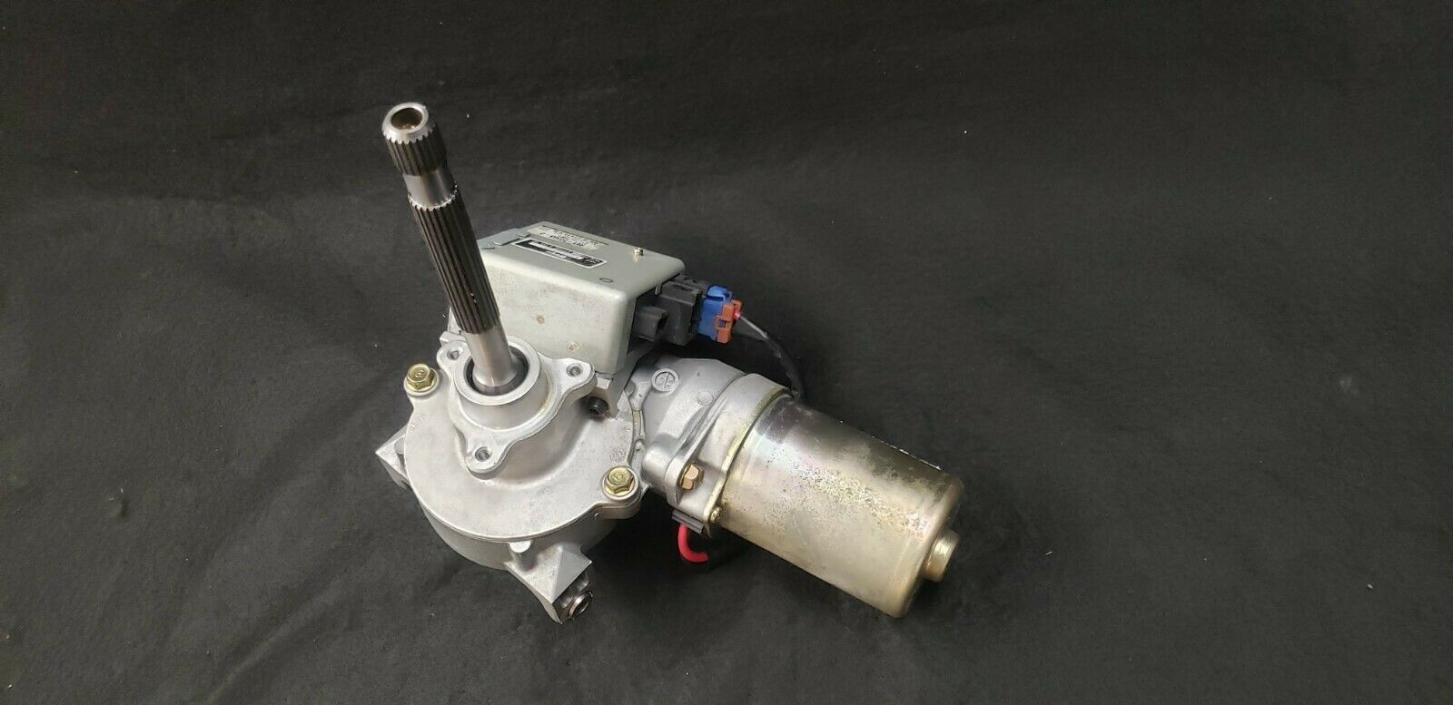
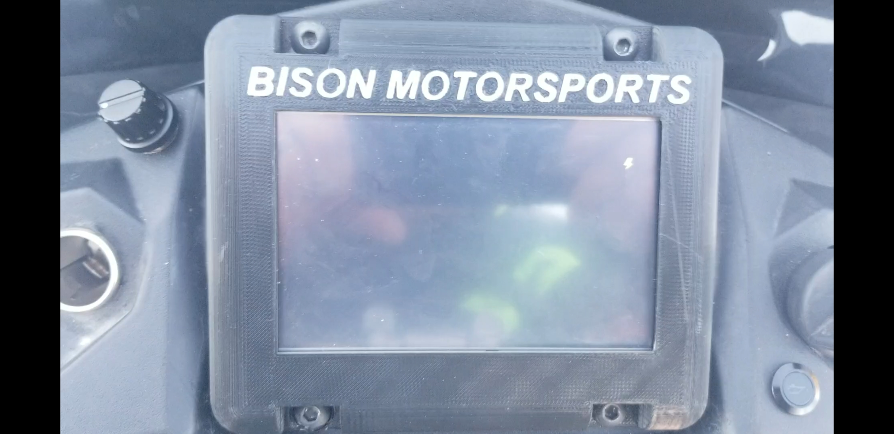
Innovations
Electric Power Steering Assist
83% steering torque reduction at full power
Custom Digital Display
https://dudazps6njn84.cloudfront.net/00/s/Nzc3WDE2MDA=/z/Wg4AAOSw04ZccyAs/$_57.JPG?set_id=8800005007

Slide 12
Questions?
https://www.socialtalent.com/blog/recruitment/unusual-interview-questions-infographic

