Slide 1
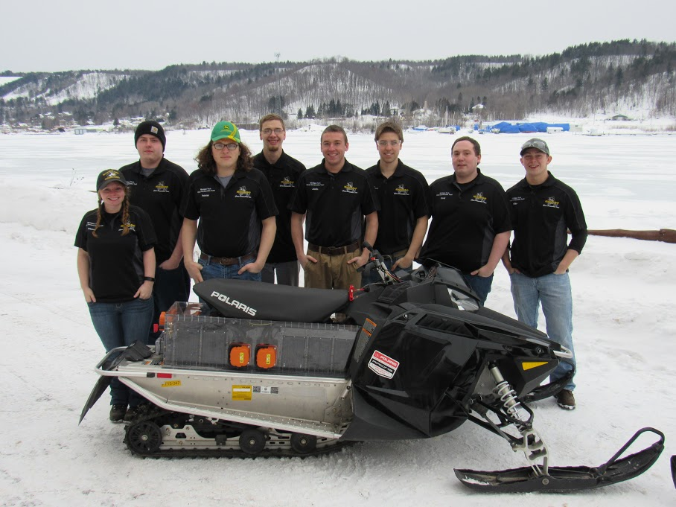
Innovations in Zero Emissions Snowmobile Technology
Justin
Scholl
Nick
Brodowski

Slide 2
Overview
Concept & Objectives
Componet Overview
Design
  Battery System and Housing
  Motor and Drivetrain
  Cooling System
Range and Performance
Enviromental Impact
MSRP and Dealer Perspective

Slide 3
Introduction
Our Goal
  “To design a state of the art all electric snowmobile that is affordable, easy to maintain, and useful for any application”
Competition Objective-Zero Emission
  The Greenland Ice Cap acts like a sponge, absorbing atmospheric chemicals produced naturally, or via anthropogenic activities. Many of these chemicals are also photoactive in the lower troposphere and even in the upper layers of the snow. Research underway at Summit Station seeks to understand the processes involved, and how it might play into the global cycling of these agents. Some of the chemical constituents under study are measured in parts per billion. Emissions resulting from the burning of fossil fuels on site can hopelessly skew the research results. Due to the sensitive nature of much of the research being conducted at Summit Station, NSF seeks to find a "zero-emissions" vehicle for transporting researchers and support staff to and from research sites
Notes:
Paraphrase this, but show that their statement was the basis for the design.

Slide 4
Design Objectives
Minimize Weight
  Target: Under 700 Lbs
Maximize Range
  Target: 20 Miles
    Maximize Battery Capacity
    Minimize Charge Time
Maintain user comfort and usability
  Maintain OEM Style Aesthetics
  Maintain OEM Handling Characteristics

Slide 5
Componet Overview
To Meet the design objectives and improve design feasibility, current production parts were selected based on their performance characteristics.
Component | Description
Chassis | 2017 Polaris Indy 600
Engine | Parker GVM 142-75 PMAC Motor
Power Storage | Brammo 15/90 Li-ion
Drive Train | Transmission: Brammo GVM 6-Speed Drive: Direct Chain Drive
Suspension | OEM Polaris
Track | Camoplast Ice Attack 121x15x1.063”

Slide 6
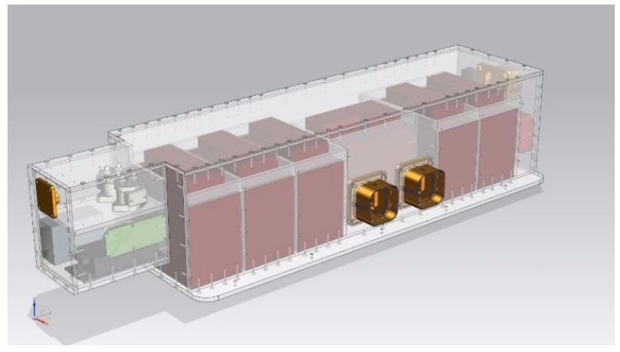
Design – Power Storage
Brammo 15/90 Li-Ion Batteries
  Extruded Aluminum Case
  Internal Cell Heaters
  Internal BMS –real time monitoring
  CAN bus Communication
Lexan Polycarbonate Housing
  Non-conductive
  Fire resistant
  Easily removable
  Clear for component visibility
The batteries, container, and related components weigh 217.4 lbs
Component | Weight(lb)
Batteries | 138.6
Polycarbonate | 58
Wires | 6.9
Maintenance Disconnects | 7
BIR | 1.9
DC-DC Converter | 2
Other | 3
Total | 217.4

Slide 7
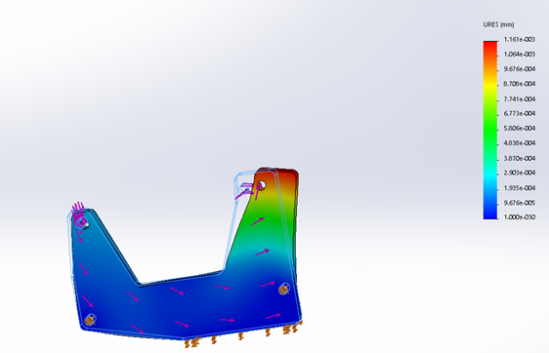
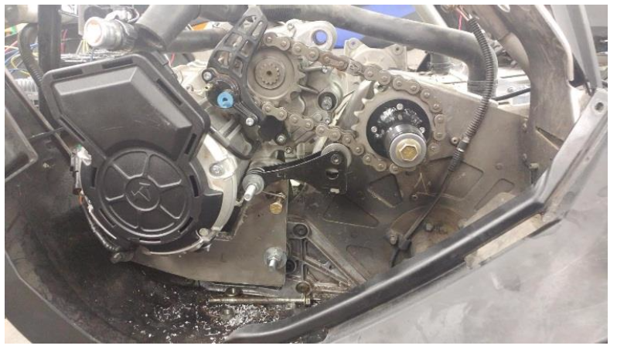
Design Cont.
Motor:
Stock mounting points with custom mounting brackets
Uses stock jackshaft and chain case
Direct Chain Drive
6 selectable gears to optimize performance in varying conditions
Peak 56 horsepower

Slide 8
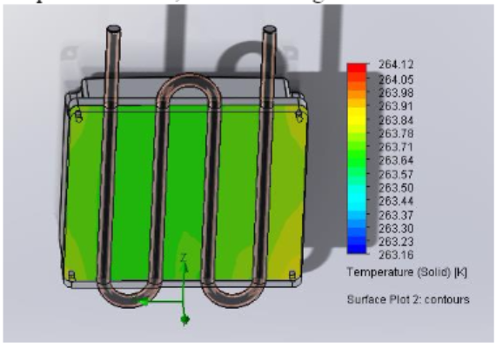
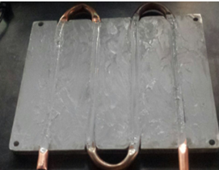
Design Cont.
Cooling System:
Motor Controller: External Water cooling, Copper Core Chill Plate
Motor: Internal Water cooling
  Improves towing capacity and performance by reducing heat buildup in the system

Slide 9
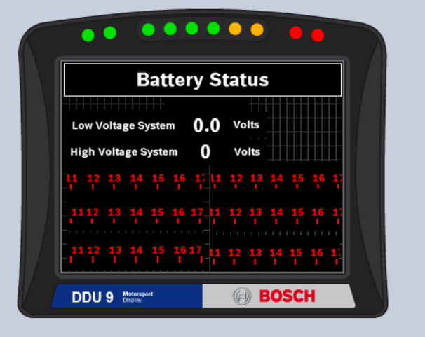
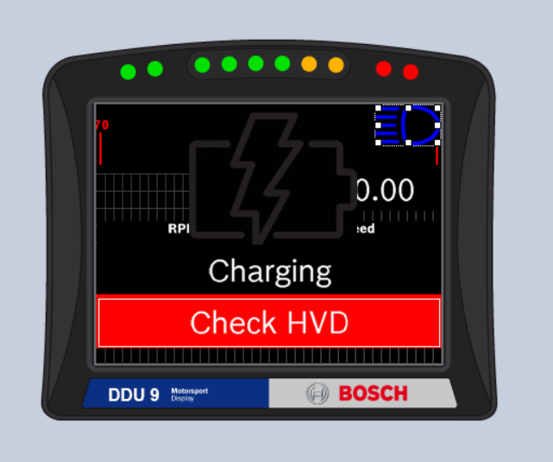
Design Cont.
Bosch Display
  Easy and user friendly
  Multi page selection from stock switches
  Real time temperature and voltage monitoring for safety
  Advanced safety system warnings

Slide 10
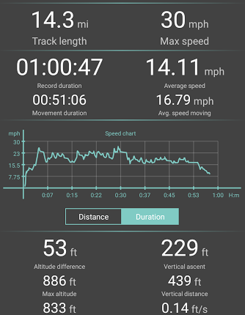
Range and Performance
Range Test at Expected Operating Conditions
  On Trail
  4th gear
  180lb rider
  ½ Mile between stops
Relative Performance
  In Comparison to a stock Polaris Indy 600
  >90% electrical system efficiency
Parameter | Stock | Modified
Weight (Lbs) | 522 | 669
Range (Miles) | 144 | 14.3
Noise (dBA) | 65 | 61
Top Speed (mph) | 90 | 45

Slide 11
Environmental Perspective
No air quality impact due to the burning of fossile fuels
Reduced risk of soil contamination from spilled fuel & oil
More acurate atmospheric research measurements
Higher energy efficiency

Slide 12
MSRP and Dealer Perspective
Final MSRP of the 2017 Zero Emission Sled was calculated to be $18,071
  Stock MSRP cost $8,399
  Price difference is consistent with increased cost of electric vehicles in the automotive industry
Service
  Clear Lexan construction allows for easy inspection
  Maintenance Disconnects allow safe working conditions
  No structural Chassis modifications, parts and service for non electrical components are readily available and established
  Modular Design lowers service time and complexity, reducing the risk of reassembly errors

Slide 13
Conclusion
Using a permanent magnet AC motor and Lithium Ion Batteries, a 14.3 mile average range was measured
At 669 Lbs, the snowmobile remains menuverable without sacrificing traction.
Electrical and Mechanical components can be installed without chassis modifications.
  Can be packaged as a kit to convert existing snowmobiles.
Design allows for use of existing service centers.

Slide 14














Specail Thanks To:

Slide 15
Questions

