Slide 1
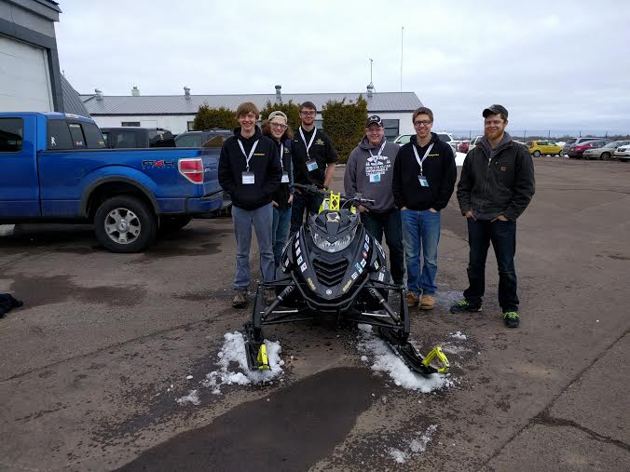

Michigan Technological University
Nicholas Brodowski
Paul Hanafin
Innovations For A Greener Tomorrow
Notes:
Both

Slide 2
Overview
Introduction
Chassis Design
Electrical Design
MSRP
Conclusion
Questions
2
Notes:
Bryce

Slide 3
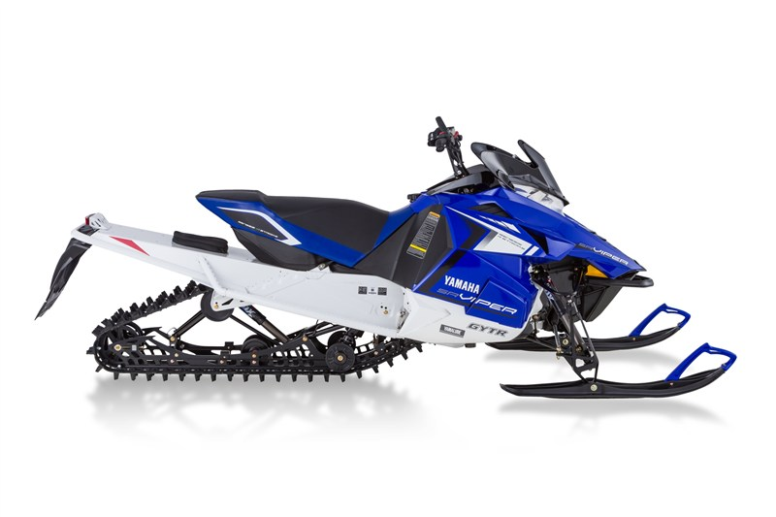
Introduction
MTU’s ZE Entry:
  2014 Yamaha Viper XTX
Goals for 2016 Competition
  Develop a competitive ZE platform
    Improve Circuitry
    Meet Rules and Regulations
  Receive and collect testing data
3
Notes:
Chad

Slide 4
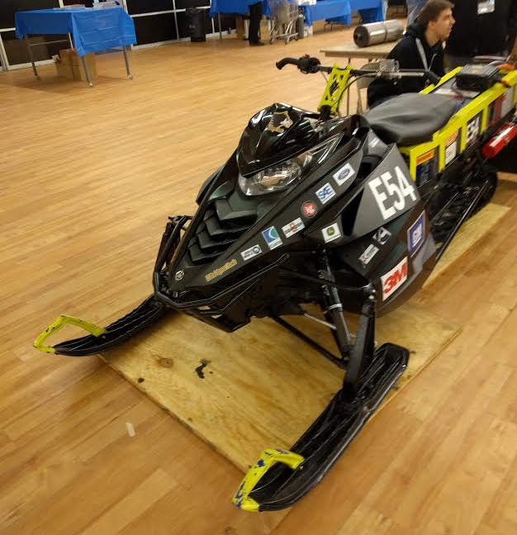
Design Strategy
Optimization and maximizing:
  Simplicity
  Range
  Towing capacity
  Weight
  Performance
  “Without sacrificing reliability, and maintaining industry Safety standards”
4

Slide 5
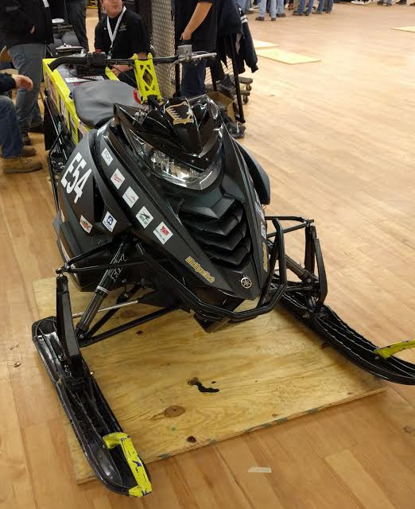
Chassis Design Overview
2014 Yamaha Viper SRV Chassis
  Estimated at 759lbs
  Heavy duty touring suspension
Original motor mounting location
  Direct belt drive system
  Easily adjustable belt tensioner
Battery box added onto tunnel
Rear skid mounting brackets
5

Slide 6
Estimated Weight
component | weight
Batteries | 368lbs
Chassis | 250lbs
Motor and controller | 65lbs
Battery Box | 46lbs
Wires | 30lbs
Total: | 759lbs
6

Slide 7
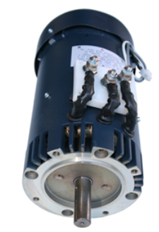
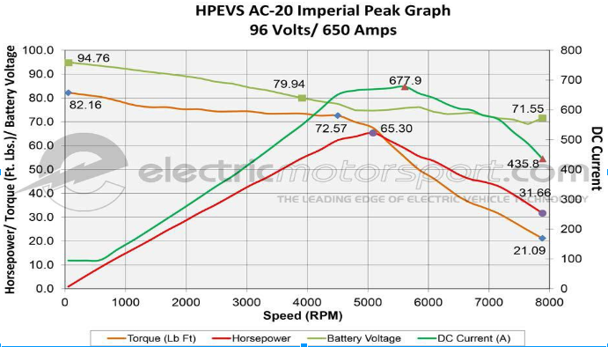
AC Electric Motor
3 Phase Induction motor
65 peak HP
82Ft-Lbs of torque
Direct drive with machined aluminum mount.
7

Slide 8
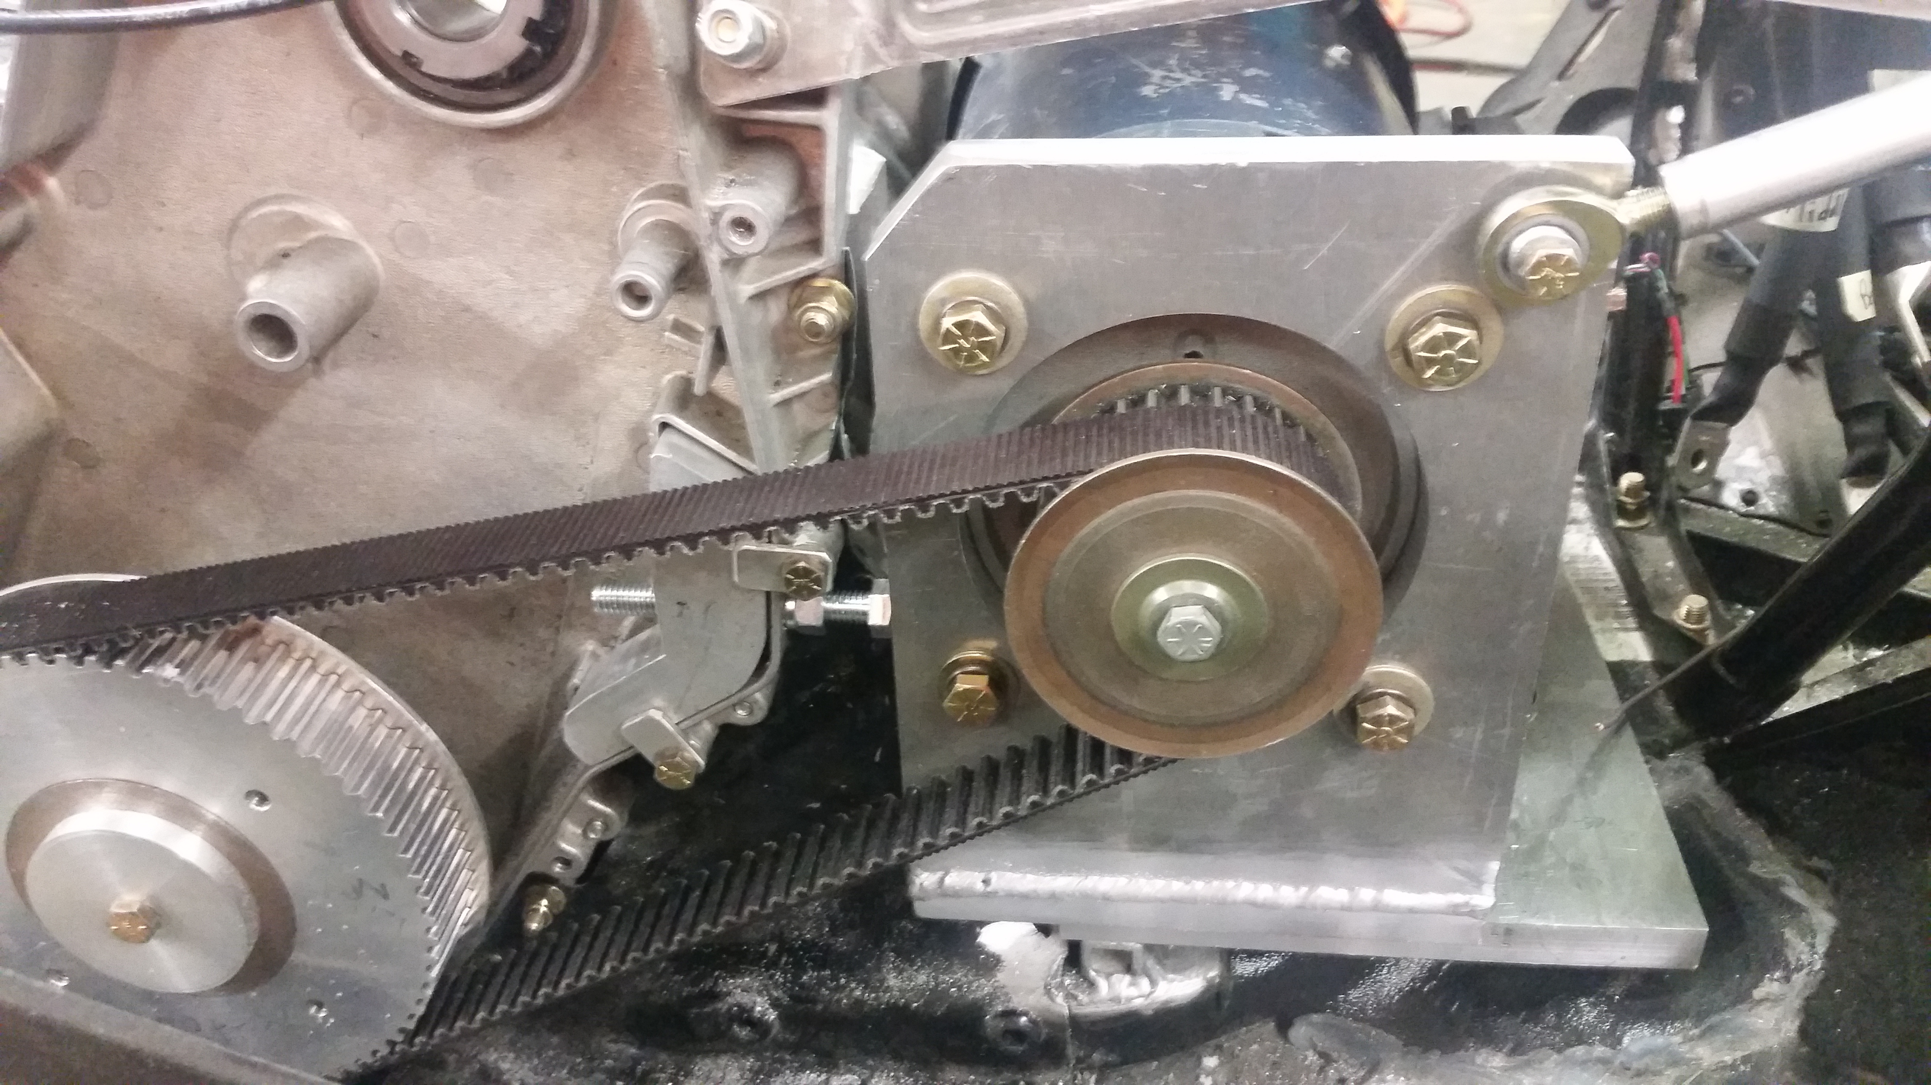
Motor Mounting
Machined aluminum mounting bracket
Two piece system allows adjustable positioning for tensioning needs
8

Slide 9
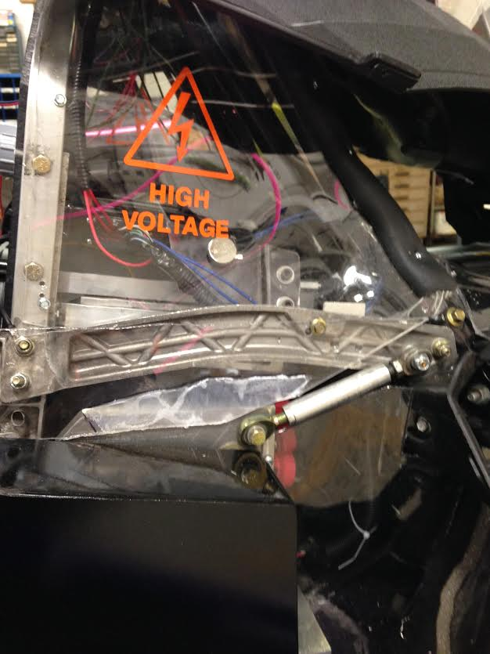
High Voltage Enclosure
Enclosed by 1/8” polycarbonate
User protected from HV components
Electrical components in motor compartment:
  Motor
  Motor Controller
  Charger
  Bender
9
Notes:
^Picture^

Slide 10
Battery Containment
Goal to improve accessibility and modularity
Constructed from 3/8” polycarbonate with a 1/8 inch 6061-T6 Exoskeleton
Polycarbonate box had an FEA analysis performed to ensure structural integrity
Additional emergency fire safety testing was completed
Designed to maintain stability and control
Contains BMS system
10

Slide 11
Rear Skid Mounting
Created to allow Yamaha Venture skid to fit into the viper chassis
Bracket was analyzed using FEA to stress and strain experienced throughout the part.
Cut-outs to attempt to lighten the component
11

Slide 12
Electrical Design Overview
“All-in-one” modular design.
  All electrical components are designed to be easily removable for service
  96V (tractive) electrical system
  12V (accessories) electrical system
  Complete isolation between the two systems.
12

Slide 13
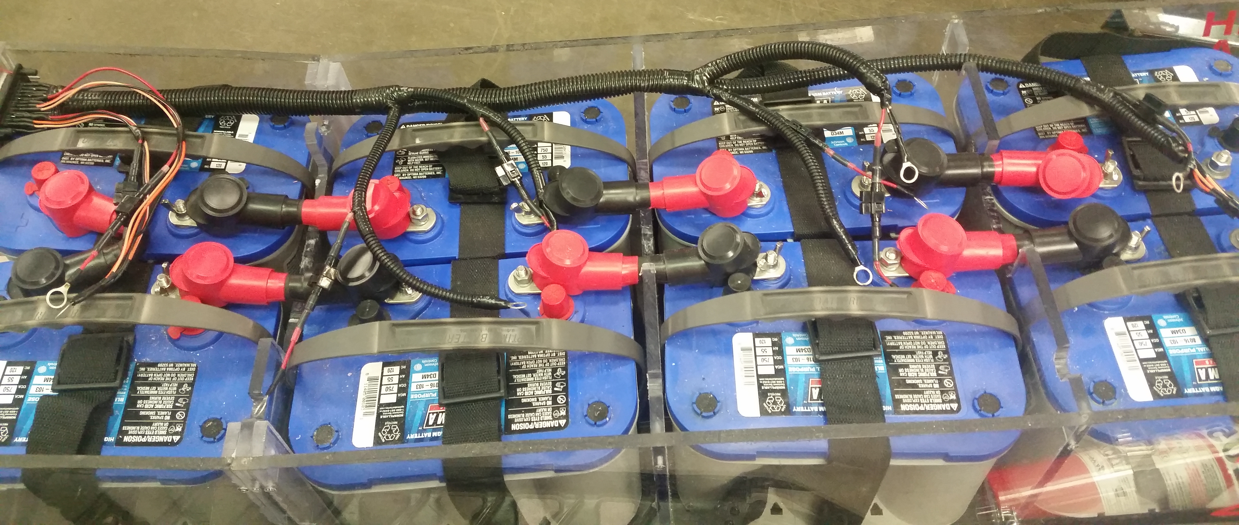
Accumulator System
Battery Pack
Optima D34 12V lead acid (Blue Top)
8 Cells total
96VDC Nominal
Maintenance disconnect
  Splits Batteries into 2 separate 4 cell segments
13
Notes:
^Change Picture^

Slide 14
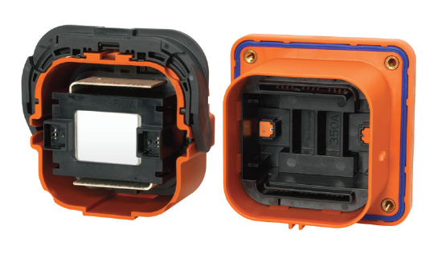
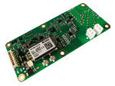
Safety Precautions
Isolated motor controller LV system prevents
Nonconductive Polycarbonate battery box and shielding
Bender IR155-3203 Isolation Monitoring Device
BMS fault latching circuitry
Emergency high voltage disconnect.
14
Notes:
HVD picture snipped from (https://www.google.com/url?sa=i&rct=j&q=&esrc=s&source=images&cd=&ved=0ahUKEwigiqLk4rHLAhUjs4MKHeOuBjsQ5TUICQ&url=http%3A%2F%2Fwww.te.com%2Fcontent%2Fdam%2Fte-com%2Fdocuments%2Fhybrid-and-electric-mobility-solutions%2Fglobal%2F8-1773462-2-msd.pdf&psig=AFQjCNG3f0Ws8GjmaXfwb52soD3T_xDmBw&ust=1457549859301727&cad=rjt)

Slide 15
Safety Shutdown Devices
Location of shut down devices
  Handlebars
    Tether
    Kill Switch
  Dash
    Key Switch
  Battery Box
    TSMS
    HVD
Electrical fault latches
  BMS over temperature
  IMD low isolation
15
Notes:
Picture^

Slide 16
Battery Management System
Ensures safe charging and discharging of the accumulator
Manzanita Micro mk3s lead regulators
Monitors voltage and temperature
Balance charges within the pack via charge regulation
New BMS Housing and wiring
16
Notes:
Add pictures^

Slide 17
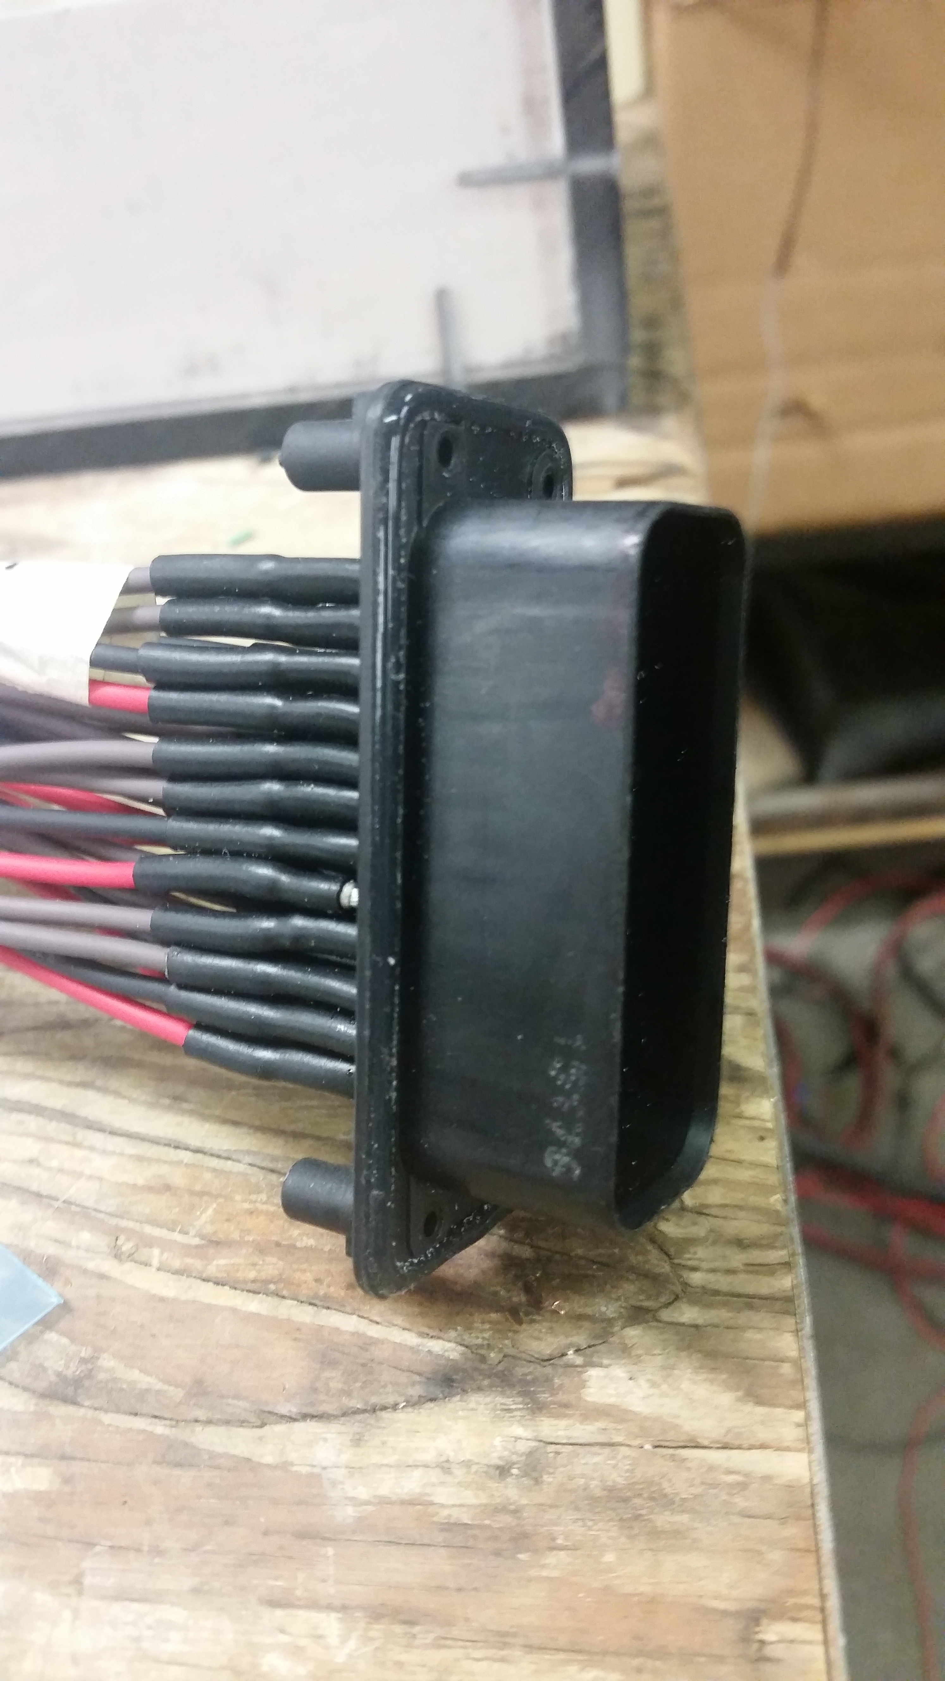
Modular Electronics
Low Voltage and High Voltage Systems
  Modular Design
  Professional Look
  Waterproofs the entire circuit
  Rated for high current transfer
17

Slide 18
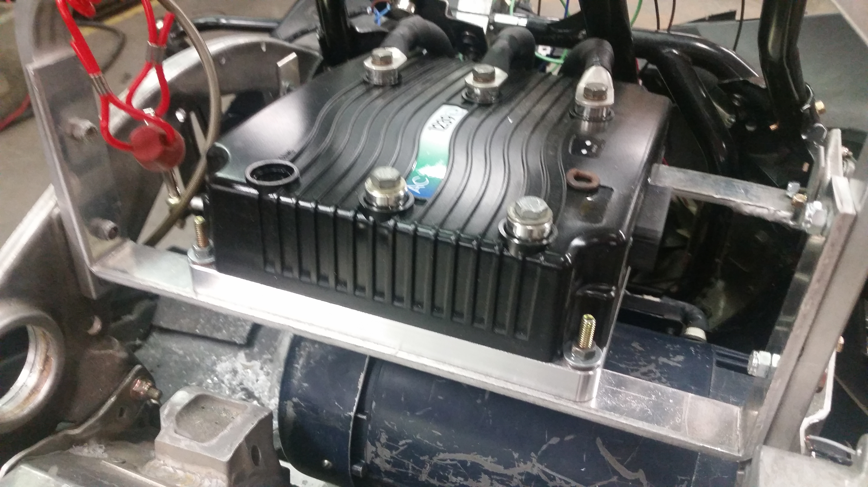
Motor Controller
Curtis 1239-7501e motor controller
  Fully Isolated
  Relocated above motor
Curtis Spyglass 840 for operator to monitor speed and charge
Programmed for optimal acceleration, power, and handling
Forced air cooling
Custom aluminum heatsink
18
Notes:
Strikethrough indicates my uncertainty of importance

Slide 19
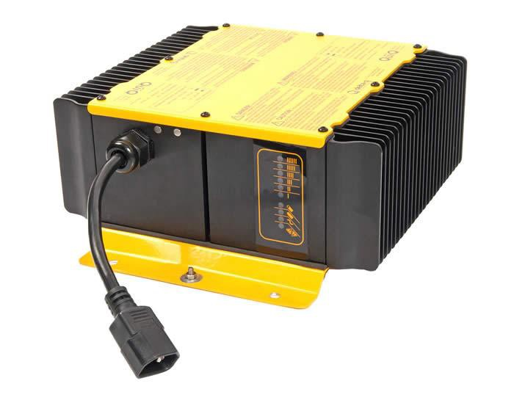
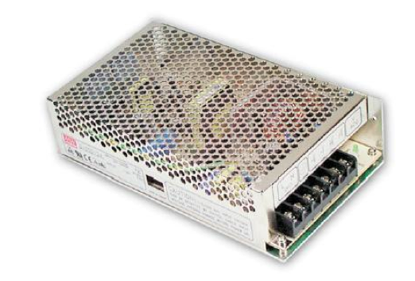
System Charging
On-board battery charging system
1 kW delta-q, qui-q charger (10.7A maximum)
BMS operates BIR with a “safe-to-charge” signal
Mean Well SD-150D-12
Charges low voltage battery
Provides power to the low voltage circuitry
Complete system isolation
Input Range: 72-144VDC
Adjustable DC output
19

Slide 20
MSRP
Final MSRP value of the 2016 MTU ZE entry was calculated to be $19,040.49
Additional $5,541.49 over stock MSRP
  Battery Management System
  Motor Controller
  Base sled circuitry
  Modular Design
  Suspension modification (weight management)
20
Notes:
Chad

Slide 21
Conclusion
Snowmobile met design goals for this competition year
  Electrical Systems Technical inspection was passed
  Components and wiring were improved over previous design
  Testing was completed to discover and eliminate weak portions of the design
21
Notes:
Chad

Slide 22
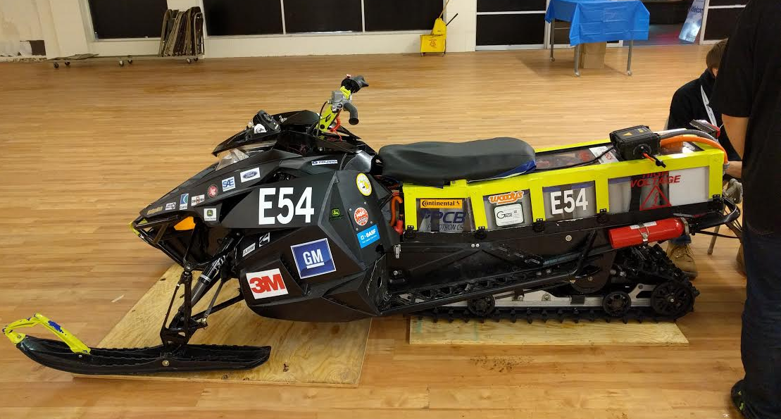
Questions
22
Notes:
Chad

Slide 23
















Thank You Sponsors!

