Slide 1
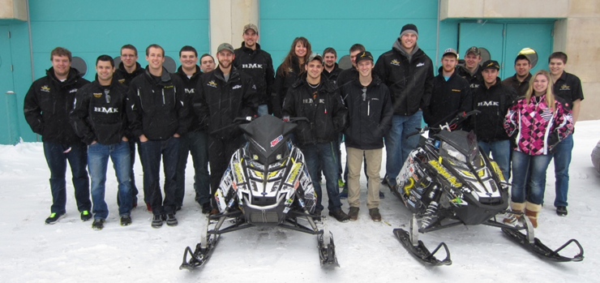
Michigan Technological University Clean Snowmobile Enterprise
Zero Emissions Team
Adrienne Piron
Ethan Hill

Slide 2
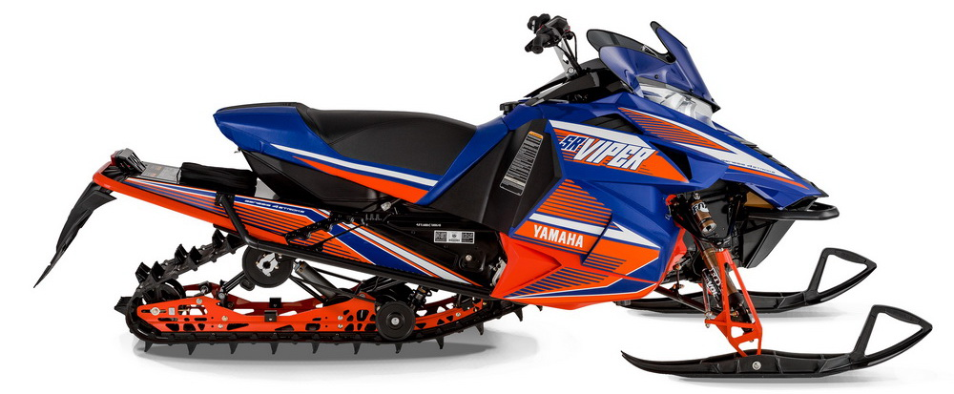
Overview
Chassis Selection
Battery Design
Performance
Driver Interface
Serviceability
Durability
Low Environment Impact
Conclusion

Slide 3
Chassis Selection
Meets our requirements best 2014 Yamaha Viper
Quality[weight] | Snowmobile
 | Yamaha Apex (Trail) | SR Viper SE (Crossover) | Phazer (Mountain)
Weight[2] | 0 | 0 | 1
Efficiency[3] | 1 | 2 | 0
Handling[3] | 0 | 1 | 0
Traction[3] | 1 | 1 | 0
Noise[3] | 0 | 1 | 1
Packaging Space[3] | 1 | 1 | 0
Cost[1] | 0 | 1 | 0
Weighted Total | 3 | 7 | 2
Low Cost = Affordable
Efficiency = Dependable

Slide 4
Battery Design
Battery Choice:
Lead Acid D34M Optima Marine Deep Cycle battery
High voltage and minimum amperage
96V nominal supplying 55Ah
Chose pack size of 8 batteries:
Simulation of other options:
Mount batteries to tunnel
Most space and build mount to accommodate with weight
 | 72V (6 batteries) | 96V (8 batteries)
Weight: | 258lb | 344lb
Cost: | 1500 | 2000

Slide 5
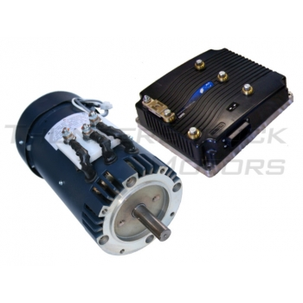
Performance
HPEV AC-20 motor with Curtis 1238-7501 Controller produce 65HP & 82 ft-lb. of torque

Slide 6
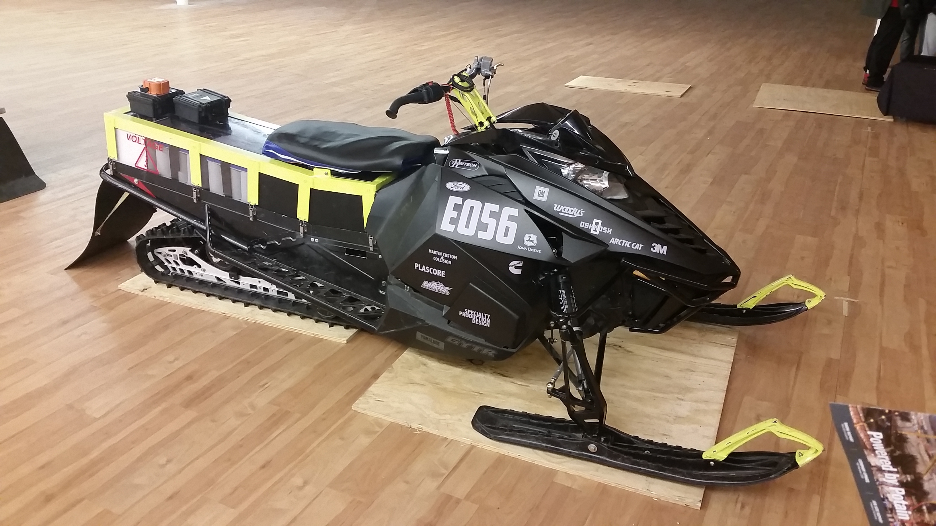
Driver Interface
User has visible LED’s on dash for status output, headlights, optional heated handles and comfortable seating.
Modified tunnel to
mount rider only
¾ inch higher than
stock sled.

Slide 7
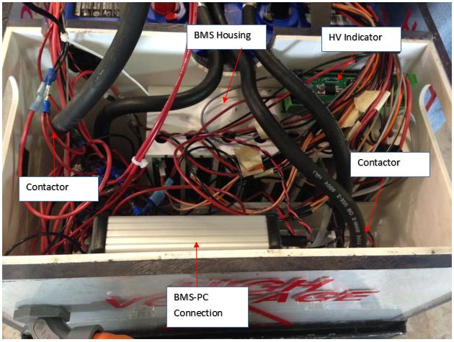
Serviceability
Design aspect to easily troubleshoot and maintain problems.
Battery Box is made with polycarbonate for visible problems with batteries or wiring.
HV electronics are located at the end of the battery to help with clean and easy maintenance. (BMS, BMS equipment to connect to PC, contactors, DC-DC Converter and HV Indicator)

Slide 8
Low Environmental Impact
Noise is limited, being supplied only from the track.
this snowmobile exhausts no emissions
98% of the lead within lead acid batteries may be recycled

Slide 9
Conclusion
Chassis: Durable to handle weight, comfortable and affordable
Performance: Low cost and simple
Affordable: $18,000 MSRP
Serviceability: Simple design with spares available

Slide 10
Thank You Sponsors!

