Slide 1
Michigan Tech’s E-Rush
Presented by:
Terry Gregoricka
Adrienne Piron

Slide 2
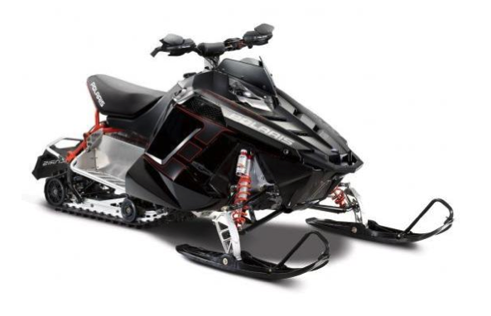
Abstract
2010 Polaris Rush
Electric Powered
Powered by Hi Performance Golf Cars AC-20
Curtis motor controller
CALB 70AH batteries
MTU designed rear drive system

Slide 3
Design Strategy
Range
Towing capacity
Innovation
Safety
Weight, handling, acceleration, cost, and durability.

Slide 4
Chassis and Electrical Design
2010 Polaris Rush
Lightweight
Adjustable rear suspension
Low cost
Rear mounted motor
Easily accessible
“All-in-one system”
HV and 12 V system

Slide 5
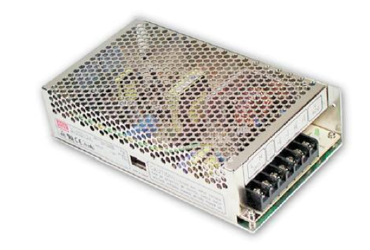
DC to DC Converter
Mean Well SD-150D-12
Similar to AC Transformer
Complete Isolation between HV and LV
Isolation up to 1500V
Range of 72-144V

Slide 6
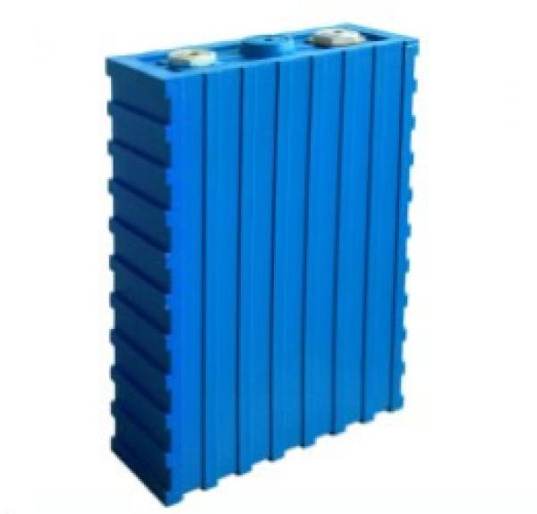
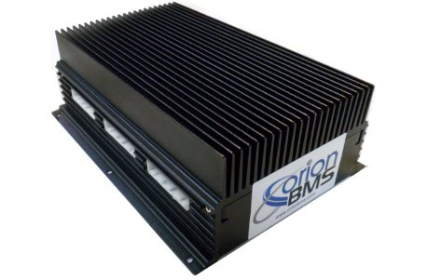
Accumulator System
Batteries
Battery Management System

Slide 7
Batteries
35 Lithium Iron Phosphate
Selected for stability characteristics
Chinese Aviation Lithium Batteries (CALB)
Connected in Series
Produces 114V (3.2V each)
Short time discharge rating of these cells is 700A

Slide 8
Battery Management System
Was necessary to manage the batteries
Orion has one of the smartest BMS modules on the market
Thus can manage a large range of parameters
Monitors voltage, current, temperate, and controls the charging system

Slide 9
Battery Containment
Goal was to maintain low center of gravity
Constructed using 1/8 inch 6061-T6 aluminum
Modeled to be similar to original engine
Analysis was done on CAD to apply loads

Slide 10
Battery Containment

Slide 11
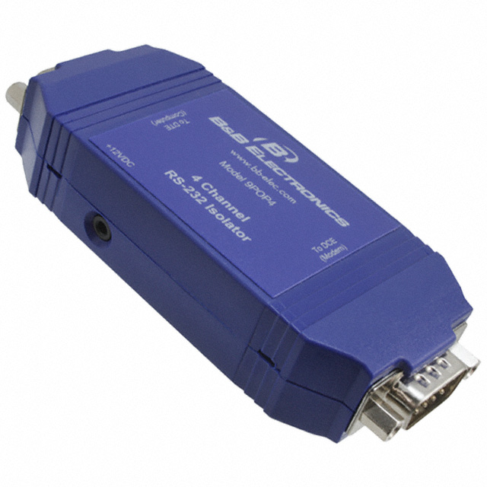
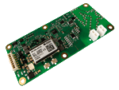
Safety Precautions
Isolated display to prevent HV going to dash
Nomex and polycarbonate lined battery box
Bender IR155-3204 ground fault circuit

Slide 12
Speed Control
Curtis 1238-7501 motor controller
Converts DC to AC
3 phase motor
Curtis Spyglass 840 for operator to view various parameters

Slide 13
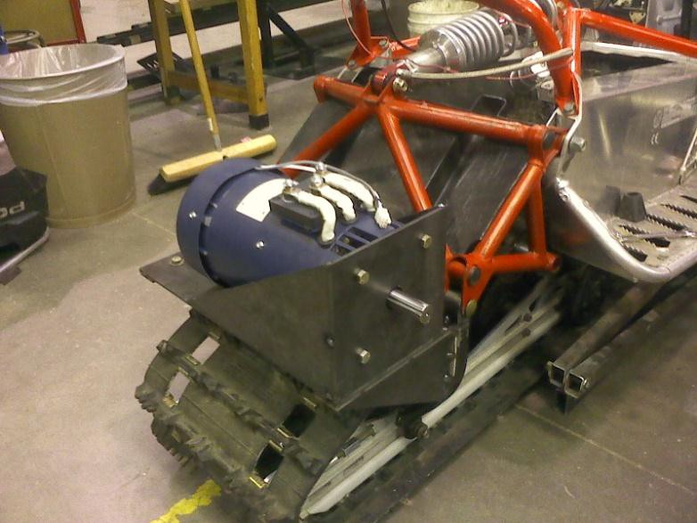
Motor and Motor Controller
Motor Controller under Charger
AC-20 Motor

Slide 14
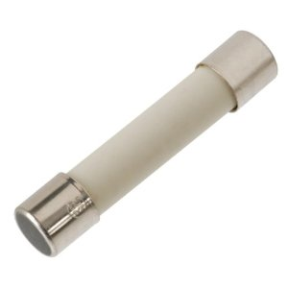
High Voltage Fusing
Only 1 fuse is in the battery pack
Rated for pack voltage and continuous ampere rating of the wire
Using a 250A Bussman slow blow fuse

Slide 15
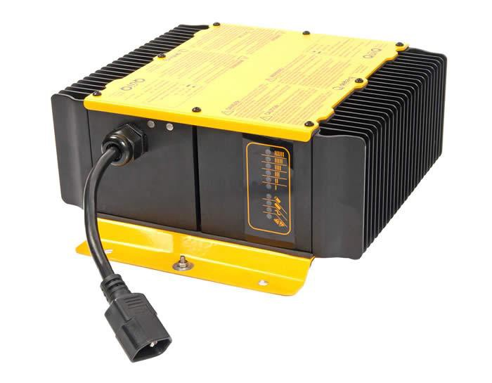
System Charging
On board charging system
1 kW delta-q, qui-q charger
BMS and charger are in communication
BMS states if it is safe to charge

Slide 16
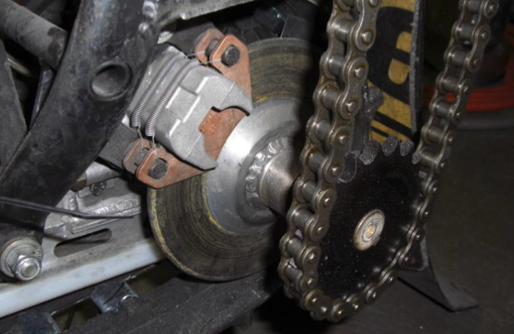
Power Transmission
Motor and brakes located in the rear
Leads to more efficient drive system
Direct motor to track system

Slide 17
Weight
Stock chassis 271 lbs
Battery pack weight 192 lbs
Battery housing weight 25 lbs
Motor and controller 65 lbs
Final design weight 600 lbs

Slide 18
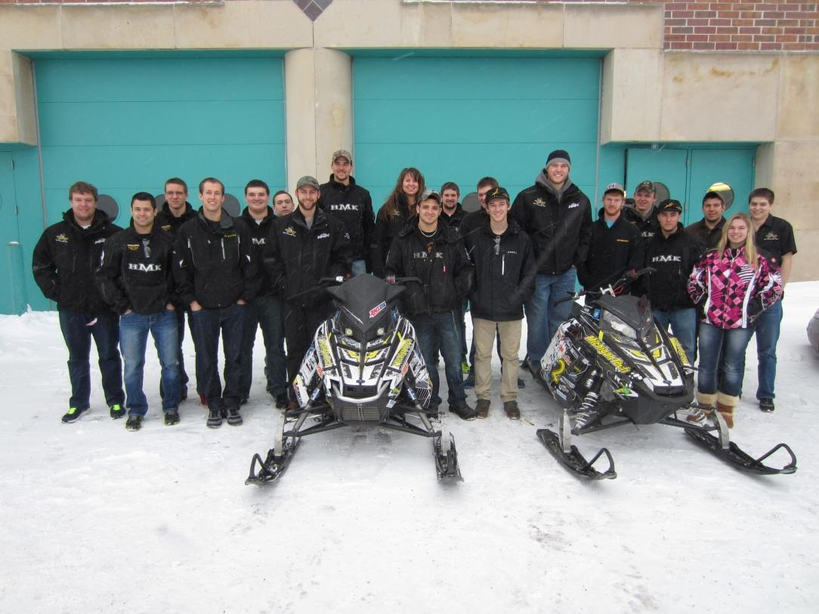
MSRP
The total cost of our sled was calculated to be $16,041.47

Slide 19
Thank You Sponsors!

Slide 20
Thank You Sponsors!

