Slide 1
2018 IC Design Presentation
Clean Snowmobile Enterprise: Michigan Tech-IC
Presenters:
Shane Severn
Paul Hanafin
3/2018
2018 IC Design Presentation
Notes:
Oral Design Presentation Description
A ten (10) minute oral presentation of the rationale and approach to the conversion is required, followed by a five (5) minute question and answer period. The presentation should state clearly how your modified snowmobile addresses the needs of snowmobilers (performance), environmentalists/land managers/regulatory agencies (noise and emissions), and snowmobile dealers/outfitters (cost, durability, resale value). Your presentation should focus on how your snowmobile will economically and practically reduce the impact that snowmobiles have on the environment. The presentation will be judged on content, format, and delivery. All statements must be backed up with test results and science. This is a marketing delivery that must be based on FACTS.
Each team is required to submit an electronic copy of their oral design presentation to competition organizers at the end of the presentation. Electronic copies may be submitted on a CD or data stick. Teams that fail to provide an electronic copy of their oral presentation will receive zero (0) points for this event. This requirement will be strictly enforced!
Oral Design Presentation Scoring
Oral design presentation judges will include snowmobilers, environmentalists, land managers, and engineers. A sample oral design presentation judging form is located in the Rules Appendix. The average of the judges’ scores for each team will equal the points awarded to that team on a 100-point scale weighted as described in the sample judging form. The minimum performance level for this event is presenting the oral design presentation. If the average of the judges’ presentation score is less than 5 points, the team will receive the minimum performance
level score of 5 points.
Score the following categories on the basis of 0-12.5 points each according to the following scale (any number or fraction
along this scale may be used).
0 = inadequate or no attempt
2.5 = attempted but below expectation
5 = average or expected
7.5 = above average but still lacking
10 = excellent, meets intent
12.5 = extraordinary, far exceeds expectations
_______ CONTENT (Design Process): Does the presentation describe how the team designed their
snowmobile? Did the team have clear objectives as to the decisions they made in designing their
snowmobile?
_______ CONTENT (Innovation): Did the team take an innovative approach in their design or were there any innovative features in their snowmobile compared to current snowmobiles on the market today.
_______ CONTENT (Emissions, Noise, and Fuel Economy): Did the team address the highest priority goals of the Challenge: Emissions, Noise, and Fuel Economy?
_______ CONTENT (Test results): Are test results given for all of the “claims” made about the modified snowmobile? Is the presentation based on “good science” (as opposed to a slick sales job)? Is data provided to support all conclusions?
_______ ORGANIZATION: Were the concepts presented in a logical order progressing from basic
concept and showing how the engineering accomplished the concept? Was it clear to the audience
what was to be presented and what was coming next? Were distinct introduction and overviews as
well as summary and conclusions given?
_______ VISUAL AIDS: Were visual aids used? Was the text readable? Were illustrations, graphs, and tables clearly explained? Were the visual aids effective?
_______ DELIVERY: Did the presenter speak in a clear voice? Did the presenter show enthusiasm and promote confidence in the technical aspects? Did he/she maintain eye contact?
_______ QUESTIONS: Did the answer illustrate that the team fully understood the question? Is there doubt that the team understood the answer? Did the team promote complete confidence in their response to the questions?
_______ TOTAL = PRESENTATION POINTS (100 points maximum)

Slide 2
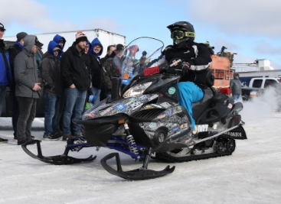
Agenda
Platform Background
Engine Control Strategy
Engine Tune Development
Emissions
Noise Reduction Strategy
Sound Profile Characterization
Solution Implementation
Conclusions

Slide 3
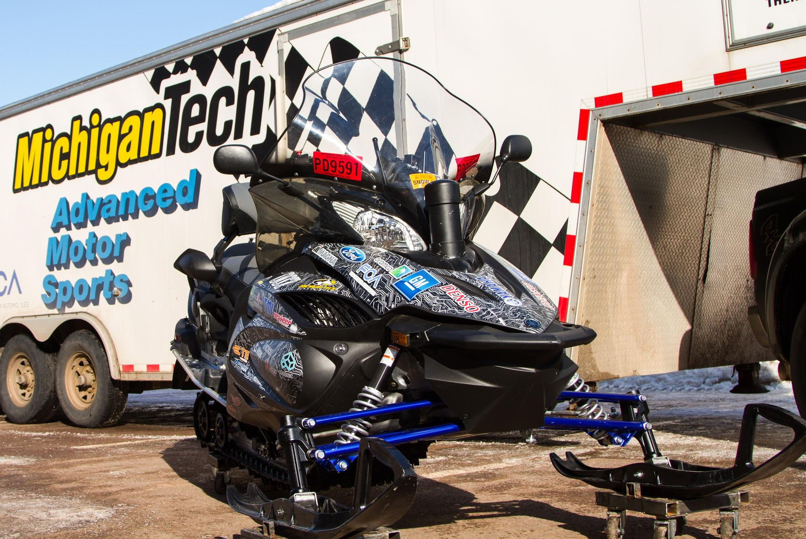
Competition Snowmobile
Chassis: 2016 Yamaha RS Venture TF BAT
Engine: 1049cc Yamaha Genesis
Four-Stroke
Liquid Cooled
3 Cylinder
Track: Ported Camso Crossover
151” x 15” 2.52 pitch
Notes:
Our sled:
Chassis: 2016 Yamaha RS Venture TF BAT
Engine: 1049cc Yamaha Genesis
Four-Stroke
Liquid Cooled
3 Cylinder
Track: Camso Ripsaw Crossover 151” x 15” 1.25 pitch

Slide 4
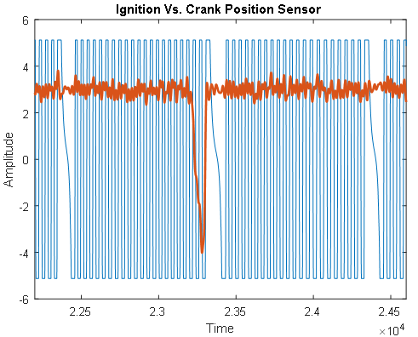
Engine Calibration Development
Ignition vs cps sensor waveform chart
Acquiring Stock Engine Calibration
CPS, MAP, and TPS Sensors
Ignition and injector waveforms
Developing New Engine Calibration
MoTec M130 ECU with Development License
5 Target Modes
Mode | Crankshaft Speed (rpm) | Crankshaft Torque (lb-lbs)
1 | 8300 | 44
2 | 7055 | 22.44
3 | 6225 | 14.52
4 | 5395 | 8.36
5 | Idle | 0

Slide 5
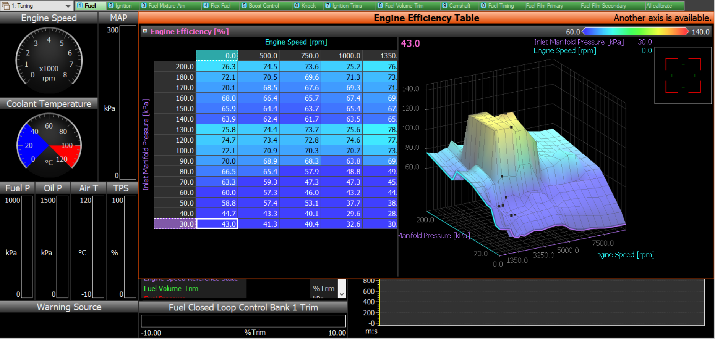
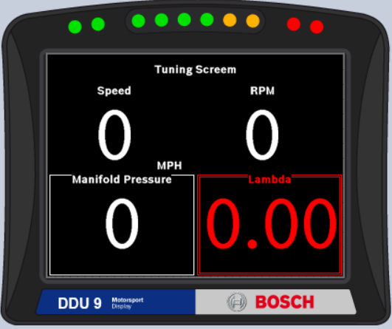
Tuning With MoTec
Ignition vs cps sensor waveform chart
Electronic Throttle Control
Complete Flex Fuel Capabilities
Closed Loop Fueling
Lambda to CAN (Lambda 1 Target)
Set Fuel Aim Table
Programmable Bosch Display
Live updates on snow
Manifold Pressure
Lambda
Ethanol Analyzer
Notes:
We were aiming to target a lambda value of one With MoTec we were able to use a Lambda to CAN adapter and actively return the lambda value to the ECU to compinate and adjust to hit out target (Im not sure on how to word this but this is what I am thinking)

Slide 6
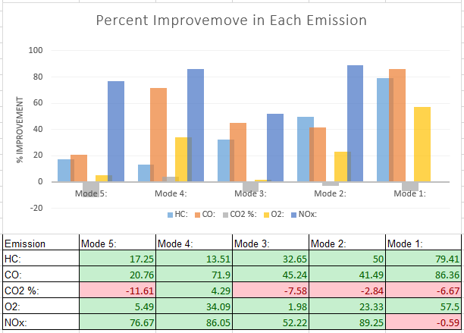
Emissions
2018 Dyno Picture
Three Way Metallic Catalytic Converter
Overall improvement in CO and UHC in all 5 modes
NOx Emissions improvement in modes 2-5
2018 Emissions Comparison Table

Slide 7
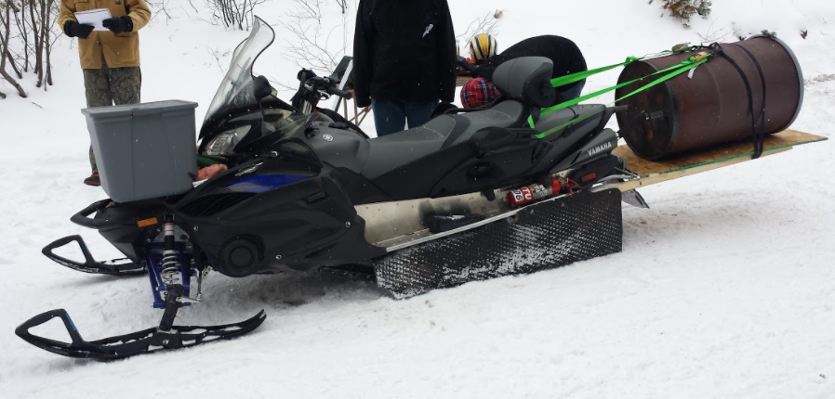
Noise Reduction Strategy:
Sound Profile Characterization
Intake Attenuation
Overkill Intake
Exhaust Attenuation
Overkill Exhaust
Chassis Attenuation
Soundown™
Track Skirts
Overkill Exhaust Picture

Slide 8
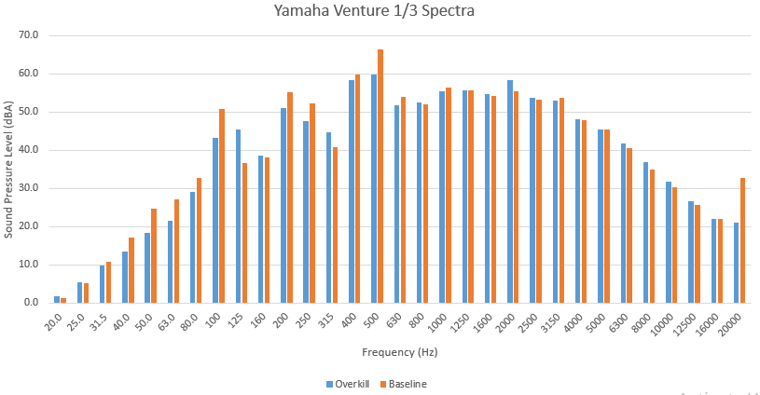
Overkill Results:
Bogey Contributions
Intake/Exhaust Contributions
Track Contributions
Overkill Exhaust Picture

Slide 9
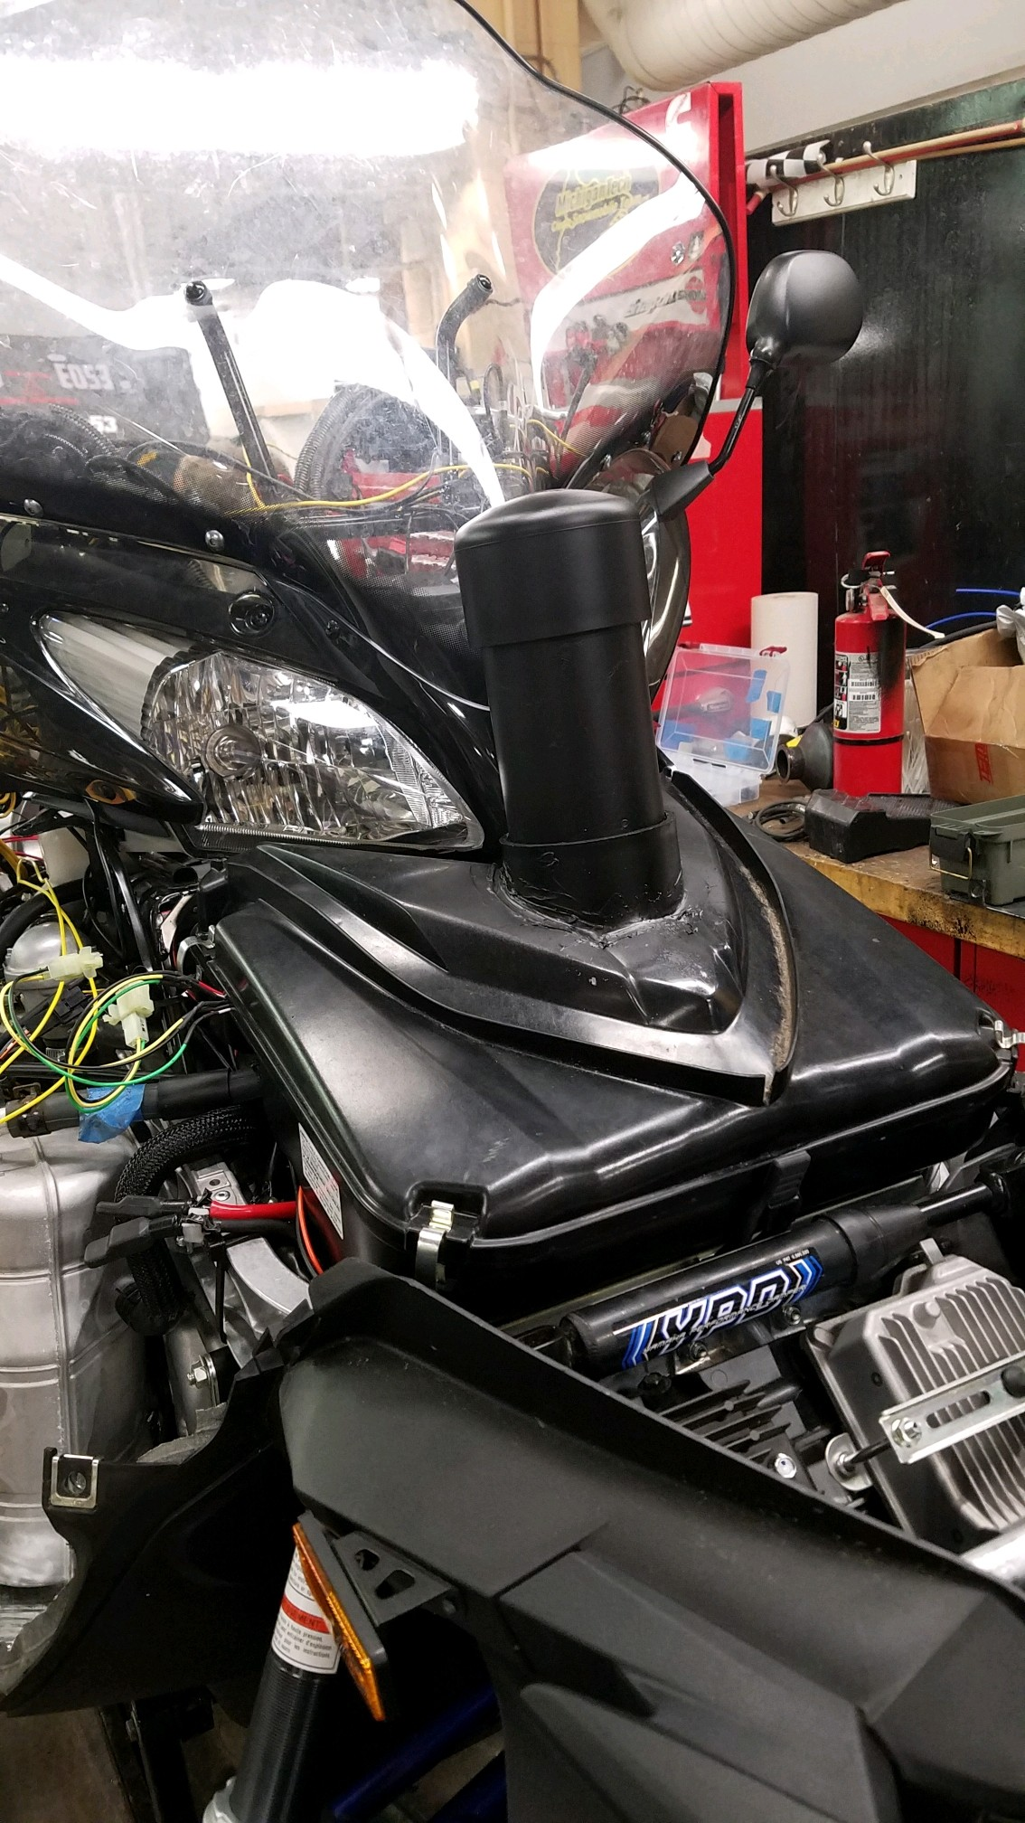
Intake Solution:
Intake Quarter Wave Resonator
Tuned to 265 Hz
Heating elements used to combat temperature induced performance fluctuations
Improvement of 3.1 dBA at 265 Hz

Slide 10
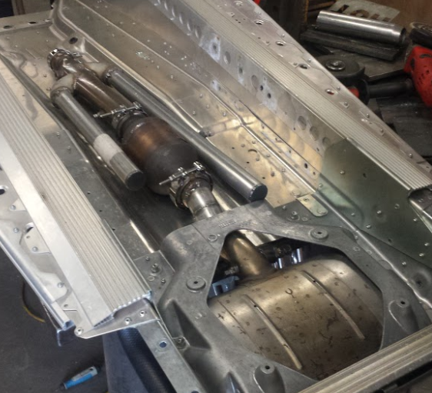
Exhaust Solution:
 | CFM | Back Pressure (iwg)
With Catalyst | 75.53 | 4.89
 | 50.34 | 2.24
OEM | 75.13 | 2.65
 | 50.54 | 1.22
Flow Restriction
Exhaust Quarter Wave Resonators
Two resonators tuned to frequencies 265 Hz and 397.5 Hz
Improvement of 3.1 dBA at 265 Hz
Improvement of 2.4 dBA at 397.5 Hz
Picture of Track and Suspension

Slide 11
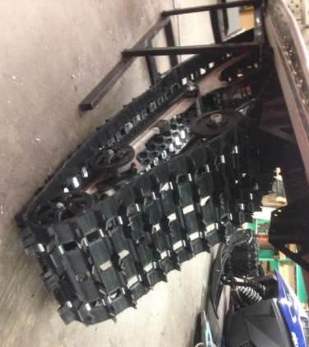
Track/Skid Solution:
Ported Camso Crossover 151” x 15”
Bogey configuration
Offset
Removed
Improvement of 2.1 dBA at 488 Hz (Track)
Improvements of 1.3, 4.0, and 2.4 dBA at 100, 200, and 400 Hz (Bogey)

Slide 12
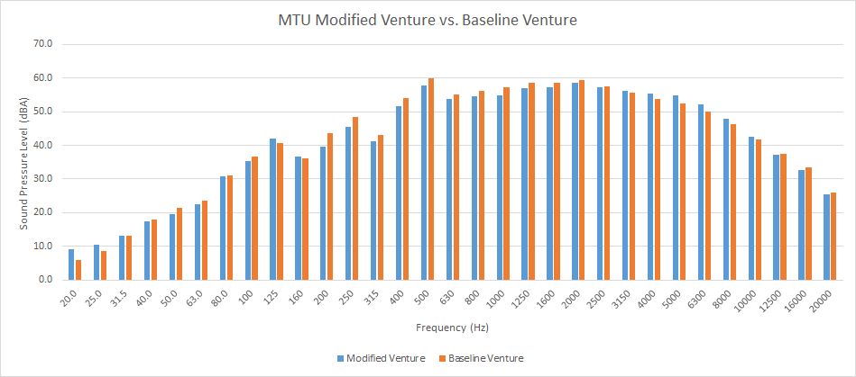
Overall Noise Reduction: 1.5 dBA
Bogey Improvements
Intake/Exhaust Improvements
Track Improvements

Slide 13
Conclusions
Isolated sound emissions from various components
Developed engine calibration with MoTec ECU
Reduction in Co, UHC, and NOx for fewer emissions
Implemented quarter wave resonators in the intake and exhaust to reduce engine noise
Altered bogey wheel configuration and installed a ported Camso Crossover track

Slide 14
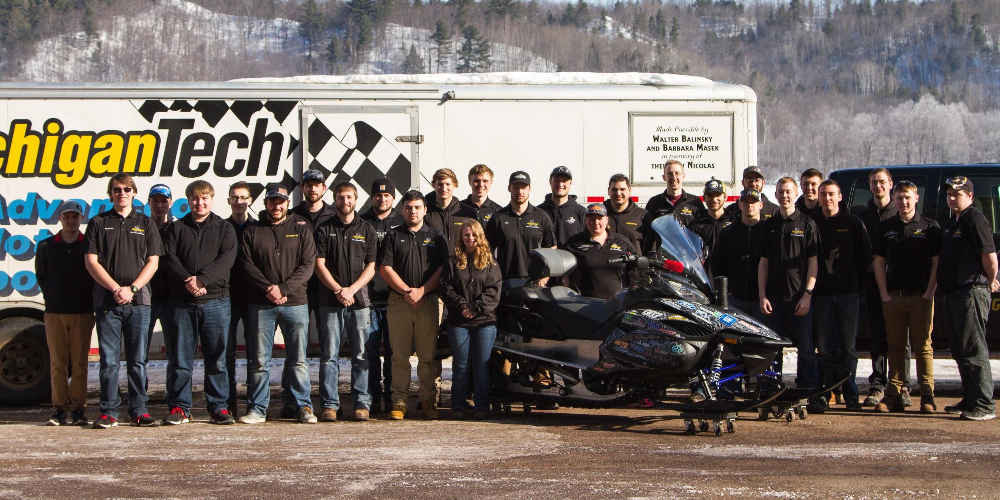
Questions?
Notes:
Our team consists of:
Find how many members we have
With majors of mechanical, general, electrical, and computer engineering.
Also mechanical engineering technology and engineering management
We have 3 subteams
Chassis team, IC team, and business team

