Slide 1
2017 IC Design Presentation
Clean Snowmobile Enterprise: Michigan Tech-IC
Presenters:
Mark Brouwer
Paul Hanafin
Notes:
Oral Design Presentation Description
A ten (10) minute oral presentation of the rationale and approach to the conversion is required, followed by a five (5) minute question and answer period. The presentation should state clearly how your modified snowmobile addresses the needs of snowmobilers (performance), environmentalists/land managers/regulatory agencies (noise and emissions), and snowmobile dealers/outfitters (cost, durability, resale value). Your presentation should focus on how your snowmobile will economically and practically reduce the impact that snowmobiles have on the environment. The presentation will be judged on content, format, and delivery. All statements must be backed up with test results and science. This is a marketing delivery that must be based on FACTS.
Each team is required to submit an electronic copy of their oral design presentation to competition organizers at the end of the presentation. Electronic copies may be submitted on a CD or data stick. Teams that fail to provide an electronic copy of their oral presentation will receive zero (0) points for this event. This requirement will be strictly enforced!
Oral Design Presentation Scoring
Oral design presentation judges will include snowmobilers, environmentalists, land managers, and engineers. A sample oral design presentation judging form is located in the Rules Appendix. The average of the judges’ scores for each team will equal the points awarded to that team on a 100-point scale weighted as described in the sample judging form. The minimum performance level for this event is presenting the oral design presentation. If the average of the judges’ presentation score is less than 5 points, the team will receive the minimum performance
level score of 5 points.
Score the following categories on the basis of 0-12.5 points each according to the following scale (any number or fraction
along this scale may be used).
0 = inadequate or no attempt
2.5 = attempted but below expectation
5 = average or expected
7.5 = above average but still lacking
10 = excellent, meets intent
12.5 = extraordinary, far exceeds expectations
_______ CONTENT (Design Process): Does the presentation describe how the team designed their
snowmobile? Did the team have clear objectives as to the decisions they made in designing their
snowmobile?
_______ CONTENT (Innovation): Did the team take an innovative approach in their design or were there any innovative features in their snowmobile compared to current snowmobiles on the market today.
_______ CONTENT (Emissions, Noise, and Fuel Economy): Did the team address the highest priority goals of the Challenge: Emissions, Noise, and Fuel Economy?
_______ CONTENT (Test results): Are test results given for all of the “claims” made about the modified snowmobile? Is the presentation based on “good science” (as opposed to a slick sales job)? Is data provided to support all conclusions?
_______ ORGANIZATION: Were the concepts presented in a logical order progressing from basic
concept and showing how the engineering accomplished the concept? Was it clear to the audience
what was to be presented and what was coming next? Were distinct introduction and overviews as
well as summary and conclusions given?
_______ VISUAL AIDS: Were visual aids used? Was the text readable? Were illustrations, graphs, and tables clearly explained? Were the visual aids effective?
_______ DELIVERY: Did the presenter speak in a clear voice? Did the presenter show enthusiasm and promote confidence in the technical aspects? Did he/she maintain eye contact?
_______ QUESTIONS: Did the answer illustrate that the team fully understood the question? Is there doubt that the team understood the answer? Did the team promote complete confidence in their response to the questions?
_______ TOTAL = PRESENTATION POINTS (100 points maximum)

Slide 2
Agenda
Competition Snowmobile
Performance
Noise and Emissions
Vibration Isolation
Cost, Durability, Resale Value
Conclusions

Slide 3
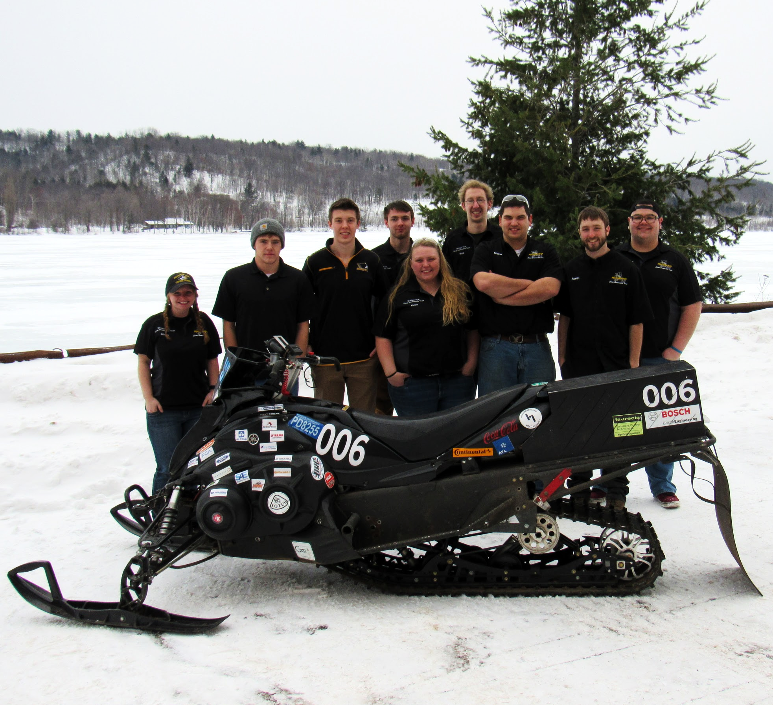
Competition Snowmobile
Chassis: 2014 Yamaha Phazer
Engine: 499 cc stock Genesis 80
Four-Stroke
Liquid Cooled
2 Cylinder
Track: Camso Hacksaw-
144”x14” 2.52 pitch
HALF PAGE IMAGE SIZE EXAMPLE
Notes:
Our sled:
Chassis: 2014 Yamaha Phazer
Engine: 499 CC stock Genesis 80
Four-Stroke
Liquid Cooled
2 Cylinder
Track: Casmso Hacksaw-
144”x14” 2.52 pitch

Slide 4
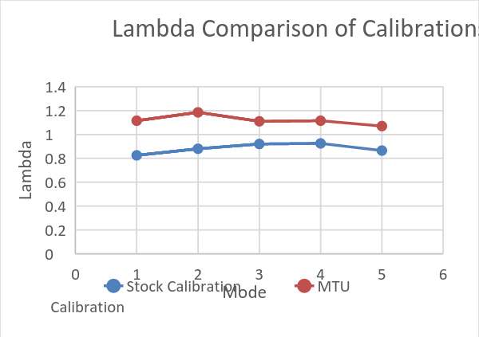
Performance
Engine Tune (PE ECU)
lambda= 1.1
Adjusted Chaincase Gearing
Follow 5 Modes when ramping through power pull
Ram Air Intake
Improved airflow into system
HALF PAGE IMAGE SIZE EXAMPLE

Slide 5
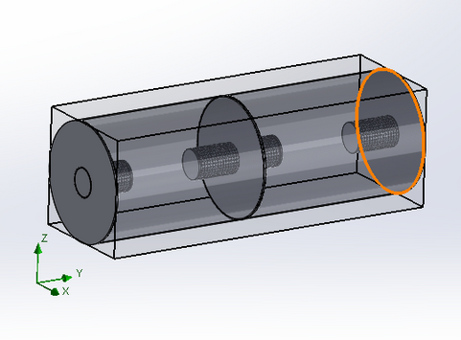
Performance (Cont.)
Custom Exhaust
Pass-through design
Multi-chambered
Perforated tube with solid end caps separate chambers
Packed with dual-layer Silkosoft
HALF PAGE IMAGE SIZE EXAMPLE

Slide 6
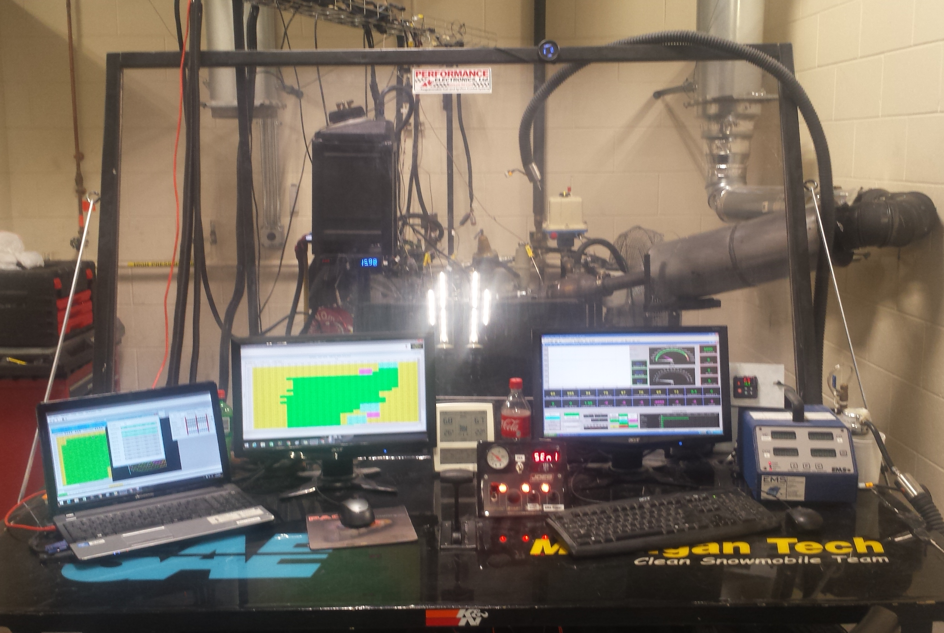
Noise and Emissions
Overall reduction in CO and UHC for all 5 modes
Reduction in NOx in modes 1-3

Slide 7
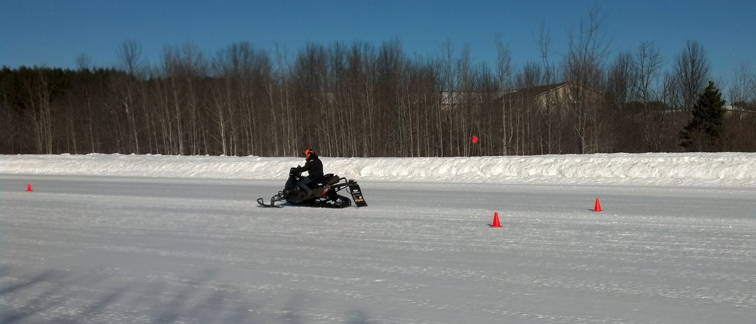
Noise Testing
New competition muffler design tested against tunnel dump design from 2016 competition
New muffler design emits consistent noise level independent of snow conditions
HALF PAGE IMAGE SIZE EXAMPLE

Slide 8
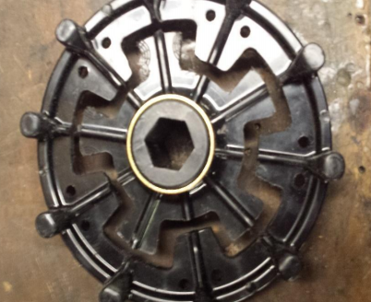
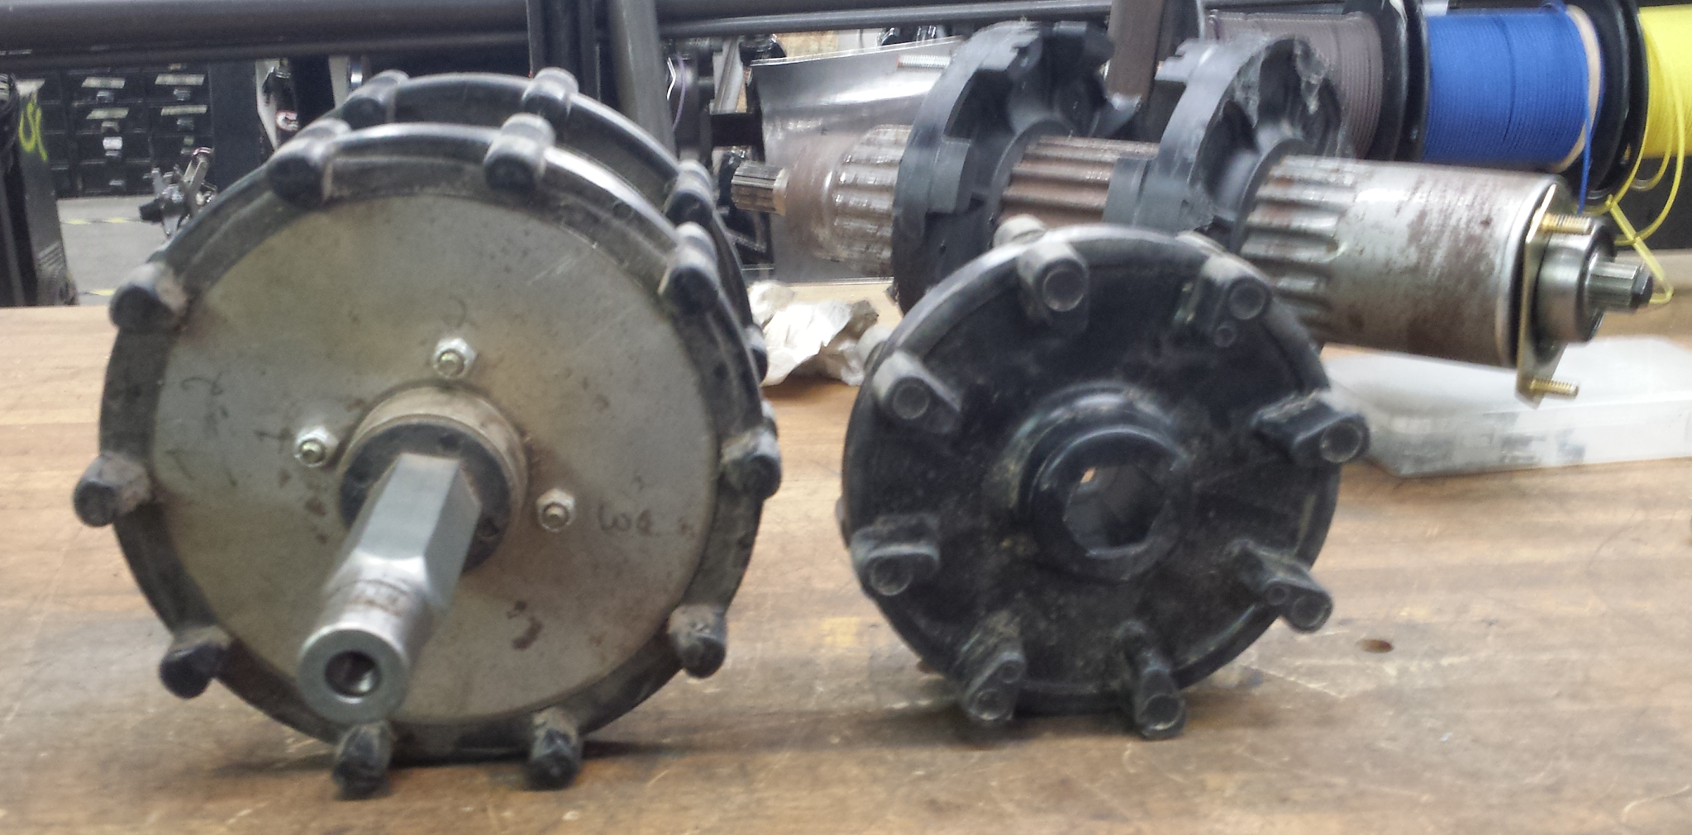
Vibration Isolation (2015-2017)
10 tooth isolated drivers
5 point channel cut between inner drive spline and outer drive teeth
Channel filled with high density rubber and bullet-proofed with side steel plates to prevent catastrophic separation
Notes:
Mention how innovative the high density rubber fill is.

Slide 9
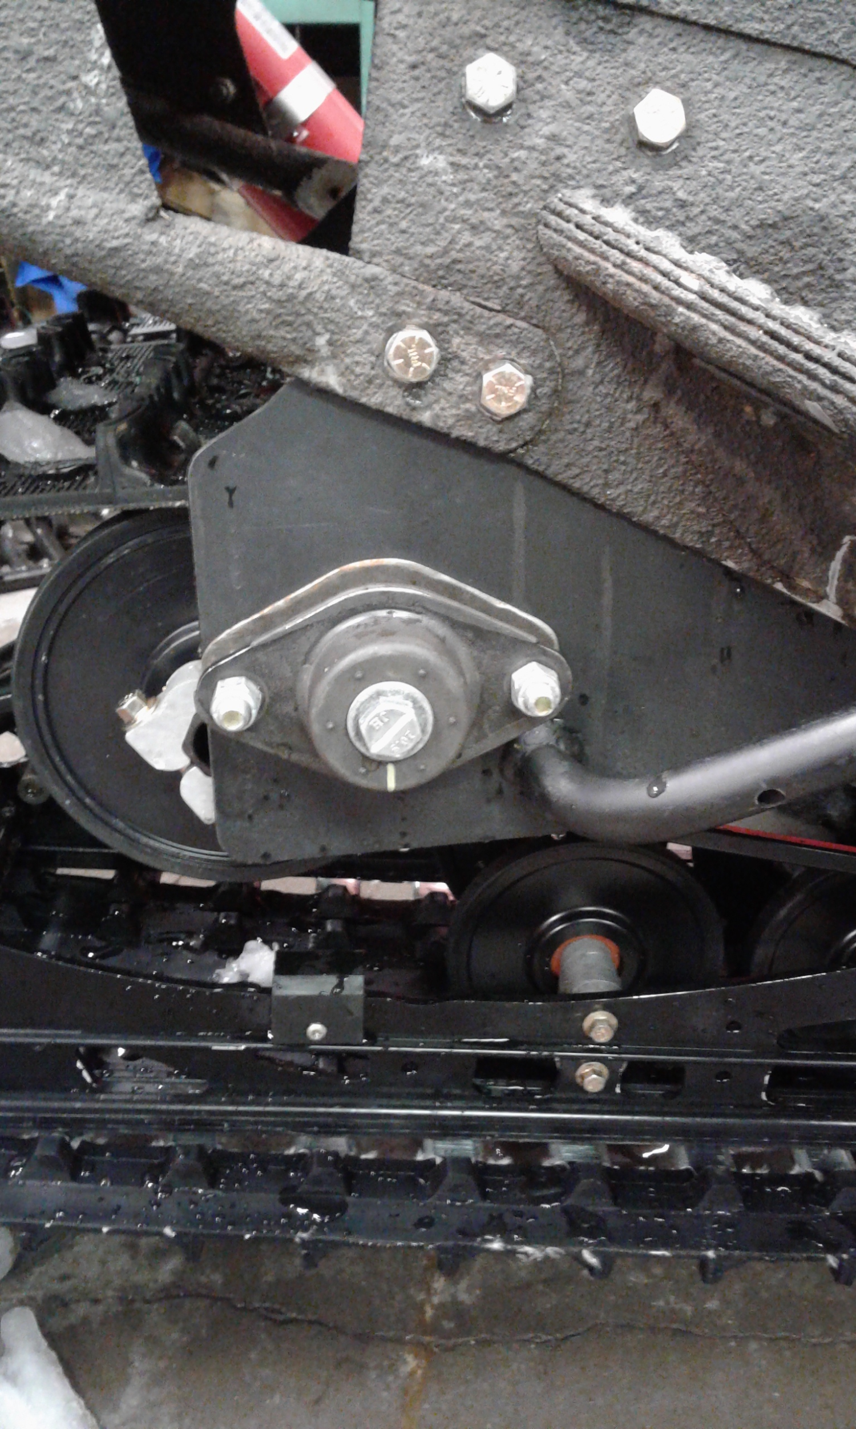
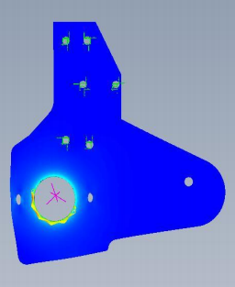
Vibration Isolation (2015-2017)
Rear skid isolators
Isolators and 137” Viper skid and big wheel kit required chassis modification to fit tunnel.
FEA conducted on mount plates, and lateral supports added to ensure adequate rigidity

Slide 10
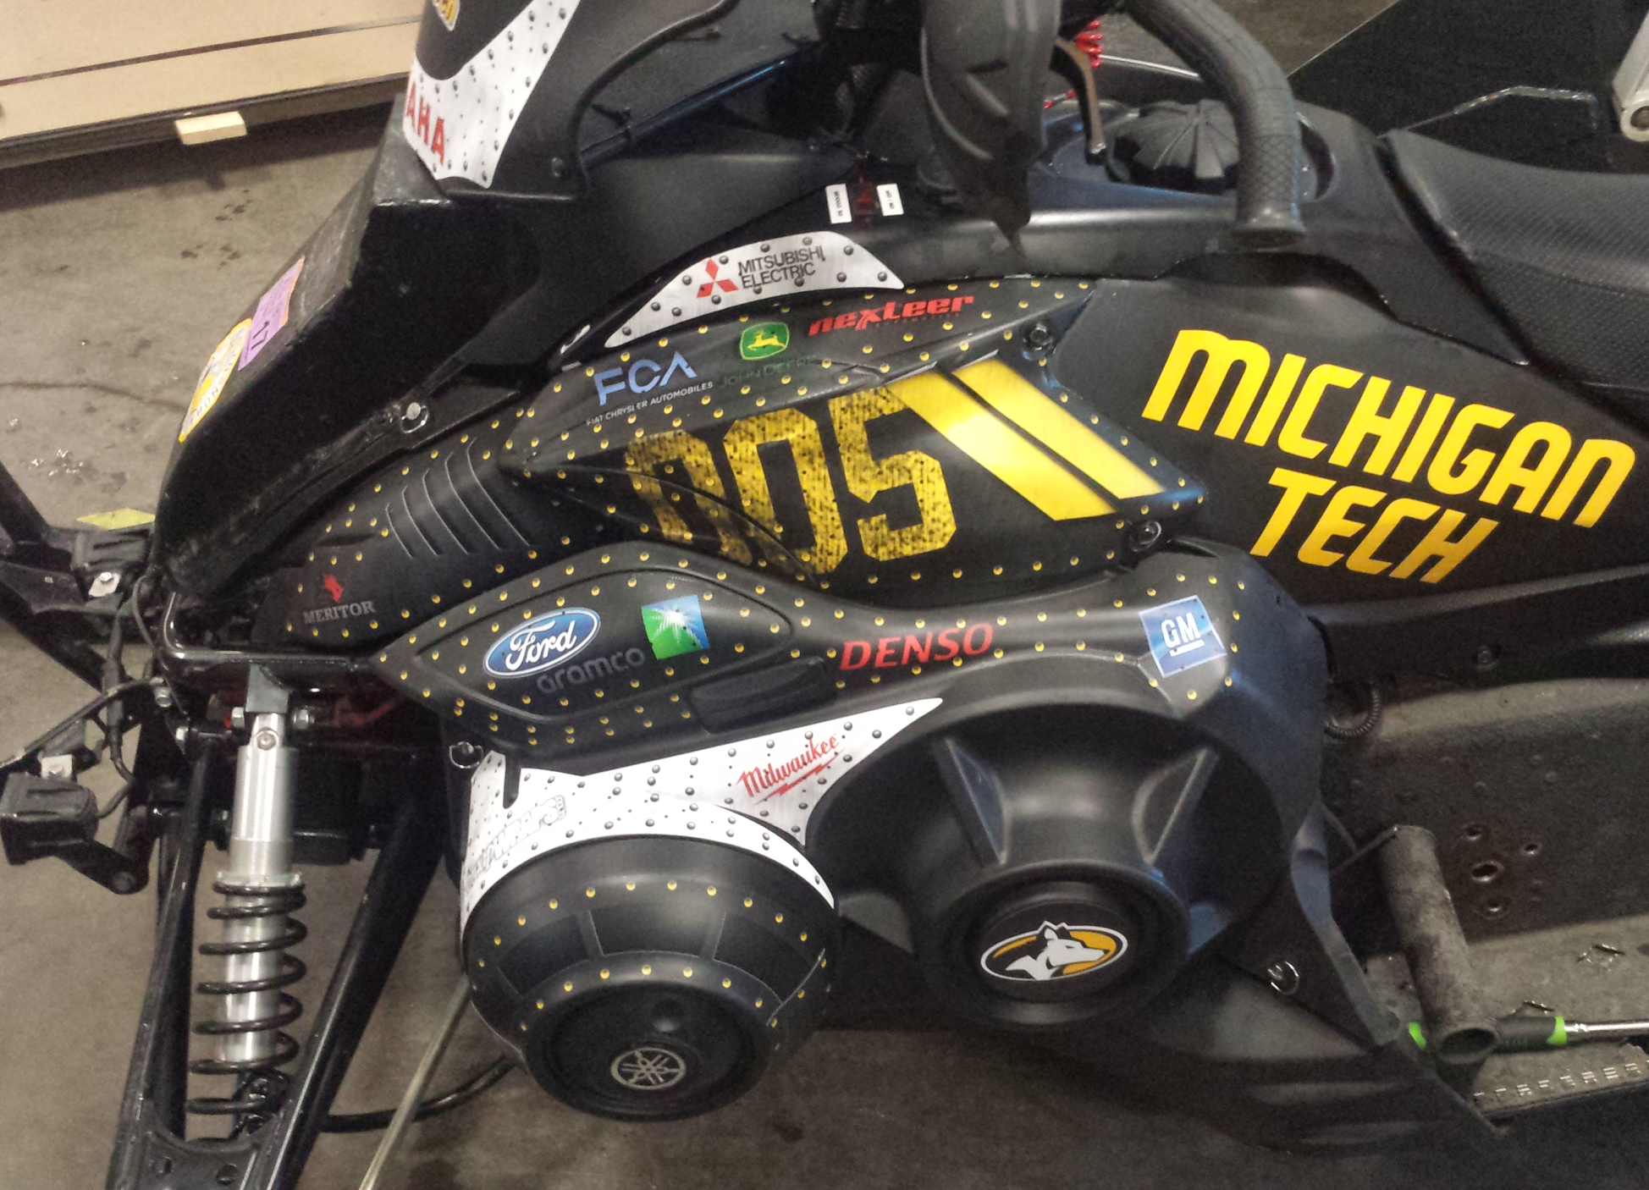
Cost, Durability, Resale Value
MSRP
$12,341.81
Includes advancements in
Chassis
Flex fuel technology
Fuel management
Significant emissions reductions
HALF PAGE IMAGE SIZE EXAMPLE

Slide 11
Conclusions
Efficiency due to lambda 1.1
Custom built muffler to decrease noise
Reduce CO, UHC and NOx for cleaner emissions
Driver modifications and skid isolators put in place to decrease vibration

Slide 12
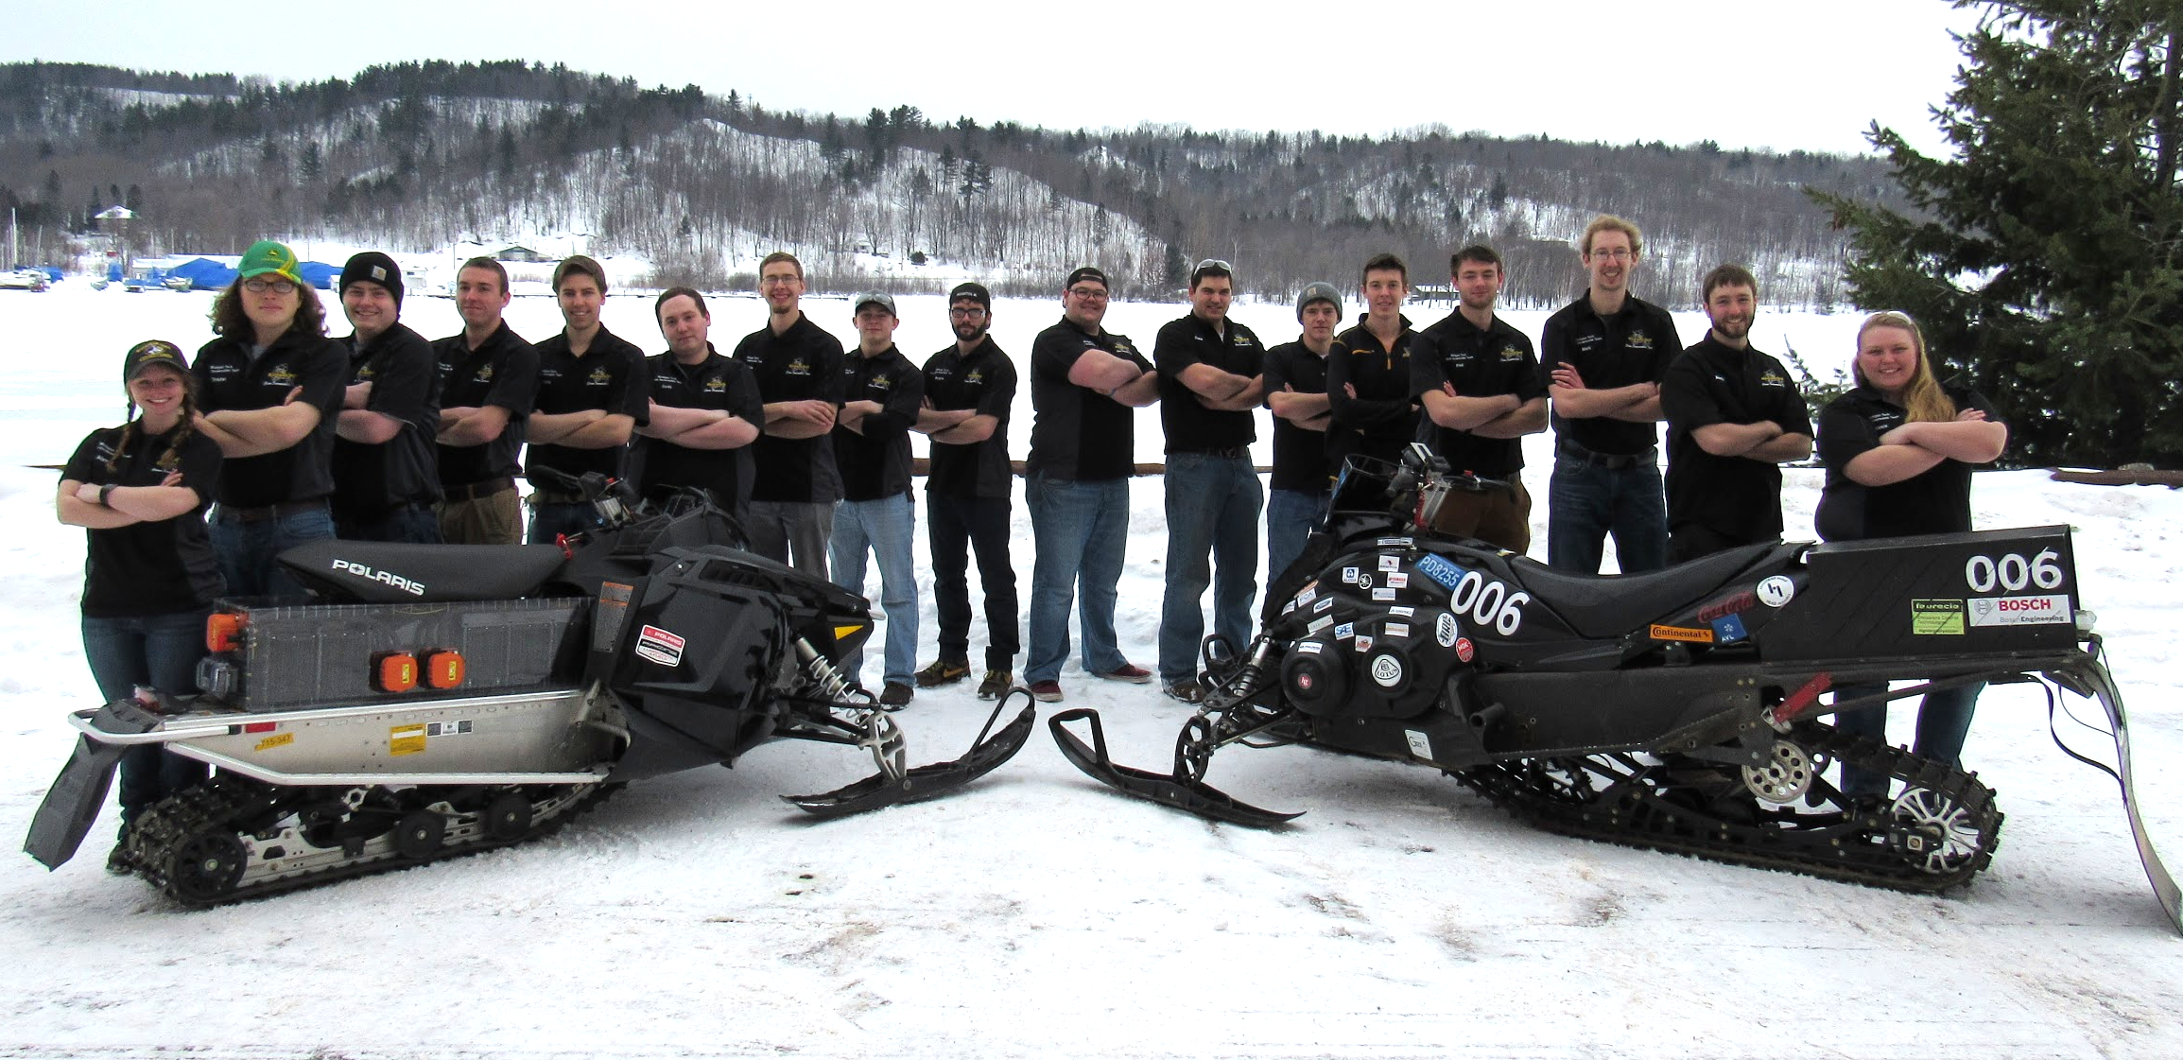
Questions?
Notes:
Our team consists of:
24 members
With majors of mechanical, general, electrical, and computer engineering.
Also mechanical engineering technology and engineering management
We have 4 subteams
Chassis team, IC team, ZE team, and business team

