Slide 1
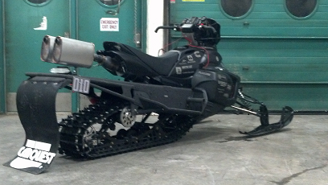

Michigan Technological University
Bill Gielda
Max Farrell
Development and Implementation of Flex Fuel Technology of a 2014 Yamaha Phazer 500

Slide 2
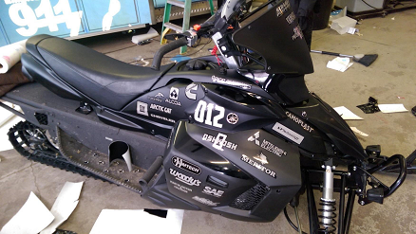
Overview
Design Approach
Engine Calibration
Exhaust Development
Chassis Improvements
MSRP
Conclusion/Questions

Slide 3
Design Focus
Lean Burn Calibration
Noise and Vibration
Rolling Resistance
Exhaust
MSRP

Slide 4
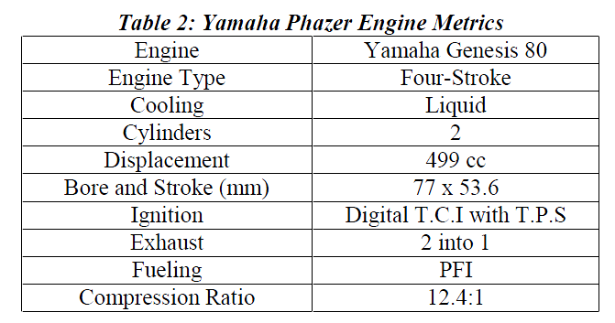
Calibration
DAQ for stock ECU data Recording
Post processing stock ECU
Develop Spark and Fuel tables
Performance Electronics PE3 ECU
Land and Sea water brake dynamometer
Continental Flex-Fuel Sensor

Slide 6
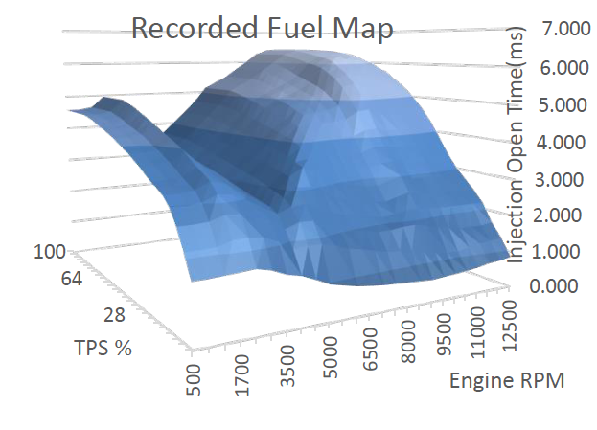
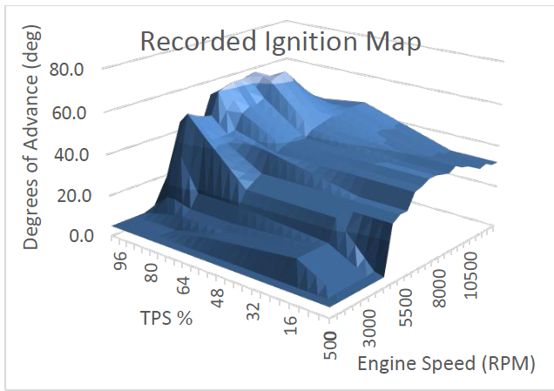
Stock Calibration Development

Slide 7
Lean Calibration Development

Slide 8
Calibration Zones
Zone 1 –Idle Region Lambda value target was 1.1
Zone 2 – Tip-in, Clutch Engagement, Target lambda was 1
Zone 3 - cruise region of the base tables, Low speed Points, Target engine speed for endurance run, Lambda target ranged from 1.0-1.1, when cruising target lambda 1.1 for max fuel econ and reduce emissions
Zone 4- Acceleration events, throttle bade not complete open, target lambda 1.1-1.0
Zone 5- throttle-chop. Delivered fuel still pursued the lambda value of 1.00, ignition values the team set high enough to protect exhaust components, Ignition advance values of 35 degrees Before Top Dead Center (BTDC) and 50 degrees BTDC
Zone 6 was treated as the WOT portion of the base tables, max power production, fueling enrichment added for guarantee the reaction of the oxygen molecules within the intake charge resulting in a more complete burn, The target lambda value for Zone 6 is 0.95-0.90 lambda
Zone 7 -low manifold pressures, typically associated with engine braking, CVT does not allow extreme engine braking, Very short time in, target lambda value of 1.1-1.0, moderate ignition advance, similar to zone 3.

Slide 9
Exhaust Development
Dual Exhaust
Walker Quiet Flow SS
Triple Chamber expansion passages
High and Low Frequencies
Silencer
5 inch dia x 12 inch length
Double packed insulation
Catalyst
Butanol specific
Substrate make up FeCrAl Alloy

Slide 10
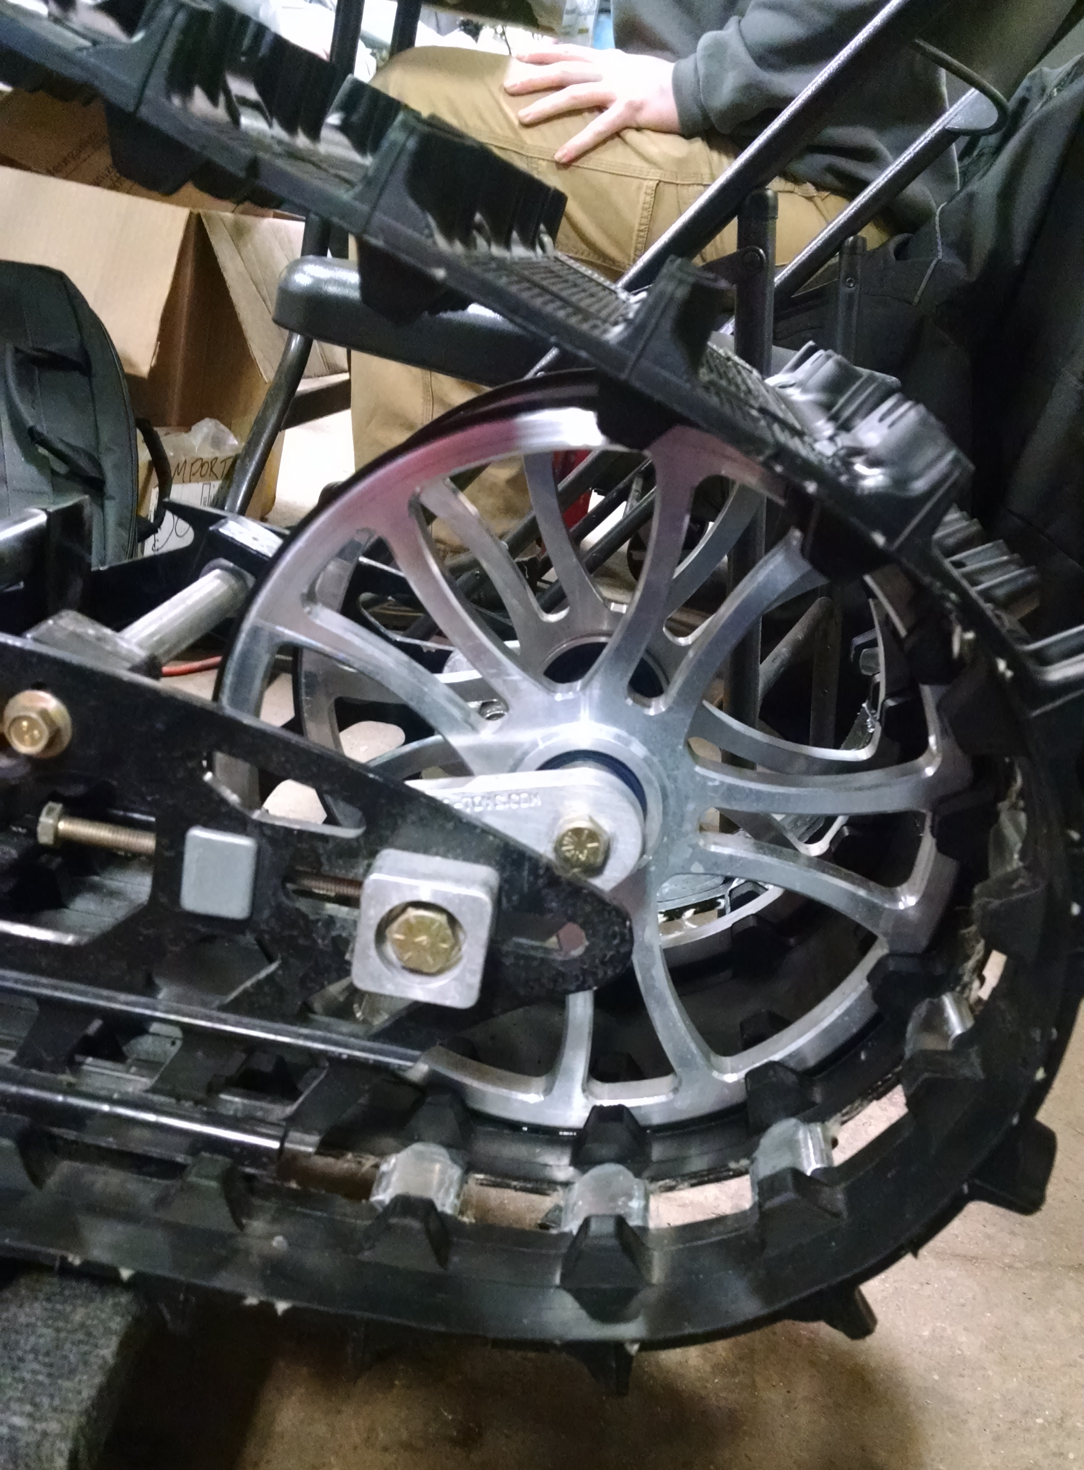
Chassis Improvements
Rolling Resistance
10” Rear Idler Wheels
7.5” Top Support Wheels
10-Tooth Drivers
19:42 Stock Ratio
17:46 Adjusted
58% Overall Reduction

Slide 11
Chassis Improvements
Skid Replacement
2014 Yamaha Viper 137” OEM skid
Skid geometry replicated for Phazer chassis
144” Camoplast Hacksaw

Slide 12
MSRP
Final calculated cost of $9,428.40
Completed cost is $829.40 over stock MSRP.

Slide 13
















Thank You Sponsors!

Slide 14
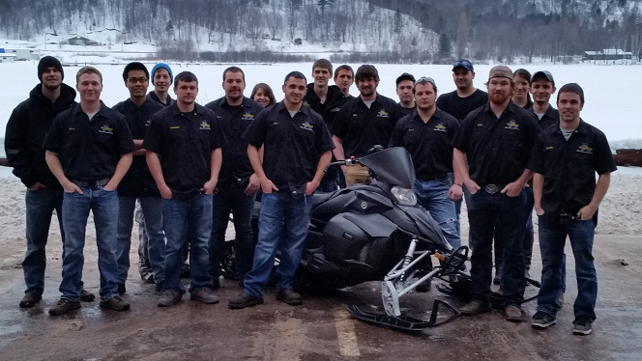
Conclusion/Questions

