Slide 1
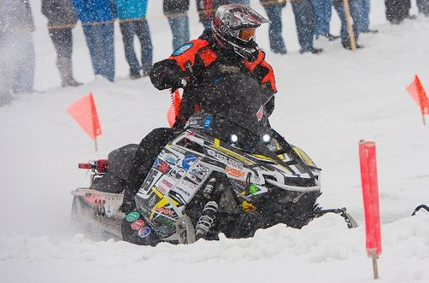

Michigan Technological University
Innovations and Improvements to the 875cc Polaris Indy for the 2014 SAE Clean Snowmobile Challenge
Cody Fackender
Devin Loeks

Slide 2
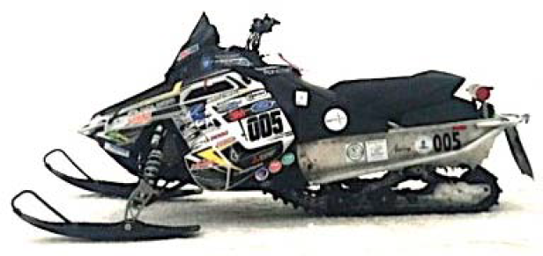
Overview
Design
Calibration
Intake
Exhaust
Vibrations Analysis
Weight Reduction
MSRP

Slide 3
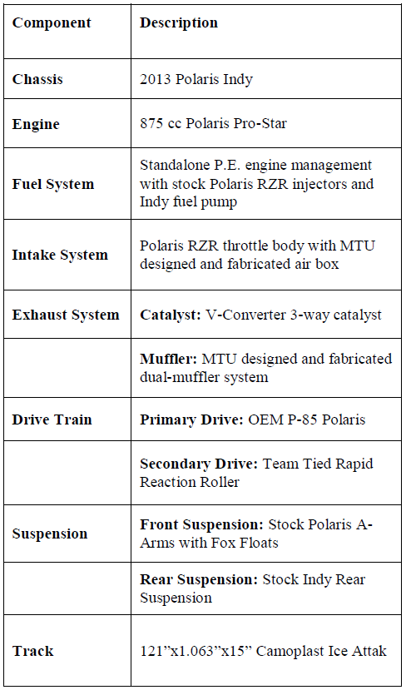
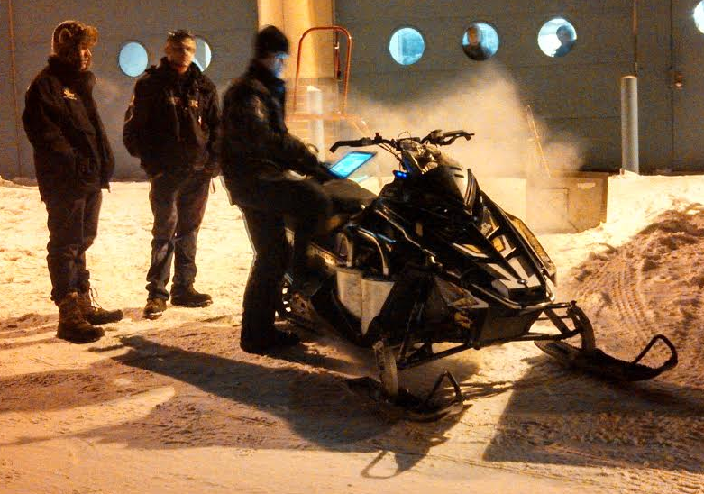
Design

Slide 4
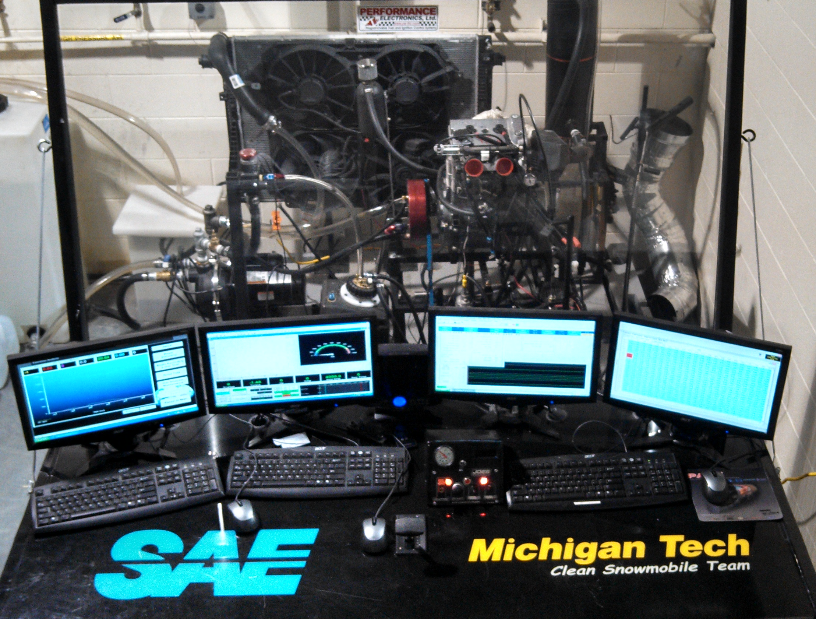
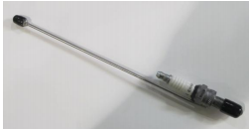
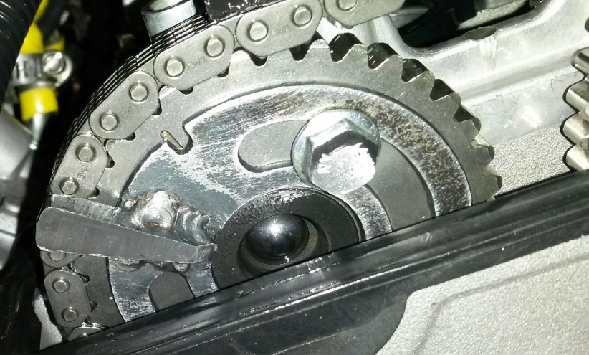
Calibration
Performance Electronics PE3 ECU
Hall effect cam position sensor
Sequential injection
Land and Sea water brake dynamometer
PCB pressure transducer

Slide 5
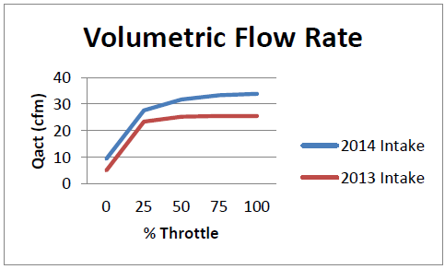
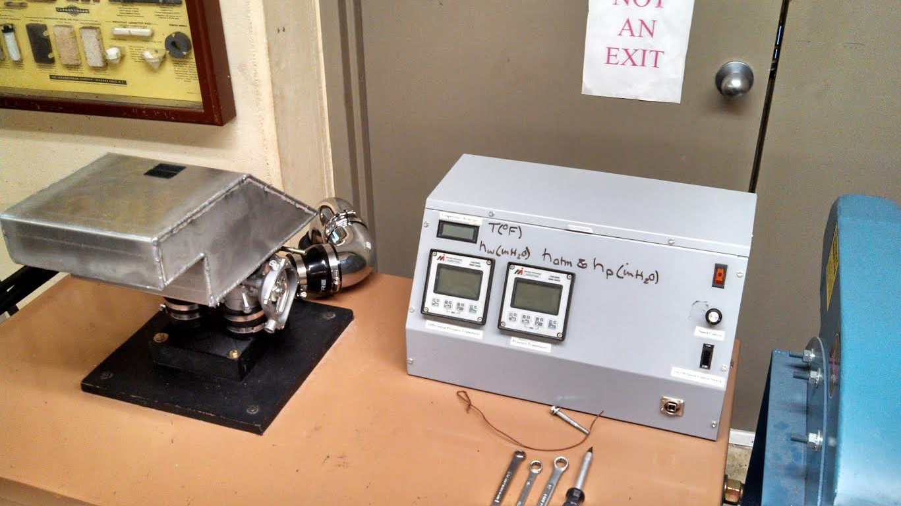
Intake
Benchmarked
Decreases noise
Increases performance
Side panel inlet location

Slide 6
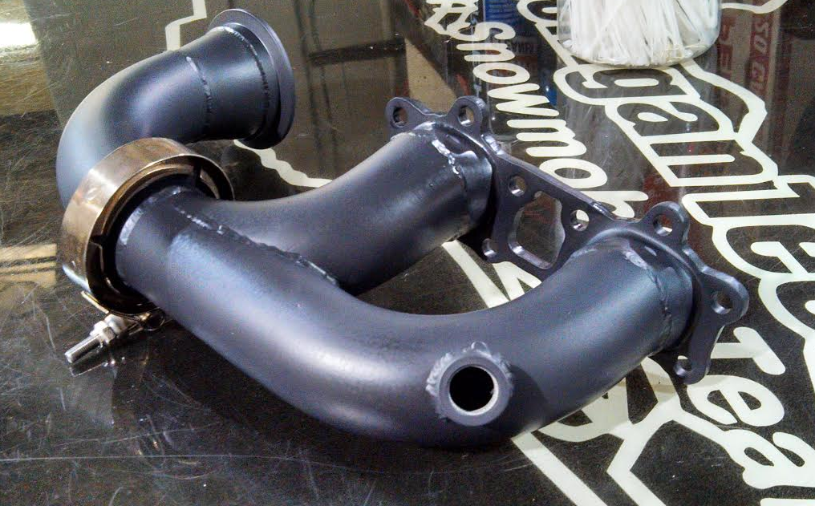
Exhaust
3D printed prototype
Ceramic coated header
                Adjustable outlet
Dual-muffler system
18 pounds
Solidworks flow analysis
V-converter 3-way catalyst

Slide 7
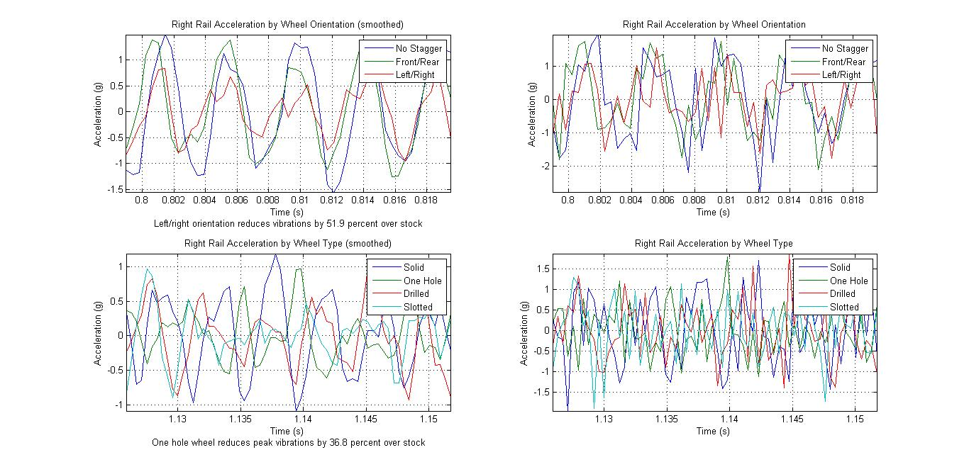
Vibrations Analysis
FEA completed
Designs manufactured
Bogey wheel rail alignment
Bogey wheel design type

Slide 8
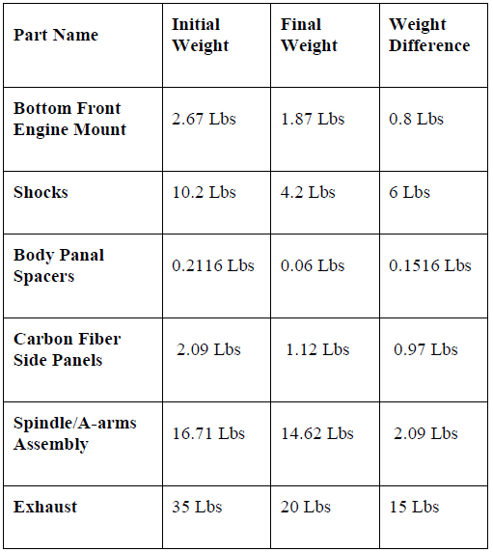
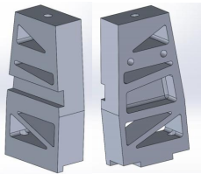
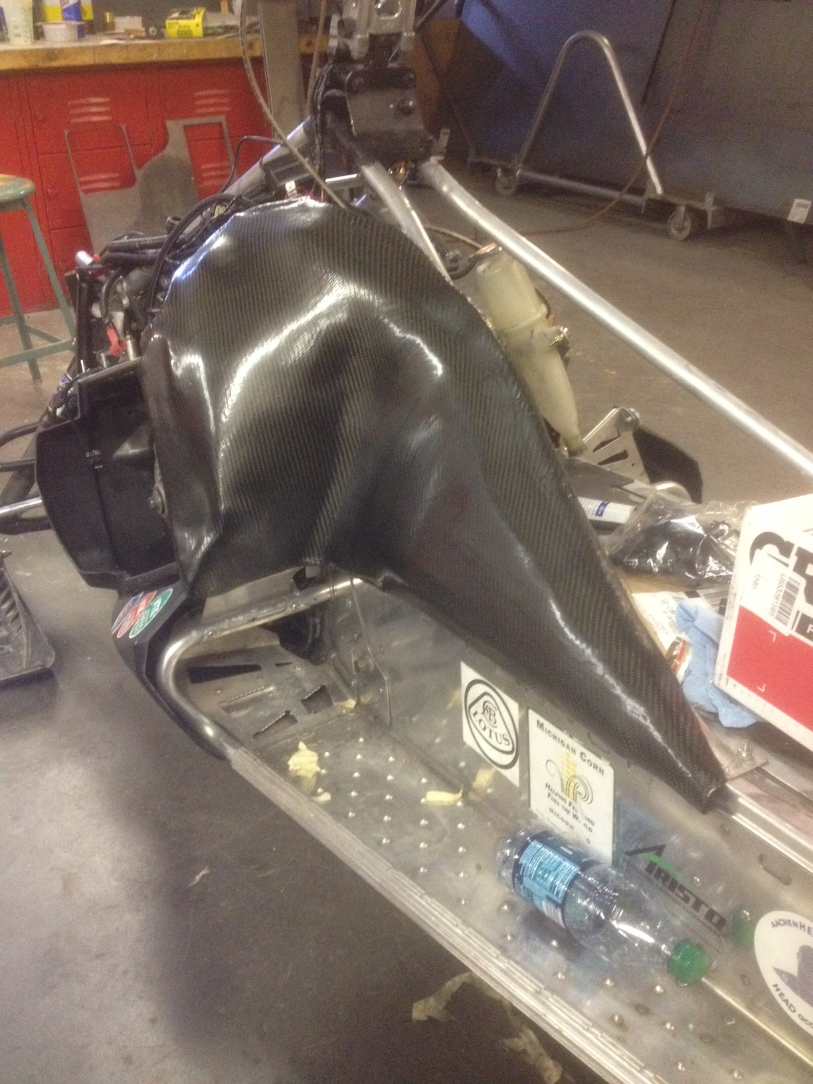
Weight Reduction

Slide 9
MSRP
Base MSRP: 875cc Polaris Indy |  | $7,999
Engine | $ 960.39
Exhaust System | $ 346.32
Front Suspension | $ 1,191.82
Drivetrain | $ 504.63
Noise/Vibration | $ 81.25
Chassis | $ 614.17
Modifications |  | $ 3,698.58
Total MSRP |  | $11,698

Slide 10
















Thank You Sponsors!

