Slide 1
2019 Michigan Tech CI Design Presentation
Clean Snowmobile Enterprise: Michigan Tech-CI
Presenters:
[Nick Brodowski & Justin Scholl]
3/2019
2019 CI Design Presentation
Notes:
Justin start

Slide 2
Agenda
2019 MTU Competition Focus
Competition Snowmobile Overview
Engine Systems
Control
Intake, Exhaust and Aftertreatment
Chassis Mounting
Electronic CVT
Cost, Durability, Resale Value
Conclusions
Notes:
Justin

Slide 3
2019 Competition Focus
Primary Focus on Reliability and emissions
Robust engine mounting
Reliable and efficient engine/calibration
Low Emissions (E Score > 200, Pass competition soot requirements)
Manufacturability
Other Objectives
Quiet operation
Efficient CVT calibration
Improved handling characteristics
Notes:
Nick

Slide 4
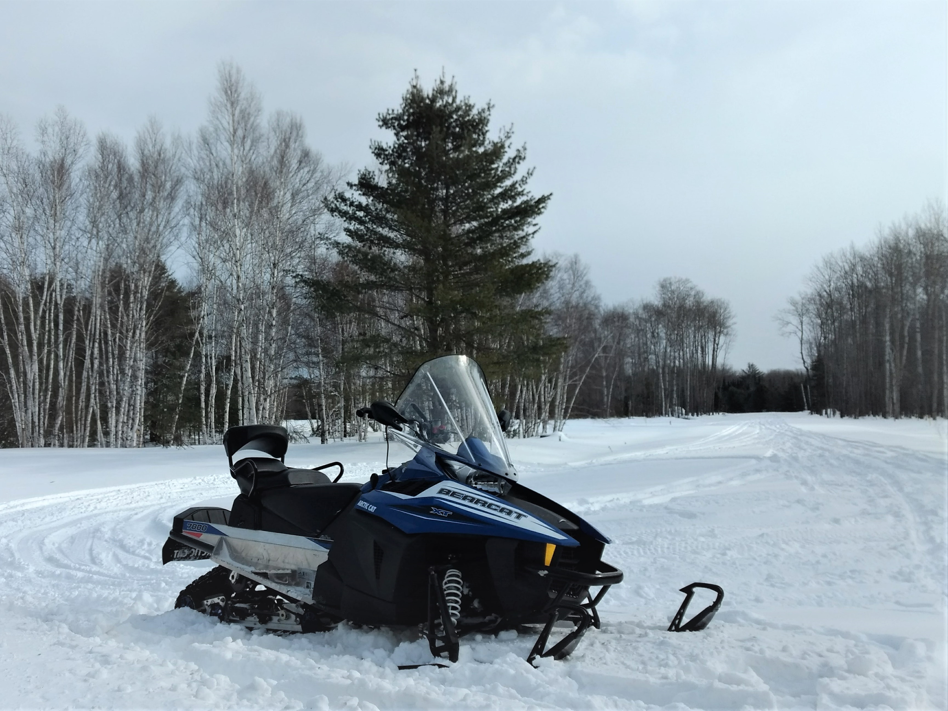
Competition Snowmobile
Chassis: 2016 Arctic Cat Bearcat 7000XT
Engine: KDW993T
Four-Stroke Liquid Cooled Diesel
3 Cylinder, Turbocharged
Vconverter DOC and DPF
Clutch: Polaris Ranger Diesel (TEAM)
Belt: Arctic Cat 1100 turbo
Track: Camso Crossover
154” x 20” 1.38” lug height
Notes:
Justin

Slide 5
Engine Selection
KDW993T turbocharged diesel engine
Currently used in military applications
Extremely similar to the KDW1003 found in powersports industry
Mechanical Indirect Injection
Electronic Fuel rail actuator
Rated 75.1HP
MTU Calibration: 36HP
Notes:
Nick

Slide 6
Engine Control
Made use of electric fuel rail actuator to electronically control fuel delivery
Programmed all fuel and engine control through an Arduino Uno Microcontroller
Bench tested fuel servo motor to tune for optimal step response
PID fuel control: user throttle lever position input, engine speed feedback
Notes:
Justin

Slide 7
Intake and Turbocharger
24mm TEL Turbocharger remotely mounted with flexible hotside piping
Polaris FST Intercooler
Increase Volumetric Efficiency
In front of OEM radiator
Space between intercooler and radiator
High mounting point allows airflow to radiator, bypassing intercooler
Notes:
Nick

Slide 8
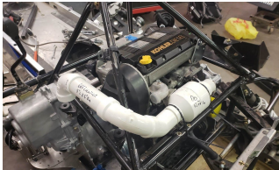
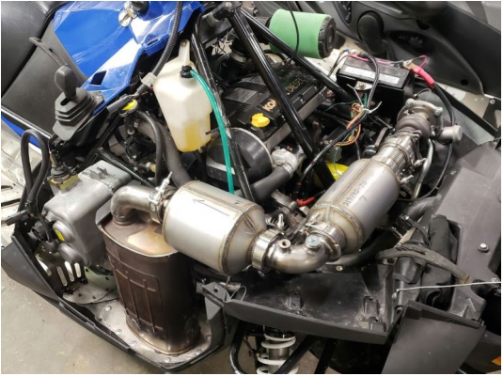
Exhaust and Aftertreatment
VConverter DOC and DPF
Targeting hydrocarbons and soot
Custom built for space and packaging requirements
Prototype Exhaust modeled in PVC pipe to determine packaging and routing requirements
Notes:
Justin

Slide 9
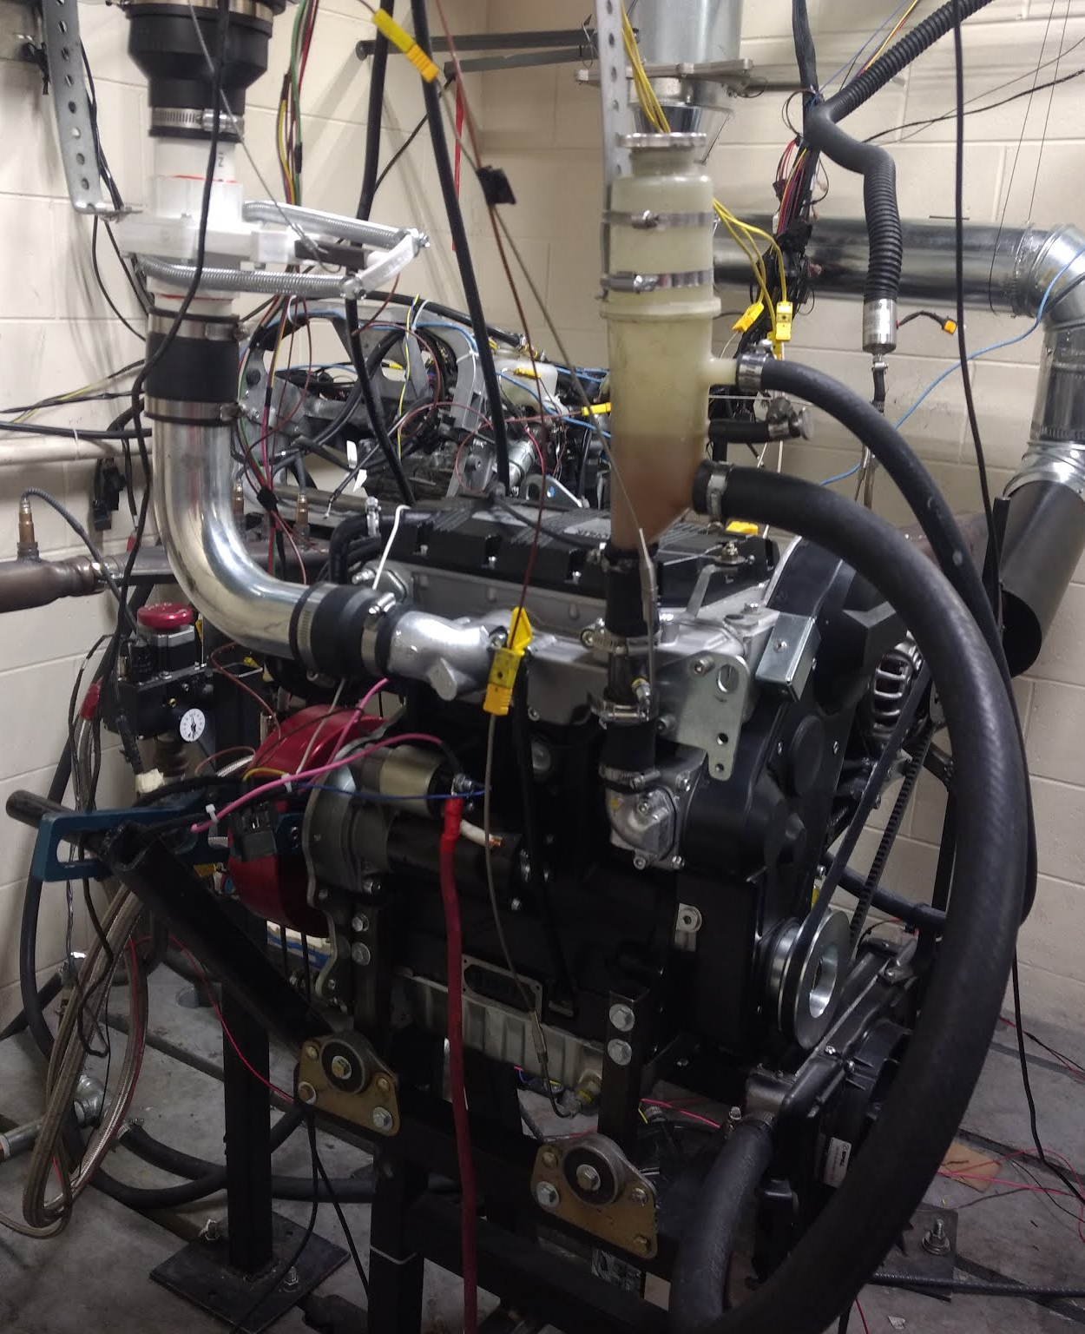
Engine calibration and results
PID fuel control limited to 42% fuel delivery
Lambda 1.65 minimum across power sweep
Peak 36HP at 4000RPM, targeting clean operation
Competition E-Score: 202.91, with 0.15g of soot.
Notes:
Nick

Slide 10
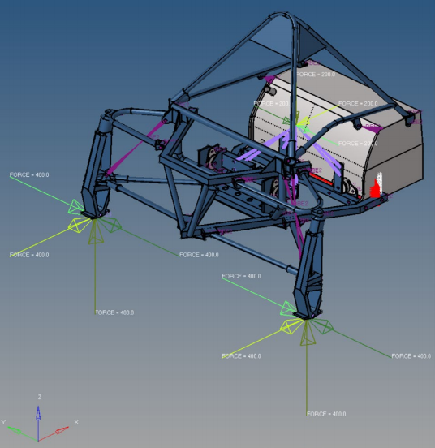
Engine Mounting
Engine placed in OEM location
Rotated 10 degrees to clear pyramidal overstructure and steering post
Chassis modification to front engine mounts
Validation of structural integrity through FEA
Notes:
Justin

Slide 11
Noise Reduction
Noise reduction severity was determined by running an N/A, no intake, no exhaust damping J1161 sound test.
Results: 70dBA (ref 20 uPa)
Yamaha Phazer muffler added to reduce exhaust noise
Foam pre-filter added to reduce high frequency intake noise
Notes:
Nick

Slide 12
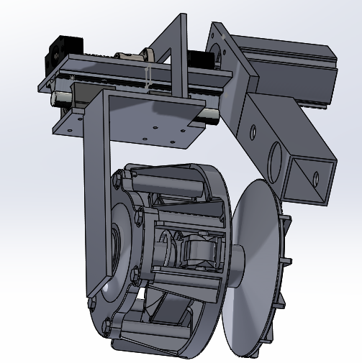
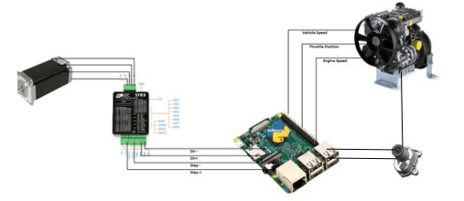
ECVT
Goal:
Improve flexibility of CVT operation, lower fuel consumption, and improve efficiency
Electronically assist the CVT with a stepper motor
Improve performance and fuel economy
Not implemented at competition this year
Further Development in progress
Notes:
Justin

Slide 13
Manufacturability
Goal: target solutions that are reproducible by OEMs
OEM outward appearance
Minimal modifications to overall structure
Reuse of snowmobile manufacturer OEM fuel system parts
Battery in storage space under rear seat
Commercially available engine commonly used in powersports industry
Notes:
Nick

Slide 14
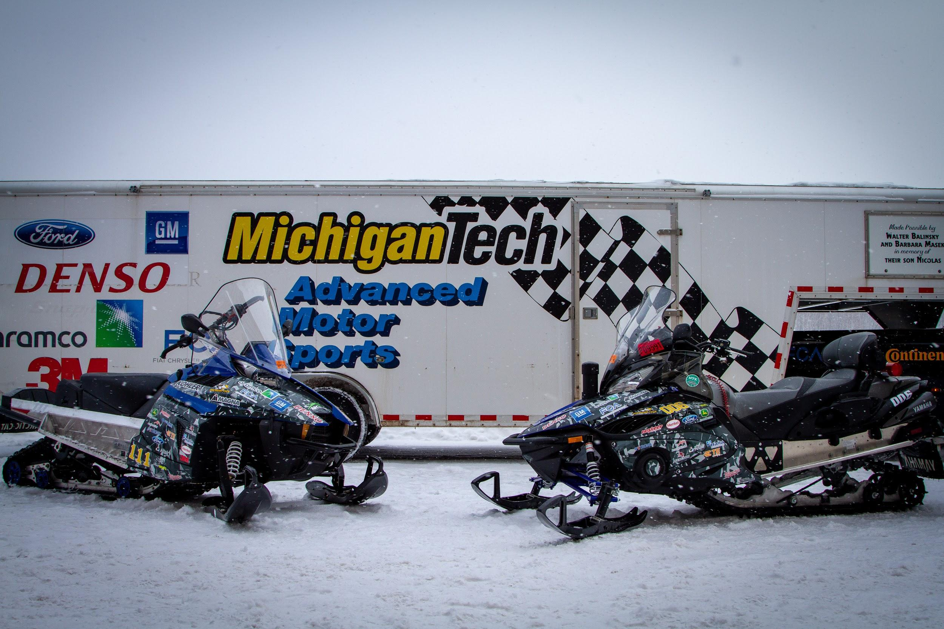
Cost, Durability, Resale Value
MSRP
$13,822.00
Included improvements
Exhaust and after treatment
Engine control
Notes:
Justin

Slide 15
Conclusions
Michigan Tech’s 2019 Diesel entry
Reliable and efficient engine/calibration
Custom microcontroller engine management
Targeting Lambda >1.65
Cleaner emissions
202.9 E score with 0.15g soot
Robust engine placement
Focus on reliability and Manufacturability
Notes:
Nick

Slide 16
Thank you Sponsors!

Slide 17
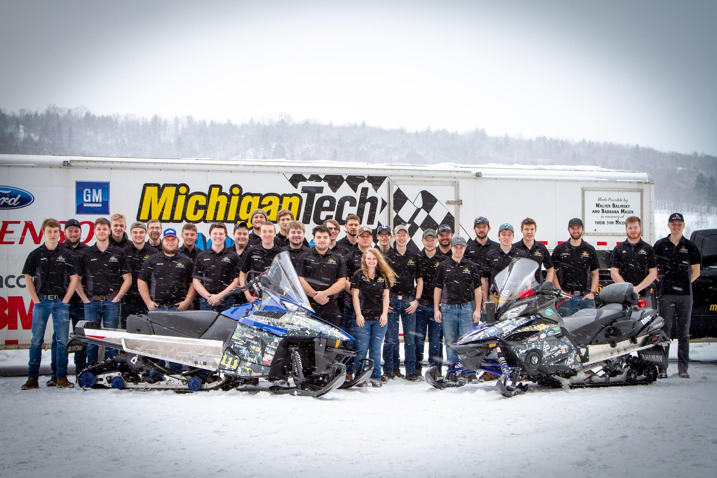
Questions?

Slide 18
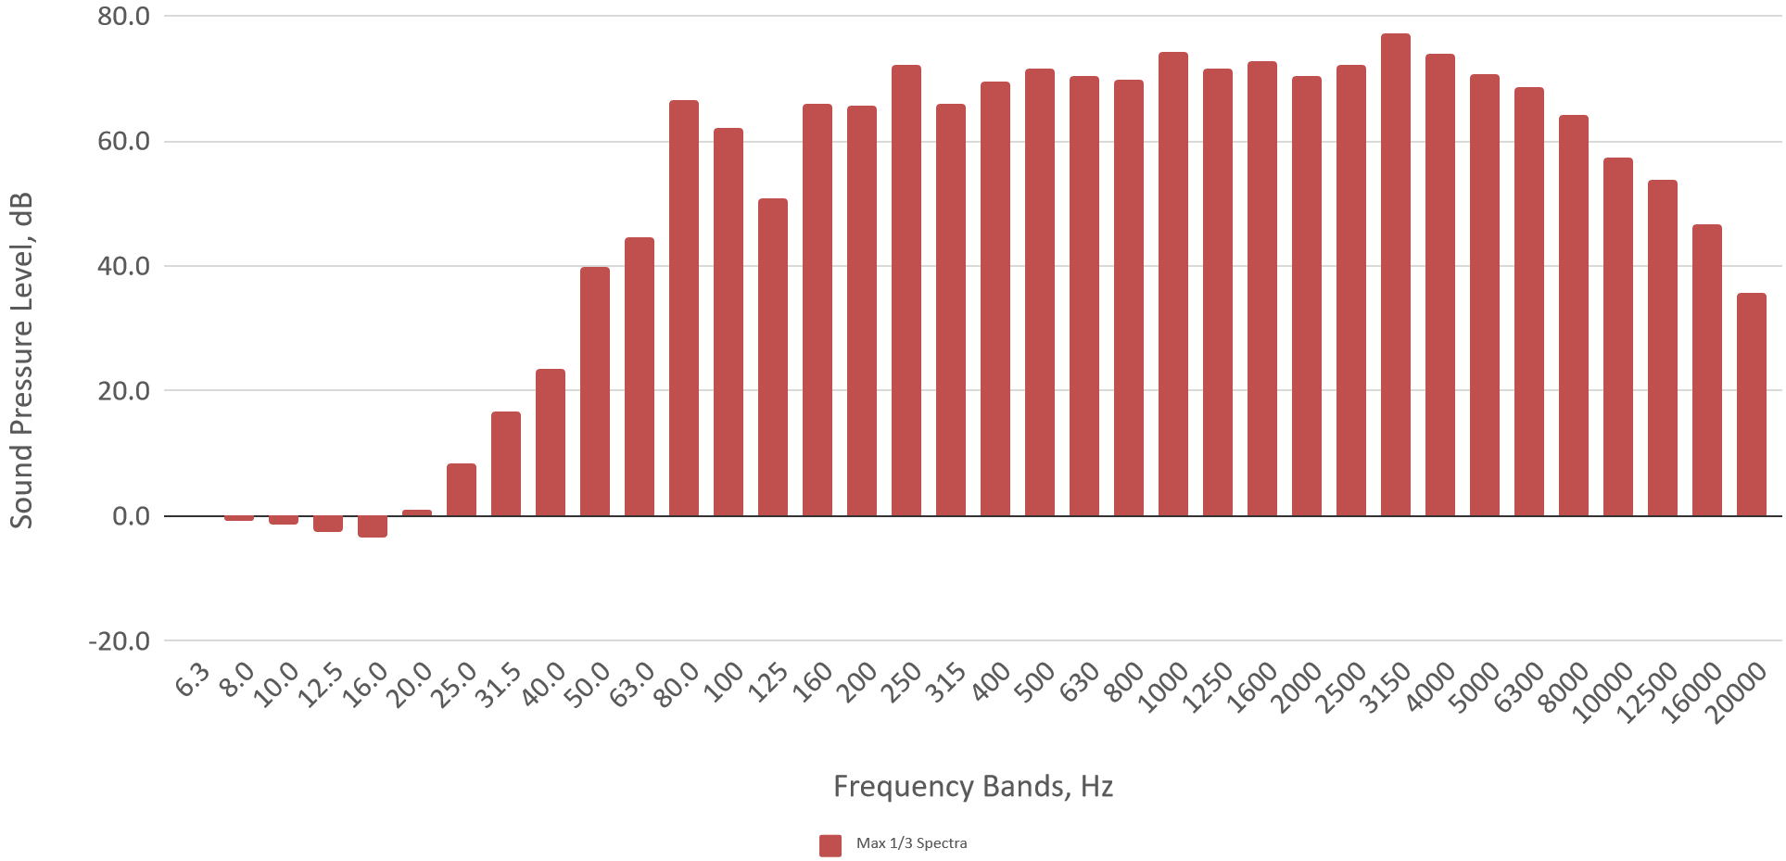
J1161 sound test results: 70.0dBA ref 20uPa

