Slide 1
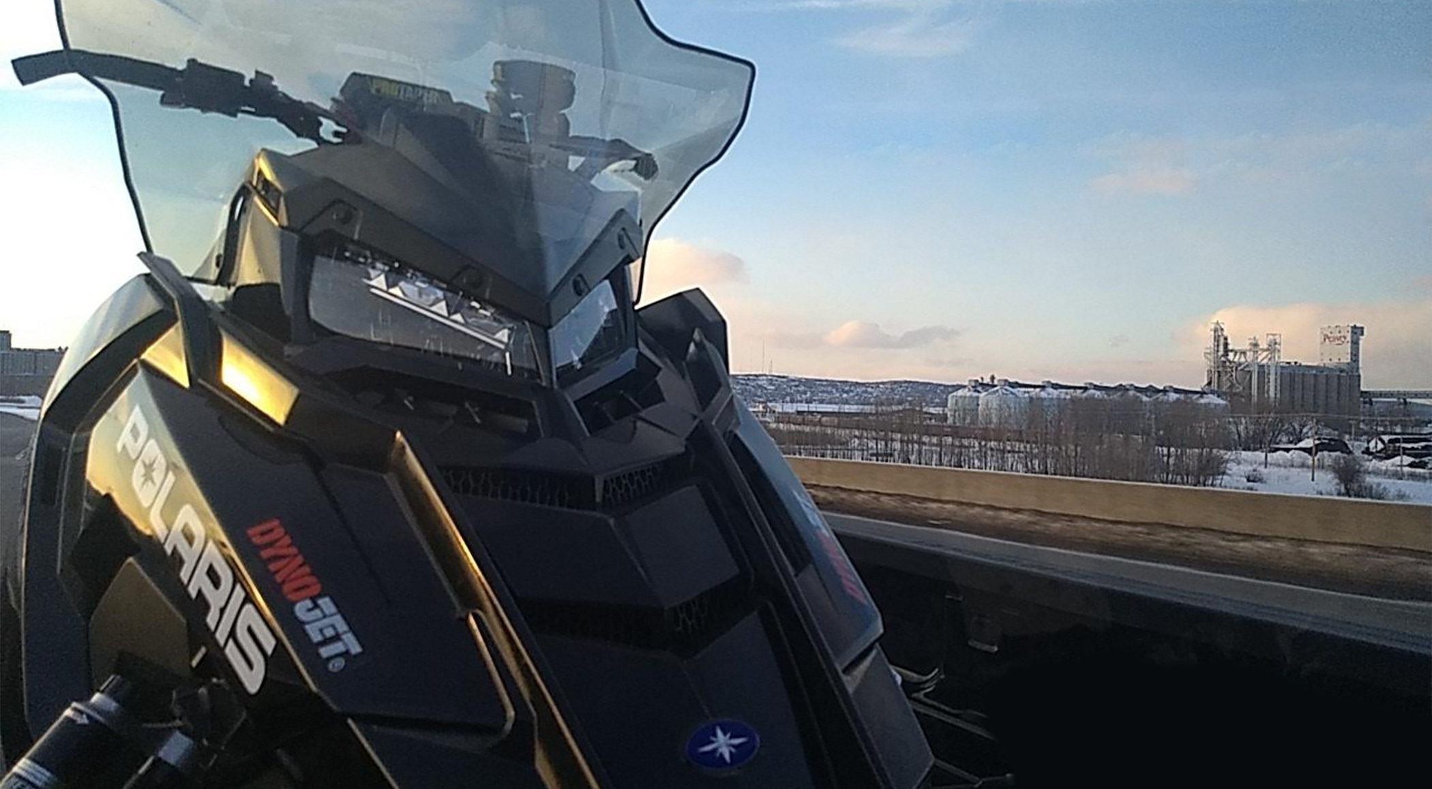
2019 SI Design Presentation
Montana State Clean Snowmobile Challenge
Notes:
Greetings, introduction

Slide 2
Agenda
Program Background
Innovations
Dual catalytic converter system
Flex-fuel compatibility via Dynojet Power Commander V
Snow flap modification
Conclusion
Notes:
Quickie

Slide 3
Competition Snowmobile
Chassis: Polaris Switchback Assault 2019
Engine: Polaris Cleanfire, 2015
Two Stroke
Track: Polaris 144” long, 1.35” high lug, Cobra Track
Catalytic Converter: BASF Bi-metal
Skis: Stock
Notes:
Run through slide, process of getting sled

Slide 4
Team Organization
President:
Aaron Juntunen*⤊✝
Vice President:
Isaac Hiner
Treasurer:
Joseph Swenson
Members:
Brendon Laporte*✝
Nicholas Lemon*⤊
Laura Camilleri
Ross Keene⌁
Erick Phillips ⥡
Faculty Advisor:
Dr. David Miller
Glenn Foster*
Joseph Tuhy ⥡
Thomas Burney*⥡
Ethan Sauer*⌁
Shawn Heilman*⌁
Key:
* Member is present at 2019 competition
⥡ Muffler Team
⤊ Expansion Chamber Team
✝Catalytic Team
⌁Electronics Team
Notes:
Just run through
(Emissions, Noise, and Fuel Economy was the basis upon which tasks were chosen

Slide 5
Innovations Overview
 | Drivability | Ease of Application(x3) | Noise reduction (x2) | Fuel Economy (x2) | Emissions reduction (x2) | Time | Total
Dual catalytic converter system | 3 | 3 (9) | 1 (2) | 1 (2) | 5 (10) | 3 | 26
Flex-fuel compatibility via Dynojet Power Commander V | 3 | 2 (6) | 1 (2) | 4 (8) | 4 (8) | 2 | 27
Snow flap modification | 3 | 5 (15) | 3 (6) | 1 (2) | 1 (2) | 5 | 33
Muffler modifications | 3 | 2 (6) | 5 (10) | 1 (2) | 1 (2) | 1 | 23
Dual expansion chambers | 3 | 1 (3) | 2 (4) | 4 (8) | 3 (6) | 1 | 26
Chassis modifications | 5 | 1 (3) | 1 (2) | 2 (4) | 1 (2) | 1 | 17
Notes:
Innovations process, whittling down of projects

Slide 6
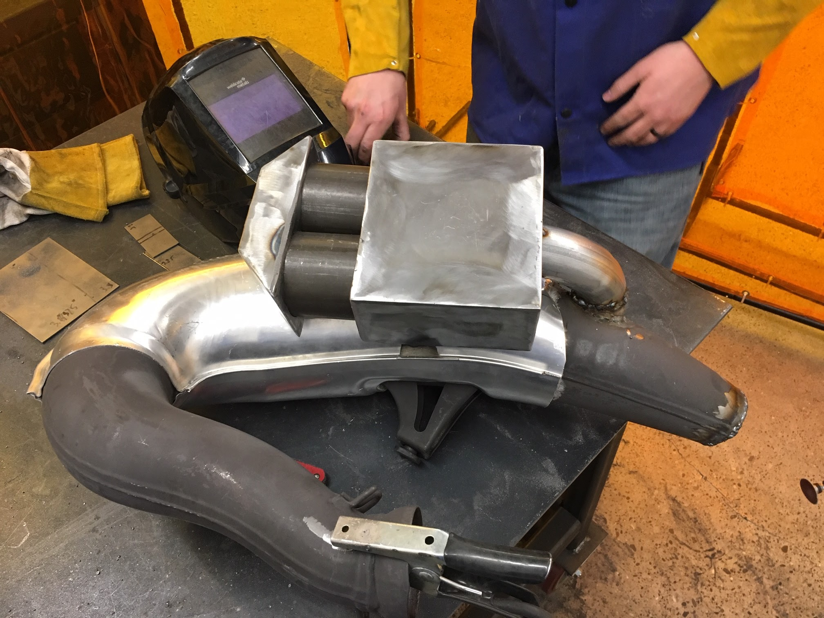
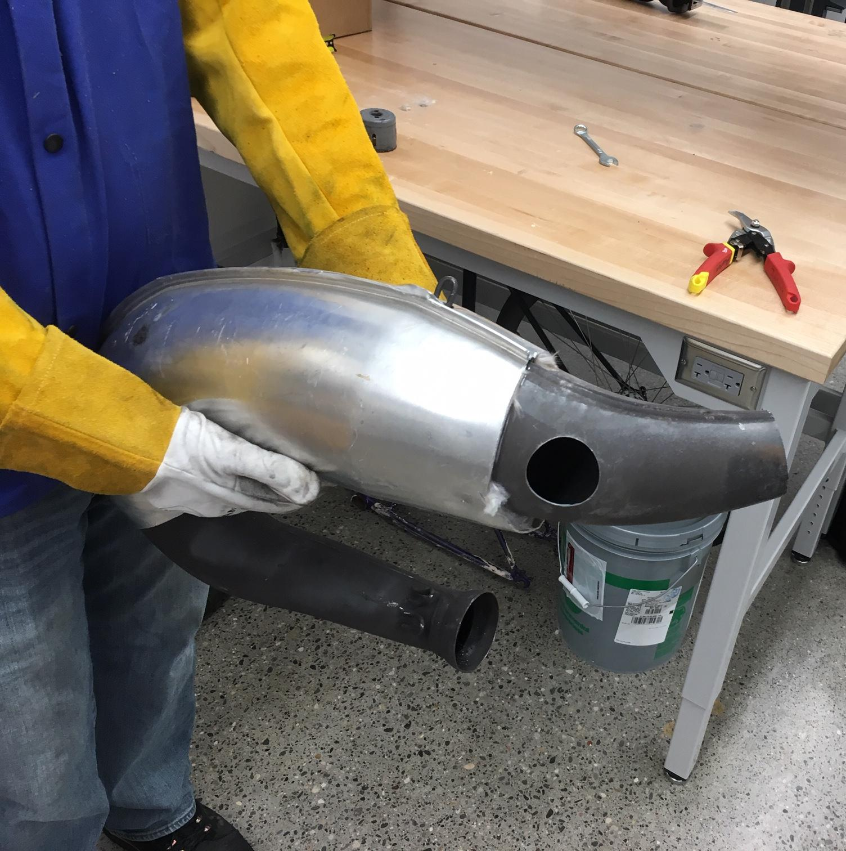
Dual Catalytic Converter System
BASF Bi-Metal Catalytic Converters
Parallel design
EGT Sensor
Notes:
Keep stock muffler, no room between muffler and expansion chamber
Cat specs
Box design
Cats chosen for Oxygen efficient storage and release due to 2stroke high o2 content

Slide 7
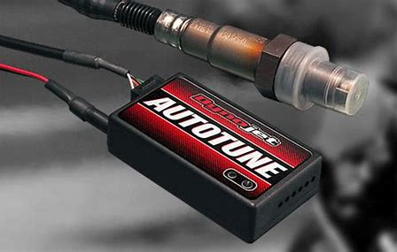
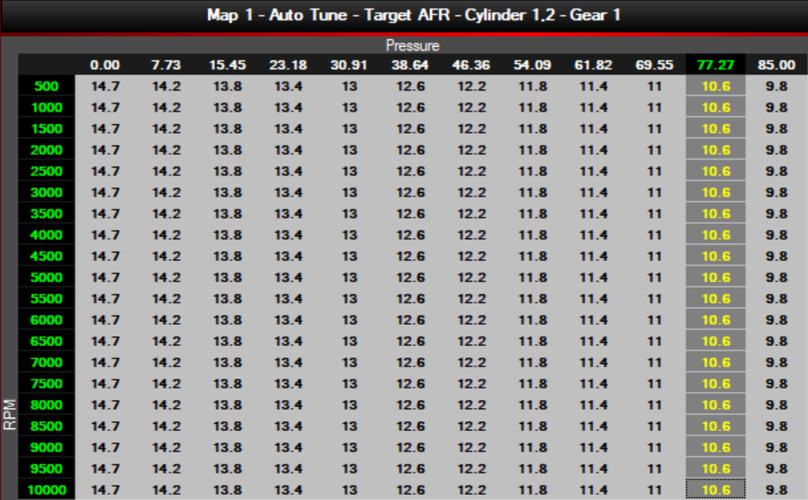
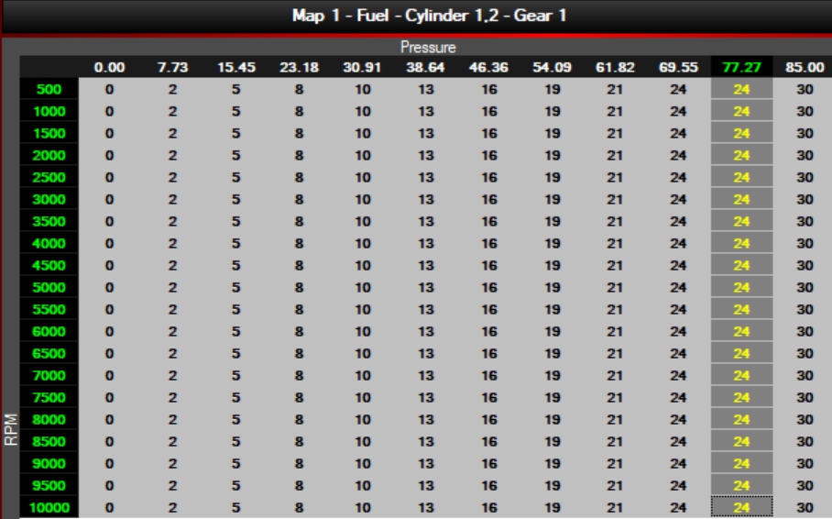
Flex-Fuel Compatibility
Dynojet Power Commander V
Dynojet Auto Tune Kit
Wideband O2 Sensor
Ethanol Content Sensor

Slide 8
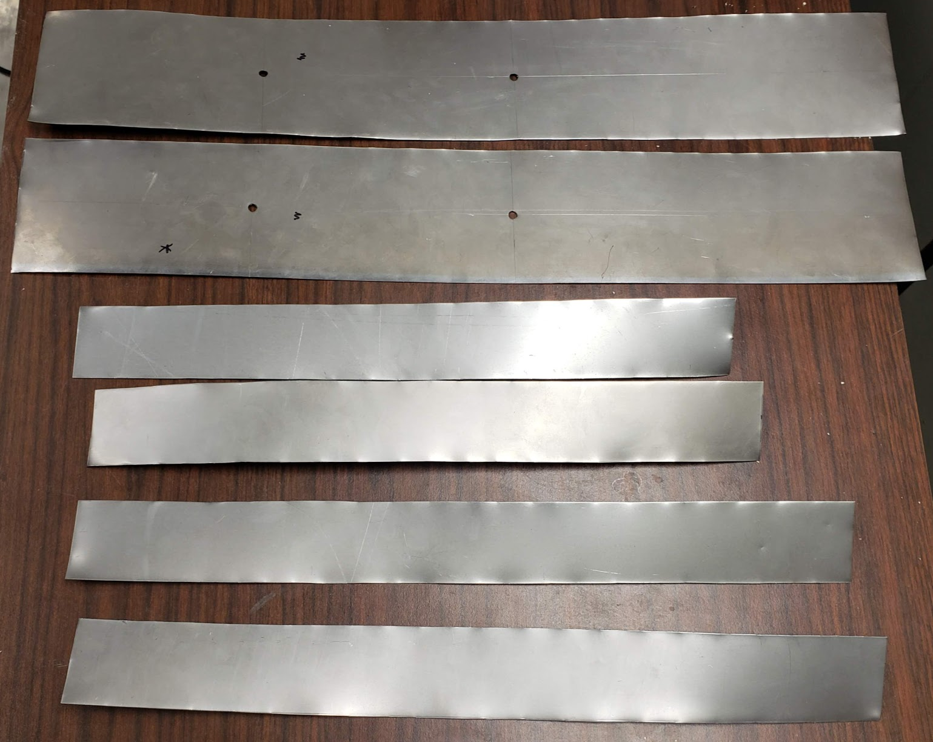
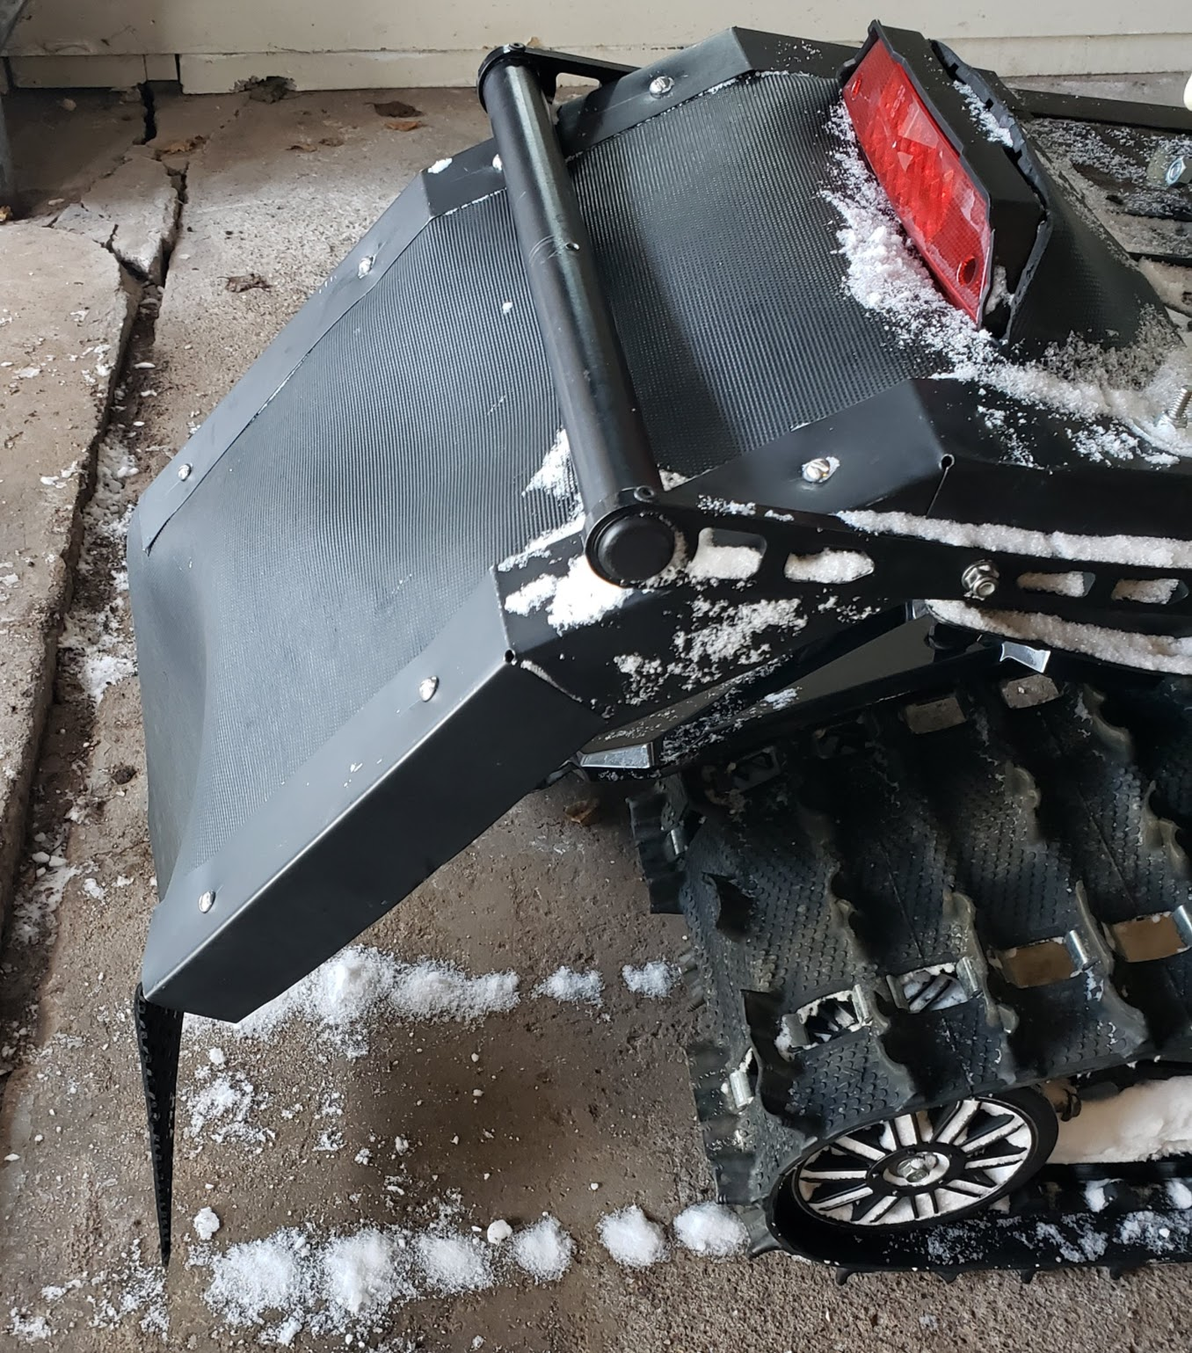
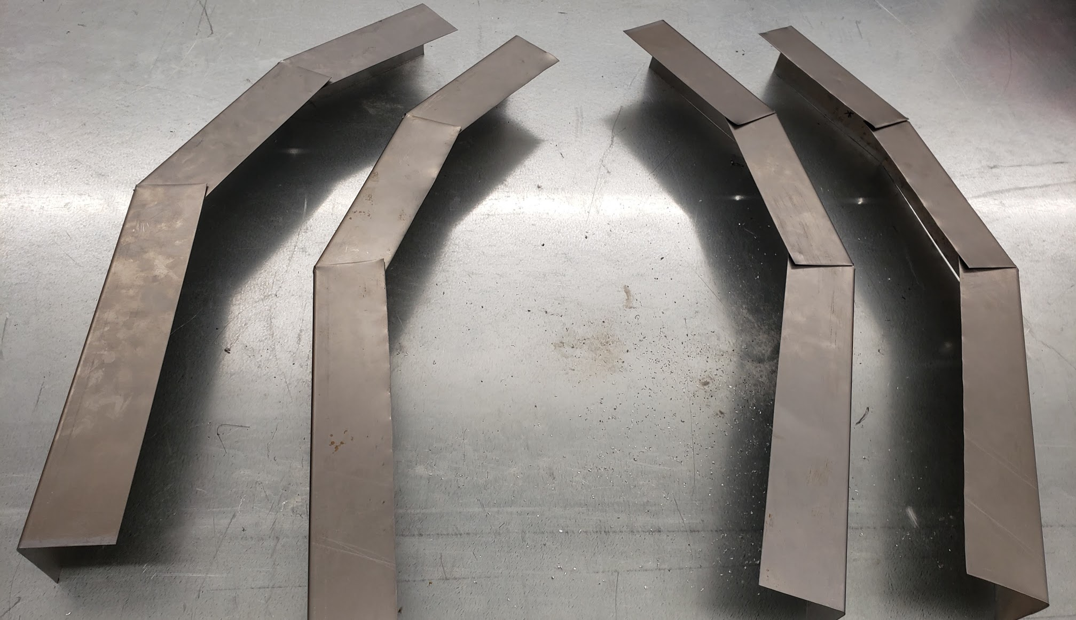
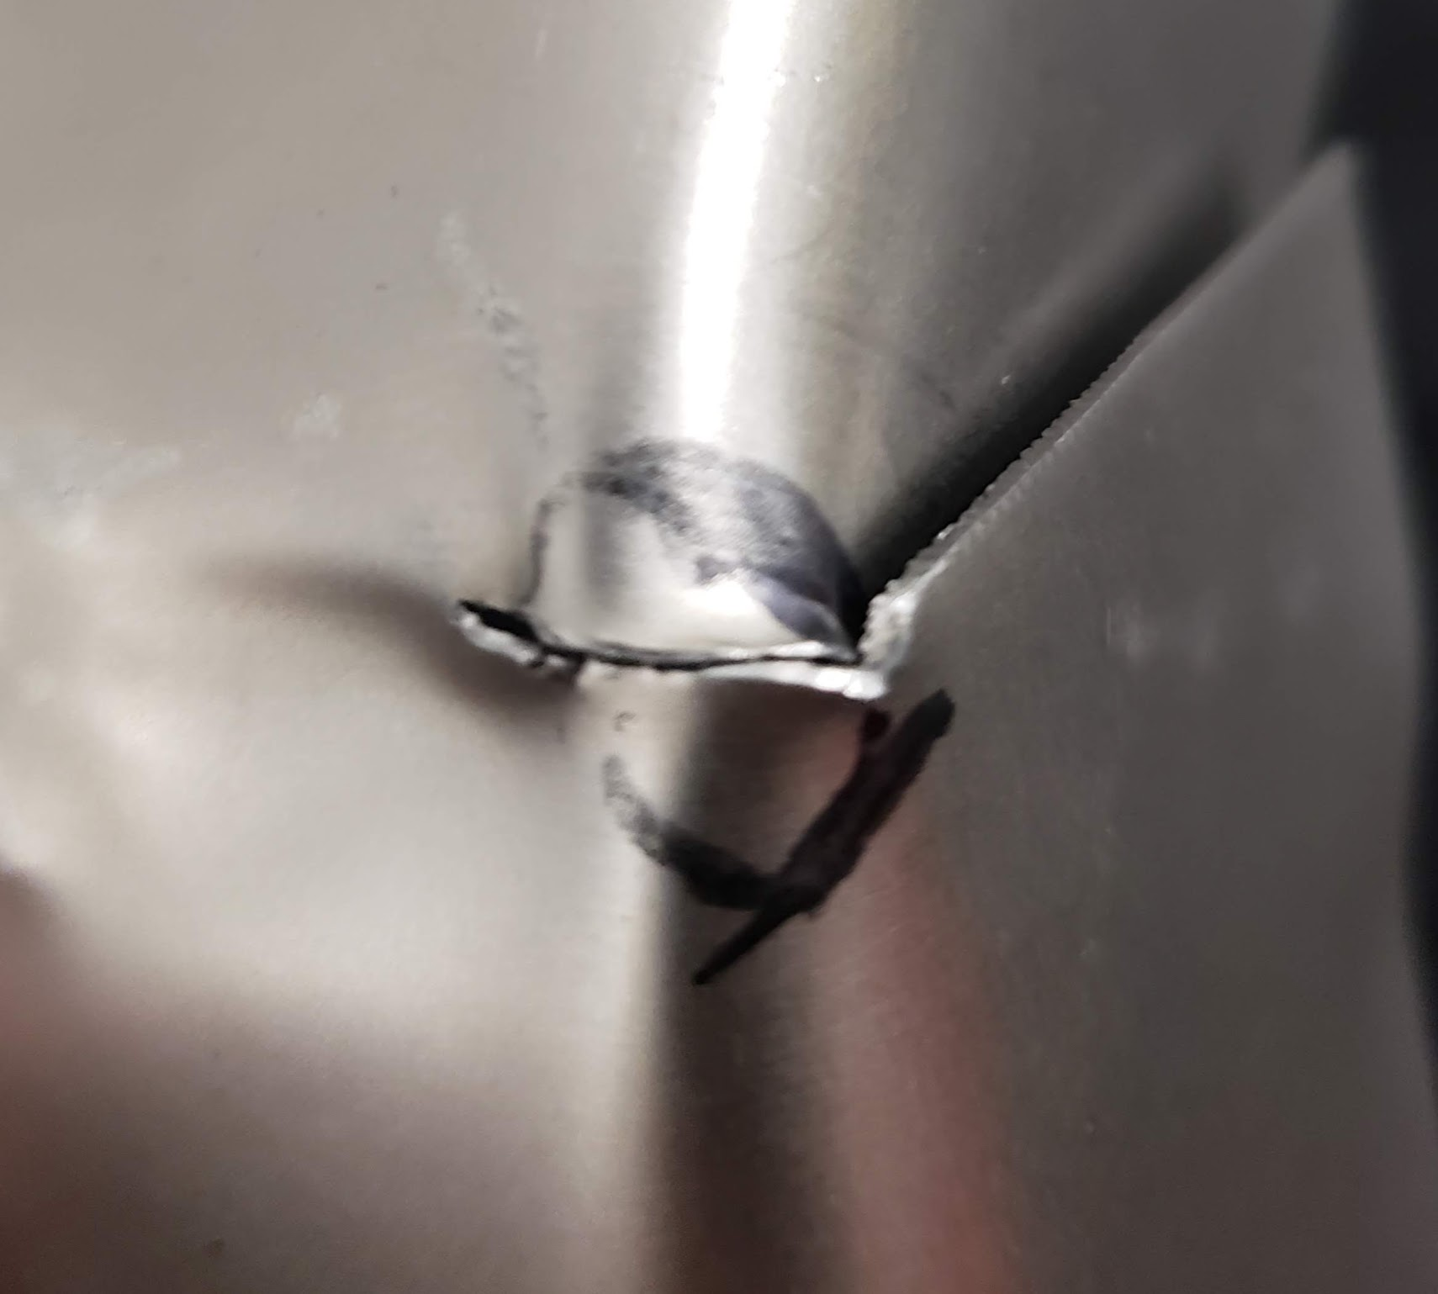
Snow Flap
Rigid Frame Design
Rubber Flap Material
Notes:
Design objectives
Constraints with tow bar
Why materials were chosen

Slide 9
Sponsors
Thank you to:
Dr. Dan Miller
Dr. David Miller
Glenn Foster
Notes:
Thank you to our sponsors helping us get off the ground and competing in our first year. Thank you to our ME Head, and faculty advisors

Slide 10
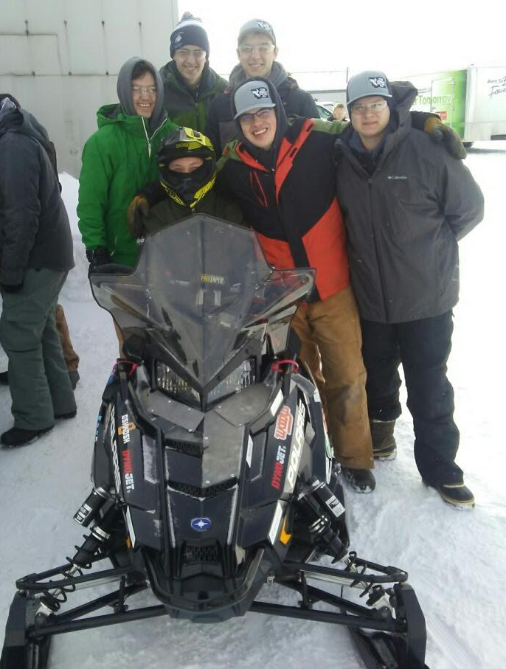
Questions

