Slide 1
Wendigo 2014 – An Arctic and Antarctic Snowmobile
McGill Electric Snowmobile Team
Presented by
Cyrille Goldstein
Dante Filice
March 6, 2014

Slide 2
Design Criteria
Operator concerns:
Sufficient range
Towing ability
Power and performance
Excellent driver interface
Outfitter/Maintenance concerns:
Low cost
Serviceable
Durable
Easy to drive
Environmental concerns:
Quiet

Slide 3
Chassis Selection
Compared four types of snowmobiles from BRP:
Ski Doo MXZ 550F meets our requirements best
Short track is more efficient Sufficient range
Light weight Higher performance
Low cost Affordable
 | Sled
Quality (weight) | Tundra Sport 550F (Baseline) | MXZ 550F | Expedition Sport 550F | Renegade Sport 550F
Weight (2) | 0 | 0 | -1 | 0
Efficiency (3) | 0 | 1 | 0 | 0
Handling (3) | 0 | 1 | 1 | 1
Traction (3) | 0 | -1 | 1 | 1
Noise (3) | 0 | 1 | 0 | 0
Packaging Space (3) | 0 | 1 | 1 | 1
Cost (1) | 0 | 1 | 0 | 0
Weighted Total | 0 | 11 | 7 | 9
Notes:
Chassis selection is the basis of performance and design of the snowmobile

Slide 4
Range
Sled usage at Summit Station, Greenland:
Multiple short trips of 1.5 miles or less*
Very few trips over 4 miles*
Charging capability throughout the day
8-10 mile range deemed sufficient for extensive use at summit station
*U Madison and U McGill summer testing data from Summit Station

Slide 5
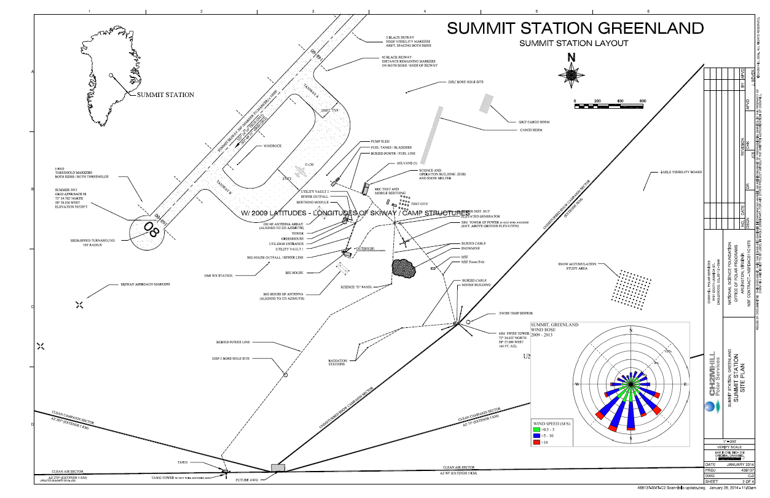

Slide 6
Range
PSAT simulation used to predict performance across different snow conditions.
Validates that in all but poor snow conditions, our 10 mile range goal is attainable
Based off of a 3.2 kWh battery pack (20 cells)

Slide 7
Battery Design
Battery choice:
LTC 45 Ah Lithium Ion Cobalt cell
Higher capacity cell allows fewer cells for same capacity – less points of failure, less components in the pack
Chose a pack size of 20 cells
Able to package entire power-train in the engine bay of the chassis
Allows us to meet our goal of 8-10 mile range for effective use in Greenland
26 cells possible to package
Requires moving power-train under the seat, hurting ergonomics, serviceability, and increasing cost
Used a simulation to compare the two options:
 | 72V (20 cells) | 96V (26 cells)
Range (miles) | ≈ 10 | ≈14
Weight (lbs) | 66 | 86
Cost | $ 6000 | $ 7800

Slide 8
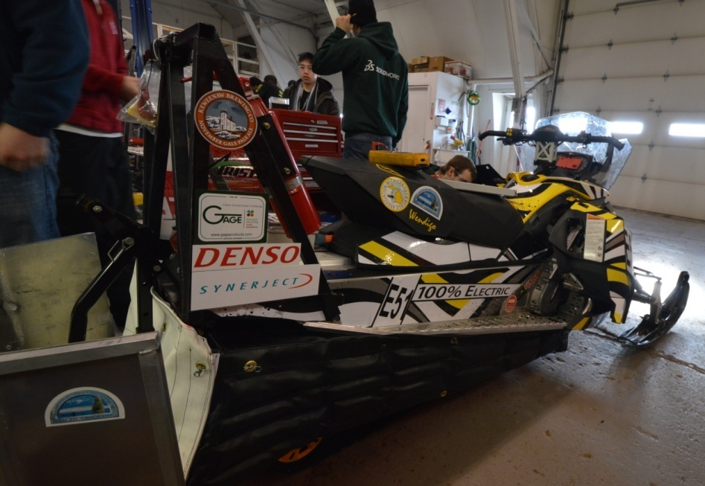
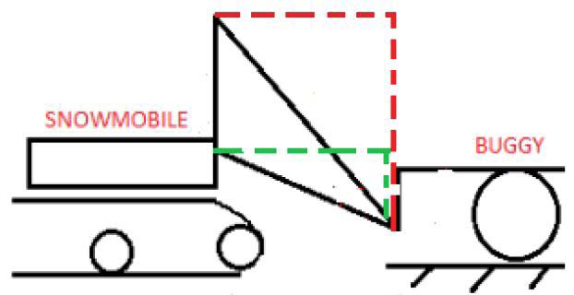
Towing Ability
Trade off of a shorter (more efficient) track, is reduced traction
An elevated hitch has been designed to increase the downwards force on the rear of the hitch.

Slide 9
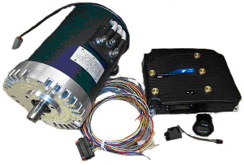
Performance
HPEV AC-15 motors with Curtis 1238 controller produce 34kW & 81Nm peak torque for good towing capacity.
Extensive dynamometer testing to maximize efficiency.
Acquired data for current, torque, efficiency, slip gain, power, and other parameters.

Slide 10
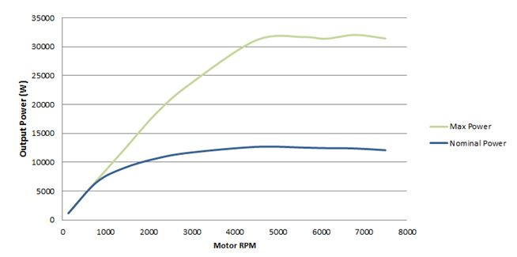
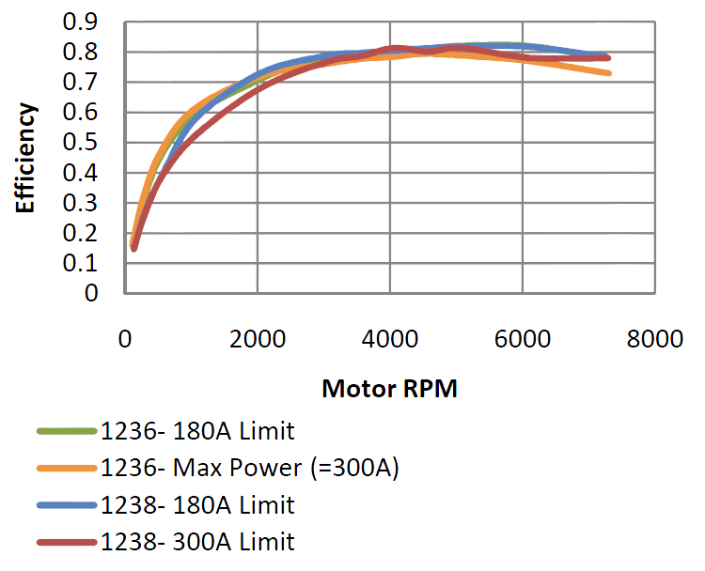
Performance
Drive ratio chosen to have sufficient torque, while maintaining a high enough efficiency to meet our 8-10 mile range goal.
3:1 reduction chosen to keep our sled efficient in the 20mph hour range
Motor at ≈3000 rpm, in the efficient range

Slide 11
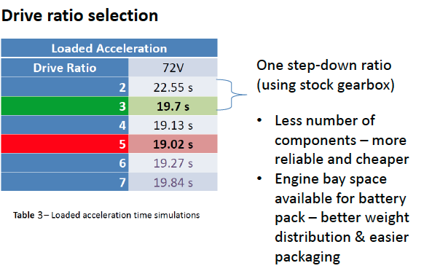
Performance
Also validated in a PSAT simulation of the loaded acceleration.
Loaded acceleration provides insight into towing capacity, and performance under tow
3:1 ratio also keeps the design much simpler as opposed to a two stage reduction

Slide 12
Driver Interface
By programming the Curtis 1238 motor controller we were able to integrate different driving modes based on application.
4 modes: - Range (long distance, most efficient) - Pull (for maximum towing needs) - Handling - Acceleration
Also a CAN system which communicates between dash, battery pack (BMS), motor controller and to a user (via Bluetooth) was integrated

Slide 13
Easy to Drive
Easily understandable controls:
Indicator lights to show state of battery pack and ground fault
Displays, ignition sequence and cargo space same as IC sled.
Weight distribution maintained from IC sled
– familiar for beginner to advanced drivers
Comments from subjective handling judges validate that keeping the sled weight, and weight distribution, similar to the IC sled is very desirable.

Slide 14
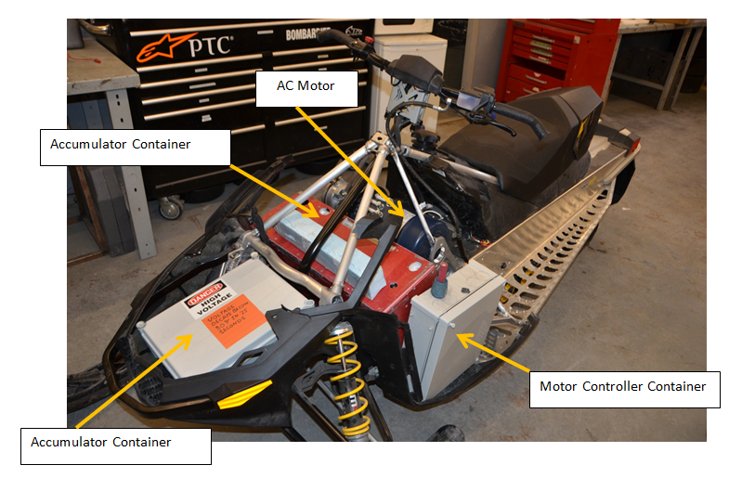
Serviceability
Modular design leads to easy troubleshooting and maintenance.
Electronics box, motor controller box, high voltage battery pack, low voltage enclosure.
Whole boxes can be removed for service and maintenance.
Complicated electronic work can happen off-board of the snowmobile
Increases safety
Low voltage container
Lo

Slide 15
Durability
Previous generation of LTC cells lasted 7 years
Based on dynamometer testing the 7 year old cells were at 70% of their original capacity
Slightly higher cost of LTC cells is justified due to their durability and reliability
Also reduces environmental impact – battery cells do not need to be disposed of or recycled as often

Slide 16
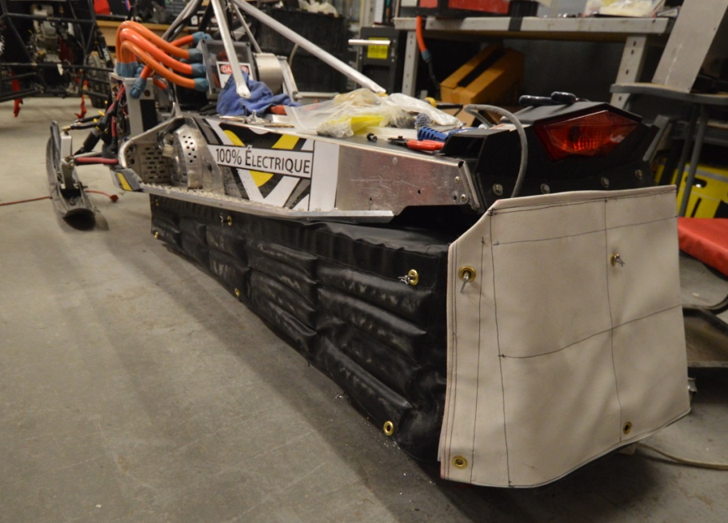
Low Environmental Impact
Noise
Track and vibrating chassis components are the main sources of noise in electric sleds.
Noise from track mitigated by sound absorbing and reflecting skirt that surrounds track.
A studded track can be replaced with a quieter non-studded track without compromising towing capacity thanks to the elevated hitch design.

Slide 17
Sound Skirt
Three layers :
Gore-Tex: sound absorbing, also tear proof and waterproof
Wood flour: sound dissipating, particulate matter dissipates sound energy, also light weight
Vinyl: Sound reflective, meant to reflect sound not already absorbed or dissipated by first layers, rated for snowmobile use to -40° F.
Particularly targets frequencies between 500-8000Hz, identified emitted frequencies from a snowmobile in the 125-8000Hz range. Sacrifice made in targeting lower frequencies due to weight restriction.
Innovative idea about the skirt is that it is easily adjustable or removable with no tools, can be adjusted for snow conditions, driver weight, or if there is no need to run quietly.

Slide 18
Conclusion
Chassis: light weight, comfortable & affordable
Range: 10+ miles, reliable energy accumulator
Performance: low cost, simple and powerful powertrain
New features such as sound skirt, performance selection switch and new body sled wrap.
Improved dashboard with CAN and Bluetooth communication abilities.
Affordable: approx. $16,000 MSRP
Serviceability: modular and simple design, spares readily available
Ergonomics & User friendliness : minimum modifications during electrical conversion and performs similar to the stock sled
Low environmental impact: zero emissions & quiet operation

Slide 19
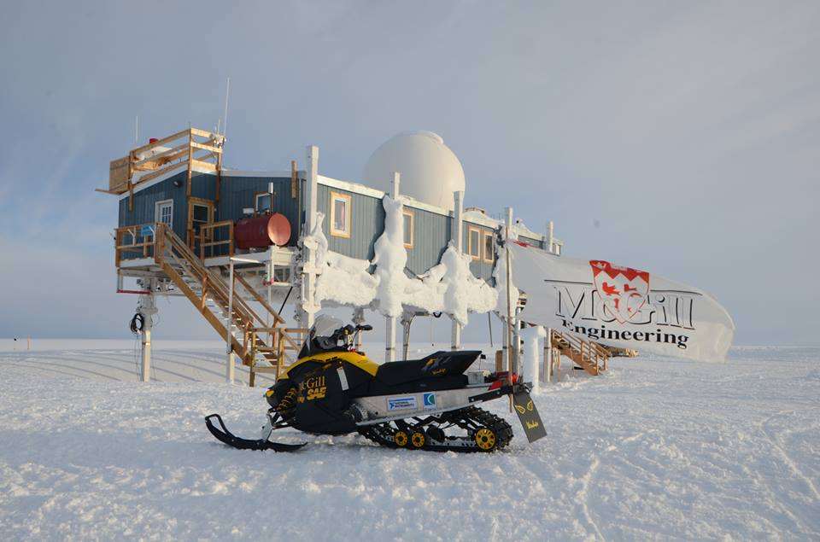
Questions?

