Slide 1
Kettering University
Development of a Flexible Fueled Snowmobile for the 2016 SAE Clean Snowmobile Challenge

Slide 2
2016 Design Approach
Versatility
Performance 70 hp class snowmobile Miller cycle engine for high efficiency and performance
Advanced Controls
Full Authority Engine Management
Electronic Throttle
Custom engine code
Noise Attenuation
Affordable, lightweight silencer with acoustic valve
Emissions
Extended Lean-Burn Operation
Lean NOx Trap Catalyst
Dynamic Performance
Performance increase over OE model
Lightest weight without fuel at CSC 2014 and CSC 2015
Best spark ignited fuel economy at CSC 2014 and CSC 2015

Slide 3
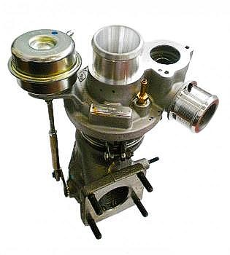
Miller Cycle 600 ACE Engine
Stock 12:1 compression ratio to preserve efficiency
Late intake valve closing for reduced pumping losses
Increased torque with turbocharger boost
Decreased BSFC from stock naturally aspirated
Improved vehicle performance—appeals to more riders

Slide 4
Engine Modifications
 | Rotax 600 ACE | Kettering 600 ACE
Displacement | 600 cm³
Configuration | Inline 180° Two Cylinder
Block Material | Aluminum
Valve Actuation | Dual Overhead Camshaft, Type 1 (Direct Acting Bucket)
Valves per Cylinder | Four
Compression Ratio | 12
Bore x Stroke | 74 x 69.7 mm
Intake Valve Open/Close | 3 BTDC / 37 ABDC | 21 ATDC / 61 ABDC
Exhaust Valve Open/Close | 44 BBDC / 6 ATDC
Engine Control System | Bosch Motronic ME17.8.5 | Woodward MotoTron 128 Custom developed code
Electronic Throttle System | N/A | Custom torque-based
Ignition System | 35 mJ Coil on Plug | 96 mJ Coil near Plug
Engine Weight | 40 kg (88 lb)
Maximum Power | 42 kW (56 hp) | 54 kW (74 hp)
Maximum Torque | 55 Nm (42 ft*lb) | 69 Nm (51 ft*lb)
Fuel Compatibility | 91+ AKI Gasoline up to E-10 | 91+ AKI Gasoline up to E-85
Turbocharger | N/A | Garrett MGT1246 Hybrid
Maximum Boost Pressure | N/A | 1.6 bar absolute

Slide 5
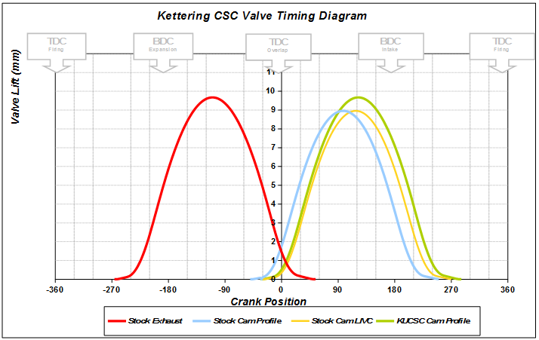
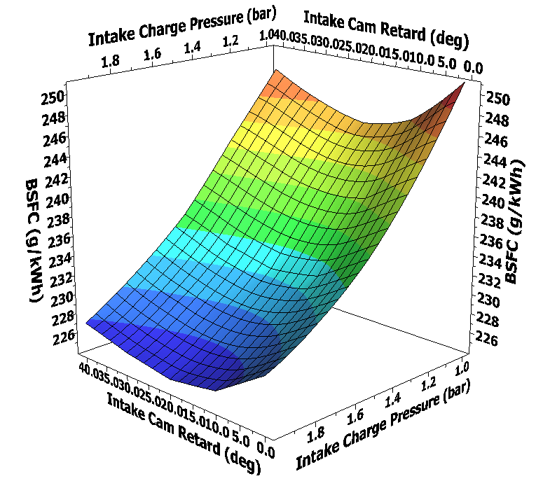
Late Intake Valve Closing
Simulation DOE shows most efficient:
20 degree intake cam retard from OE
Increasing intake charge pressure up to knock limit
Exhaust camshaft as intake cam: LC 126 ATDC, IVC 21 ABDC
Turbocharger provides intake charge pressure for high power

Slide 6
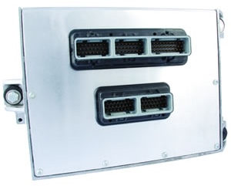
Engine Management System
Full-Authority Engine Management
Electronic Throttle Control System
Enhanced cylinder balance

Slide 7
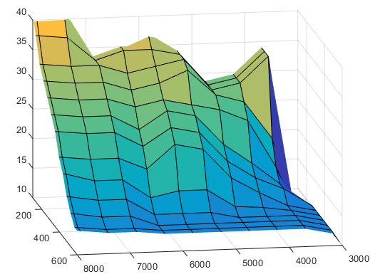
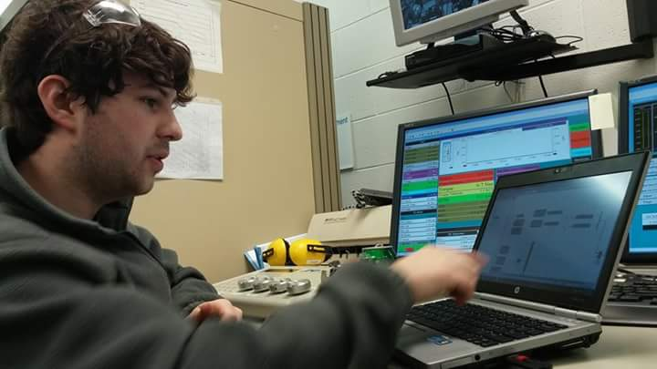
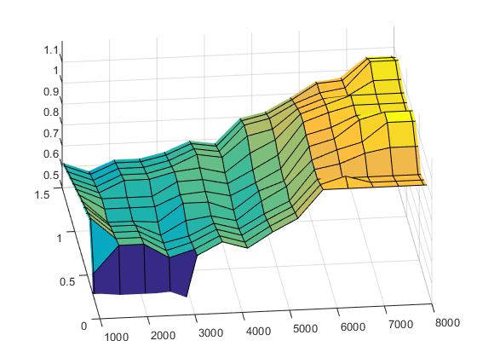
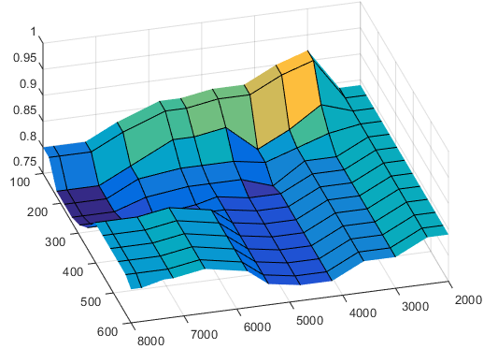
Engine Mapping
Spark Advance (Lean)
Volumetric Efficiency
Lean Stability Limit

Slide 8
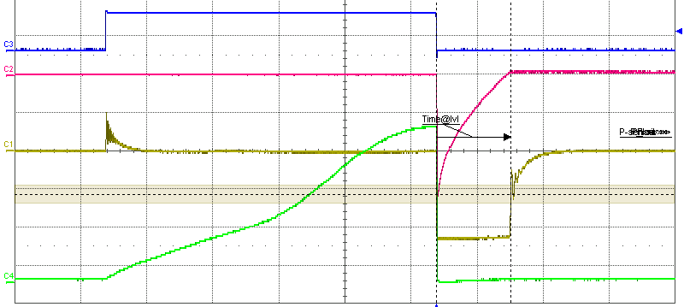
High Energy Ignition Coils
Coils tested with 95 mJ secondary energy
2.25ms spark duration
High energy/long duration spark optimal for lean combustion
Trigger Signal
Secondary Current
Secondary Voltage
Primary Current

Slide 9
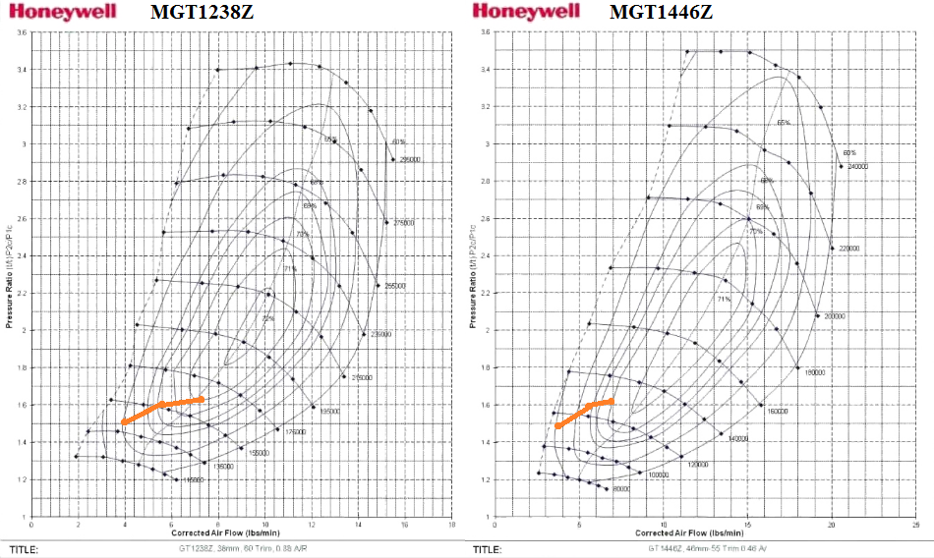
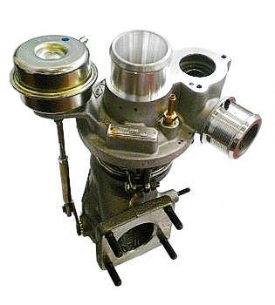
Compressor Matching
Honeywell Garrett MGT1246Z hybrid turbocharger
MGT1238Z Compressor, MGT1446Z Turbine
Large turbine wheel and housing for low backpressure with large pulses from odd-firing engine

Slide 10
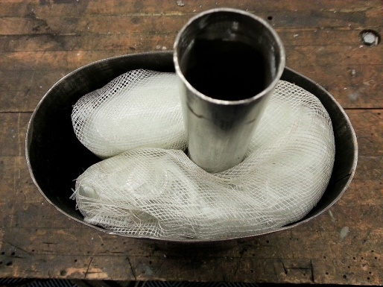
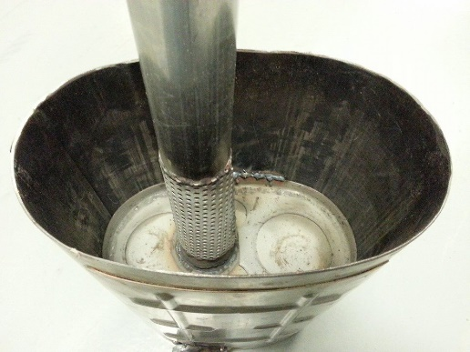
Catalytic Silencer design
Silencer weighs 10 lb (6lb under stock)
Passive acoustic valve is in production on passenger cars
Resistive tuning attenuates low-frequency content
Valve opens with increased mass flow at high power levels
Catalyst integrated in silencer

Slide 11
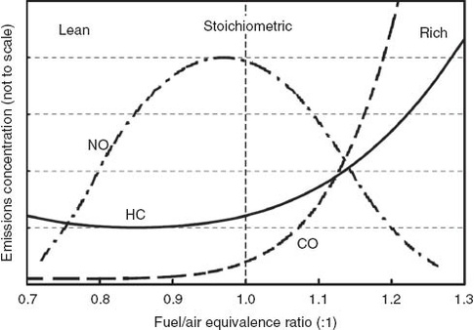
Emissions and Aftertreatment
Substrate | Ceramic
Density | 900 cells/in2
Size | 110mm x 116mm length
Loading | Platinum – 40 g/ft3
 | Rhodium – 8 g/ft3
 | Barium - Proprietary
Ideal
Three-Way Catalyst
Kettering Lean-Burn

Slide 12
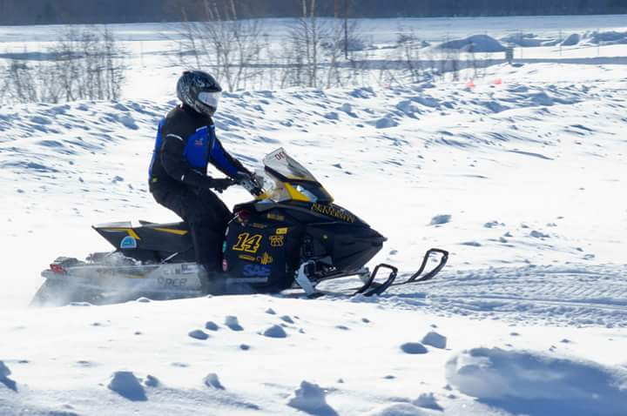
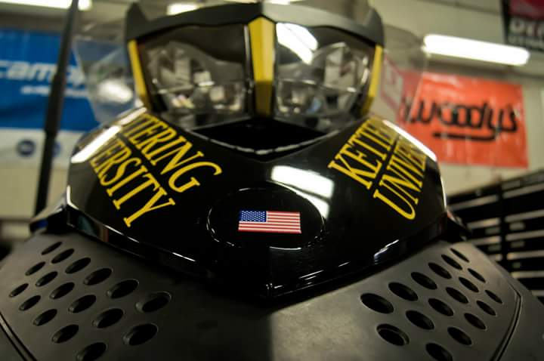
Dynamic Performance-Light Weight
499 lb with fluids, without fuel
Lightest snowmobile at CSC 2014 and CSC 2015
Best spark ignited fuel economy at CSC 2014 and CSC 2015
Cost-effective at $8657 MSRP

Slide 13
Thanks to our Sponsors!

